Slide 1
Running Rock
Project Proposal

Slide 2
Problem Statement

Slide 3
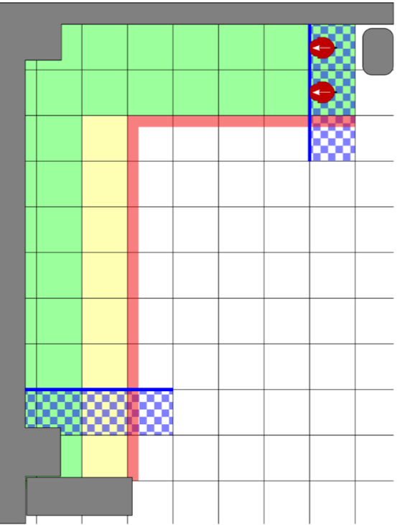
The Problem
Complete as many laps as possible within two minutes
Stay within green area
Avoid red area and walls

Slide 4
Our Solution
DE2Bot follows the wall
Turns Accordingly
Completes laps in L shape

Slide 5
Technical Design

Slide 6

Design Plan
Modular Code
Base code using Movement API
Modules to improve performance

Slide 7
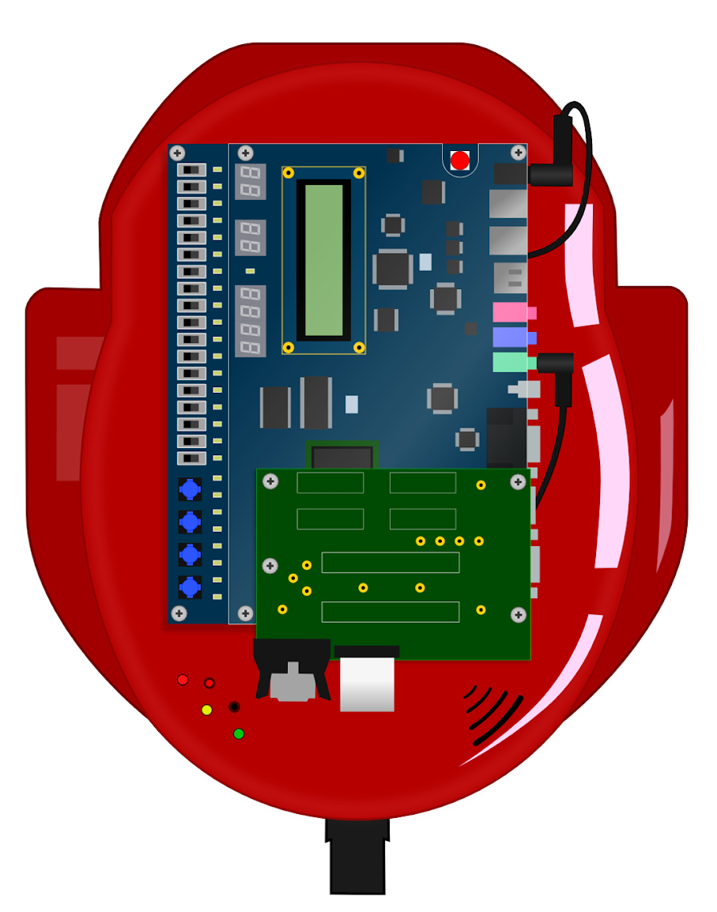
Given Resources
Movement API
Target direction
Sonars
0, 2, 3, 5
Timer
Modules

Slide 8
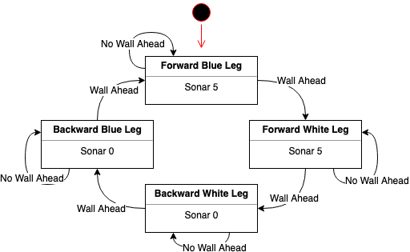
Main Code: Foundation

Slide 9
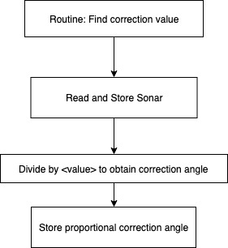
Differential Correction
Correct for odometry drift
Set target distance from the wall
Sample current distance
Find difference
Divide it by some value
Obtain the correction angle proportional to the difference

Slide 10
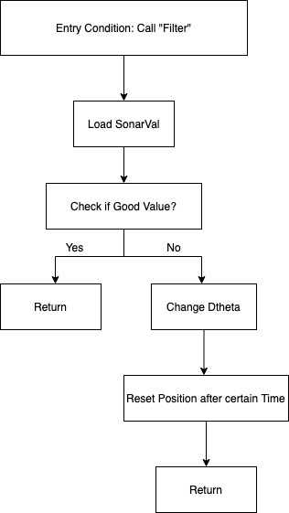
Sonar Filter
Correct for sonar inaccuracies
Certain angles of the robot can cause sonar pulses to not return
Filtering allows the robot to ignore these “garbage” values

Slide 11
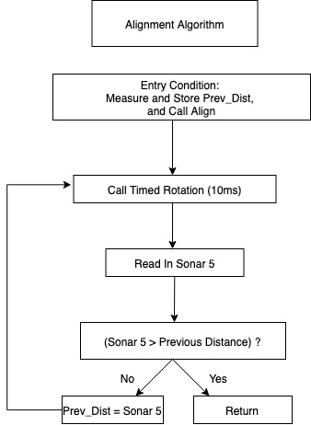
Wall Alignment
Decrease accumulated error
Performed after turning
Used to reset robot odometry
Should align robot parallel to nearest wall

Slide 12
Time Management

Slide 13
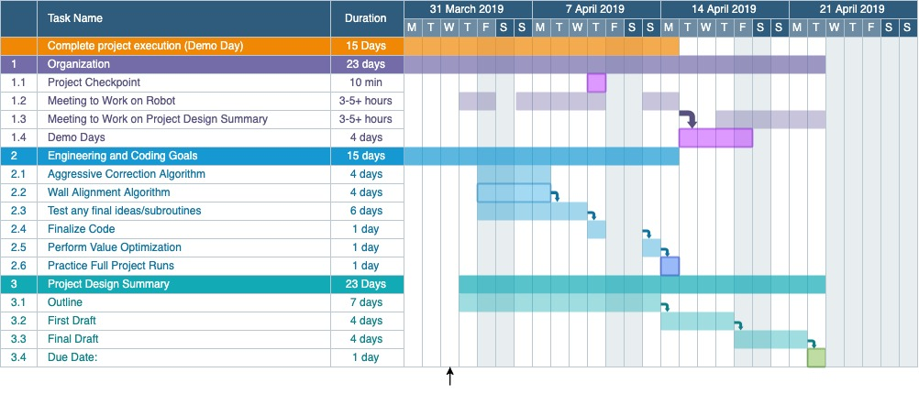
Project Management: Gantt Chart

Slide 14
Engineering and Coding Timeline
Current Stage: (Finish by end of Wednesday)
Differential Correction Algorithm
Wall Alignment Routine
Final Ideas
Next Stage: (Finish by Friday)
Finalize Code

Slide 15

Thursday and Sunday before Demo
Final Stage:
Value Optimization
Fine Tuning
Full Practice Runs

Slide 16
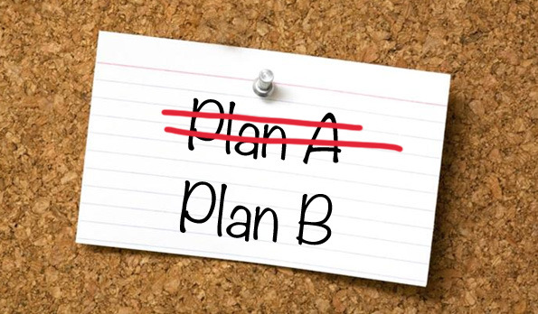
Back-Up and Contingency Plans
Problem: Robot can get stuck
Soln: Manual reset option for robot
Problem: Cannot optimize improvement modules
Soln: Rely on foundation code

Slide 17
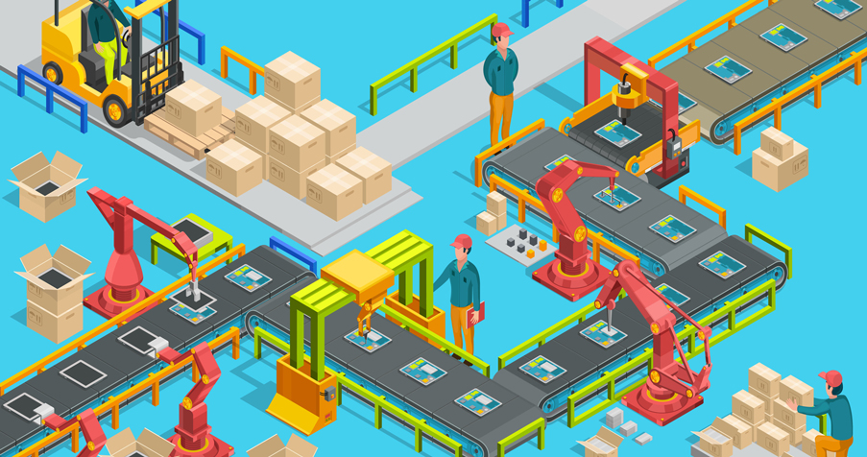
Project Management: Division of Labor
Work on modules independently
Foundation Code
Differential Correction
Wall Alignment Routine
Sonar Filter
Jointly work together on fine tuning and adjustments

Slide 18
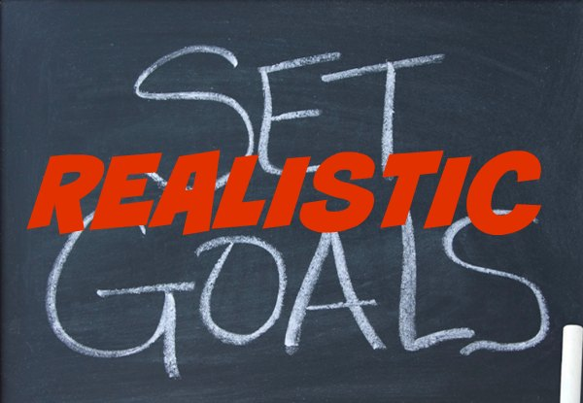
Is our plan realistic?
Can we finish what we are working on?
How many laps do we expect to complete?

Slide 19

Project Design Summary
Writing Process
Everyone will work on outlining and writing through Google Docs
Independently work on Intro and Conclusions

Slide 20
Conclusion

Slide 21

Summary
Modular Code
Incorporate many different performance improvement modules on top of the foundation code
Back-up plans if bot is not performing as expected
Notes:
Summary Slide:
Here are some important points of our project proposal.
Once again, our code will be modular. This will be and has been very beneficial to us in incorporating many different performance improvement routines into our code. As you might see our Differential Correction and wall alignment routines will be important to improving the consistency of how our robot will perform. Without such routines, our robot may only be able to perform half a lap; however, with our current algorithms and other implementations, we hope to be able to complete 3 laps. Reducing odometry drift and error propagation clearly proves to be hugely beneficial to us. On top of this, we have many back-up plans that we call fall to if robot does not perform as expected.

Slide 22

On Demo Day
Finalized Code
Optimized Values
Utilized best routines
Expectations:
Robot will travels consistently
Stay within the green area
Avoid collisions
Notes:
What we have currently accomplished is implementing a solution that will allow the robot to be able to complete two laps. Of all the routines, we have explained so far, the only code in development is the differential correction and wall alignment. We can already complete 2 laps consistently, and from what we have seen, our actions like value optimization will have a huge impact on our robot’s success on demo day.
After finalizing code, optimized values, utilized best routines, we expect that our robot will travel consistently, stay within the green area and avoid collisions.

Slide 23
Thank You for Your Attention, Any Questions?

