Slide 1
Applying Computer Vision Methodologies to Classify Species of Arachnids
Student: Matthew Martinez
Advisor: Dr. Mahmoud Quweider
Instructor: Dr. Robert Schweller

Slide 2
Outline
Introduction
Methods - Classification
Texture
Laws, Haralick
Color
HSB
Methods – Recognition
Tests
Results
Conclusion

Slide 3
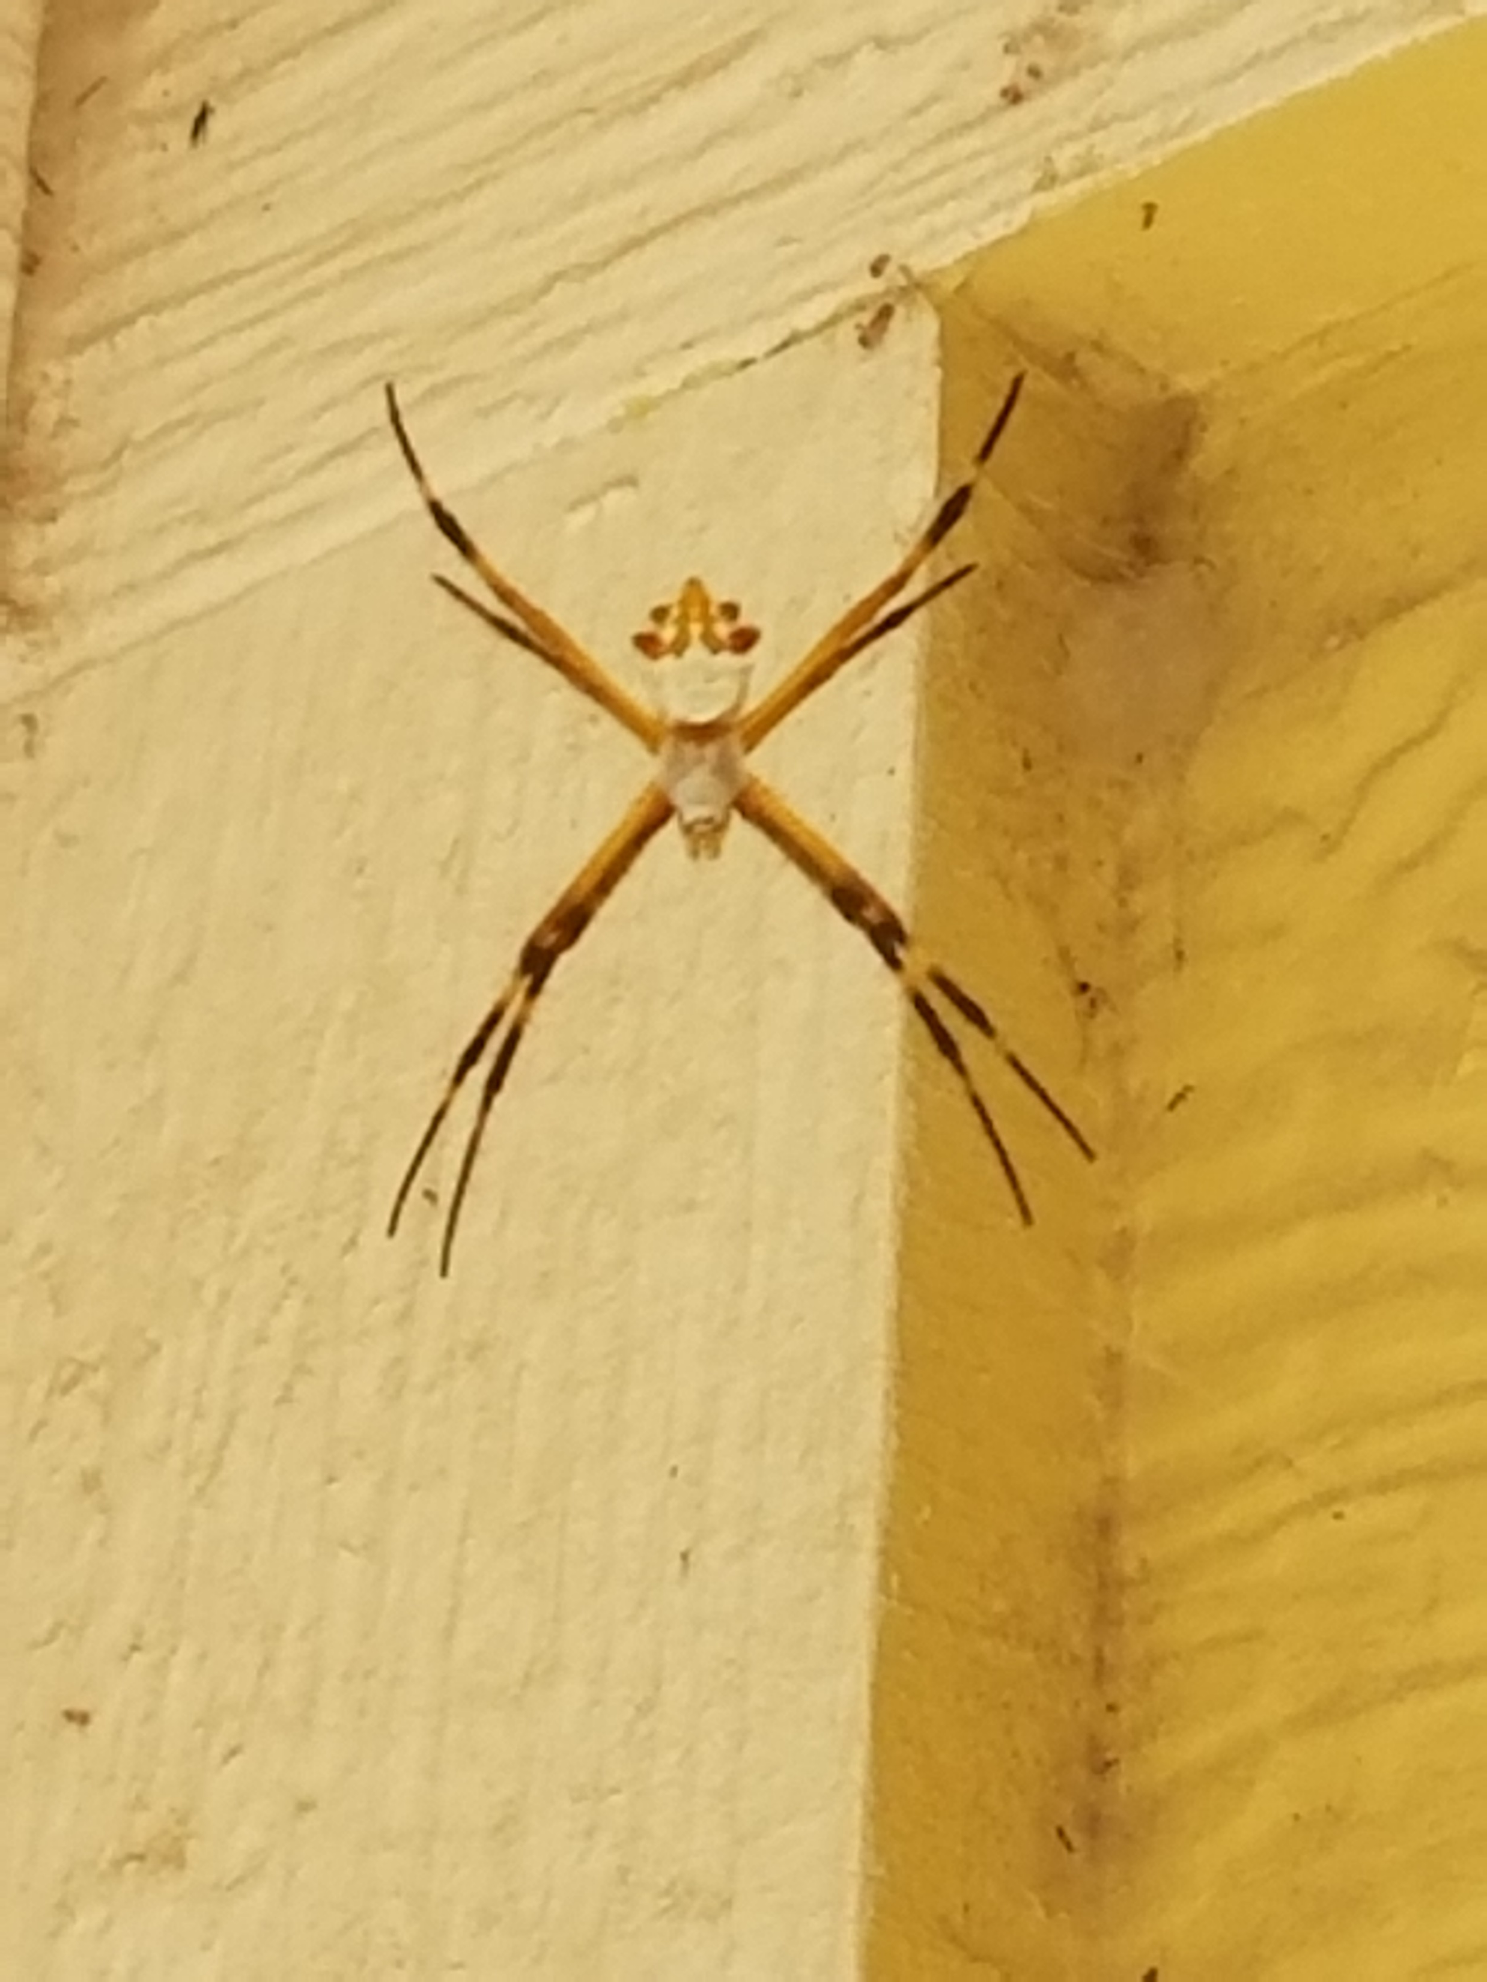
Intro
Motivation
Why Spiders?
Practical
Common
Educational

Slide 4
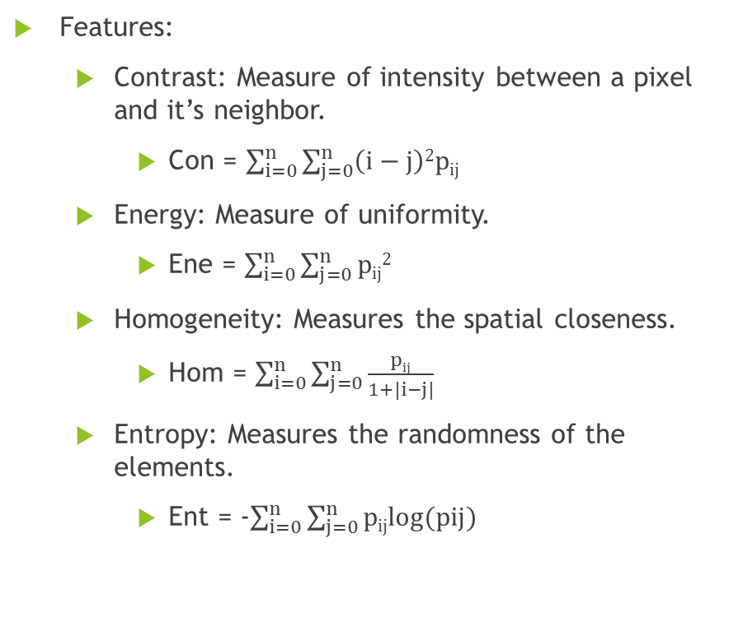
Texture - Haralick
Features:
Contrast: Measure of intensity between a pixel and it’s neighbor.
Con = $\sum_{i=0}^{n}{\sum_{j=0}^{n}{\left(i−j\right)2pij}}$
Energy: Measure of uniformity.
Ene = $\sum_{i=0}^{n}{\sum_{j=0}^{n}{pij2}}$
Homogeneity: Measures the spatial closeness.
Hom = $\sum_{i=0}^{n}{\sum_{j=0}^{n}{\frac{pij}{1+|i−j|}}}$
Entropy: Measures the randomness of the elements.
Ent = -$\sum_{i=0}^{n}{\sum_{j=0}^{n}{pijlog(pij)}}$
j
0 1 2 3
0 | 0 | 1 | 1
0 | 0 | 1 | 1
0 | 2 | 2 | 2
2 | 2 | 3 | 3
0
1
2
3
2 | 2 | 1 | 0
0 | 2 | 0 | 0
0 | 0 | 3 | 2
0 | 0 | 0 | 1
i
Sample image
Cooccurrence Matrix

Slide 5
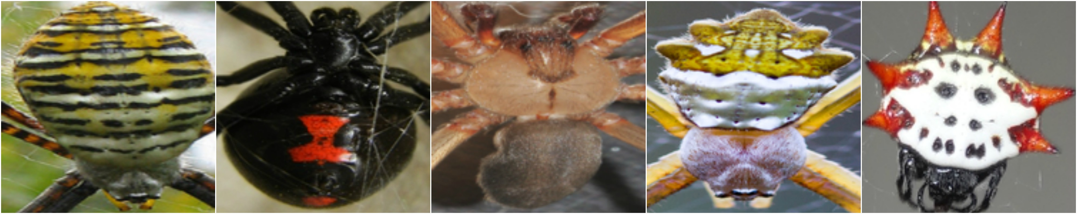
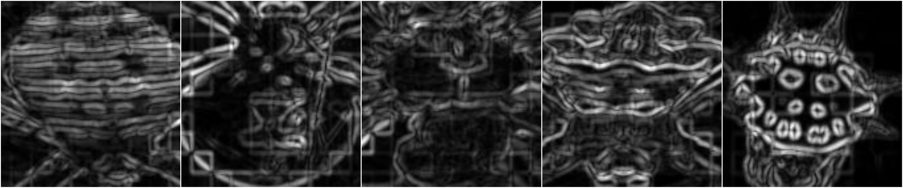
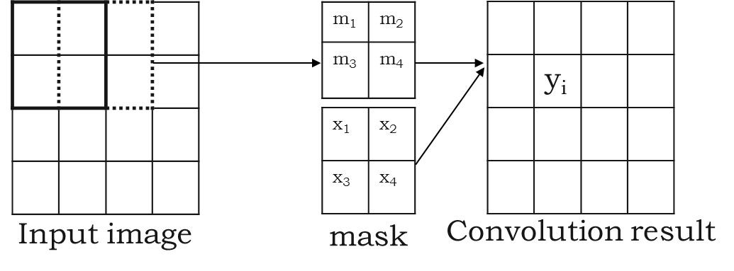
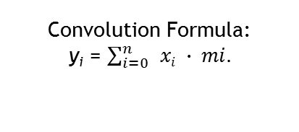
Texture - Laws
Masks: 5 Features
Average Gray Level [1 4 6 4 1]
Edge [-1 -2 0 2 1]
Spot [-1 0 2 0 -1]
Ripple [1 -4 6 -4 1]
Wave [-1 2 0 -2 1]
Convolution Formula:
y_{i} = $\sum_{i=0}^{n}{ }xi ∙ mi.$

Slide 6
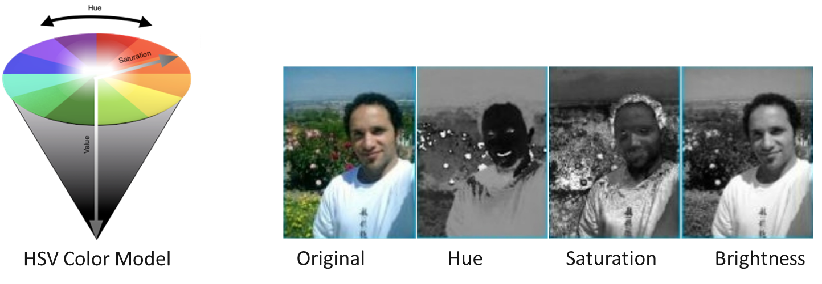
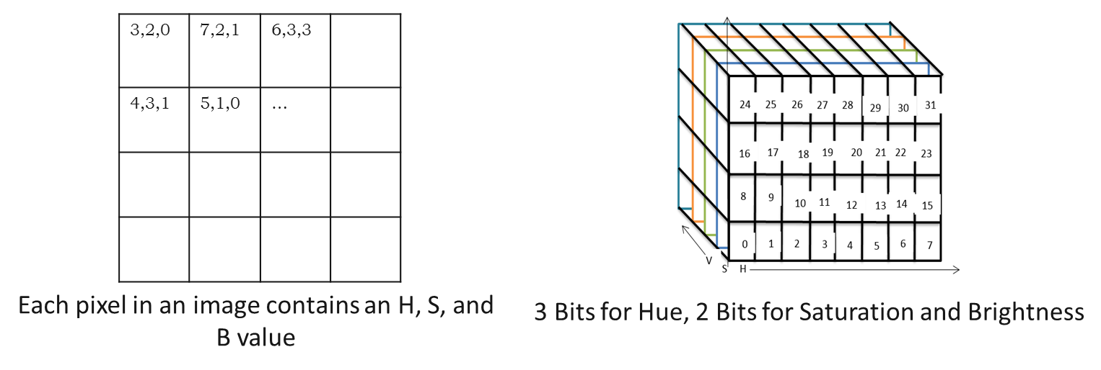
Color – HSB (Hue, Saturation, Brightness)

Slide 7
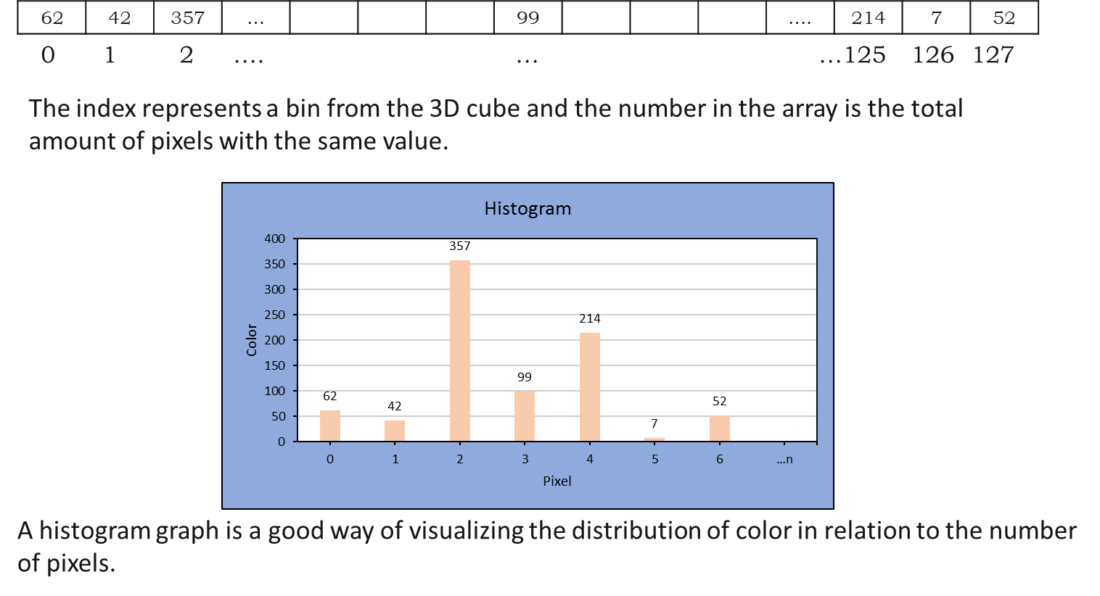
Color Con.

Slide 8
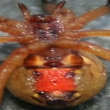
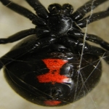
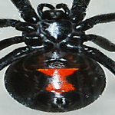
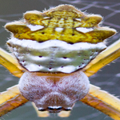
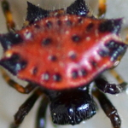
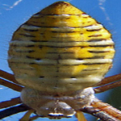
Recognition – Haralick and Laws
Sp. 1
New Sp.
Sp. 4
Sp. 2
Sp. 3
Sp. 5

Slide 9
Recognition - Color
Spider 1
Spider 2
Unknown Spider
Spider 3

Slide 10
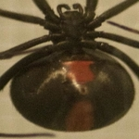
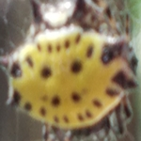
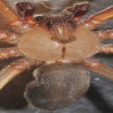
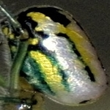
Tests
Test
Laws
Haralick
HSB

Slide 11
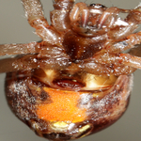
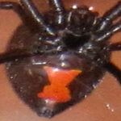
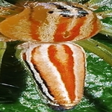
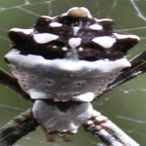
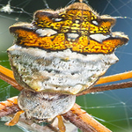
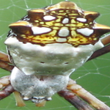
Tests
Test
Laws
Haralick
HSB

Slide 12
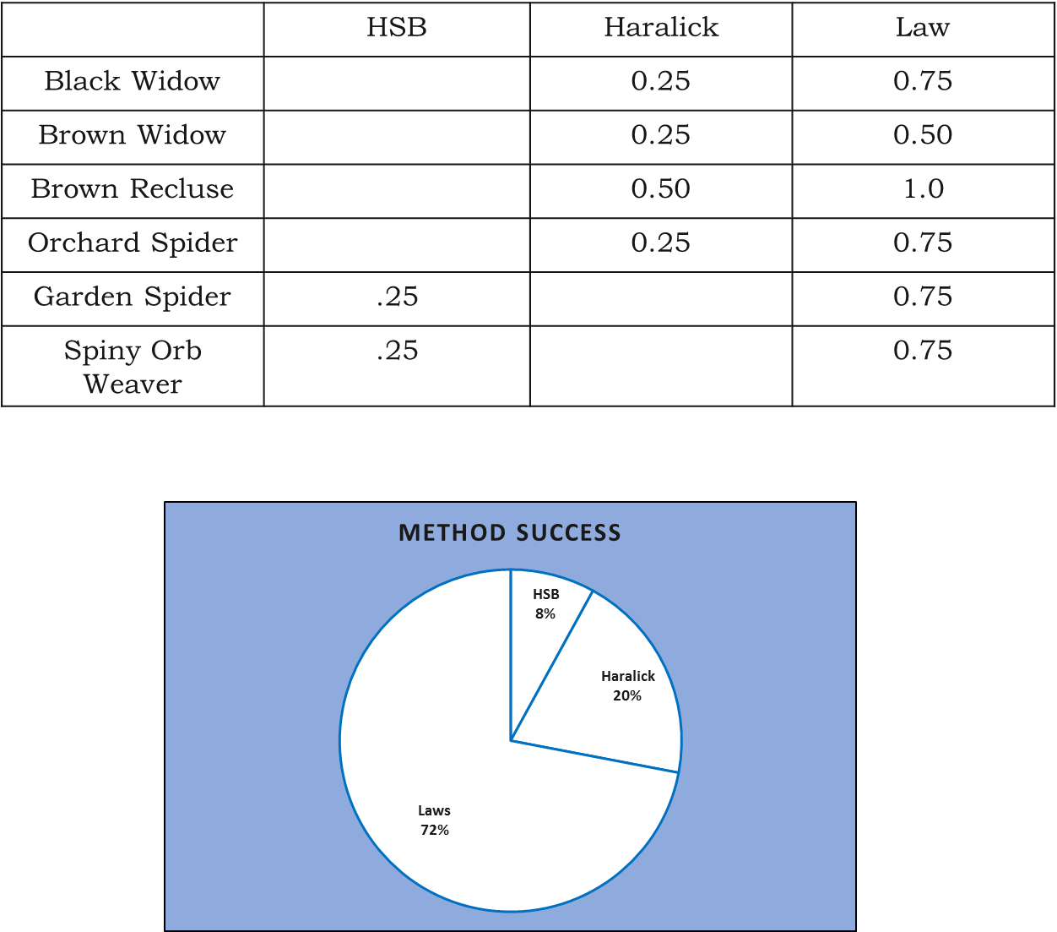
Results

Slide 13
Conclusion
Challenges
Obtaining Images
Alignment
Environment
Interchangeable Data

Slide 14
Questions?

