Slide 1

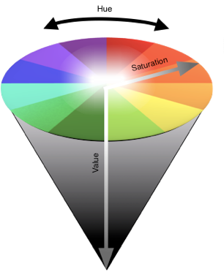
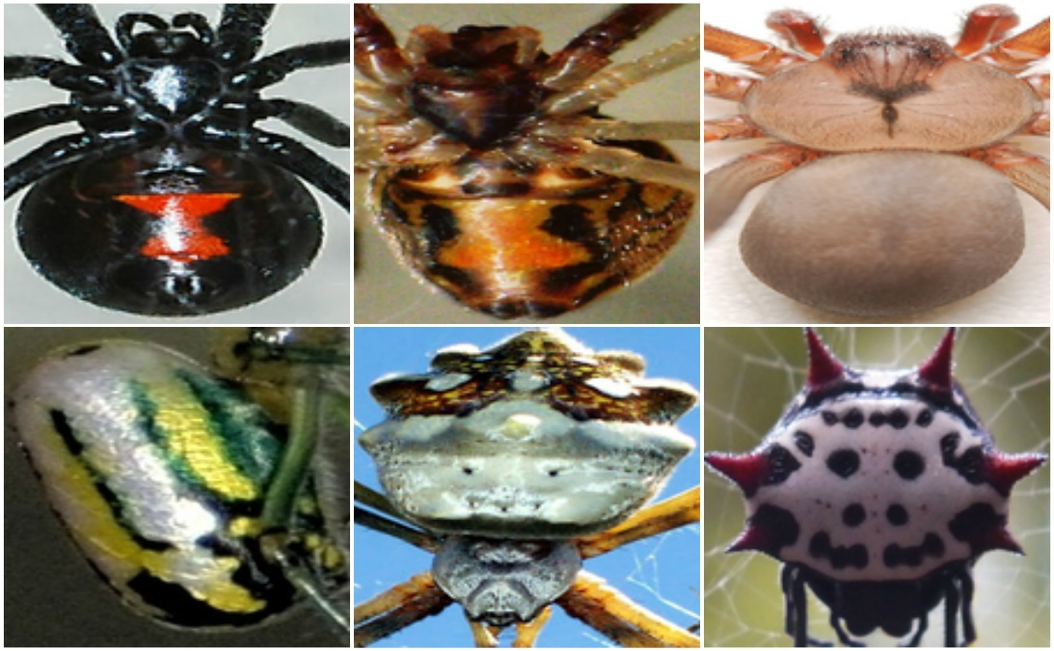
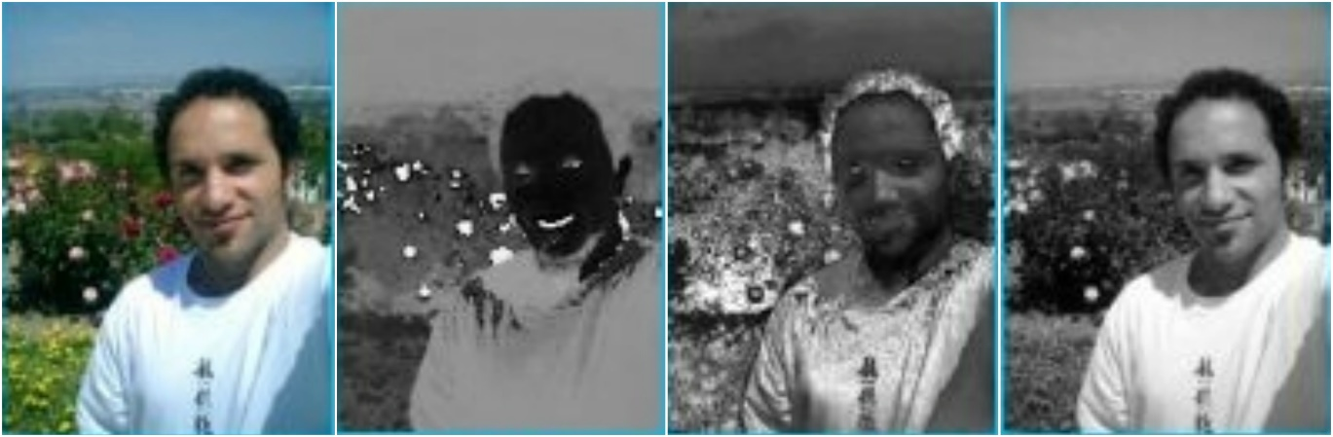
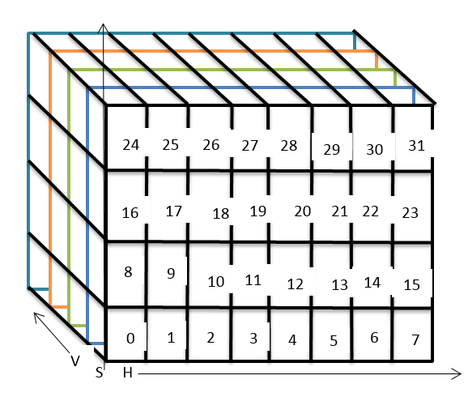
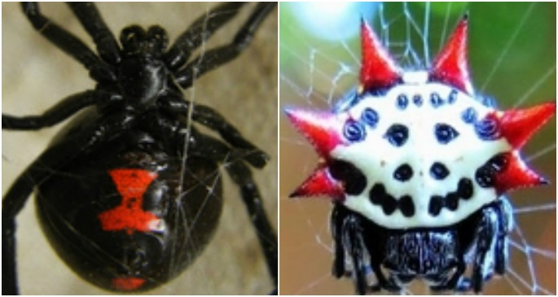
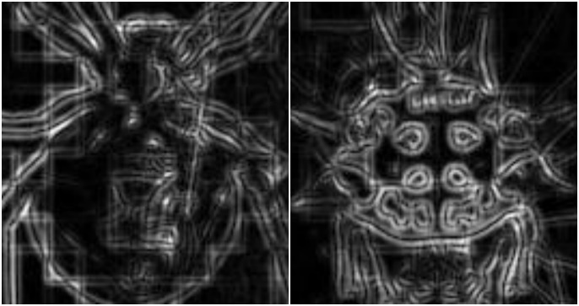

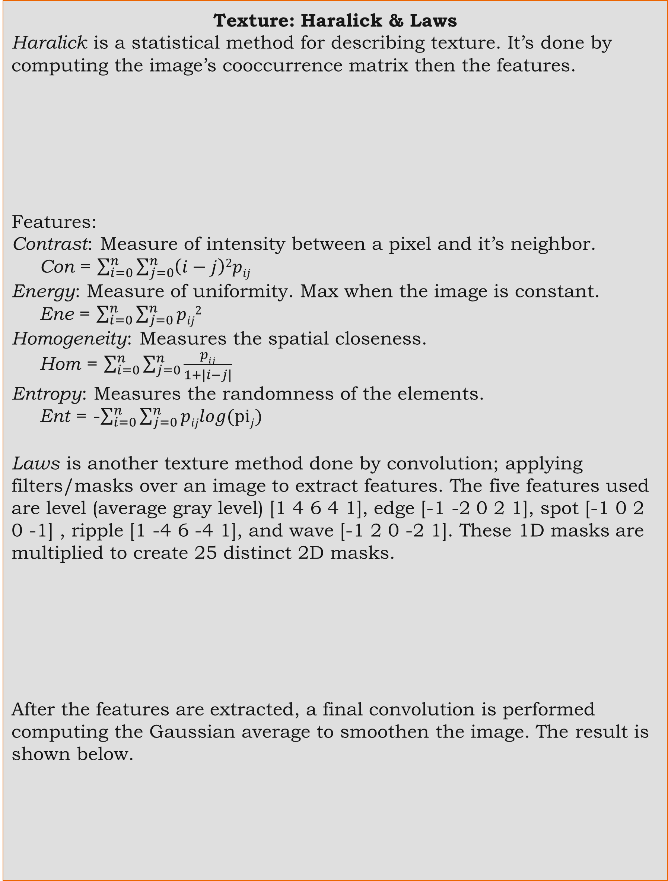


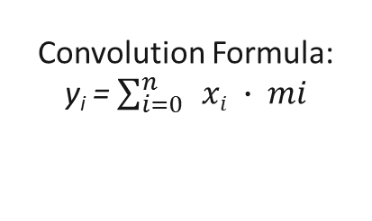

Applying Computer Vision Methodologies to Classify and Recognize Species of Arachnids
Student: Matthew Martinez
Advisor: Dr. Mahmoud Quweider
Instructor: Dr. Robert Schweller
1. Abstract
3. Methods For Classification
5. Results
Computer vision is a field in computer science that deals with how computers can understand something in an image or video. It seeks to replicate a human’s visual system. Some examples are face recognition and object detection.
Computers can be programmed to recognize things in images by supplying a set of training images to learn from. The training set then becomes what the computer knows. After the training, a new image it analyzed and the computer returns the most similar result. This process mimics when a human learns or sees something for the first time and then remembers it.
More specifically, recognition is done by choosing a set of features, in this case texture and color, to classify each species. The closer a new images features are to one in the training, then it is most likely that training image.
Texture: Haralick & Laws
Haralick is a statistical method for describing texture. It’s done by computing the image’s cooccurrence matrix then the features.
Features:
Contrast: Measure of intensity between a pixel and it’s neighbor.
Con = $\sum_{i=0}^{n}{\sum_{j=0}^{n}{\left(i−j\right)2pij}}$
Energy: Measure of uniformity. Max when the image is constant.
Ene = $\sum_{i=0}^{n}{\sum_{j=0}^{n}{pij2}}$
Homogeneity: Measures the spatial closeness.
Hom = $\sum_{i=0}^{n}{\sum_{j=0}^{n}{\frac{pij}{1+|i−j|}}}$
Entropy: Measures the randomness of the elements.
Ent = -$\sum_{i=0}^{n}{\sum_{j=0}^{n}{pijlog(pij)}}$
Laws is another texture method done by convolution; applying filters/masks over an image to extract features. The five features used are level (average gray level) [1 4 6 4 1], edge [-1 -2 0 2 1], spot [-1 0 2 0 -1] , ripple [1 -4 6 -4 1], and wave [-1 2 0 -2 1]. These 1D masks are multiplied to create 25 distinct 2D masks.
After the features are extracted, a final convolution is performed computing the Gaussian average to smoothen the image. The result is shown below.
Color: HSB (Hue, Saturation, Brightness)
Color is another approach for classifying images that uses histograms, the distribution of colors, for image classification.
The following diagrams are a 3D, 1D and graph representation of how a color histogram is visualized. Image undergoes quantization to reduce the number of bins from 2²⁴ to 2⁷.
There are 9 species with 5 images per species in the database. 4 different unknown images of each of the species in the following table were tested.
Example Test Images (In Order)
Four different images tested on each method
The results show that at least one or more methods returned the correct species.
j
0
1
2
3
0 1 2 3
i
0 | 0 | 1 | 1
0 | 0 | 1 | 1
0 | 2 | 2 | 2
2 | 2 | 3 | 3
2 | 2 | 1 | 0
0 | 2 | 0 | 0
0 | 0 | 3 | 2
0 | 0 | 0 | 1
Sample image
Cooccurrence Matrix
HSV Color Model
Original Hue Saturation Brightness
 | HSB | Haralick | Law
Black Widow |  | 0.25 | 0.75
Brown Widow |  | 0.25 | 0.50
Brown Recluse |  | 0.50 | 1.0
Orchard Spider |  | 0.25 | 0.75
Garden Spider | .25 |  | 0.75
Spiny Orb Weaver | .25 |  | 0.75
3,2,0 | 7,2,1 | 6,3,3
4,3,1 | 5,1,0 | …
Each pixel in an image contains an H, S, and B value
3 Bits for Hue, 2 Bits for Saturation and Brightness
m₁ | m₂
m₃ | m₄
 | y_{i}
62 | 42 | 357 | … |  |  |  | 99 |  |  |  | …. | 214 | 7 | 52
2. Introduction
Convolution Formula:
y_{i} = $\sum_{i=0}^{n}{ }xi ∙ mi$
0 1 2 …. … …125 126 127
The objective of my research is to take an image, feed it to the computer, and have the computer tell me what species of spider is in the image. It’s like face recognition but with spiders.
This idea came to me because of my love for nature. While spending time at wildlife refuges and parks I often encounter small mammals, reptiles, insects, and arachnids and I have genuine curiosity to know the species of these sentient beings.
I decided spiders were good candidate for research because they are misunderstood so this research can help educate people about the importance of arachnids as most serve an important function in ecosystems.
To accomplish my objective I extracted texture and color features separately using three different methods. Using more than one method will increase accuracy by returning more results because where one method fails another may succeed.
x₁ | x₂
x₃ | x₄
The index represents a bin from the 3D cube and the number in the array is the total amount of pixels with the same value.
Input image
mask
Convolution result
A histogram graph is a good way of visualizing the distribution of color in relation to the number of pixels.
6. Conclusion
Original Image
Processed Image
In conclusion, the methods utilized in the research can be used to successfully classify and recognize species of arachnids but only by combining them.
An issue that affected accuracy is that Laws and Haralick methods requires all the images major axes to be aligned horizontally on the Y-axis and that proved to be a difficult problem on it’s own.
The hardest challenge of this project was attempting to acquire accurate results in a natural environment. One of computer visions biggest setbacks is that the less controlled an environment is, the harder is it to get the desired outcome.
An advantage of my research is its flexibility. These methods can easily be applied to other types of images by swapping out the database. They may also be transferred to other mediums like web or mobile applications.
4. Recognition
Haralick
Recognize by taking Euclidian distance. $d\left(p,q\right)=\sqrt{\left(p1−q1\right)2+\left(p2−q2\right)2+…+\left(pn−qn\right)2}$
Laws
Laws is much more complex but the final result is a 2D array where each column is a spider and each row is a Euclidean distance from the pixel of an unknown spider and the spider in the database.
HSB Color
Histogram Intersection.
$$∩\left(H,H^{′}\right)= \sum_{m=0}^{M−1}{min⁡(Hm,H^{′}m})$$
1 2 3 4
10 | 15 | 6 | 9 | 11
Con
Ene
Hom
Ent
_{p1}
_{p2}
_{p3}
_{p4}
₁₀
₅
₁₅
₋₅
_{q1}
_{q2}
_{q3}
_{q4}
₂₀ | ₅ | ₅₀ | ₅₀
₄₅ | ₁₅ | ₅₅ | ₈₅
₃₀ | ₁₀ | ₄₀ | ₉₀
₋₂₅ | ₋₅ | ₋₃₀ | ₋₇₀
5 | 9 | 10 | 6 | 1
Species 1
1 2 3 4
3 | 7 | 4 | 10 | 2
₀
₁
₂
₄
₅ | ₂₀ | ₇ | ₁₀
₂ | ₂₄ | ₈ | ₁
₁₀ | ₅₆ | ₁₂ | ₁₃
₇ | ₉₉ | ₅ | ₈
Unknown Image
Species 2
0 | 3 | 11 | 20 | 0
Species 3
Unknown Spider
Each column is a spider.
Each row is a feature.
Step 1 - Calculate histogram intersection.
$∩\left(Un.,Sp.1 \right)$ = 27 $∩\left(Un.,Sp.2 \right)$ = 21 $∩\left(Un.,Sp.3 \right)$ = 19
Step 2 - Sum The Values In The Arrays.
Unknown Image Total = [5 + 9 + 10 +6 + 1] = 31
Species 1 Total = 51
Species 2 Total = 26
Species 3 Total = 34
Step 3 Normalize: 1-($∩$[i] –(min(Un. Total, Sp. Totals[i])))
Distance 1: 1 – (27/ min(31,51) = 1 – 0.87 = 0.13
Distance 2: 1 – (21/ min(31,26) = 1 – 0.80 = 0.20
Distance 3: 1 – (19/ min(31,34) = 1 – 0.61 = 0.39
The shortest distance is distance 1, therefore, the unknown image is most likely to be species 1.
Distance from spider 1: 48
Distance from spider 2: 12
Distance from spider 3: 73
Distance from spider 4: 133
Shortest distance is spider 2, therefore, the unknown spider is most likely to be that species.
Smallest Distance for Pixel 0: Spider 1
Smallest Distance for Pixel 1: Spider 4
Smallest Distance for Pixel 2: Spider 1
Smallest Distance for Pixel 3: Spider 1
Most smallest distances are from spider 1, therefore, the unknown spider is most likely to be that species
7. Future Directions
Image alignment – Improve Accuracy
User Defined Classification System
Multiplatform – Mobile application, Website
Multispecies – Classify and recognize multiple species
References
1. Gonzalez, Rafael C., and Richard E. Woods. Digital image processing. New York, NY: Pearson, 2018. Print.
2. Lemaitre, Guillaume, and Miroslav Rodojevic. Texture segmentation: Co-occurrence matrix and Laws’ texture masks methods. Tech. N.p., n.d. Web. 1 Feb. 2017.
3. "Chapter 7 Texture." N.p.: n.p., n.d. 1-13. Http://courses.cs.washington.edu/courses/cse576/book/ch7.pdf. Web. 1 Feb. 2017.
4. Davis, E. R. Introduction to Texture Analysis. Rep. N.p., n.d. Web. 1 Feb. 2017.

