Slide 1
Large Language Models Based Mutation Testing
Supervisor: Song wang Student: Matthew Forget
Student ID: 212798542
August 2024

Slide 2
Background and motivation
- What is mutation testing? We need to test our tests! Is coverage enough?
- Pitest (PIT for java), the current state of the art mutation tester
- PIT is deterministic …
- PIT has 29 mutant types. The 10 most common include NegationConditional, Math, False/True returns, Increments, and ConditionalsBoundary
- The rise of large language models (LLMs) like gpt-3.5-turbo offers an opportunity to explore automated and potentially more efficient ways to generate and evaluate mutants

Slide 3
Research Question
- Can gpt-3.5-turbo, a large language model, effectively generate software mutants that rival or exceed those generated by PIT?
- Why is this important?? Answering this question could lead to a significant shift in how mutation testing is conducted, potentially making it faster, more accessible, and scalable for large software projects

Slide 4
Evaluation Metrics
- The idea is to compare the mutations generated by gpt-3.5-turbo to the mutations generated by PIT
- Mutation score
- Compilable - Match percentage

Slide 5
Experiment Projects
- 10 maven projects were chosen to be compared:
Apache commons email - PIT version 1.16.1 (latest)
Apache commons net - PIT version 1.16.1 (latest)
Apache commons codec - PIT version 1.16.1 (latest) Apache commons pool - PIT version 1.16.1 (latest)
Apache commons collections - PIT version 1.16.1 (latest)
Apache commons DBCP - PIT version 1.16.1 (latest)
Apache commons IO - PIT version 1.15.3
Apache commons text - PIT version 1.16.1 (latest)
Apache httpcomponents - PIT version 1.16.1 (latest)
Apache commons imaging - PIT version 1.16.1 (latest)
- These projects were selected for their complexity, wide usage, and comprehensive test suites

Slide 6
Experiment Setup (PIT side)
1. Run PIT on all projects
2. For each project, collect data on mutation distribution and mutation scores (number of killed mutations / total number of mutations)
3. Parse the data to retrieve the top 10 mutants used, and the classes, methods, and the usage count of each mutant
4. For each mutant, pick 10 unique methods, and ~ 3 unique classes. 10 projects, 10 mutant types, 10 methods, = roughly 1000 mutations to compare!
All of this information is stored in a CSV file for later use

Slide 7
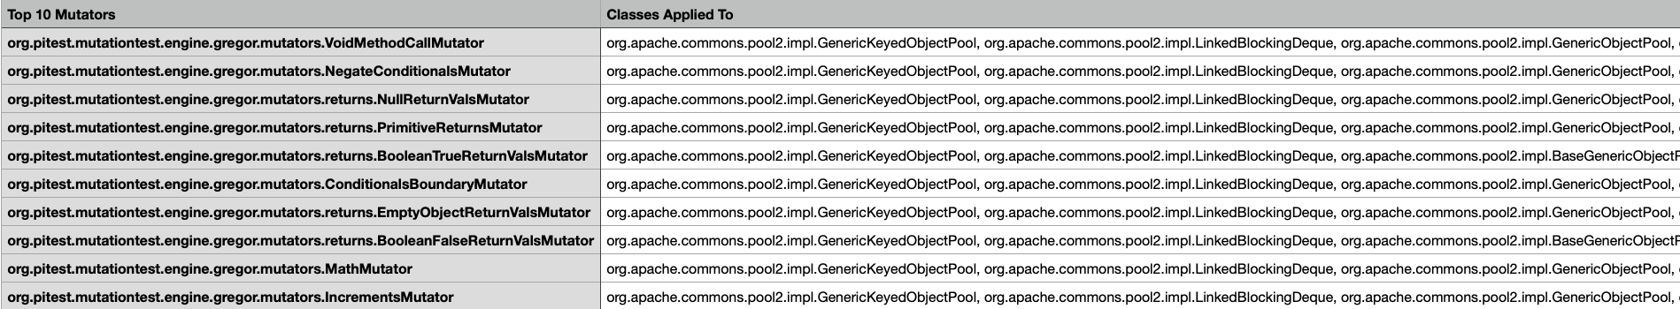
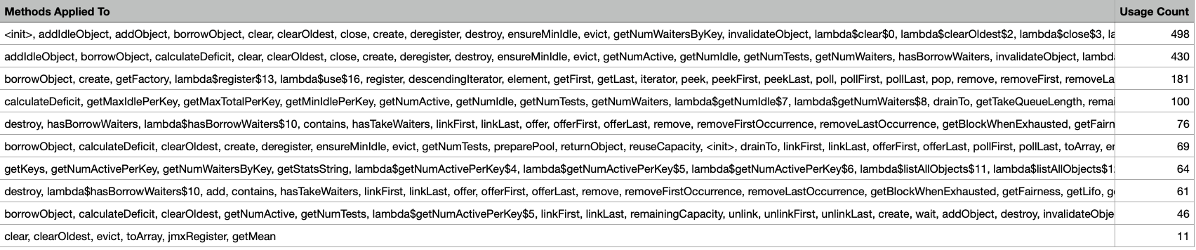
Example
Here are the top 10 mutants for Apache commons pool

Slide 8
Experiment Setup (LLM side)
1. Using OpenAI API, write a python script to prompt gpt-3.5-turbo with an example of applying a mutation to a method, then ask it to produce a mutation for a given method. This is done using the same methods and mutations from PIT, to compare fairly (example of prompt on next slide)
2. Once this is done, write a script to one by one, replace the method in the original project with the mutated version, and run the test suite. Only one mutation per test run. (example of a mutated methods on later slide)
3. If tests pass, the mutant is said to have ‘survived’. If the tests fail, or a compilation error occurs, the mutant is said to have been ‘killed’
4. This information (class, original method, mutated method, line number, mutant, compilable, and killed/survived) is stored in a CSV
5. Write a python script to calculate the percentage of compilable mutants from the LLM, the mutant scores for the LLM and PIT given the same methods and mutants, and the percentage of mutants that are the same between the LLM and PIT.
Libraries used: openai, os, pandas, shutil, subprocess, difflib

Slide 9
Example prompt for NegateConditionalsMutator
Below is an example of Java code and its mutated version using the NegateConditionals mutator, which negates a conditional:
Orginal:
public int numbers(int x, int y) {
if (x == y){
return x;
}
return y;
}
Mutated:
public int numbers(int x, int y) {
if (x != y){
return x;
}
return y;
}
—
Based on the above example, mutate the following java method, but include only the entire mutated method in your response. Only mutate one conditional. Do not include any labels, annotations, other text, or formatting markers (e.g., ```java). Please only apply the mutation once in the following method:

Slide 10
Example of successful method mutation
From Apache Commons Codec
Negate conditional:
Original:
public void addLast(final E e) {
if (!offerLast(e)) {
throw new IllegalStateException("Deque full");
}
}
Mutated:
public void addLast(final E e) {
if (offerLast(e)) {
throw new IllegalStateException("Deque full");
}
}

Slide 11
Example of unique method mutation
BooleanTrue Mutator (makes a return value true):
Example from Apache commons codec
Original:
private boolean conditionCH1(final String value, final int index) {
return contains(value, 0, 4, "VAN ", "VON ") || contains(value, 0, 3, "SCH") ||
contains(value, index - 2, 6, "ORCHES", "ARCHIT", "ORCHID") ||
contains(value, index + 2, 1, "T", "S") ||
(contains(value, index - 1, 1, "A", "O", "U", "E") || index == 0) &&
(contains(value, index + 2, 1, L_R_N_M_B_H_F_V_W_SPACE) || index + 1 == value.length() - 1);
}
Mutated:
private boolean conditionCH1(final String value, final int index) {
return contains(value, 0, 4, "VAN ", "VON ") || contains(value, 0, 3, "SCH") ||
contains(value, index - 2, 6, "ORCHES", "ARCHIT", "ORCHID") ||
contains(value, index + 2, 1, "T", "S") ||
true; <— did not make whole return value true
}

Slide 12
Example of failed method mutation
Math Mutator (swaps mathematical operators with different operators):
Example from Apache commons Codec
Original:
private static long getLittleEndianLong(final byte[] data, final int index) {
return (long) data[index ] & 0xff |
((long) data[index + 1] & 0xff) << 8 |
((long) data[index + 2] & 0xff) << 16 |
((long) data[index + 3] & 0xff) << 24 |
((long) data[index + 4] & 0xff) << 32 |
((long) data[index + 5] & 0xff) << 40 |
((long) data[index + 6] & 0xff) << 48 |
((long) data[index + 7] & 0xff) << 56;
}
Mutated:
private static long getLittleEndianLong(final byte[] data, final int index) {
return (long) data[index ] & 0xff |
((long) data[index + 1] & 0xff) << 8 |
((long) data[index + 2] & 0xff) << 16 |
((long) data[index + 3] & 0xff) << 24 |
((long) data[index + 4] & 0xff) << 32 |
((long) data[index + 5] & 0xff) << 40 |
((long) data[index + 6] & 0xff) << 48 |
((long) data[index + 7] & 0xff) << 56;
}

Slide 13
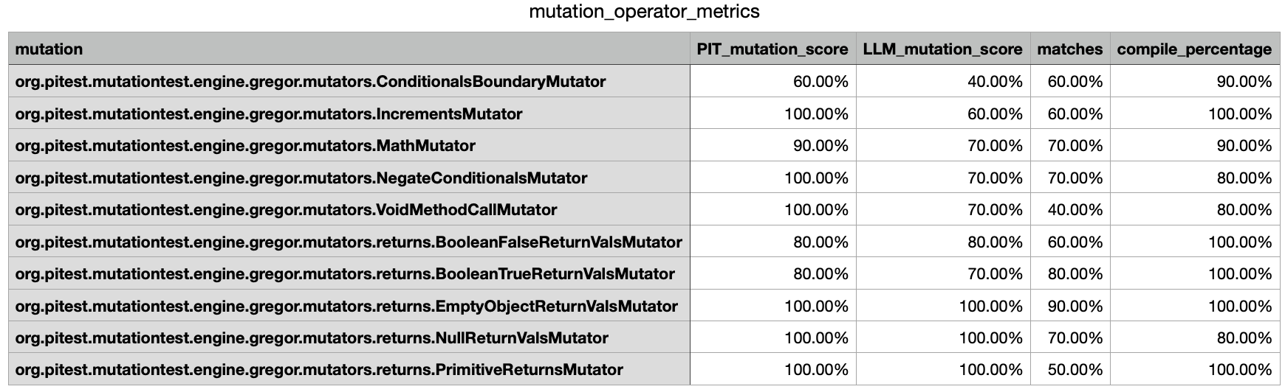
Results
Example from Apache Commons Codec

Slide 14
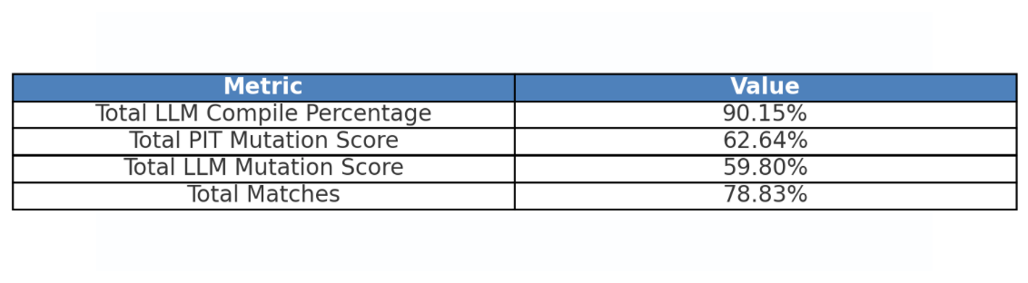
Results Total

Slide 15
Case Study
Let us compare the results of applying MathMutator for Apache commons Codec LLM: mutator PIT score LLM score match compile

Slide 16
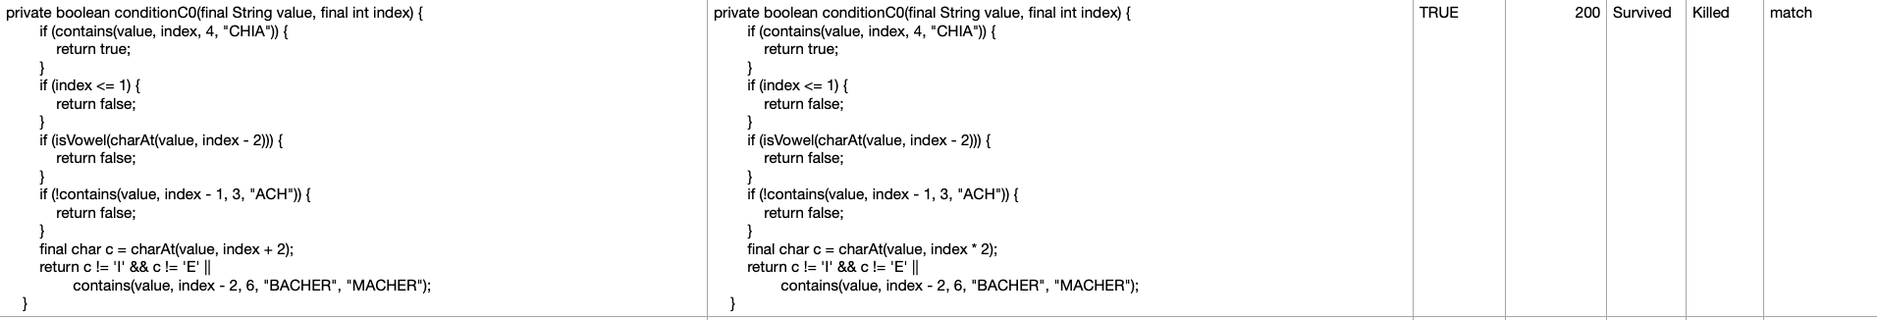
Case Study
Let us compare the results of applying MathMutator for Apache commons Codec original method mutated method compilable line LLM PIT match
PIT: index + 2 into index - 2
LLM: index + 2 into index * 2
The LLMs mutation survived while PITs was killed

Slide 17
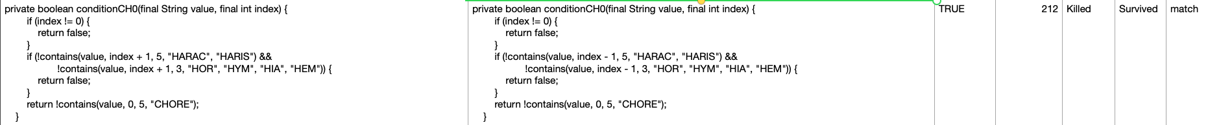
Case Study
Let us compare the results of applying MathMutator for Apache commons Codec original method mutated method compilable line LLM PIT match
LLM: mutated two lines when specified to mutate one
The LLMs was likely killed due to two mutants being easier to detect

Slide 18
Case Study
Let us compare the results of applying MathMutator for Apache commons Codec original method mutated method compilable line LLM PIT match
LLM: did not mutate anything in the method
This is why there is no matching line, and the LLMs method survived the tests while PITs did not

Slide 19
Case Study
Let us compare the results of applying MathMutator for Apache commons Codec original method mutated method compilable line LLM PIT match
LLM: The LLM mutated 5 lines when instructed to only mutate one. The match is because PIT also mutated at least one of these lines
This is a mistake on behalf of the LLM

Slide 20
Case Study
Let us compare the results of applying MathMutator for Apache commons Codec original method mutated method compilable line LLM PIT match
LLM: The LLM correctly mutated the 3rd line from * to / PIT: PIT also mutated the same line in the same way
Both mutations were killed

Slide 21
Case Study
Let us compare the results of applying MathMutator for Apache commons Codec original method mutated method compilable line LLM PIT match
LLM: The LLM incorrectly applied 5 mutations when instructed to only apply one

Slide 22
Case Study
Let us compare the results of applying MathMutator for Apache commons Codec original method mutated method compilable line LLM PIT match
LLM: The LLM again incorrectly applied 5 mutations, changing | to & once, and changing & to | 4 times

Slide 23
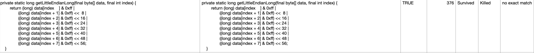
Case Study
Let us compare the results of applying MathMutator for Apache commons Codec original method mutated method compilable line LLM PIT match
LLM: The LLM filed to apply any mutation despite being instructed to, causing no match with PIT, and a survived test run

Slide 24
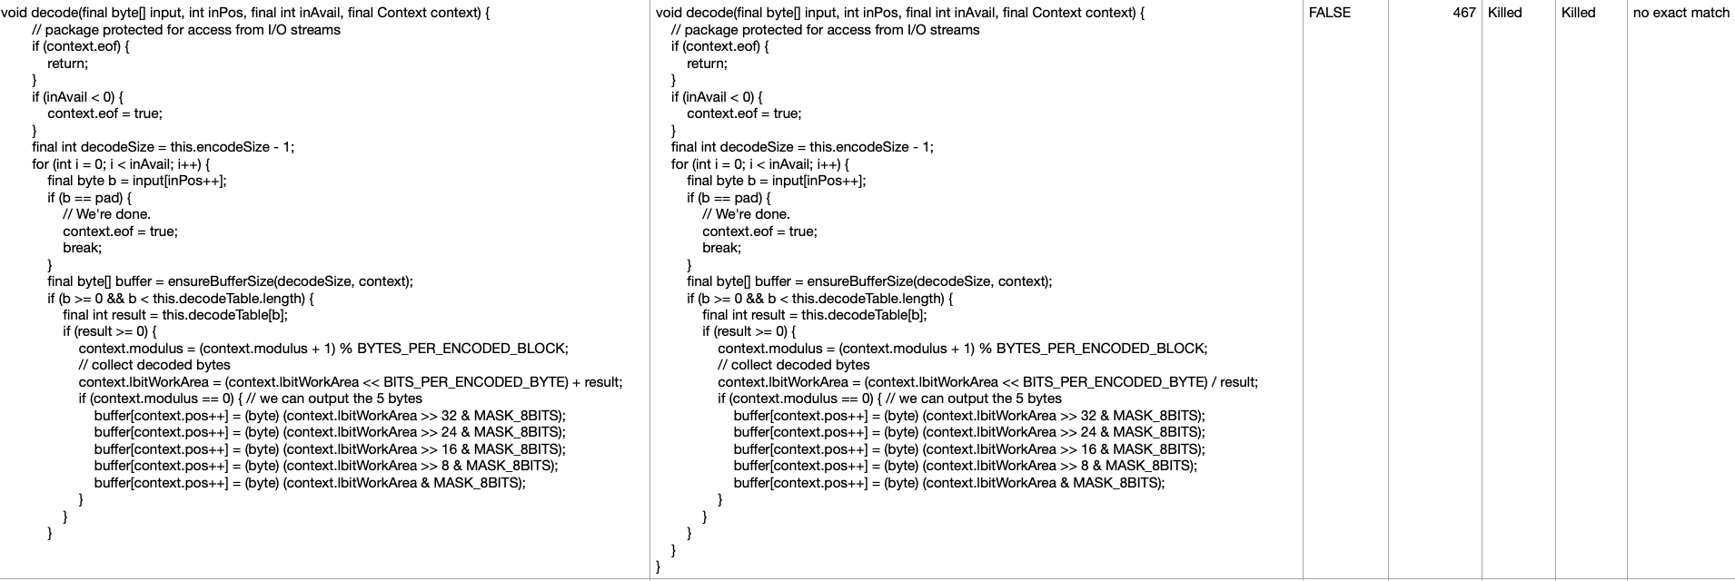
Case Study
Let us compare the results of applying MathMutator for Apache commons Codec original method mutated method compilable line LLM PIT match
LLM: The LLM again correctly mutated the same line as PIT, changing a + to a /, however the LLM added extra closing brackets, making it not compilable

Slide 25
Case Study
Let us compare the results of applying MathMutator for Apache commons Codec original method mutated method compilable line LLM PIT match
LLM: The LLM correctly mutated & into | in the 3rd line, matching PITs mutation

Slide 26
Conclusion
Overall Performance: In our comparison between GPT-3.5-turbo and PIT for mutation testing, GPT-3.5-turbo generally performed either equal to or worse than PIT in terms of effectiveness and reliability.
Compilation Errors: The LLM-generated mutants occasionally introduced errors that prevented the code from compiling. These mistakes, though not frequent, contributed to a portion of the mutants being unusable.
Mutation Score: When comparing the mutation scores, GPT-3.5-turbo achieved scores roughly equivalent to those produced by PIT, but slightly lower on average. This is likely due to instances where the LLM either failed to apply mutations correctly or applied them in ways that did not align with the intended mutation operators, resulting in less challenging or ineffective mutants.
Match Percentages: The lower match percentages between LLM-generated mutants and those produced by PIT indicate that GPT-3.5-turbo often applied mutations differently. While this led to some novel mutants, it also meant that the LLM was less consistent in generating the specific types of mutations typically targeted by traditional tools like PIT.
Implications: These findings suggest that while GPT-3.5-turbo has potential in the field of mutation testing, particularly for generating novel mutations, it currently lacks the precision and reliability of traditional tools like PIT. The occasional errors and the slight underperformance in mutation scores indicate that further refinement is needed before LLMs can be considered a fully viable alternative to established mutation testing methods.

