Slide 1
The examination of pay discrimination based on race in the MLB
Matthew nay

Slide 2
Intro and Motivation
The current makeup of players in the MLB in 2022:
White - 62.1%
Hispanic or Latino - 28.5%
Black or African American - 7.2%
Asian - 1.9%
Hawaiian or Pacific Islander - 0.3%
American Indian or Alaska Native - 0.1%
Been studied before and nothing has been found:
Medoff (1975)
Christiano (1986, 1988)
Kahn (2000)
King and Palmer (2006)

Slide 3
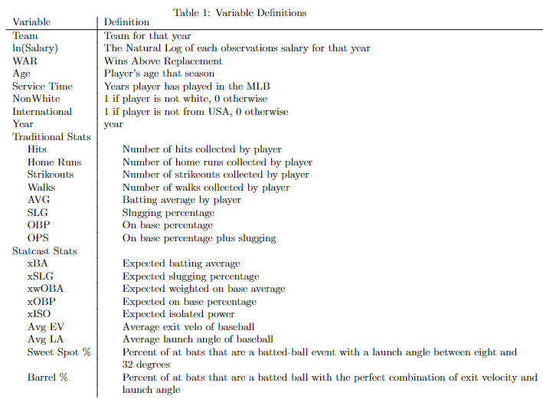
Data Set Details
At its largest:
Hitters: 587 observations, 26 variables
Pitchers: 286 observations, 31 variables
Data decisions:
Need to be eligible to qualify for season awards
Need to have signed a contract, can’t be making league minimum

Slide 4
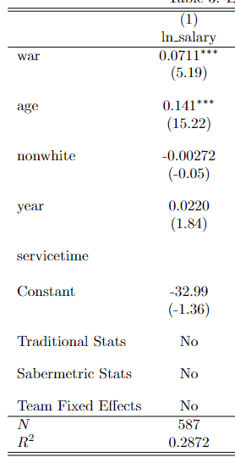
First Model

Slide 5
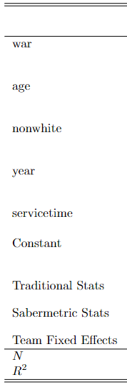

Seventh Model

Slide 6
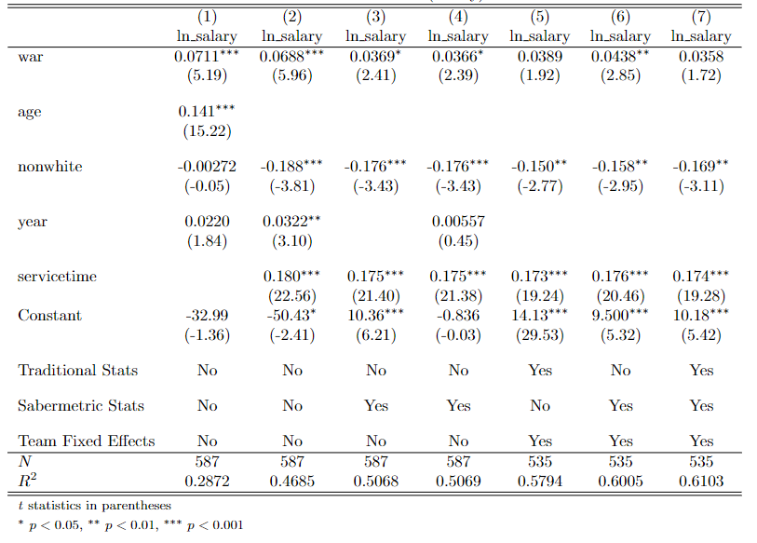
Effect of NonWhite on ln(Salary) - Hitters

Slide 7
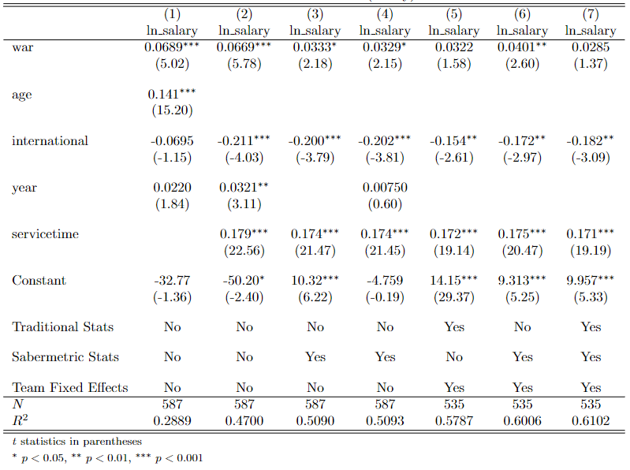
Effect of International on ln(Salary) - Hitters

Slide 8
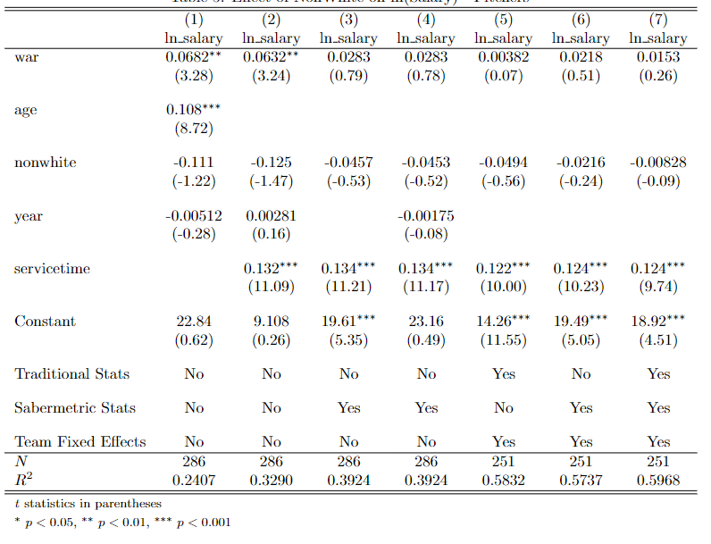
Effect of NonWhite on ln(Salary) - Pitchers

Slide 9
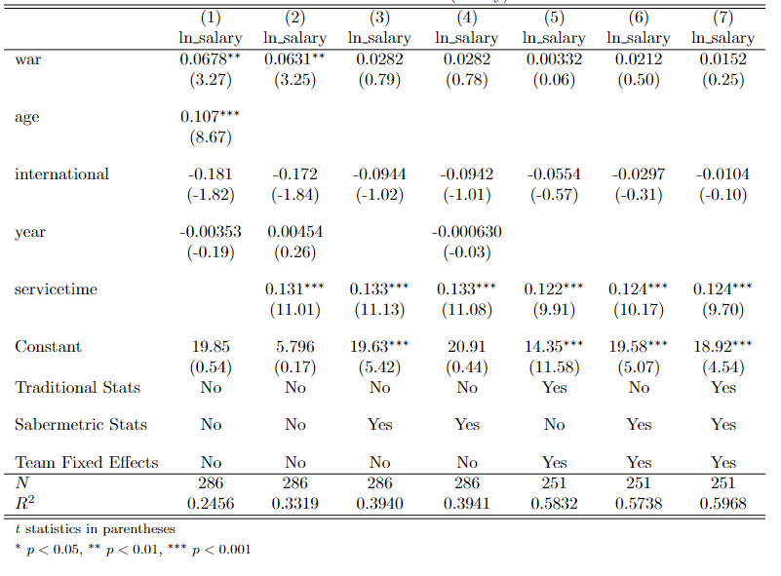
Effect of International on ln(Salary) - Pitchers

Slide 10
Conclusion
Findings:
There is statistically significant evidence to support that there is pay discrimination within the MLB for hitters
ServiceTime is a better representative for ‘experience’
Traditional stats are still great variables to use when predicting player value
Next Steps:
Further examine other factors on salary differentials
Player position, contract length, and free agency status
Develop more accurate measure for a player’s race
Further examine the effectiveness of diversity and inclusion in sports

