Slide 1



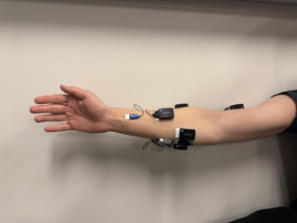
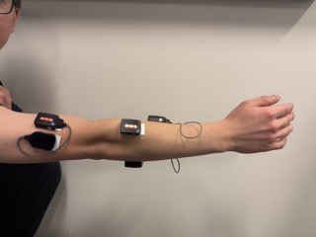
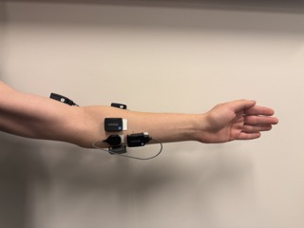
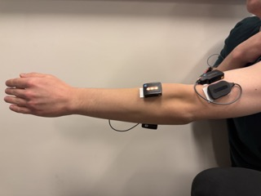
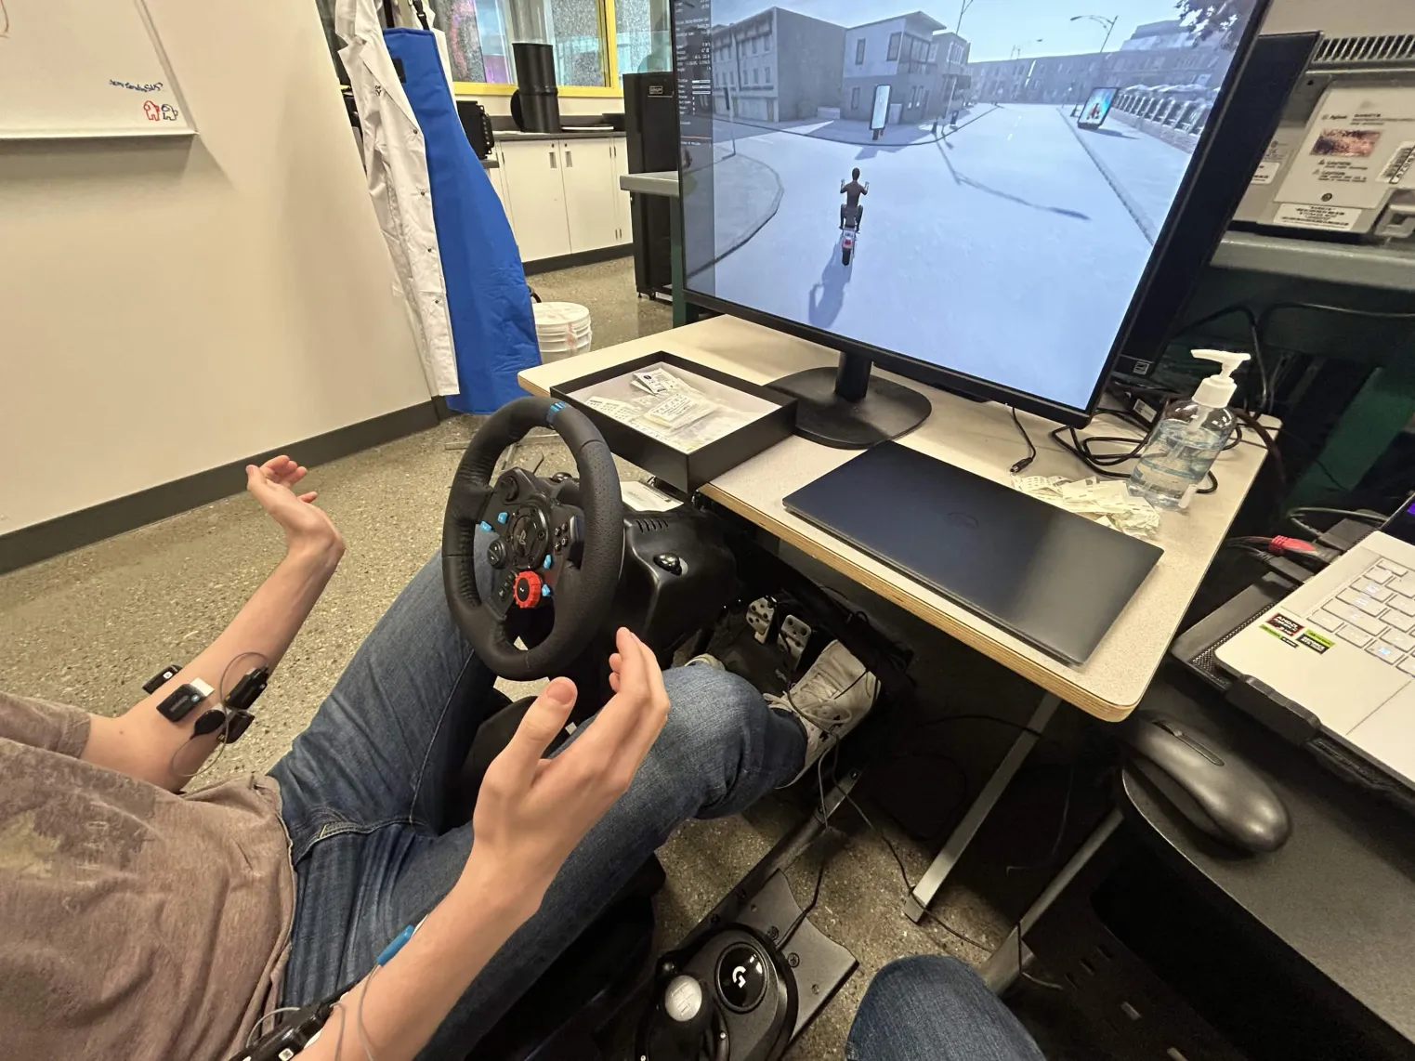

Investigation of Characteristics of Two-Handed Interactions
with AI-Powered Electromyography (EMG) Sensors
ENEL 500 Capstone Design Project | Team #4 | HERO Lab | Schulich School of Engineering, University of Calgary
Iggy Abi-Abiola (Project Manager) | Ziad Shamma | Matthew Nechita
Sponsor: Dr. Junho Park | Academic Advisor: Mohamed Helaoui | Support Technician: Allynne Casilan
33
2000 Hz
200 / 100
0.90
3 ms
strict EMG channels
shared resampled time base
window / step samples
current test accuracy
median processing latency
17 right-arm + 16 left-arm channels
Matched offline and realtime preprocessing
100 ms window with 50 ms stride
Earlier model ~0.65 | +25 points
p95 ~4 ms inside realtime loop
End-to-End System Architecture
Strict-layout
collection
Resampling
Filtering
Windowing +
calibration
GestureCNNv2
Runtime tuning
CARLA control
Delsys GUI + paired sensors
multi-sensor streams -> 2000 Hz
60/120 Hz notch + 20-450 Hz bandpass
200/100 samples + neutral/MVC scaling
Residual 1D CNN + channel attention
smoothing + confidence gate + hysteresis
steering / indicators / horn + logging
Problem & Motivation
Sensor Layout & Strict Placement Policy
Signal Processing & Realtime Inference
• Upper-limb loss or impairment can make conventional steering difficult or impossible.
• Basnet et al. showed single-arm EMG control was feasible, but lane-keeping error, workload, and usability still lagged a steering wheel.
• This capstone investigates whether a two-handed EMG interface can provide more natural and more stable control.
• The current emphasis is reproducibility: strict placement, matched preprocessing, logged runtime behaviour, and simulator evaluation.
Fixed pair-number contract
• Raw multi-sensor EMG streams are resampled to a shared 2000 Hz time grid before training and inference.
• The active filter stack uses 60 / 120 Hz notch filtering and a 20-450 Hz bandpass to suppress noise while retaining muscle activity.
• Windows are 200 samples with a 100-sample step; per-session neutral / MVC calibration stabilizes amplitude variation.
• The active deployment subset is the strict three-gesture steering set: neutral, left_turn, right_turn.
Target fs | 2000 Hz
Filters | 60/120 notch; 20-450 bandpass
Window / step | 200 / 100
Scenario presets | lane_keep_5min, highway_overtake
Mini Sensor
Sensor type | Right arm | Left arm
Avanti | 1, 2, 3 | 4, 5, 6
Maize | 7 | 8
Galileo | 9 | 10
Mini | 11 | -
Avanti sensor
Maize Sensor
Project Objectives & Contributions
• Right arm resolves to 17 strict channels; left arm resolves to 16 strict channels.
• Pair identity is preserved during both training and inference, so channel meaning cannot drift between sessions.
• This strict layout replaces mixed historical layouts that degraded cross-session reproducibility.
• Build a dual-arm surface EMG interface using Delsys Trigno sensors and a custom Python collection workflow.
• Preserve a stable channel contract across sessions through strict sensor placement by fixed pair number.
• Mirror offline and online preprocessing to avoid train-deploy mismatch.
• Publish steering and discrete driving commands into CARLA, then evaluate offline, latency, and scenario-level performance.
CNN Model & Runtime Stabilization
Galileo Sensor
Maize Sensor
• GestureCNNv2 uses a residual 1D CNN backbone with channel attention.
• A pre-normalization energy bypass preserves rest-vs-active amplitude information that would otherwise be weakened by per-window normalization.
• Per-subject training currently uses 60 epochs, batch size 512, learning rate 1e-4, dropout 0.25, and label smoothing 0.05.
• Runtime stabilization combines smoothing, minimum-confidence gating, hysteresis, and ambiguity rejection to reduce neutral flicker.
Runtime preset | Value
Smoothing | 3 frames
Minimum confidence | 0.80
Dual-arm agreement | 0.55
Ambiguity rejection | margin >= 0.10
Representative forearm placements used during protocol development.
Sensor suite used across the strict workflow: Avanti • Maize • Galileo • Mini
Experimental Setup
Data Collection Protocol
2
Standard session
Neutral-recovery session
CARL scenario display
• Gestures: left_turn, right_turn, neutral, signal_left, signal_right, horn
• 5 s gesture + 5 s neutral
• 5 repetitions per session
• Calibration enabled: 5 s neutral rest + 5 s MVC
• Sequences: left_turn -> neutral and right_turn -> neutral
• 3 s gesture + 5 s neutral
• 6 repetitions
• Added specifically to improve return-to-neutral stability
The deployed tuning preset in the current branch is flicker_mild_margin.
Left Turn Gesture Command
Challenges & Mitigations
Delsys sensor suite
Challenge | Mitigation
Neutral flicker after gesture release | Neutral-recovery data, confidence gating, hysteresis
Session drift / placement variability | Strict pair mapping, calibration, placement checklist
signal_right confusion | Targeted data collection, class balancing, confusion-driven tuning
Integration latency / jitter | Realtime logging in inference loop and CARLA client
Steering rig + pedals
Gesture Set & Command Mapping
Gesture | Mapped action | Status
neutral | Maintain heading / hold lane | active
left_turn | Steer left | active
right_turn | Steer right | active
signal_left | Left indicator | expanded set
signal_right | Right indicator | expanded set
Reverse | Reverse gear | active
Dual-arm EMG driving bench used for realtime testing and simulator integration.
• Wireless Delsys sensors stream to Python through the Delsys SDK bridge.
• Real-time inference is integrated with a modified CARLA manual-control client.
• Current evaluation scenarios emphasize lane-keeping and overtaking with logged completion state.
Next Steps to Final Capstone Demonstration and Beyond
Significance & Research Direction
• Complete the replicated strict CNN workflow for the second arm and finalize fused control behaviour.
• Run closed-loop CARLA validation with logged lane error, RMSE, invasions, success / failure, and completion time.
• Expand participant data across multiple sessions to improve generalization.
• Finalize report figures, poster evidence, and a publication-ready manuscript draft.
• Assistive driving HMI research requires stable, transparent engineering evidence before any real-vehicle claim.
• The strongest current contribution is a defensible simulator-first pipeline that can be repeated, debugged, and extended inside HERO Lab.
Hardware / Software Stack
Sensors | Delsys Trigno hardware + custom Python GUI
Processing | NumPy, SciPy, libEMG, resampling + filtering
Learning | PyTorch GestureCNNv2
Simulator | Python client + CARLA control and logging
Results & Implementation Status
Accuracy Improvement
Per-Class Performance
Latency Measurement
Current Status
Earlier model
Current model
• right_turn: precision ~0.98, F1 ~0.90
• left_turn: precision ~0.92, F1 ~0.89
• signal_left: F1 ~0.85
• neutral: balanced precision / recall ~0.73
• Main remaining gap: signal_right recall ~0.56
3 ms
median processing latency
✓
Strict-layout data collection working
0.65
0.90
4 ms
p95 latency in the realtime loop
✓
Resampling, filtering, recalibration implemented
+25 percentage-point improvement in test accuracy
• Includes filtering, windowing, normalization, CNN forward pass, and smoothing.
• Excludes hardware acquisition / wireless transmission delay, measured separately later.
✓
GestureCNNv2 active for training
• Result shown is from the final-evaluation pipeline.
• Primary improvement driver: CNN + matched preprocessing + runtime stabilization.
✓
Dual-arm strict realtime inference working
Confusion-matrix driven retraining is the main next tuning path.
✓
CARLA lane-keeping and overtake logging active
References: Basnet et al., Evaluating the Feasibility of EMG-Based Human-Machine Interfaces for Driving (2025); Delsys Trigno Avanti technical specifications (2024).
Contact: igdaliah.abiabiola@ucalgary.ca | junho.park@ucalgary.ca
Acknowledgments: HERO Lab, Dr. Junho Park, Mohamed Helaoui, Allynne Casilan.
2026 Capstone Design Fair.

