Slide 1
AAVAIL
Revenue Projection Project

Slide 2
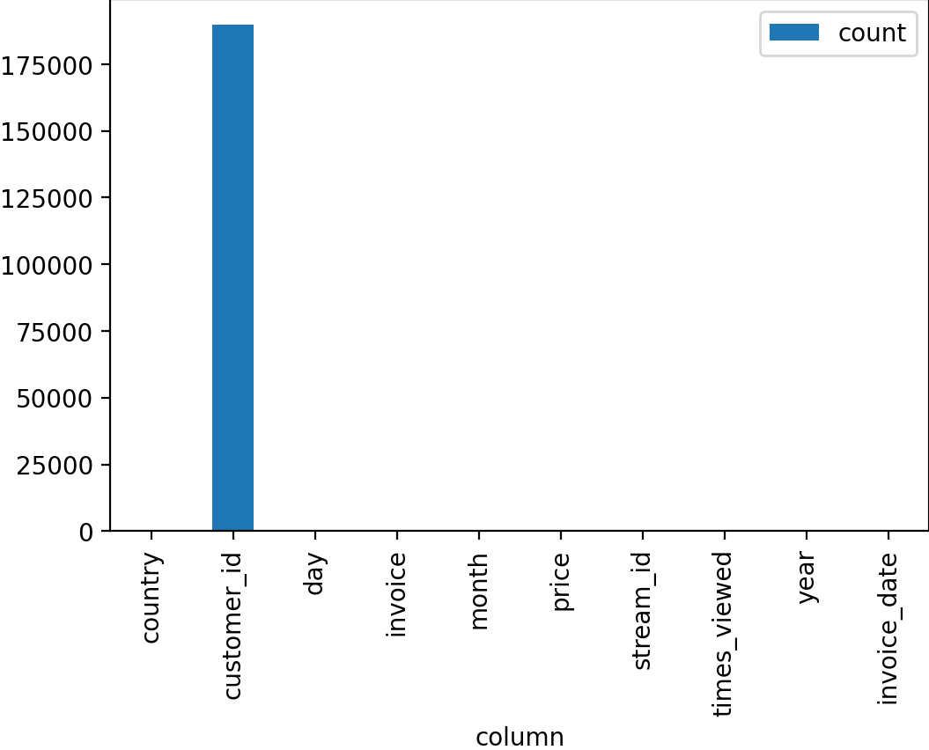
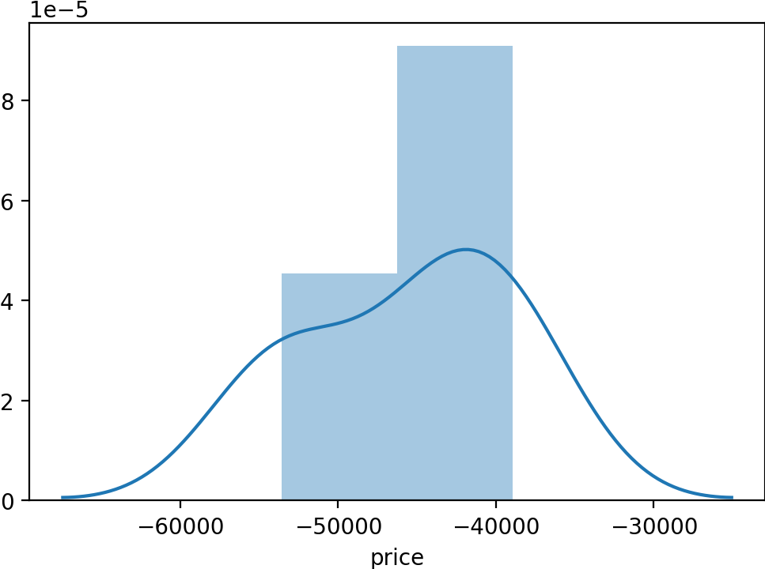
The Dataset
We analysed data from invoices looking into the detail.
Interesting observations off the cuff reveal:
A significant amount of missing customer IDs
A huge skew towards the United Kingdom
Negative values in the invoice field
A large number of countries

Slide 3
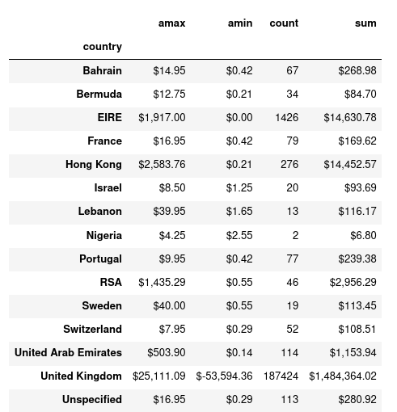
Missing Data analysis
Further analysis indicates that a lot of this “bad data” (with no customer_id) is related:
Bulk of missing customers is UK
Negative values are for missing customer
Action: Remove this data and re-analyse

Slide 4
The extent of the churn problem
Looking at the data from Singapore (left) and USA (right) split by subscription type it is clear that:
Singapore has significantly higher churn rate than the USA
Churn is a problem across all subscription types
Churn is particularly a problem on the “Premium” and “Unlimited” plans.

Slide 5
Next STEPS
Identify the root causes of subscriber churn in Singapore
Further data analysis to identify primary causes
Predictive model to identify potential churners
Remedial actions to satisfy those consumers

