Slide 1
AAVAIL
Revenue Projection Project
EDA

Slide 2
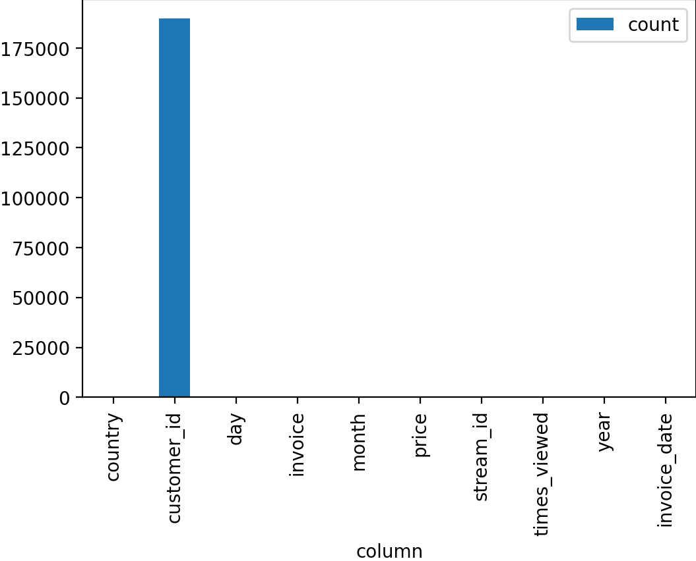
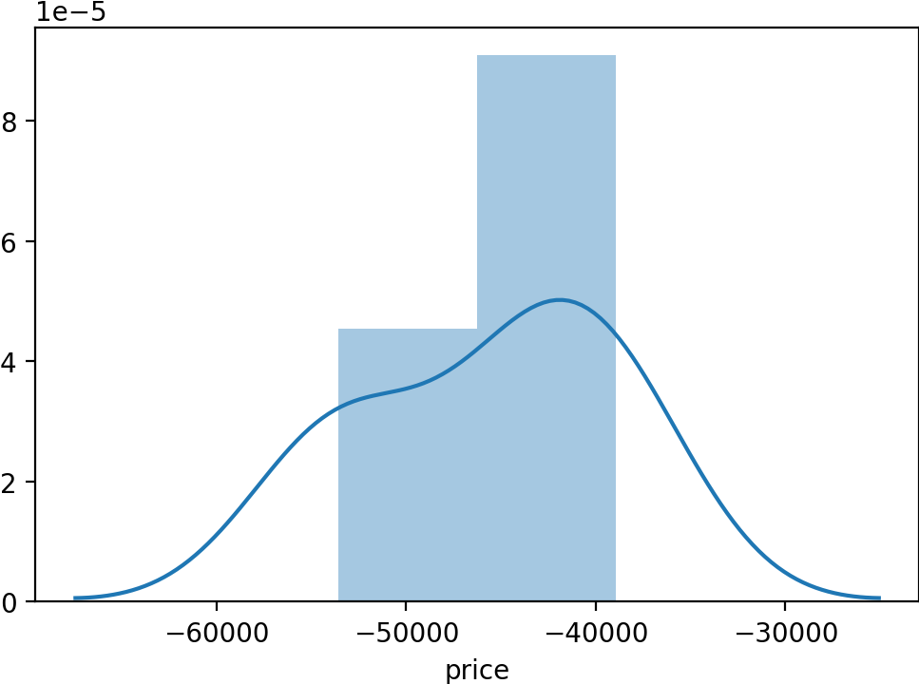
The Dataset
We analysed data from invoices looking into the detail.
Interesting observations off the cuff reveal:
A significant amount of missing customer IDs
A huge skew towards the United Kingdom
Negative values in the invoice field
A large number of countries

Slide 3
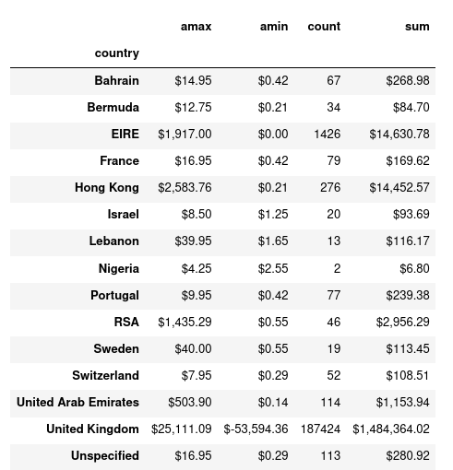
Missing Data analysis
Further analysis indicates that a lot of this “bad data” (with no customer_id) is related:
Bulk of missing customers is UK
Negative values are for missing customer
Action: Discuss this data with domain expert
Include in overall Revenue Modelling until clarity is obtained

Slide 4
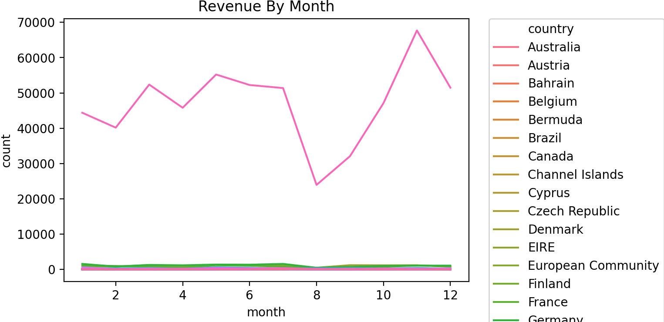
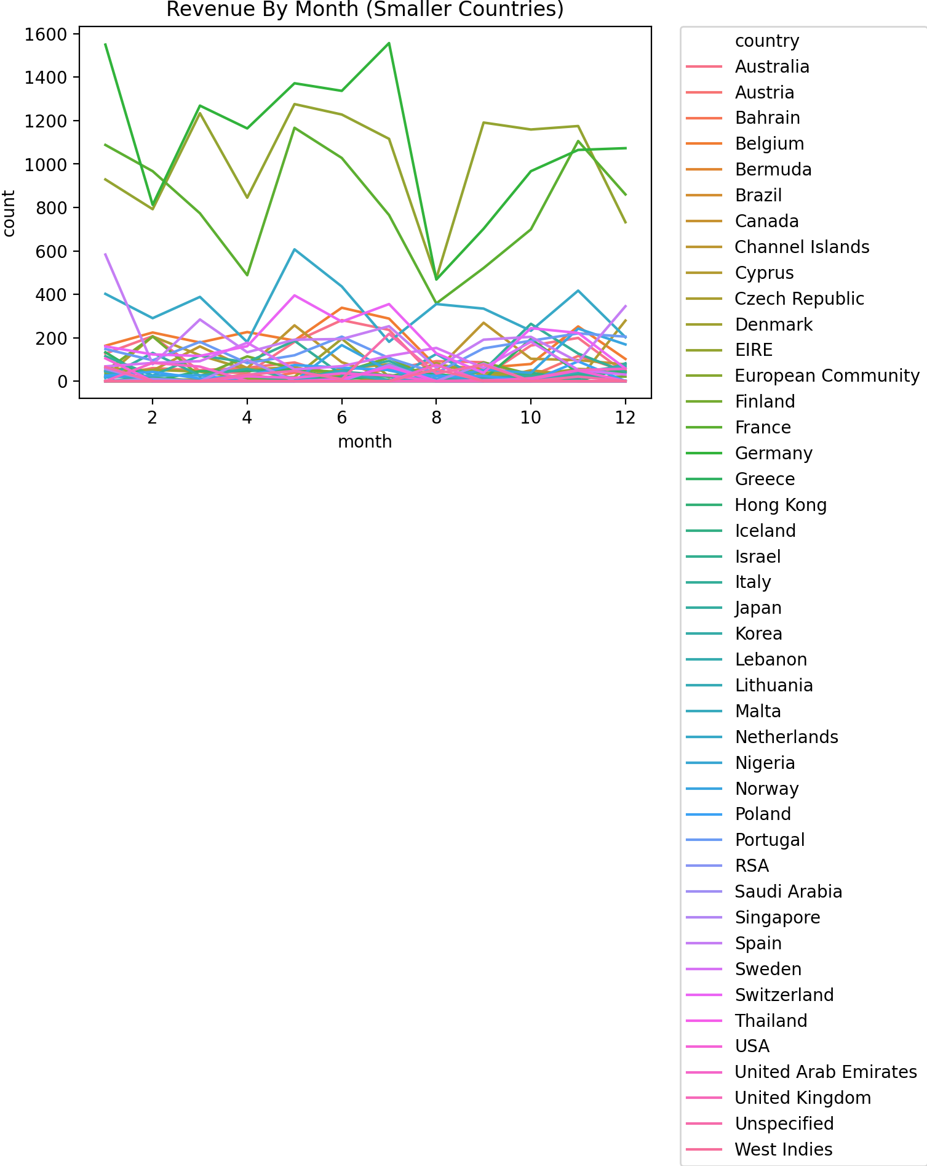
Revenue
Looking at revenue by month we see a large drop in August and a spike at the end of the year.
Excluding the UK (which dominates the data) this is less pronounced – possibly due to limited operations and customers in these smaller countries.

