Slide 1
AAVAIL
Revenue Projection Project
Production Analysis

Slide 2
DAta
Data was generated for this analysis by running the Python script to process the cs-production data and then compare that to what the model predicts (Random Forest estimator)
This data was saved in a CSV and analysed using a Jupyter Notebook.
In this the “target” refers to the actual production data

Slide 3
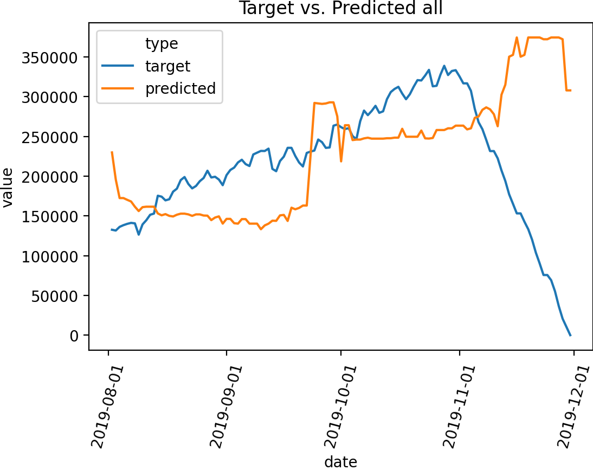
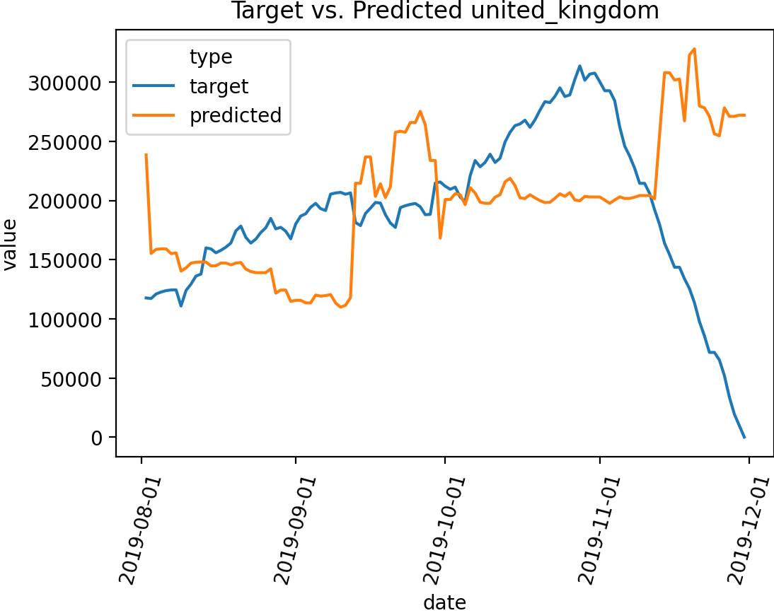
All Country Accuracy
This shows the prediction roughly in line with the target until November after which the target drops off.
This needs to be investigated – I would suspect that perhaps all the data for November is not available.
A similar picture is present in the UK data (which dominates the dataset)

Slide 4
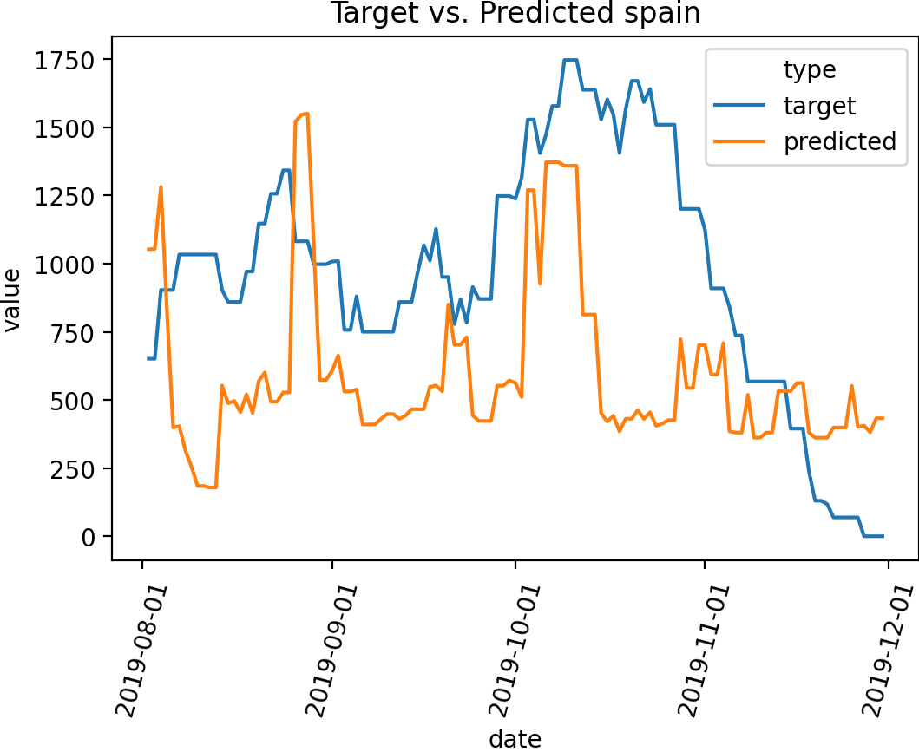
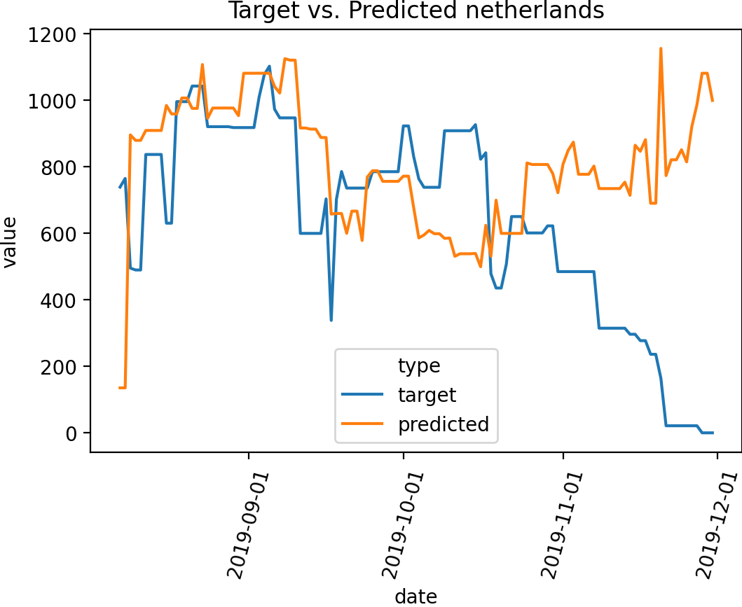
Netherlands and Spain
The model appears to be working acceptably for Netherlands, however Spain the model is under-predicting revenue

Slide 5
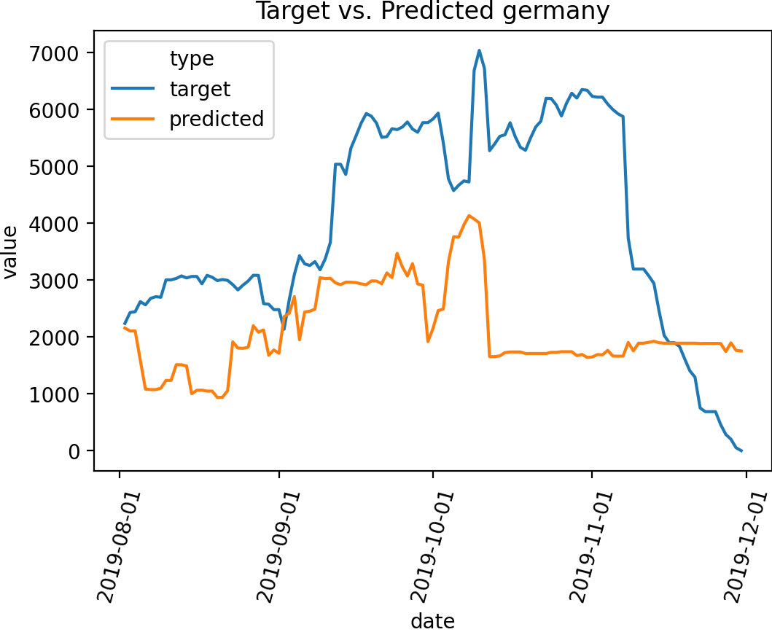
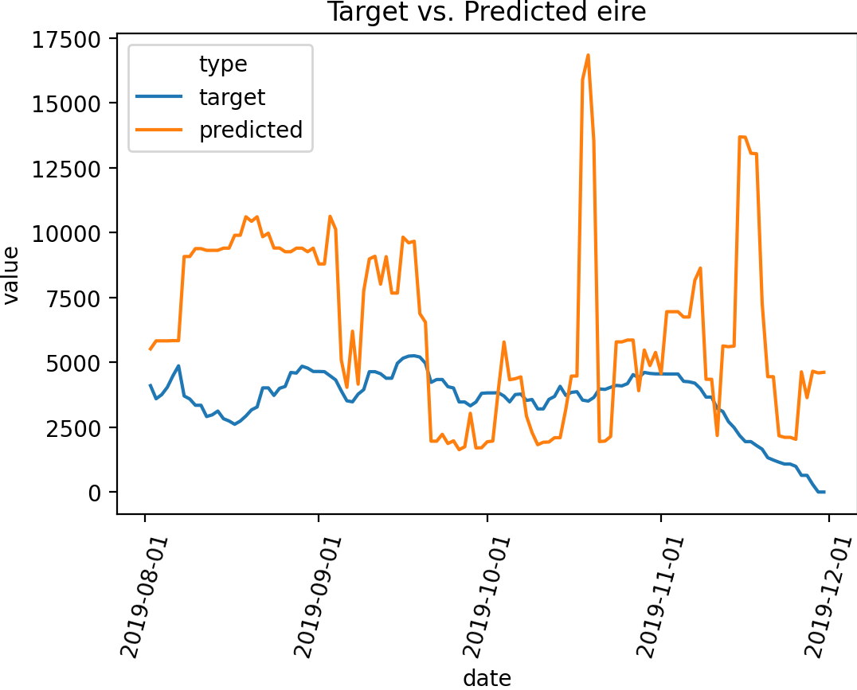
Germany and Eire
This is highlighted further with Germany (which seems to be much bigger than anticipated) while Eire shows the model over-predicting revenue and acting fairly wildly with wide spikes.

Slide 6
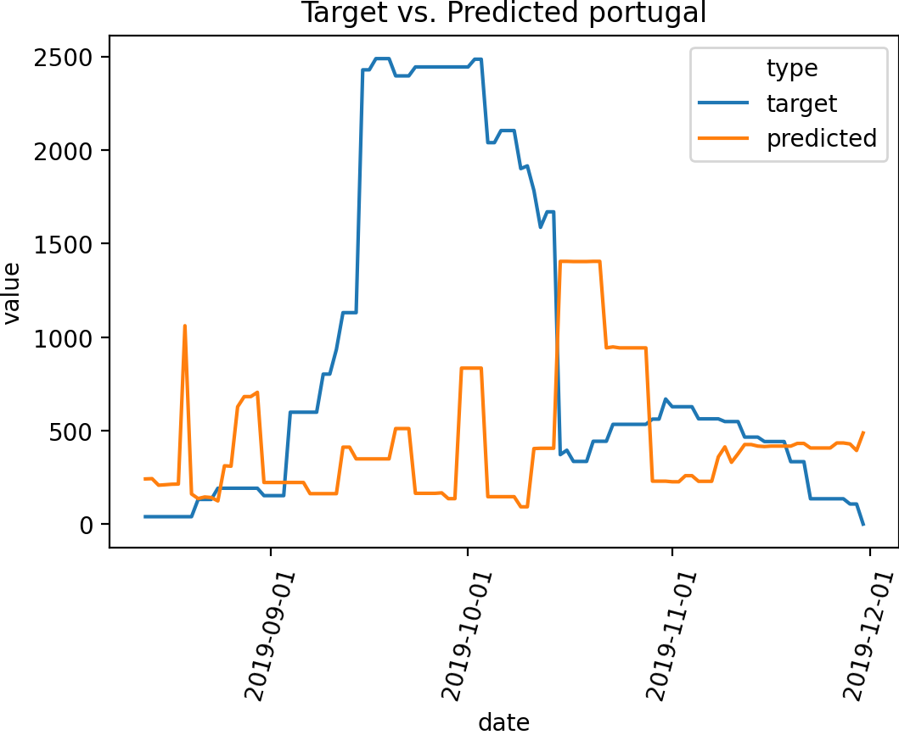
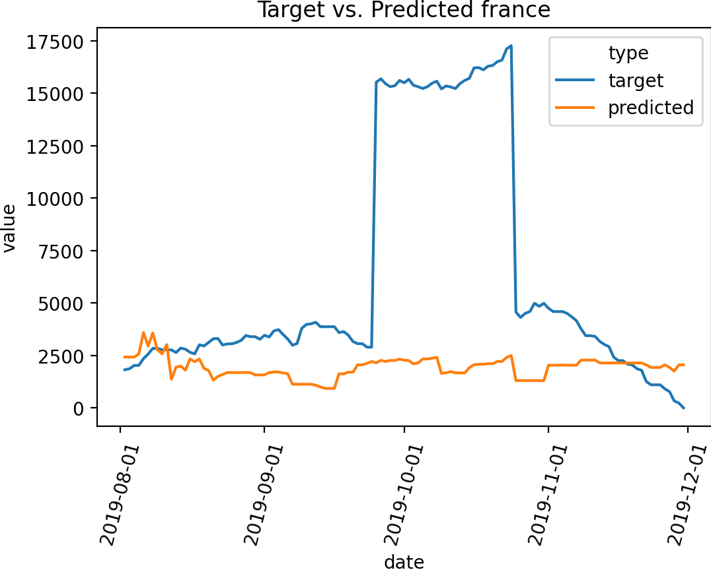
France and Portugal
Both France and Portugal show spikes in revenue that the model does not predict.
These spikes are interesting and may be due to underlying business changes, once off events or errors in the data that will need to be corrected.

Slide 7
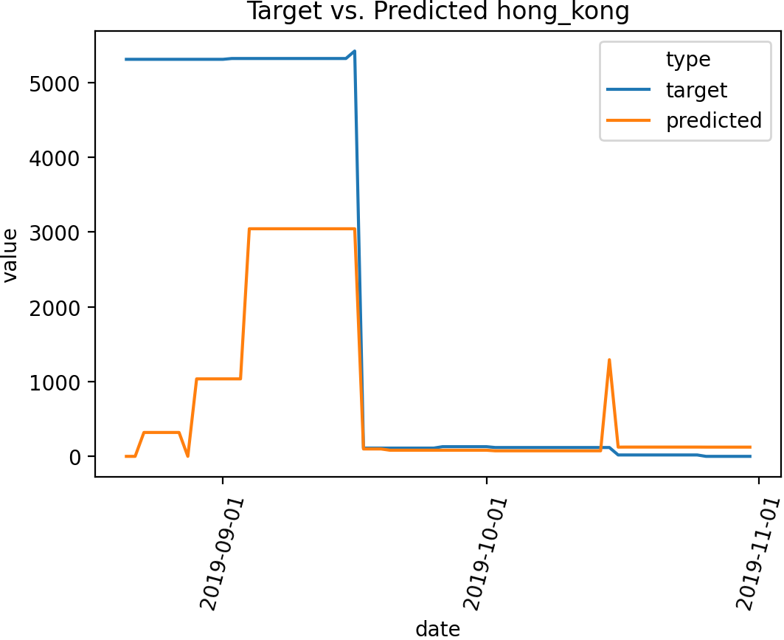
Hong Kong
Hong Kong appears to be generating twice the revenue than what is projected.
This is off a very low base – perhaps this is a new operation that still requires establishment.

Slide 8
Conclusion
The model appears to working acceptably but could use some tuning.
This is particularly true in smaller countries where data is not available.
There are also data anomalies that need to be investigated and inputted into the next round of analysis.

