Slide 1
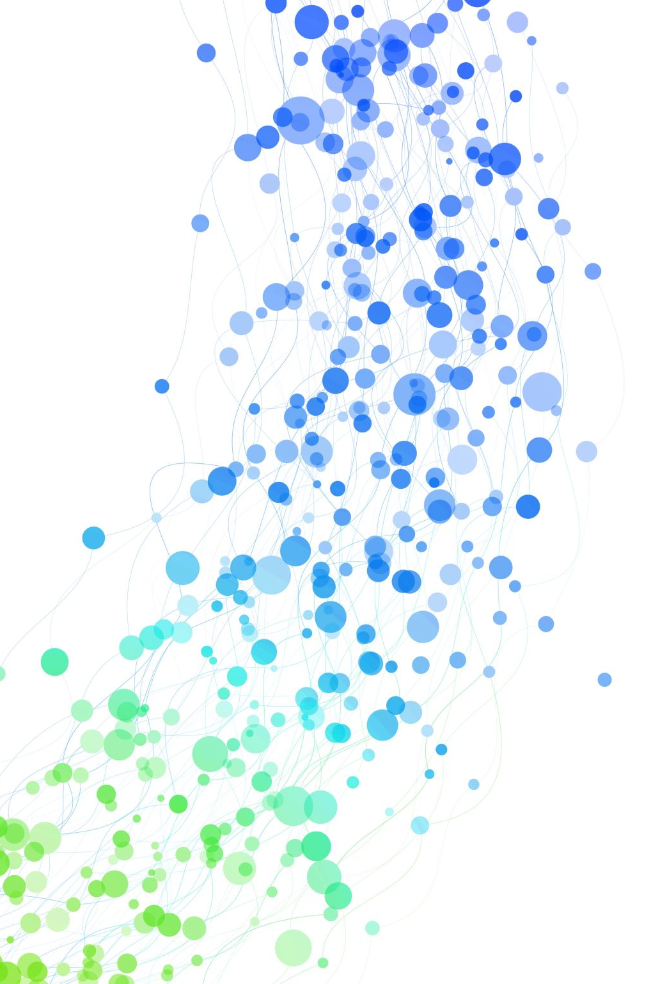
Matthew L. Pergolski Applied Data Science Capstone Portfolio
Syracuse University, Master of Science in Applied Data Science

Slide 2
Agenda
Introduction
Personal Interest in Data Science
MSADS Program
Career Goals
Program Objectives / Outcomes
Data Science Life Cycle
Coursework / Curriculum
Projects
Conclusion

Slide 3
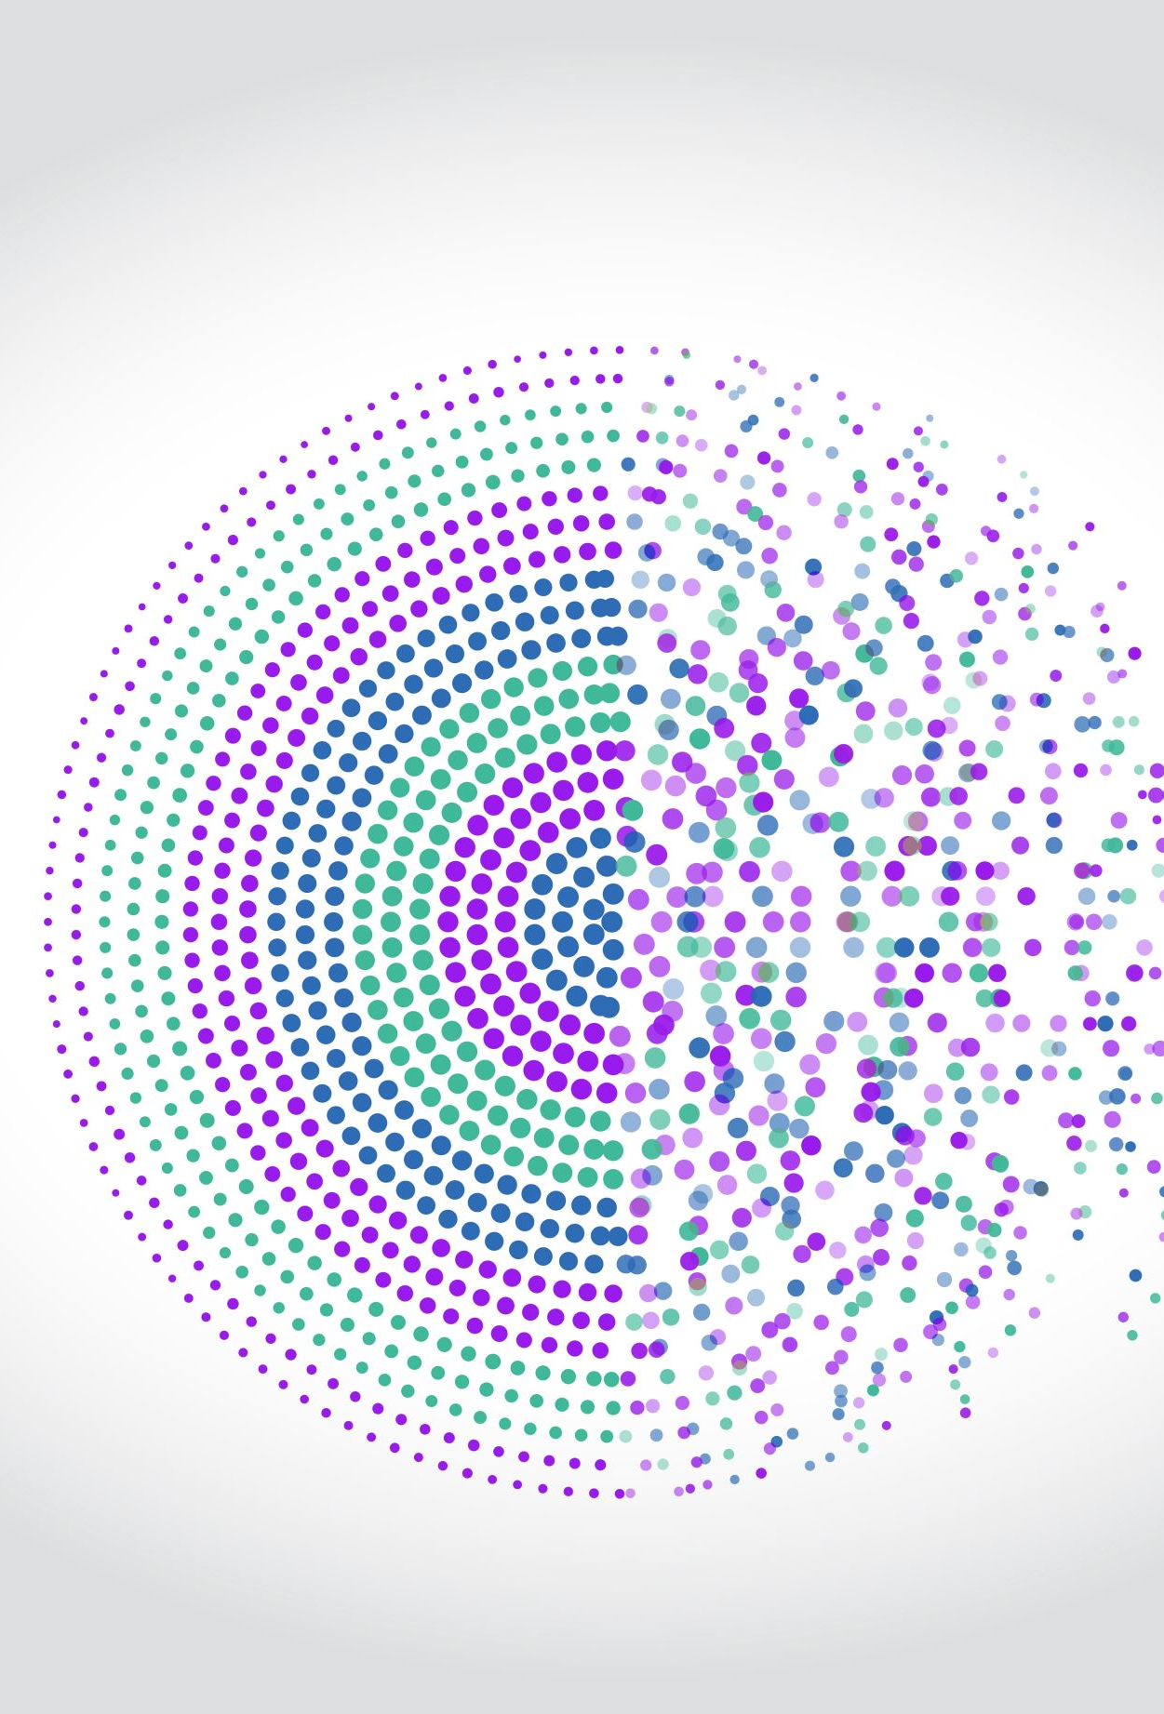
Introduction
Background
Undergraduate degree: University of Wisconsin-Eau Claire
Industry: Aerospace
Transition to data science driven by a desire for more advanced automation and problem-solving

Slide 4
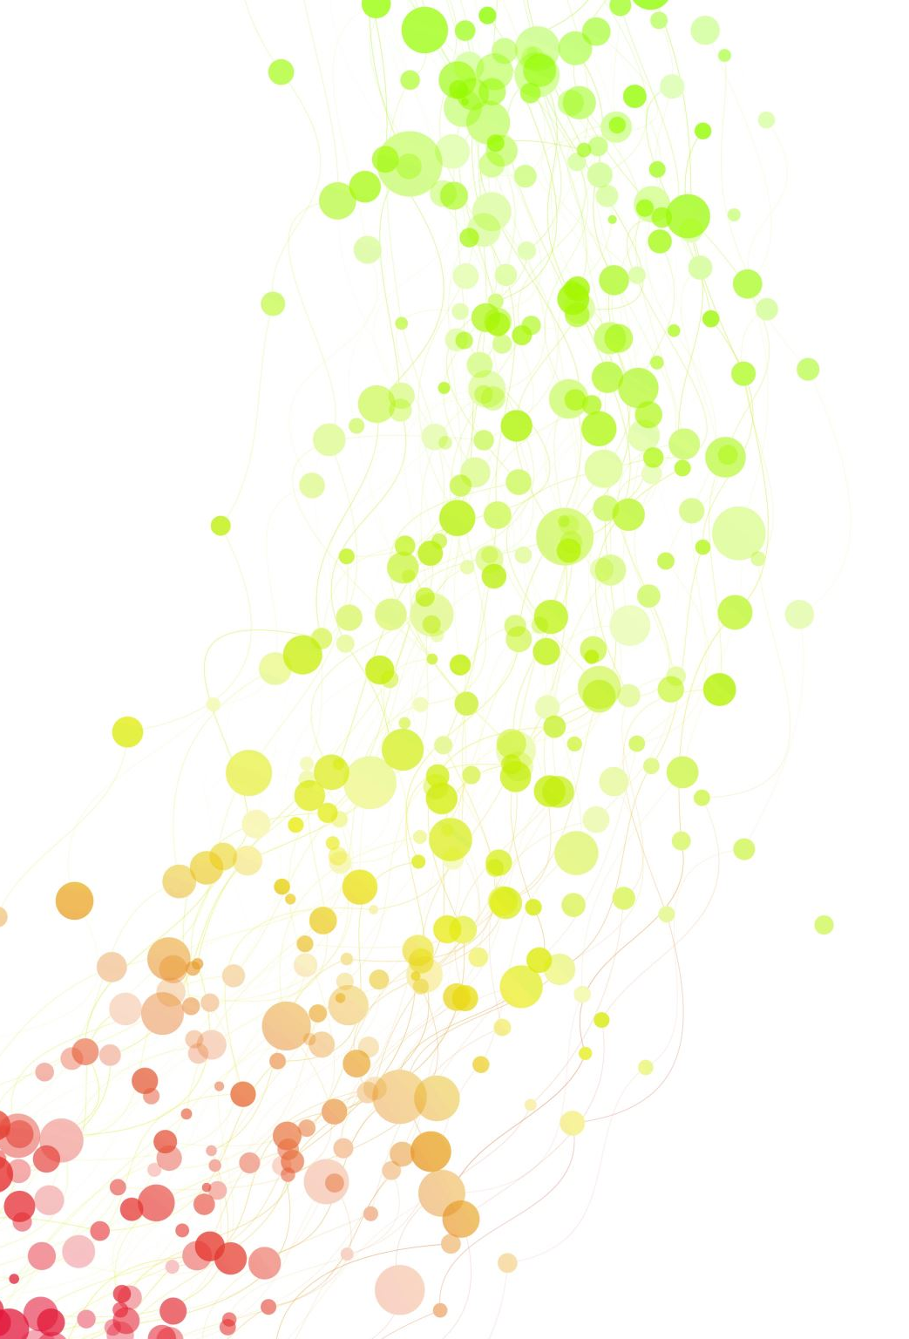
Personal Interest in Data Science
Initial interest in Excel and VBA, but quickly recognized limitations
Discovery of Python and its potential for automation
COVID-19 pandemic provided an opportunity to explore data science

Slide 5

Master of Science in Applied Data Science Program
Emphasis on practical, real-world applications of data science
Available tuition assistance from employer
Preparedness for the program
Undergraduate courses
Programming courses via Coursera, Data Camp, etc.

Slide 6

Career Goals
Desire to master fundamental and advanced data science topics
Commitment to lifelong learning through online platforms and personal projects
Current position as a Data Scientist (Level III) obtained during the program

Slide 7

Program Objectives and Outcomes
Collecting, storing, and accessing data
Creating actionable insights in various contexts (societal, business, political)
Applying visualization and predictive models
Using programming languages like R and Python
Communicating insights to diverse audiences
Applying ethical considerations in data science practices

Slide 8
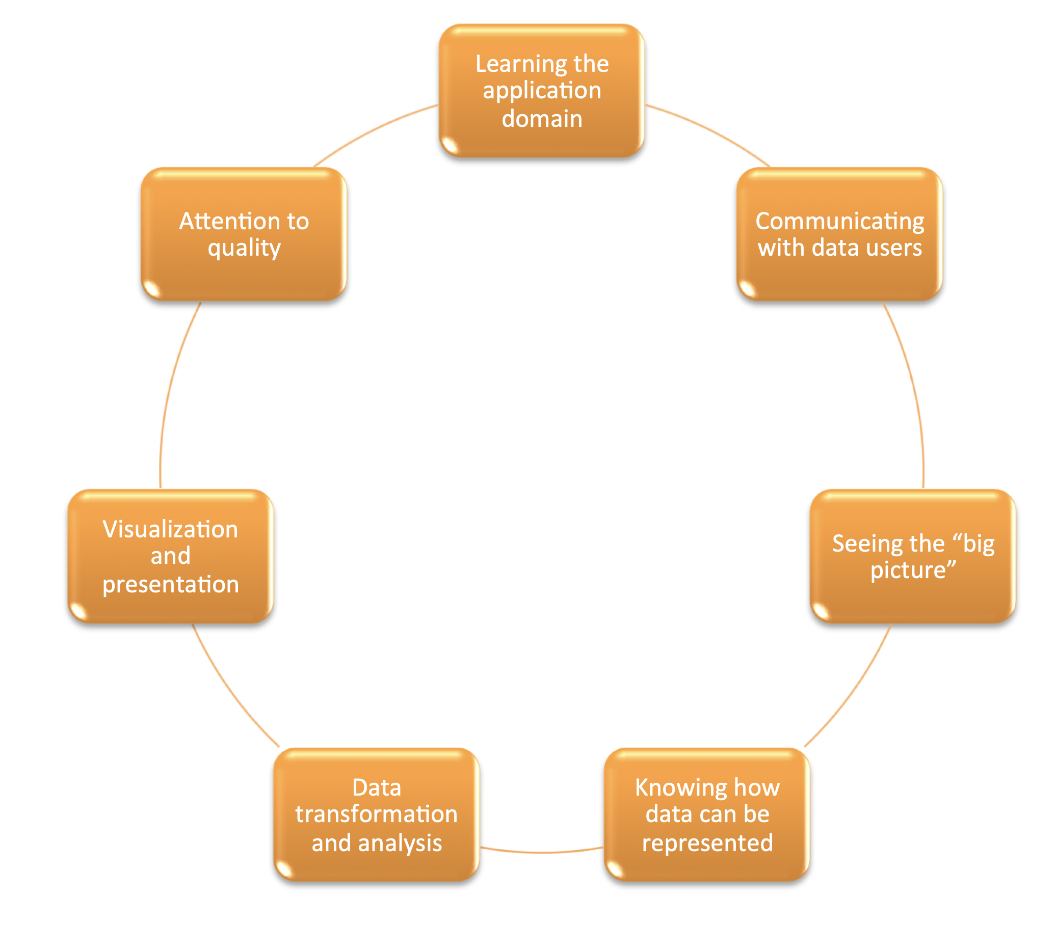
Data Science Life Cycle

Slide 9
Coursework and Curriculum
IST 687 | Introduction to Data Science
IST 772 | Quantitative Reasoning in Data Science
IST 707 | Applied Machine Learning
IST 659 | Data Administration Concepts and Database Management
IST 652 | Scripting for Data Analysis
IST 769 | Advanced Big Data Management
IST 664 | Natural Language Processing
SCM 651 | Business Analytics
IST 718 | Big Data Analytics
IST 736 | Text Mining
IST 691 | Deep Learning In Practice

Slide 10

IST 718: Big Data Analytics
Developed an image classification model to distinguish between normal and pneumonia-affected chest X-rays.
Dataset consisted of 5,863 chest X-rays, each categorized as either normal or pneumonia
The project utilized two deep learning models:
ResNet: This model architecture is known for its ability to effectively learn features from images. ResNet models with varying layers (18, 50, and 152) achieved accuracies between 81% and 85%
VGG-16: This model is another widely used deep learning architecture for image classification. Fine-tuning and increasing the number of epochs for the VGG-16 model resulted in a training accuracy of 97.9% and validation accuracies similar to ResNet

Slide 11
IST 736: Text Mining
Developed a text mining application to help prospective students explore course syllabi for the Master of Science in Applied Data Science program at Syracuse University.
The application leverages several text mining techniques:
Term frequency analysis: This technique allows the application to identify the most frequent terms in each syllabus, providing insights into the key concepts covered in each course
Document similarity search: This technique enables the application to compare syllabi based on their content, allowing prospective students to find courses that are similar to those they are interested in
Topic modeling: This technique allows the application to uncover the underlying themes and topics covered across the entire curriculum
Prospective students can use this information to understand the breadth and depth of the program's offerings.

Slide 12
IST 691: Deep Learning in Practice
This project involved creating an interactive application that classifies bird species based on audio recordings. The application uses artificial neural networks and evaluates different training strategies to optimize performance:
Learning rate optimization: This technique involves finding the optimal learning rate for the neural network, which can significantly impact its performance
Early stopping: This technique helps prevent the model from overfitting the training data by stopping the training process when the model's performance on a validation set starts to decrease
Stratified sampling: This technique ensures that the training and validation sets have a balanced representation of each bird species, improving the model's ability to generalize to unseen data

Slide 13
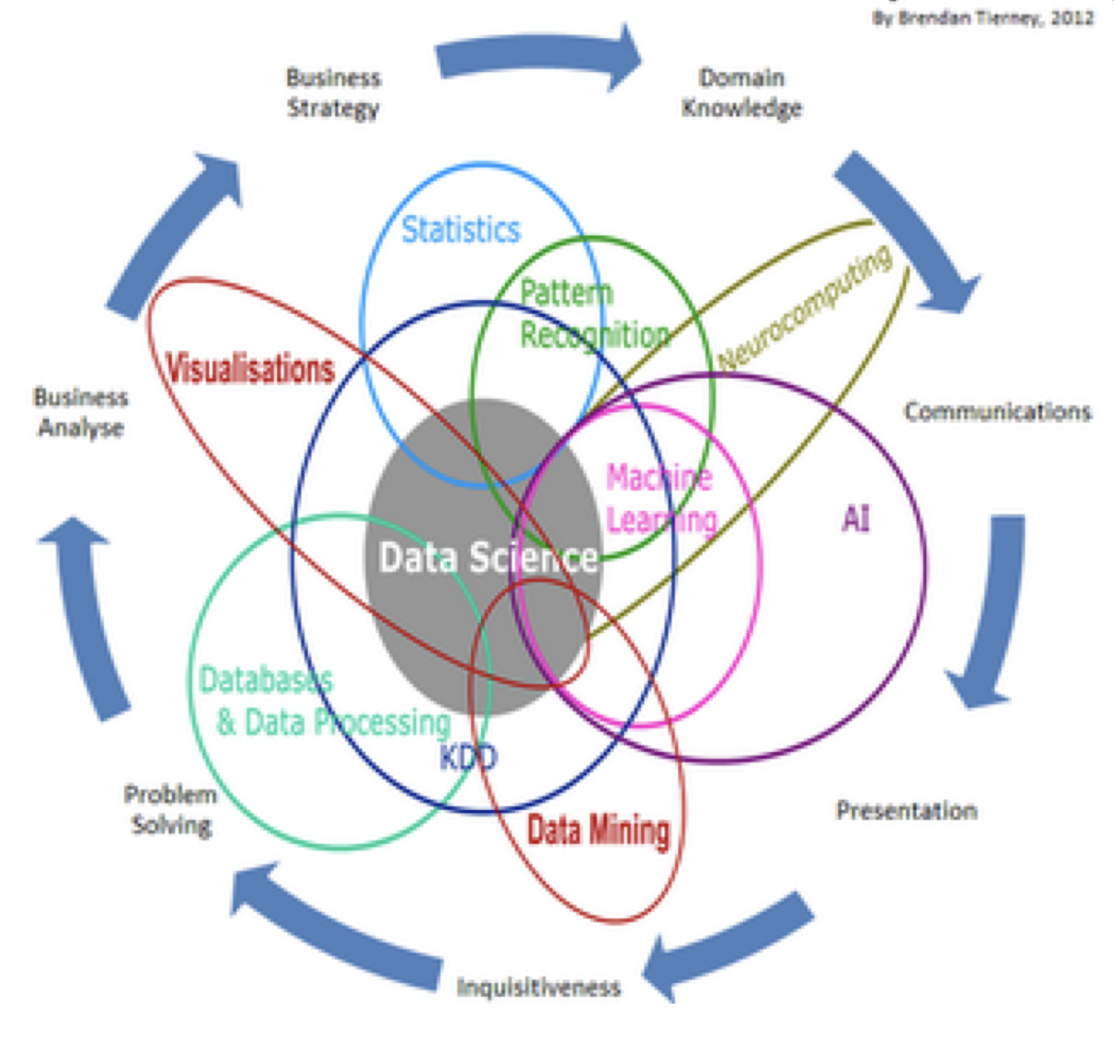
Conclusion

