Slide 1
Monthly SP Sync
August 12, 2026
1

Slide 2
Agenda
General & Team Updates
browser() introduction
MLRAD/Custom Data Refresher
G-Computation Knowledge Share

Slide 3
browser() overview
Benji Wagner

Slide 4
Debugging functions with the interactive debugger
Why use browser()?
Step inside a function mid-execution
Provides insight into the function environment
Useful for:
Understanding large, complex functions
Debugging errors inside a function

Slide 5
How to use browser()
Simply type ‘browser()’ as a standalone function call inside your function
Re-run your entire function with the new browser() statement
Call your function, either from the console or from a script

Slide 6
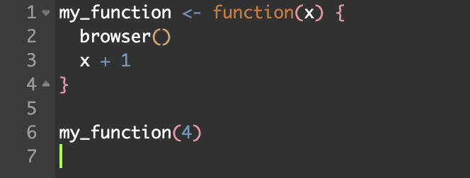
Example

Slide 7
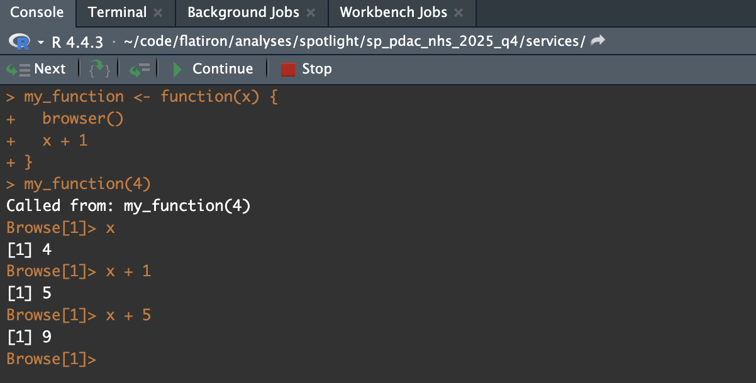
Example

Slide 8
Debugger Commands
n
Next statement
c
Continue (proceeds to next browser() statement or end of function)
s
Step into loop/function call
f
Finish loop/function
Q
Quit debugger

Slide 9
Custom Data and MLRAD Refresher
Yichen Lu

Slide 10
Not the most common, but we have projects with custom data
Before services, there is a data curation phase
SP is not directly involved
To abstract additional information for the population of interest
Add cohort selection criteria using an existing database - usually referred to as Hybrid Cohort Selection [HCS]
Start with an existing database (EDM, MLRAD, Panoramic)
Output: spotlight tables that include all variables (from the existing database or from abstraction) for patients satisfying all HCS criteria
Service phase: Abstracted variables can be used as I/E criteria (w/ the HCS) or in the analyses
Abstract additional information for patients who meet the HCS criteria
👤 CD
👤 DA
👤 SWE
👤 SP
👤 DA

Slide 11
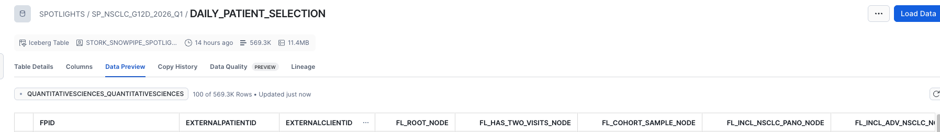
Combine the patient_selection spotlight table and abstracted data to generate the attrition diagram
Use the the patient_selection spotlight table to recreate the HCS cohort
Apply additional I/E criteria analytically, after HCS criteria, to get the final cohort
ToF
EDM/RAD/MLRAD/Panoramic
HCS criteria
💡 Leverage the data dictionary and the Floodlight page to understand the HCS cohort size and the abstracted variables
Custom abstraction
Spotlight tables
Additional I/E using Spotlight tables
Analytic tables (ship)

Slide 12
Sometimes you hit the Jackpot: additional I/E fall between HCS criteria
Use ToF tables (instead of spotlight tables) to derive additional I/E
Merge with HCS steps via fpids to find overlapping patients for the analytic cohort
Using the Spotlight tables directly still gets the final cohort right, but the attrition is not accurate
ToF
EDM/RAD/MLRAD/Panoramic
❗ Only use spotlight tables (i.e., tables in the data dictionary) for subsequent analyses. Check the mapping table in the flatironship to confirm the right tables are being pulled in (e.g., _lineoftherapy vs _extractedlot)
HCS criteria
Additional I/E
Custom abstraction

Slide 13


Not the most common, but we also have projects that start with MLRAD
Flatironship currently does not build MLRAD ship directly
Loading MLRAD tables can look like this
mlrad_tables <- flatironconnect::gather_tables_database(
database = "MLRAD",
schema = "CRAD_DEID_202605"
)
But MLRAD does not include structured tables. To locate these, build a ship with RAD tables with the matching MLRAD schema and merge them with the MLRAD tables using fpids.
ship <- flatironship::build_ship(
schema = "CRAD_DEID_202605",
database = "rad",
location = "snowflake",
which_tables = "all"
)
MLRAD data dictionary

Slide 14
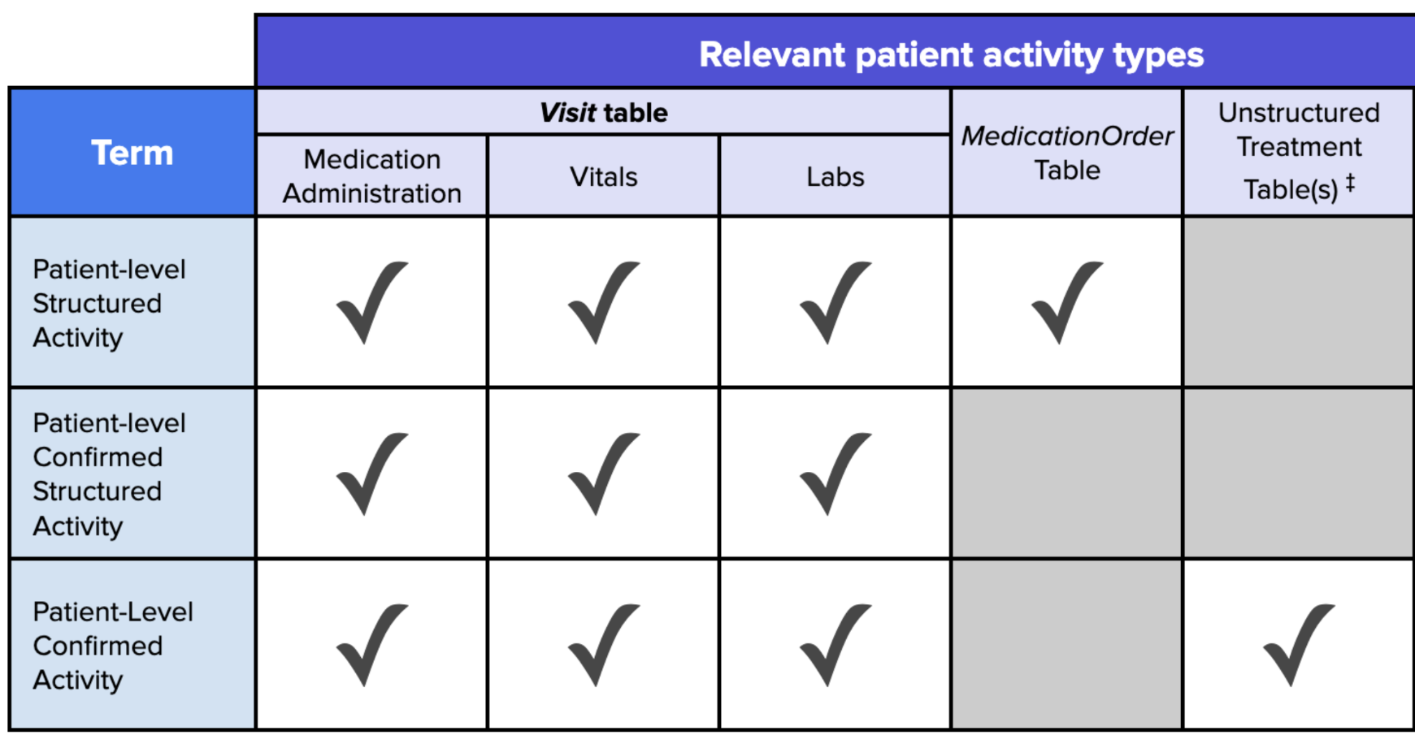
The last confirmed activity date from the RAD ship cannot be used directly for MLRAD
The variable needs to be updated to also account for
ML-extracted oral spans
# get last oral date from MLRAD
last_oral_df <- mlrad_tables$orals %>%
filter(fpid %in% cohort_fpid) %>%
mutate(oral_date = coalesce(end_date, start_date)) %>%
group_by(fpid) %>%
summarise(last_oral_date = max(oral_date, na.rm = T))
# update the last confirmed activity from RAD to incorporate oral from MLRAD
orpp_df <- ship$orpp %>%
left_join(last_oral_df, by = "fpid") %>%
mutate(last_confirmed_activity_update = pmax(last_confirmed_activity, last_oral_date))

Slide 15
All information presented has been added to the
CSS SP Execution Brain Dump
Use this file for watchouts
Add all learnings to this file - big or small, it can literally be anything SP execution-related!
Let us know if you would like to do a mini presentation on things you added to the file during the SP monthly

Slide 16
G-Computation
Matthew Pesavento
Notes:
Per discussion w/ Yichen - moving this topic to next month’s agenda!

Slide 17
G-COMPUTATION
Causal Identification from the Conditional Independence Assumption
to Time-Varying Confounding
Part I — Foundations of Causal Inference

Slide 18
Preview of conference today
What I hope you learn today:
Causal inference estimates the difference in outcomes for the same unit under treatment and under non-treatment. [Impossible for any single person, but conceptual goal]
Causal inference thinks about the Data Generating Process; predictive modeling thinks about finding the line of best fit within observed data.
G-computation is one computational method for simulating counterfactual outcomes particularly when you have a time-varying covariate that is a both a mediator of past tx and a confounder of future tx.
Its strengths: (1) Can estimates effects across essentially any* counterfactual reality; (2) Truly solves the problem of bad controls
Its weakness: By itself it is not a causal inference method. If you mis-specify the model, it is just a tool that estimates a biased relationship.
How to do g-computation in R
Future natural extension of this is IPCW
G-Computation
4
Notes:
* here means that g-computation needs every covariate profile in the data to have some real chance of being both treated and untreated (in epi terms, I think this is called “Positivity”). Where that chance is near zero, there's little or no data to check the prediction against — so the simulated outcome comes from the model's assumed functional form (e.g., linearity), not from anything actually observed. The more extreme the counterfactual, the more you're extrapolating on faith in the model, not evidence in the data.
→ One example: If you want to estimate a world in which a patient never receives chemo, but all patients of a particular disease type *do* get chemo at some point, then your estimate will be simulated from a reality that never exists, based on pure model extrapolation.

Slide 19
1
What Is Causal Inference? “Correlation does not necessarily imply causation”
1.1 Potential outcomes and the counterfactual
1.2 Twins, matching, and synthetic controls
Notes:
We’ve all heard the phrase ‘correlation does not imply causation’. My first informal foray into causal inference was a director of mine in my first job out of undergrad reframing that sentence as “correlation does not necessarily imply causation.” In the course of this conference today, my goal is to hopefully give you the basic tools to think about what causation means, and to introduce a method (g-computation) that aims to get us closer to causation.

Slide 20
1. WHAT IS CAUSAL INFERENCE?
1.1 Potential Outcomes and the Counterfactual
The cleanest way to picture a causal effect is to imagine the experiment you wish you could run.
Take a person and clone them down to the last detail — same genes, same history, same mood that morning. Give the treatment to the clone; withhold it from the original.
Any difference in their outcomes is caused by the treatment, full stop — because nothing else about the two differed. This imagined comparison is the definition of a causal effect. The Y_{i}(1), Y_{i}(0) notation simply writes it down.
For a binary treatment D_{i} ∈ {0, 1}, each individual i carries two potential outcomes:
Y_{i}(1) = outcome if treated, Y_{i}(0) = outcome if untreated
The individual causal effect is the comparison between them:
τ_{i} = Y_{i}(1) − Y_{i}(0)
The fundamental problem of causal inference: each person lives in exactly one world. We observe at most one of Y_{i}(1), Y_{i}(0) — the treatment actually received selects which one
The missing potential outcome is not measurement error — it is structurally missing data. Every method in this literature is a strategy for filling in that blank credibly.
G-Computation
1. What Is Causal Inference?
3
Notes:
What is causation? Conceptually, the causal impact of something is the impact, holding all else constant. E.g. If I want to know the difference in outcomes from treating a patient with chemo + io vs. chemo, I want to hold everything else constant and give that exact same patient (at the same point in his/her cancer journey) chemo, and then chemo + io.
Obviously we can’t do that, and so we have to think about ways that we could estimate this across a population.

Slide 21
1. WHAT IS CAUSAL INFERENCE?
1.2 Twins, Matching, and Synthetic Controls
Nobody has a cloning machine, so applied work turns to designs that approximate the clone — twin studies, matching, individual fixed effects (panel data) and synthetic controls.
Natural: identical twins.
Nature runs a rough version of the clone experiment for us: monozygotic twins share a genome and most of their early environment — the untreated twin stands in for the missing Y(0) of the treated twin. Not a perfect clone, though: twins still differ in ways that can matter (particularly behaviorally).
The Twinsburg, Ohio phenomenon: Every summer the Twins Days Festival in Twinsburg, Ohio draws thousands of twin pairs, and researchers set up booths to recruit pairs who differ on some exposure of interest (one smoked, one didn’t; one finished college, one didn’t).
Constructed: matching and synthetic controls.
Matching is the observational version of the same move: find untreated units that look identical on the covariates you measured, and borrow their outcome as the stand-in for Y(0).
Synthetic control generalizes this to aggregate units — a weighted composite of donor units whose pre-treatment trajectory reproduces the treated unit’s, a “digital twin” built from a blend.
The crucial catch — and the whole subject ahead:
You can only match on what you observe — when a hidden difference also drives the outcome, the stand-in is contaminated (omitted-variable / selection bias). Panel data is a huge benefit for this reason, but it still only removes the bias from time-invariant unobserved variables.
G-Computation
1. What Is Causal Inference?
5
Notes:
You’ve probably heard of “Twins experiments” – but now you can see what this is trying to do. Matching, synthetic controls, digital twins (?) are all extensions of twins studies – but all focus on creating groups of observably similar individuals and then arguing/assuming that unobservable characteristics follow these observable similarities.
Individual fixed effects, DnD, RDD, first differences, ecc. – these are all ways of accounting for unobservable differences in individuals but they assume that unobservable characteristics are time invariant (if not, no help).

Slide 22
2
The Data-Generating Process
2.1 The DGP: the true recipe behind Y
2.2 When does βˆ recover β? The CIA
2.3 Causal inference vs. predictive modeling

Slide 23
2. THE DATA-GENERATING PROCESS
2.1 The Data-Generating Process
Every dataset is the output of a real, mostly hidden process in the world — its data-generating process (DGP): the true recipe for how a variable comes to be.
Imagine conceptually that the recipe for a heart attack is some real combination of {age, genetics, comorbidities, and chance} (even though this recipe is probably unknown in reality)
For a single cause X and outcome Y, we write that true recipe as:
Y = f(X) + e
f(X) is the structural (causal) part; e is every other influence on Y.
The coefficient β inside of f, is a fact about the world — the relationship between X and Y that we are trying to learn.
We never see f directly: we only ever see a sample the DGP happened to produce, so we estimate B̂
When the expectation value of B̂ equates to the real β from the DGP, then we have a causal estimate.
That occurs when E[e | X] = 0 (the Conditional Independence Assumption ←→ CIA)
Intuitively: “The treatment X is as good as randomly assigned”
G-Computation
2. The Data-Generating Process
8
Notes:
Before we talk about modeling, it’s critical to think about the data generating process: it is the *true recipe* for how a variable comes into being (**even if no one ever writes it down**)
→ e.g. recipe for a heart attack
Conceptually we can write down the DGP for Y as a function that depends on a bunch of stuff, X, and everything else that affects Y.
→ Beta is the true relationship between X and Y ←→ beta_hat is the estimated relationship between X and Y. When Beta_hat matches Beta in expectation, Beta_hat is a causal estimate of X on Y.
When does this happen? When E[error | X] = 0 … or intuitively when nothing that determines Y outside of X is systematically related to X.. When we move X by some fixed amount, in expectation, we know what the effect will be.
Again - intuitively - X is as good as randomly assigned, at least conditionally.
Example for people reading slide notes but not presented: suppose admission to a charter school is determined by a lottery within the subgroup of people who are below a particular income. Then admission is certainly not randomly assigned unconditionally (because cov(admission, income) != 0); but if we include income in the model, then conditional on income, admission is randomly assigned. Absent of this, any estimation of outcomes | admission will be biased by the additional relationship between outcomes and income.

Slide 24
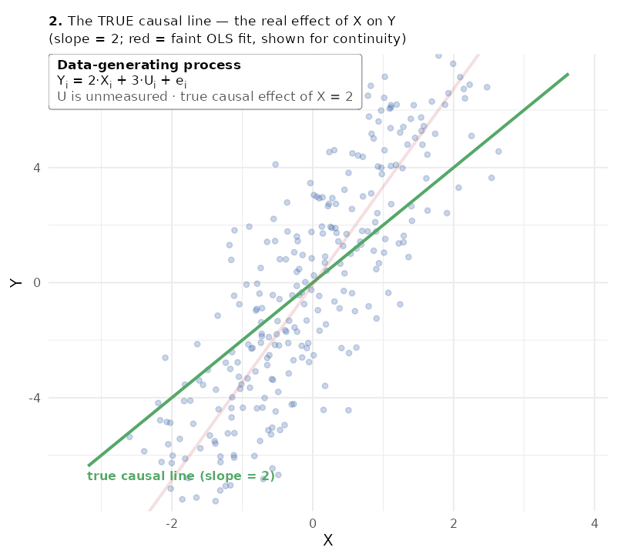
2. THE DATA-GENERATING PROCESS
2.2 Causal Inference vs. Predictive Modeling
Prediction
Asks: given X, what’s my best guess for Y?
Target: E[Y | X] — the best-fitting line.
What matters: the fitted value Ŷ.
A biased βˆ is not a problem — the goal is only to trace the observed X–Y relationship.
Causation
Asks: if I reach in and change X, how does Y move?
Target: the structural slope β.
What matters: the coefficient βˆ itself.
Whether βˆ is a trustworthy stand-in for β — not just a good fit to this sample.
Predictive and Causal modeling coincide when E[Y | X] = f(X) + E[e | X] = f(x) , i.e. E[e | X] = 0
Predictive (faint red, OLS) vs. causal (green, true slope = 2) lines — they diverge whenever Cov(e, X) ≠ 0.
G-Computation
2. The Data-Generating Process
9
Notes:
Focus on the figure: This illustrates the difference between predictive and causal inference well.
We know the true (causal) relationship between Y and X from the DGP is 2, but OLS here gives us something else (3.4) – why? Because OLS estimates E[Y|X] so it puts U in the error term. Because X and U are correlated, the estimate on X is biased by that covariance between X and U.
Predictive modeling doesn’t care that the true relationship is 2. What it cares about is – given that I observe this relationship between Y and X, what my best guess (LoBF) of Y, Y_hat? All the bias in the model estimates doesn’t really matter, because it tells me something important to estimate Y_hat.
Causal inference says - I think I’m estimating the effect of X on Y, but in reality, I’m estimating the effect of something else entirely (namely X + the relationship of U and X).
Extra info for slide ref (don’t read) * X is correctly observed; no measurement error
* the issue lies in the fact that the relationship between X and Y is a blend of the effect of X→Y and U→Y because error = f(e, U) and cov(U,X)!=0.
* if i have my Y on X graph where U is an OV, causal inference would say the LoBF doesn't really do anything meaningful from a causal inference pov. it captures the real empirical relationship between X and Y, but it doesn’t isolate the causal contributions of X (it’s a blend of X’s effect and U’s).

Slide 25
3
Why the Conditional Independence Assumption Fails
3.1 Omitted variables and selection bias
3.2 Simultaneity, measurement error, and bad controls

Slide 26
3. WHY THE CIA FAILS
3.1 Four Ways the CIA Fails
MECHANISM
WHERE IT ENTERS
INTUITIVE CONSEQUENCE
Omitted variables / Selection
(§3.1)
Unmeasured U
correlated with X
Estimated coefficient on X absorbs the correlation between the observed value X and the unobserved U that’s in e
Simultaneity
(reverse causality)
X affects Y; and Y affects X
Estimated coefficient on X reflects a blend of X’s effect on Y and Y’s affect on X.
Measurement error
in X
Observe X* = X + w
in place of X (where w ~ N(0,sd_{w})
As X* gets noisier and noisier (w ↑), estimated coefficient on X attenuates to zero (see Handbook Chapter 1 for visual).
Bad controls
Condition on a necessary variable (to avoid Omitted Variable Bias) that itself is caused by another necessary variable. [aka - Mediator]
(a) swaps the estimated coefficient from the total effect to the direct effect (e.g. smoking and KRAS); or (b) introduces spurious relationship that may break the CIA
Bad controls are different in kind from the other three: the damage comes from what the analyst puts into X, not from what the DGP leaves out of it — the subject of the rest of this conference.
G-Computation
3. Why the CIA Fails
13
Notes:
If you’re reading this and wondering: what about measurement error in Y? → no bias but increase standard errors, and lose estimate precision.
Bad controls is the culprit today – it’s actually different than the others, because it’s not estimating a biased relationship; actually, the problem here is that the relationship that you think you’re estimating is wrong. You think you’re estimating the “total effect”, but in reality, you’re just estimating the partial (direct) effect. Example will hopefully make this clear.
A&P in “Mostly Harmless Econometrics” [Joshua Angrist won the nobel prize with 2 other econometricians who are top of the field in causal inference methods; book is roughly the handbook for applied econometricians; publised ~2009?] only say this about Bad Controls: (paraphrase from page 68) “~ by estimating with the bad control, you’re closer to the true coefficient than if you left it out; and if you make some assumptions, you can say that the causal effect of interest is somewhere between the coef with OVB and the coef with the bad control”. [Main point here is that this is simply what they say – even they don’t go on to discuss g-computation as a solution for this]

Slide 27
4
Motivating G-Computation
4.1 The scenario: a treatment-induced confounder
4.2 Clinical example: chemotherapy and neutropenia
4.3 Two options, both wrong
4.4 Why is Lt a bad control?

Slide 28
4. MOTIVATING G-COMPUTATION
4.1 The Scenario: A Treatment-Induced Confounder
Example:
RQ: We want to evaluate survival at 24m for patients who receive full course of chemo vs not
Chemo affects survival but also causes AE (neutropenia) that determines next dosing decision.
To focus on the strength of g-computation, make this assumption:
Neutropenia is not caused by a latent variable “frailty” that itself affects survival, or we control for it.
Cov[error_{neutropenia}, error_{survival}) := 0
** If this assumption is not made, CIA fails and g-computation has just recovered a biased estimate of counterfactual outcomes.
IPCW (prob of censor) is the logical extension of this method if you believe censoring is not non-informative
G-Computation
4. Motivating G-Computation
15
Notes:
Intuition: By including Lt in the model, you’re forcing a comparison among patients who have the same toxicity status (neutropenia in t, or no neutropenia in t).
– Some got neutropenia because of their past chemo even without being frail; some got there due purely to some unobserved frailty —-> actually there are 4 groups (chemo+not frail, not chemo + not frail, not chemo + frail, chemo + frail,)
– So now your estimates comes from comparing two different groups of people who already have different survival chances of survival (frail, which have worse outcomes already, and not frail), which is not at all consistent with potential outcomes frame (remember cloning thought experiment).
Drive home: G-computation isn’t a magic pill. If you have violated the CIA, no matter what you do, your coefficients are still biased and you’re going to get garbage out of your model.
– You essentially need some way of making dosing decisions independent of frailty.
—----For example: an instrumental variable that affects dosing, but is independent of frailty and has no effect on survival [e.g. aggressive dosing-preference MDs]
—----RDD could also be something to consider if there’s a white blood count threshold that determines dosing decision and exploit the window around that threshold

Slide 29
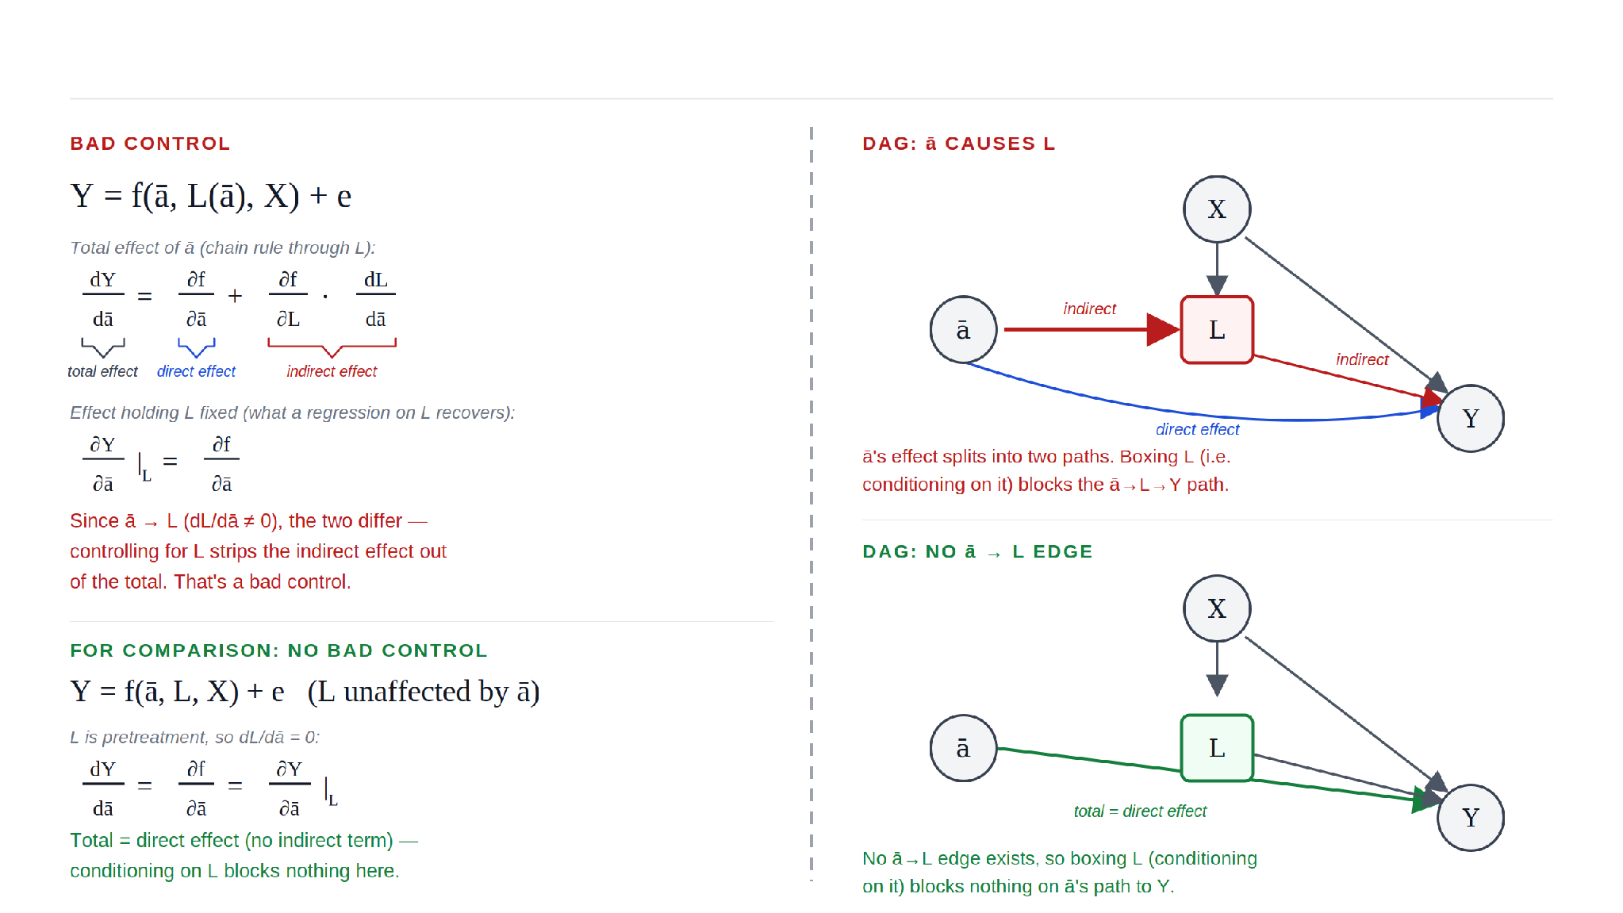
Bad Controls: Are we estimating the effect of ā that we think we are?
Notes:
In this slide, I tried to think hard about what’s important to convey here: It’s the effect of bad controls.
Here is out example from the previous slide in both math on left and visual form on right, for people who are more comfortable with each respectively.
Math:
Think back to Calculus 3 – the total effect of a\bar on Y is the total derivative of Y with respect to a\bar → which is just the partial derivative of f wrt a\bar + partial of f wrt L * total derivative of L wrt a\bar (by chain rule)
What’s this mean? It means that if you include L in the model, E[Y | L] = f(a\bar) → d[Y|L]/da\bar , so the partial of f wrt a\bar only (ie only the direct effect) → but we know the total effect is more than this, so we’re misestimating the effect, not by bias, but because we’re estimating a different relationship than we think we are.
DAG:
Ideally showing the same thing. The relationship between a\bar and Y in the DGP is direct effect of a\bar on Y + indirect relationship of a\bar → L → Y.
By conditioning on L, we block the indirect path and only our coefficient only estimates the direct relationship.

Slide 30
4. MOTIVATING G-COMPUTATION
4.1 The Scenario: A Treatment-Induced Confounder
Example:
RQ: We want to evaluate survival at 24m for patients who receive full course of chemo vs not
Chemo affects survival but also causes AE (neutropenia) that determines next dosing decision.
Neutropenia is caused by a latent variable “frailty” that itself affects survival.
(1) Y = β₁a_{t-1}+ β₂a_{t} + γL_{t} + e (2) L_{t}= ca_{t-1}+ u_{t} (3) Cov(u_{t},e) ≠ 0
Sub in L_{t} to Y → Y = β₁a_{t-1}+ β₂a_{t} + γ [ca_{t-1}+ u_{t}] + e
Take expectation E[Y | X] (recall causal when E[Y | X] = f(X)) : E[Y | a_{t-1}, a_{t}, L_{t}] = (β₁+ γc) a_{t-1} + β₂a_{t} + E[γu_{t} + e] | a_{t-1}, a_{t}, L_{t}]
But Cov(u_{t},e) ≠ 0 → So E[e | X] = E[e | a_{t-1}, a_{t}, L] ≠ 0
The two KEY parts here are that:
(1) frailty is a latent variable, and so as long as frailty and dose decisions are related, there is an OVB problem – G-computation cannot fix that. [Need something like an Instrument Variable]
(2) by including L_{t} in the model, you’re creating a “bad controls” problem? → G-computation can solve this part*
f(x)
E[e|X]
G-Computation
4. Motivating G-Computation
15
Notes:
Intuition: By including Lt in the model, you’re forcing a comparison among patients who have the same toxicity status (neutropenia in t, or no neutropenia in t).
– Some got neutropenia because of their past chemo even without being frail; some got there due purely to some unobserved frailty —-> actually there are 4 groups (chemo+not frail, not chemo + not frail, not chemo + frail, chemo + frail,)
– So now your estimates comes from comparing two different groups of people who already have different survival chances of survival (frail, which have worse outcomes already, and not frail), which is not at all consistent with potential outcomes frame (remember cloning thought experiment).
Drive home: G-computation isn’t a magic pill. If you have violated the CIA, no matter what you do, your coefficients are still biased and you’re going to get garbage out of your model.
– You essentially need some way of making dosing decisions independent of frailty.
—----For example: an instrumental variable that affects dosing, but is independent of frailty and has no effect on survival [e.g. aggressive dosing-preference MDs]
—----RDD could also be something to consider if there’s a white blood count threshold that determines dosing decision and exploit the window around that threshold

Slide 31
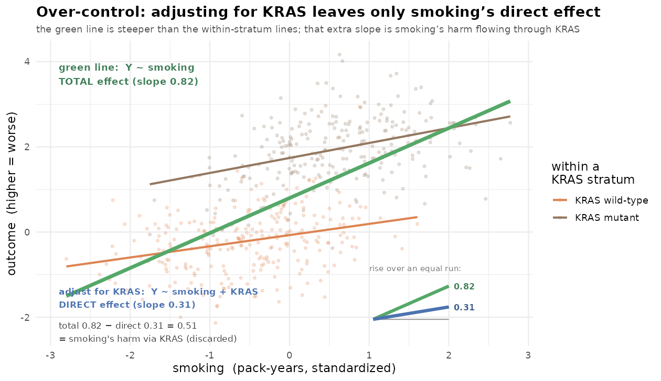
4. MOTIVATING G-COMPUTATION
4.1 The Scenario: A Treatment-Induced Confounder
Example:
Instead … Neutropenia is not caused by a latent variable “frailty” that itself affects survival, or we control for it.
(1) Y = β₁a_{t-1}+ β₂a_{t} + γL_{t} + e (2) L_{t}= ca_{t-1}+ u_{t} (3) Cov(u_{t},e) = 0
No longer the issue of E[e | a_{t-1,} a_{t,}, L_{t}] != 0 → We can estimate β₁, β₂, γ causally (Yay)
But an issue remains → by controlling for L_{t} , we are now only estimating the direct effect of a_{t-1} on Y
Direct effect: a_{t-1} → Y (β₁)
Indirect effect: a_{t-1} → L_{t} → Y (γc)
Total effect: (β₁ + γc)
See Handbook, Chapter 1.5.1
G-Computation
4. Motivating G-Computation
15
Notes:
In fact, even if Cov(ut,e) = 0 (say you controlled for frailty, and nothing else jointly sits in e and ut that affects Y), you’d still have a problem of Lt being a mediator (see Handbook Chapter 1.5.1). By conditioning on Lt, you’d only being estimating the direct effect of a_{t-1} → Y and not the indirect path of a_{t-1} → Lt → Y.
Figure: Y ~ f(smoking, kras) and smoking ~ g(kras). So by controlling for kras, you’re isolating the direct effect when you think you might be getting the total effect Smoking → Kras → Outcome (indirect) Smoking → Outcome (direct)

Slide 32
5
The Single Time Point Model
5.1 Standardization: g-computation without simulation
5.2 Worked example: anthracycline and 24-month survival
5.3 ATE, ATT, and ATU from the same predictions
5.4 The same example as a survival curve

Slide 33
5. THE SINGLE TIME POINT MODEL
5.1 Worked Example: Anthracycline and 24-Month Survival
Y = alive at 24 months (yes/no)
D = anthracycline-containing 1L chemo regimen (yes/no); [no = non-anthracycline-containing 1L chemo regimen]; made once at beginning
L₀ = pre-index grade 3+ neutropenia status;
X₀ = time invariant baseline characteristics
Identifying assumption — the point-treatment CIA: E[e | D, X₀, L₀] = 0
Conditioning on baseline covariates and baseline neutropenia makes D as good as randomly assigned (Is this true? Probably not…)
Let’s work through an example – open positron / RStudio and paste in .R file
G-Computation
5. The Single Time Point Model
24
Notes:
This one is called “single_time_point_example.R”

Slide 34
6
The Multiple Time Point Model
6.1 g-computation with monte carlo simulation

Slide 35
5. THE SINGLE TIME POINT MODEL
6.1 Worked Example: Neutropenia and Dosing
Y = death (hazard) in interval t (Y ~ survival at 24m is estimated at the end)
āₜ = the full chemo-dosing history through interval t (Dummy variable: aₜ ∈ {0,1})
L̄ₜ = the full grade 3+ neutropenia history through interval t (also a dummy variable)
X₀ = time-invariant baseline characteristics (L₀, sex, race, region, ECOG, subtype, year of 1L start) — includes baseline neutropenia, fixed at t = 0
Again, there is nothing other than baseline controls that suggests the E[eₜ | āₜ, L̄ₜ, X₀] = 0 [∀ t], so this unlikely to be causal.
Let's work through an example — open positron/RStudio and paste in second .R file.
G-Computation
5. The Single Time Point Model
24
Notes:
This is called “full_gcomputation_example.R”

Slide 36
5. THE SINGLE TIME POINT MODEL
6.1 G-Computation: Simulate any counterfactual reality you’d like
In our example, our research question was: “What’s the effect of pushing through neutropenia (ie continuing dose) vs holding back (ie stopping dose in this period) on survival [for patients with metastatic breast cancer]?”
Our two realities were:
Every time a patient gets neutropenia, continue giving chemo (always dose); vs.
Every time a patient gets neutropenia, don’t give chemo in next period
But we could have simulated essentially (subject to “Positivity”) any counterfactual reality we were interested in…
E.g. “What is the difference of giving chemo for 3m on, 3m off; vs. 3m on, 6m off.?”
E.g. “What if we give chemo for 4 consecutive 3m intervals in a row, then stop chemo entirely for 4m?”
G-Computation
5. The Single Time Point Model
24
Notes:
A brief addendum is that g-computation can conceptually be used to estimate the outcomes for any counterfactual state (in the full example, notice that I added a fourth state called “custom_alternate” which is some arbitrary state where the doctor just doses chemo 3m on, 3m off. I added this to show that you could simulate really any of the 2^8 states that you want; but the important thing to underline is that there might be pretty poor support for these states in your models, which forces your model to extrapolate outcomes into unobserved scenarios (like no chemo at all).

Slide 37
Team Updates

Slide 38
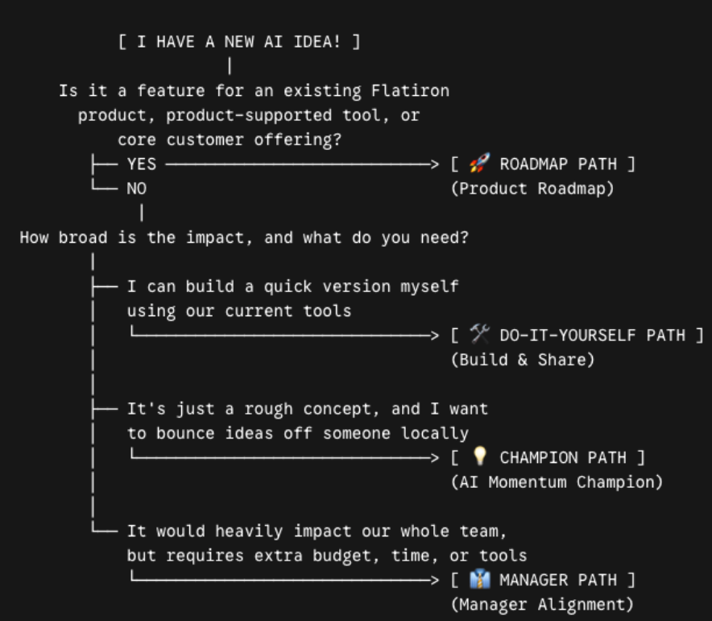
General & Team Updates
📖 SP Playbook on AI
AI Idea Decision Workflow
SP Innovation
Build yourself! Get started on your AI ideas.
Need brainstorming? Contact Jonathan Bryan
Want to share or test? Reach out to the SP Incubator
Need more investment? Align with your Manager
SP Incubator
Team: Daniel, Jonathan, Mike, Xilin
Action: Tag or DM any of them!
Process: SP Incubator sends validated ideas to AE

Slide 39
General & Team Updates
PAIRS Resources & Training
Access training materials and future roadmaps:
🎓 Resources for PAIRS
🗺️ What’s next for PAIRS
What’s Next & Active Initiatives
Code readability: Led by SP Incubator
Evaluation framework: Makes updating PAIRS faster
Time out issues: In progress with Platform team
Knowledge Center: Larger strategic effort
r-btw friction: Minimizing friction
Easier iteration: Exploring options to iterate without the entire PAIRS pipeline

Slide 40
General & Team Updates
Q4 & STI Focus
Q4 crunch ahead:
Encourage where possible to deliver results earlier to free up time in Q4.
Strategic Alignment:
Telescope insights are an integral part of our active STI goals.
Telescope Staffing & Workflow
Will start staffing SP to Telescope
Telescope alone: To support refinement of definitions.
Telescope + SP-led coded outputs:
Telescope does not output R code right now.
Can output fpids, which can be used by SP + backtracking derivation of necessary variables via PAIRS.

