Slide 1
Modeling Customer Churn
Matthew Cheng

Slide 2

What is customer churn?
Percentage of customers who have stopped purchasing a product or service in a certain period of time
Ex. if 3% of Netflix customers ended their subscription within the current billing cycle, then their customer churn is 3% for that cycle

Slide 3

Importance of Customer Churn
Companies want to minimize customer churn
Indicator for how well the company is running
Customer retention has better return on investment than customer acquisition

Slide 4
Research Problem
Main goal: Model customer churn in order to accurately predict whether a certain customer will cancel their subscription or not
Additional:
What customer attributes best predict customer churn?
What can companies do to improve their customer retention?

Slide 5
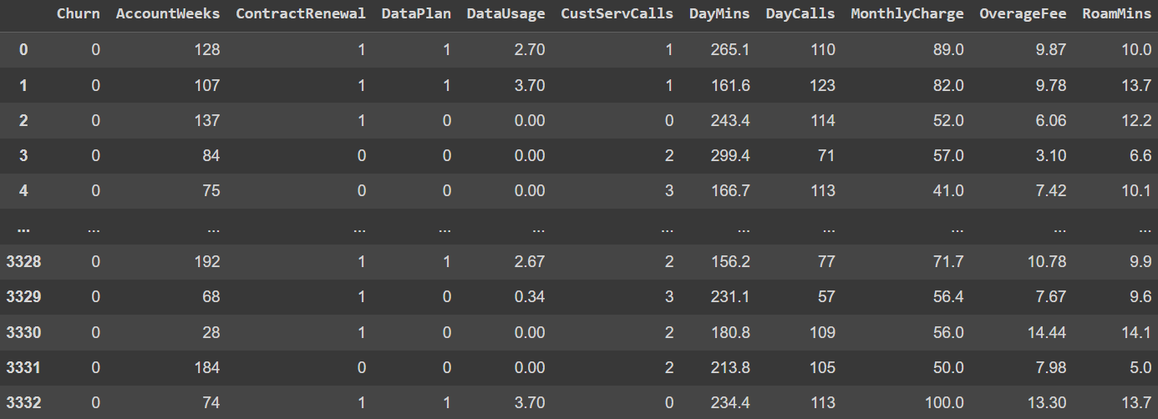
Dataset
Customer Churn dataset from Kaggle
Customer data from a telecommunications company that includes 10 features, such as AccountWeeks, DataPlan, and MonthlyCharge
3333 observations

Slide 6

Overview of Models
Potential Models:
Locally Weighted Regression
Generalized Additive Model
Random Forest Regressor
Neural Network
DenseNet
Plan:
GridSearchCV and manual testing to find optimal models
10-Fold cross-validation

Slide 7
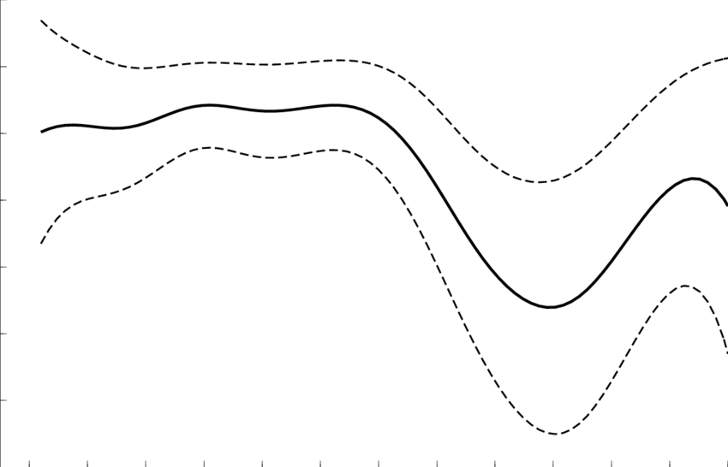
Model 1: Generalized Additive Model
GAM:
Average the prediction from each feature’s cubic spline
Knots = 30
10-Fold cross-validation accuracy: 85.51%
Nadaraya-Watson
Laplacian kernel
10-Fold cross-validation accuracy: 83.01%

Slide 8
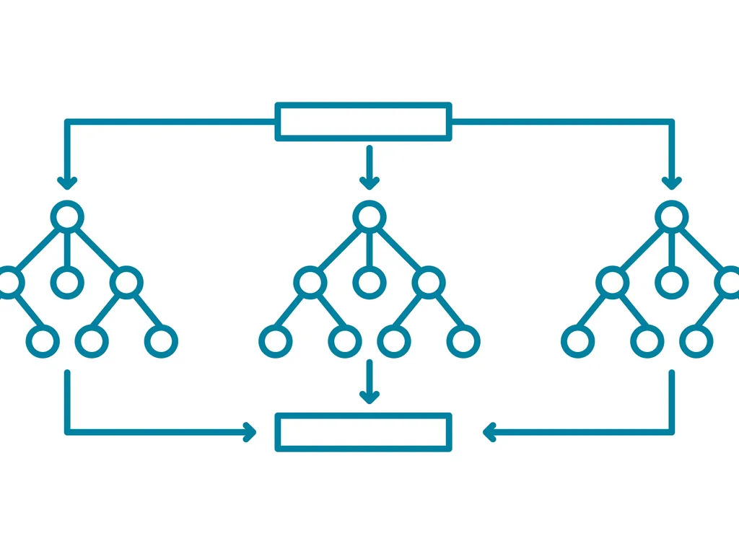
Model 2: Random Forest Regressor
Optimal params
max_depth = 6
min_samples_leaf = 2
min_samples_split = 2
n_estimators = 65
10-Fold cross-validation accuracy: 93.40%

Slide 9
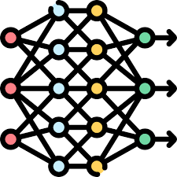
Model 3: Neural Network
3 gelu hidden layers
64, 32, 16 neurons
Dropout(0.2) and batch normalization in between
Softmax activation
Binary cross-entropy loss
10-Fold cross-validation accuracy: 90.12%

Slide 10
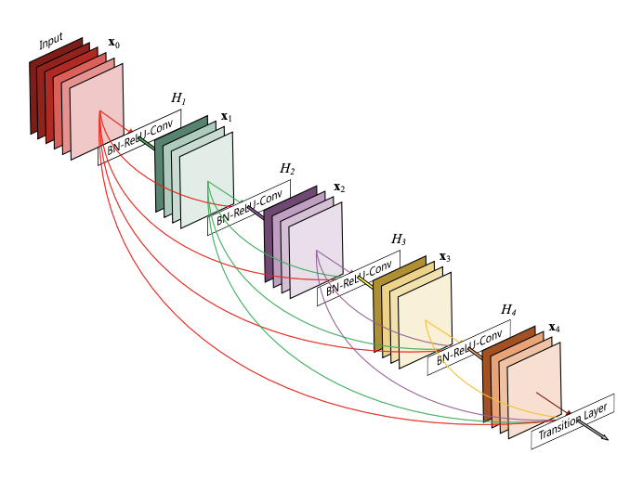
Model 4: DenseNet
Similar to DenseNet from class, adapted from 2D to 1D
Conv1D
Increase blocks from 3 to 4
Decrease growth rate and learning rate
Reaching low max very quickly
Decrease dropout rate
Softmax vs Sigmoid activation
10-Fold cross-validation accuracy: 85.49% ceiling

Slide 11
Improvements to Models
Feature engineering: polynomial features
Variable selection:
ElasticNet & Ridge
LinearSVC & ExtraTreesClassifier
Boosting:
Boost models with identical models
Boost models with a different “weak learner”

Slide 12
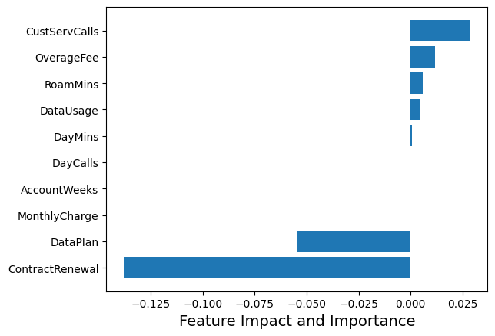
LinearSVC Feature Impact and Importance Ranking
Increases customer churn:
CustServCalls
OverageFee
RoamMins
DataUsage
DayMins
DayCalls
Decreases customer churn:
ContractRenewal
DataPlan
MonthlyCharge
AccountWeeks
Notes:
Some features like Monthly charge may contribute positively or negatively?

Slide 13
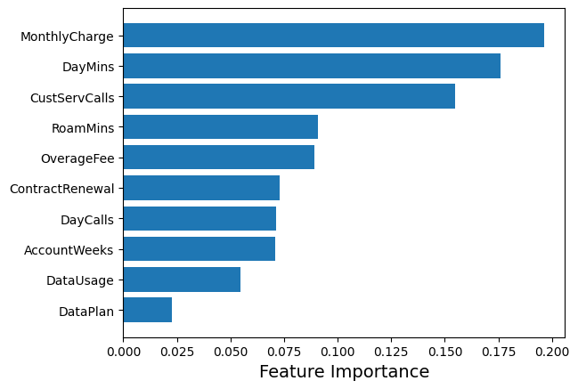
ExtraTreesClassifier Importance
MonthlyCharge
DayMins
CustServCalls
RoamMins
OverageFee
ContractRenewal
DayCalls
AccountWeeks
DataUsage
DataPlan

Slide 14
Potential Takeaways (so far)
Features have different importance to different models
Having a data plan and renewing a contract are good signs that a customer will be staying longer
Calls to customer service are linked with customer churn
Companies should pay attention to
Monthly charges
Average daytime minutes
Customer service calls

Slide 15
Results (so far):
Random Forest Regressor: 93.40%
Neural Network: 90.12%
GAM: 85.51
DenseNet: 85.49
NadarayaWatson: 83.01%

Slide 16

Work in Progress
Boosting current models
Feature selection
Feature engineering for models
Feature engineering for feature importance
Discover potential relationships in the data

