Slide 1
RFID Mapping and Localization
Critical Design Review

Slide 2
Top Action Items
“Identify why you are doing this project.”
“Figure out some way to reduce costs.”
“Indicate how everything will be connected.”
“Compile a complete schematic of the system.”
“Plan out how the packaging is going to be done.”

Slide 3
Action Item:
“Identify why you are doing this project.”

Slide 4
Background
RFID systems are used for tracking Wal-Mart inventory, identifying lost animals, preventing shoplifting, and even tracking patients’ medicine intake.
Honeywell’s expectations:
To be used as a locator of parts—not inventory.
Multi-path can be ignored for now.
All parts, boards and documentation will be turned over to them at the end.
Any excess monetary needs will be provided by them.

Slide 5
Action Item:
“Figure out some way to reduce costs.”

Slide 6
Cost Changes
PDR:
Revised:
$26.56 (saving $38.44)
1 @ $123.75 (saving $421.25)
3 @ $54.99 (saving $15.03)
5 for $201.75 (saving $78.25)
$1,030.25 (saving $664.75)
Total Savings: $1,217.72

Slide 7
Cost Breakdown

Slide 8
Action Item:
“Indicate how everything will be connected.”

Slide 9
Connections
PC to UHF Reader
Ethernet to Serial or Ethernet to Ethernet (from Matt or Matt)
PC to ArduinoUno
USB to mini-USB (comes with Arduino)
UHF Reader to Sum/Delta Network
RP-TNC to SMA adapter to SMA (coax from Prof. Allen)
Sum/Delta to Switching Network and Antennas
SMA to SMA (coax from Prof. Allen)
ArduinoUno to RF Switch Control
Wire from board to banana clip or soldered directly to header coming out of switch

Slide 10
Action Item:
“Compile a complete schematic of the system.”

Slide 11
Schematic

Slide 12
Schematic (w/ Connections)

Slide 13
Action Item:
“Plan out how the packaging is going to be done.”

Slide 14


Packaging
Non-conductive material
As compact as possible
Front panel: Antennas
Inside of box: power splitter, sum/delta network, uhf reader, coax connections
UHF reader connections will have to exit the box
Front
18”
18”
18”

Slide 15
Design Changes since PDR
1. UHF Reader Selection
2. Sum/Delta Network
3. Risk Factors

Slide 16
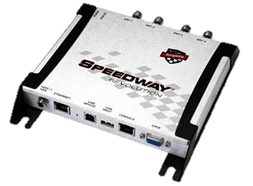
Impinj Speedway Revolution R420
Four monostatic RP-TNC antenna ports
Device capable of interrogating RFID tags, and able to supply useful RSSI, phase, and dynamic power settings
Chosen over ThingMagic’s M6 due to active development community and ease of use of the SDK.
Software interface: Octane API/LLRP
Received a 35% college discount, making the cost $1,585*0.65 = $1,030.25

Slide 17
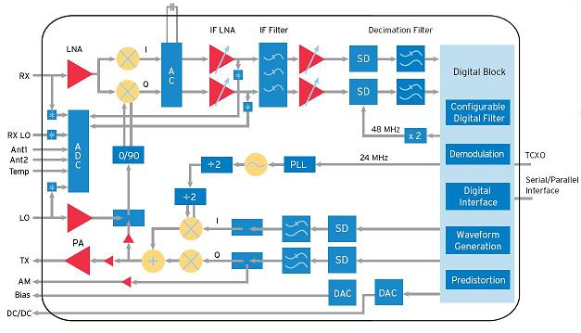
Schematic
Impinj Indy R1000 Reader Chip
Source: http://rfid.net/product-listing/reviews/128-the-impinj-indy-r1000-reader-chip

Slide 18
Steering and +/Δ Network
Only one receive antenna will be steered, eliminating the need for 3 of the 4 evaluation boards
Power splitters to be used for the sum/delta network instead of a hybrid coupler
0° 0°
0° 0°
0° 0° 0° 0°
0° 180°
0° 0°
Sum
Delta

Slide 19
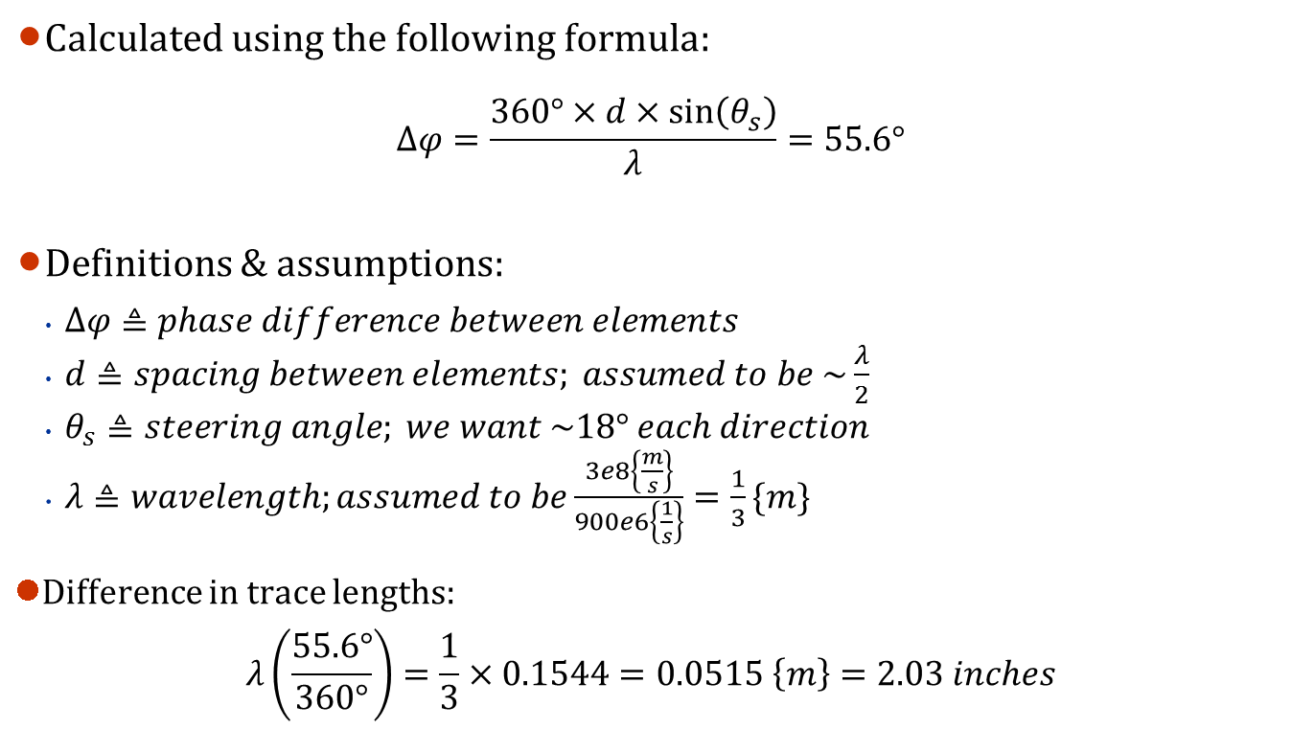
Trace Length Calculation
Calculated using the following formula:
$$∆φ=\frac{360°×d×\sin\left(θ_{s}\right)}{λ}=55.6°$$
Definitions & assumptions:
$∆φ≜phase difference between elements$
$d≜spacing between elements; assumed to be \sim \frac{λ}{2}$
$θ_{s}≜steering angle; we want \sim 18° each direction$
$λ≜wavelength;assumed to be\frac{3e8\left\{\frac{m}{s}\right\}}{900e6\left\{\frac{1}{s}\right\}}=\frac{1}{3}\{m\}$
Difference in trace lengths:
$$λ\left(\frac{55.6°}{360°}\right)=\frac{1}{3}×0.1544=0.0515 \left\{m\right\}=2.03 inches$$

Slide 20
Risk Analysis
Risk: Honeywell is unable to fabricate the steering network PCB in time
Mitigation: We are buying a switch and will use different lengths of coax to steer the antenna
Risk: Problems with multipath and obstructions lead to inconsistent results during testing
Mitigation: Perform experiments in an open space outside
Risk: Issues getting the phase network to function properly.
Mitigation: Rely on functionality of UHF reader alone to accomplish basic localization.
Risk: Honeywell can’t provide the necessary coax cables
Mitigation: Excess from Nichols Hall will be used, courtesy of Prof. Allen

Slide 21
Milestones
Milestone #1 (by April 6th):
Successfully read an RFID tag using the reader as it normally functions (that is, without the steering network). This we will do by connect the antennas directly to the reader and following its testing documentation.
Milestone #2 (by April 20th):
Successfully steer the receiving beam. This includes the switching networks, Arduino, and software. The steering can be tested theoretically (using network analyzers) or physically (using a antenna pattern cross-section).

