Slide 1
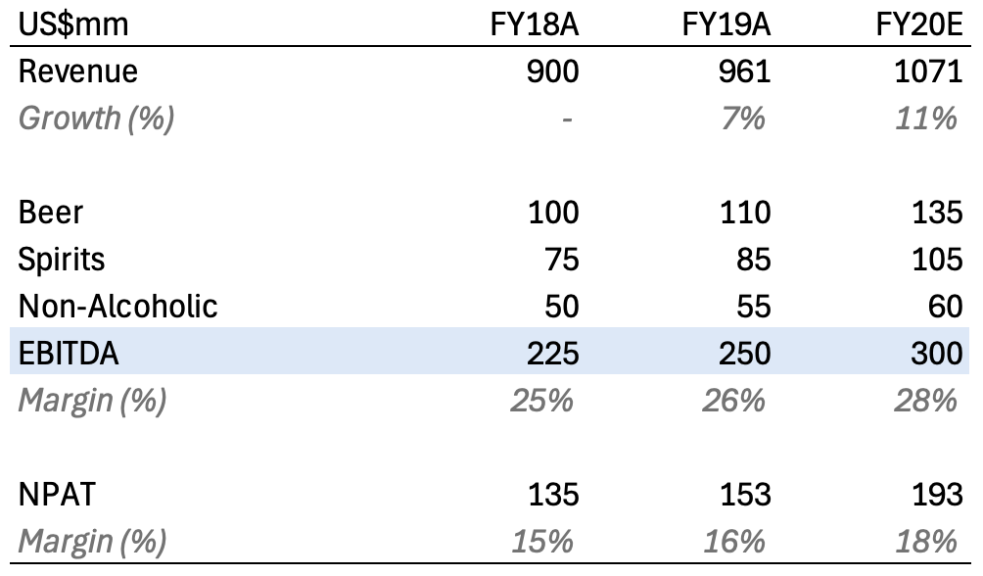
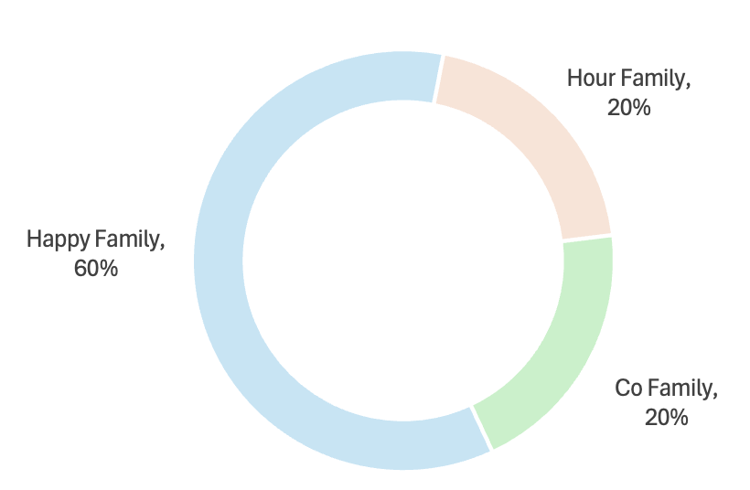
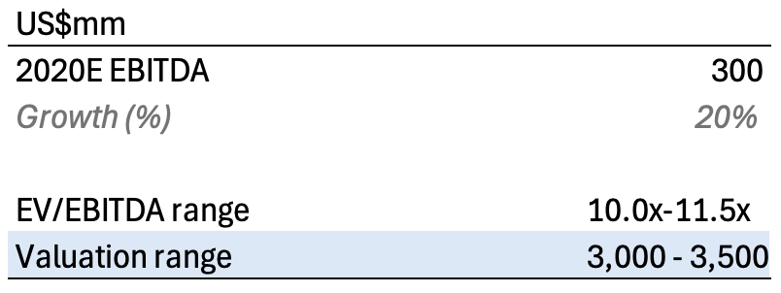
HappyHour Co. Company Profile
Leading producer and marketer of beer and spirits in Singapore and Malaysia with growing operations in the region
Overview
Key financials
Producer and marketer of beer, spirits and non-alcoholic beverages
Headquarter in Singapore with operations in Malaysia and China; manufacturing outsourced to Brew Co. in Malaysia
Distribution and direct sales across all markets
#1 player in beer and spirits in Singapore and Malaysia; #1 in non-alcoholic beverages in Malaysia
High end product offerings in spirits segment (vodka, tequila) commanding premium valuation
Growth strategy: recently expanded into China; new bottling facilities planned for Cambodia
Founded in 1975 by Ms. Happy
Shareholders
Indicative valuation
Source: Company website; Broker industry reports; News articles
1

Slide 2
Overview of auction process and key workstreams
 | Date | Event | Key workstreams
Round 1: Indicative Bid Phase | Mar 19, 2020 | Commencement of Indicative Bid Phase Release of Indicative Bid Documents | Due Diligence Conduct initial due diligence based on the Indicative Bid Documents Maintain Q&A log Valuation Conduct initial valuation based on the Indicative Bid Documents Structure and Financing Confirm buyer entity and any co-investor involvement Confirm preliminary financing approach Approvals Identify any internal or regulatory approvals required
 | From 9am Apr, 9 2020 to 5pm Apr 13, 2020 (HKT) | Lodgment of Indicative Bid Questions
 | By 5pm May 13, 2020 (HKT) | Indicative Bid deadline
Round 2: Final Bid Phase | Late May 2020 | Commencement of Final Bid Phase Release of Process Letter Two | Site Visits & Management Presentation Arrange site visit and management presentation Prepare follow-up questions for management Due Diligence Continue to conduct due diligence using additional information provided in data room Update and maintain Q&A log Valuation Refine valuation analysis based on financial forecast provided Financing Confirm financing sources Approvals Begin preparation of internal and regulatory approval materials
 | Late Jul 2020 | Final Bids due
1

