Slide 1

Projects presentation
Middleware Technologies for Distributed Systems
POLITECNICO DI MILANO

Slide 2

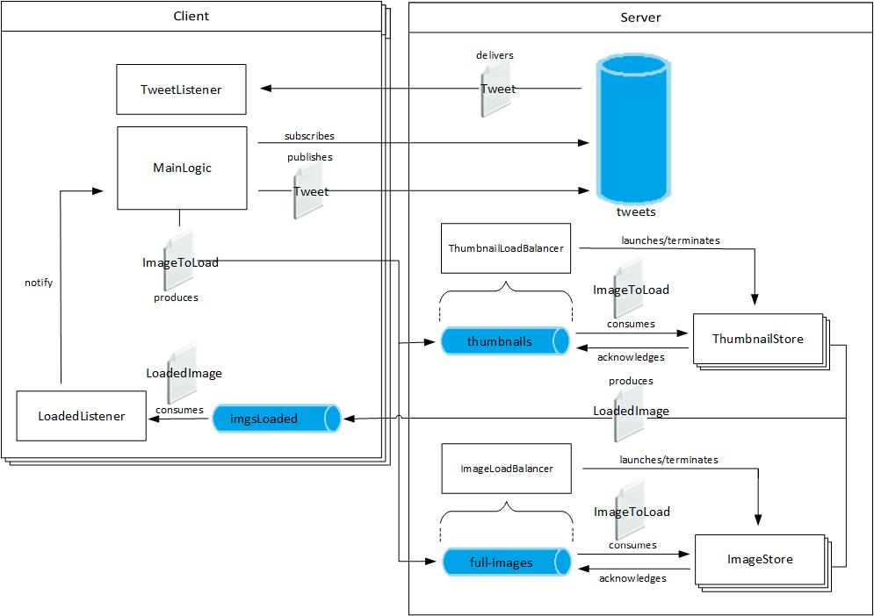
JMS Project - Architecture
Matteo Locatelli & Matthew Rossi
POLITECNICO DI MILANO

Slide 3
JMS Project - Messages
Matteo Locatelli & Matthew Rossi
ImageToLoad:
String username: used to store the image in the client personal folder
int id: reflects client order of the images
String extension
byte[] img
LoadedImage:
int id: id of the loaded image, to guarantee that the order is preserved
URL url: url to download the image
boolean thumbnail: tells if the loaded image is a thumbnail
Tweet:
String text
ArrayList<URL> images
ArrayList<URL> thumbnails
POLITECNICO DI MILANO

Slide 4
JMS Project – Queue/Topic
Matteo Locatelli & Matthew Rossi
Queue
thumbnails
queue used by the clients to send images to the thumbnail store service
full-images
queue used by the clients to send images to the image store service
imagesLoaded
temporary queue on the client used by the storage services to acknowledge the correct upload of the images
Topic
Tweet
topic that clients use to send tweets and subscribe to in a durable way (so to receive messages sent when they were offline)
POLITECNICO DI MILANO

Slide 5
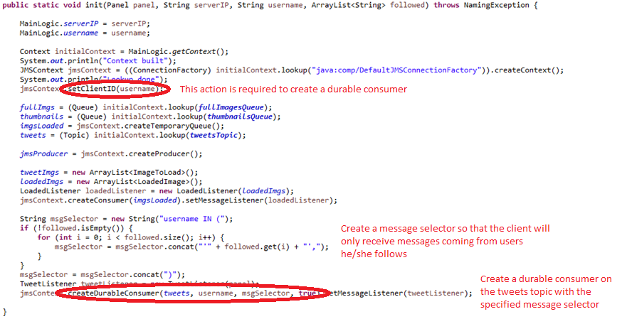
JMS Project – Client initialization
Matteo Locatelli & Matthew Rossi
POLITECNICO DI MILANO

Slide 6
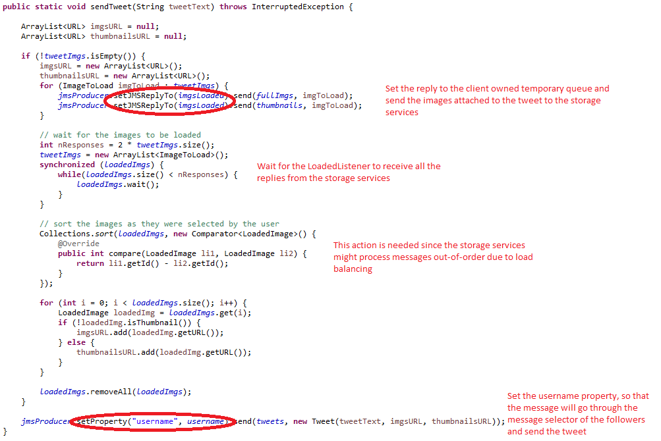
JMS Project – Send tweet
Matteo Locatelli & Matthew Rossi
POLITECNICO DI MILANO

Slide 7
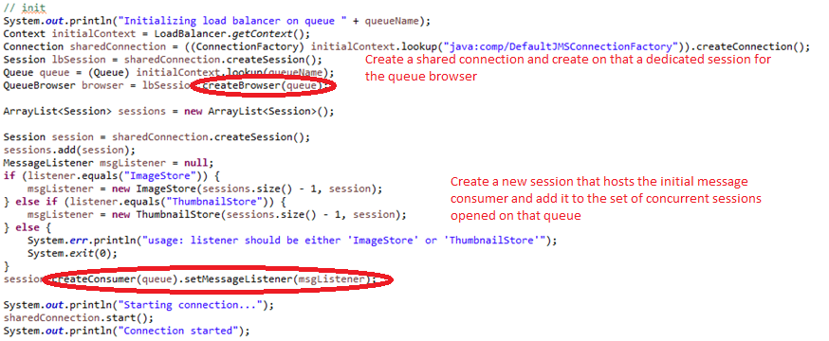
JMS Project – Server initialization
Matteo Locatelli & Matthew Rossi
POLITECNICO DI MILANO

Slide 8
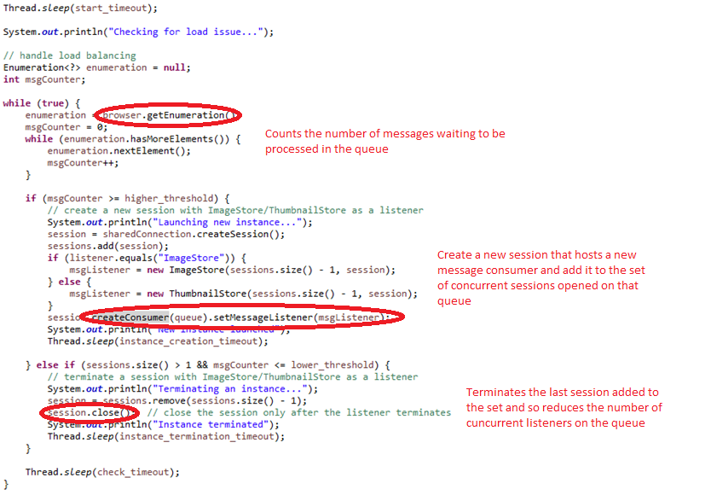
JMS Project – Load balancing
Matteo Locatelli & Matthew Rossi
POLITECNICO DI MILANO

