Slide 1
Cookbook Application
By L. Martin, D. Romero, M. Saunders,
D. Young

Slide 2
Outline
Overview/Summary
Requirements
Functional
Non-Functional
Constraints
Object Modeling
Example 1 -- Modify Recipe
Use Case
Sequence Diagram
Example 2 -- Create Cookbook
Use Case
Sequence Diagram

Slide 3
Outline
Overview/Summary
Requirements
Functional
Non-Functional
Constraints
Object Modeling
Example 1 -- Modify Recipe
Use Case
Sequence Diagram
Example 2 -- Create Cookbook
Use Case
Sequence Diagram

Slide 4
Summary
Create and store recipes
Create and store cookbooks
Add recipes to cookbooks
Search for and share recipes amongst other users

Slide 5
Outline
Overview/Summary
Requirements
Functional
Non-Functional
Constraints
Object Modeling
Example 1 -- Modify Recipe
Use Case
Sequence Diagram
Example 2 -- Create Cookbook
Use Case
Sequence Diagram

Slide 6
Functional Requirements
Creation
The system will allow registered users to create cookbooks
The system will allow registered users to create recipes
The system will allow registered users to create ingredients
The system will allow registered users to add ingredients to recipes
The system will allow registered user to edit recipes they have previously added
The system will allow administrators to modify ingredients
The system will allow administrators to modify recipes
The system will allow registered users to add recipes to cookbooks
Search
The system will allow all users to browse all recipes by category, difficulty, time, title, author
The system will allow users to place recipes into one of that user’s cookbooks
Membership
The system will allow anonymous user to sign up as a registered user to store user data
The system will allow users to login to registered user accounts

Slide 7
Non-Functional Requirements
The system will allow the application to run on any browser that supports HTML 5
User information will be secured by password
Constraints
There must be a database in this application
The front-end of this application must run in a web browser
The system will allow for 3 actors/types of users
The application must be completed by April 21, 2015

Slide 8
Outline
Overview/Summary
Requirements
Functional
Non-Functional
Constraints
Object Modeling
Example 1 -- Modify Recipe
Use Case
Sequence Diagram
Example 2 -- Create Cookbook
Use Case
Sequence Diagram

Slide 9
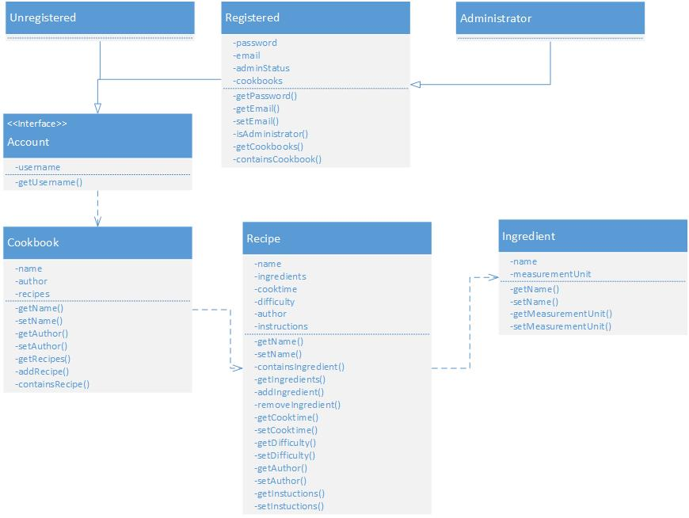
Object Model

Slide 10
Outline
Overview/Summary
Requirements
Functional
Non-Functional
Constraints
Object Modeling
Example 1 -- Modify Recipe
Use Case
Sequence Diagram
Example 2 -- Create Cookbook
Use Case
Sequence Diagram

Slide 11
Modify recipe
Name | Modify Recipe by Registered User
Actor | Registered User
Description | The system will allow registered users to modify an existing recipe.
Trigger Event | The user clicks a button to “Modify a Recipe”.
Pre-conditions | The website is available. The user is registered. The recipe being modified exists and was created by this user.
Post-conditions | The recipe is modified. The modified recipe is displayed to the user.

Slide 12
Modify recipe
Normal Course
The system displays a registered users homepage ← User Account The user clicks the button to “Open Cookbook”. The system displays the cookbooks recipes. The user clicks a recipe. The system displays the recipe selected by the user. The user select to “Modify Recipe”. The system displays the same recipe form displayed when creating a recipe, but the fields are pre-populated with the existing data. ← Recipe form with existing data The user edits the recipe data and click “Submit”. ← Recipe form with modified data The system updates the recipe in the database and displays the updated recipe page. → Modified Recipe
Exceptions
E1: Cancel modification (deviates after step 7) The user selects cancel on the recipe form The user is returned to the recipe page and the recipe remains unmodified.

Slide 13
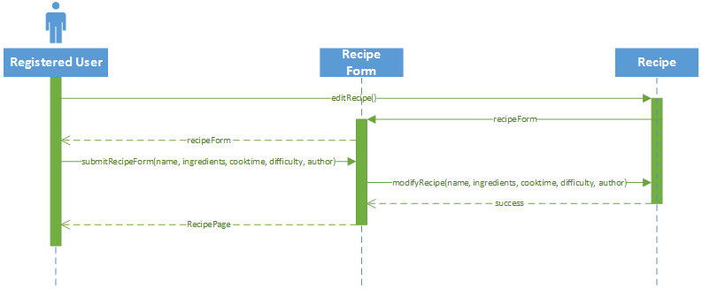
Modify Recipe

Slide 14
Outline
Overview/Summary
Requirements
Functional
Non-Functional
Constraints
Object Modeling
Example 1 -- Modify Recipe
Use Case
Sequence Diagram
Example 2 -- Create Cookbook
Use Case
Sequence Diagram

Slide 15
Cookbook creation
Name | Cookbook Creation
Actor | Registered User
Description | The system will allow registered users to create cookbooks. These cookbooks will be used to store recipes.
Trigger Event | The user clicks a button to “Create a Cookbook”.
Pre-conditions | The website is available The user is registered
Post-conditions | The new cookbook is created The new cookbook is displayed on the user’s homepage

Slide 16
Cookbook creation
Normal Course
The system displays a registered users homepage ← User Account The user clicks the button to “Create a Cookbook” The system displays a dialog box for the cookbooks name ← Cookbook form The user inputs the name of the cookbook and clicks OK ← Cookbook name The system creates a new cookbook object and displays it to the users home page → new cookbook
Exceptions
E1: Cancel creation The user selects cancel on the dialog box prompting for the cookbook name. The user is returned to the user’s homepage and the cookbook is not created.

Slide 17
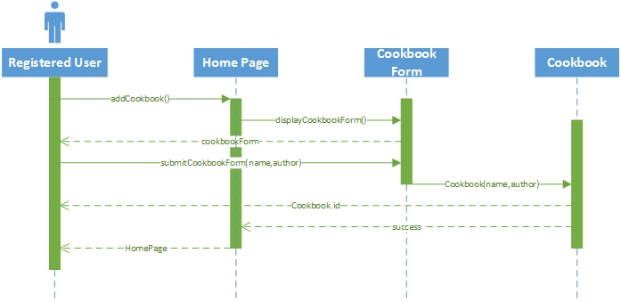
Create Cookbook

Slide 18
COMMENTS

