Slide 1
Family Tree (Group 5)
Sindy Giraldo (Note Taker)
Robert Hertzbach (First Alternate)
Piero Messarina (Time Keper)
Matthew Saunders (Team Leader)

Slide 2
Overview
System Requirements
Testing Approach
Test Schedule
HW / SW Requirements
Features Tested
Features Not Tested
Unit Testing
Subsystem Testing
System Testing
Demo

Slide 3
System Requirements
ID: A&S-001R
Name: Register User Success
Participating Actors: User
Entry Condition:
The user does not have an account, and wishes to use the application.
The user is in the main page “famillytree.com”
Events flow:
User clicks on the register button
System redirects to and displays the registration page
User enters the information required to create account: a. Name b. Email (will be user name)
c. Password d. Confirm Password
System validates data a. User name (email) is valid b. User name (email) available c. Password meets the required specifications
d. Personal information valid
Redirect to Welcome Page
Exit Conditions: User is successfully registered
Alternative flow: None
Non-Functional Requirement:
Registration process should take no longer than 1sec after submitting form.
Registration process should be a one-click process.

Slide 4
System Requirements
ID: A&S-001L (Fig. 9)
Name: Login Success Participating
Actors: User
Entry Condition:
The user is in the main page “famillytree.com”
The user is already registered
Events flow:
User enters the log in information
System check credential and grant access
System presents Welcome Page
Exit Conditions:
User is logged in the system
Alternative flow: None
Non-Functional Requirements:
Log in process should take no longer than 0.5 sec
Password should not be shown while the user types

Slide 5
Testing Approach
Three levels of testing
Unit Testing
Tests each method of a class individually
JUnit
Subsystem Testing
Tests interaction between classes in the package
JUnit
System Testing
Tests the behavior of the system against the design specification
Rational Functional Tester (RFT)

Slide 6
Testing Approach
Stub Objects
Used to inject dependencies into methods or objects under test
Only used in Unit and Subsystem Testing
Facade
A class between the test class and methods being tested
Only used in Subsystem Testing

Slide 7
Test Schedule
Gantt Chart

Slide 8
Hw / SW Requirements
Minimal Hardware Requirements:
1GHz processor, 100 MB free of RAM. - Internet connection.
Minimal Internet Browser Requirements:
Internet Explorer 8
Safari 4
Firefox 4
Chrome 7 (recommended)

Slide 9
Features Tested
Use Cases Tested:
A&S-001R
A&S-003R
A&S-001L
A&S-002L
A&S-003L
A&S-004L
A&S-005L
A&S-001A
A&S-002A
A&S-003A
A&S-004A

Slide 10
Features Not Tested
Use Cases NOT Tested:
A&S-002R
A&S-004R
A&S-001SC
A&S-002SC
A&S-003SC
A&S-001L (link to tree)
A&S-002L (link to tree)

Slide 11
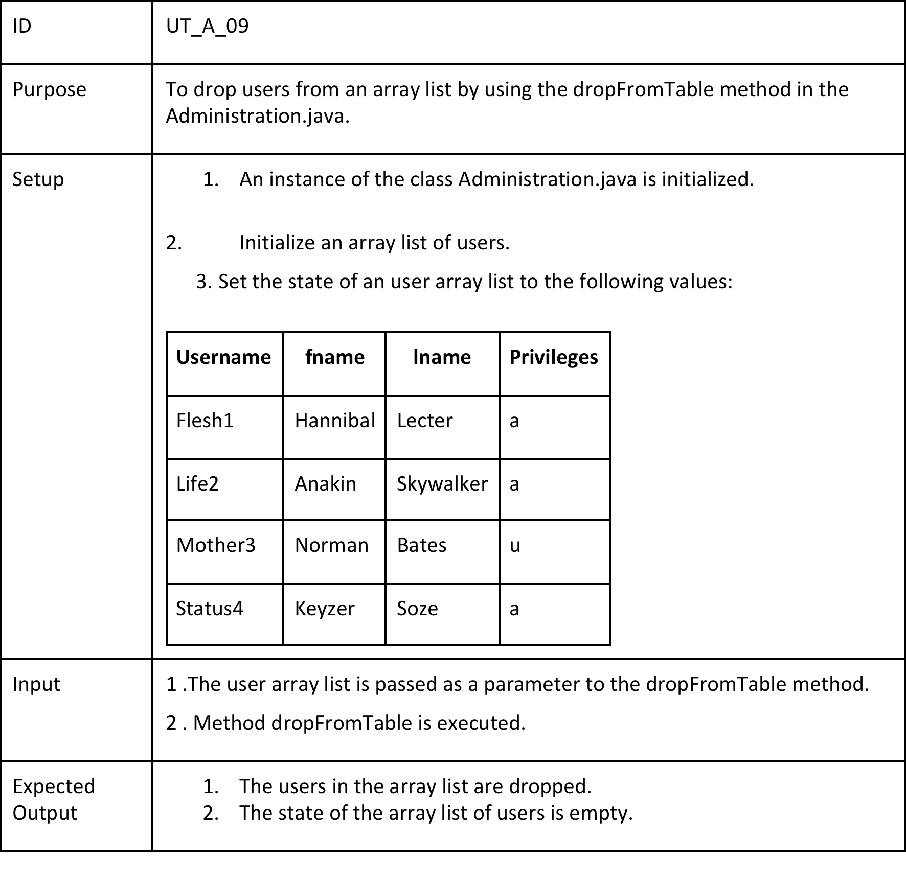
Unit Test

Slide 12
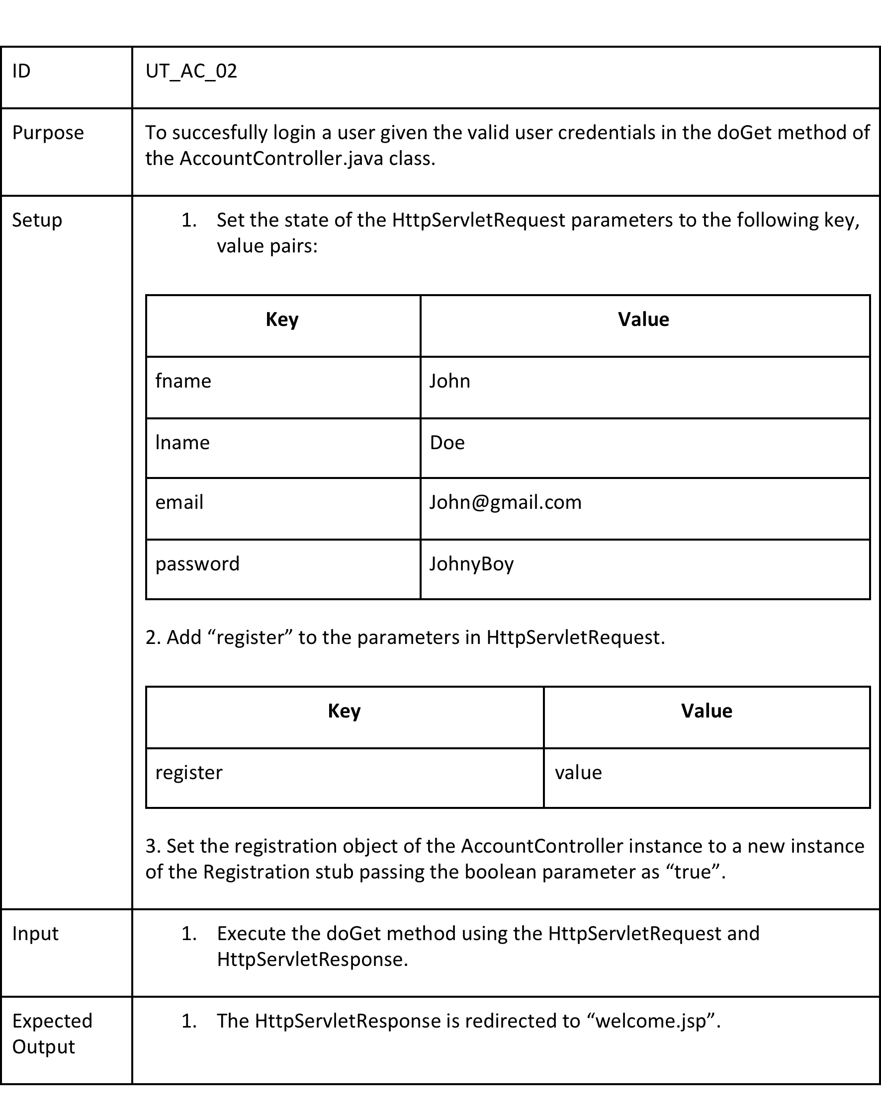
Unit Test

Slide 13
Subsystem Test

Slide 14
Subsystem Test

Slide 15
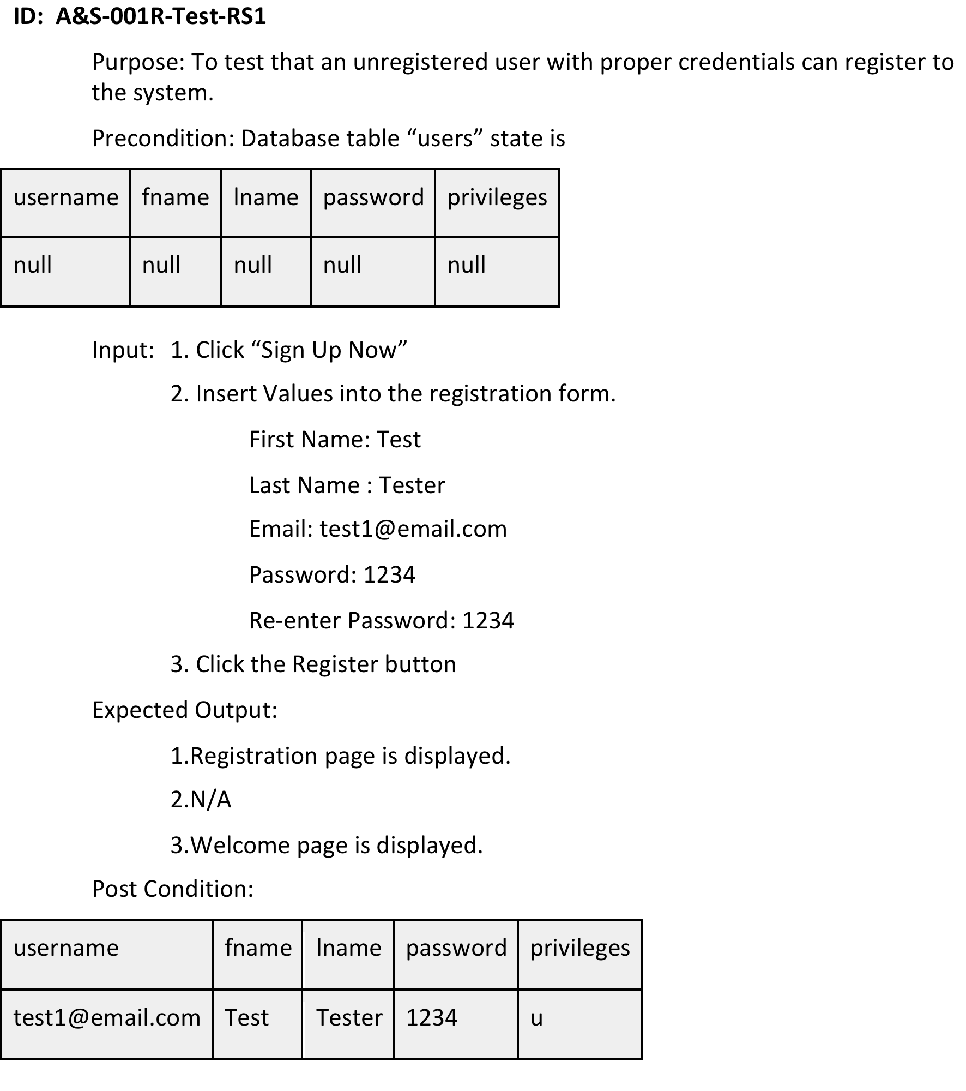
System Test

Slide 16
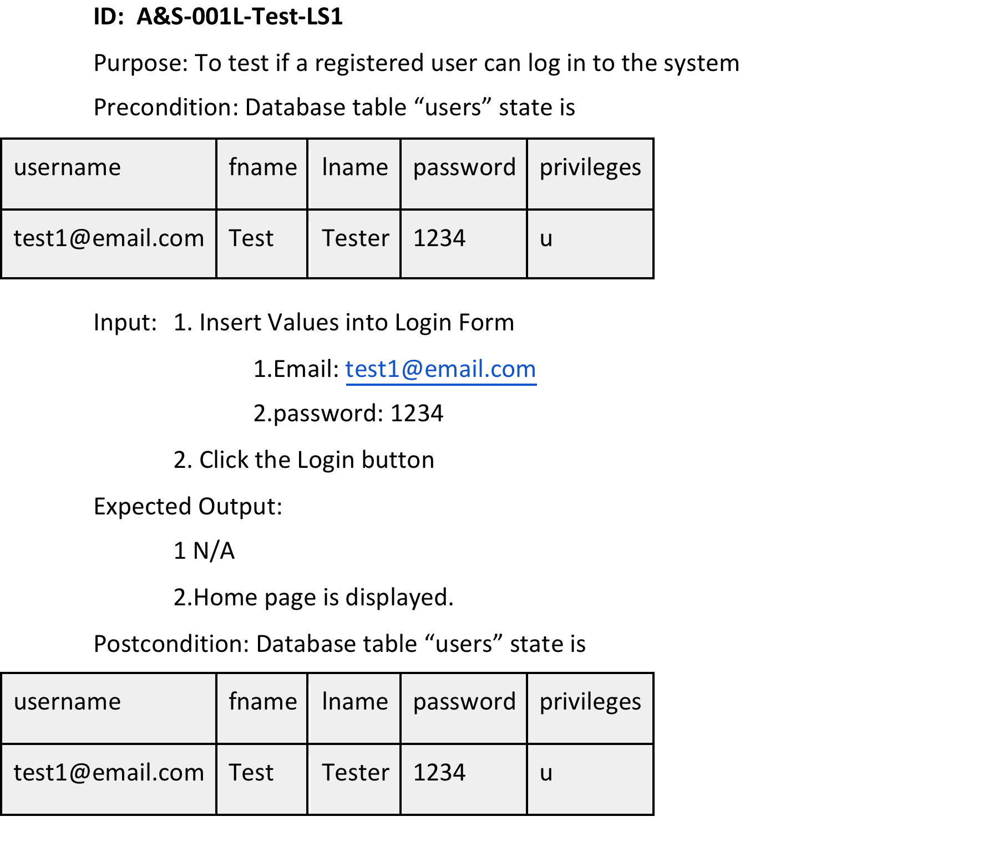
System Test

Slide 17
Demo

