Slide 1
Tokenization
From Text to Tokens: How Language Models Read
Matthew Kehoe, April 2026

Slide 2
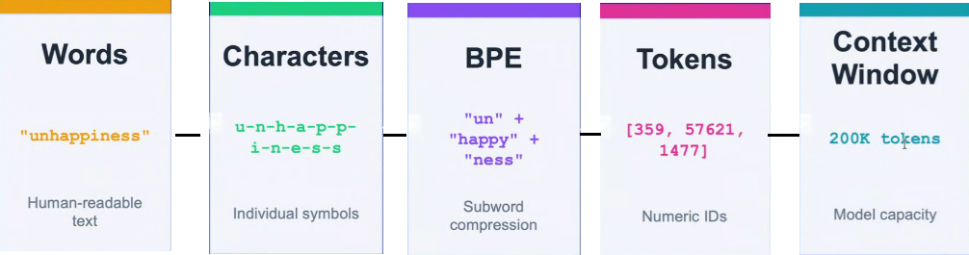
Tokenization: From Words to Context
For most LLMs processing English text, 1 token ≈ 4 characters on average
The context window defines the maximum total tokens the model can process in a single interaction

Slide 3
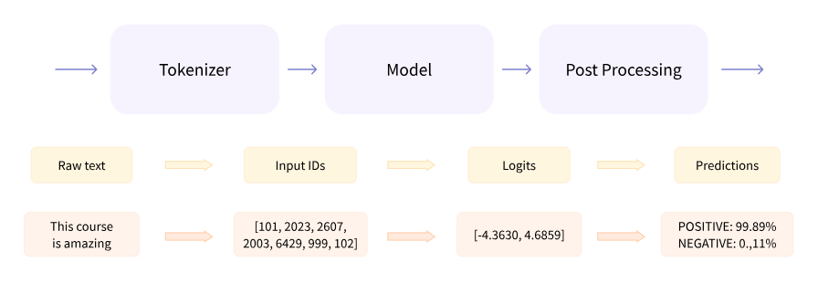
What does a Tokenizer do?
Neural networks can’t process raw text directly, so the first step is to convert the text inputs into numbers that the model can make sense of. To do this we use a tokenizer, which:
Splits the input into words, subwords, or symbols (like punctuation) that are called tokens
Maps each token to an integer
Adds additional inputs that may be useful to the model
Example from: https://huggingface.co/learn/llm-course

Slide 4
From Raw Text to Discrete Units
How do we represent an input text?
Computers cannot process raw text directly. To perform computation, we must represent an input string x as a sequence of discrete units ⟨x₁, …, x_{n}⟩.
Tokenization is the process of decomposing a string into smaller, manageable segments called tokens.
Is a "word" the right unit of measurement, or should we go deeper?

Slide 5
Same String, Different Splits
One standard method of tokenization is splitting by white space and punctation.
Consider the string “The GPU costs $1,499.99 and draws 250W.”
How should we represent the sequence?
Option 1: x = ⟨The, GPU, costs, $1,499.99, and, draws, 250W, .⟩
Option 2: x = ⟨The, GPU, costs, $, 1,499, ., 99, and, draws, 250, W, .⟩
Tokenization is not simple; choosing the wrong unit can destroy the meaning of specialized symbols.

Slide 6
When Splitting Rules Change Meaning
A tokenizer must also decide how to handle complex strings:
Contractions: aren't (One token, or are + n't?)
Hypens: start-of-the-art or prize-winning
Proper Nouns: O'Neill (Internal punctuation that shouldn't be split)
Morphemes: unlockable (does "un-" mean "cannot be locked" or "able to be unlocked"?)
Different languages (e.g., Chinese, Thai) use no whitespace, so word boundaries must be inferred rather than split on
Turkish and Arabic pack multiple morphemes into single words, making whitespace splitting too coarse

Slide 7
Tokenization: different methods
How should we split text into tokens?
Too coarse
Every word is a token
Middle ground
Tokens split words logically
Too fine
Every character is a token
Input: “doesn’t”
↓
↓
↓
doesn’t
does
n’t
d
o
e
s
n
’
t
1 token
2 tokens
7 tokens
Can't handle unseen words or represent morphological variants ("run", "runs", "running")
Handles unknowns, captures morphology, and keeps vocabulary size manageable
Very long sequences. No linguistic structure. Model must learn meaning from scratch.

Slide 8
Word-level Tokenization
Word-level tokenization treats diﬀerent forms of the same root as completely separate (e.g., “run”, “runs”, “runner”, “running”, etc.)
This means separate features or embeddings. English has ~170,000 words, many only seen once in training data
Rare words (e.g., "unhospitalized") appear 1-2 times, so embedding doesn't learn anything meaningful
Pre-trained embeddings (e.g., word2vec, GloVe) partially help, so “run” and “running” end up nearby in vector space. Although the model still stores and updates them independently
OOV words are still unrepresentable, and low-frequency words stay poorly estimated

Slide 9
Word-level Tokenization
Handling Unknown Words
What happens when the model encounters a word not seen during training?
With word-level tokenization, we could assign it to a special <UNK> token
We would then use UNK during training so that the model can learn a generalized representation for rare or unseen tokens
Why is this bad?

Slide 10
Word-level Tokenization
Limitations of <UNK>
Mapping unknown words to <UNK> discards all meaning they carry
Especially damaging in medical, legal, or multilingual text where rare terms carry critical meaning
The patient was prescribed Lisinopril for hypertension and Dapagliflozin for type 2 diabetes.
The patient was prescribed <unk> for <unk> and <unk> for type 2 diabetes.
We are traveling from Reykjavík to Akureyri via the Ring Road.
We are traveling from <unk> to <unk> via the <unk>.

Slide 11
Character-level Tokenization
Split every string into individual characters rather than words
e.g., “running” → [r, u, n, n, i, n, g] is 7 tokens instead of 1
Advantages over word-level
Small vocabulary: ~100–300 tokens cover English and similar Latin-script languages (letters, digits, punctuation)
Zero unknown-word problem since every string is representable
Disadvantages
Sequences grow 4–7x longer: expensive for attention and memory
Model must learn that “c”, “a”, “t” → “cat” with no linguistic shortcuts
The model gets no built-in notion of words or morphemes: all structure must be learned from scratch

Slide 12


Subword Tokenization
Word-level: issues with unknown words and information sharing, and complexity increases with vocabulary size
Also, fits poorly to some languages
Character-level: long sequences, the model needs to do a lot of heavy lifting to rediscover existing linguistic structure
Subword is a middle ground
Subword tokenization first developed for machine translations
Based on byte pair encoding (Gage, 1994)
This is now the industry standard, used across most modern LLMs
Neural Machine Translation of Rare Words with Subword Units
Rico Sennrich and Barry Haddow and Alexandra Birch
School of Informatics, University of Edinburgh
{rico.sennrich,a.birch}@ed.ac.uk, bhaddow@inf.ed.ac.uk
The main motivation behind this paper is that the translation of some words is transparent in that they are translatable by a competent translator even if they are novel to him or her, based on a translation of known subword units such as morphemes or phonemes.

Slide 13
Byte Pair Encoding (BPE)
𝒱 ← All characters in the training data (as base tokens)
For k steps:
Tokenize the data, taking the longest prefix each time
Count the frequency of adjacent token pairs in the data
Choose the pair ⟨l, r⟩ that occurs most frequently
Add the pair to the vocabulary as a new token 𝒱 ← 𝒱 ∪ {lr}
Return 𝒱
Training Data
Word | Frequency
hug | 10
pug | 5
pun | 12
bun | 4
hugs | 5
Example from: https://huggingface.co/docs/transformers/tokenizer_summary

Slide 14
Byte Pair Encoding (BPE)
𝒱 ← All characters in the training data (as base tokens)
Word | Frequency
hug | 10
pug | 5
pun | 12
bun | 4
hugs | 5
For k steps:
Tokenize the data, taking the longest prefix each time
Count the frequency of adjacent token pairs in the data
Choose the pair ⟨l, r⟩ that occurs most frequently
Add the pair to the vocabulary as a new token 𝒱 ← 𝒱 ∪ {lr}
Return 𝒱
𝒱 = {b, g, h, n, p, s, u}
Example from: https://huggingface.co/docs/transformers/tokenizer_summary

Slide 15
Byte Pair Encoding (BPE)
𝒱 ← All characters in the training data (as base tokens)
For k steps:
𝒱 = {b, g, h, n, p, s, u}
Word | Frequency
h+u+g | 10
p+u+g | 5
p+u+n | 12
b+u+n | 4
h+u+g+s | 5
- Tokenize the data, taking the longest prefix each time
Count the frequency of adjacent token pairs in the data
Choose the pair ⟨l, r⟩ that occurs most frequently
Add the pair to the vocabulary as a new token 𝒱 ← 𝒱 ∪ {lr}
Return 𝒱
Example from: https://huggingface.co/docs/transformers/tokenizer_summary

Slide 16
Byte Pair Encoding (BPE)
𝒱 ← All characters in the training data (as base tokens)
For k steps:
- Tokenize the data, taking the longest prefix each time
𝒱 = {b, g, h, n, p, s, u}
Word | Frequency
h+u+g | 10
p+u+g | 5
p+u+n | 12
b+u+n | 4
h+u+g+s | 5
Pair | Frequency
u+g | 20
p+u | 17
u+n | 16
h+u | 15
g+s | 5
- Count the frequency of adjacent token pairs in the data
Choose the pair ⟨l, r⟩ that occurs most frequently
Add the pair to the vocabulary as a new token 𝒱 ← 𝒱 ∪ {lr}
Return 𝒱
14
…
Example from: https://huggingface.co/docs/transformers/tokenizer_summary

Slide 17
Byte Pair Encoding (BPE)
𝒱 ← All characters in the training data (as base tokens)
For k steps:
Tokenize the data, taking the longest prefix each time
Count the frequency of adjacent token pairs in the data
𝒱 = {b, g, h, n, p, s, u}
Word | Frequency
h+u+g | 10
p+u+g | 5
p+u+n | 12
b+u+n | 4
h+u+g+s | 5
Pair | Frequency
u+g | 20
p+u | 17
u+n | 16
h+u | 15
g+s | 5
- Choose the pair ⟨l, r⟩ that occurs most frequently
- Add the pair to the vocabulary as a new token 𝒱 ← 𝒱 ∪ {lr}
Return 𝒱
15
…
Example from: https://huggingface.co/docs/transformers/tokenizer_summary

Slide 18
Byte Pair Encoding (BPE)
Updated vocabulary:
𝒱 ← All characters in the training data (as base tokens)
For k steps:
Tokenize the data, taking the longest prefix each time
Count the frequency of adjacent token pairs in the data
Choose the pair ⟨l, r⟩ that occurs most frequently
𝒱 = {b, g, h, n, p, s, u, ug}
Word | Frequency
h+u+g | 10
p+u+g | 5
p+u+n | 12
b+u+n | 4
h+u+g+s | 5
Pair | Frequency
u+g | 20
p+u | 17
u+n | 16
h+u | 15
g+s | 5
- Add the pair to the vocabulary as a new token 𝒱 ← 𝒱 ∪ {lr}
Return 𝒱
…
Example from: https://huggingface.co/docs/transformers/tokenizer_summary

Slide 19
Byte Pair Encoding (BPE)
𝒱 ← All characters in the training data (as base tokens)
For k steps:
𝒱 = {b, g, h, n, p, s, u, ug}
Word | Frequency
h+ug | 10
p+ug | 5
p+u+n | 12
b+u+n | 4
h+ug+s | 5
- Tokenize the data, taking the longest prefix each time
Count the frequency of adjacent token pairs in the data
Choose the pair ⟨l, r⟩ that occurs most frequently
Add the pair to the vocabulary as a new token 𝒱 ← 𝒱 ∪ {lr}
Return 𝒱
Example from: https://huggingface.co/docs/transformers/tokenizer_summary

Slide 20
Byte Pair Encoding (BPE)
𝒱 ← All characters in the training data (as base tokens)
For k steps:
- Tokenize the data, taking the longest prefix each time
𝒱 = {b, g, h, n, p, s, u, ug}
Word | Frequency
h+ug | 10
p+ug | 5
p+u+n | 12
b+u+n | 4
h+ug+s | 5
Pair | Frequency
u+n | 16
h+ug | 15
p+u | 12
p+ug | 5
ug+s | 5
- Count the frequency of adjacent token pairs in the data
Choose the pair ⟨l, r⟩ that occurs most frequently
Add the pair to the vocabulary as a new token 𝒱 ← 𝒱 ∪ {lr}
Return 𝒱
…
Example from: https://huggingface.co/docs/transformers/tokenizer_summary

Slide 21
Byte Pair Encoding (BPE)
Updated vocabulary:
𝒱 ← All characters in the training data (as base tokens)
For k steps:
Tokenize the data, taking the longest prefix each time
Count the frequency of adjacent token pairs in the data
Choose the pair ⟨l, r⟩ that occurs most frequently
Add the pair to the vocabulary as a new token 𝒱 ← 𝒱 ∪ {lr}
𝒱 = {b, g, h, n, p, s, u, ug, un, hug}
Word | Frequency
hug | 10
p+ug | 5
p+un | 12
b+un | 4
hug+s | 5
Final tokenizations:​
hug → [hug]​
hugs → [hug, s]​
pug → [p, ug]​
pun → [p, un]​
bun → [b, un]
Return 𝒱
Example from: https://huggingface.co/docs/transformers/tokenizer_summary

Slide 22
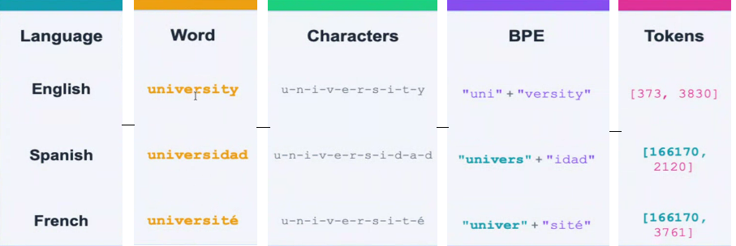
Cross-Lingual Token Reuse: Language Agnostic BPE
Same morphemes → Shared Token Ids Across Languages
Token 166170 is shared between Spanish and French: BPE learns cross-lingual subword patterns

Slide 23
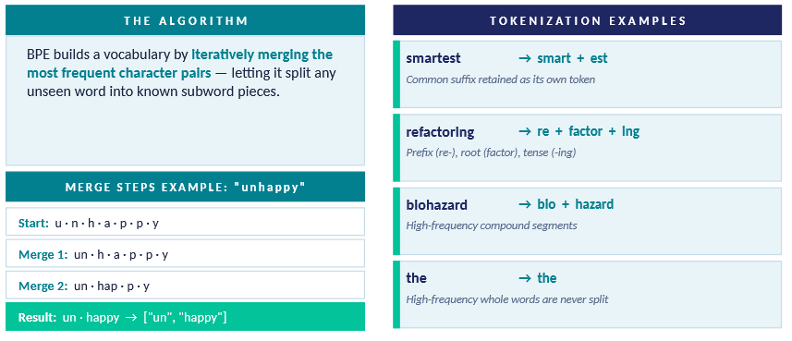
How BPE Handles Unseen Words
Shared subwords like "walk" may appear across walking, walked, and walker giving the model indirect cues about morphology.

Slide 24
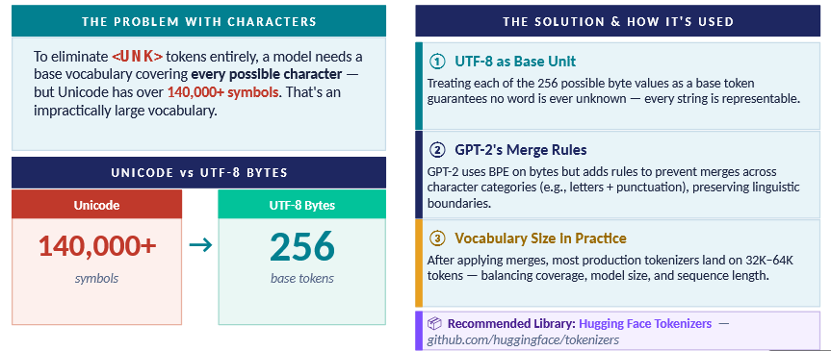
BPE in Practice: Bytes, Vocabulary & Tooling
Because any text, regardless of language, emoji, or symbol, can be represented as a sequence of UTF-8 bytes: no symbol in any language can ever be out of vocabulary.

Slide 25
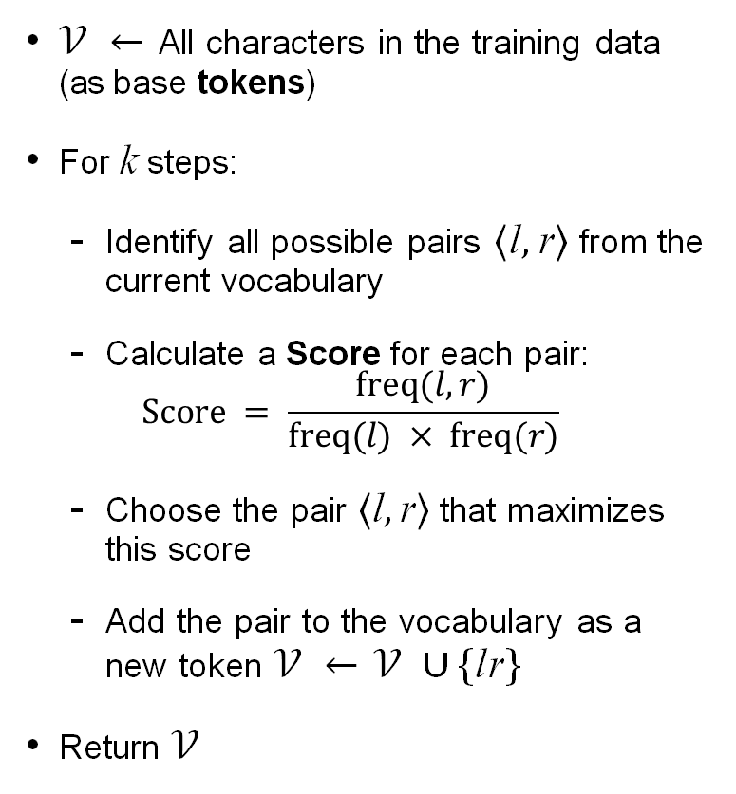
Wordpiece
𝒱 ← All characters in the training data (as base tokens)
For k steps:
Identify all possible pairs ⟨l, r⟩ from the current vocabulary
Calculate a Score for each pair:
$$Score = \frac{freq(l,r)}{freq(l) × freq(r)}$$
Choose the pair ⟨l, r⟩ that maximizes this score
Add the pair to the vocabulary as a new token 𝒱 ← 𝒱 ∪ {lr}
Return 𝒱
Training Data
Word | Frequency
hug | 10
pug | 5
pun | 12
bun | 4
hugs | 5
Example from: https://huggingface.co/docs/transformers/tokenizer_summary

Slide 26
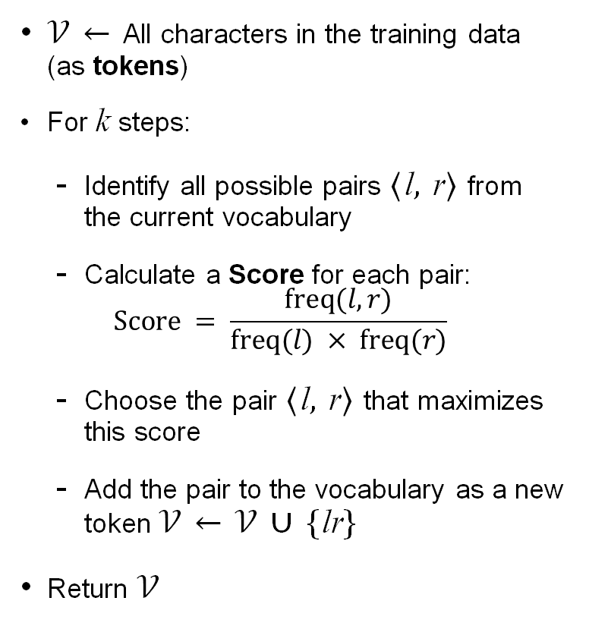
Wordpiece
Word | Frequency
hug | 10
pug | 5
pun | 12
bun | 4
hugs | 5
𝒱 ← All characters in the training data (as tokens)
For k steps:
Identify all possible pairs ⟨l, r⟩ from the current vocabulary
Calculate a Score for each pair:
$$Score = \frac{freq(l,r)}{freq(l) × freq(r)}$$
Choose the pair ⟨l, r⟩ that maximizes this score
Add the pair to the vocabulary as a new token 𝒱 ← 𝒱 ∪ {lr}
Return 𝒱
𝒱 = {b, h, p, ##g, ##n, ##s, ##u}
Note: ## marks non-initial subword tokens
Example from: https://huggingface.co/docs/transformers/tokenizer_summary

Slide 27
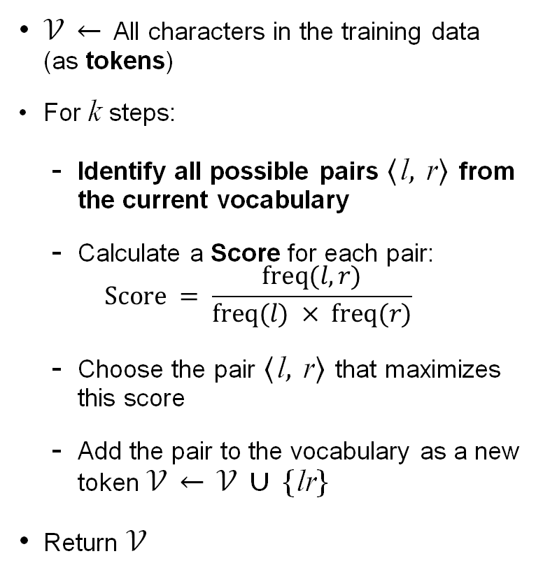
Wordpiece
𝒱 = {b, h, p, ##g, ##n, ##s, ##u}
Word | Tokens
hug (×10) | h + ##u + ##g
pug (×5) | p + ##u + ##g
pun (×12) | p + ##u + ##n
bun (×4) | b + ##u + ##n
hugs (×5) | h + ##u + ##g + ##s
𝒱 ← All characters in the training data (as tokens)
For k steps:
Identify all possible pairs ⟨l, r⟩ from the current vocabulary
Calculate a Score for each pair:
$$Score = \frac{freq(l,r)}{freq(l) × freq(r)}$$
Choose the pair ⟨l, r⟩ that maximizes this score
Add the pair to the vocabulary as a new token 𝒱 ← 𝒱 ∪ {lr}
Return 𝒱
Token frequencies: Pair Frequencies:
h = 15 h + ##u = 15
p = 17 p + ##u = 17
b = 4 b + ##u = 4
##u = 36 ##u + ##g = 20
##g = 20 ##u + ##n = 16
##n = 16 ##g + ##s = 5
##s = 5
Highest: freq(##g + ##s) / (freq(##g) * freq(##s)) =
5 / (20 * 5) = 0.05
Example from: https://huggingface.co/docs/transformers/tokenizer_summary

Slide 28
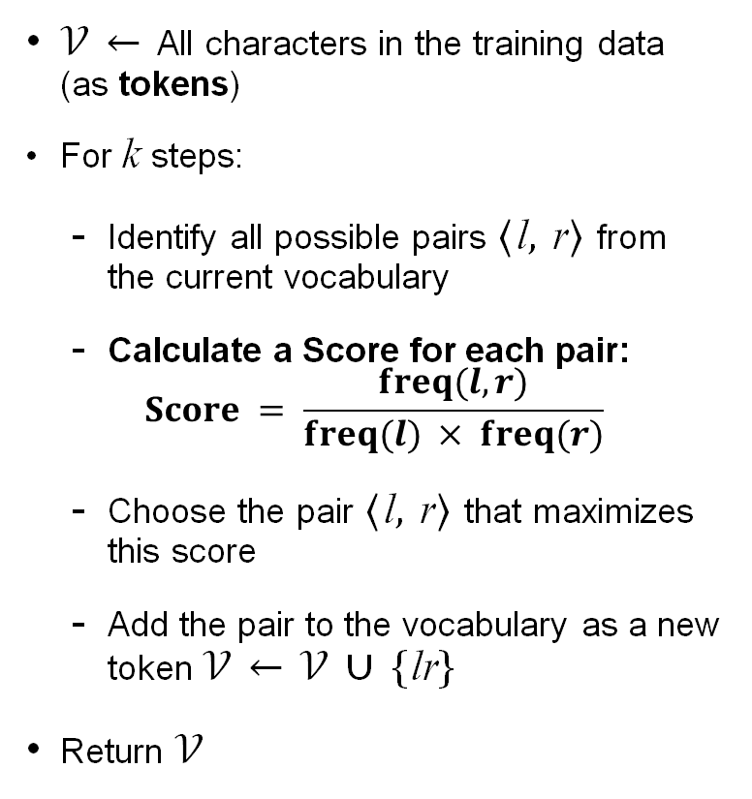
Wordpiece
𝒱 = {b, h, p, ##g, ##n, ##s, ##u}
Pair | Freq(pair) | Score
h + ##u | 15 | 0.028
p + ##u | 17 | 0.028
b + ##u | 4 | 0.028
##u + ##g | 20 | 0.028
##u + ##n | 16 | 0.028
##g + ##s | 5 | 0.050
𝒱 ← All characters in the training data (as tokens)
For k steps:
Identify all possible pairs ⟨l, r⟩ from the current vocabulary
Calculate a Score for each pair:
$$Score = \frac{freq(l,r)}{freq(l) × freq(r)}$$
Choose the pair ⟨l, r⟩ that maximizes this score
Add the pair to the vocabulary as a new token 𝒱 ← 𝒱 ∪ {lr}
Return 𝒱
Highest score: ##g + ##s (0.050)
All ##u pairs: 1/36 ≈ 0.028 (##u freq=36). ##g+##s has no ##u → 5/(20×5) = 0.050
Example from: https://huggingface.co/docs/transformers/tokenizer_summary

Slide 29
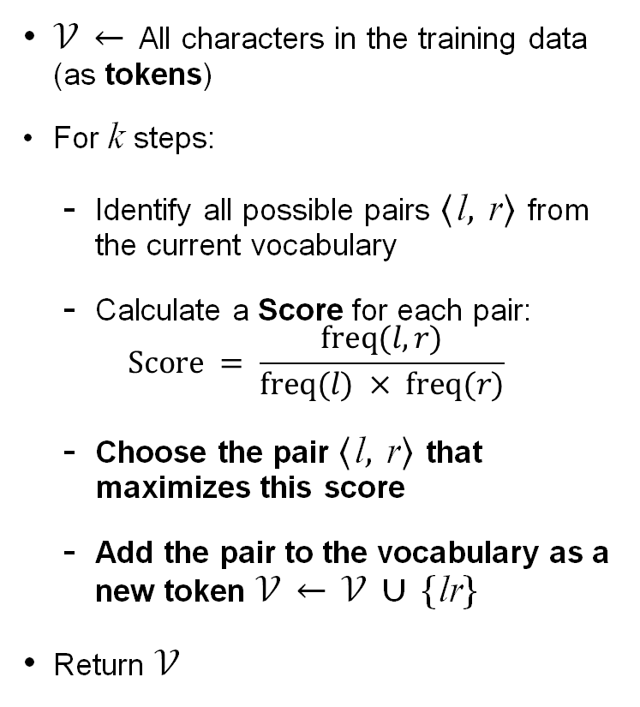
Wordpiece
Best pair: ##g + ##s (score = 0.050)
Merge: ##g + ##s → ##gs
𝒱 ← All characters in the training data (as tokens)
For k steps:
Identify all possible pairs ⟨l, r⟩ from the current vocabulary
Calculate a Score for each pair:
$$Score = \frac{freq(l,r)}{freq(l) × freq(r)}$$
Choose the pair ⟨l, r⟩ that maximizes this score
Add the pair to the vocabulary as a new token 𝒱 ← 𝒱 ∪ {lr}
Return 𝒱
Updated vocabulary:
𝒱 = {b, h, p, ##g, ##n, ##s, ##u, ##gs}
Word | Tokens
hug (×10) | h + ##u + ##g
pug (×5) | p + ##u + ##g
pun (×12) | p + ##u + ##n
bun (×4) | b + ##u + ##n
hugs (×5) | h + ##u + ##gs
Re-tokenize using longest prefix match:
hugs → h + ##u + ##gs
(others unchanged)
Example from: https://huggingface.co/docs/transformers/tokenizer_summary

Slide 30
Wordpiece
𝒱 ← All characters in the training data (as tokens)
For k steps:
Identify all possible pairs ⟨l, r⟩ from the current vocabulary
Calculate a Score for each pair:
$$Score = \frac{freq(l,r)}{freq(l) × freq(r)}$$
Choose the pair ⟨l, r⟩ that maximizes this score
Add the pair to the vocabulary as a new token 𝒱 ← 𝒱 ∪ {lr}
Return 𝒱
𝒱 = {b, h, p, ##g, ##n, ##s, ##u, ##gs}
Pair | Freq(pair) | Score
h + ##u | 15 | 0.028
p + ##u | 17 | 0.028
b + ##u | 4 | 0.028
##u + ##g | 15 | 0.028
##u + ##n | 16 | 0.028
##u + ##gs | 5 | 0.028
All scores are tied. Could break tie by
taking the highest raw pair frequency
→ p + ##u (freq=17)
Example from: https://huggingface.co/docs/transformers/tokenizer_summary

Slide 31
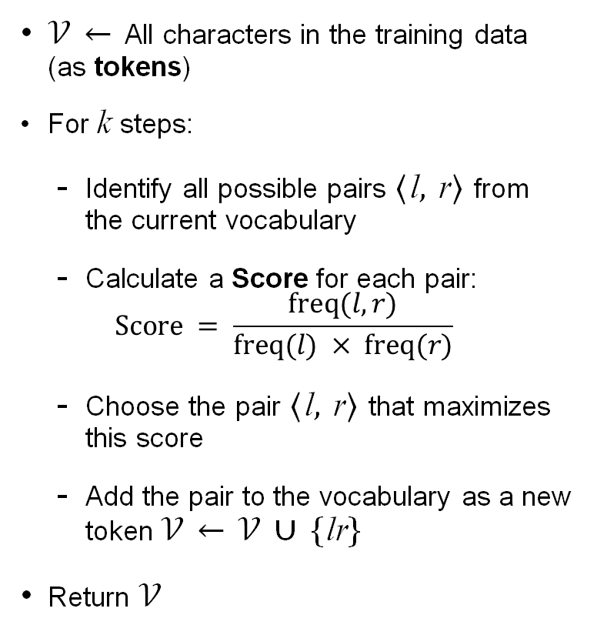
Wordpiece
𝒱 ← All characters in the training data (as tokens)
For k steps:
Identify all possible pairs ⟨l, r⟩ from the current vocabulary
Calculate a Score for each pair:
$$Score = \frac{freq(l,r)}{freq(l) × freq(r)}$$
Choose the pair ⟨l, r⟩ that maximizes this score
Add the pair to the vocabulary as a new token 𝒱 ← 𝒱 ∪ {lr}
Return 𝒱
After further merges:
𝒱 = {b, h, p, ##g, ##n, ##s, ##u,
##gs, pu, hug, ##ug, pun, bun, hugs}
Final tokenizations:
hug → [hug]
hugs → [hugs]
pug → [pu, ##g]
pun → [pun]
bun → [bun]
-
Example from: https://huggingface.co/docs/transformers/tokenizer_summary

Slide 32
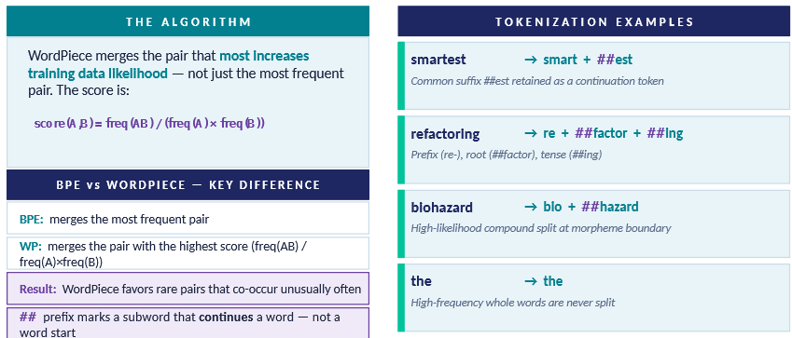
How WordPiece Handles Unseen Words
WordPiece (as in BERT) favors linguistically meaningful splits by scoring on co-occurrence likelihood, not raw frequency.

Slide 33
Resources
Hugging Face: https://huggingface.co/
Documentation at https://huggingface.co/docs
Courses at https://huggingface.co/learn
Language Model Tokenizer: https://platform.openai.com/tokenizer
Tokenizer Playground: https://huggingface.co/spaces/Xenova/the-tokenizer-playground

