Slide 1




CEFE SOCIAL NETWORKS COURSE
Matthew Silk
Matthew.Silk@ed.ac.uk

Slide 2

BEGINNER SOCIAL NETWORKS COURSE
Plan for the next two weeks:
SESSION 1 – What is a network?
SESSION 2 - How do we describe network structures?
SESSION 3 - How do we test hypotheses in networks?
Course materials:
https://github.com/NETDEM-project/CEFE_Networks_Course

Slide 3
Plan for today:
What is a network?
What do network datasets look like?
Network basics in R
Weighted and dynamic networks

Slide 4

What is a network?
Networks represent interactions and consist of:
Nodes/vertices/actors
connected by
Links/edges

Slide 5
What is a network?
Networks represent interactions and consist of:
Nodes/vertices/actors
connected by
Links/edges

Slide 6




What is a network?
Nodes
Networks represent interactions and consist of:
Nodes/vertices/actors
connected by
Links/edges

Slide 7





What is a network?
Nodes
Networks represent interactions and consist of:
Nodes/vertices/actors
connected by
Links/edges
Edges

Slide 8
What is a network?

Slide 9
CEFE SOCIAL NETWORKS COURSE
What is a network?
Networks help link individual behaviours to population patterns

Slide 10
CEFE SOCIAL NETWORKS COURSE
What do network datasets look like?
a) An ADJACENCY MATRIX
 | 1 | 2 | 3 | 4 | 5 | 6 | 7 | 8
1 | 0 | 1 | 1 | 0 | 0 | 1 | 0 | 0
2 | 1 | 0 | 0 | 1 | 0 | 0 | 0 | 0
3 | 1 | 0 | 0 | 1 | 1 | 0 | 0 | 0
4 | 0 | 1 | 1 | 0 | 0 | 0 | 0 | 0
5 | 0 | 0 | 1 | 0 | 0 | 1 | 1 | 0
6 | 1 | 0 | 0 | 0 | 1 | 0 | 1 | 0
7 | 0 | 0 | 0 | 0 | 1 | 1 | 0 | 1
8 | 0 | 0 | 0 | 0 | 0 | 0 | 1 | 0
1
2
3
4
5
6
7
8

Slide 11
CEFE SOCIAL NETWORKS COURSE
What do network datasets look like?
b) An EDGE LIST
ID 1 | ID 2
1 | 2
1 | 3
1 | 6
2 | 4
3 | 4
3 | 5
5 | 6
5 | 7
6 | 7
7 | 8
1
2
3
4
5
6
7
8

Slide 12
CEFE SOCIAL NETWORKS COURSE
What do network datasets look like?
b) An EDGE LIST
ID 1 | ID 2 | Attribute
1 | 2
1 | 3
1 | 6
2 | 4
3 | 4
3 | 5
5 | 6
5 | 7
6 | 7
7 | 8
1
2
3
4
5
6
7
8

Slide 13
CEFE SOCIAL NETWORKS COURSE
What do network datasets look like?
b) An INCIDENCE MATRIX or GROUP-BY-INDIVIDUAL MATRIX
Groups
1
2
3
4
5
6
7
8
9
10
Individuals | 2 | 3 | 4 | 5 | 6 | 7 | 8
1 | 2 | 3 | 4 | 5 | 6 | 7 | 8
1 | 1 | 0 | 0 | 0 | 0 | 0 | 0
1 | 0 | 1 | 0 | 0 | 0 | 0 | 0
1 | 0 | 0 | 0 | 0 | 1 | 0 | 0
0 | 1 | 0 | 1 | 0 | 0 | 0 | 0
0 | 0 | 1 | 1 | 0 | 0 | 0 | 0
0 | 0 | 1 | 0 | 1 | 0 | 0 | 0
0 | 0 | 0 | 0 | 1 | 1 | 0 | 0
0 | 0 | 0 | 0 | 1 | 0 | 1 | 0
0 | 0 | 0 | 0 | 0 | 1 | 1 | 0
0 | 0 | 0 | 0 | 0 | 0 | 1 | 1
1
2
3
4
5
6
7
8

Slide 14
Network basics in R
Now head to the R Markdown for Session 1 and work through the section SESSION 1: PART 3

Slide 15
Different network representations
We have started with the most simple way to think about animal social networks – recording simply whether two individuals share a social connection or not.
BUT
The social lives of animals are much more complex than this, so in the next section we are going to go through different ways to include extra information in our social network representations.

Slide 16
Different network representations
We have started with the most simple way to think about animal social networks – recording simply whether two individuals share a social connection or not.
BUT
The social lives of animals are much more complex than this, so in the next section we are going to go through different ways to include extra information in our social network representations.
We will start with types of static representation that ignore how interactions might change over time to account for:
The frequency and duration of interactions (weighted networks and multigraphs)
Who interacted with whom (directed networks)

Slide 17
Different network representations
We have started with the most simple way to think about animal social networks – recording simply whether two individuals share a social connection or not.
BUT
The social lives of animals are much more complex than this, so in the next section we are going to go through different ways to include extra information in our social network representations.
We will start with types of static representation that ignore how interactions might change over time to account for:
The frequency and duration of interactions (weighted networks and multigraphs)
Who interacted with whom (directed networks)
We will then finish by thinking about dynamic representations that include information about temporal changes to interaction patterns

Slide 18
Static network representations
Weighted networks are commonly used to study animal social networks
Also provide information on the strength of social connections
ID 1 | ID 2 | Attribute
1 | 2 | 3
1 | 3 | 1
1 | 6 | 1
2 | 4 | 1
3 | 4 | 1
3 | 5 | 1
5 | 6 | 2
5 | 7 | 2
6 | 7 | 2
7 | 8 | 1
 | 1 | 2 | 3 | 4 | 5 | 6 | 7 | 8
1 | 0 | 3 | 1 | 0 | 0 | 1 | 0 | 0
2 | 3 | 0 | 0 | 1 | 0 | 0 | 0 | 0
3 | 1 | 0 | 0 | 1 | 1 | 0 | 0 | 0
4 | 0 | 1 | 1 | 0 | 0 | 0 | 0 | 0
5 | 0 | 0 | 1 | 0 | 0 | 2 | 2 | 0
6 | 1 | 0 | 0 | 0 | 2 | 0 | 2 | 0
7 | 0 | 0 | 0 | 0 | 2 | 2 | 0 | 1
8 | 0 | 0 | 0 | 0 | 0 | 0 | 1 | 0
1
2
3
4
5
6
7
8

Slide 19
Static network representations
There are lots of different ways to weight social network edges
Counts of associations/interactions

Slide 20
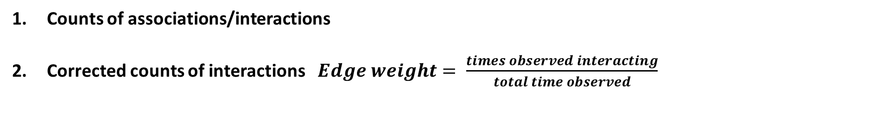
Static network representations
There are lots of different ways to weight social network edges
Counts of associations/interactions
Corrected counts of interactions $Edge weight= \frac{times observed interacting}{total time observed}$

Slide 21
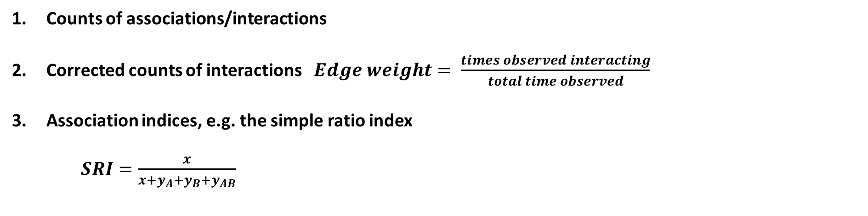
Static network representations
There are lots of different ways to weight social network edges
Counts of associations/interactions
Corrected counts of interactions $Edge weight= \frac{times observed interacting}{total time observed}$
Association indices, e.g. the simple ratio index
$SRI=\frac{x}{x+y_{A}+y_{B}+y_{AB}}$
Lots of variations which are described here: https://doi.org/10.1016/j.anbehav.2017.08.029
Number of times A and B observed together
Number of times just A observed
Number of times just B observed
Number of times A and B observed separately

Slide 22
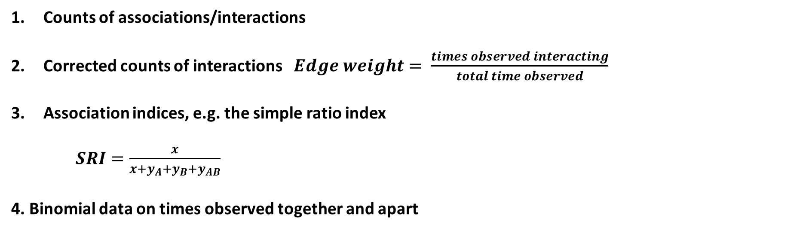
Static network representations
There are lots of different ways to weight social network edges
Counts of associations/interactions
Corrected counts of interactions $Edge weight= \frac{times observed interacting}{total time observed}$
Association indices, e.g. the simple ratio index
$SRI=\frac{x}{x+y_{A}+y_{B}+y_{AB}}$
4. Binomial data on times observed together and apart
Lots of variations which are described here: https://doi.org/10.1016/j.anbehav.2017.08.029
Good description of why this is a good method: https://doi.org/10.1101/2021.12.20.473541

Slide 23
CEFE SOCIAL NETWORKS COURSE
Static network representations
An alternative to using weighted networks is to use multigraphs
Sometimes the number of strength of interactions/associations provide different information
ID 1 | ID 2 | Attribute
1 | 2 | 3
1 | 3 | 1
1 | 6 | 1
2 | 4 | 1
3 | 4 | 1
3 | 5 | 1
5 | 6 | 2
5 | 7 | 2
6 | 7 | 2
7 | 8 | 1
 | 1 | 2 | 3 | 4 | 5 | 6 | 7 | 8
1 | 0 | 3 | 1 | 0 | 0 | 1 | 0 | 0
2 | 3 | 0 | 0 | 1 | 0 | 0 | 0 | 0
3 | 1 | 0 | 0 | 1 | 1 | 0 | 0 | 0
4 | 0 | 1 | 1 | 0 | 0 | 0 | 0 | 0
5 | 0 | 0 | 1 | 0 | 0 | 2 | 2 | 0
6 | 1 | 0 | 0 | 0 | 2 | 0 | 2 | 0
7 | 0 | 0 | 0 | 0 | 2 | 2 | 0 | 1
8 | 0 | 0 | 0 | 0 | 0 | 0 | 1 | 0
1
2
3
4
5
6
7
8

Slide 24
Static network representations
So when might you want to use weighted networks versus multigraphs?
The distinction between weighted networks and multigraphs is most useful when both their number/frequency and duration are important.
Considering multigraphs can also be helpful when designing permutation procedures for analysing the networks.

Slide 25
Static network representations
You can also create directed networks
ID 1 | ID 2 | Attribute
1 | 2 | 3
1 | 3 | 1
2 | 4 | 1
3 | 5 | 1
4 | 3 | 1
5 | 7 | 2
6 | 1 | 1
6 | 5 | 2
6 | 7 | 2
7 | 8 | 1
 | 1 | 2 | 3 | 4 | 5 | 6 | 7 | 8
1 | 0 | 3 | 0 | 0 | 0 | 0 | 0 | 0
2 | 0 | 0 | 0 | 1 | 0 | 0 | 0 | 0
3 | 1 | 0 | 0 | 0 | 1 | 0 | 0 | 0
4 | 0 | 0 | 1 | 0 | 0 | 0 | 0 | 0
5 | 0 | 0 | 0 | 0 | 0 | 0 | 2 | 0
6 | 1 | 0 | 0 | 0 | 2 | 0 | 2 | 0
7 | 0 | 0 | 0 | 0 | 0 | 0 | 0 | 1
8 | 0 | 0 | 0 | 0 | 0 | 0 | 0 | 0
1
2
3
4
5
6
7
8

Slide 26
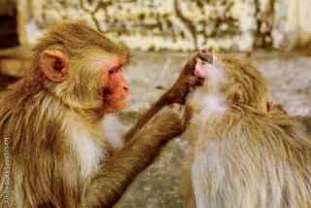
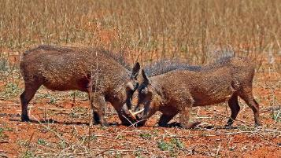
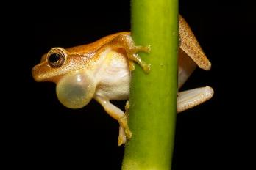
Static network representations
You can also create directed networks
1
2
3
4
5
6
7
8

Slide 27
Dynamic network representations
We may also need to represent the temporal dynamics of networks
All network data starts with a temporal component
Most efficiently stored as edge lists
We have to decide:
If it is important to include?
How to include it?
ID 1 | ID 2 | Weight | Time
1 | 2 | 3 | 01/01/2023 07:45
1 | 3 | 1 | 01/01/2023 07:49
1 | 6 | 1 | 03/01/2023 10:18
2 | 4 | 1 | 01/01/2023 07:59
3 | 4 | 1 | 01/01/2023 11:47
3 | 5 | 1 | 02/01/2023 15:32
5 | 6 | 2 | 02/01/2023 09:46
5 | 7 | 2 | 02/01/2023 16:02
6 | 7 | 2 | 01/01/2023 08:30
7 | 8 | 1 | 04/01/2023 12:35

Slide 28
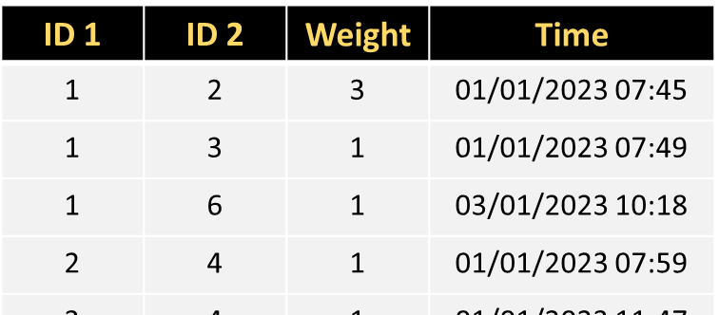
Dynamic network representations
We may also need to represent the temporal dynamics of networks
We have to decide:
2) How to include it?
TIME-ORDERED NETWORKS
TIME-AGGREGATED NETWORKS
t=1
t=2
t=3

Slide 29
Dynamic network representations
We may also need to represent the temporal dynamics of networks
TIME-ORDERED NETWORKS
Retain the most information about the system
Fewer subjective decisions required
Harder to work with – few descriptive measures and models are available

Slide 30
Dynamic network representations
We may also need to represent the temporal dynamics of networks
Adopts same data structures and models as static networks
More statistical tools available
Need to decide how to aggregate the social data
Snapshots (single moment in time)
Aggregate over biologically justified timescales
Rolling windows (e.g. months 1-3, months 2-4 etc.)
TIME-AGGREGATED NETWORKS
t=1
t=2
t=3

Slide 31
Different network representations
1. Go to the R Markdown for Session 1 and work through the section SESSION 1: PART 6

Slide 32
Plan for the next two weeks:
SESSION 1 – What is a network?
SESSION 2 - How do we describe network structures?
SESSION 3 - How do we test hypotheses in networks?
Course materials:
https://github.com/NETDEM-project/CEFE_Networks_Course

Slide 33
Plan for today:
The basics of network structure
Describing node-level or microscale structure of networks
Describing mesoscale structure of networks
Describing macroscale structure of networks

Slide 34
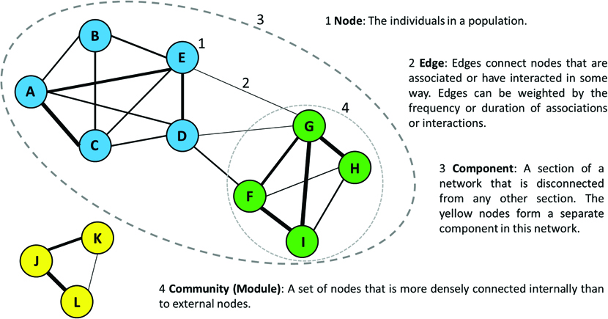
The basics of network structure

Slide 35
2. Describing microscale structure of networks
We can use network measures of network metrics to quantify an individual’s social network position. These measures are mainly:
CENTRALITY measures that capture how “central” or influential an individual is in the network.
However, there are other measures that capture other aspects of an individual’s social network position such as:
CLUSTERING COEFFICIENT
EDGE WEIGHT VARIANCE

Slide 36
2. Describing microscale structure of networks
There are MANY CENTRALITY measures
We will introduce some here but it is not an exhaustive list
DEGREE is the number of connections a node has
igraph::degree(network)
Degree can be standardized by dividing by the number of nodes minus one

Slide 37
2. Describing microscale structure of networks
There are MANY CENTRALITY measures
We will introduce some here but it is not an exhaustive list
DEGREE is the number of connections a node has
igraph::degree(network)
STRENGTH (WEIGHTED DEGREE) takes into account the weight of each edge
igraph::strength(network)

Slide 38
2. Describing microscale structure of networks
There are MANY CENTRALITY measures
We will introduce some here but it is not an exhaustive list
DEGREE is the number of connections a node has
STRENGTH (WEIGHTED DEGREE) takes into account the weight of each edge
Degree and strength are LOCAL measures of centrality that take into account only immediate neighbours

Slide 39
2. Describing microscale structure of networks
There are MANY CENTRALITY measures
We will introduce some here but it is not an exhaustive list
DEGREE is the number of connections a node has
STRENGTH (WEIGHTED DEGREE) takes into account the weight of each edge
Degree and strength are LOCAL measures of centrality that take into account only immediate neighbours
In directed networks you can calculate separate “in-” and “out-” versions of the measures

Slide 40
2. Describing microscale structure of networks
There are MANY CENTRALITY measures
We will introduce some here but it is not an exhaustive list
EIGENVECTOR CENTRALITY
igraph::eigen_centrality(network)
Eigenvector centrality take into account a wider neighbourhood when measuring an individual’s centrality

Slide 41
2. Describing microscale structure of networks
There are MANY CENTRALITY measures
We will introduce some here but it is not an exhaustive list
EIGENVECTOR CENTRALITY
igraph::eigen_centrality(network)
Eigenvector centrality take into account a wider neighbourhood when measuring an individual’s centrality
There are additional, slightly modified variations of eigenvector centrality
igraph::page_rank(network)

Slide 42
2. Describing microscale structure of networks
There are MANY CENTRALITY measures
We will introduce some here but it is not an exhaustive list
BETWEENNESS measures how many shortest paths an individual lies on
igraph::betweenness(network)
High
Medium
Low

Slide 43
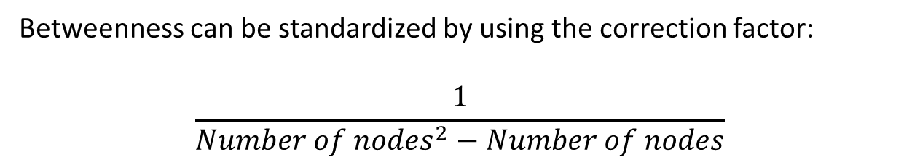
2. Describing microscale structure of networks
Edges can have betweenness centrality scores too!
There are MANY CENTRALITY measures
We will introduce some here but it is not an exhaustive list
BETWEENNESS measures how many shortest paths an individual lies on
igraph::betweenness(network)
Betweenness can be standardized by using the correction factor:
$$\frac{1}{{Number of nodes}^{2}−Number of nodes}$$
High
Medium
Low

Slide 44
2. Describing microscale structure of networks
There are MANY CENTRALITY measures
We will introduce some here but it is not an exhaustive list
BETWEENNESS measures how many shortest paths an individual lies on
CLOSENESS measures who has the shortest paths on average to other nodes
High
Medium
Low
igraph::closeness(network)

Slide 45
2. Describing microscale structure of networks
There are MANY CENTRALITY measures
We will introduce some here but it is not an exhaustive list
BETWEENNESS measures how many shortest paths an individual lies on
CLOSENESS measures who has the shortest paths on average to other nodes
High
Medium
Low
Betweenness and closeness are GLOBAL measures of centrality that take into account only immediate neighbours

Slide 46
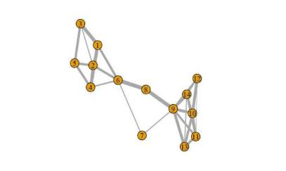
2. Describing microscale structure of networks
An important note on calculating betweenness and closeness in igraph
https://twitter.com/mattjsilk/status/997029135548669957
By default in shortest paths calculations igraph treats edge weights as costs
This is not a sensible option for most social networks
So we MUST manually specify edge weights in the calculation or use tnet (where this is done automatically)
7
8

Slide 47
2. Describing microscale structure of networks
There are MANY CENTRALITY measures
We will introduce some here but it is not an exhaustive list
BETWEENNESS measures how many shortest paths an individual lies on
CLOSENESS measures who has the shortest paths on average to other nodes
High
Medium
Low
FLOW BETWEENNESS is an alternative global measure that quantifies “information flow” through a node
sna::flowbet(adjacency_matrix)

Slide 48
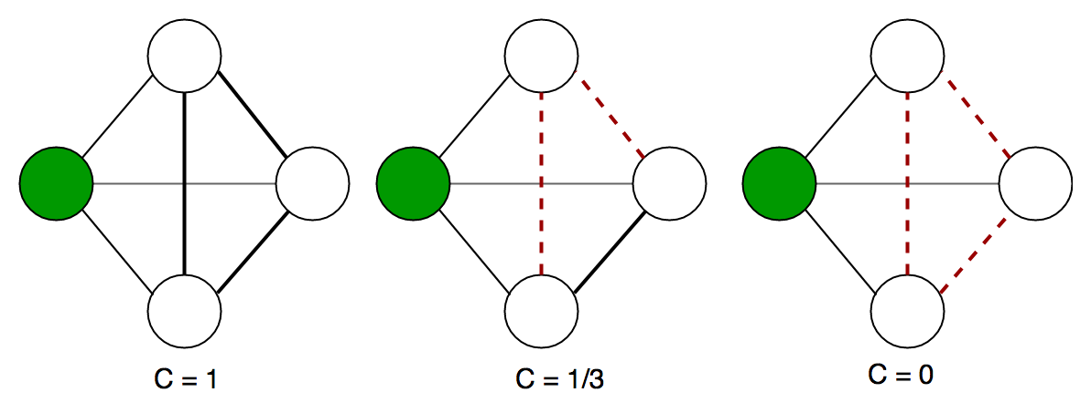
2. Describing microscale structure of networks
A quick overview of the other measures…
CLUSTERING COEFFICIENT measures if a focal node’s connections also tend to be connected with each other

Slide 49
2. Describing microscale structure of networks
A quick overview of the other measures…
CLUSTERING COEFFICIENT measures if a focal node’s connections also tend to be connected with each other
EDGE WEIGHT VARIANCE measures how differentiated an individual’s social connections are

Slide 50
2. Describing microscale structure of networks
A quick overview of the other measures…
CLUSTERING COEFFICIENT measures if a focal node’s connections also tend to be connected with each other
EDGE WEIGHT VARIANCE measures how differentiated an individual’s social connections are
These measures can tell us about how socially embedded an individual is, which may be important in assessing social integration in a group

Slide 51
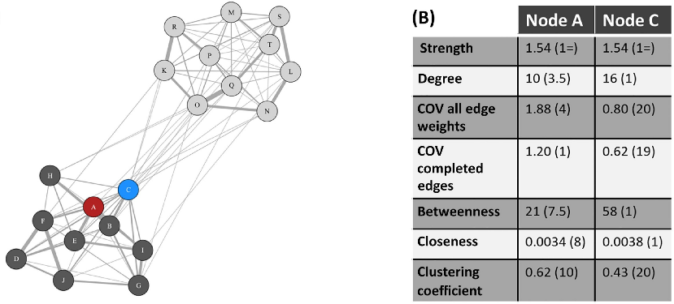
2. Describing microscale structure of networks
Using multiple social network measures can tell us more about an individual’s social network position than just picking one

Slide 52
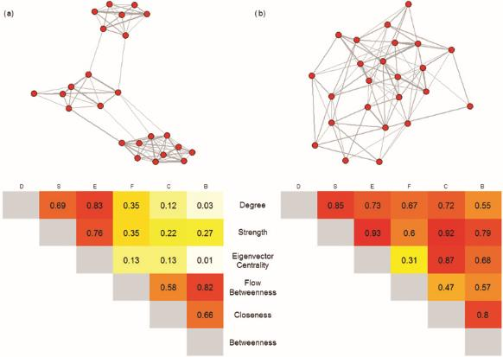
2. Describing microscale structure of networks
Using multiple social network measures can tell us more about an individual’s social network position than just picking one
BUT the correlation between different centrality measures can depend on the network structure

Slide 53
2. Describing microscale structure of networks
1. Go to the R Markdown for Session 2 and work through the section SESSION 2: PART 2

Slide 54
3. Describing mesoscale structure of networks
It might also be important to identify the structure of neighbourhoods within networks as they could have important ecological and evolutionary consequences
We are going to focus on Community Structure which is known to be important in animal networks

Slide 55
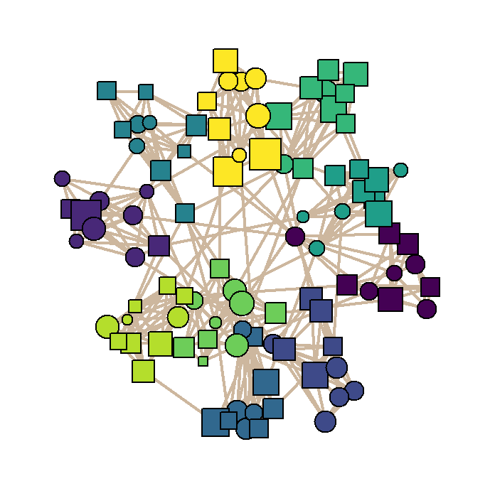
3. Describing mesoscale structure of networks
COMMUNITY STRUCTURE
Some networks are divided into groups which have more edges within clusters than between them.
These are called modules or communities
Community structure can be important for ecological processes such as disease transmission

Slide 56
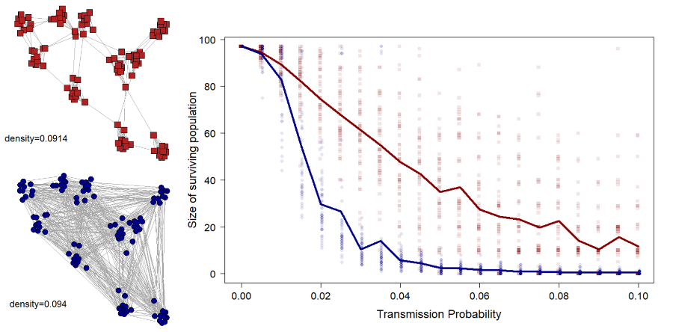
3. Describing mesoscale structure of networks
COMMUNITY STRUCTURE

Slide 57
3. Describing mesoscale structure of networks
COMMUNITY STRUCTURE
There are two routes to finding community structure:
Community detection algorithms
Statistical models called stochastic block models
We will introduce community detection algorithms here as a descriptive tool but be warned that they need to be used carefully; using statistical models is better for formal analysis of communities
https://skewed.de/tiago/blog/descriptive-inferential

Slide 58
3. Describing mesoscale structure of networks
COMMUNITY STRUCTURE
There are two routes to finding community structure:
Community detection algorithms
There are MANY community detection algorithms:
https://igraph.org/c/doc/igraph-Community.html
They won’t always give the same results
It can be difficult to decide which is best – read the help pages carefully for clues

Slide 59
3. Describing mesoscale structure of networks
COMMUNITY STRUCTURE
There are two routes to finding community structure:
Community detection algorithms
There are MANY community detection algorithms:
https://igraph.org/c/doc/igraph-Community.html
They won’t always give the same results
It can be difficult to decide which is best – read the help pages carefully for clues
The infomap algorithm is often a good place to start

Slide 60
3. Describing mesoscale structure of networks
COMMUNITY STRUCTURE
There are two routes to finding community structure:
Community detection algorithms
Most community detection methods maximise MODULARITY
Modularity is a measure of the strength of division of a network into the assigned groups
High modularity indicates many more connections within groups than expected by chance

Slide 61
4. Describing macroscale structure of networks
There are also a wide range of measures to describe the structure of the network as a whole.
I will provide an overview of the most commonly used and/or useful here

Slide 62
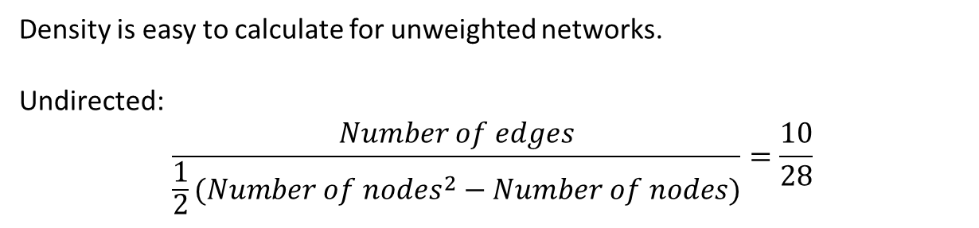
4. Describing macroscale structure of networks
There are also a wide range of measures to describe the structure of the network as a whole.
I will provide an overview of the most commonly used and/or useful here
DENSITY (sometimes called connectance for ecological networks) is the proportion of possible edges that are connected
Density is easy to calculate for unweighted networks.
Undirected:
$$\frac{Number of edges}{{\frac{1}{2}(Number of nodes}^{2}−Number of nodes)}=\frac{10}{28}$$

Slide 63
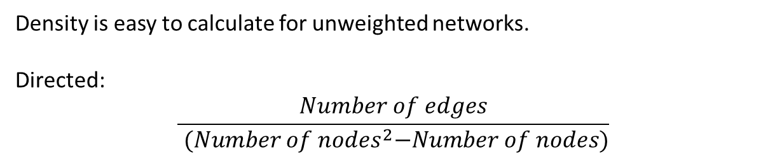
4. Describing macroscale structure of networks
There are also a wide range of measures to describe the structure of the network as a whole.
I will provide an overview of the most commonly used and/or useful here
DENSITY (sometimes called connectance for ecological networks) is the proportion of possible edges that are connected
Density is easy to calculate for unweighted networks.
Directed:
$$\frac{Number of edges}{{ (Number of nodes}^{2}−Number of nodes)}$$

Slide 64
4. Describing macroscale structure of networks
There are also a wide range of measures to describe the structure of the network as a whole.
I will provide an overview of the most commonly used and/or useful here
DENSITY (sometimes called connectance for ecological networks) is the proportion of possible edges that are connected
Density is easy to calculate in igraph
igraph::edge_density(network)

Slide 65
4. Describing macroscale structure of networks
There are also a wide range of measures to describe the structure of the network as a whole.
I will provide an overview of the most commonly used and/or useful here
DENSITY (sometimes called connectance for ecological networks) is the proportion of possible edges that are connected
Networks with high density are more efficient – better at spreading information but more susceptible to disease outbreaks

Slide 66
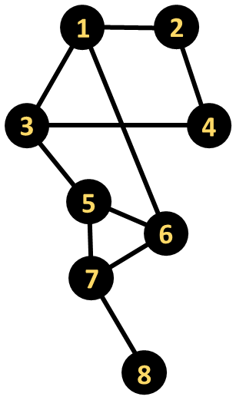
4. Describing macroscale structure of networks
There are also a wide range of measures to describe the structure of the network as a whole.
I will provide an overview of the most commonly used and/or useful here
AVERAGE PATH LENGTH is the average shortest route (in terms of number of edges traversed) between all possible pairs of nodes in the network
1—2: path length = 1
1—3: path length = 1
1—4: path length = 2
1—5: path length = 2
1—6: path length = 1
1—7: path length = 2
1—8: path length = 3
You can calculate average path length in igraph
igraph::mean_distance(network)

Slide 67
4. Describing macroscale structure of networks
There are also a wide range of measures to describe the structure of the network as a whole.
I will provide an overview of the most commonly used and/or useful here
AVERAGE PATH LENGTH is the average shortest route (in terms of number of edges traversed) between all possible pairs of nodes in the network
1—2: path length = 1
1—3: path length = 1
1—4: path length = 2
1—5: path length = 2
1—6: path length = 1
1—7: path length = 2
1—8: path length = 3
You can calculate average path length in igraph
igraph::mean_distance(network)
BUT in weighted networks you have to remember to convert edge weights again so that the weights are not treated as costs

Slide 68
4. Describing macroscale structure of networks
There are also a wide range of measures to describe the structure of the network as a whole.
I will provide an overview of the most commonly used and/or useful here
GLOBAL EFFICIENCY is the average of inverse distances between all pairs of nodes.
1—2: inverse path length = 1
1—3: inverse path length = 1
1—4: inverse path length = 1/2
1—5: inverse path length = 1/2
1—6: inverse path length = 1
1—7: inverse path length = 1/2
1—8: inverse path length = 1/3
You can calculate efficiency length in igraph
igraph::global_efficiency(network)
BUT in weighted networks you have to remember to convert edge weights again so that the weights are not treated as costs

Slide 69
4. Describing macroscale structure of networks
There are also a wide range of measures to describe the structure of the network as a whole.
I will provide an overview of the most commonly used and/or useful here
GLOBAL EFFICIENCY is the average of inverse distances between all pairs of nodes.
1—2: inverse path length = 1
1—3: inverse path length = 1
1—4: inverse path length = 1/2
1—5: inverse path length = 1/2
1—6: inverse path length = 1
1—7: inverse path length = 1/2
1—8: inverse path length = 1/3
You can calculate efficiency length in igraph
igraph::global_efficiency(network)
Efficiency can be useful in understanding transmission speeds through social networks

Slide 70
4. Describing macroscale structure of networks
There are also a wide range of measures to describe the structure of the network as a whole.
I will provide an overview of the most commonly used and/or useful here
NODE-LEVEL METRIC DISTRIBUTIONS can also provide useful information about the network
Mean values
Coefficient of variation
Full metric distributions
For example, the degree distribution of a network is a key part of calculating the R₀ of a pathogen spreading across it

Slide 71
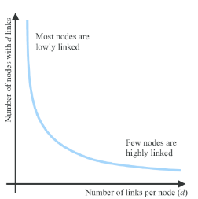
4. Describing macroscale structure of networks
There are also a wide range of measures to describe the structure of the network as a whole.
I will provide an overview of the most commonly used and/or useful here
NODE-LEVEL METRIC DISTRIBUTIONS can also provide useful information about the network
The degree distribution can be calculated in igraph using
igraph::degree_distribution(network)
A power law degree distribution is a feature of some social networks that are highly centralized

Slide 72
4. Describing macroscale structure of networks
Go to the R Markdown for Session 2 and work through the section SESSION 2: PARTS 3 & 4

Slide 73
Plan for the next two weeks:
SESSION 1 – What is a network?
SESSION 2 - How do we describe network structures?
SESSION 3 - How do we test hypotheses in networks?
Course materials:
https://github.com/NETDEM-project/CEFE_Networks_Course

Slide 74
Plan for today:
The challenges of social network analysis
Nodal regressions: using network measures to explain other traits
Nodal regressions: asking what explains network position
Dyadic regressions

Slide 75
The challenges of social network analysis
There are various challenges that can make statistical modelling of networks complicated
Non-independence
    Non-independence among the network position of different individuals

Slide 76
The challenges of social network analysis
There are various challenges that can make statistical modelling of networks complicated
Non-independence
    Non-independence among the network position of different individuals
    Non-independence among edges (or social relationships)

Slide 77
The challenges of social network analysis
There are various challenges that can make statistical modelling of networks complicated
Non-independence
    Non-independence among the network position of different individuals
    Non-independence among edges (or social relationships)
Covariance among network neighbours

Slide 78
The challenges of social network analysis
There are various challenges that can make statistical modelling of networks complicated
Non-independence
    Non-independence among the network position of different individuals
    Non-independence among edges (or social relationships)
Covariance among network neighbours
Sensitivity to missing data

Slide 79
The challenges of social network analysis
What happens if I remove some individuals from this network?
- The centrality of different individuals changes (especially for global centrality measures)
- Centrality measures are now less accurate

Slide 80
The challenges of social network analysis
What happens if I remove some individuals from this network?
- The centrality of different individuals changes (especially for global centrality measures)
- Centrality measures are now less accurate
What happens if a new edge forms in the network?
- Are closely connected nodes also likely to form new social connections?

Slide 81
The challenges of social network analysis
How do network neighbours affect each others trait values?

Slide 82
The challenges of social network analysis
How do network neighbours affect each others trait values?
- Positive covariance (e.g. group traits, affiliative interactions)

Slide 83
The challenges of social network analysis
How do network neighbours affect each others trait values?
- Positive covariance (e.g. group traits, affiliative interactions)
- Negative covariance (e.g. dominance)

Slide 84
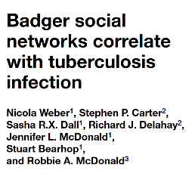

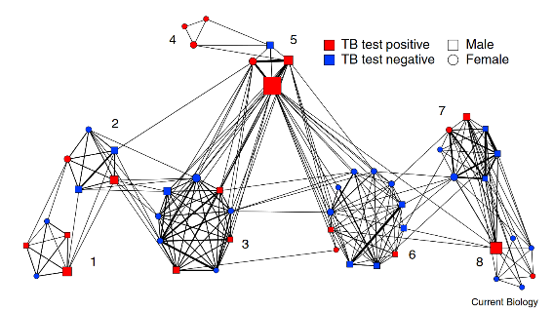
2. Nodal regressions: using network measures to explain other traits
I might want to test a hypothesis in which individual traits are explained by network position

Slide 85
2. Nodal regressions: using network measures to explain other traits
I might want to test a hypothesis in which individual traits are explained by network position
Body Condition ~ Clustering Coefficient + Closeness

Slide 86
2. Nodal regressions: using network measures to explain other traits
I might want to test a hypothesis in which individual traits are explained by network position
Body Condition ~ Clustering Coefficient + Closeness
Individuals that are more socially integrated (have more friends which share friends) can spend more time feeding and so are in better body condition
Individuals with higher closeness have more access to social information on the best foraging areas and so are in better body condition

Slide 87
2. Nodal regressions: using network measures to explain other traits
I might want to test a hypothesis in which individual traits are explained by network position
Body Condition ~ Clustering Coefficient + Closeness
Individuals that are more socially integrated (have more friends which share friends) can spend more time feeding and so are in better body condition
Individuals with higher closeness have more access to social information on the best foraging areas and so are in better body condition
The main potential issues to consider here are:
Sampling constraints
Covariance

Slide 88
2. Nodal regressions: using network measures to explain other traits
I might want to test a hypothesis in which individual traits are explained by network position
Sampling constraints
Using association indices or binomial edge weights
Body Condition ~ Clustering Coefficient + Closeness
The main potential issues to consider here are:
Sampling constraints
Covariance

Slide 89
2. Nodal regressions: using network measures to explain other traits
I might want to test a hypothesis in which individual traits are explained by network position
Sampling constraints
Using association indices or binomial edge weights
Controlling for numbers of observations or duration of time monitored
Body Condition ~ Clustering Coefficient + Closeness
The main potential issues to consider here are:
Sampling constraints
Covariance

Slide 90
2. Nodal regressions: using network measures to explain other traits
I might want to test a hypothesis in which individual traits are explained by network position
Sampling constraints
Using association indices or binomial edge weights
Controlling for numbers of observations or duration of time monitored
Propagating uncertainty in edge weights
Body Condition ~ Clustering Coefficient + Closeness
The main potential issues to consider here are:
Sampling constraints
Covariance

Slide 91
2. Nodal regressions: using network measures to explain other traits
I might want to test a hypothesis in which individual traits are explained by network position
Covariance
Network autocorrelation models (NAMs)
  User-specified dependencies among nodes
  Greater subjectivit
Body Condition ~ Clustering Coefficient + Closeness
The main potential issues to consider here are:
Sampling constraints
Covariance

Slide 92
2. Nodal regressions: using network measures to explain other traits
I might want to test a hypothesis in which individual traits are explained by network position
Covariance
Network autocorrelation models (NAMs)
  User-specified dependencies among nodes
  Greater subjectivity
Use network directly to model covariance structure
Body Condition ~ Clustering Coefficient + Closeness
The main potential issues to consider here are:
Sampling constraints
Covariance

Slide 93
2. Nodal regressions: using network measures to explain other traits
I might want to test a hypothesis in which individual traits are explained by network position
Go to the R Markdown for Session 3 and work through the section SESSION 3: PART 1

Slide 94
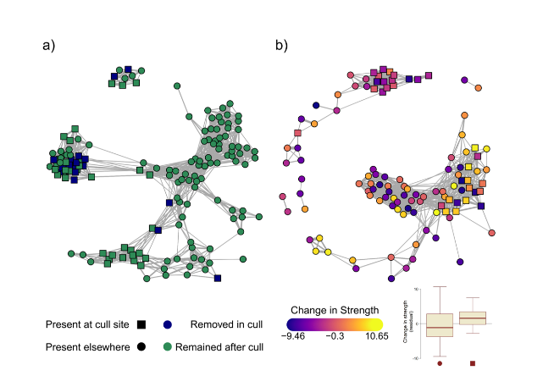
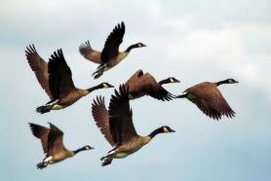

3. Nodal regressions: asking what explains network position
I might want to test a hypothesis in which network position is explained by individual traits

Slide 95
3. Nodal regressions: asking what explains network position
I might want to test a hypothesis in which network position is explained by individual traits
Betweenness ~ Sex * Body Size
Large males have higher betweenness in a group-living animal as they seek out-of-group mating opportunities and defend territory boundaries
The main potential issues to consider here are:
Sampling constraints
Non-independence

Slide 96
3. Nodal regressions: asking what explains network position
I might want to test a hypothesis in which network position is explained by individual traits
Sampling constraints
Using association indices or binomial edge weights
Controlling for numbers of observations or duration of time monitored
Propagating uncertainty in edge weights
Betweenness ~ Sex * Body Size
Large males have higher betweenness in a group-living animal as they seek out-of-group mating opportunities and defend territory boundaries
The main potential issues to consider here are:
Sampling constraints
Non-independence

Slide 97
3. Nodal regressions: asking what explains network position
I might want to test a hypothesis in which network position is explained by individual traits
Betweenness ~ Sex * Body Size
Non-independence
Get clever with random effects
  But you need to be careful!
Go Bayesian
  Bayesian inference is a little more robust to the problems caused
Use dyadic regressions instead
  Works indirectly and only for some social network measures
Large males have higher betweenness in a group-living animal as they seek out-of-group mating opportunities and defend territory boundaries
The main potential issues to consider here are:
Sampling constraints
Non-independence

Slide 98
4. Nodal regressions: asking what explains network position
I might want to test a hypothesis in which network position is explained by individual traits
Go to the R Markdown for Session 3 and work through the section SESSION 3: PART 2

Slide 99
4. Dyadic regressions
I might want to test hypotheses directly related to the edges in the network
e.g. Social network structure is associated with home range overlap
 | 1 | 2 | 3 | 4 | 5 | 6 | 7 | 8
1 | 0 | 5 | 4 | 1 | 2 | 4 | 3 | 1
2 | 5 | 0 | 3 | 5 | 2 | 1 | 2 | 1
3 | 4 | 3 | 0 | 4 | 4 | 4 | 3 | 1
4 | 1 | 5 | 4 | 0 | 2 | 1 | 1 | 2
5 | 2 | 2 | 4 | 2 | 0 | 3 | 5 | 2
6 | 4 | 1 | 4 | 1 | 3 | 0 | 3 | 2
7 | 3 | 2 | 3 | 1 | 5 | 3 | 0 | 4
8 | 1 | 1 | 1 | 2 | 2 | 2 | 4 | 0
~

Slide 100
4. Dyadic regressions
I might want to test hypotheses directly related to the edges in the network
e.g. Social network structure is associated with home range overlap
 | 1 | 2 | 3 | 4 | 5 | 6 | 7 | 8
1 | 0 | 5 | 4 | 1 | 2 | 4 | 3 | 1
2 | 5 | 0 | 3 | 5 | 2 | 1 | 2 | 1
3 | 4 | 3 | 0 | 4 | 4 | 4 | 3 | 1
4 | 1 | 5 | 4 | 0 | 2 | 1 | 1 | 2
5 | 2 | 2 | 4 | 2 | 0 | 3 | 5 | 2
6 | 4 | 1 | 4 | 1 | 3 | 0 | 3 | 2
7 | 3 | 2 | 3 | 1 | 5 | 3 | 0 | 4
8 | 1 | 1 | 1 | 2 | 2 | 2 | 4 | 0
Matrix regression is a simple tool when finding relationships with other networks or matrices
R package sna
Uses MRQAP to assess statistical significance (a permutation test)
~

Slide 101
4. Dyadic regressions
I might want to test hypotheses directly related to the edges in the network and node traits
e.g. Social network edges are more likely between individuals of the same sex and similar sizes
ID 1 | ID 2 | Weight | Sex | Size difference
1 | 2 | 3 | MM | 0.32
1 | 3 | 1 | MF | 0.47
1 | 6 | 1 | MF | 0.12
2 | 4 | 1 | MM | 0.05
3 | 4 | 1 | MF | 0.14
3 | 5 | 1 | FF | 0.20
5 | 6 | 2 | FF | 0.36
5 | 7 | 2 | FF | 0.11
6 | 7 | 2 | FF | 0.09
7 | 8 | 1 | MF | 0.02

Slide 102
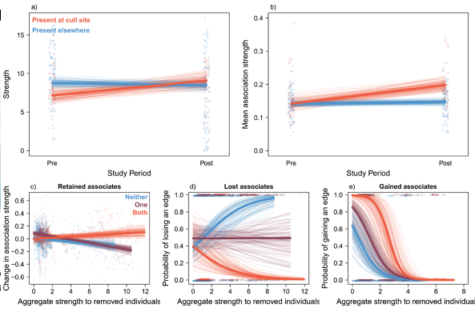
4. Dyadic regressions
I might want to test hypotheses directly related to the edges in the network and node traits

Slide 103
4. Dyadic regressions
I might want to test hypotheses directly related to the edges in the network and node traits
e.g. Social network edges are more likely between individuals of the same sex and similar sizes
Multiple-membership random effects can help control for non-independence in dyadic regressions
Possible using brms (more user friendly)
Or using other Bayesian modelling frameworks (INLA, Stan, Nimble etc.)
ID 1 | ID 2 | Weight | Sex | Size difference
1 | 2 | 3 | MM | 0.32
1 | 3 | 1 | MF | 0.47
1 | 6 | 1 | MF | 0.12
2 | 4 | 1 | MM | 0.05
3 | 4 | 1 | MF | 0.14
3 | 5 | 1 | FF | 0.20
5 | 6 | 2 | FF | 0.36
5 | 7 | 2 | FF | 0.11
6 | 7 | 2 | FF | 0.09
7 | 8 | 1 | MF | 0.02

Slide 104
4. Dyadic regressions
I might want to test hypotheses directly related to the edges in the network and node traits
Go to the R Markdown for Session 3 and work through the section SESSION 3: PART 5

