Slide 1


MyDancr for
26 locations
Public discovery and
in-club guest engagement
A proposal for your club group
01
Notes:
Introduction for a corporation operating 26 strip-club locations, as supplied by the user. No corporation name was supplied. MyDancr combines public discovery with venue-scoped in-club tools. All pricing, ROI, growth and rollout timing in this deck are proposals or explicitly labeled illustrations. The cover is previously generated conceptual lounge artwork, not a photograph of one of the prospective customer’s properties.
Sources reviewed October 2, 2026:
D:\Codex\MyDancr-clean-2026-09-11\output\presentations\assets\polished-deck\lounge-cover.png
D:\Codex\MyDancr-clean-2026-09-11\output\presentations\assets\polished-deck\cover-prompt.txt
D:\Codex\MyDancr-clean-2026-09-11\public\outputs\mydancr-logo-current.png
D:\Codex\MyDancr-clean-2026-09-11\docs\mydancr-internal-integration.md

Slide 2
One platform for your 26 locations
A consistent guest experience with a local identity at every club
26
Outside the club
Help guests discover clubs and dancers,
see who is working, and plan a visit.
locations
Inside the club
Let guests browse the active roster and
request a dancer through their table QR.
One rollout playbook
Local club ownership
Shared performance definitions
Internal and external access in every proposed tier
MYDANCR
02
Notes:
The two experiences use existing MyDancr capabilities. Both channels are included in the subscription proposal from the user’s discussion. Each dancer separately chooses Internal, External or Both at check-in, so subscription access does not override dancer consent. The group playbook and common reporting definitions are proposed implementation services. Do not imply an existing portfolio-wide login, multi-location switcher or automated corporate dashboard. Each venue retains its scoped team access.
Sources reviewed October 2, 2026:
D:\Codex\MyDancr-clean-2026-09-11\docs\mydancr-internal-integration.md
D:\Codex\MyDancr-clean-2026-09-11\src\lib\dancr\venue-access.ts
D:\Codex\MyDancr-clean-2026-09-11\docs\venue-onboarding.md

Slide 3
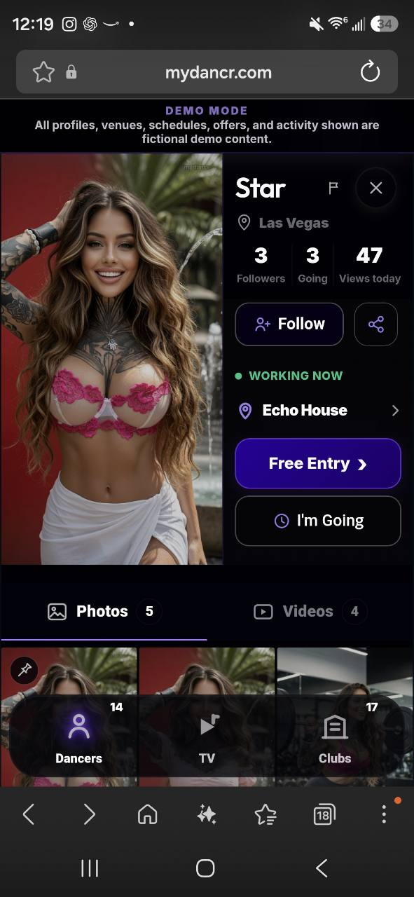
Discovery that supports a visit
Profiles and live club context give guests a clear next action
A live view of the floor
Club pages combine location, hours and
Working Now dancers with approved profiles.
Media that guests can share
Photos, videos and MyDancr TV help dancers
and clubs reach audiences beyond the venue.
A direct path to arrival
Guests can follow, get directions, signal
“I’m Going” and open available entry offers.
Existing demo interface
Fictional profile and activity
MYDANCR
03
Notes:
Screenshot supplied by the user, showing a fictional dancer profile. It is a demo interface reference rather than live customer results, and current styling may differ. Working Now derives from confirmed eligible club check-ins. Follow, Share, Directions, I’m Going, gallery and available Club Deal actions are existing product features. I’m Going records intent, not arrival. Media visibility and approval rules apply. Upcoming schedules are retired, so this deck does not advertise schedule posting. Club pickup and guest-list features are available where configured, but they are not required for this slide’s core claim.
Sources reviewed October 2, 2026:
D:\Codex\MyDancr-clean-2026-09-11\docs\working-now-club-participation.md
D:\Codex\MyDancr-clean-2026-09-11\src\live-shell\app\11-post-verified-shift.js
D:\Codex\MyDancr-clean-2026-09-11\src\live-shell\app\08-save-customer-deal-pass.js
D:\Codex\MyDancr-clean-2026-09-11\.codex-remote-attachments\01a0f678-59cd-7bf1-9af1-25d4f30ea736\89fbf673-75a8-4940-8cab-64c9abaf4bb7\1-24507.jpg

Slide 4
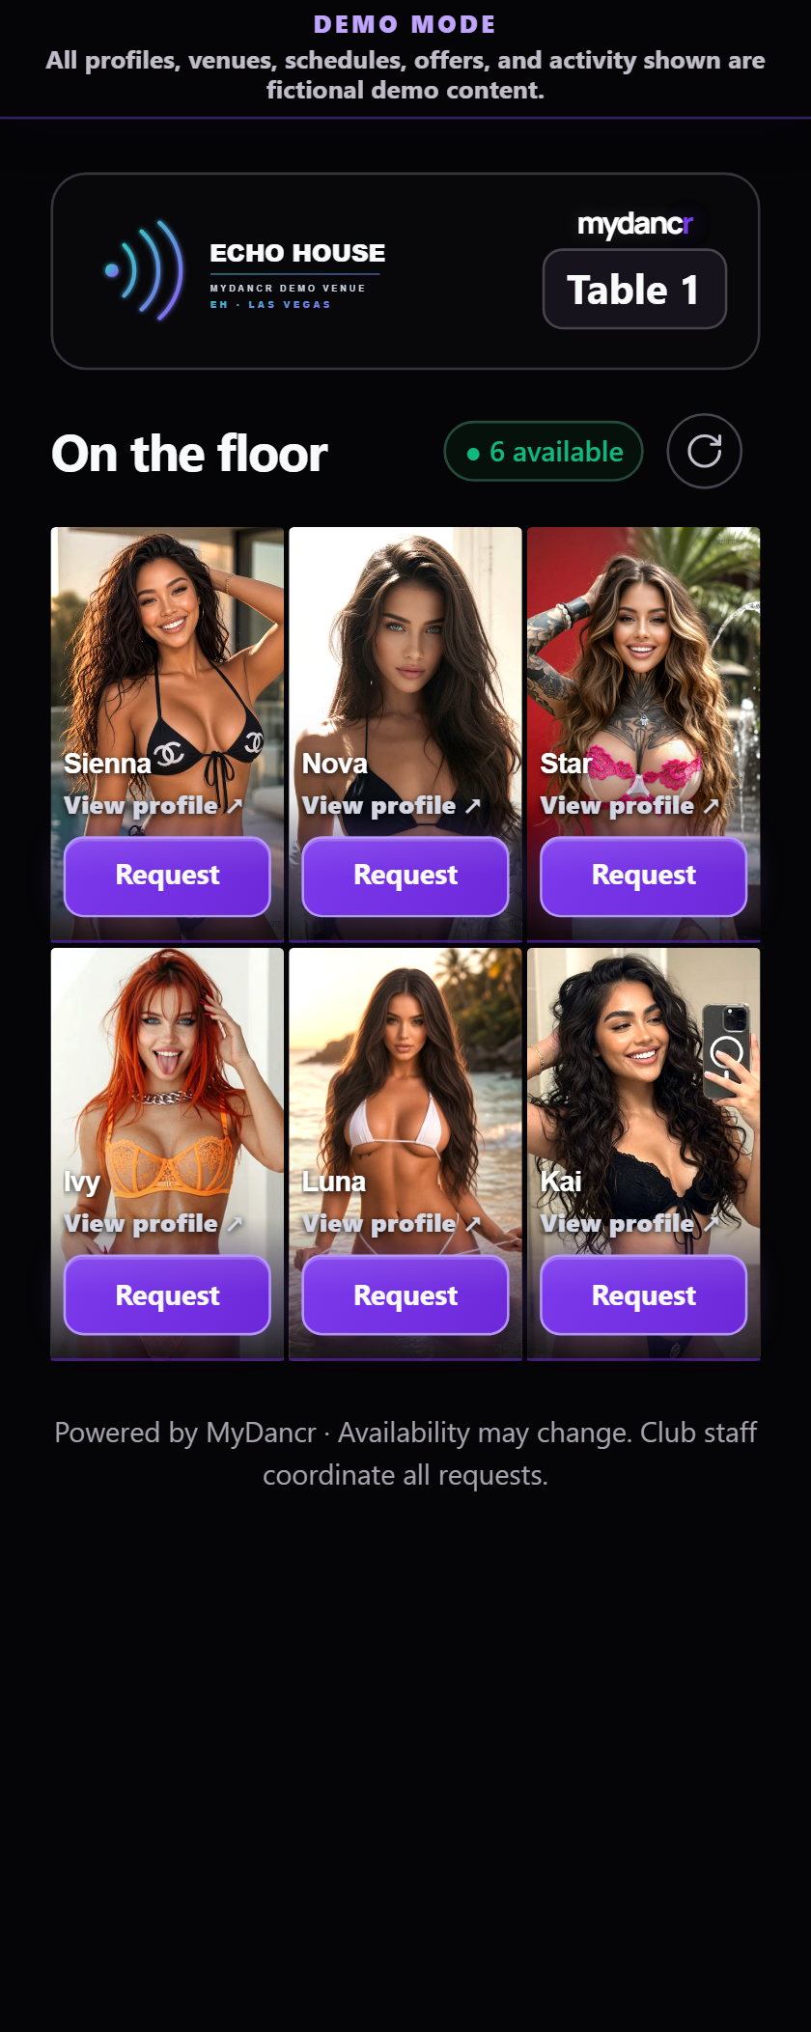
A table scan connects guests to the floor
Guests browse the roster. Your team coordinates the request.
01
Scan the table QR
Open that club’s roster on the guest’s phone.
02
Choose an available dancer
Browse approved photos and the full profile.
03
Send a table request
Staff see the table and dancer in their inbox.
04
Coordinate through your team
Enable phone alerts and track request status.
Existing fictional demo roster
Dancers choose Internal, External or Both at check-in.
MYDANCR
04
Notes:
The screenshot is an existing repository demo capture. Table links show active dancers who opted into Internal or Both. Guests can request from a roster or an authorized full profile. Acknowledgement means staff saw the request, not that the dancer accepted it. Club staff coordinate requests. Eligible owner, manager and staff devices can enable phone alerts subject to browser permission and device setup. Dancers retain control of visibility. NFC check-in and end-of-shift controls support current roster status. The proposed launch includes real-device operational acceptance with venue staff, not a promise that a scan guarantees presence, service or a completed sale.
Sources reviewed October 2, 2026:
D:\Codex\MyDancr-clean-2026-09-11\docs\mydancr-internal-integration.md
D:\Codex\MyDancr-clean-2026-09-11\docs\internal-table-request-push.md
D:\Codex\MyDancr-clean-2026-09-11\docs\working-now-club-participation.md
D:\Codex\MyDancr-clean-2026-09-11\.qa\internal-brightness\live-android-small.png

Slide 5
Analytics from discovery to admission
Existing venue reports make customer actions and their sources visible
Stage | Available measures | Management question
Reach | Card impressions, unique browsers, TV views and video completions | Which content attracts attention?
Intent | Directions, planned visits, offer clicks and pass claims | Where does interest become action?
Confirmed use | Redeemed entry passes and claim-cohort conversion | Which offers produce confirmed uses?
Attribution | Club cards, club pages, dancer profiles and eligible TV activity | Which source deserves more focus?
Proposed corporate scorecard: common periods and definitions across all 26 clubs.
A pass use confirms redemption. New-visitor lift requires a baseline and club records.
Corporate consolidation and subscription-cost inputs are implementation scope.
MYDANCR
05
Notes:
Capabilities verified in the current venue analytics component and documentation. Tonight, 7-day and 30-day reporting includes prior-period comparison. Unique browsers are browser identifiers, not an exact count of people. Planned visits are intent. Only redeemed passes count as verified admissions in this reporting. Claim-cohort conversion uses the claim cohort and should not divide unrelated period admissions by period claims. TV outcome attribution requires a confirmed venue tag and an explicit video-to-club click; the subsequent browser attribution window is 30 minutes, while newly issued passes retain video credit through redemption. Media shares and venue actions do not constitute a complete measured viral referral tree. Proposed corporate reporting must be assembled or separately scoped; the application currently resolves access per venue. Authoritative, period-matched subscription costs are not yet connected to the native cost-per-admission figure. New visitors and incremental lift need privacy-appropriate venue records and a baseline or comparison group.
Sources reviewed October 2, 2026:
D:\Codex\MyDancr-clean-2026-09-11\docs\venue-subscription-analytics.md
D:\Codex\MyDancr-clean-2026-09-11\app\dashboard\VenueValueAnalytics.tsx
D:\Codex\MyDancr-clean-2026-09-11\src\lib\dancr\venue-analytics.ts
D:\Codex\MyDancr-clean-2026-09-11\src\lib\dancr\venue-access.ts

Slide 6
Illustrative economics for 26 locations
Both internal and external access included in the modeled subscription
$500
$13,000
$156,000
Per club / month
Group / month
Group / year
Assumption: $50 contribution per additional visit after incremental costs
Extra visits per club/month | Extra visits across 26 clubs | Contribution before subscription | Net after subscription | Subscription ROI
10 | 260 | $13,000 | $0 | 0%
20 | 520 | $26,000 | $13,000 | 100%
40 | 1,040 | $52,000 | $39,000 | 300%
Illustration, not a forecast. Assumes all 26 clubs qualify for $500/month. Final tier mix,
implementation services, hardware, taxes and other rollout costs require a separate scope.
MYDANCR
06
Notes:
Commercial planning illustration based on the user’s proposed $500 monthly minimum. This is not an approved group quote or a claim that all 26 venues qualify for the entry tier. Calculations: 26 × $500 = $13,000/month; ×12 = $156,000/year. Extra visits per club of 10/20/40 imply 260/520/1,040 extra group visits per month. At an assumed $50 club-retained contribution after incremental expenses and discounts, contribution is $13,000/$26,000/$52,000. Subtracting $13,000 subscription gives $0/$13,000/$39,000 monthly net contribution. Subscription ROI = (contribution − subscription) / subscription = 0%/100%/300%. The $50 input is a hypothetical model input, not an industry benchmark, customer spend estimate or dancer earnings. No internal labor savings are added, avoiding double counting. Full implementation ROI must include setup, hardware, custom development, staff training time, taxes and other incremental costs. Validate new visitors and causality using baseline/comparison methods and venue records before claiming incremental return. For a different tier mix, replace the monthly group subscription before recalculating.
Sources reviewed October 2, 2026:
D:\Codex\MyDancr-clean-2026-09-11\docs\venue-subscription-analytics.md
D:\Codex\MyDancr-clean-2026-09-11\app\dashboard\VenueValueAnalytics.tsx

Slide 7
The external sharing opportunity
26 locations provide more starting points for relevant local discovery
01
Approved media
Dancers and clubs give guests something
relevant to discover and share.
02
Shared profiles and club links
Existing audiences introduce new people
to the MyDancr experience.
03
Local discovery and visits
Guests explore a nearby club, follow it
and may use an entry offer.
04
Repeat discovery
Visitors can return and share again,
creating another round of exposure.
Growth depends on consent, content quality, audience overlap and local relevance.
MYDANCR
07
Notes:
This is a proposed organic growth mechanism grounded in existing profile/venue sharing, approved media, follow, Club Deal and MyDancr TV features. The platform does not guarantee virality, new visitors, automated social posting or network-wide referrals. Club links and dancer profiles may expose the app to people outside the original venue audience, but new users must still find a relevant location and choose to visit. Geographic distance, repeated exposure to the same people, privacy choices, competing offers and content quality affect reach and conversion. Private Internal table links must stay within the club context and must not be used as public acquisition links. Use shareable public profiles and venue links. The crowd artwork is a repository decorative background and does not depict actual customer attendance.
Sources reviewed October 2, 2026:
D:\Codex\MyDancr-clean-2026-09-11\docs\mydancr-internal-integration.md
D:\Codex\MyDancr-clean-2026-09-11\docs\venue-subscription-analytics.md
D:\Codex\MyDancr-clean-2026-09-11\src\live-shell\app\02-venue-interactions.js
D:\Codex\MyDancr-clean-2026-09-11\public\venue-card-backdrop-v1.webp

Slide 8
Exponential growth is a scenario to earn
Illustration: 1,000 initial engaged app visitors, followed through five sharing rounds
New engaged app visitors in each round
2,488
new engaged visitors
in round 5 at 1.2
Compounding requires
each visitor to bring
more than one new
engaged visitor.
Illustration, not a forecast. Rounds are sharing cycles, not months. App visitors are not club
admissions. Sustained growth above 1 requires evidence and eventually meets saturation.
MYDANCR
08
Notes:
Mathematical illustration, not measured MyDancr results or a forecast. Each line starts from 1,000 newly engaged external app visitors in round 0. New visitors in round t = 1,000 × r^t, where r is the average number of additional distinct engaged visitors generated by each visitor through sharing. The three r assumptions are 0.6, 1.0 and 1.2. Rounded series: [1000,600,360,216,130,78], [1000,1000,1000,1000,1000,1000], [1000,1200,1440,1728,2074,2488]. The graph shows each round’s new cohort, not cumulative audience. Sharing rounds have no assumed calendar duration. The model assumes a constant r, unique reachable people, no overlap and no saturation for the displayed cycles. Real-world r can decline with duplicated audiences, weak click-through, geographic mismatch or saturation. r > 1 produces exponential growth only while its assumptions hold. App visits do not equal in-person visits or verified new customers. Validate referral reach with permitted campaign measurement, track engagement in MyDancr, and reconcile new-club-customer evidence during the pilot. Existing analytics record shares and eligible attribution but do not yet establish a complete measured referral reproduction rate.
Sources reviewed October 2, 2026:
D:\Codex\MyDancr-clean-2026-09-11\docs\venue-subscription-analytics.md
D:\Codex\MyDancr-clean-2026-09-11\app\dashboard\VenueValueAnalytics.tsx

Slide 9
A staged rollout across all 26 locations
Proposed 12-week program, paced by readiness and agreed delivery capacity
3
8
15
Pilot clubs
Expansion clubs
Remaining clubs
Weeks 1–4
Weeks 5–8
Weeks 9–12
Select different club formats.
Configure, train and observe
real operating shifts.
Use the approved playbook.
Train local champions and
review adoption each week.
Roll out by region or readiness.
Support each launch and
review group performance.
Expansion gate
Accurate rosters, trained staff, working table requests and
an agreed contribution model before the next wave.
MYDANCR
09
Notes:
This is a proposed rollout plan, not a committed implementation schedule. Three pilot locations plus eight expansion locations plus fifteen remaining locations equals the user’s 26-location corporation. Timing depends on the signed scope, venue information, approved media, verification readiness, hardware delivery, staffing and real-device acceptance. Choose pilot clubs with differing formats and establish a baseline before activation. Separate adoption from impact: roster accuracy and staff request handling indicate readiness; verified offer use is a product outcome; incremental admissions and contribution require comparisons and venue financial inputs. Corporate leadership appoints an operations owner and marketing lead; each club appoints a manager champion. Human staff perform physical NFC/table QR acceptance as part of operational onboarding. No software E2E tests or automated app journeys were performed for preparation of this deck.
Sources reviewed October 2, 2026:
D:\Codex\MyDancr-clean-2026-09-11\docs\venue-onboarding.md
D:\Codex\MyDancr-clean-2026-09-11\docs\mydancr-internal-integration.md
D:\Codex\MyDancr-clean-2026-09-11\docs\internal-table-request-push.md

Slide 10
Hands-on onboarding for your business
Proposed implementation services, agreed with your operations and marketing teams
01
Discovery workshop
Configured around your clubs
Map club formats, guest flow and success measures.
02
Guided configuration
Brand details and approved offers
Table labels and floor workflow
Owner, manager and staff access
Dancer visibility choices
Prepare club pages, approved offers, tables and team roles.
03
Role-specific training
Coach managers, hosts, door staff and participating dancers.
04
Launch support
Scope corporate reporting,
integrations and operating-rule
changes together before rollout.
Validate devices and workflows, then review results weekly.
Next step: select three pilot clubs and book a joint implementation workshop
MYDANCR
10
Notes:
Close with a concrete, proposed next step: choose three pilot locations and agree an implementation workshop with corporate operations, marketing and local champions. Offer hands-on setup and role-specific training as scoped services, with session format, travel, timing, support coverage, customization deliverables and fees confirmed in the agreement. Current venue onboarding requires an authorized request, MyDancr review and commercial agreement, private workspace/code, prepared venue page, venue review and approval before publication. Configuration can cover supported club details, official logos, hours, approved offers, table labels, team roles and dancer visibility choices. MyDancr controls venue page presentation and contracted Club Deal preparation; do not imply owners can freely alter all offers or operating rules. NFC expiry/cooldown and privacy rules remain existing platform behavior until any change is separately agreed and implemented. Do not promise unlimited custom development, POS integration, automatic corporate rollups or on-site staffing at every location. Launch support includes agreed real-device setup for NFC and table requests and training for permitted phone alerts. Define a named contact on each side, training materials, escalation ownership and ongoing review cadence.
Sources reviewed October 2, 2026:
D:\Codex\MyDancr-clean-2026-09-11\docs\venue-onboarding.md
D:\Codex\MyDancr-clean-2026-09-11\docs\mydancr-internal-integration.md
D:\Codex\MyDancr-clean-2026-09-11\docs\internal-table-request-push.md
D:\Codex\MyDancr-clean-2026-09-11\docs\working-now-club-participation.md

