Slide 1
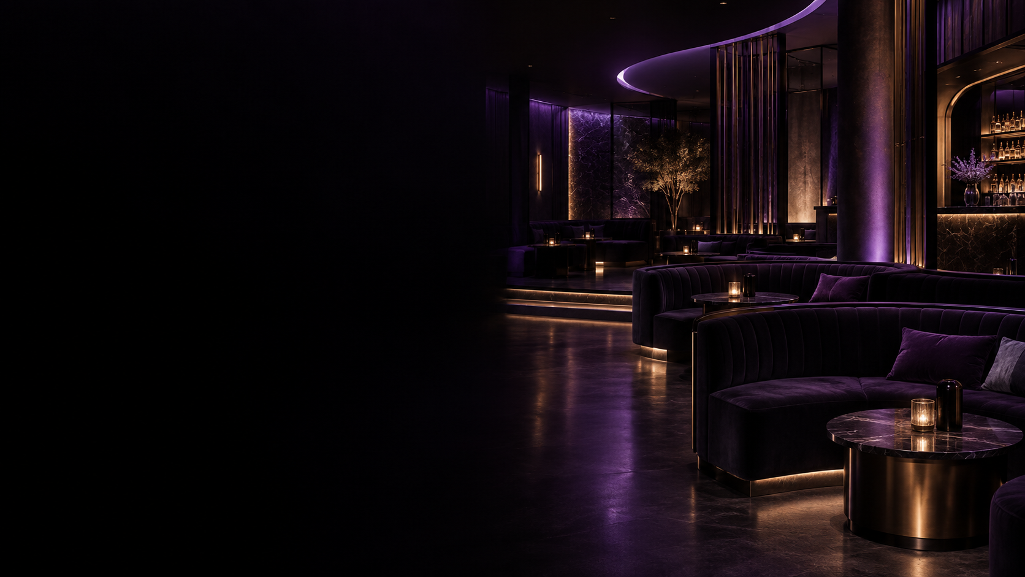

FOR YOUR CLUB GROUP
Turn guest interest
into measurable action.
A connected discovery and in-club experience designed around the venue — before, during and between visits.
DISCOVERY
CONVERSION
IN-CLUB
MEASUREMENT
Marketing partnership + one-location pilot proposal

Slide 2
THE VALUE
One connected guest journey. Five clear benefits.
MyDancr connects discovery, action, in-club engagement and measurable follow-through in one venue-centered experience.
01
02
03
04
05
DISCOVERABILITY
CONVERSION
IN-CLUB
RETENTION
MEASUREMENT
Current club + dancer activity gives guests more context when choosing where to go.
Directions, venue offers and pickup requests give interest a clear next step.
Table QR requests create a structured handoff from guest to venue staff.
Follows, alerts and shareable content create reasons to revisit the experience.
Venue reporting separates awareness, intent and verified pass use.
MYDANCR KEEPS THE CLUB ATTACHED TO THE JOURNEY
Discover → Choose → Take action → Engage inside → Stay connected

Slide 3
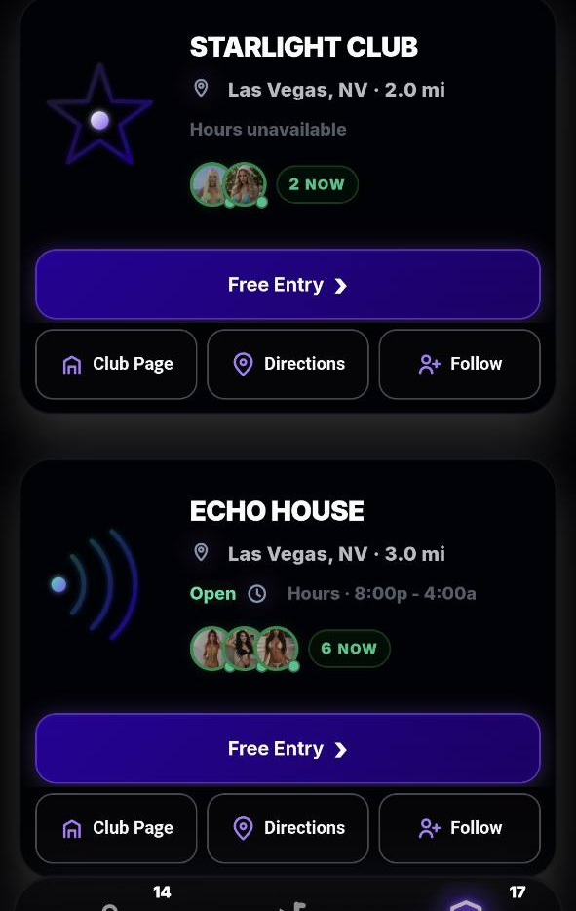
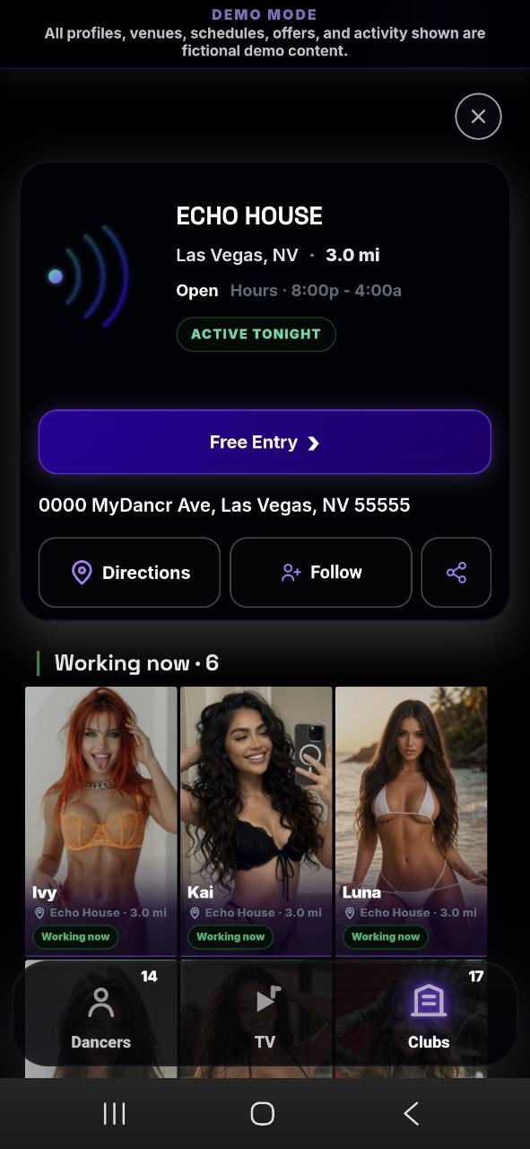
BEFORE THE VISIT
Help guests choose your club — then give them a next step.
Turn a static listing or social post into a venue-connected experience with current context and clear actions.
01
CURRENT CLUB + DANCER CONTEXT
Working Now signals, venue details and approved profiles give the guest more information at the moment of decision.
02
A CLEAR ACTION
Directions, a venue-defined offer or a club pickup request can move consideration toward a visit.
03
THE CLUB STAYS THE DESTINATION
Dancer activity is shown in venue context, so attention can lead back to the club page and club actions.
PILOT QUESTION: does this create more meaningful intent and verified arrivals?
Demo interface • fictional club/profile content. Pickup is a request handled by the venue. Offer eligibility remains subject to venue rules.

Slide 4
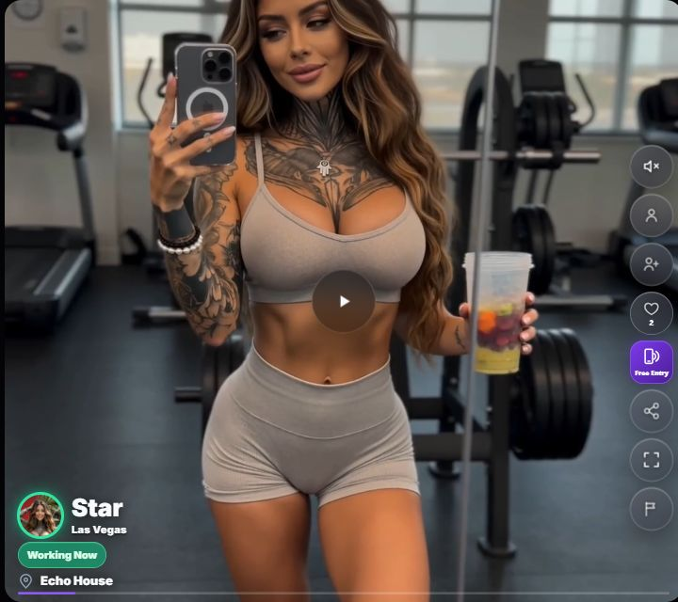
MYDANCR TV
Shareable video can bring your club a much wider audience.
TV clips can bring new viewers to MyDancr, with venue links that keep your club connected to the attention.
WATCH
SHARE
DISCOVER
ACT
MyDancr TV
›
Shared video link
›
Your club
›
Venue page + offers
VIRAL REACH POTENTIAL
Shareable videos can reach beyond your current followers and bring new viewers to MyDancr.
Venue tags connect the video to your club, giving viewers a direct path to your venue page.
A widely shared video can give the club substantial exposure and create more opportunities for visits.
Track eligible TV views and club actions to see which content attracts interest.
Demo interface with fictional content. Viral reach and audience size depend on sharing and engagement and are not guaranteed.
Notes:
MyDancr TV screenshot source: https://www.mydancr.com/?city=Las+Vegas&view=tv, captured October 2, 2026. This is the actual demo interface with fictional profiles and activity.
Feature basis: the existing MyDancr TV interface supports shareable video links and venue links. Existing reporting attributes eligible TV activity. Viral reach, new traffic, club exposure and subsequent visits are potential outcomes, not measured results or guarantees.

Slide 5
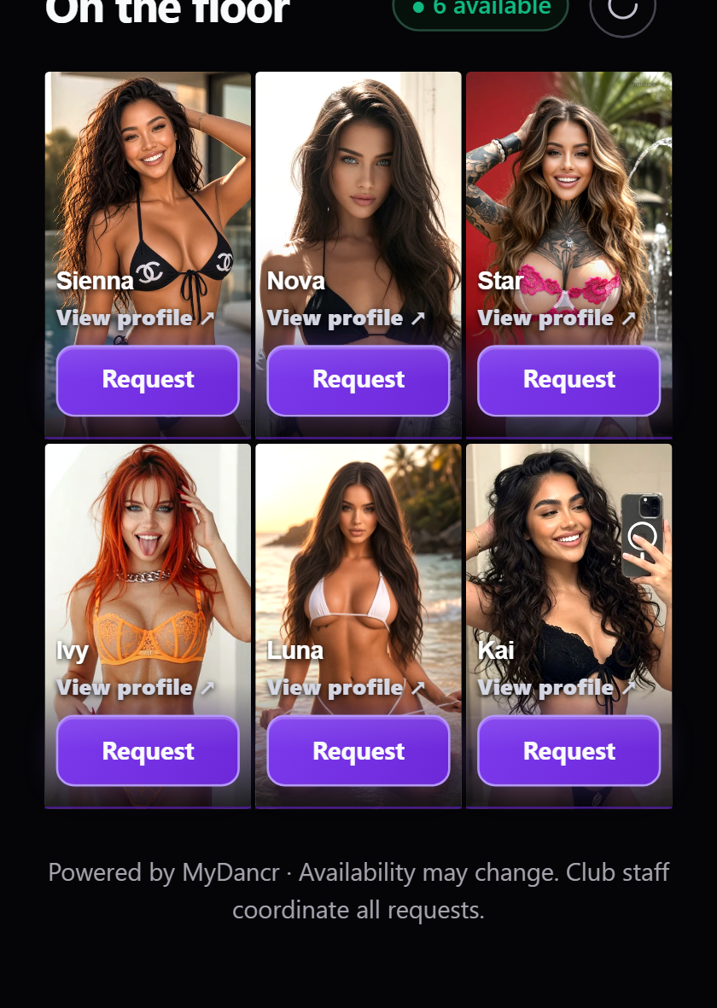
INSIDE THE CLUB
Turn “I want to meet her” into a structured staff request.
The optional table experience is designed to reduce friction for the guest while keeping coordination with venue staff.
01
SCAN THE TABLE QR
The guest opens that club’s current eligible roster.
02
EXPLORE A FULL PROFILE
Approved photos and videos help the guest choose.
03
SEND A REQUEST TO STAFF
The request identifies the dancer and table so the venue team can coordinate.
CLUB BENEFIT • lower-friction guest request + clearer staff handoff
No customer-to-dancer messaging, payment, pricing or negotiation in the table-request flow. Requests do not confirm dancer acceptance or a purchase.

Slide 6
CONTROL
Add a digital layer without taking operating control away from the club.
MyDancr provides the platform and support; the venue keeps control of local rules, staff and guest handling.
MYDANCR
YOUR CLUB
DANCERS
Platform + enablement
Local control
Profile ownership
Venue workspace + prepared official page
Approve the exact venue page
Own their profile + approved media
Onboarding and staff training
Set local offer + operating rules
Choose Internal, External or Both
Reporting + review cadence
Control authorized staff access
Control eligible check-in status
Launch support + product updates
Handle pickups, redemptions + table requests
Control their follow/share activity
THE RESULT
A consumer-facing experience with venue operations and approvals still where they belong — with the club.

Slide 7
MEASUREMENT
See where attention turns into action.
Venue reporting separates awareness, intent, verified pass use and in-club engagement instead of treating every click as a visit.
AWARENESS
INTENT
ARRIVAL
IN-CLUB
CONTENT
Venue-card impressions
+ unique browsers
Directions • claims
pickup requests • follows
Redeemed admission passes
Table requests
Button sources + eligible
MyDancr TV attribution
›
›
›
›
Are guests finding the location?
Are they taking a next step?
Are claimed offers being used?
Is the optional on-premise layer being used?
What surfaces are associated with action?
WHAT MYDANCR CAN VERIFY
Product actions + redeemed passes
WHAT NEEDS CLUB DATA
Total visits • VIP spend • revenue • incremental value
Verified admissions count redeemed passes. Product analytics alone do not establish incremental revenue; pilot review should reconcile with club records.

Slide 8
CUSTOMER DATA + RE-ENGAGEMENT
Turn guest actions into a permission-based audience.
Transportation forms, guest-list forms, account sign-ups and club follows create useful customer signals inside MyDancr.
WHERE CUSTOMER DATA COMES FROM
WHAT THAT CAN GIVE THE CLUB
1
TRANSPORTATION FORMS
KNOWN GUESTS
Build a richer picture of who is interacting with the club through MyDancr.
Pickup requests can capture guest contact information and visit intent.
2
GUEST-LIST FORMS
Guest-list submissions create another direct club interaction tied to the customer.
INTENT SIGNALS
See actions such as transportation requests, guest-list activity and follows.
3
ACCOUNT SIGN-UPS
A MyDancr account creates a persistent customer identity instead of a one-time anonymous visit.
DIRECT RE-ENGAGEMENT
Guests who follow the club and opt in can receive club notifications through the app.
4
CLUB FOLLOWS
Following a club is an explicit signal that the guest wants to stay connected to that venue.
FOLLOW THE CLUB
›
OPT IN
›
CLUB NOTIFICATION
Customer data access, retention and notifications should follow user consent, account preferences and the operator’s agreed privacy rules.

Slide 9
VIP RELATIONSHIP LAYER
Create an invite-only VIP relationship layer.
A club manager can send selected high-value customers a private link to join a MyDancr experience built around existing club relationships.
01
02
03
04
05
MANAGER INVITE
VIP JOINS
PRIOR CONNECTIONS
“I’M COMING IN”
DANCER ALERT
Private link sent by the club manager.
›
Customer opens the invite-only experience.
›
See dancers the guest previously connected with in MyDancr.
›
VIP signals that they plan to visit the club.
›
Eligible prior connections can receive the arrival signal.
WHY THIS MATTERS
CLUB-CONTROLLED ACCESS
EXISTING RELATIONSHIPS
A SIGNAL — NOT A CHAT
Managers decide which high-value customers receive the invite-only link.
The arrival signal is limited to dancers the VIP already has a prior MyDancr connection with.
The VIP can indicate they are coming to the club without direct customer-to-dancer messaging or contact details.
Proposed VIP capability. Participation and notifications would remain opt-in, club-mediated and subject to platform safety and privacy controls.

Slide 10
MULTI-LOCATION VALUE
Built for one club. Repeatable across the group.
Use the same core playbook and KPI language while preserving each location’s identity and operating needs.
01
02
03
COMMON KPI LANGUAGE
LOCAL CONTROL
REPEATABLE ROLLOUT
Equivalent time periods
Each club keeps its page + assets
Shared onboarding playbook
Same action categories
Local offers + staff access
Location-level learning
Comparable pilot scorecards
Local pickups + table requests
Scale only what evidence supports
Corporate dashboard, POS / CRM integrations or custom workflows can be scoped separately as the rollout grows.

Slide 11
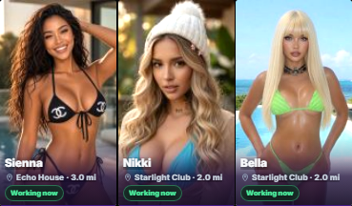
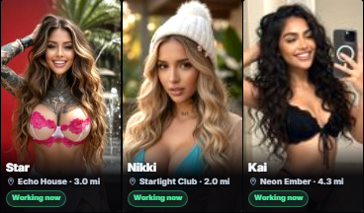
WEBSITE INTEGRATION
Put a filtered MyDancr experience directly inside your website.
Use an iframe to show only your participating clubs — keeping the guest on your site while MyDancr powers the live experience.
yourclubgroup.com/tonight
LIVE
WHAT THIS GIVES THE CLUB GROUP
YOUR BRAND. YOUR DOMAIN.
YOUR CLUB GROUP
LOCATIONS EVENTS VISIT
Guests can browse the experience without leaving your website.
MYDANCR IFRAME • YOUR CLUBS ONLY
YOUR CLUBS ONLY.
Working Now
Demo city views
The iframe can be filtered to participating locations from your group — no competitor clubs inside the embed.
Las Vegas
Dallas
Los Angeles
LIVE + MEASURABLE.
Working Now, venue actions and approved content can flow from MyDancr while eligible actions remain trackable.
START WITH THE PILOT CLUB • ADD LOCATIONS AS THE GROUP EXPANDS
YOUR WEBSITE → FILTERED MYDANCR → YOUR LOCATIONS ONLY
Demo screenshots with illustrative city labels. Final embed URL, iframe security settings and website implementation would be scoped with the operator.
Notes:
Visual sources: MyDancr external demo screenshots from tmp/aesthetic-review/home-mobile.png and tmp/working-now-discovery-production.png, plus the external venue Working Now screenshot supplied on slide 3 of the source deck. Each screenshot is cropped to its actual dancer grid. Las Vegas, Dallas and Los Angeles are illustrative city headings, not assertions about current live rosters. All pictured profiles and venue activity are demo content.

Slide 12
START SMALL. MEASURE REAL USAGE.
Start with one club.
Prove value.
Scale what works.
1 PILOT LOCATION
30 LIVE DAYS
MyDancr handles venue setup, onboarding, training and launch support. The club names a marketing + operations lead and agrees the scorecard before launch.
A contained pilot creates the club-specific evidence needed for a wider rollout decision.
01 Select location 02 Agree scope + offer 03 Set KPIs
04 Launch 05 Review at day 30

