Slide 1


Club operations &
guest discovery
For club owners and groups
operating multiple venues
Connect the guest experience with the club floor
and measurable activity at each location.
MYDANCR
1 / 5
Notes:
MyDancr provides public discovery and guest actions alongside venue-scoped operational tools and reporting. This presentation contains five slides. Product screens use fictional demo venues and profiles. The analytics examples are invented for illustration and are not operating results or promises of financial return. Corporate comparison is a management reporting example; do not present a consolidated corporate dashboard or a single-login multi-venue switcher as an implemented feature.
Product source references (repository files, reviewed October 2, 2026):
D:\Codex\MyDancr-clean-2026-09-11\app\dashboard\VenueDashboardPanels.tsx
D:\Codex\MyDancr-clean-2026-09-11\src\lib\dancr\venue-access.ts
D:\Codex\MyDancr-clean-2026-09-11\public\dancr-brand-tokens.v1.css
D:\Codex\MyDancr-clean-2026-09-11\outputs\dancr-hero.png
D:\Codex\MyDancr-clean-2026-09-11\outputs\mydancr-logo-current.png

Slide 2
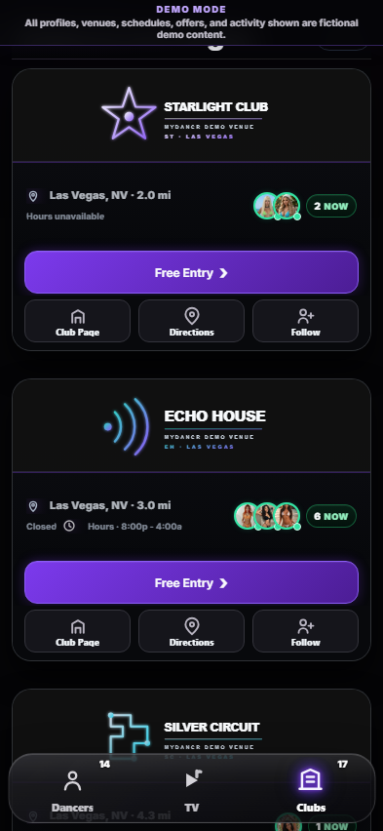
The guest experience
Discovery, visit planning and entry in one customer journey
Find a club and see who’s working
Browse clubs by city, explore dancer profiles and schedules,
and watch MyDancr TV videos.
Choose an offer and plan the arrival
Claim an entry pass, submit guest-list details or request
a club pickup where offered. Get directions to the venue.
Stay connected
Follow clubs and dancers, save offers and mark
“I’m Going” to signal a planned visit.
MYDANCR
2 / 5
Notes:
The screenshot is an existing demo capture, not live business performance; details of styling may differ from the current app. Free Entry includes independent arrival-method, transport and guest-list paths. Guest-list submission sends contact information to the venue and issues an entry pass. Pickup availability depends on the club. A saved I’m Going choice is intent, not a confirmed arrival. Following and saved offers are customer features; do not promise guaranteed repeat visits.
Product source references (repository files, reviewed October 2, 2026):
D:\Codex\MyDancr-clean-2026-09-11\src\live-shell\app\02-venue-interactions.js
D:\Codex\MyDancr-clean-2026-09-11\app\dashboard\CustomerDashboardPanels.tsx
D:\Codex\MyDancr-clean-2026-09-11\app\dashboard\VenueGuestListPanel.tsx
D:\Codex\MyDancr-clean-2026-09-11\app\dashboard\PickupDashboardPanel.tsx
D:\Codex\MyDancr-clean-2026-09-11\tmp\aesthetic-review\clubs-mobile.png

Slide 3

Inside the club
Operational tools for owners, managers and staff
Live roster & visibility
Dressing-room NFC check-in sets working status.
Dancers choose internal and external visibility.
Table QR requests
Guests view available dancers and send requests.
Staff mark requests seen, complete or dismissed.
Guest arrivals
Review guest-list details, coordinate pickups
and confirm entry-pass use at the club.
Venue management
Assign team roles, review activity, approve the
prepared club page and request offer changes.
Demo table view · requests remain staff-coordinated
MYDANCR
3 / 5
Notes:
The demo screenshot shows the in-club guest table view. Dancer availability is subject to change and staff coordinate requests; this is not a guaranteed booking or assignment. Owner, manager and staff permissions differ. Owners manage team access; managers and staff have constrained permissions. MyDancr prepares the club page and manages Club Deals; venue teams review/approve their page and request deal changes. Public and internal visibility are chosen by the dancer at check-in.
Product source references (repository files, reviewed October 2, 2026):
D:\Codex\MyDancr-clean-2026-09-11\app\internal\InternalRoster.tsx
D:\Codex\MyDancr-clean-2026-09-11\app\dashboard\VenueNfcTagPanel.tsx
D:\Codex\MyDancr-clean-2026-09-11\app\dashboard\VenueTeamPanel.tsx
D:\Codex\MyDancr-clean-2026-09-11\app\dashboard\VenueDashboardPanels.tsx
D:\Codex\MyDancr-clean-2026-09-11\src\lib\dancr\venue-access.ts
D:\Codex\MyDancr-clean-2026-09-11\.qa\internal-brightness\live-desktop.png

Slide 4
Sample club dashboard · Echo House
Illustrative figures · September 1–30, 2026 · compared with the previous 30 days
480
312
65%
96
Passes claimed
QR scan results
Claim → admission
Pickup requests
+20% vs prior
+30% vs prior
312 of 480 claims
+20% vs prior
Audience & intent | Count
Card impressions | 18,400
Unique browsers | 4,200
Directions opened | 640
New followers | 185
QR results are confirmed pass uses, not total club attendance. This example assumes all 312 uses belong to the 480 passes
claimed in the period. Unique browsers are not an exact count of people.
MYDANCR
4 / 5
Notes:
All numbers are illustrative. Current: claims 480, confirmed pass uses 312, pickups 96, impressions 18,400, unique browsers 4,200, directions 640, new followers 185. Previous 30 days: claims 400, pass uses 240, pickups 80. Changes are (current / previous - 1): 20%, 30%, 20%. Conversion is cohort redemptions / passes claimed = 312 / 480 = 65%; the example deliberately assumes period admissions and cohort redemptions coincide. Real data can differ. The product supports Tonight, 7 days and 30 days; this slide uses an illustrative closed 30-day report, not an existing custom-date picker. Current per-club reports include customer actions by source, activity tied to individual dancers, and attributed TV video activity. Cost per admission is unavailable until subscription cost for the same period is connected. No revenue or ROI estimate is presented.
Product source references (repository files, reviewed October 2, 2026):
D:\Codex\MyDancr-clean-2026-09-11\app\dashboard\VenueValueAnalytics.tsx
D:\Codex\MyDancr-clean-2026-09-11\src\lib\dancr\venue-analytics.ts
D:\Codex\MyDancr-clean-2026-09-11\src\lib\dancr\venue.ts

Slide 5
Compare performance across clubs
Illustrative management report · the same 30-day period and metric definitions
Club | Passes claimed | QR pass uses | Claim → admission | Pickup requests | New followers
Echo House | 480 | 312 | 65.0% | 96 | 185
Aurora Room | 400 | 220 | 55.0% | 72 | 150
Blue Ember | 360 | 252 | 70.0% | 60 | 120
Group total | 1,240 | 784 | 63.2% | 228 | 455
Aurora Room
Blue Ember
Review the gap between pass claims and confirmed use.
Compare offers and arrival handling behind its 70% rate.
Sample roll-up assembled from per-club metrics; this is not an existing consolidated corporate dashboard.
MYDANCR
5 / 5
Notes:
Every figure is invented for demonstration. Pass claims sum to 1,240; confirmed pass uses sum to 784; pickups sum to 228; new followers sum to 455. Group conversion is the weighted ratio 784 / 1,240 = 63.2258%, shown as 63.2%, not the unweighted average of venue percentages. As on slide 4, each venue assumes the same-period confirmed pass uses belong to that period’s claims. New follower totals are venue follows, not deduplicated group customers. Suggested management questions are hypotheses for review, not causal conclusions or guaranteed performance gains. The current application resolves access per venue; the comparison shown here is an illustrative assembled report and does not claim an implemented corporate roll-up dashboard, portfolio login or automatic consolidated export. Use common reporting windows, local operating context and consistent metric definitions when comparing locations.
Product source references (repository files, reviewed October 2, 2026):
D:\Codex\MyDancr-clean-2026-09-11\app\dashboard\VenueValueAnalytics.tsx
D:\Codex\MyDancr-clean-2026-09-11\src\lib\dancr\venue-analytics.ts
D:\Codex\MyDancr-clean-2026-09-11\src\lib\dancr\venue-access.ts

