Slide 1


Club operations &
guest discovery
For club owners and groups
operating multiple venues
Connect the guest experience with the club floor
and measurable activity at each location.
MYDANCR
1 / 7
Notes:
MyDancr provides public discovery and guest actions alongside venue-scoped operational tools and reporting. This presentation contains seven slides. Product screens use fictional demo venues and profiles. The analytics examples are invented for illustration and are not operating results or promises of financial return. Corporate comparison is a management reporting example; do not present a consolidated corporate dashboard or a single-login multi-venue switcher as an implemented feature.
Product source references (repository files, reviewed October 2, 2026):
D:\Codex\MyDancr-clean-2026-09-11\app\dashboard\VenueDashboardPanels.tsx
D:\Codex\MyDancr-clean-2026-09-11\src\lib\dancr\venue-access.ts
D:\Codex\MyDancr-clean-2026-09-11\public\dancr-brand-tokens.v1.css
D:\Codex\MyDancr-clean-2026-09-11\outputs\dancr-hero.png
D:\Codex\MyDancr-clean-2026-09-11\outputs\mydancr-logo-current.png

Slide 2
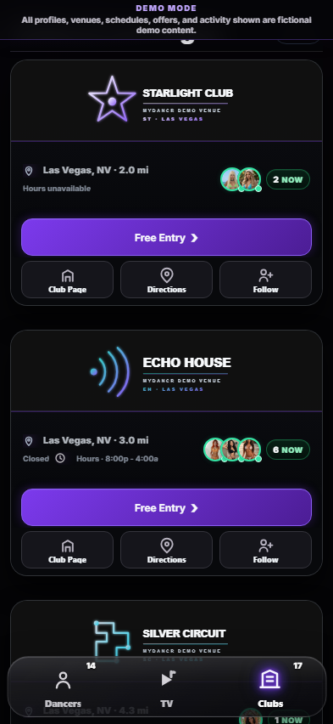
The guest experience
Discovery, visit planning and entry in one customer journey
Find a club and see who’s working
Browse clubs by city, explore dancer profiles and schedules,
and watch MyDancr TV videos.
CLUB D
Choose an offer and plan the arrival
Claim an entry pass, submit guest-list details or request
a club pickup where offered. Get directions to the venue.
CLUB A
Stay connected
Follow clubs and dancers, save offers and mark
“I’m Going” to signal a planned visit.
CLUB E
MYDANCR
2 / 7
Notes:
The screenshot is an existing demo capture, not live business performance; details of styling may differ from the current app. Free Entry includes independent arrival-method, transport and guest-list paths. Guest-list submission sends contact information to the venue and issues an entry pass. Pickup availability depends on the club. A saved I’m Going choice is intent, not a confirmed arrival. Following and saved offers are customer features; do not promise guaranteed repeat visits.
Product source references (repository files, reviewed October 2, 2026):
D:\Codex\MyDancr-clean-2026-09-11\src\live-shell\app\02-venue-interactions.js
D:\Codex\MyDancr-clean-2026-09-11\app\dashboard\CustomerDashboardPanels.tsx
D:\Codex\MyDancr-clean-2026-09-11\app\dashboard\VenueGuestListPanel.tsx
D:\Codex\MyDancr-clean-2026-09-11\app\dashboard\PickupDashboardPanel.tsx
D:\Codex\MyDancr-clean-2026-09-11\tmp\aesthetic-review\clubs-mobile.png

Slide 3

The table experience
Available dancers and requests from a table QR code
Live roster & visibility
CLUB A
Dressing-room NFC check-in sets working status.
Dancers choose internal and external visibility.
Full dancer profiles
Guests scan a table QR code and browse the roster.
A photo opens the dancer’s full profile.
Requests from the table
Guests request a dancer from the grid or profile.
The request identifies the guest’s table.
Staff coordination
Staff mark requests seen, complete or dismissed.
Club staff confirm availability.
Demo table view · requests remain staff-coordinated
MYDANCR
3 / 7
Notes:
The screenshot shows a fictional demo table roster. NFC check-in sets working status and dancers choose internal and external visibility. Guests browse full profiles and send table requests. Staff coordinate requests and confirm availability. A request does not guarantee a booking or assignment.
Product source references:
D:\Codex\MyDancr-clean-2026-09-11\app\internal\InternalRoster.tsx
D:\Codex\MyDancr-clean-2026-09-11\app\dashboard\VenueNfcTagPanel.tsx
D:\Codex\MyDancr-clean-2026-09-11\app\dashboard\VenueDashboardPanels.tsx
D:\Codex\MyDancr-clean-2026-09-11\.qa\internal-brightness\live-desktop.png

Slide 4
Club staff operations
Guest handling and venue management in the club dashboard
Guest list & entry passes
Pickup coordination
Review guest details before arrival.
Door staff check admission requirements
and scan each entry pass.
Review pickup requests and contact
guests through the pickup inbox
to arrange their ride.
Team access
Venue management
Owners invite managers and staff.
Each role receives the permissions
needed for its work.
Review and approve the prepared
club page, request offer changes
and review venue activity.
MYDANCR
4 / 7
Notes:
These capabilities come from the existing deck and the current venue dashboard. Pickup service depends on the club. Owner, manager and staff permissions differ. MyDancr prepares the club page and manages Club Deals; venue users review their page and request changes. This slide makes no claim of a corporate multi-venue dashboard.
Product source references:
D:\Codex\MyDancr-clean-2026-09-11\app\dashboard\VenueGuestListPanel.tsx
D:\Codex\MyDancr-clean-2026-09-11\app\dashboard\PickupDashboardPanel.tsx
D:\Codex\MyDancr-clean-2026-09-11\app\dashboard\VenueTeamPanel.tsx
D:\Codex\MyDancr-clean-2026-09-11\app\dashboard\VenueDashboardPanels.tsx
D:\Codex\MyDancr-clean-2026-09-11\src\lib\dancr\venue-access.ts

Slide 5
Sample club dashboard · Club A
Illustrative figures · September 1–30, 2026 · compared with the previous 30 days
480
312
65%
96
Passes claimed
QR scan results
Claim → admission
Pickup requests
+20% vs prior
+30% vs prior
312 of 480 claims
+20% vs prior
Audience & intent | Count
Card impressions | 18,400
Unique browsers | 4,200
Directions opened | 640
New followers | 185
QR results are confirmed pass uses, not total club attendance. This example assumes all 312 uses belong to the 480 passes
claimed in the period. Unique browsers are not an exact count of people.
MYDANCR
5 / 7
Notes:
All numbers are illustrative. Current: claims 480, confirmed pass uses 312, pickups 96, impressions 18,400, unique browsers 4,200, directions 640, new followers 185. Previous 30 days: claims 400, pass uses 240, pickups 80. Changes are (current / previous - 1): 20%, 30%, 20%. Conversion is cohort redemptions / passes claimed = 312 / 480 = 65%; the example deliberately assumes period admissions and cohort redemptions coincide. Real data can differ. The product supports Tonight, 7 days and 30 days; this slide uses an illustrative closed 30-day report, not an existing custom-date picker. Current per-club reports include customer actions by source, activity tied to individual dancers, and attributed TV video activity. Cost per admission is unavailable until subscription cost for the same period is connected. No revenue or ROI estimate is presented.
Product source references (repository files, reviewed October 2, 2026):
D:\Codex\MyDancr-clean-2026-09-11\app\dashboard\VenueValueAnalytics.tsx
D:\Codex\MyDancr-clean-2026-09-11\src\lib\dancr\venue-analytics.ts
D:\Codex\MyDancr-clean-2026-09-11\src\lib\dancr\venue.ts

Slide 6
Compare performance across clubs
Illustrative management report · the same 30-day period and metric definitions
Club | Passes claimed | QR pass uses | Claim → admission | Pickup requests | New followers
Club A | 480 | 312 | 65.0% | 96 | 185
Club B | 400 | 220 | 55.0% | 72 | 150
Club C | 360 | 252 | 70.0% | 60 | 120
Group total | 1,240 | 784 | 63.2% | 228 | 455
Club B
Club C
Review the gap between pass claims and confirmed use.
Compare offers and arrival handling behind its 70% rate.
Sample roll-up assembled from per-club metrics; this is not an existing consolidated corporate dashboard.
MYDANCR
6 / 7
Notes:
Every figure is invented for demonstration. Pass claims sum to 1,240; confirmed pass uses sum to 784; pickups sum to 228; new followers sum to 455. Group conversion is the weighted ratio 784 / 1,240 = 63.2258%, shown as 63.2%, not the unweighted average of venue percentages. As on slide 5, each venue assumes the same-period confirmed pass uses belong to that period’s claims. New follower totals are venue follows, not deduplicated group customers. Suggested management questions are hypotheses for review, not causal conclusions or guaranteed performance gains. The current application resolves access per venue; the comparison shown here is an illustrative assembled report and does not claim an implemented corporate roll-up dashboard, portfolio login or automatic consolidated export. Use common reporting windows, local operating context and consistent metric definitions when comparing locations.
Product source references (repository files, reviewed October 2, 2026):
D:\Codex\MyDancr-clean-2026-09-11\app\dashboard\VenueValueAnalytics.tsx
D:\Codex\MyDancr-clean-2026-09-11\src\lib\dancr\venue-analytics.ts
D:\Codex\MyDancr-clean-2026-09-11\src\lib\dancr\venue-access.ts

Slide 7
A pilot at your club
Proposed next step for an owner or venue group
One venue and a club lead
Guest experience setup
Choose the starting location and
the person responsible for rollout.
Confirm the club page and offers.
Set up NFC check-in and table QR codes.
A trial with the team
Review and expansion
Agree a trial period and train staff
to handle entry passes and requests.
Compare pass use and pickup activity.
Use staff feedback to plan the next step.
Next step: choose a pilot venue and venue lead.
MYDANCR
7 / 7
Notes:
This is a proposed pilot discussion, not a committed offer or implementation timetable. Agree scope, responsibilities and commercial terms separately. Do not promise a specific financial result. Review each venue with consistent reporting periods and the metric definitions shown on slides 5 and 6.

