Slide 1


A measurable
growth channel
for every location
MyDancr for club groups
Discovery, guest acquisition and venue performance
Notes:
Corporate introduction prepared for a club operator with multiple locations. This is a proposed partnership and rollout discussion, not a commercial offer or performance guarantee. MyDancr is a guest-facing discovery experience and a venue operations platform.
Artwork: output/presentations/assets/polished-deck/lounge-cover.png. Existing AI-generated conceptual venue artwork, not a photograph of a specific operating club. Logo: outputs/mydancr-logo-current.png.

Slide 2
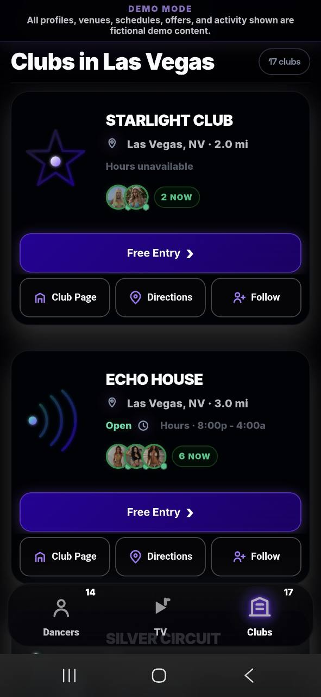
The app connects guests
with clubs and dancers
Nearby discovery
Guests compare clubs, see location details and
find dancers currently checked in.
Content that leads to a venue
MyDancr TV, dancer profiles and shared club links
give audiences more ways to find your locations.
Business benefit: a clear destination for interest
generated by your brand and participating dancers.
02
Notes:
Repository source: docs/working-now-club-participation.md (reviewed October 2, 2026).
Repository source: docs/venue-subscription-analytics.md (reviewed October 2, 2026).
Repository source: src/live-shell/app/11-post-verified-shift.js (reviewed October 2, 2026).
Screenshot: user-supplied 24433.jpg. Fictional demo content, supplied before the latest header spacing update. It illustrates the product rather than customer traction. Working Now requires an active, confirmed check-in at a participating club and expires under the existing six-hour policy. Future schedule posting is retired and is not offered here. Benefits are proposed use cases, not measured acquisition results.

Slide 3
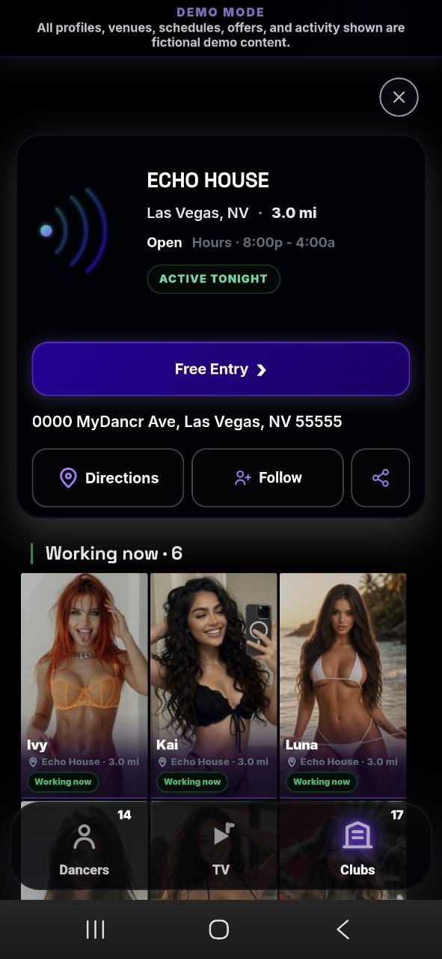
A direct path from interest
to a club visit
01
A reason to choose your club
Current dancer activity and the club’s active offer.
02
A practical next step
Free Entry, directions and eligible pickup requests.
03
A measurable arrival
Staff redeem admission passes at the venue.
Follows help guests keep the club in their discovery experience.
03
Notes:
Repository source: docs/club-deal-transportation.md (reviewed October 2, 2026).
Repository source: docs/pickup-contact-forms.md (reviewed October 2, 2026).
Repository source: docs/venue-subscription-analytics.md (reviewed October 2, 2026).
Screenshot: user-supplied 24431.jpg, fictional demo data. Current Free Entry eligibility is private-car or club-provided transport arrival. Rideshare and taxi arrivals do not qualify for that offer. Pickup submissions are requests, not confirmed rides. Clubs contact guests to arrange transport. The offer and actual arrival eligibility remain subject to venue rules. Only redeemed passes count as verified admissions; clicks and claims do not prove attendance.

Slide 4
A corporate playbook with local execution
A repeatable launch approach that preserves each club’s identity and operating needs.
At each location
Across the group
Official club page and active deal
Venue-specific owner and team access
Current dancer check-in controls
Pickup inbox and optional table requests
Shared brand and content standards
Common KPIs and review cadence
Local training and adoption champions
A repeatable playbook for expansion
Proposed corporate setup: consolidated reporting and any POS, CRM or custom integrations are scoped during onboarding.
04
Notes:
Repository source: docs/venue-onboarding.md (reviewed October 2, 2026).
Repository source: docs/working-now-club-participation.md (reviewed October 2, 2026).
Repository source: docs/pickup-contact-forms.md (reviewed October 2, 2026).
Repository source: docs/internal-table-request-push.md (reviewed October 2, 2026).
The left column summarizes documented venue capabilities. The right column describes the proposed implementation and operating model, not an existing single corporate console. Venue accounts access their own venue dashboard. Consolidated corporate analytics, cross-location identity resolution, POS/CRM integrations, procurement and group commercial arrangements require scoping and agreement. Internal table QR requests notify eligible venue staff and can support host workflows where configured. Dancer accounts remain dancer-owned.

Slide 5
Analytics tied to customer actions
Venue reports compare Tonight, 7 days and 30 days with equivalent prior periods.
What the app measures | How management can use it
Discovery and interest | Review impressions, unique browsers, directions and follows.
Claims and admissions | Compare pass claims with verified redemptions.
Dancer and TV activity | Identify content associated with clicks, claims and admissions.
Pickup demand | Review requests and passenger totals to plan follow-up.
Verified admissions count redeemed passes at the venue.
Corporate ROI also needs your costs, margins and an agreed method for measuring incremental visits.
05
Notes:
Repository source: docs/venue-subscription-analytics.md (reviewed October 2, 2026).
Repository source: src/lib/dancr/venue-analytics.ts (reviewed October 2, 2026).
Reports distinguish visitors (browser identifiers), impressions, intentions, claims, pickup requests and verified admissions. Unique browsers are not independently verified unique people. Button reports distinguish venue scroll cards, venue detail, dancer profiles and TV sources. TV outcome credit requires an explicit video-to-club click; the signed venue-specific attribution cookie lasts 30 minutes, and newly issued passes retain original credit through redemption. Historical tracking is not backfilled. Costs per admission remain unavailable until authoritative period-matched venue subscription costs are connected. Causal lift and customer spending require additional agreed measurement, such as comparable baseline periods or a holdout plus finance reconciliation.

Slide 6
Illustrative monthly return on investment
Example assumptions for 10 locations. These are planning inputs, not MyDancr pricing or results.
$40
$1,500
38 visits
Contribution per
incremental visit
Monthly program cost
per location
Monthly break-even
per location, rounded up
Scenario | Extra visits / location | Group net benefit | ROI
Lower | 50 | $5,000 | 33%
Base | 100 | $25,000 | 167%
Higher | 200 | $65,000 | 433%
ROI = (incremental contribution − total program cost) ÷ total program cost
Contribution is after variable costs and offer impact. Include fees, launch effort and ongoing operating costs.
06
Notes:
All inputs and outcomes are illustrative, created for this proposal. No audited results, commercial pricing, contractual terms or promised returns are represented.
Formula: group incremental contribution = location count × incremental admissions per location × contribution per admission. Contribution should be net of incremental service costs, promotion discount/foregone cover, and other visit-variable costs. Total program cost should include software/service fees, amortized setup and training, content/marketing spend, and additional ongoing overhead, without double-counting costs already removed from contribution.
10 locations × $1,500 monthly program cost = $15,000 group cost. Lower: 500 incremental admissions × $40 = $20,000 contribution, $5,000 net, 33.33% ROI. Base: 1,000 × $40 = $40,000 contribution, $25,000 net, 166.67% ROI. Higher: 2,000 × $40 = $80,000 contribution, $65,000 net, 433.33% ROI. Break-even: $1,500 / $40 = 37.5, rounded up to 38 additional admissions per location.
Incremental admissions must be estimated against an agreed baseline or holdout, adjusted for repeat/existing guests, seasonality and other concurrent campaigns. Attributed redemptions alone do not establish causality. Replace these inputs with the corporation’s actual location count, economics, proposal cost and observed pilot lift.

Slide 7
Sharing can compound external discovery
Club and dancer links can reach audiences beyond your current followers and customer list.
4.8×
larger generation after
six cycles at K = 1.3
K is the average number of
new app visitors each visitor
brings in the next cycle.
Illustrative model, starting with 1,000 visitors. Exponential growth requires K > 1 and an unsaturated audience.
App visitors are not club admissions. Deduplication, repeat visitors and local conversion affect the result.
07
Notes:
This is a mathematical illustration, not historical MyDancr data or a growth forecast. No external benchmark or assumed empirical viral coefficient is claimed. New referred app visitors in generation n = 1,000 × K^n. The series shows each new generation, not cumulative reach, and the horizontal axis denotes sharing cycles, not months. K is an effective referral factor incorporating the chance that a visitor shares and that sharing yields new unique visitors. It is not a measured current product KPI. At K=1.3, generation six is 4,826.809 visitors, 4.8268 times the seed generation. At K=1.0, it is 1,000. At K=0.7, it is 117.649. Audience overlap, saturation, locality, platform distribution and changing behavior can reduce K over time.
Proposed acquisition method: participating dancers and club teams share relevant content and venue links with their external audiences; recipients open MyDancr, discover a club, and some may share again or visit. External channel attribution, deduplication and referral-generation measurement need to be scoped in the pilot. Do not imply that existing share-event counts establish downstream external reach. Track admissions separately and assess incremental value.
Repository source: src/lib/dancr/venue-analytics.ts (reviewed October 2, 2026).
Repository source: docs/venue-subscription-analytics.md (reviewed October 2, 2026).

Slide 8
Hands-on implementation, location by location
Proposed rollout with a named MyDancr lead and a corporate sponsor. Timing agreed at kickoff.
01
Discovery and agreement
Select pilot clubs, define economics and agree success measures.
Confirm local operating rules and each venue’s authorized representative.
02
Private venue setup
Review requests, provision venue accounts and prepare official pages.
Load branding, address, hours and the agreed active Club Deal.
03
Team readiness and approval
Train managers, hosts and cashiers using their actual workflows.
The venue reviews the completed private page and requests corrections.
04
Supported launch and review
Venue approval publishes the completed page. Provide launch support.
Review adoption and outcomes, then agree the next group of locations.
08
Notes:
This slide proposes the hands-on service and governance model for the corporate engagement. Specific staffing, support coverage, deliverables and timing require agreement. The documented venue publication flow is request-first: authorized representative request, administrator review and commercial agreement outside the application, private workspace and signup code, account creation, MyDancr-prepared completed page, venue review/corrections, and immediate publication when the venue approves the exact package. Accounts do not gain MyDancr administrator access. There is no claim-existing-page workflow.
Repository source: docs/venue-onboarding.md (reviewed October 2, 2026).
Rollout acceptance should include correct hours/address/official media/deal, named trained staff, completed admission and pickup workflow training, consent and notification readiness where relevant, and baseline performance capture. These are proposed training and rollout activities, not automated production tests being performed for this deck.

Slide 9
Training and customization for your business
Role-based training
Configuration and agreed scope
Managers: analytics, roster and pickup inbox
Hosts and cashiers: requests and admission
Dancer champions: check-ins and sharing
Brand assets and location information
Supported deal and transport rules
Staff access and notification preferences
Reporting and integration requirements
Guided sessions, quick-reference playbooks
and an agreed post-launch support cadence.
Custom development and integrations
receive a defined scope, cost and timeline.
A measured pilot in 2–3 locations
Agree owners, a 30-day review and expansion criteria based on incremental value.
09
Notes:
Proposed next step: select two or three representative locations with a corporate sponsor and local champions. Agree commercial scope, setup requirements and a 30-day post-launch measurement review. Thirty days is a proposed first review window, not a guarantee of sufficient data or a deadline for enterprise deployment. Expansion criteria should include staff adoption, a reliable admission workflow, contribution after program cost, and evidence of incremental visitors under an agreed measurement design.
Training and support are proposed implementation services to agree with the operator. Supported configuration is not unlimited product customization. Corporate roll-ups, POS/CRM connections, bespoke pricing or offer models, and additional product features require feasibility review and a statement of work. Current offer policy, venue permissions and dancer account ownership remain applicable.
Repository source: docs/venue-onboarding.md (reviewed October 2, 2026).
Repository source: docs/working-now-club-participation.md (reviewed October 2, 2026).
Repository source: docs/internal-table-request-push.md (reviewed October 2, 2026).

