Slide 1
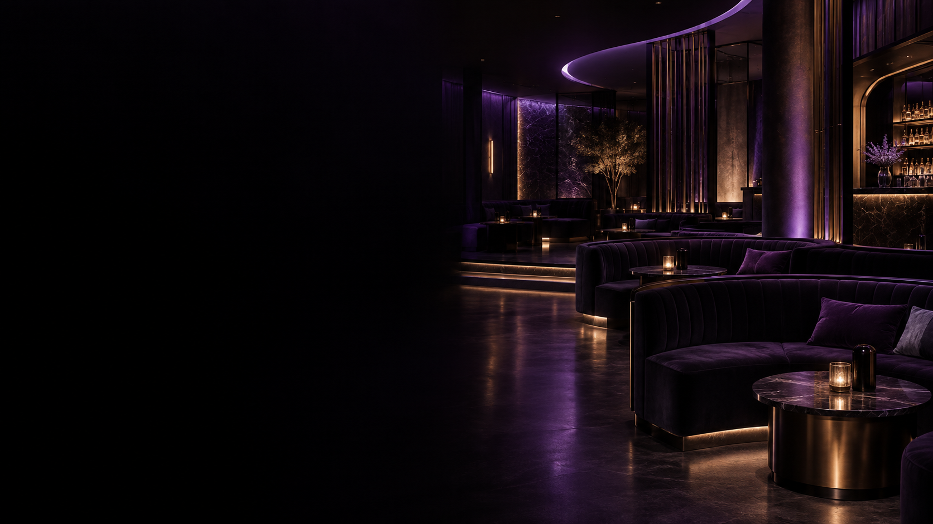

FOR YOUR CLUB GROUP
Turn guest interest
into measurable action.
A connected discovery and in-club experience designed around the venue — before, during and between visits.
DISCOVERY
CONVERSION
IN-CLUB
MEASUREMENT
Marketing partnership + one-location pilot proposal

Slide 2
THE VALUE
One connected guest journey. Five clear benefits.
MyDancr connects discovery, action, in-club engagement and measurable follow-through in one venue-centered experience.
01
02
03
04
05
DISCOVERABILITY
CONVERSION
IN-CLUB
RETENTION
MEASUREMENT
Current club + dancer activity gives guests more context when choosing where to go.
Directions, venue offers and pickup requests give interest a clear next step.
Table QR requests create a structured handoff from guest to venue staff.
Follows, alerts and shareable content create reasons to revisit the experience.
Venue reporting separates awareness, intent and verified pass use.
MYDANCR KEEPS THE CLUB ATTACHED TO THE JOURNEY
Discover → Choose → Take action → Engage inside → Stay connected

Slide 3
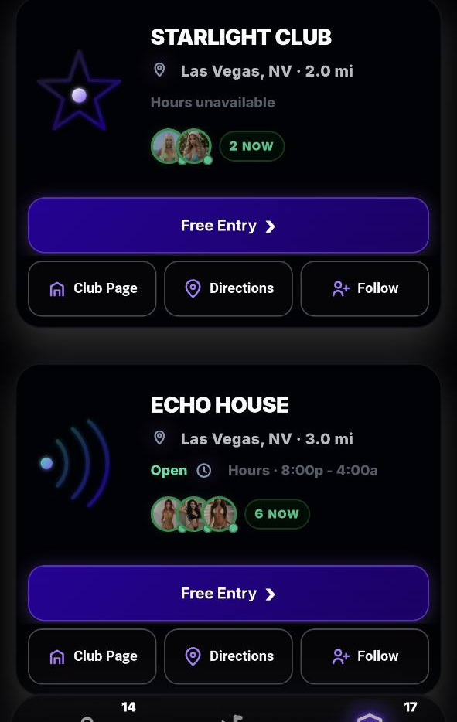
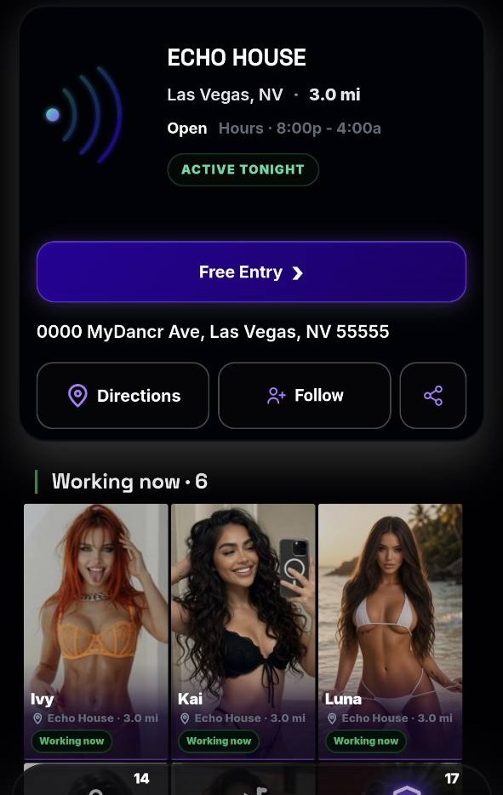
BEFORE THE VISIT
Help guests choose your club — then give them a next step.
Turn a static listing or social post into a venue-connected experience with current context and clear actions.
01
CURRENT CLUB + DANCER CONTEXT
Working Now signals, venue details and approved profiles give the guest more information at the moment of decision.
02
A CLEAR ACTION
Directions, a venue-defined offer or a club pickup request can move consideration toward a visit.
03
THE CLUB STAYS THE DESTINATION
Dancer activity is shown in venue context, so attention can lead back to the club page and club actions.
PILOT QUESTION: does this create more meaningful intent and verified arrivals?
Demo interface • fictional club/profile content. Pickup is a request handled by the venue. Offer eligibility remains subject to venue rules.

Slide 4
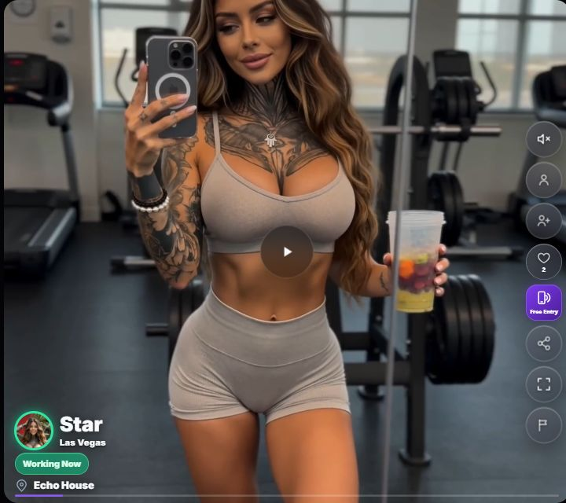
MYDANCR TV
Shareable video can bring your club a much wider audience.
TV clips can bring new viewers to MyDancr, with venue links that keep your club connected to the attention.
WATCH
SHARE
DISCOVER
ACT
MyDancr TV
›
Shared video link
›
Your club
›
Venue page + offers
VIRAL REACH POTENTIAL
Shareable videos can reach beyond your current followers and bring new viewers to MyDancr.
Venue tags connect the video to your club, giving viewers a direct path to your venue page.
A widely shared video can give the club substantial exposure and create more opportunities for visits.
Track eligible TV views and club actions to see which content attracts interest.
Demo interface with fictional content. Viral reach and audience size depend on sharing and engagement and are not guaranteed.
Notes:
MyDancr TV screenshot source: https://www.mydancr.com/?city=Las+Vegas&view=tv, captured October 2, 2026. This is the actual demo interface with fictional profiles and activity.
Feature basis: the existing MyDancr TV interface supports shareable video links and venue links. Existing reporting attributes eligible TV activity. Viral reach, new traffic, club exposure and subsequent visits are potential outcomes, not measured results or guarantees.

Slide 5
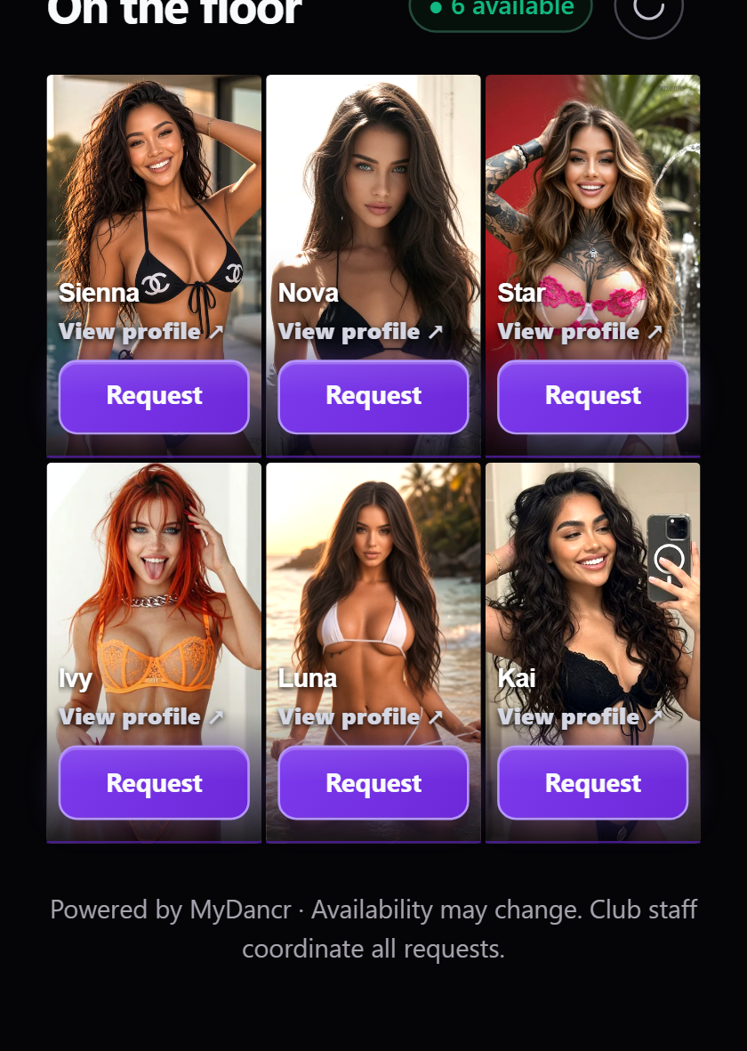
INSIDE THE CLUB
Turn “I want to meet her” into a structured staff request.
The optional table experience is designed to reduce friction for the guest while keeping coordination with venue staff.
01
SCAN THE TABLE QR
The guest opens that club’s current eligible roster.
02
EXPLORE A FULL PROFILE
Approved photos and videos help the guest choose.
03
SEND A REQUEST TO STAFF
The request identifies the dancer and table so the venue team can coordinate.
CLUB BENEFIT • lower-friction guest request + clearer staff handoff
No customer-to-dancer messaging, payment, pricing or negotiation in the table-request flow. Requests do not confirm dancer acceptance or a purchase.

Slide 6
CONTROL
Add a digital layer without taking operating control away from the club.
MyDancr provides the platform and support; the venue keeps control of local rules, staff and guest handling.
MYDANCR
YOUR CLUB
DANCERS
Platform + enablement
Local control
Profile ownership
Venue workspace + prepared official page
Approve the exact venue page
Own their profile + approved media
Onboarding and staff training
Set local offer + operating rules
Choose Internal, External or Both
Reporting + review cadence
Control authorized staff access
Control eligible check-in status
Launch support + product updates
Handle pickups, redemptions + table requests
Control their follow/share activity
THE RESULT
A consumer-facing experience with venue operations and approvals still where they belong — with the club.

Slide 7
MEASUREMENT
See where attention turns into action.
Venue reporting separates awareness, intent, verified pass use and in-club engagement instead of treating every click as a visit.
AWARENESS
INTENT
ARRIVAL
IN-CLUB
CONTENT
Venue-card impressions
+ unique browsers
Directions • claims
pickup requests • follows
Redeemed admission passes
Table requests
Button sources + eligible
MyDancr TV attribution
›
›
›
›
Are guests finding the location?
Are they taking a next step?
Are claimed offers being used?
Is the optional on-premise layer being used?
What surfaces are associated with action?
WHAT MYDANCR CAN VERIFY
Product actions + redeemed passes
WHAT NEEDS CLUB DATA
Total visits • VIP spend • revenue • incremental value
Verified admissions count redeemed passes. Product analytics alone do not establish incremental revenue; pilot review should reconcile with club records.

Slide 8
MULTI-LOCATION VALUE
Built for one club. Repeatable across the group.
Use the same core playbook and KPI language while preserving each location’s identity and operating needs.
01
02
03
COMMON KPI LANGUAGE
LOCAL CONTROL
REPEATABLE ROLLOUT
Equivalent time periods
Each club keeps its page + assets
Shared onboarding playbook
Same action categories
Local offers + staff access
Location-level learning
Comparable pilot scorecards
Local pickups + table requests
Scale only what evidence supports
Corporate dashboard, POS / CRM integrations or custom workflows can be scoped separately as the rollout grows.

Slide 9
START SMALL. MEASURE REAL USAGE.
Start with one club.
Prove value.
Scale what works.
1 PILOT LOCATION
30 LIVE DAYS
MyDancr handles venue setup, onboarding, training and launch support. The club names a marketing + operations lead and agrees the scorecard before launch.
A contained pilot creates the club-specific evidence needed for a wider rollout decision.
01 Select location 02 Agree scope + offer 03 Set KPIs
04 Launch 05 Review at day 30

