Slide 1
Feb 10 Update
Matt Stachyra

Slide 2
Recap
Usng RL to chain NNs for increasingly complex tasks.
  Actions are which NN to pass input to.
  Reward is the loss.
  Start with simple computer vision datasets, progress to robotics domain and curricula learning

Slide 3
Last 2 weeks
Pytorch tutorials
Math review
Papers
Dataset

Slide 4
Pytorch tutorials
  Focused on CNN
Math review
  Linear algebra related to computer vision
Papers
  1
  2
  3
  4
Dataset
  1
  2
  3

Slide 7
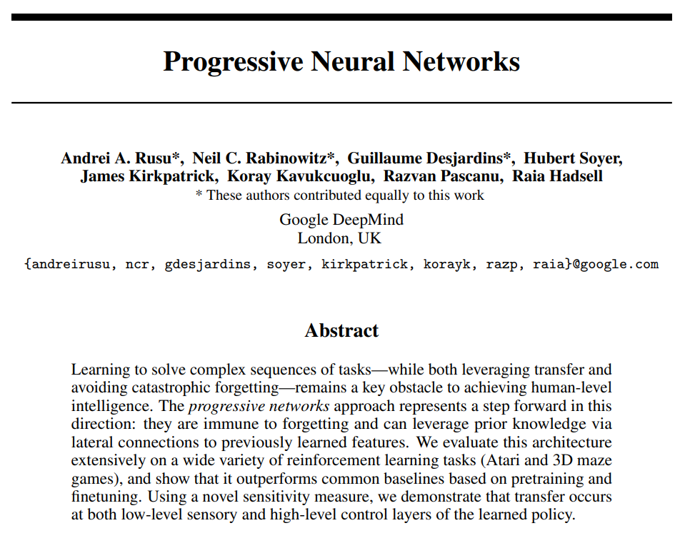
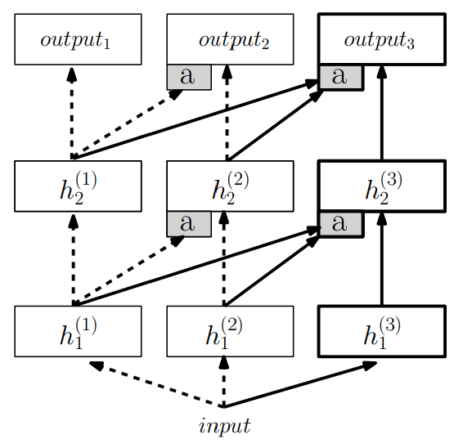
Inspired by PNNs

Slide 8
Thesis idea: using RL to chain NNs with architecture reuse for new tasks
RL identifies which NNs to pass input through and in what sequence
Paths are stored for input and labeled for what tasks they completed
Possible implementation details
  Agent samples available NNs to identify candidates with some search
  RL reward function will be the sum of the loss for the neural networks used
  NNs are trained using backprop
  2-layer structure
    Input layer with different input dimensions to accommodate different inputs
    Second layer has many simple Nns with the same architecture (their input shape is the same based on the output shape from the input layer)

Slide 9
Plan
Phase 1 – introduce architecture
  Apply to simple supervised tasks (e.g., MNIST digits)
Phase 2 – test transfer learning
  Train on a set of related tasks and observe degree of transfer using APS (Average Perturbation Sensitivity) and AFS (Average Fisher Sensitivity)
Phase 3 – advanced application
  Extend to RL tasks (e.g., Atari)

Slide 10
Why?
Transfer learning without manual intervention – for later tasks, can the RL agent identify NNs used for similar tasks and reuse them?
Explainability at symbolic level – tagging trained neural networks with tasks, and seeing which are reused, can hint at choices made

Slide 11
Open questions
How to accommodate different input dimensions?
How to handle training the RL agent versus the neural networks?
When do you stop sampling NNs as the RL agent?
When do you stop training the RL agent?
To what degree should existing weights of trained NNs be frozen (to avoid forgetting)?

Slide 12
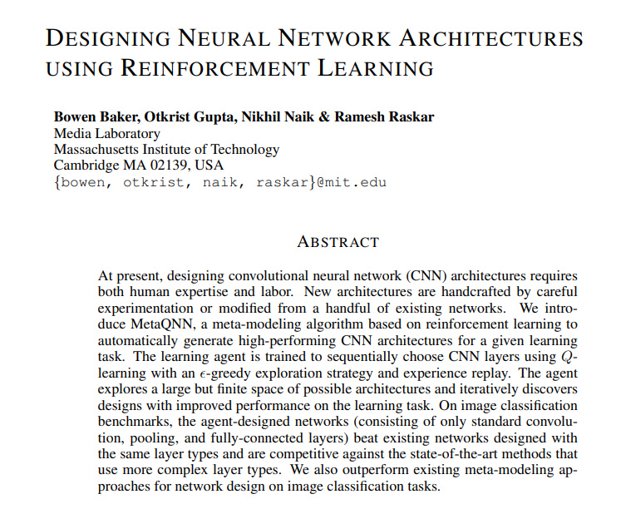
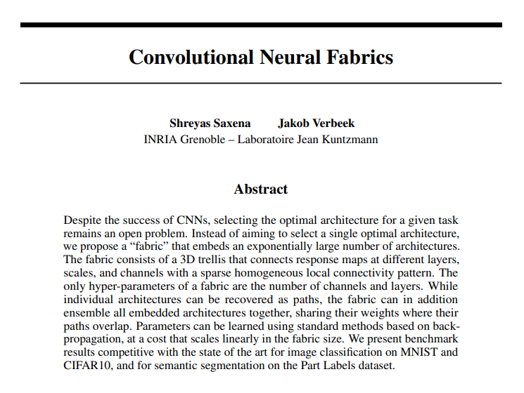
Papers identified to read (1 of 2)

Slide 13
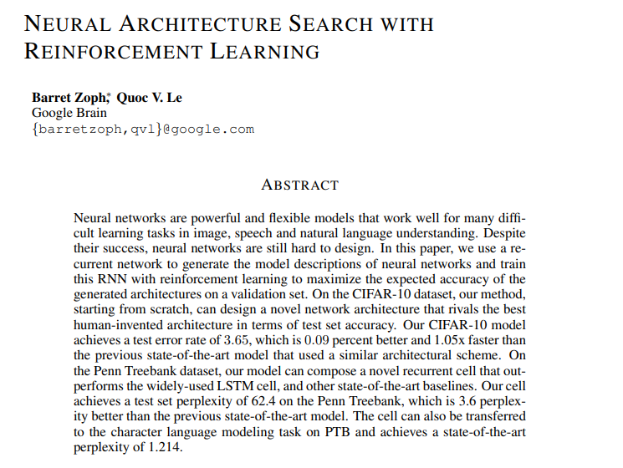
Papers identified to read (2 of 2)

