Slide 1
Location. Location. Location.
Project 1 Contributors
Danny Habetyes
Rebecca Booth
Matt Stieg

Slide 2
Our Goal
The goal of our project is to uncover states with the largest socioeconomic changes between the years 2011 and 2017. We will examine states across a number of metrics including Median Home Value, Median Income, Education Levels, Unemployment Rate, among others as the data permits. From there, we will score states to identify which states have experienced the most change and rank them on a scale of desirability through the aforementioned data.

Slide 3
Our Questions
Which states experienced the most socioeconomic growth between 2011 and 2017, in terms of percent change in :
Population growth?
Median Income?
Home purchasing power?
Education rate increase?
Unemployment decreases?
Why does it matter?
We share an interest in the affordability and equity in homes ownership.
We share an interest in which state(s) would be the best for relocation.
We found that the difference between the highest and lowest ranking states was significantly larger than we expected.

Slide 4
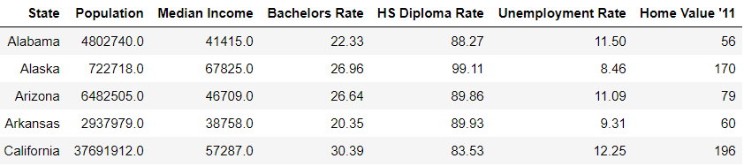
Raw Data
US Census API (acs1*) was called for all US States and D.C for Population, Median income, and Unemployment.
US Census API (acs1) was also used to call data for Education completed, including and beyond Bachelors Degree.
Quandl/Zillow API for Median Home Value per square foot was called to find Home purchasing power.
*Asc1 = American Community Survey 1-year Estimates
Notes:
Us Census API for Labor Force and then counting only those who were Unemployed.

Slide 5
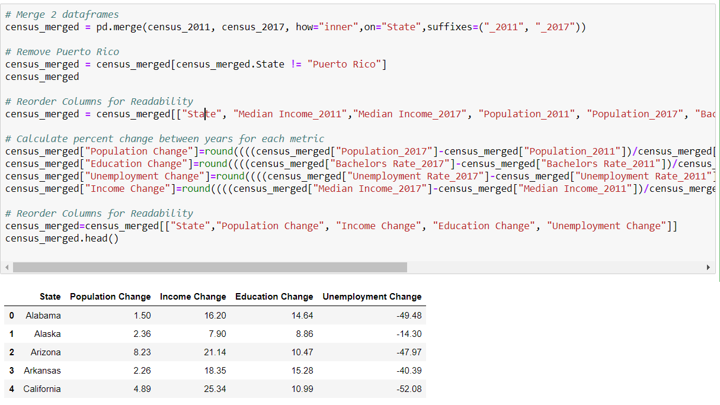
Data Cleanup
Our Major Cleanup shown here in Jupyter Notebooks.
Problems: Quandl State Identification, and Gmaps.
Notes:
Discussion of things we noticed along the way…

Slide 6
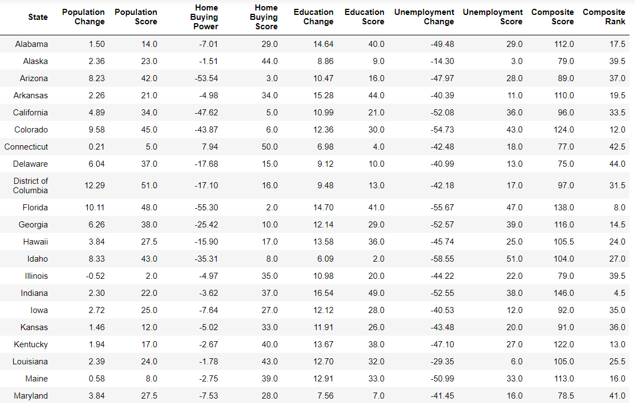
Data Analysis
We first analyzed Home Buying Power. [Home Buying power = Med Inc. Δ – Housing Δ]
The composite score was used to rank each states
Visualizations of our findings utilized those scores and rankings .

Slide 7
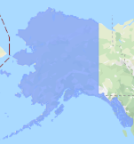
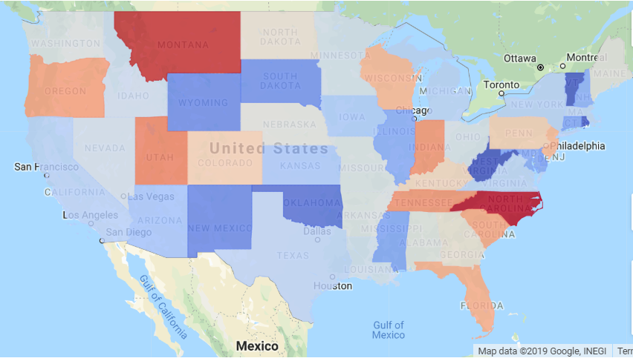
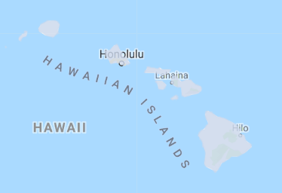
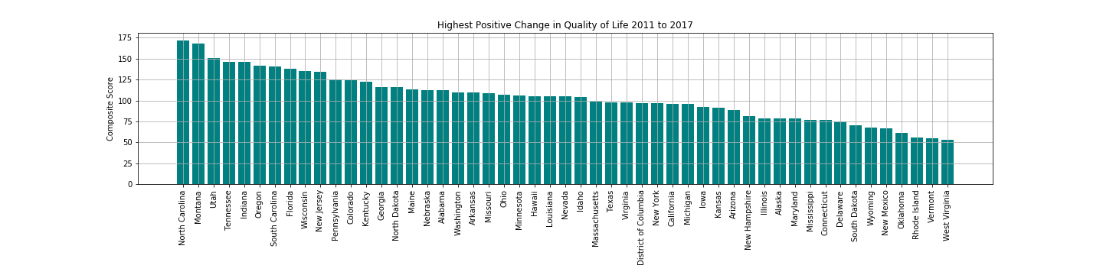
Composite Score Heat Map

Slide 8
Conclusions
Our overall goal was successful in establishing a Ranking of the States
We found that North Carolina, Montana, and Utah had the largest growth
Alternatively, Rhode Island, Vermont, and West Virginia had the smallest growth
We expected to find larger population hubs to rank higher
Home buying power had a wide variance by State ranging between 85% deficit and 8% benefit with a median of 8% deficit indicating major outliers like Nevada (-85%) and Arizona (-53%)
Education Rates have increased by 12% on average and does not vary widely by State
Unemployment has decreased by 44% on average and does not vary widely by State
We expected Home Buying Power to be a major contributor to desirability and were surprised to find that it had the lowest correlation to our composite score, whereas Education had the highest.

Slide 9
Final Thoughts
Difficulties
Quandl Formatting and Dataframe Cohesion
Census variable locating
Census Binning for Education Data
Gmaps
Git Merging . . .
Where would we dig further?
Business/Industry specific growth and Political Changes
More Benchmarking to normalize pre-existing rankings (2 Composite scores)
Fun Finding: Forbes and CNBC Ranked the “Best” and “Worst” States the same as our results!
https://www.forbes.com/, North Carolina Heads The Best States For Business 2017, https://www.cnbc.com/2017/07/11/west-virginia-americas-worst-state-for-business-in-2017.html, In an economic death spiral: West Virginia is America’s worst state for business in 2017

