Slide 1
E-commerce System Design
SWENG 837 Software Design Final Project
Presented by: Matthew Varghese

Slide 2
Introduction to the Project
An easy and secure shopping experience for customers.

Slide 3
System Overview
Key features: user authentication, product browsing, cart management, secure checkout.
React.js for the frontend, MongoDB for database management, Stripe for payments, and Heroku for backend deployment.

Slide 4
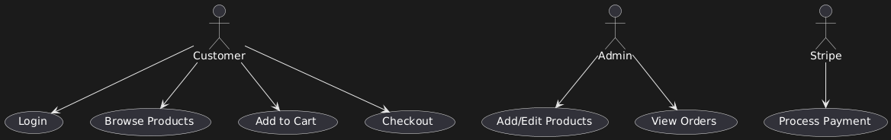
Use Case Diagram

Slide 5
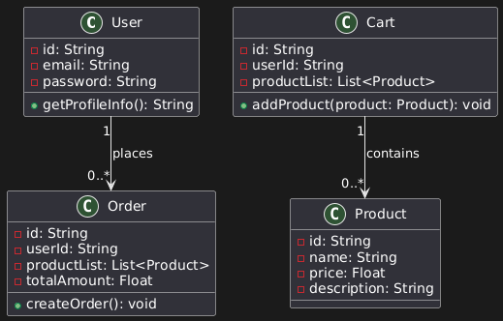
Domain Model

Slide 6
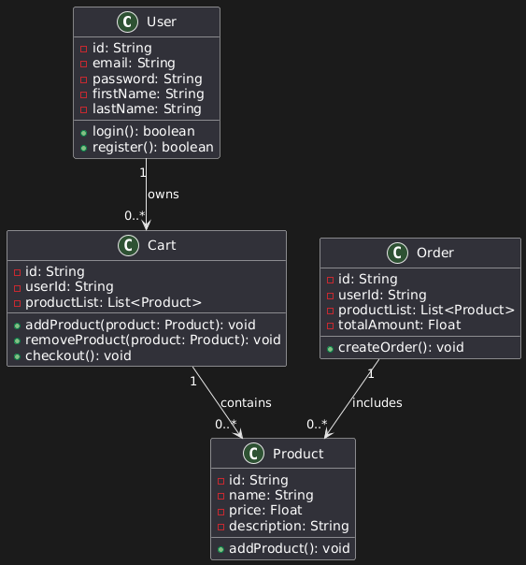
Class Diagram

Slide 7
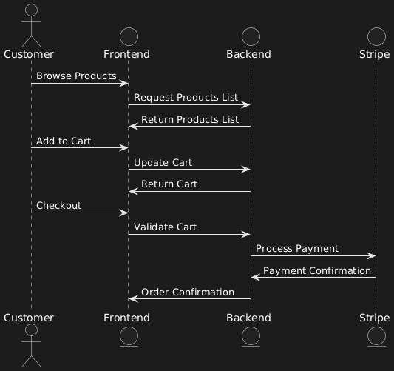
Sequence Diagram

Slide 8
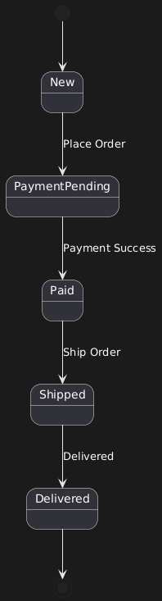
State Diagram

Slide 9
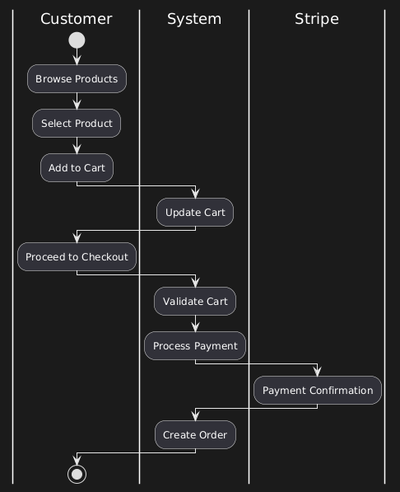
Activity Diagram (Swimlane Diagram)

Slide 10
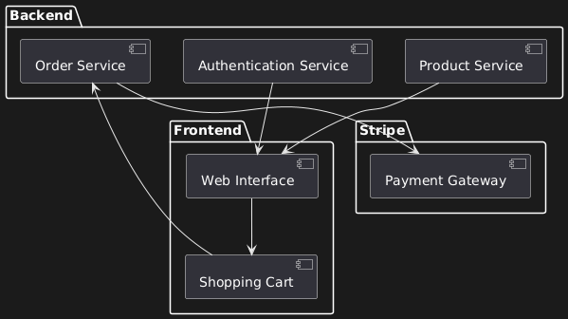
Component Diagram

Slide 11
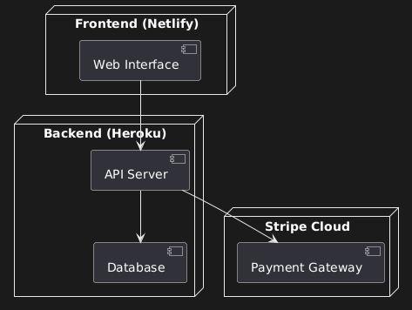
Cloud Deployment Diagram

Slide 12
Skeleton Classes and Database Tables
User Class: stores the user's information, including attributes like email, password, and other personal information. Methods are login(), register(), and updateProfile()
Product Class: Each product has an id, name, price, and description. There are methods for adding, updating, and removing products, like addProduct(), updateProduct(), and deleteProduct()
Cart Class: This class is just for the cart system. It includes an id, userId, and productList. Methods are addProduct(), removeProduct(), and checkout()
Order Class: Once a customer checks out, an order with Stripe is created. It will have id, userId, productList, and totalAmount. Methods are createOrder(), cancelOrder(), and viewOrder().

Slide 13
Design Patterns
GRASP
SOLID
GOF
Microservices

