Slide 1
Pitfalls with Regression
Matthew Vowels 2019
https://github.com/matthewvowels1
And the importance of
structure

Slide 2
Problem Set Up
A
B
Main Predictor
Outcome
C
X
Y
D
E
F
Controls e.g. demographics etc.

Slide 3
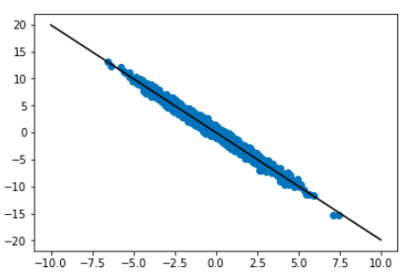








Problem Set Up
$$β_{A}$$
$$y= βX+ε$$
A
$$β_{B}$$
B
$$β_{X}$$
Coefficient = -2
X
Y
$$β_{C}$$
Y
C
$$β_{D}$$
D
$$β_{E}$$
X
E
$$β_{F}$$
F
QUESTION: How does the inclusion of controls affect our coefficient estimation?

Slide 4
Problem Set Up
Methods to Include/Exclude Variables
Model Parsimony
All at once
Forward
Backward
Should we be interpreting models derived using these methods?

Slide 5
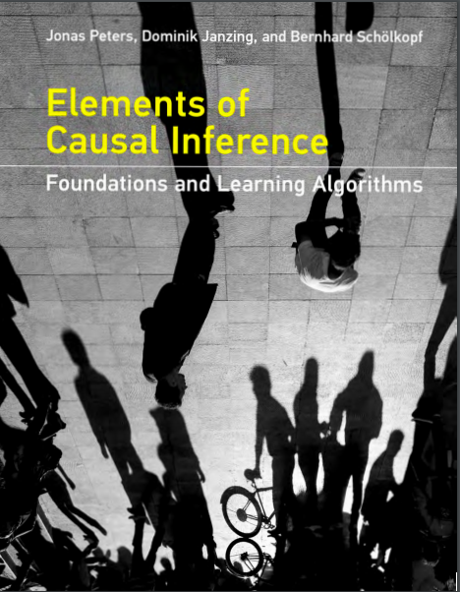
LR is a ubiquitous statistical and machine learning technique.
Does simplicity always mean it is reliable?
Coefficient estimates not as they seem
Depends on underlying generative structure
Peters, J., Janzing, D., Scholkopf, B. (2017)
Elements of Causal Inference: Foundations and Learning Algorithms
MIT Press, Cambridge, MA.

Slide 6
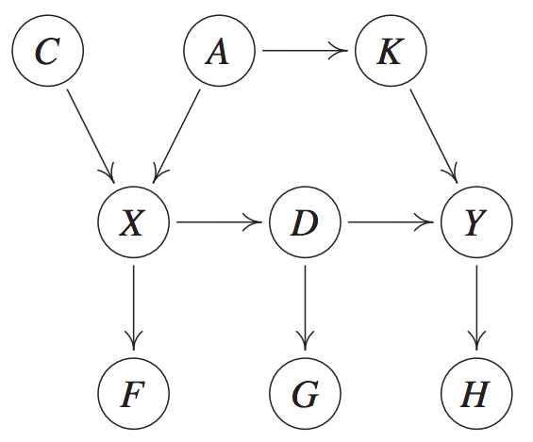
Let’s pretend we don’t know the structure, but…
pp 117
pp 115
Peters, J., Janzing, D., Scholkopf, B. (2017)
Elements of Causal Inference: Foundations and Learning Algorithms, MIT Press, Cambridge, MA.

Slide 7
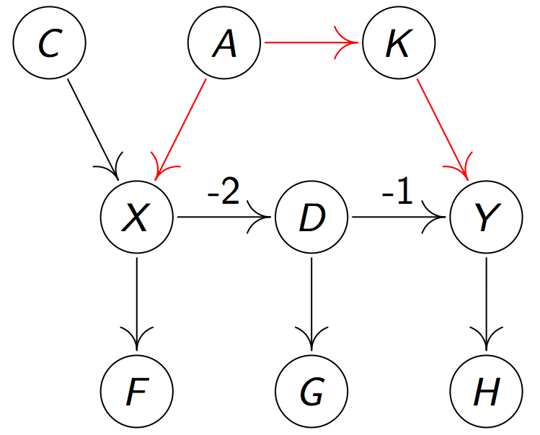
Slide 52
1
1
X > Y: (-2 * -1 = 2)
2
-2
3
1
0.5
See also 1:09:00 in https://www.youtube.com/watch?v=zvrcyqcN9Wo
Peters, J. (2017) Causality, lecture slides
http://web.math.ku.dk/~peters/jonas_files/mitTutorialJonas.pdf

Slide 8
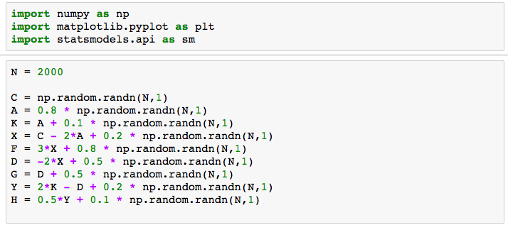
Example taken from:
Peters, J., Janzing, D., Scholkopf, B. (2017)
Elements of Causal Inference: Foundations
and Learning Algorithms
MIT Press, Cambridge, MA.
Pp. 117

Slide 9

Slide 52
1
1
2
-2
3
1
0.5
Peters, J. (2017) Causality, lecture slides
http://web.math.ku.dk/~peters/jonas_files/mitTutorialJonas.pdf

Slide 10
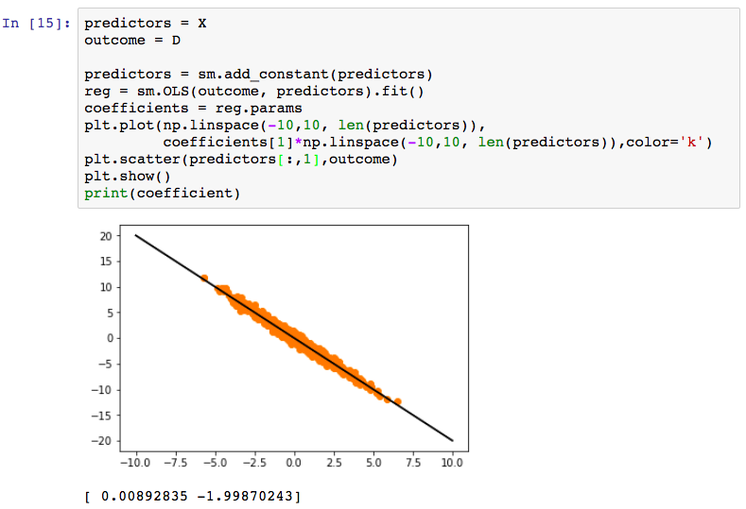
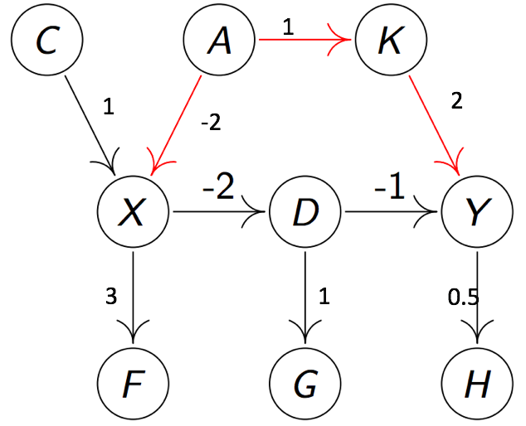


Slide 11

Slide 52
1
1
2
-2
3
1
0.5
Peters, J. (2017) Causality, lecture slides
http://web.math.ku.dk/~peters/jonas_files/mitTutorialJonas.pdf

Slide 12
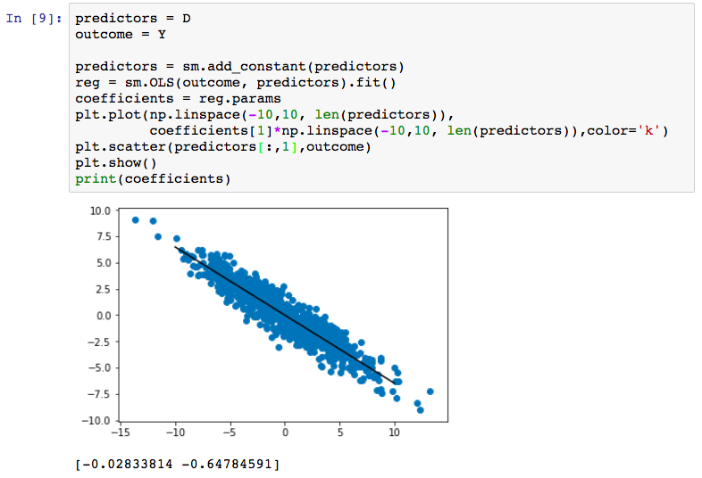



Slide 13
Slide 52
1
1
2
-2
3
1
0.5
Peters, J. (2017) Causality, lecture slides
http://web.math.ku.dk/~peters/jonas_files/mitTutorialJonas.pdf

Slide 14
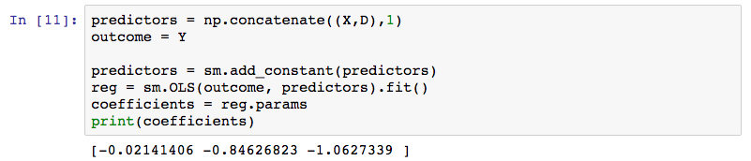
intercept
X
D
Sign has changed!

Slide 15
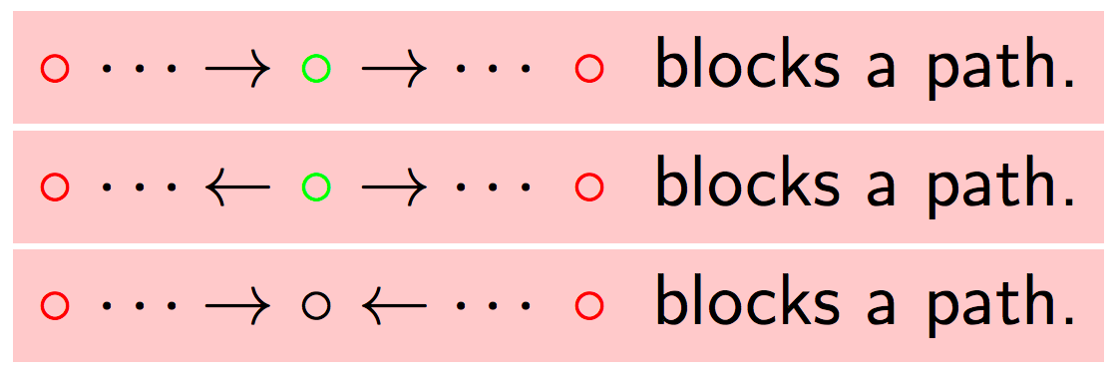
Peters, J. (2017) Causality, lecture slides
http://web.math.ku.dk/~peters/jonas_files/mitTutorialJonas.pdf

Slide 16
Slide 52
1
X > Y (-2 * -1 = 2)
Adjust for backdoors
Possible adjustment variables include:
{A}, {K}, {A,K}
Including F, G, H will not affect our estimation
1
2
-2
3
1
0.5
Peters, J. (2017) Causality, lecture slides
http://web.math.ku.dk/~peters/jonas_files/mitTutorialJonas.pdf

Slide 17
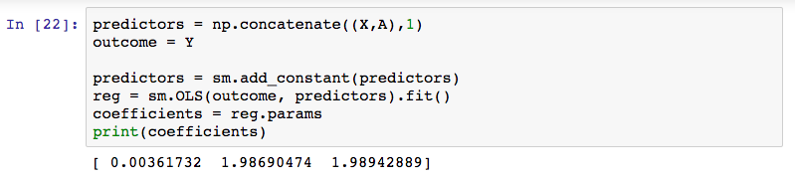
intercept
X
A
X > Y: (-2 * -1 = 2)

Slide 18
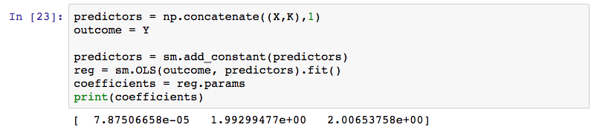
intercept
X
K
X > Y: (-2 * -1 = 2)

Slide 19
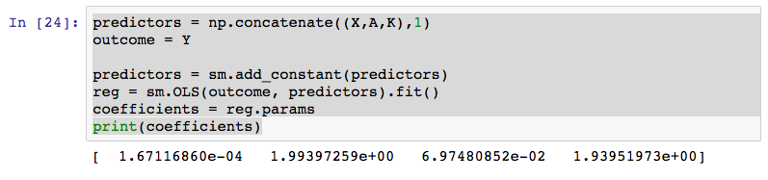
X
A
K
intercept
X > Y: (-2 * -1 = 2)

Slide 20
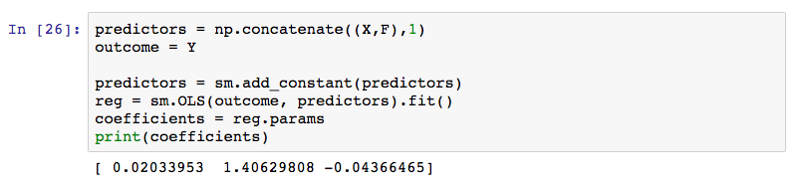
X
K
intercept
F
X > Y: (-2 * -1 = 2)

Slide 21
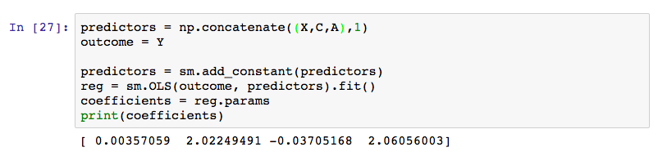
intercept
X
C
A
X > Y: (-2 * -1 = 2)

Slide 22
Take-aways
Reliable estimation heavily depends on choice of controls (or, in SCM, ‘adjustment’ variables) and the underlying structure. Can even invert correlation sign!
Using all variables, OR using forward or backward methods are very unlikely to yield reliable estimates.
We should refrain from interpreting such models – at best, they may be useful for prediction and little else.
We need to consider the underlying structure carefully (e.g. by using SCM)

