Slide 1
Targeted Learning Procedure
M.J. Vowels 2020

Slide 2
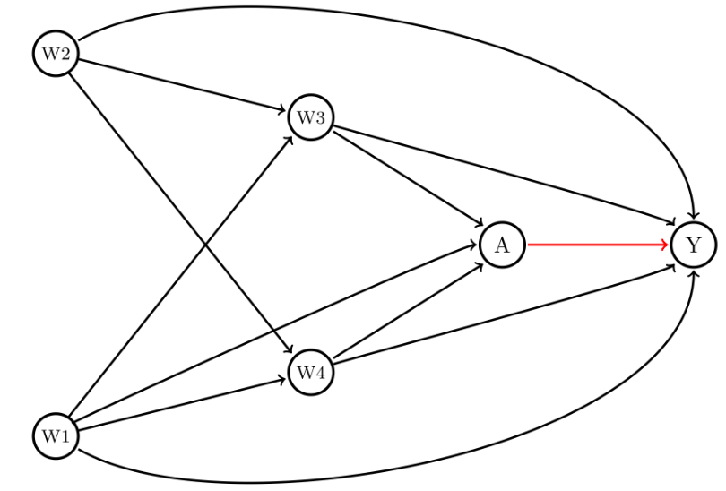
W1
W2
A
Y
W3
W4
https://migariane.github.io/TMLE.nb.html

Slide 3
We have outcome Y {0,1}, treatment A {0,1} and covariates W.
If we are simulating data we can generate ground-truth counterfactuals
y | A=1, W = sigmoid(-1 + 1 + beta*W) where beta & W are ground truth
y | A = 0, W = sigmoid(-1 + 0 + beta*W) where beta & W are ground truth
S.t. y = (y_1 * A) + (y_0 * (1-A))
And therefore we have access to the ground-truth True Psi (ATE) = E(y_1 – y_0)
Naïve_Psi (ATE): regress y ~ intercept + Psi*A + Beta*W
From (3) and (4) we have
(Naïve_psi – true_psi) / true_psi * 100 = relative naïve bias
(Naïve_psi – true_psi) = naïve bias
Find Q_AW = logit(P(Y=1|A,W)) for A=1 and A=0: <<<<< g-computation
Train classifier (e.g. SuperLearner) M e.g. as y ~ -1 + A + W
Q_1W is found by predicting (linear) when A=1 using M, setting A=1 for ALL sample
Q_0W is found by predicting (linear) when A=0 using M, setting A=0 for ALL sample
Q_1W := exp(Q_1W)/(1+exp(Q_1W))
Q_0W := exp(Q_0W)/(1+exp(Q_0W))
Mean(Q_1W - Q_0W) = Q0_TMLE
Find propensity scores g(A,W): <<<<< exposure mechanism (i.e. who gets treatment?)
Train classifier (e.g. SuperLearner) G logit(P(A=1 |W)) e.g. as A ~ -1 + W and then take sigmoid to get probs
Find stabilised inverse probability of treatment weights (IPTW) or ‘clever covariates’ H0 and H1 and the fluctuation parameters epsilon0 and epsilon1. Essentially we update initial estimate of Q.
Use logit(Q_AW) (conditional probability of outcome) as a fixed intercept, the propensity scores g, and calculate:
H0 = -II(A=0)/(1-g1w) for each individual
H1 = II(A=1)/g1w for each individual
Epsilon = coeff(glm(Y ~ -1 + (A/g1w – (1 - A)/(1-g1w)) + offset(Q_AW))) WHERE (A/g1w – (1 - A)/(1-g1w)) is the difference between H0 and H1
Update Q0W and Q1W with the epsilon params logit(Q*) = logit(Q) + epsilon*H
Finally calculate Psi_TMLE as mean(Q*(A=1,W) – Q*(A=0,W))
https://migariane.github.io/TMLE.nb.html

