Slide 1
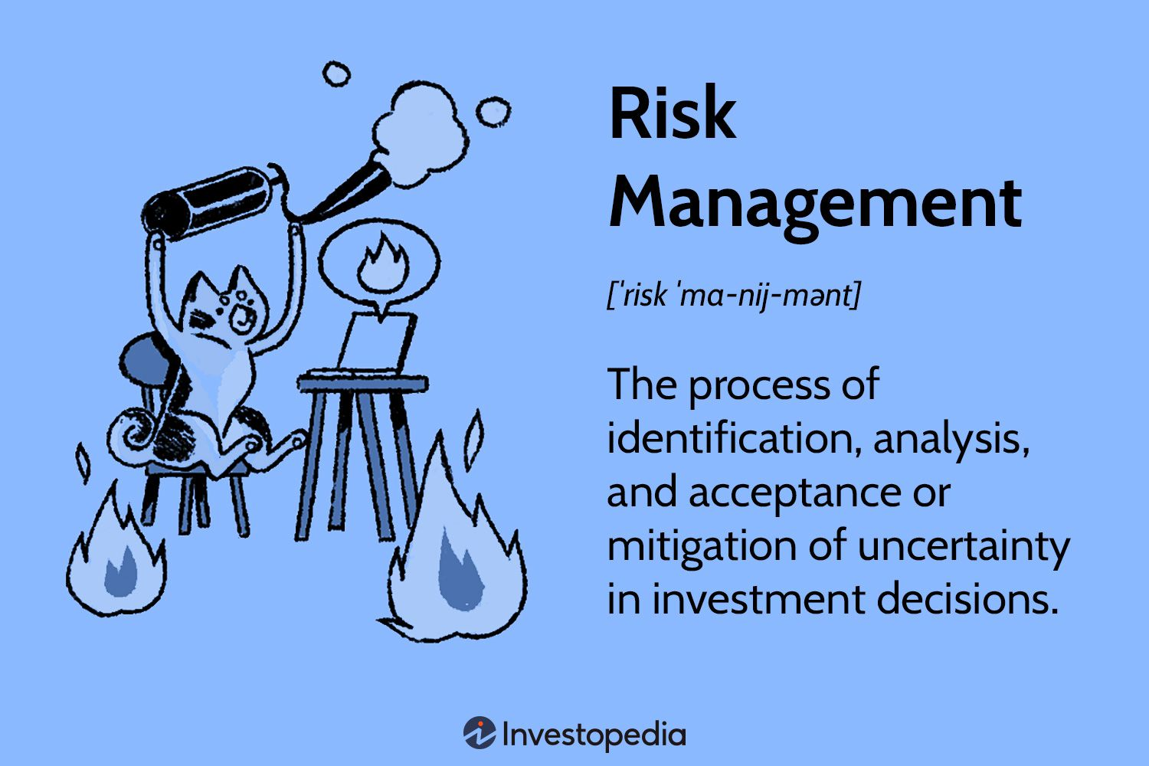
Machine Learning in Risk Modeling
History + Overview
Maroon Capital Board Presentation
Analyst: Matthew Li

Slide 2
Table of Contents
Brief History of Financial Risk Modeling
Introduction to Applicable ML Models
How ML has Improved Financial Risk Modeling
Further Applications

Slide 3
Previous Financial Risk Modeling Techniques
A mix of historical, probabilistic, and correlation analysis
Historical Simulation
Monte Carlo
Using historical data to find probability distributions and risk correlations in past data
Assumes that previous indicators of risk will persist
Invented in Monaco in the 1940s through roulette
Basic principle is in ergodicity: the statistical behavior of a moving point in an enclosed system
3 main assumptions: returns are normally distributed, expected returns are constant over time, all return parameters are known¹
Value-at-Risk (VaR)
Parametric Models
Statistic that calculates the possible financial losses of a set of assets within a time frame
Can be computed using historical, variance-covariance, and Monte Carlo methods
Reduces chance of firm holding many highly correlated assets
Specific probability distributions for inputs
e.g., normal, lognormal distributions
Allow for further extrapolation beyond historical data through closed-form expressions
https://macabacus.com/blog/financial-risk-modeling-management-strategies
https://aws.amazon.com/whatis/montecarlosimulation/#:~:text=The%20Monte%20Carlo%20simulation%20is%20a%20probabilistic%20model%20that%20can,home%20and%20office%20is%20fixed.

Slide 4
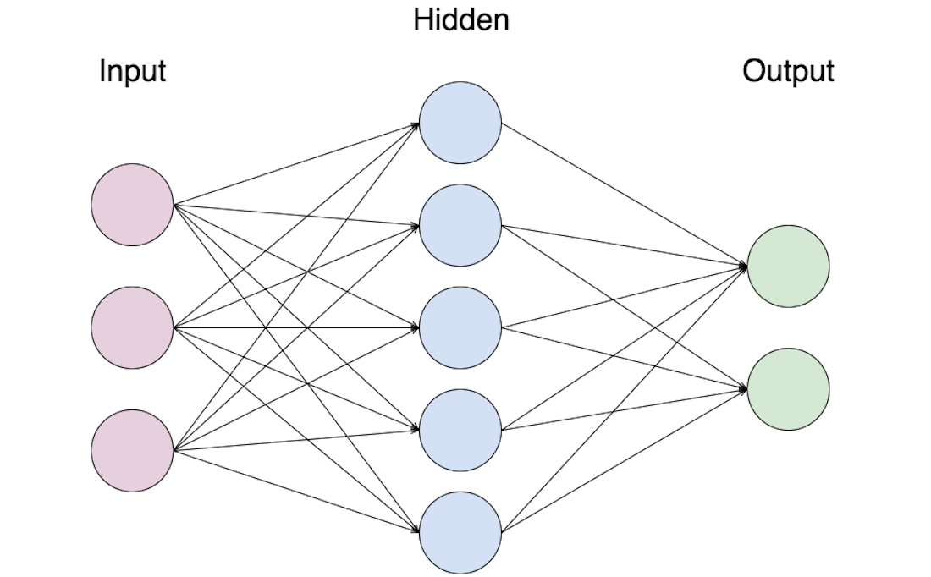
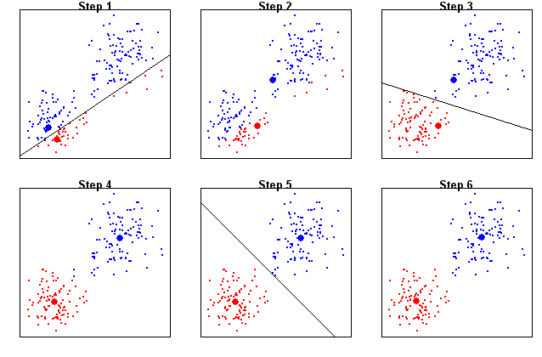
Machine Learning Techniques and Models
Machine Learning is a subset of statistics leading to revolutionary regressions and modeling
Important Techniques and Features
Neural Network Node Structure
Supervised learning – using multiple input variables to model out an output and check back for accuracy to revise model parameters
Unsupervised learning – using data to predict and identify structures and patterns
Better than linear regression since the models can point out non-linear relationships
Linear methods include: partial least squares, principal component analysis
Non-linear methods include: penalized regression, least absolute shrinkage and selection operator (LASSO), elastic nets
Problem of overfitting for overly complex models
K-Means Clustering Algorithm
https://www.iif.com/portals/0/Files/private/32370132_van_liebergen_-_machine_learning_in_compliance_risk_management.pdf

Slide 5
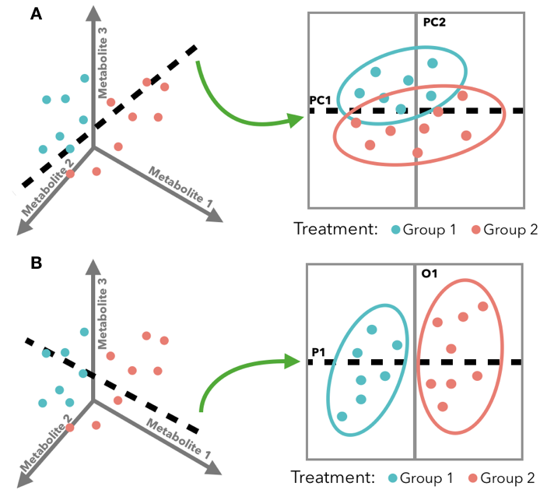
Supervised Linear Regression
Principal Components, Ridge, Partial Least Squares, LASSO
Basic Idea
Partial Least Squares Example
One of the most popular types of algorithms due to wide range of use cases
Similar to regular statistical linear regression models
Used to simulate mathematical relationship between variables for continuous predictors
Principal Components Analysis (PCA) – used to represent a multivariate data table as a smaller set of variables to better observe trends
Ridge Regression (L2) – regression across highly correlated variables using ridge estimators instead of ordinary least squares, creating lower, biased variance
Partial Least Squares – similar to PCA, but instead of reducing dimensionality, it translates variables to a new space, making it a bilinear factor model
https://ericrscott.com/project/pls-ecology/

Slide 6
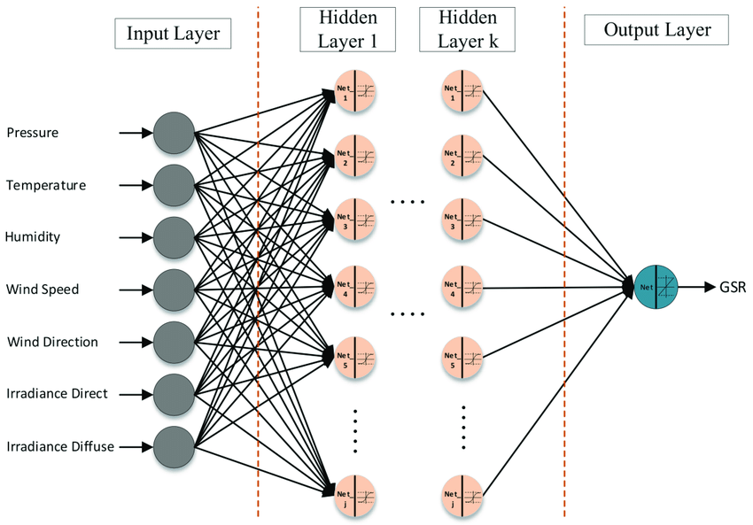
Supervised Non-Linear + Linear Regression
Penalized Regression (LASSO, LARS, Elastic Nets), Neural Networks, Deep Learning
Key Components and Difference from Linear
Neural Network Structure
Key difference is that the equation can include polynomial terms, interaction effects, and variable transformations
LASSO (L1), although traditionally linear, can be used with polynomial terms to become non-linear
LARS can also be fitted with non-linear models, targeting highly correlated predictors in a set
Elastic Nets (L1 + L2) attempts to combine ridge and LASSO to regularize statistical models, also consider linear
Neural Networks uses a structure of nodes to predict an outcome using various layer complexities
Deep Learning is the more complex, higher-level version of neural networks

Slide 7
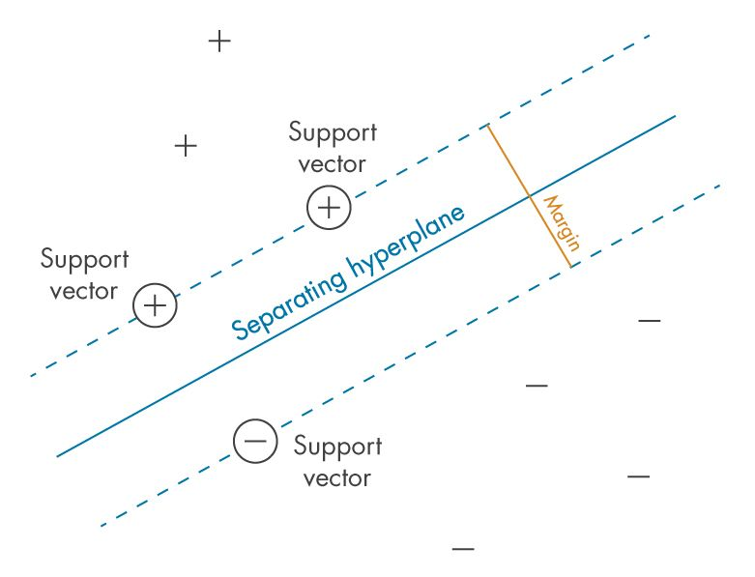
Supervised Linear Classification
Support Vector Machines
Key Features and Differences from Regression
Support Vector Machine Diagram
Classification groups into buckets whereas regression looks for a specific output value
Support Vector Machines (SVMs) is an algorithm that splits data into groups and classifies data
Can be considered for regression as well and excels specifically in binary classification settings
Theoretically, any unsupervised algorithm has its supervised counterpart (although not always recommended
e.g., K-means can be implemented with SVM to create a supervised algorithm

Slide 8
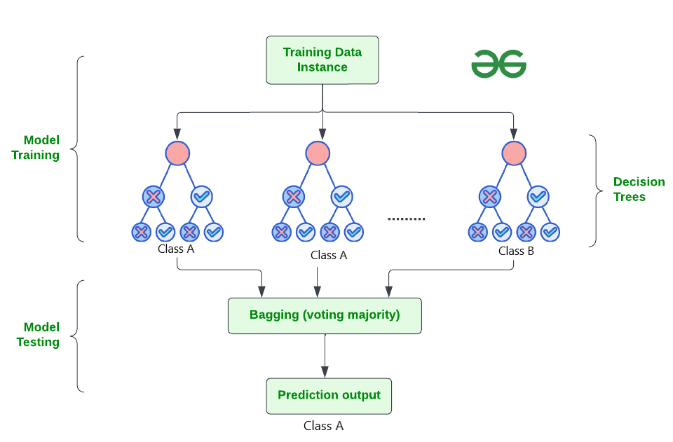
Supervised Non-Linear Classification
Decision Trees (Classification, Regression, Random Forest), Support Vector Machines, Deep Learning
Efficiencies with Non-Linear Classification
Random Forest Graph
Non-linear classification allows for more efficient, correct division of data
Decision Trees are models that follow a tree like structure to determine various classifications
ID3: Iterative Dichotomiser 3 – utilizes entropy
C4.5: v2 of ID3 – uses information gain and gain ratios to evaluate split points within decision trees
CART: Classification and Regression Trees – utilizes Gini impurity to identify the best attributes to split itself on
Random Forest – utilizes a set of trees
SVMs can be modified to become non-linear
Deep Learning is typically non-linear since it can take into account multiple features and classify with weights
https://hunch.net/~coms-4771/quinlan.pdf

Slide 9
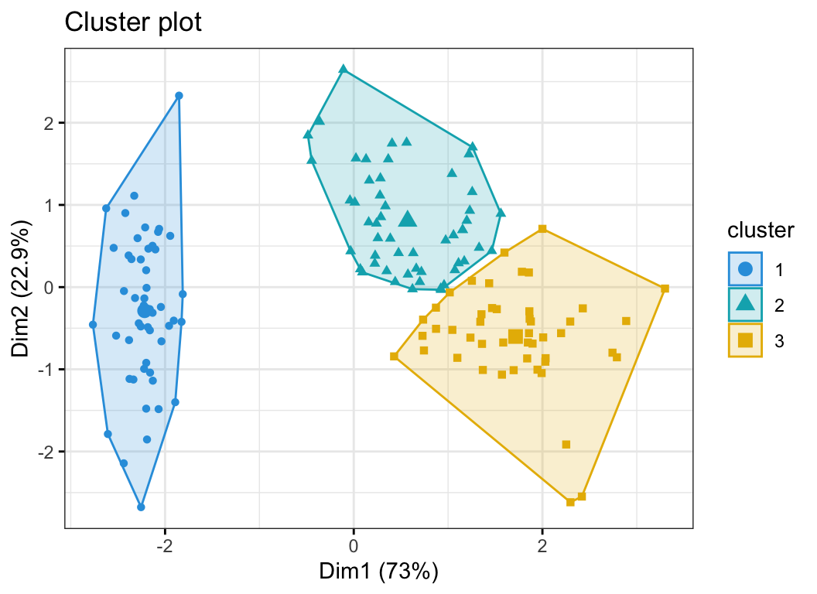
Unsupervised Clustering
Clustering Methods (K-, X-means, hierarchical), PCA, Deep Learning
Key Points and Advantages
K-means Graph
Unsupervised utilizes unlabeled data, which is significantly more prevalent
K-means partitions n data points into k clusters with areas known as Voronoi cells, minimizing intra-cluster variance – mean squared error (MSE)
X-means is an improved version of K-means with an improved local decision maker
Bayes Information Criterion
Akaike Information Criterion
Hierarchical Agglomerative Clustering (HAC) uses a tree, a dendrogram, for group objects with general strategies including single-linkage and complete-linkage clustering (SLINK and CLINK, respectively)
https://www.sciencedirect.com/science/article/pii/S1110866522000639#:~:text=X%2Dmeans%20%5B29%5D%20is,to%20obtain%20a%20better%20cluster.

Slide 10
Struggle with Complex Financial Instruments
Traditional Methods of Risk Analysis Fall Short on Capturing the True Essence of Instruments like Derivatives
Current Inefficiencies
Machine Learning Solution
Data selection is slow and cross-correlation among explanatory variables is common
Many key assumptions in models like Monte Carlo may not hold up in the real world
Large portfolios have many cross-correlated assets and including these considerations is hard for non-Machine Learning algorithms
Extremely complex results that can be hard to read, understand, and implement
VaR often establishes a 99% confidence interval, leaving a 1% chance for a huge loss (inaccurate weighting)
GIGO
Many financial crises since the inception of VaR, the most widely used financial risk model, despite advances in its implementation
Manages garbage in a little more efficiently and can exclude certain useless data
Void if the whole dataset is garbage
Can perform more complex cross-correlation analyses through algorithm structure
Hidden layers in neural networks
Complex, adaptive categorization algorithms
Entropy-based decision making in tree structure
Does not rely on previous assumptions
Creates easier-to-read solutions
https://www.ncbi.nlm.nih.gov/pmc/articles/PMC8219786/
Notes:
https://www.linkedin.com/pulse/enhancing-market-risk-models-machine-learning-techniques-ali-h-rizvi/

Slide 11
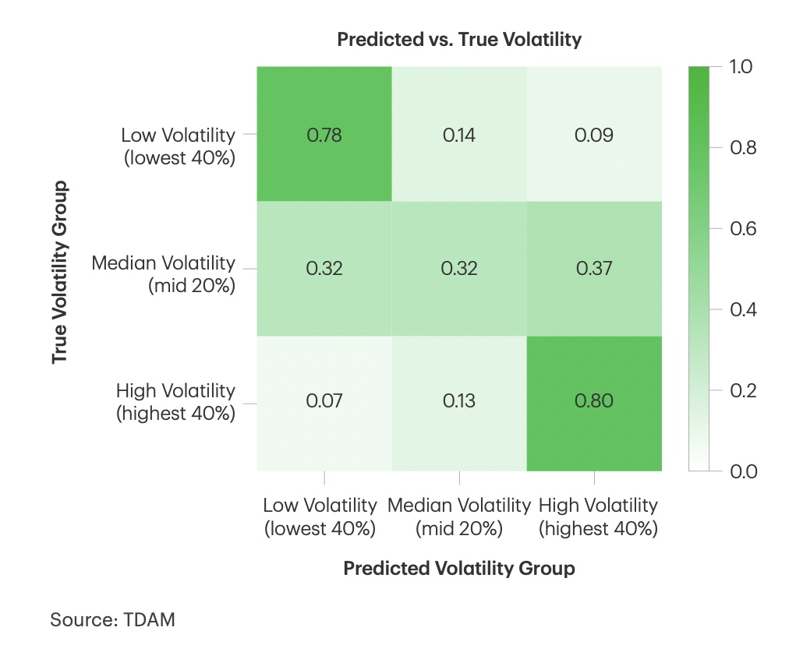
Case Study: TD Bank
TD Bank’s Machine Learning Implementation in Risk Forecasting
Key Findings
Confusion Matrix from Machine Learning Model
S&P standard deviation is ~14%
After volatility reduction model, SD is ~11%
After additional ML reduction, SD is ~10%
ML models face significant success in picking reduced volatility assets for low volatility funds
Idiosyncratic risk is independent and uncorrelated with risk model factors, which can be identified by ML models
Limitation is that it reduces the size of the universe of investible stocks
More problematic in already smaller equity universes
https://www.td.com/us/en/asset-management/documents/pdf/TDAM-USA-Low-Vol-Machine-Learning.pdf

Slide 12
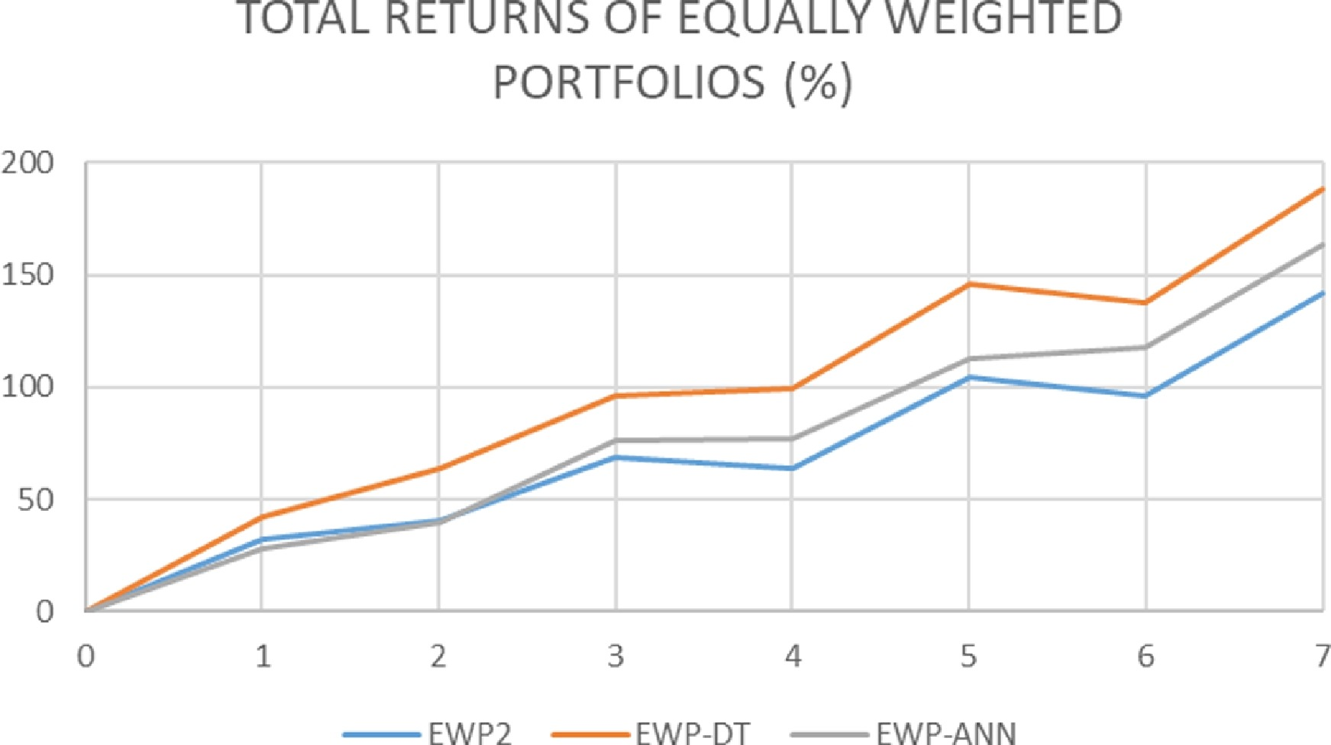
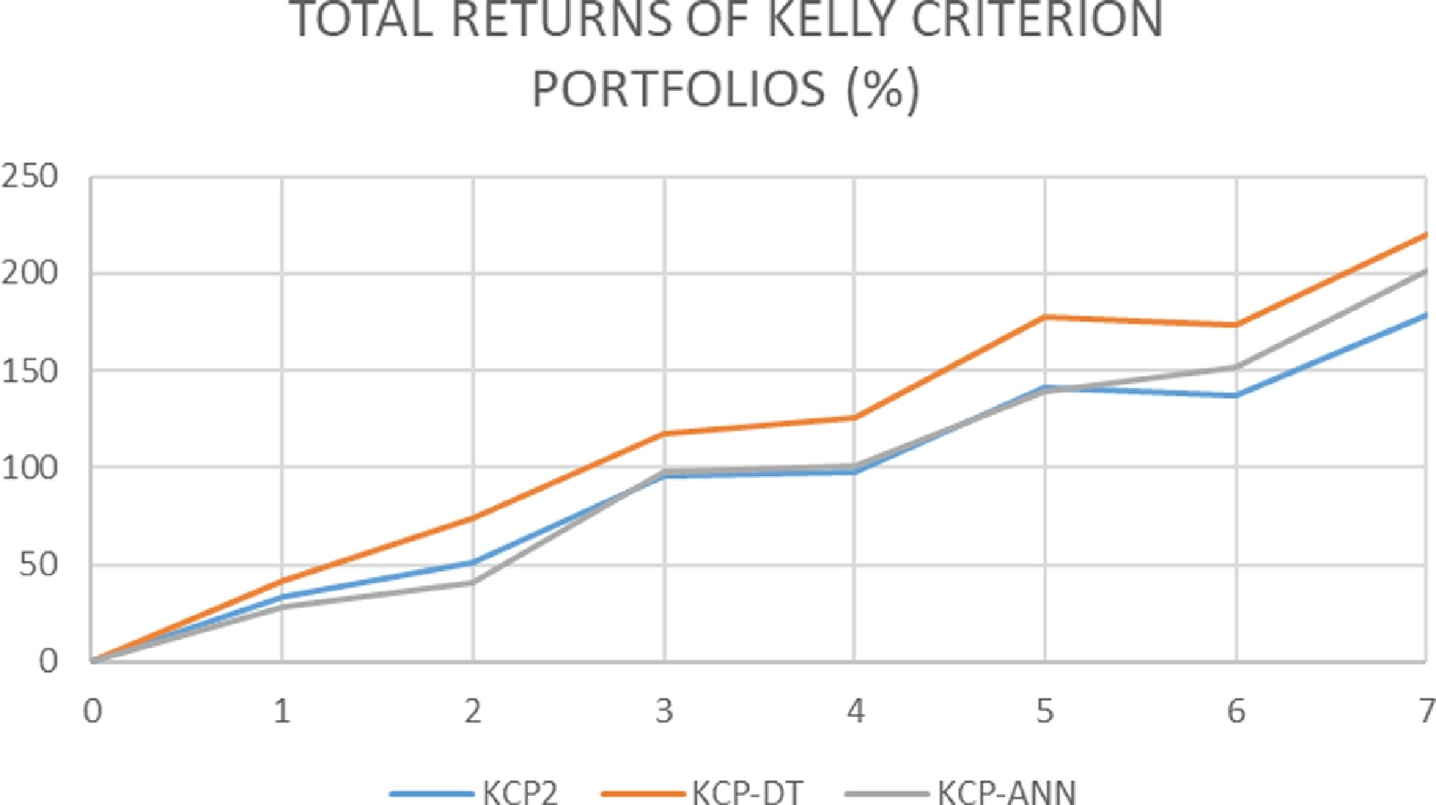
Case Study: AIRMS
Artificial Intelligence Risk Management System (AIRMS)
Implementation and Findings
Results
Utilized artificial neural networks and decision trees on dynamic sliding windows in 5 major FOREX pairs to determine a breakout strategy from 2010-2016
Outperformed a SVM, genetic algorithm combination
Globally-optimal classification tree analysis (GO-CTA)
Limited at 20 features
Applied to the enhanced equally weighted portfolio (EWP2) and enhanced Kelly criterion portfolio (KCP2), strategies that relate to SD
Results showed a 50% increase in profit when using the suggestion from the machine learning models compared to regular strategies
Further work could be done in other markets, implementing SVMs, more complex NNs (RNNs, LSTM, GRU)
https://www.sciencedirect.com/science/article/pii/S0957417418301908?via%3Dihub

Slide 13

Questions?

