Slide 1

Searching with Apache Solr
SWEX Gathering 2025
Matthias Graf | 1. April 2025 | Schlieren
Notes:
Cool that someone is interested in Solr
The goal for today is to show you what Solr is and how it can be easily integrated
No deep dive into the internal mechanisms of Solr; if you are interested in specific topics, please let me know!
Slides are from a presentation at the Java Forum. There’s a lot more information that I will briefly cover—feel free to interrupt me if you have questions.

Slide 2
What is Search?

Slide 3
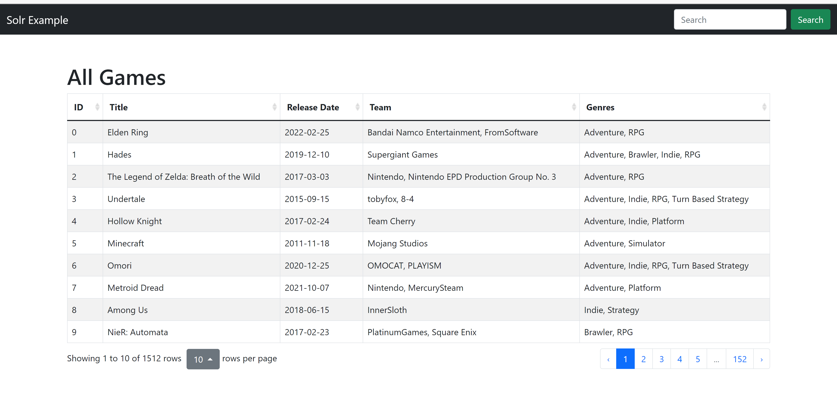
Filtern oder Suchen?
Filtering
Searching
Notes:
In a web application, a search function generally allows users to input a query to locate content or data from a broader dataset.
The user often does not know exactly what data he is looking for; he wants to find all kind of data related to his query.
We do not want to filter data according to some categories, we want to search for context
A good search function is immensely important when it comes to the usability of an application.
Even inexperienced users can then easily and quickly operate an application and find necessary data.
Nowadays, users expect a good search function.
A good search function is difficult to implement. The desired results are not clearly defined and depend on the context of the user
​
​
​
​
​

Slide 4
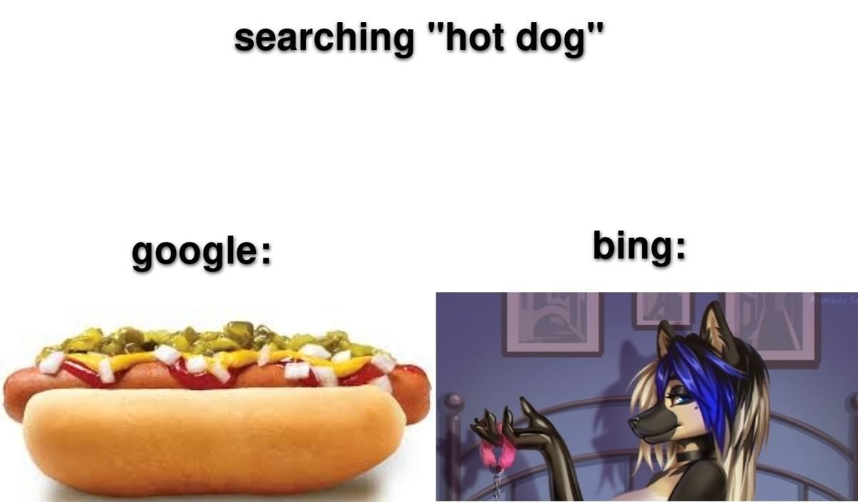
Notes:
What do I mean by that? See meme
To get good search results, we must understand what the user is looking for.
As this is usually not the case and changes with the availability of a search function, it should be monitored and challenged with the user. Do not spend to much time in pre-user-optimization, but start slow and then improve!
Search function need to incorporate different new features like stemming, distance search, phonetic matching, synonyms, spelling etc.
We need a dedicated tool. No SQL queries or self developed logic

Slide 5
What is Solr?

Slide 6
Apache Solr
Facts and Figures
Open-Source-Enterprise-Suchplattform
Developed in Java, based on Apache Lucene (as e.g. Elasticsearch)
Index-Search
Provide features like Highlighting, Faceting, Clustering, Stemming, Replication, Balancing, Binary documents, etc.
Use by DuckDuckGo, Adobe, Instagram, eBay, Netflix, Disney etc.
Übergabe Lucene an die Apache Foundation
Übergabe Solr an die Apache Foundation
Solr wird eigenes Apache Top-Level Project
1999
2001
2004
2006
2012
2021
2022
Erste Version der Such- Engine Lucene
Erste Version Solr als interne Suche bei CNET
Merge der Projekte Solr und Lucene, Release 4.0
Aktuelles Major-Release 9.0

Slide 7
Begriffe
Document | A set of data that describes something. The fundamental unit of information in Solr. Documents are composed of fields (semi-structured). They should have an ID.
Field | Part of a document, fields can contain different types of data, e.g., text, floating-point numbers, lists, etc.
Collection | Documents grouped into a single logical index with a single configuration.
Core | A single Solr instance/logical node. Multiple cores can run on a single physical node. Each core runs one collection
Shard | A collection can be distributed on multiple cores by splitting it up in shards. Each document is assigned to one shard.

Slide 8
What is an „index“?
Spaghetti Carbonara
Id: 1
Zutaten: Spaghetti, Ei,…
Zubereitungszeit: 25 min
Zubereitung: Spaghetti im Salzwasser al dente garen. Zutaten mischen …
Zubereitung
Zutaten...........1,2
Teig...................2
Vorbereiten.......2
Salz................1,2
Mischen.........1,2
Spaghetti...........1
Al-Dente............1
Garen................1
Zwiebel..............3
Bratbutter..........3
Bouillon.............3
Erbsen...............3
Zubereitungszeit
145……………….2
25…………………1
Erdbeertörtchen
Id: 2
Zutaten: Zucker, Ei, Sahne,…
Geräte: Backofen
Zubereitungszeit: 145 min
Zubereitung: Alle Zutaten für den Teig vorbereiten. Mehl, Salz und Zucker mischen …
Indexing
Zutaten
Ei……….1,2
Zucker……2
Sahne…….2
Spaghetti…1
Erbsen
Id: 3
Typ: Grundrezept
Zubereitung: Zwiebel in der heissen Bratbutter 5 Minuten anbraten. Mit Bouillon ablöschen und Erbsen beifügen…
Typ
Grundrezept..3
Geräte
Backofen…..2
Inverted Index
Semistrukturierte Daten (Dokumente)
Notes:
Solr is an index-based search... But what is an index?
An index can be thought of as a keyword directory at the end of a book.
Solr takes semi-structured documents as input. In a process called "indexing," these documents are read and their fields are divided into "tokens." From these tokens, a keyword directory is created.
Ver

Slide 9



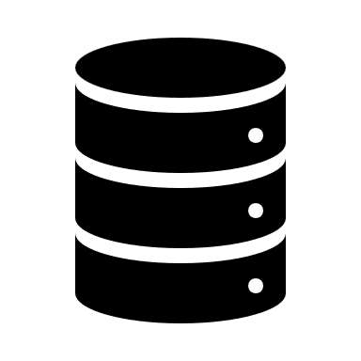
How does solr work?
<XML>
Query
solrconfig
Input Documents
Search Handler
Update Request Handler
Query
Parser
Response
Writer
Tokenizer
Filter
Filter
Tokenizer
Filter
Filter
Lucene
<XML>
schema
Notes:
Solr provides a REST API that has two important functions: "Search" and "Update."
Additionally, it provides a basic UI
Through the update interface, new documents can be added. These documents are then broken down into tokens by a "tokenizer" (e.g., Whitespace Tokenizer). The tokens can be further processed using filters (e.g., synonyms, stemming, spellcheck, etc.). Afterward, the tokens are added to the Lucene index.
Additionally, the content can also be stored in Lucene.
Through the search interface, search queries can be made. These queries can be processed through the same or a different pipeline.
After processing, IDs and possibly stored field values can be returned.
The pipeline is defined by the "schema." This is central for optimizing the search.
However, there is an "automatic" schema that can be used as a starting point.
Beside the schema, there is a configuration file defining the endpoints etc.

Slide 10
How can I use Solr?

Slide 11
Docker-Setup
Start solr using Docker
docker run -p 8983:8983 -t solr
Erweitertes Start solr using Docker Compose
solr:
image: 'solr:9.8.0'
ports:
- "8983:8983"
command:
- solr-precreate
- COLLECTION_NAME
- /template
volumes:
- ./CONFIG_DIR:/template/conf
- solr-data:/var/solr

Slide 12
Tipps und Tricks
Solr is easy to integrate but difficult to master. Start with an MVP and build up slowly
What and how is the user searching? Optimize using this context!
How is the user searching? Custom queries vs. Solr queries?
Schema optimizations
Continuous monitoring and optimization
Best practices
One collection for different data
Include as much data as possible; schema changes and reindexing are costly
Pain points
Permission checks on search results?
When to update the index? High load or outdated data?
Notes:
Was gilt es zu beachten?

Slide 13

Fragen?
More Information
solr.apache.org/guide
Official Solr Documentation; Tutorials, Guides for Deployment und Configuration, Documentation of Query-Parser and much more
hub.docker.com/_/solr
Official Docker-Image
baeldung.com/apache-solrj
SolrJ-Tutorial
github.com/lizzyTheLizard/solr-jfs2023
Slides and examples

