Slide 1
CSE 190: Database Analytics
Final Presentation
Jay Ceballos, Matthias Springer

Slide 2
Base Tables
CREATE TABLE members (
id integer PRIMARY KEY,
name varchar(255),
nation varchar(255),
birthday date,
created timestamp
);
CREATE TABLE topics (
id integer PRIMARY KEY,
name varchar(255)
);
CREATE TABLE posts (
id integer PRIMARY KEY,
author integer references members(id),
title varchar(255),
text varchar(255),
topic integer references topics(id),
created timestamp
);
-- friend relationship is symmetric
CREATE TABLE friends (
x integer references members(id),
y integer references members(id),
created timestamp
);
CREATE TABLE viewed ( -- had to change table name from "view" to "viewed"
reader integer references members(id),
post integer references posts(id)
);

Slide 3
Workload
Separate inserts 10000 members, 10000 friends, 15000 topics, 7500 posts, 10000 views
Activity mix 25000 insertions
10% members
20% friends
5% topics
25% posts
40% views
next operation independent of previous operation
10000 queries (query 1 and query 2 each)

Slide 4
Query 1: unoptimized
SELECT (1.0 * numerator.cnt / denominator.cnt) AS v, numerator.author as a, numerator.reader as r
FROM (SELECT posts.author AS author, viewed.reader AS reader, COUNT(*) AS cnt
FROM posts, viewed
WHERE posts.id = viewed.post AND viewed.reader = 8937
GROUP BY posts.author, viewed.reader) AS numerator,
(SELECT posts.author AS author, COUNT(*) AS cnt
FROM posts
GROUP BY posts.author) AS denominator
WHERE numerator.author = denominator.author;
Calculate numerator (#posts) for all authors
Calculate denominator (#read posts) for all authors, readers

Slide 5
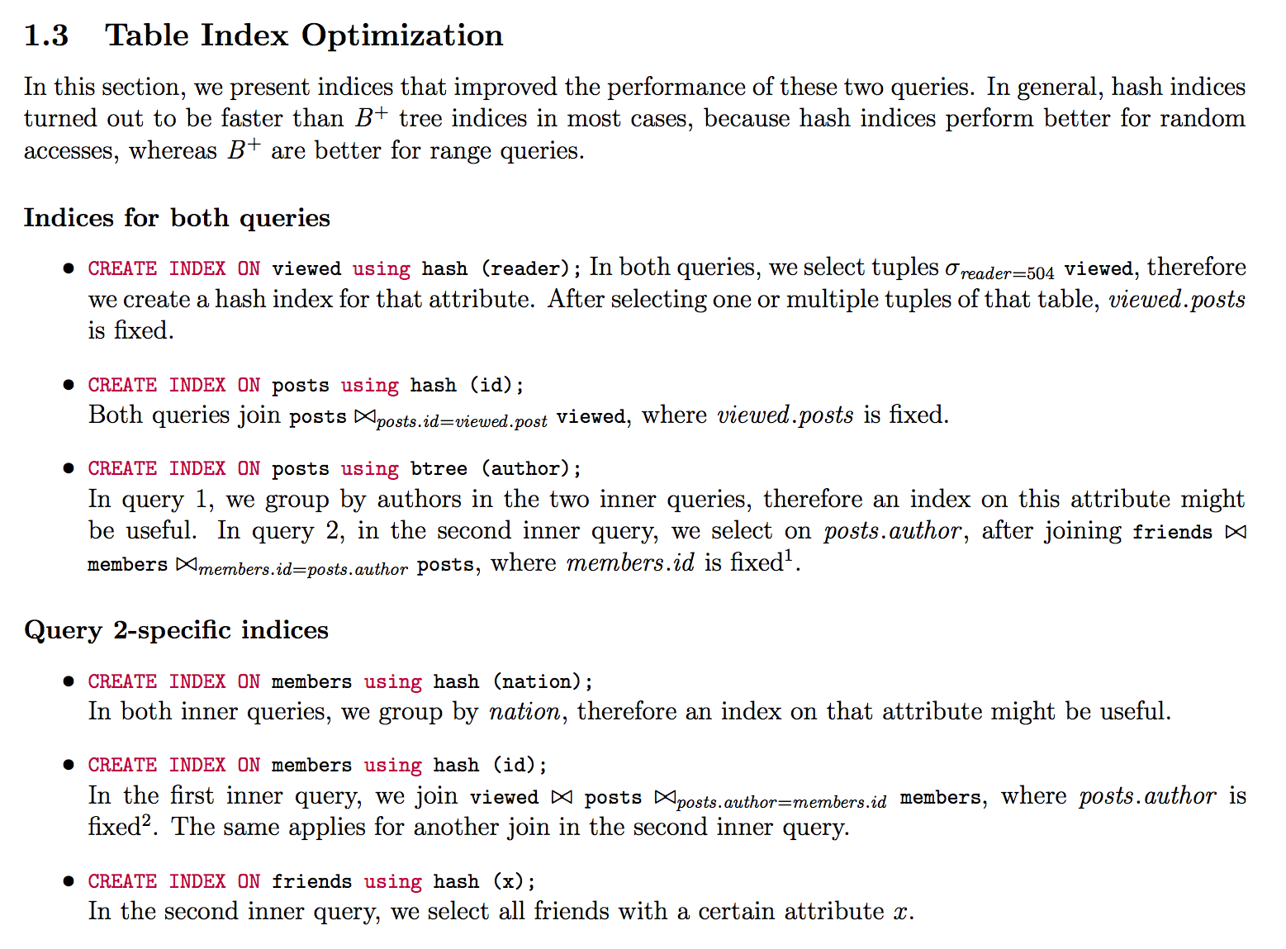
Query 1: without IVM, indices
CREATE INDEX ON viewed using hash (reader);
CREATE INDEX ON posts using hash (id);
CREATE INDEX ON posts using btree (author);
For random access, hash index is better than B+ tree index
later...

Slide 6
Query 1: Materialized Views (MV)
CREATE MATERIALIZED VIEW mv_arv AS (SELECT (1.0 * numerator.cnt / denominator.cnt) AS ratio, numerator.author, numerator.reader
FROM (SELECT posts.author AS author, viewed.reader AS reader, COUNT(*) AS cnt
FROM posts, viewed
WHERE posts.id = viewed.post
GROUP BY posts.author, viewed.reader) AS numerator,
(SELECT posts.author AS author, COUNT(*) AS cnt
FROM posts
GROUP BY posts.author) AS denominator
WHERE numerator.author = denominator.author);
SELECT author AS a, ration as v, reader AS r FROM mv_arv WHERE reader = 8937;
Refresh MV after insert into views
Create index on mv_arv(reader)

Slide 7
Query 1: MV Evaluation
INSERTs are slow: regenerate whole table after each INSERT into viewed
Querying is fast: just lookup result in table
No further experiments with materialized views

Slide 8
Query 1: IVM Without NULL tuples
INSERT INTO viewed
(post, reader)
INSERT INTO friends
(x, y)
INSERT INTO posts
(author, ...)
author_id := NEW.post.author.id
ivm_arv(author=NEW.author). denominator += 1
exists ivm_arv(author_id, NEW.reader)?
true
false
increment numerator
num_posts := COUNT(posts. author.posts);
CREATE TABLE ivm_arv (
author integer,
reader integer,
numerator integer,
denominator integer
);
insert(author_id, NEW.reader, 1, num_posts)

Slide 9
Query 1: IVM SQL Trigger Example
INSERT INTO viewed(reader, post)
author_index := (SELECT posts.author FROM posts WHERE posts.id = NEW.post);
IF EXISTS (SELECT * FROM ivm_arv WHERE reader = NEW.reader AND author = author_index) THEN
UPDATE ivm_arv
SET numerator = numerator + 1
WHERE reader = NEW.reader AND author = author_index;
ELSE
num_posts := (SELECT COUNT(*) FROM posts WHERE author = author_index);
INSERT INTO ivm_arv
VALUES (author_index, NEW.reader, 1, num_posts);
END IF;

Slide 10
Query 1: IVM (Alternative) With NULL tuples
INSERT INTO viewed
(post, reader)
INSERT INTO friends
(x, y)
INSERT INTO posts
(author, ...)
ivm_arv(author=NEW.post.author, reader=NEW.reader). denominator += 1
num_posts := COUNT(posts(author=NEW.x))
author_id := NEW.post.author.id
exists ivm_arv(author_id, NEW.reader)?
exists ivm_arv(author_id)?
true
true
false
INSERT INTO ivm_arv(NEW.x, NEW.y, 0, num_posts);
increment denominator
INSERT INTO ivm_arv(NEW.author, friends.y, 0, 1) FROM friends WHERE friends.x=NEW.author
CREATE TABLE ivm_arv (
author integer,
reader integer,
numerator integer,
denominator integer
);

Slide 11
Query 1: IVM Which version is better?
It depends
With NULL tuples
frequent insertions into friends, posts
few insertions into viewed (complicated trigger, requires check whether tuple exists)
Without NULL tuples
few insertions into friends, posts
frequent insertions into view
assumption: typical workload in a social network

Slide 12
Query 1: IVM
INSERT INTO viewed: increment numerator in IVM table
INSERT INTO friends
symmetric => always triggered in pairs
If NEW.x has posts => insert (x, y, 0, #posts)
“0” because y cannot have read posts by x yet
INSERT INTO posts
For every friend of author:
If tuple exists in iv_arv: increment numerator
Otherwise: insert (author, friend, 0, 1)
“Simplifying assumption: don’t have to report 0 ratios”
Simpler: 1 trigger (viewed), check if tuple exists in viewed
Our assumption: much more views on viewed than on friends, posts => keep trigger on viewed as fast as possible
CREATE TABLE ivm_arv (
author integer,
reader integer,
numerator integer,
denominator integer
);
CREATE OR REPLACE FUNCTION f_insert_view() RETURNS trigger AS $f_insert_view$
BEGIN
UPDATE ivm_arv
SET numerator = numerator + 1
WHERE reader = NEW.reader AND author = (SELECT posts.author FROM posts WHERE posts.id = NEW.post);
RETURN NEW;
END;
$f_insert_view$ LANGUAGE plpgsql;

Slide 13
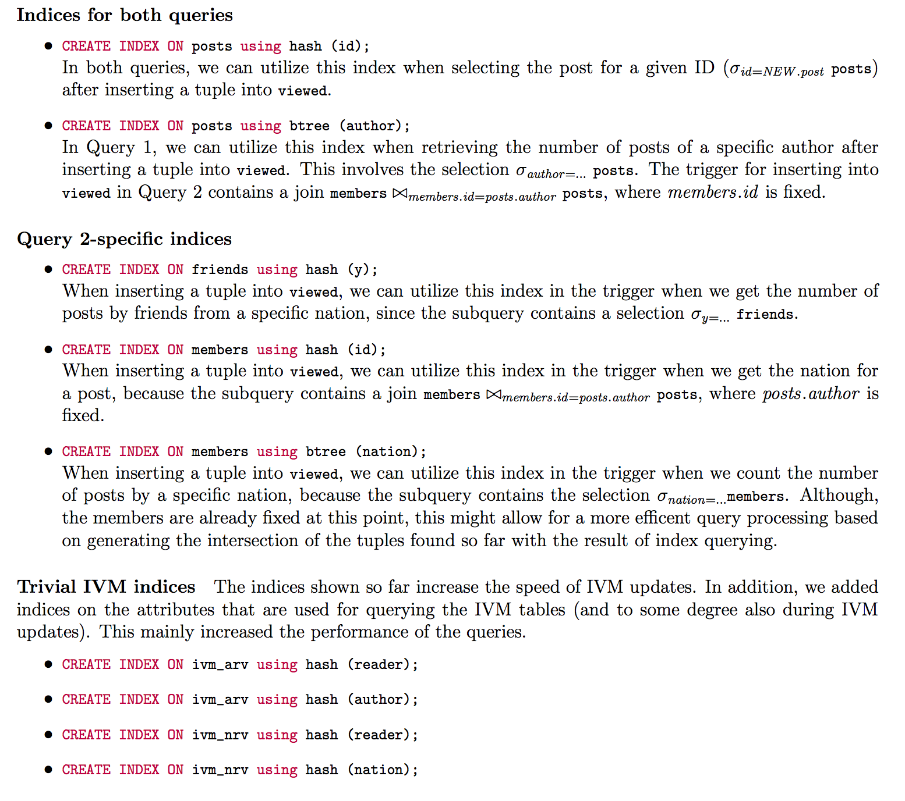
Query 1: IVM (Indices)
Trivial indices
CREATE INDEX ON ivm_arv using hash (reader);
CREATE INDEX ON ivm_arv using hash (author);
CREATE INDEX ON posts using hash (id);
CREATE INDEX ON posts using btree (author);
CREATE INDEX ON friends using hash (x);
later...

Slide 14
Query 1: IVM Further optimizations
INSERT INTO viewed
(post, reader)
Tried using IVM for #posts, turned out to be slower
Index is good enough
num_posts := (SELECT counter FROM ivm_posts_by_author WHERE author = NEW.x);
num_posts := (SELECT COUNT(*) FROM posts WHERE author = NEW.x);
author_id := NEW.post.author.id
exists ivm_arv(author_id, NEW.reader)?
true
false
increment numerator
num_posts := COUNT(posts. author.posts);
insert(author_id, NEW.reader, 1, num_posts)

Slide 15
Performance Results
Every value is the smallest of 3 runs.
Type | INSERT members | INSERT friends | INSERT posts | INSERT views | Query 1 | Query 2 | INSERT Mix 1 | Query 1 (Mix) | Query 2 (Mix)
unopt. | 3.008 | 6.121 | 2.700 | 2.949 | 33.817 | 31.390 | 9.285 | 30.962 | 24.562
indices | 3.180 | 6.652 | 3.099 | 3.297 | 31.599 | 10.985 | 10.426 | 26.176 | 11.931
IVM | 3.550 | 9.144 | 18.787 | 45.118 | 9.560 | 9.439 | 44.644 | 6.916 | 6.246
IVM+index | 3.547 | 9.290 | 16.291 | 8.091 | 3.265 | 3.254 | 27.042 | 3.357 | 3.333
We want to improve on “INSERT posts” and “INSERT views”
“INSERT members” and “INSERT friends” is not much slower than the unoptimized version
We can’t be better than the unoptimized version
Query analysis: on the next slides

Slide 16
Query 1: Improvement Problem Descripton
Table “posts”
Table “ivm_arv”
id | author | ...
1 | 4
2 | 67
3 | 3
author | reader | numerator | denominator
3 | 7 | 23 | 100
3 | 87 | 5 | 8
1 | 3 | 0 | 90
… | … | … | …
Problem: insert in posts might trigger a lot of updats in ivm_arv
E.g.: 1 inserts in posts => 2 updates in ivm_arv

Slide 17
Query 1: Improvement Solution
Table “posts”
Table “ivm_arv”
id | author | …
23 | 4 | …
5 | 67 | …
… | … | …
author | reader | numerator | denominator
6 | 7 | 23 | 100
5 | 87 | 5 | 8
1 | 3 | 0 | 90
… | … | … | …
Table “posts_temp”
author | #new_posts
5 | 6
… | …
“ivm_arv” contains data for “posts” without “posts_temp”.
When “posts_temp” reaches n tuples, we update “ivm_arv” with all these tuples at once.
We can even aggregate the sum of posts per author.
Up to n tuples.

Slide 18
Query 1: Improvement Implementation: INSERT INTO POSTS
post_temp(author, counter);
Insert NEW into posts
Insert/Update NEW into posts_temp:
UPDATE posts_temp SET counter = counter + 1 WHERE author = NEW.author
If |posts_temp| > n: update ivm_arv (trigger on posts_temp)
UPDATE ivm_arv SET denominator = denominator + counter FROM ivm_arv, posts_temp WHERE ivm_arv.author = posts_temp.author
Clear posts_temp

Slide 19
Query 1: Improvement Implementation: INSERT INTO POSTS: QUERY IVM TABLE
Before: SELECT author AS a, numerator * 1.0 / denominator AS v, reader AS r FROM ivm_arv WHERE reader = 8937;
After: SELECT author AS a, numerator / (denominator + ( SELECT counter FROM posts_temp WHERE author = a)) AS v, reader AS r FROM ivm_arv WHERE reader = 8937;

Slide 20
Query 1: Improvement Evaluation: INSERT INTO POSTS
Before: every time an author posted something, we had to update all tuples for all of his friends (increment denominator)
After: every time an author posts something, we increment one number
Evaluation
The denser the friendship graph is, the better (1 instead of many updates)
Query: do another query + add to denominator (could create index on author for temp table if n is big)

Slide 21
Query 1: Improvement of other INSERTs
INSERT INTO viewed: causes only 1 update ivm_arv (increment numerator) => no further optimization
For alternative version:
INSERT INTO friends: causes only 1 insertion into ivm_arv (insert (x, y, 0, #posts) tuple) => no further optimization

Slide 22
Query 2: unoptimized
SELECT (1.0 * numerator.cnt / denominator.cnt) AS v, numerator.author as a, numerator.reader as r
FROM (SELECT posts.author AS author, viewed.reader AS reader, COUNT(*) AS cnt
FROM posts, viewed
WHERE posts.id = viewed.post AND viewed.reader = 8937
GROUP BY posts.author, viewed.reader) AS numerator,
(SELECT posts.author AS author, COUNT(*) AS cnt
FROM posts
GROUP BY posts.author) AS denominator
WHERE numerator.author = denominator.author;

Slide 23
Query 2: without IVM, indices
all indices from Query 1 + some more

Slide 24
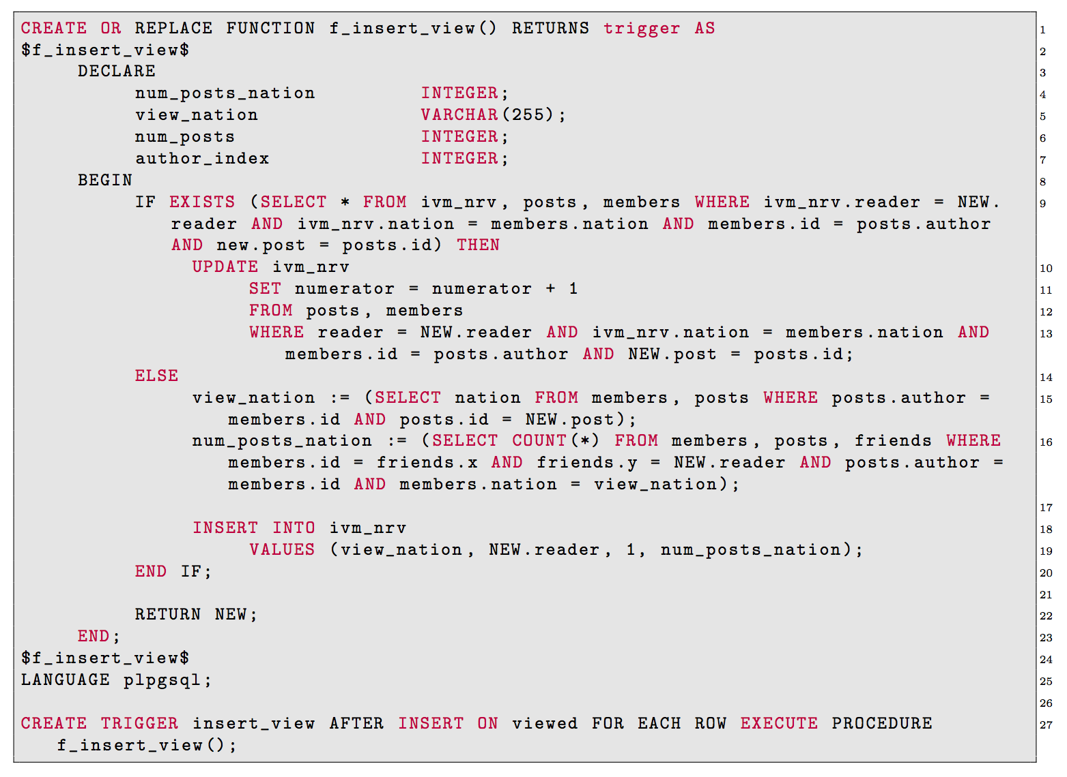
Query 2: IVM
CREATE TABLE ivm_nrv (
nation varchar(255),
reader integer,
numerator integer,
denominator integer
);

Slide 25
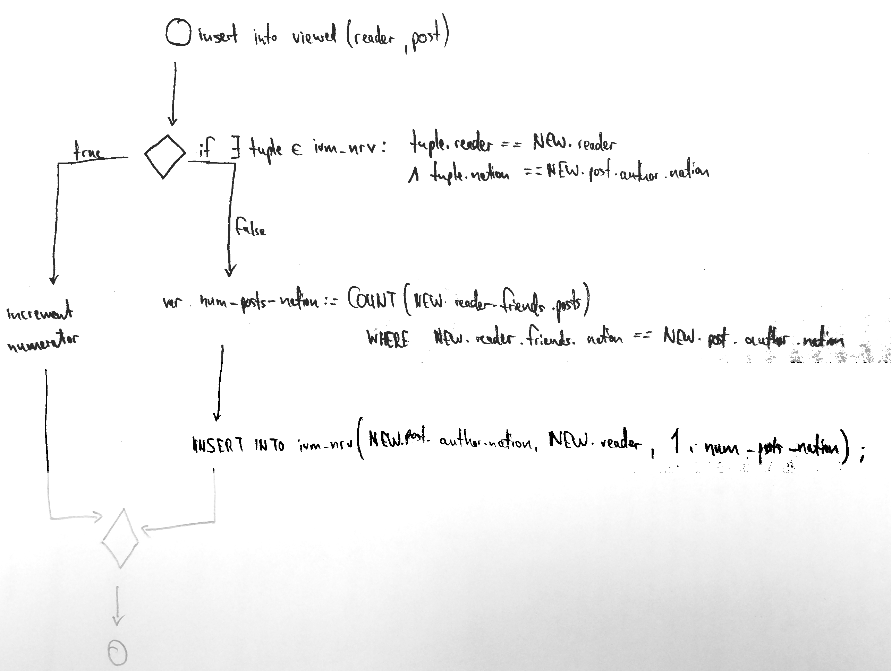
Query 2: IVM (Explanation) INSERT INTO VIEWED

Slide 26
Query 2: IVM (Explanation) INSERT INTO POSTS
Get author’s nation
For all of author’s friends
INCREMENT denominator of tuples in ivm_nrv WHERE nation=author’s nation AND reader=friend (if tuple exists)

Slide 27
Query 2: IVM (Explanation) INSERT INTO FRIENDS
Get friends (x)’s nation
If there is a tuple for nation, friend (x) in ivm_nrv
INCREMENT tuple by number of friend (x)’s posts

Slide 28
Query 2: IVM (Indices)

Slide 29
Query 2: IVM Improvement
Same as for Query 1
INSERT INTO posts: store in temp_posts until n tuples reached
Check all of post.author.friends, increment (post.author.nation, friend) by SUM(posts by author)
INSERT INTO friends: just 1 increment => no optimization
INSERT INTO viewed: just 1 update/insert => no optimization

Slide 30
Parallel Programming: Query 1 Partition by author
Node 1 Members round robin
Node 2 Members round robin
Node 3 Members round robin
Distribute members round robin
Store posts on the author’s node
Store views (post, reader) on post.author’s node
Query 1 (given p, r): send to p.author’s node
Generate numerator: all views for posts of a are on that node
Generate denominator: all posts of a are on that node
Query can be answered without moving data around
Query Execution: For every member,
for all distinct readers of his/her posts,
get #posts and #posts read by reader
Execute Query 1 on all nodes multiple
times independently

Slide 31
Parallel Programming: Query 2 Partition by nation
Node 1 USA, Netherlands
Node 2 China
Node 3 Germany, Japan
members from USA, Netherlands
posts where author = ...
views where post.author = ...
friends where x = ...
Distribute members, their posts and views of their posts according to their nation
Gather statistics before partitioning: try to keep amount of data constant per node
“Replication” of friends
Does not scale
Run Query 2 on every node multiple times independently
Query Execution: For every distinct reader,
get all his friends’ posts and the posts he/she
read (group by nation).

Slide 32
Parallel Programming: Query 2 Partition by author
Node 1 Members round robin
Node 2 Members
round robin
Node 3 Members round robin
members from 1-1000
posts where author = ...
views where post.author = ...
friends where x = ...
For every distinct viewed.reader:
count number of posts read GROUP BY nation
count number of posts of all friends GROUP BY nation
send to hash(nation) (single tuple per node)
send to hash(viewed.reader) (multiple tuples at once)
a: less traffic, scaling limited by number of nations (and prone to skew)
b: more traffic, better scaling, less prone to skew

Slide 33
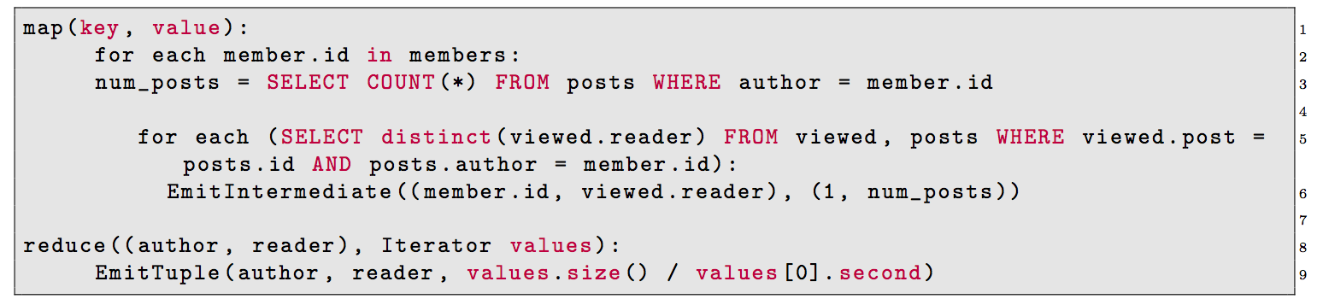
Map Reduce: Query 1 Assuming round-robin distribution of members
Improvement: generate exact value already in mapper, reducer just outputs result.

Slide 34
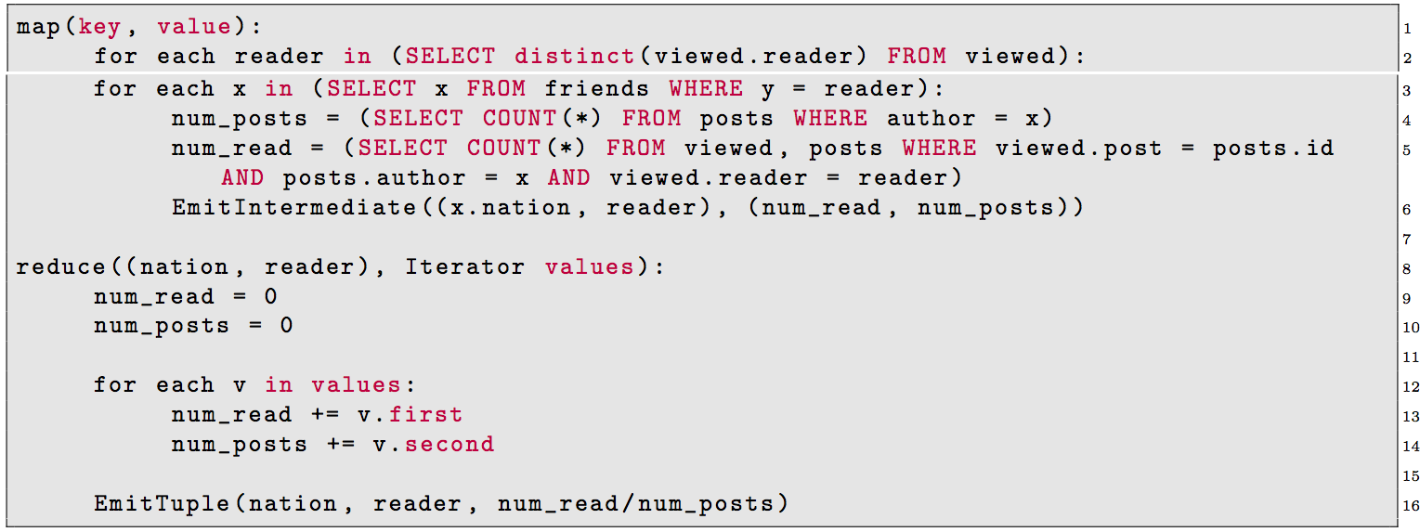
Map Reduce: Query 2 Assuming round-robin distribution of members, replication of friends table

