Slide 2
Base Tables
CREATE TABLE members (
id integer PRIMARY KEY,
name varchar(255),
nation varchar(255),
birthday date,
created timestamp
);
CREATE TABLE topics (
id integer PRIMARY KEY,
name varchar(255)
);
CREATE TABLE posts (
id integer PRIMARY KEY,
author integer references members(id),
title varchar(255),
text varchar(255),
topic integer references topics(id),
created timestamp
);
-- friend relationship is symmetric
CREATE TABLE friends (
x integer references members(id),
y integer references members(id),
created timestamp
);
CREATE TABLE viewed ( -- had to change table name from "view" to "viewed"
reader integer references members(id),
post integer references posts(id)
);

Slide 3
Workload

Slide 4
Query 1: unoptimized
SELECT (1.0 * numerator.cnt / denominator.cnt) AS v, numerator.author as a, numerator.reader as r
FROM (SELECT posts.author AS author, viewed.reader AS reader, COUNT(*) AS cnt
FROM posts, viewed
WHERE posts.id = viewed.post AND viewed.reader = 8937
GROUP BY posts.author, viewed.reader) AS numerator,
(SELECT posts.author AS author, COUNT(*) AS cnt
FROM posts
GROUP BY posts.author) AS denominator
WHERE numerator.author = denominator.author;
Todo: explain speed

Slide 5
Query 1: without IVM, indices
CREATE INDEX ON posts using hash (id);
CREATE INDEX ON viewed using hash (post);
CREATE INDEX ON viewed using hash (reader);
CREATE INDEX ON posts using btree (author);
For random access, hash index is better than B+ tree index

Slide 6
Query 1: Materialized Views (MV)
CREATE MATERIALIZED VIEW mv_arv AS (SELECT (1.0 * numerator.cnt / denominator.cnt) AS ratio, numerator.author, numerator.reader
FROM (SELECT posts.author AS author, viewed.reader AS reader, COUNT(*) AS cnt
FROM posts, viewed
WHERE posts.id = viewed.post
GROUP BY posts.author, viewed.reader) AS numerator,
(SELECT posts.author AS author, COUNT(*) AS cnt
FROM posts
GROUP BY posts.author) AS denominator
WHERE numerator.author = denominator.author);
SELECT author AS a, ration as v, reader AS r FROM mv_arv WHERE reader = 8937;
Refresh MV after insert into views
Create index on mv_arv(reader)

Slide 7
Query 1: MV Evaluation
TODO: exact numbers
INSERTs are slow: regenerate whole table after each INSERT into viewed
Querying is fast: just lookup result in table
TODO: runtime with/without index

Slide 8
Query 1: IVM
INSERT INTO viewed: increment numerator in IVM table
INSERT INTO friends
symmetric => always triggered in pairs
If NEW.x has posts => insert (x, y, 0, #posts)
“0” because y cannot have read posts by x yet
INSERT INTO posts
For every friend of author:
If tuple exists in iv_arv: increment numerator
Otherwise: insert (author, friend, 0, 1)
“Simplifying assumption: don’t have to report 0 ratios”
Simpler: 1 trigger (viewed), check if tuple exists in viewed
Our assumption: much more views on viewed than on friends, posts => keep trigger on viewed as fast as possible
CREATE TABLE ivm_arv (
author integer,
reader integer,
numerator integer,
denominator integer
);
CREATE OR REPLACE FUNCTION f_insert_view() RETURNS trigger AS $f_insert_view$
BEGIN
UPDATE ivm_arv
SET numerator = numerator + 1
WHERE reader = NEW.reader AND author = (SELECT posts.author FROM posts WHERE posts.id = NEW.post);
RETURN NEW;
END;
$f_insert_view$ LANGUAGE plpgsql;

Slide 9
Query 1: IVM (Indices)
CREATE INDEX ON ivm_arv using hash (reader);
CREATE INDEX ON ivm_arv using hash (author);
CREATE INDEX ON posts using hash (id);
CREATE INDEX ON posts using btree (author);
CREATE INDEX ON friends using hash (x);
TODO: explain

Slide 10
Query 1: IVM (Further optimizations)
Tried using IVM for #posts, turned out to be slower
Index is good enough
num_posts := (SELECT counter FROM ivm_posts_by_author WHERE author = NEW.x);
num_posts := (SELECT COUNT(*) FROM posts WHERE author = NEW.x);

Slide 11
Query 1: Improvement (Problem)
Table “views”
Table “ivm_arv”
reader | post
23 | 4
5 | 67
… | …
author | reader | numerator | denominator
6 | 7 | 23 | 100
5 | 87 | 5 | 8
1 | 3 | 0 | 90
… | … | … | …
Problem: #inserts into views = #updates in ivm table
E.g.: 1000 inserts in views => 1000 updates in ivm table

Slide 12
Query 1: Improvement (Solution)
Table “posts”
Table “ivm_arv”
id | author | …
23 | 4 | …
5 | 67 | …
… | … | …
author | reader | numerator | denominator
6 | 7 | 23 | 100
5 | 87 | 5 | 8
1 | 3 | 0 | 90
… | … | … | …
Table “posts_temp”
author | #new_posts
5 | 6
… | …
“ivm_arv” contains data for “posts” without “posts_temp”
When “posts_temp” reaches n tuples, we update “ivm_arv” with all these tuples at once.
Up to n tuples.

Slide 13
Query 1: Improvement (Implementation) INSERT INTO POSTS
post_temp(author, counter);
Insert NEW into posts
Insert/Update NEW into posts_temp:
UPDATE posts_temp SET counter = counter + 1 WHERE author = NEW.author
If |posts_temp| > n: update ivm_arv (trigger)
UPDATE ivm_arv SET denominator = denominator + counter FROM ivm_arv, posts_temp WHERE ivm_arv.author = posts_temp.author
Clear posts_temp

Slide 14
Query 1: Improvement (Implementation) INSERT INTO POSTS: QUERY IVM TABLE
Before: SELECT author AS a, numerator * 1.0 / denominator AS v, reader AS r FROM ivm_arv WHERE reader = 8937;
SELECT author AS a, numerator / denominator + ( SELECT counter FROM posts_temp WHERE author = a) AS v, reader AS r FROM ivm_arv WHERE reader = 8937;

Slide 15
Query 1: Improvement (Evaluation) INSERT INTO POSTS
Before: every time an author posted something, we had to update all tuples for all of his friends (increment denominator)
After: every time an author posts something, we increment one number
Evaluation
The denser the friendship graph is, the better (1 instead of many updates)
Query: do another query + add to denominator (could create index on author for temp table if n is big)

Slide 16
Query 1: Improvement of other INSERTs
INSERT INTO friends: causes only 1 insertion into ivm_arv (insert (x, y, 0, #posts) tuple) => no further optimization
INSERT INTO viewed: causes only 1 update ivm_arv (increment numerator) => no further optimization

Slide 17
Query 2: unoptimized
SELECT (1.0 * numerator.cnt / denominator.cnt) AS v, numerator.author as a, numerator.reader as r
FROM (SELECT posts.author AS author, viewed.reader AS reader, COUNT(*) AS cnt
FROM posts, viewed
WHERE posts.id = viewed.post AND viewed.reader = 8937
GROUP BY posts.author, viewed.reader) AS numerator,
(SELECT posts.author AS author, COUNT(*) AS cnt
FROM posts
GROUP BY posts.author) AS denominator
WHERE numerator.author = denominator.author;

Slide 18
Query 2: without IVM, indices
TODO

Slide 19
Query 2: IVM
CREATE TABLE ivm_nrv (
nation varchar(255),
reader integer,
numerator integer,
denominator integer
);
CREATE OR REPLACE FUNCTION f_insert_view() RETURNS trigger AS $f_insert_view$
BEGIN
IF EXISTS (SELECT * FROM ivm_nrv, posts, members
WHERE ivm_nrv.reader = NEW.reader AND ivm_nrv.nation = members.nation
AND members.id = posts.author AND new.post = posts.id) THEN
UPDATE ivm_nrv
SET numerator = numerator + 1
FROM posts, members
WHERE reader = NEW.reader AND ivm_nrv.nation = members.nation
AND members.id = posts.author AND NEW.post = posts.id;
ELSE
view_nation := (SELECT nation FROM members, posts
WHERE posts.author = members.id AND posts.id = NEW.post);
num_posts_nation := (SELECT COUNT(*) FROM members, posts, friends
WHERE members.id = friends.x AND friends.y = NEW.reader AND
posts.author = members.id AND members.nation = view_nation);
INSERT INTO ivm_nrv
VALUES (view_nation, NEW.reader, 1, num_posts_nation);
END IF;
RETURN NEW;
END;
$f_insert_view$ LANGUAGE plpgsql;

Slide 20
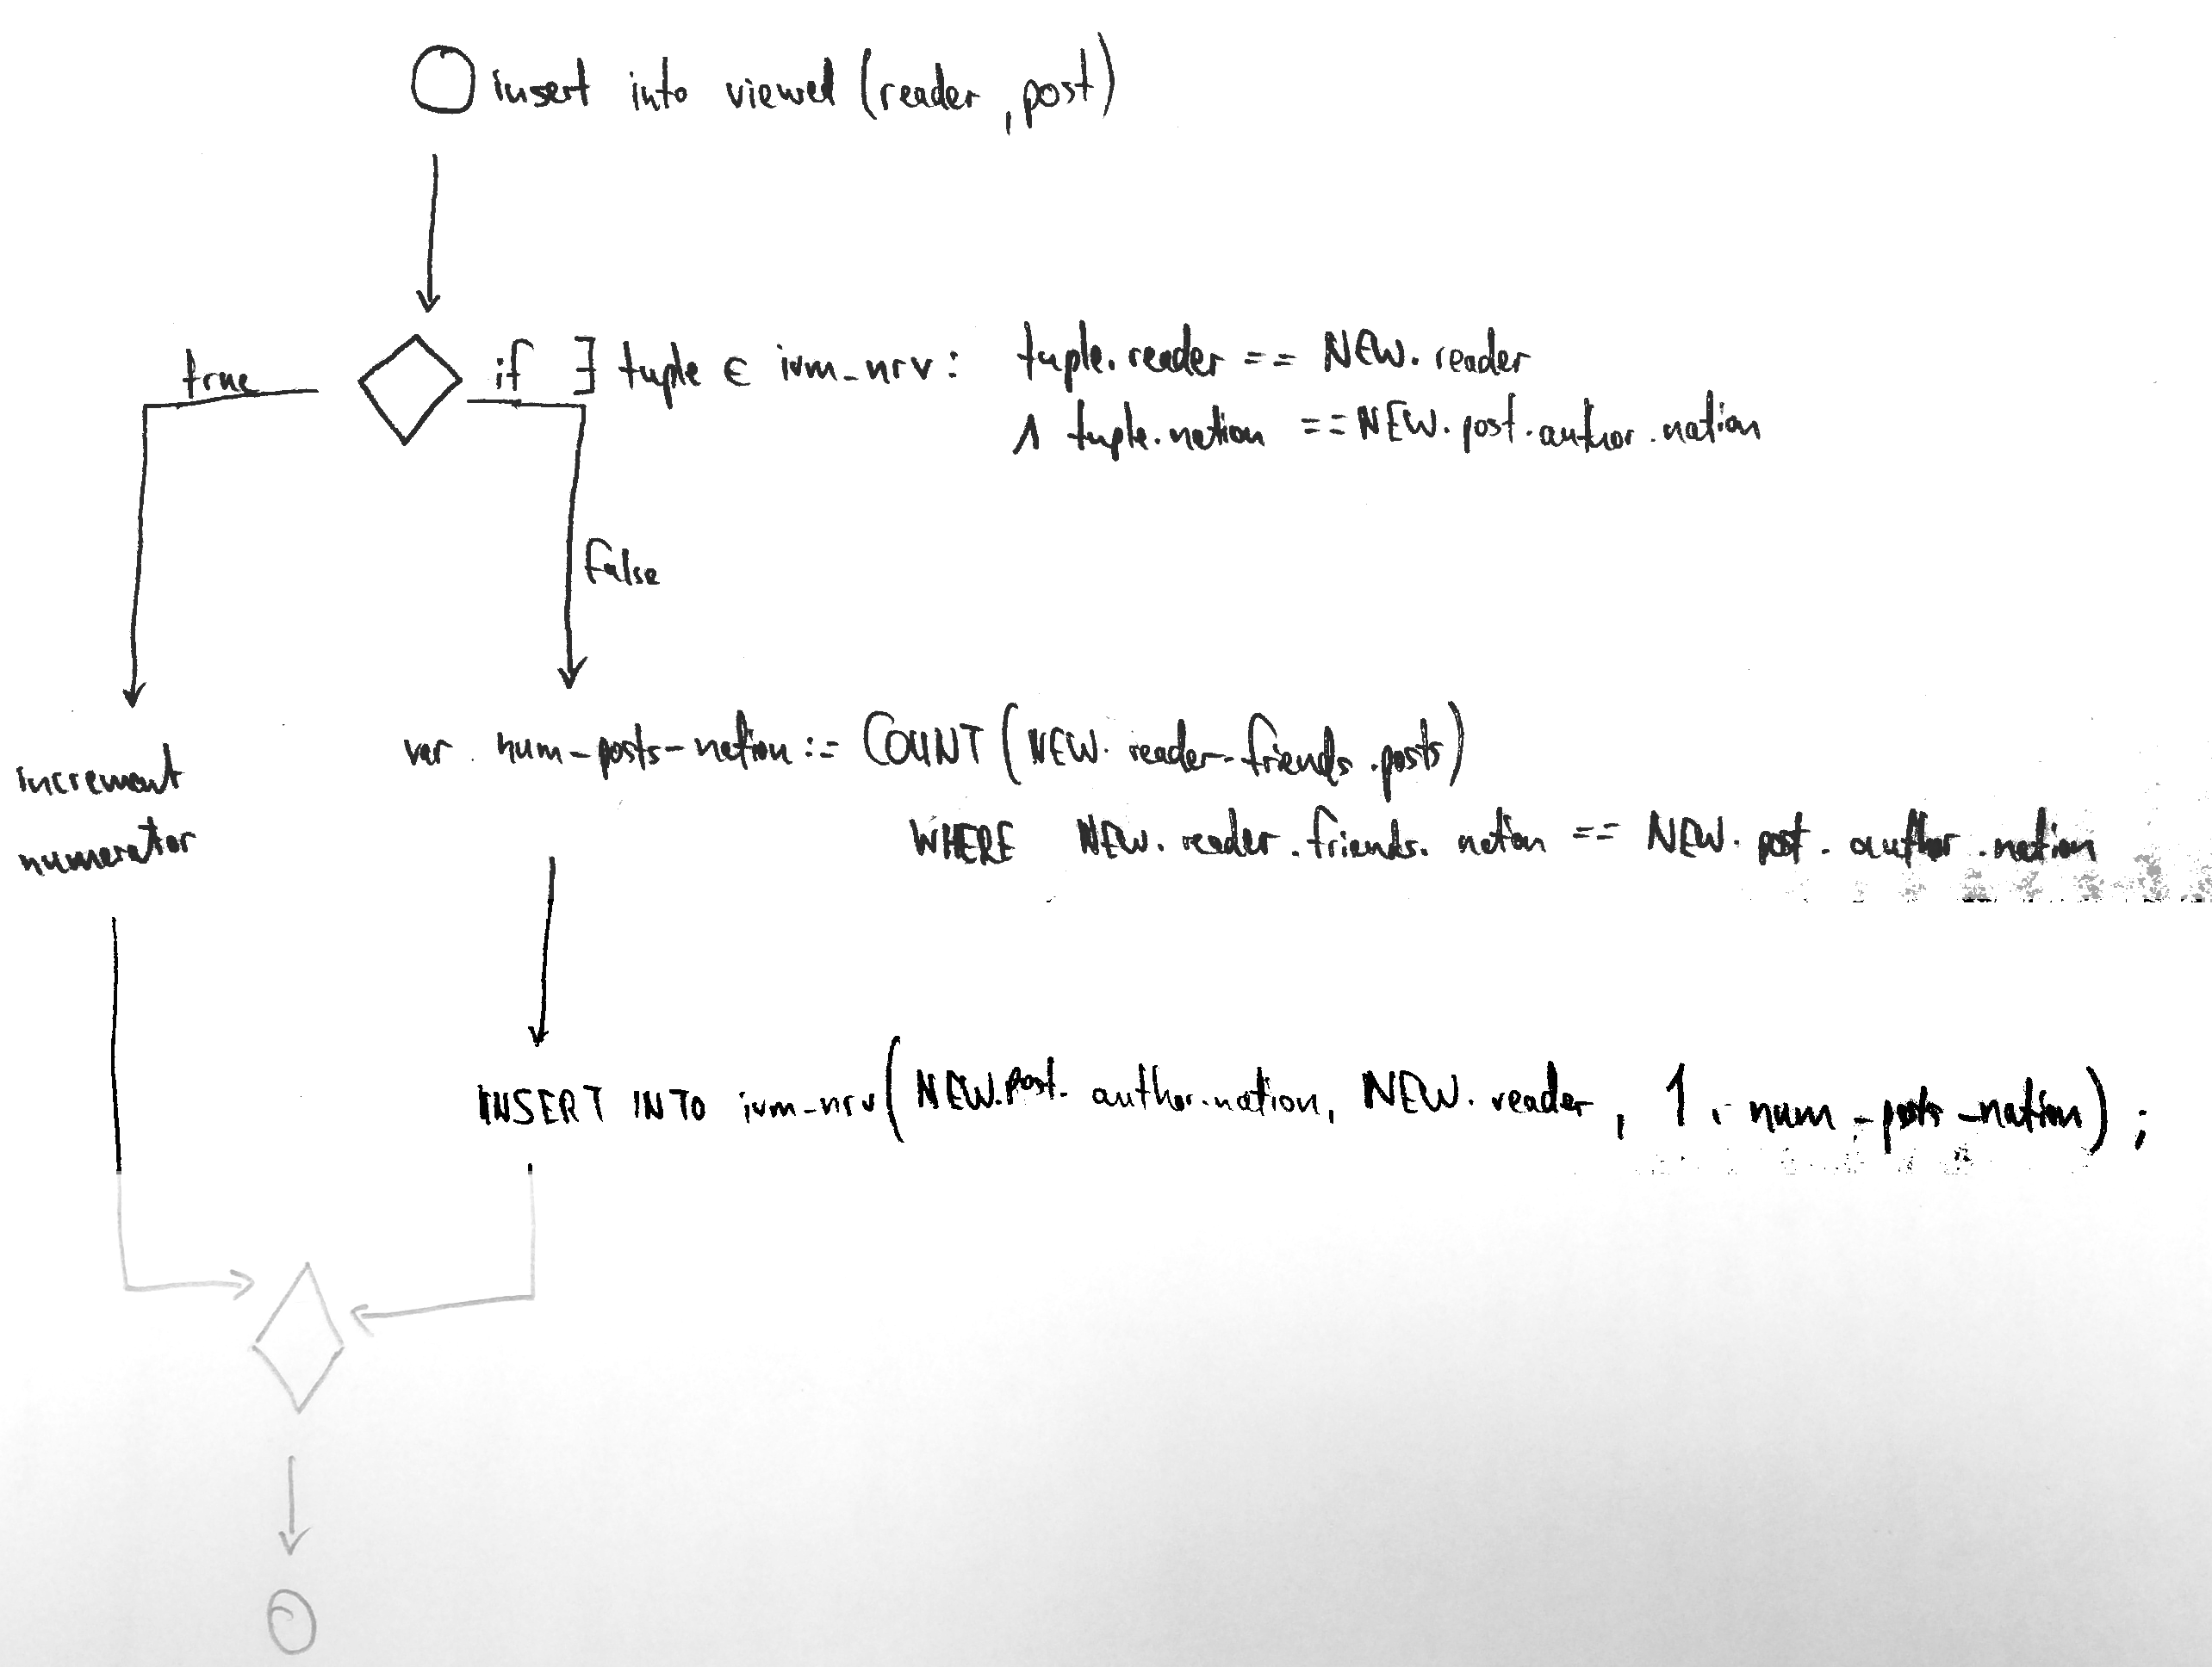
Query 2: IVM (Explanation) INSERT INTO VIEWED

Slide 21
Query 2: IVM (Explanation) INSERT INTO POSTS
Get author’s nation
For all of author’s friends
INCREMENT denominator of tuples in ivm_nrv WHERE nation=author’s nation AND reader=friend (if tuple exists)

Slide 22
Query 2: IVM (Explanation) INSERT INTO FRIENDS
Get friends (x)’s nation
If there is a tuple for nation, friend (x) in ivm_nrv
INCREMENT tuple by number of friend (x)’s posts

Slide 23
Query 2: IVM (Indices)
TODO

Slide 24
Query 2: IVM Improvement
Same as for Query 1
INSERT INTO posts: store in temp_posts until n tuples reached
Check all of post.author.friends, increment (post.author.nation, friend) by SUM(posts by author)
INSERT INTO friends: just 1 increment => no optimization
INSERT INTO viewed: just 1 update/insert => no optimization

Slide 25
Parallel Programming: Query 1
Node 1
Node 2
Node 3
Distribute members round robin
Store posts on the author’s node
Store views (author, reader) on author’s node
Query 1 (given a, r): send to a’s node
Generate numerator: all views for posts of a are on that node
Generate denominator: all posts of a are on that node

