Slide 1
Extended formulations for some 0-1 symmetry-breaking polytopes
Yuri Faenza
Università di Roma Tor Vergata
Joint work with
Volker Kaibel
Otto von Guericke Universitaet, Magdeburg

Slide 2

Outline
Motivation: symmetric 0-1 formulations
Orbitopes: definition and overview of known results
Detailed look at packing and partitioning orbitopes wrt the full symmetric group

Slide 3

The graph coloring problem
Input: a connected graph G (V,E)
k-coloring: a mapping G {1,…, k}; such that no adjacent vertices have the same color;
Graph coloring problem: find minimum k such that a k-coloring exists.
Notes:
Definition of k-coloring – example of coloring – minimum k such that a k coloring exists

Slide 4
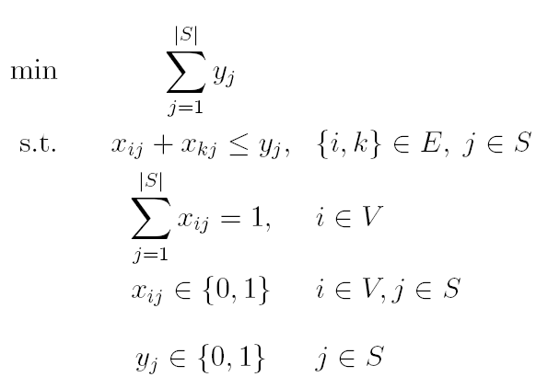
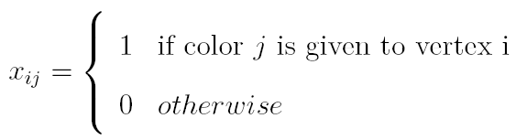
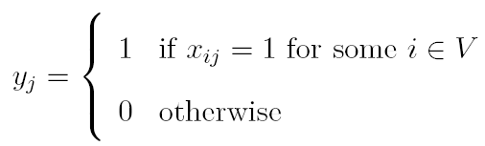
Graph coloring: a 0-1 formulation
Notes:
Assegnamento - attivazione

Slide 5
Symmetry harms: symmetric groups(1)
1
 |  |  | 1
1
1
1
1
vertices
1
1
Notes:
In the empty boxes we have 0s;

Slide 6
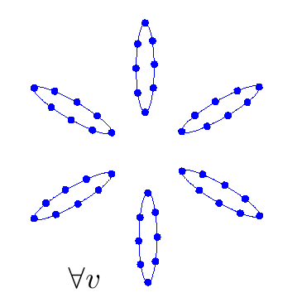
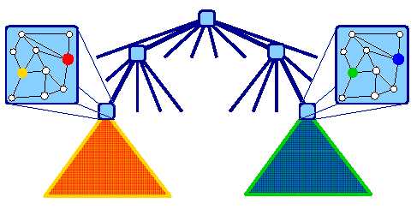
Symmetry harms: symmetric groups(2)
Only one is needed!
Notes:
If we represent solutions with a point, we can represent solution from the same orbit as solution connected by a line

Slide 7
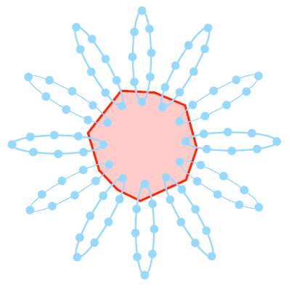
Dealing with symmetry
Isomorphism pruning (Margot&al., 02+)
Orbital Branching (Linderoth&al., 07+)
Orbitopes (06+)
Notes:
Definition of k-coloring – example of coloring – minimum k such that a k coloring exists

Slide 8
Outline
Motivation: symmetric 0-1 formulations
Orbitopes: definition and overview of known results
Detailed look at packing and partitioning orbitopes wrt the full symmetric group

Slide 9


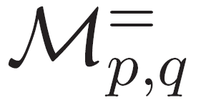


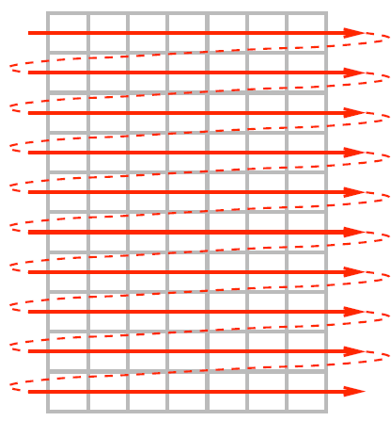
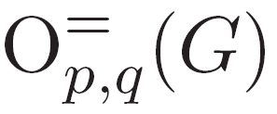


Orbitopes

Slide 10
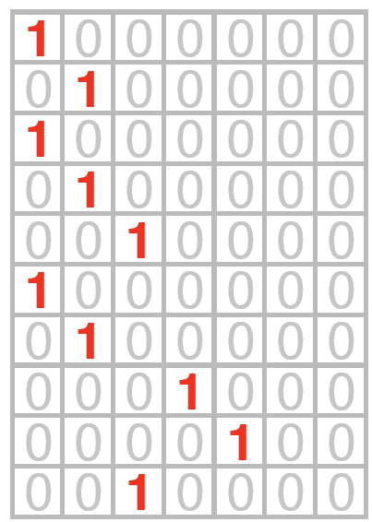





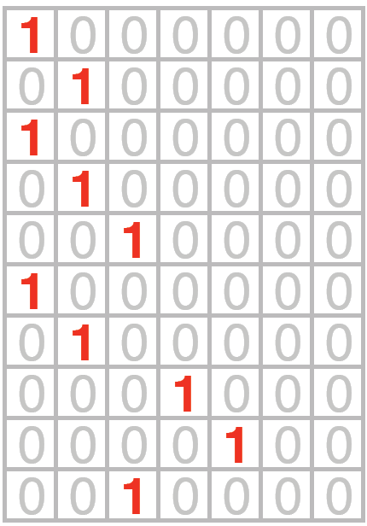

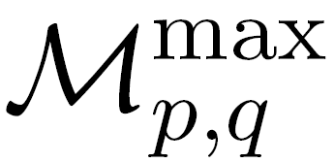

Partitioning Orbitopes wrt Sq

Slide 11
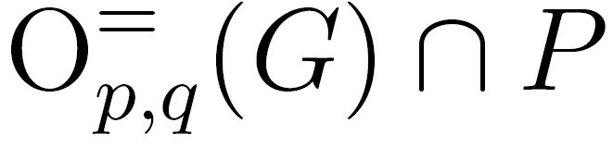
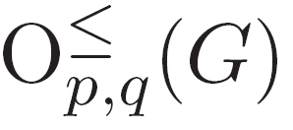
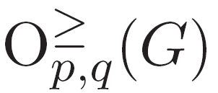
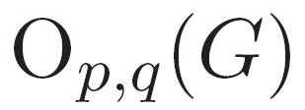
Orbitopes in action

Slide 12






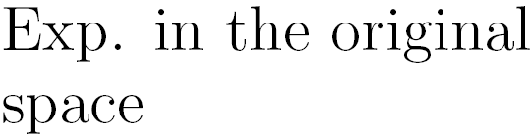

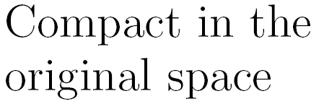

Complexity table
LP Formulation
[ Kaibel, Pfetsch06]
[Kaibel,Peinhardt,Pfetsch07]

Slide 13
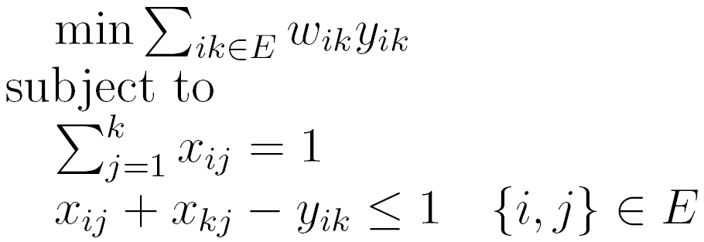
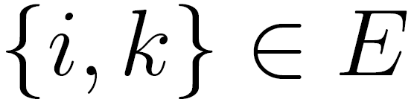
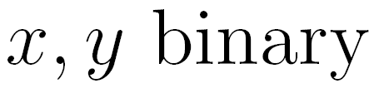
The Graph partitioning problem
Input: a connected graph G (V,E) and nonnegative edge weights w on arcs, a strictly positive integer k.
k-partition: a partition of V in k subset
Graph partitioning problem: find the k-partition of V that minimizes the sum of the weights of the edges that connect nodes of the same subset.

Slide 14


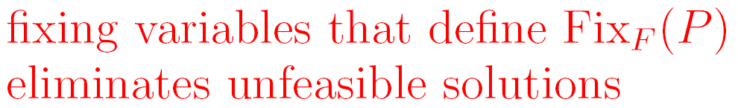
Simultaneous fixing

Slide 15
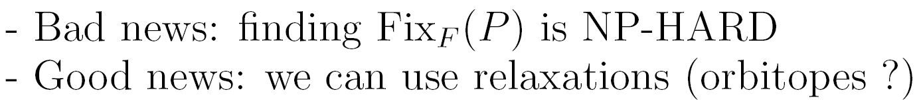


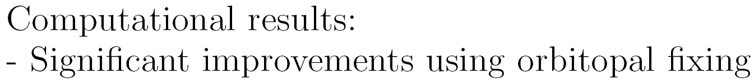
Orbitopal fixing

Slide 16


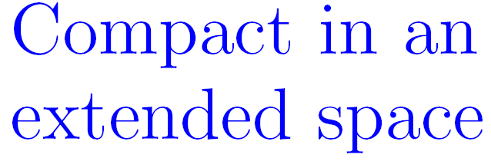

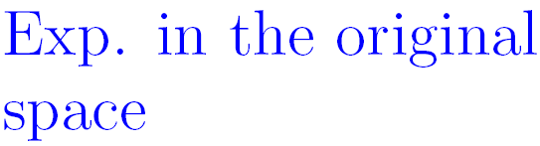
Complexity table
LP Formulation
[ Kaibel, Pfetsch06]
[ Kaibel, Loos07]
[Kaibel,Peinhardt,Pfetsch07]

Slide 17


Extended formulation

Slide 18
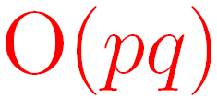

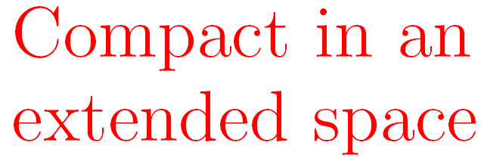
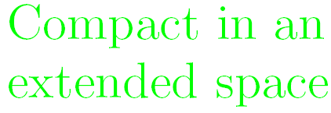
Complexity table
LP Formulation
[ Kaibel, Pfetsch06]
[ Kaibel, Loos07]
[ Kaibel, Loos07]
[Kaibel,Peinhardt,Pfetsch07]
[Tawarmalani07]
[ F. , Kaibel08]

Slide 19
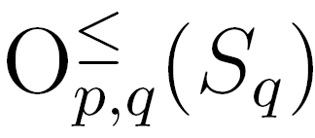
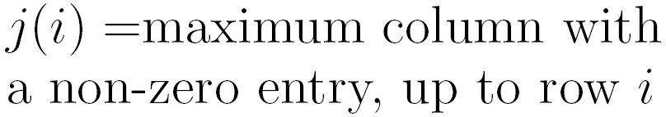


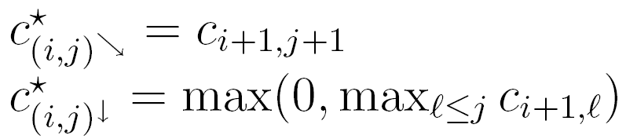
A combinatorial algorithm for
1
1
1
1
1
j
1
1
1
1
1
i
1
1
1
1

Slide 20
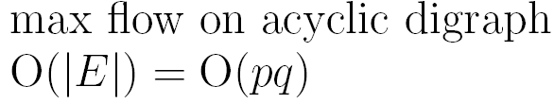
A combinatorial algorithm for

Slide 21
Outline
Motivation: symmetric 0-1 formulations
Orbitopes: definition and overview of known results
Detailed look at packing and partitioning orbitopes wrt the full symmetric group
at the blackboard

