Slide 1



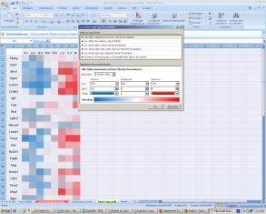
Figure 5
A
B
C
0.05 1.0 20.0
0.05 1.0 20.0
0.05 1.0 20.0

