Slide 1
Ordinal Decision Trees
Qinghua Hu
Harbin Institute of Technology
10. 20. 2010

Slide 2
Outline
Problem of ordinal classification
Rule learning for classification
Evaluate attribute quality with rank entropy in ordinal classification
Construct ordinal decision trees
Experimental analysis
Conclusions and future work

Slide 3
1. Ordinal classification
There are two classes of classification tasks
  Nominal classification
  assign nominal class labels to objects according to their features
  Ordinal classification
  assign ordinal class labels to objects according to their criteria

Slide 4
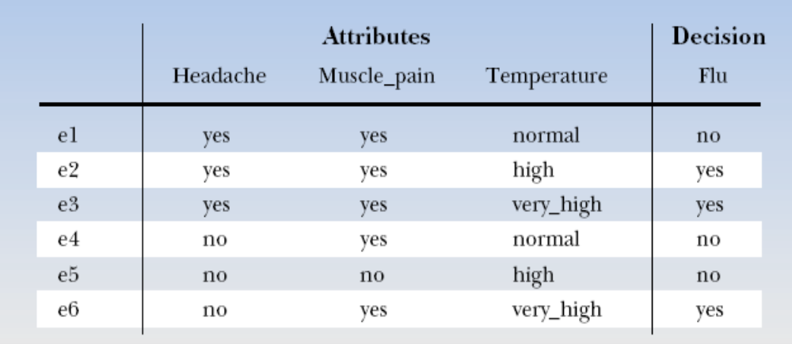
1. Ordinal classification
Nominal classes vs. ordinal classes
Take disease diagnosis as an example

Slide 5
1. Ordinal classification
Nominal classes vs. ordinal classes
Decision
slight
severe
severe
severe
Severe
moderate
There is an ordinal structure between the decision severity of Flu:
severe>moderate>slight

Slide 6
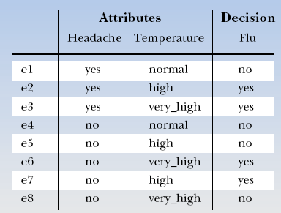
1. Ordinal classification
Nominal classification
Different assumptions are used in nominal and ordinal classification
As to nominal, the same feature values, the same decision
Inconsistent samples

Slide 7
1. Ordinal classification
Ordinal classification:
The better features, the better decision
the worse feature values, but get the better decision
Decision
slight
severe
severe
severe
Severe
moderate

Slide 8
1. Ordinal classification
Ordinal classification occurs in a wide range of applications, such as
  Production quality measure
  Bank credit analysis
  Disease or fault severity evaluation
  Submission or project review
  Social investigation analysis
  ……

Slide 9
1. Ordinal classification
Different consistency assumptions are used
  nominal classification
  The objects taking the same or similar feature values should be classified into the same class; otherwise, the task is not consistent
  If x=y, then d(x)=d(y)

Slide 10
1. Ordinal classification
Different consistency assumptions are used
  ordinal classification
  The objects taking the better feature values should be classified into the better classes; otherwise, the task is not consistent
  If x>=y, then d(x)>=d(y)

Slide 11
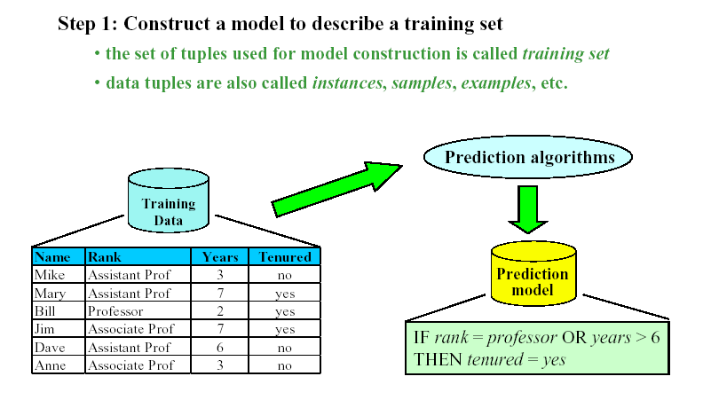
2. Rule learning for ordinal classification

Slide 12
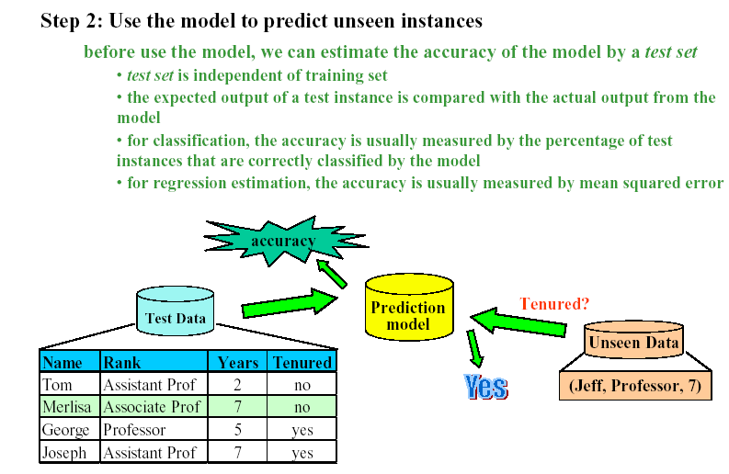
2. Rule learning for ordinal classification

Slide 13
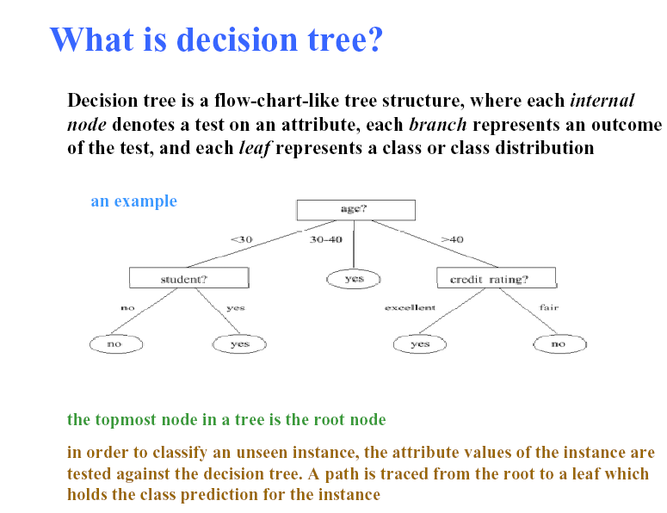
2. Rule learning for classification

Slide 14
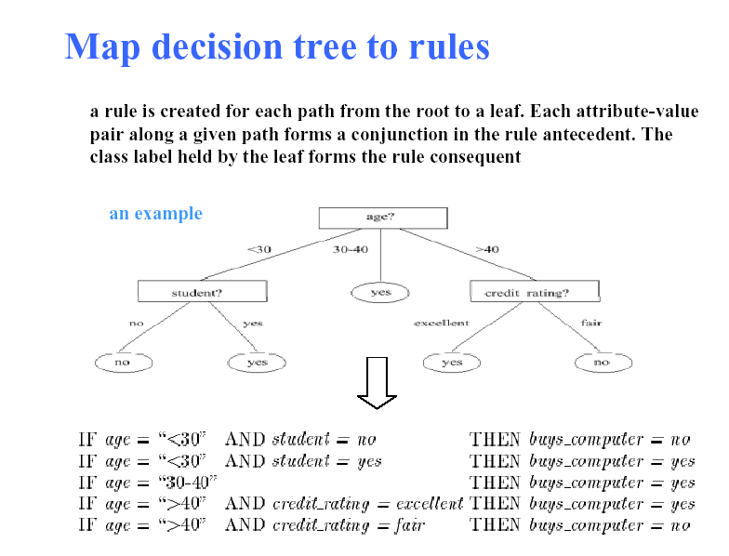

Slide 15
2. Rule learning for ordinal classification
Decision tree algorithms for nominal classification
  CART—— Classification and Regression Tree (Breiman et al. 1984)
  ID3, C4.5, See5 —— R. Quinlan 1986, 1993, 2004
Disadvantage in ordinal classification
These algorithms adopt information entropy and mutual information to evaluate the capability of features in classification, which does not consider the ordinal structure in ordinal data. Even given a consistent data set, these algorithms may output inconsistent rules

Slide 16
2. Rule learning for ordinal classification
The most important issue in constructing decision trees is to design a measure for computing the quality of features, and select the best to divide samples.

Slide 17
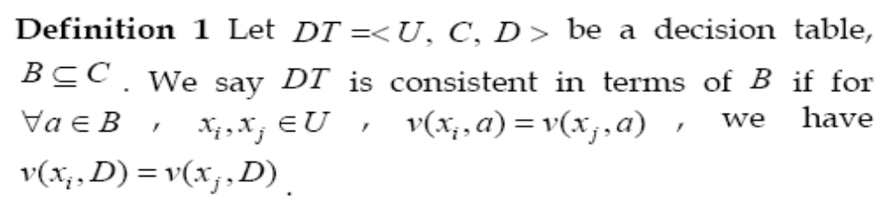
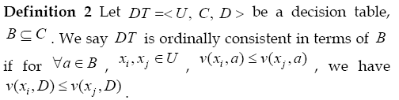
3. Attribute quality in ordinal classification
Ordinal information, Q. Hu, D. Yu, et al. 2010

Slide 18
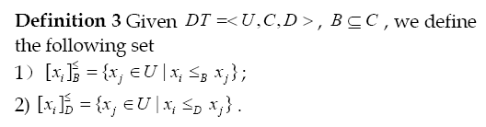
3. Attribute quality in ordinal classification
The subset of samples which feature values are better than x_{i} in terms of attributes B.
The subset of samples which decisions are better than x_{i}.

Slide 19
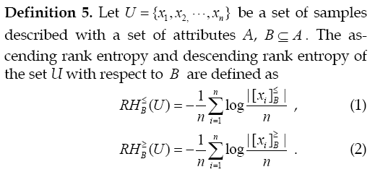
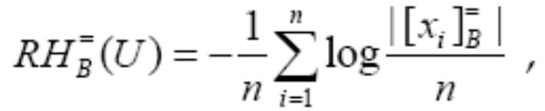
3. Attribute quality in ordinal classification
Number of elements
Shannon’s entropy is defined as

Slide 20
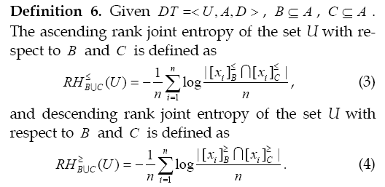
3. Attribute quality in ordinal classification

Slide 21
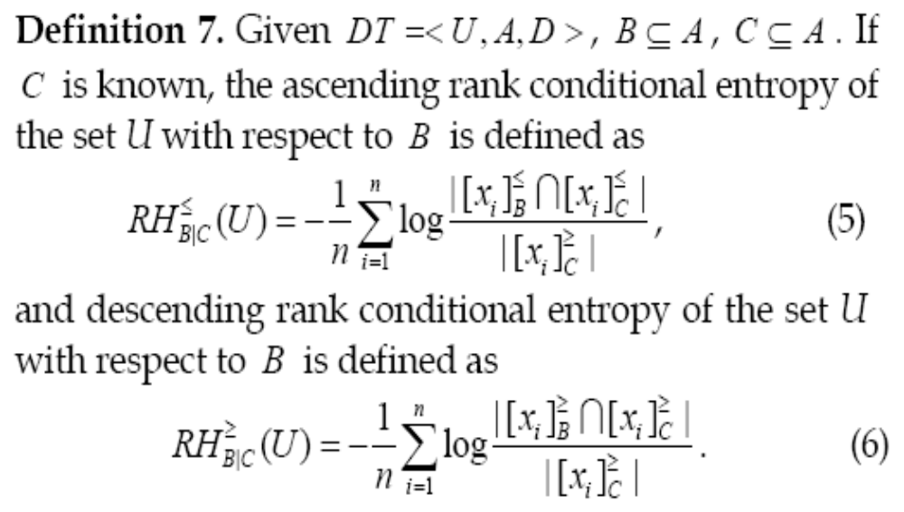
3. Attribute quality in ordinal classification

Slide 22
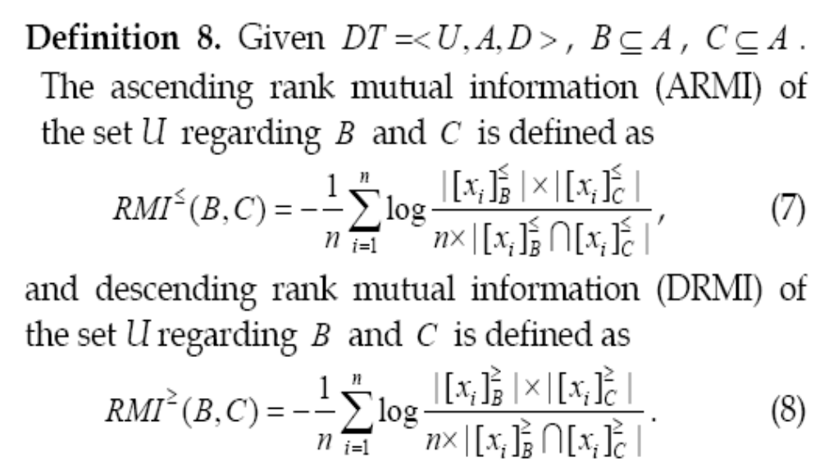
3. Attribute quality in ordinal classification
If B is a set of attributes and C is a decision, then RMI can be viewed as a coefficient of ordinal relevance between B and C, so it reflects the capability of B in predicting C.

Slide 23
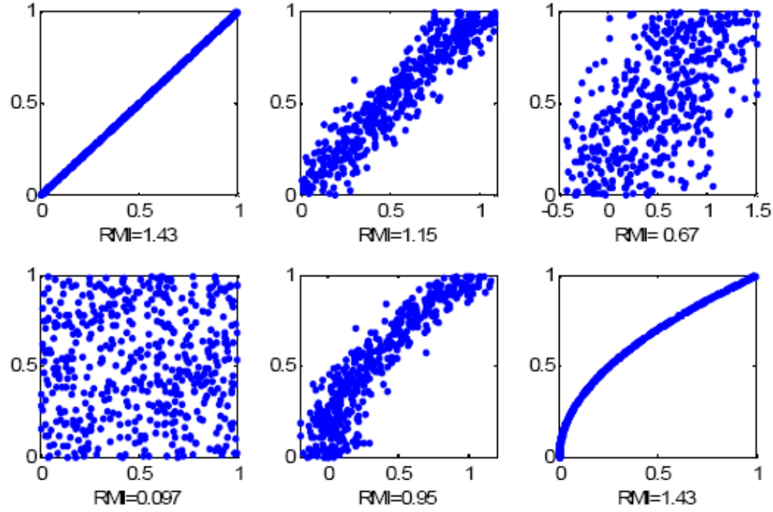
3. Attribute quality in ordinal classification
the ascending rank mutual information between X and Y. If we consider x is a feature, y is a decision, then we can see RMI reflects the ordinal consistency

Slide 24
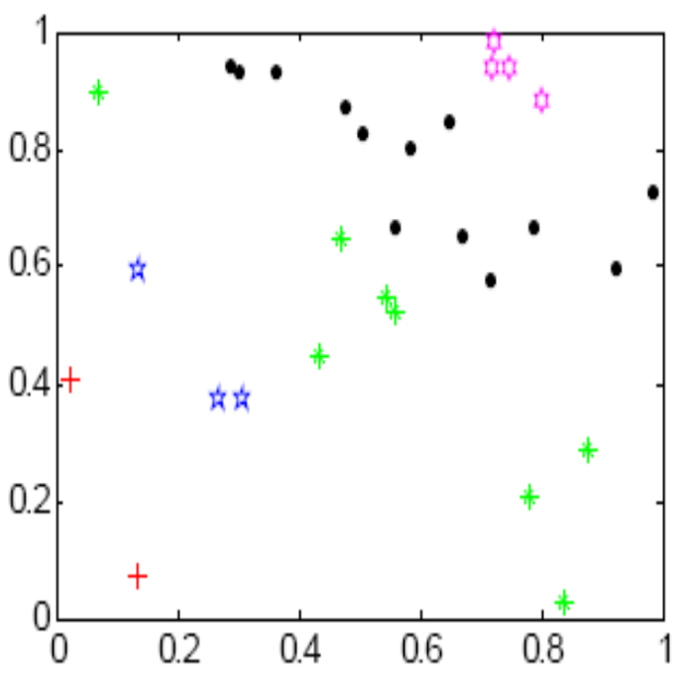
4. Ordinal tree construction
Given a set of training samples, how to induce a decision model from the data? (REOT)
1. Compute the rank mutual information between each feature and decision based on samples in the root node
2. Select the feature with the maximal mutual information and split samples according to the feature values
3. Compute the rank mutual information between each features and decision based on samples in this node and select the best feature until each node is pure

Slide 25
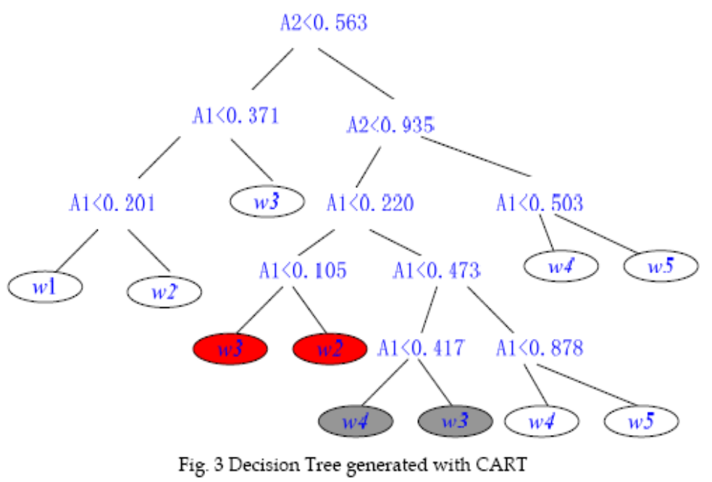
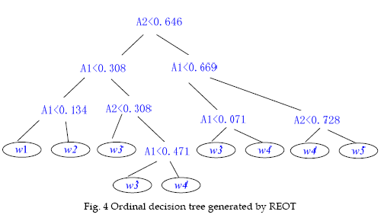
5. Experimental analysis
Inconsistent rules
30 samples
2 attributes
5 classes

Slide 26
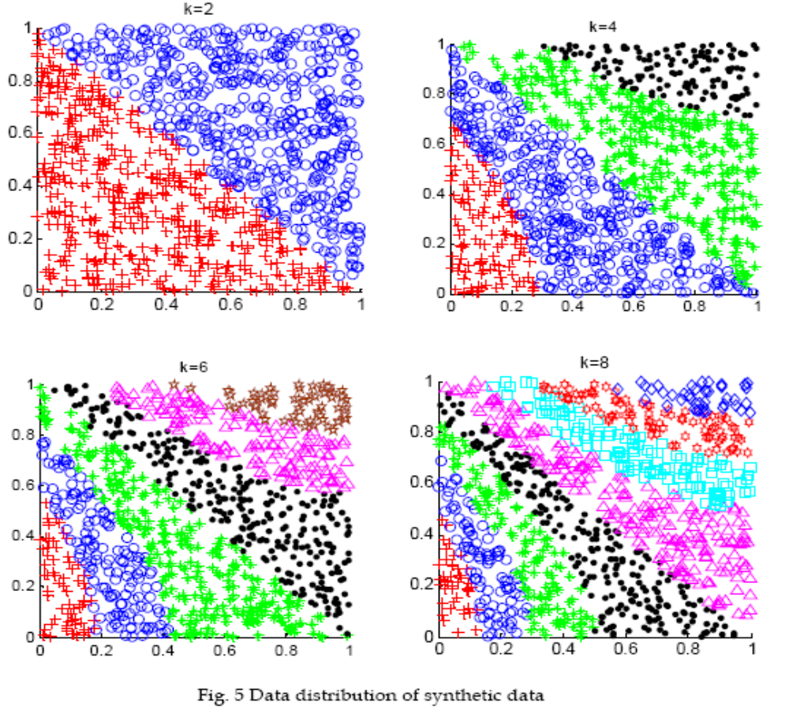
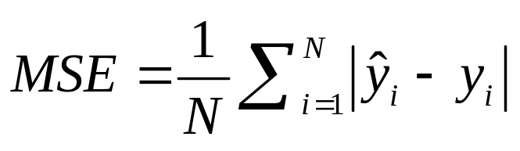
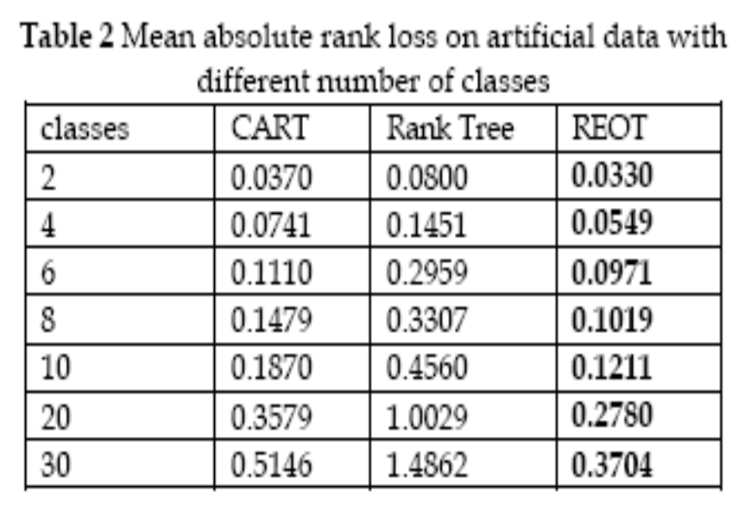
5. Experimental analysis

Slide 27
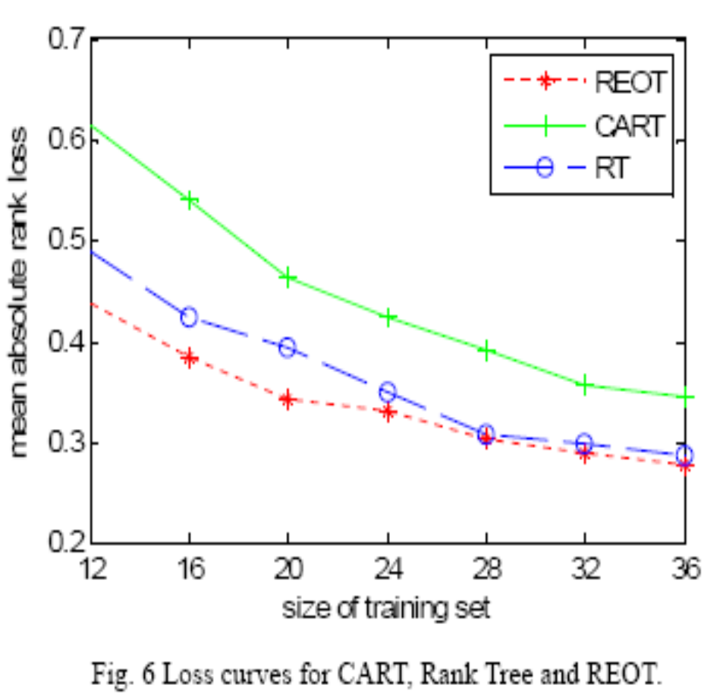
5. Experimental analysis

Slide 28
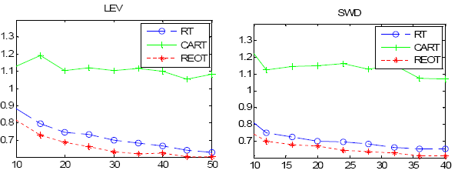
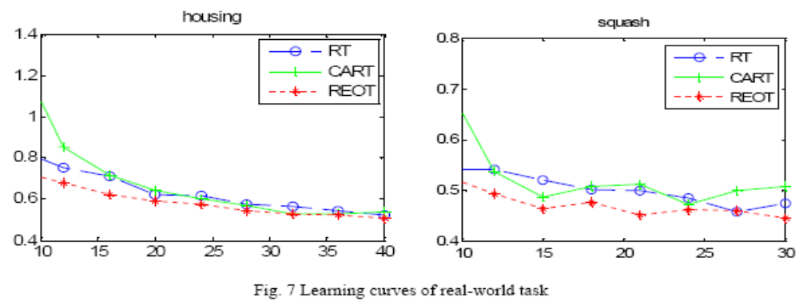
5. Experimental analysis

Slide 29
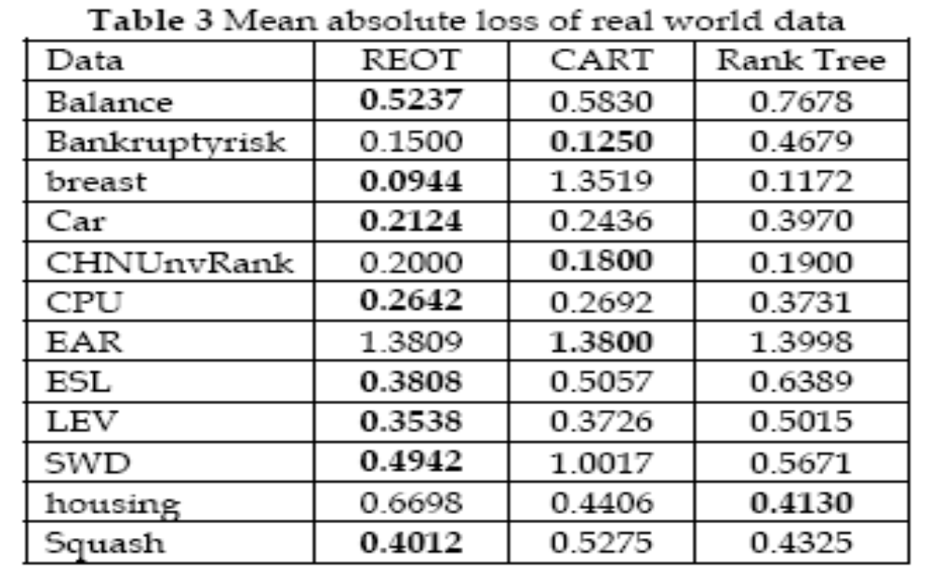
5. Experimental analysis

Slide 30
6. Conclusions and future work
Ordinal classification learning is very sensitive to noise; several noisy samples may completely change the evaluation of feature quality. A robust measure of feature quality is desirable.
Rank mutual information combines the advantage of information entropy and dominance rough sets. This new measure is not only able to measure the ordinal consistency, but also robust to noisy information.
The proposed ordinal decision tree algorithm can produce monotonously consistent decision trees if the given training sets are monotonously consistent. It also gets a more precise decision model than CART and REOT if the datasets are not consistent.

Slide 31
6. Conclusions and future work
In real-world applications, some of features are ordinal, others are nominal. This is the most general case.
We should be able to distinguish between ordinal features and nominal features and use the proper information structures hidden in them.
We will develop algorithms for learning rules from mixed features in the future.

Slide 32
Thank You!

