Slide 1



CySBML: a Cytoscape plugin for SBML
Matthias König¹, Andreas Dräger² and Hermann-Georg Holzhütter¹
¹Institute of Biochemistry, University Medicine Charité Berlin, Berlin, Germany
²Center for Bioinformatics Tuebingen (ZBIT), University of Tuebingen, Tübingen, Germany
Matthias König
Group Seminar Berlin [18|06|12]

Slide 2

Cytoscape & SBML
Cytoscape
  Open-source platform for complex network analysis and visualization (Shannon, et al., 2003)
Systems Biology Markup Language (SBML)
  Free and open interchange format for computer models of biological processes (Hucka, et al., 2003)
  Supported by over 230 software tools
  Representation of models for a wide range of cell biology like metabolism, cell signaling and gene regulation
  Common standard of interoperability and exchange to work with diverse tools on building, curation, annotation, simulation, analysis, and visualization of the same model
  BioModels : standard repository of SBML models
  (Li, et al., 2010)

Slide 3


Model Annotation
Preserving models without the semantic layer of information needed for an unambiguous identification and interpretation of model components is meaningless (Courtot, et al., 2011).
SBML is annotated based on
  MIRIAM (Minimum Information Required for the Annotation of Models) (Laibe and Le Novère, 2007)
  SBO (Systems Biology Ontology) a set of controlled vocabularies in systems biology (Le Novère, 2006)

Slide 4


CySBML
SBML plugin for Cytoscape based on JSBML (Dräger, et al., 2011), a free, open-source Java™ library for SBML.
Supports all versions and levels of SBML
Handles SBML Models and SBML Qualitative Models
Supports SBML Layout extension (Gauges, et al., 2006)
Access to BioModels via web services (Li, et al., 2010)
Reads MIRIAM annotations of the SBML elements and provides access to the annotated resources within the network visualization
Validation of imported SBML files
Navigation menu based on SBML structure

Slide 5
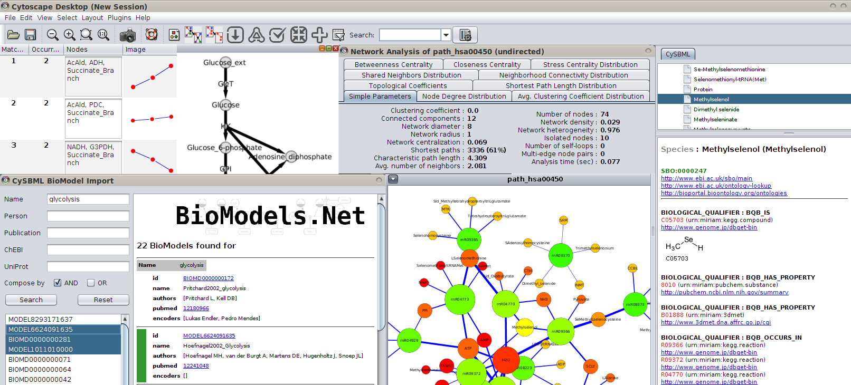
CySBML Interface
Interplay
FluxViz & NetMatch
CySBML Menu Bar
SBML Navigation Tree
Interplay
NetworkAnalyzer
Annotation Area &
WebLinks
BioModel Import

Slide 6
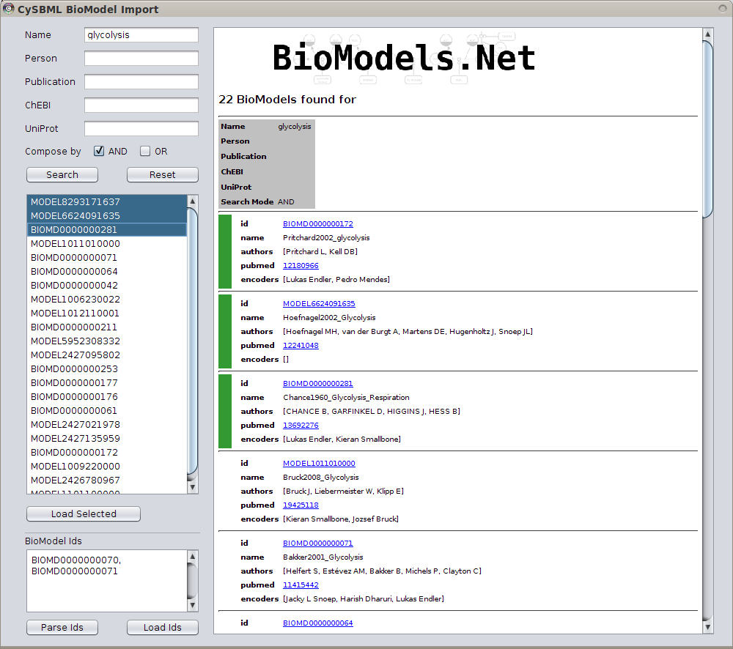
BioModel Import
SBML BioModels search via
  identifiers
  name
  author
  publication
  ChEBI
  UniProts
Import multiple models for comparative analysis

Slide 7
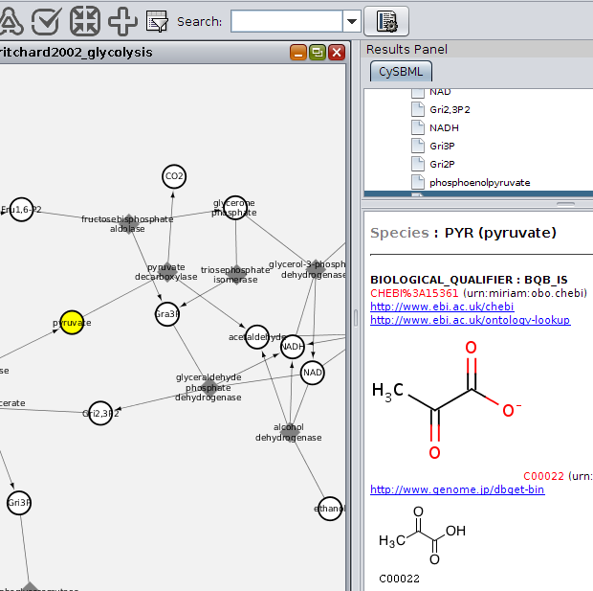
CySBML Annotations
Parsed MIRIAM & SBO annotations
Access to annotated resources within the network visualization
WebLinks to online resources and databases
Integration of information from wide range of sources

Slide 8
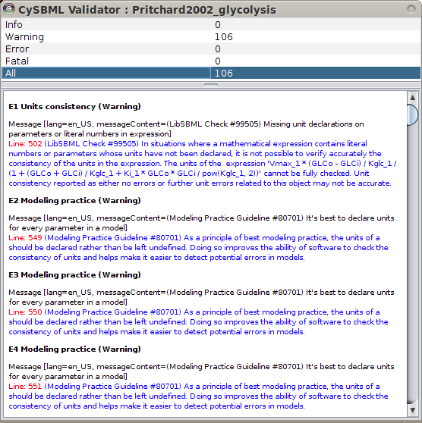
SBML Validation
imported SBML models can be validated
Validation results can be filtered with respect to the severity of the errors

Slide 9
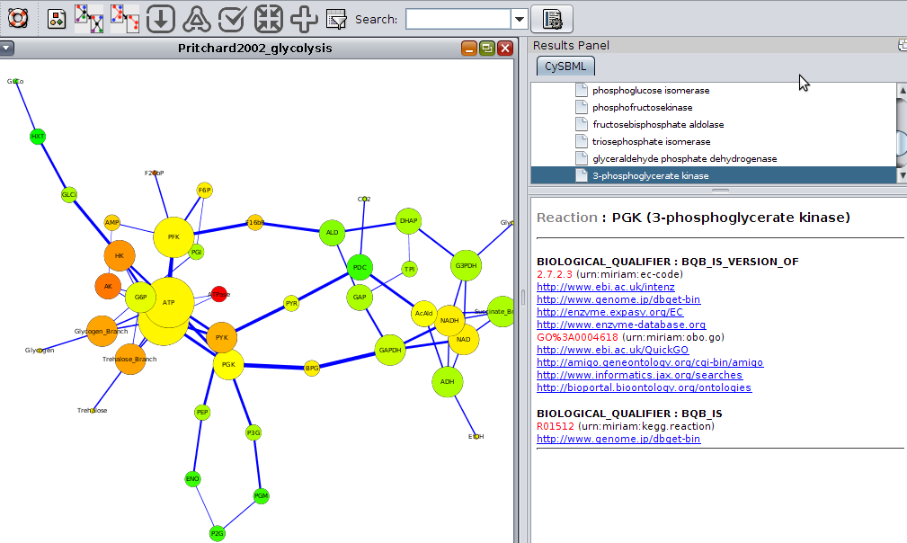
Integration with other Plugins
Seamless integration with other plugins NetworkAnalyzer (Assenov, et al., 2008), FluxViz (König and Holzhütter, 2010) or NetMatch (Ferro, et al., 2007)
SBML information provided as Cytoscape node and edge attributes
Rich functionality for SBML endcoded networks

Slide 10
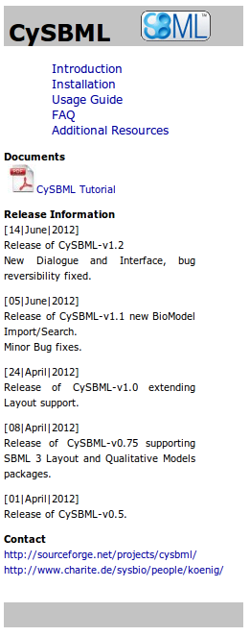
Availibility
Availability and implementation: Freely available for noncommercial purposes via the Cytoscape plugin manager, Cytoscape App Store or for download at http://sourceforge.net/projects/cysbml/
Contact: matthias.koenig@charite.de
Supplementary information: Tutorial, usage guide, installation instructions and additional figures are available for download at http://www.charite.de/sysbio/people/koenig/software/cysbml/.

Slide 11


Thanks to
Andreas Dräger & Prof. Holzhütter
Camille Laibe (BioModel WebServices) for implementing additional BioModel WebService functionality
Qual Team and Finja Büchel, Florian Mittag, and Nicolas Rodriguez (Qual implementation in JSBML)
Sebastian Fröhlich and Clemens Wrzodek (Layout support in JSBML)
Sonia Villegas, Michael Weidlich, and Christian Bölling for testing CySBML.
Funding: Virtual Liver Network
[grant numbers 0315756 and 0315741].

Slide 12
References
Assenov, Y., et al. (2008) Computing topological parameters of biological networks, Bioinformatics, 24, 282–284.
Courtot, M., et al. (2011) Controlled vocabularies and semantics in systems biology, Mol Syst Biol, 7, 543.
Dräger, A., et al. (2011) JSBML: a flexible Java library for working with SBML, Bioinformatics, 27, 2167–2168.
Ferro, A., et al. (2007) NetMatch: a Cytoscape plugin for searching biological networks, Bioinformatics, 23, 910–912.
Gauges, R., et al. (2006) A model diagram layout extension for SBML, Bioinformatics, 22, 1879–1885.
Hucka, M., et al. (2003) The systems biology markup language (SBML): a medium for representation and exchange of biochemical network models, Bioinformatics, 19, 524–531.
König, M. and Holzhütter, H.-G. (2010) Fluxviz - cytoscape plug-in for visualization of flux distributions in networks, Genome Inform, 24, 96–103.
Laibe, C. and Le Novère, N. (2007) MIRIAM Resources: tools to generate and resolve robust cross-references in Systems Biology, BMC Syst Biol, 1, 58.
Le Novère, N. (2006a) Model storage, exchange and integration, BMC Neurosci, 7 Suppl 1, S11.
Le Novère, N. (2006b) Adding semantics in kinetics models of biochemical pathways. In Hicks, K. (ed), 2nd International ESCEC Workshop. ESEC. Beilstein Institut, Rüdesheim, Germany, Rüdessheim/Rhein, Germany, pp. p. 137–153.
Li, C., et al. (2010) BioModels Database: An enhanced, curated and annotated resource for published quantitative kinetic models, BMC Syst Biol, 4, 92. Shannon, P., et al. (2003) Cytoscape: a software environment for integrated models of biomolecular interaction networks, Genome Res, 13, 2498–2504

