Slide 1

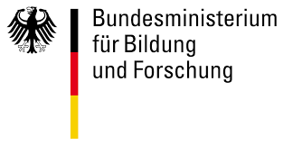
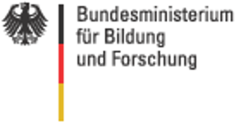
cy3sbml: A Cytoscape App for SBML
Matthias König*, Nicolas Rodriguez & Andreas Dräger
*LiSyM Systems Medicine of the Liver
Humboldt University Berlin, Institute for Theoretical Biology
livermetabolism.com
App store (v0.2.2 for Cy3.4)
http://apps.cytoscape.org/apps/cy3sbml
Source Code (v0.3.0-SNAPSHOT for Cy3.5-SNAPSHOT)
https://github.com/matthiaskoenig/cy3sbml

Slide 2

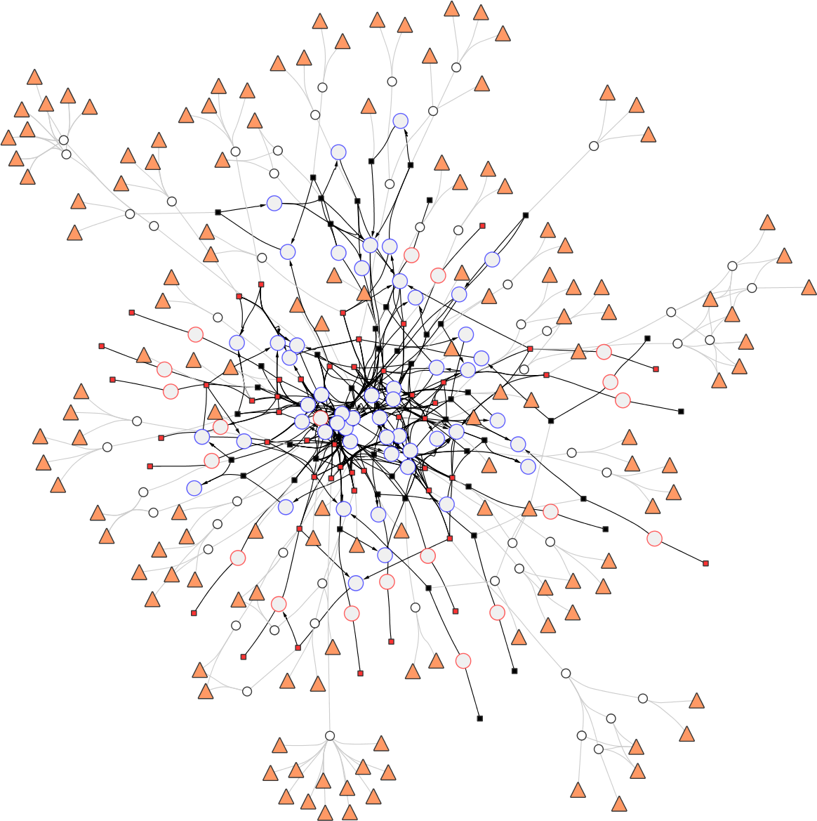
Cytoscape
Open source software platform for visualizing complex networks
Integrating networks with any type of attribute data.
apps for implementation of additional features
Large functionality out of the box
  Visual Mappings
  SubNetworks
  Groups
  Hierarchical Networks
  NetworkAnalyzer
Large community
Cytoscape 3.4
http://www.cytoscape.org
Cytoscape 3.5-SNAPSHOT
http://code.cytoscape.org/

Slide 3

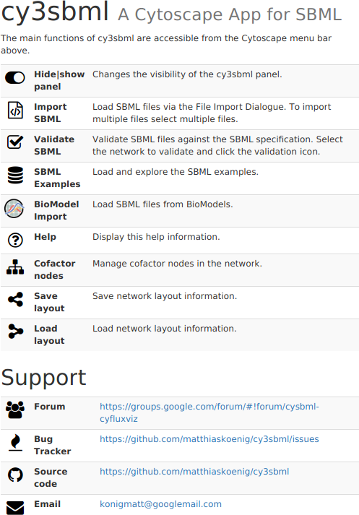

cy3sbml
Small Tool Manifesto
  Every single tool should do the smallest possible task really well
cy3sbml is
  Mission: visualization of SBML information within the network context
  Vision: visualization tool for computational models and simulations which seamlessly integrates with computational modeling workflows and frameworks
cy3sbml is NOT
  NO model builder
  NO simulator
  NO analysis tool
Small Tool Manifesto
https://github.com/pjotrp/bioinformatics

Slide 4



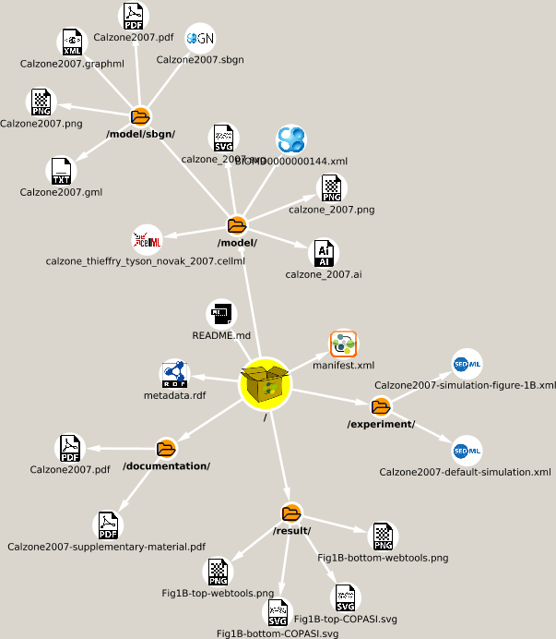
Model import
Formats
  SBML (all Levels & Versions)
  Bundles
    COMBINE Archive (OMEX)
    ResearchObject bundle
    Adobe Universal Container Format (UCF)
    ePub OCF
    Open Document package (ODF)
    ZIP
  Cytoscape Session Files
Import via File or URL
Batch support
Dedicated Web services
  BioModels Database
JWS online
http://jjj.biochem.sun.ac.za/rest/models/achcar1/sbml/?download=1
BiGG
http://bigg.ucsd.edu/static/models/iAB_RBC_283.xml
SEEK & Fairdom
https://fairdomhub.org/models/226/download?version=1

Slide 5
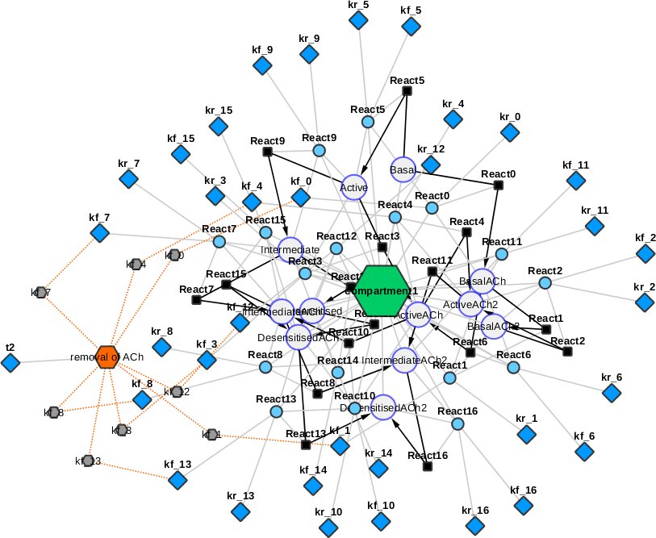
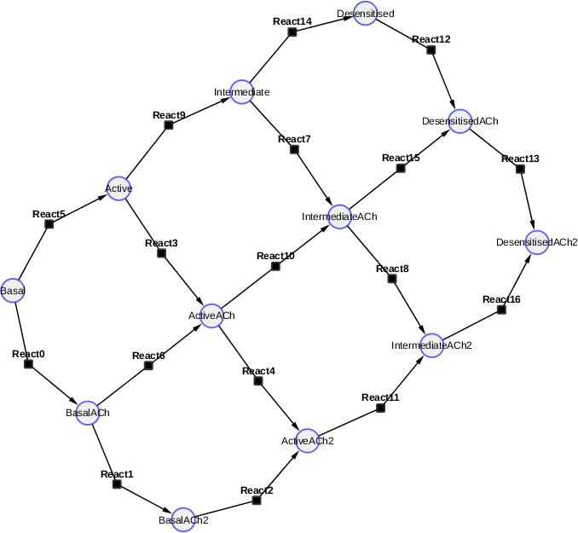
Networks
Nodes correspond to SBases & Edges to links between them
Supports
  core, fbc, groups, layout, comp*
Small to genome-scale models
Multiple views
  full networks (all SBML)
  kinetic networks (kinetic parts)
  base networks (species, reactions, gene associations)
Creation of subnetworks
  Filter based on SBML & graph attributes
  Filter based on neighbors

Slide 6
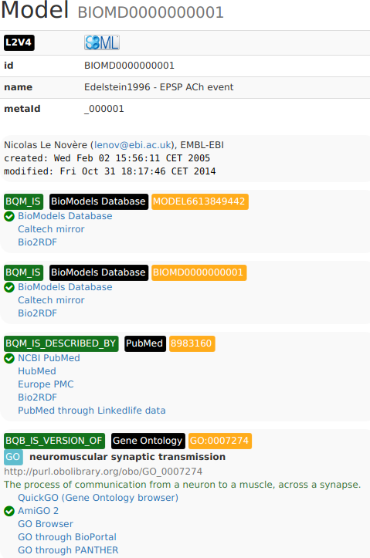


Annotations
Information about respective SBMLObject
  History
  Attributes
  Node table with attributes (for mapping)
Annotations (RDF)
  Resolution via Ontology Lookup Service (OLS)
  Secondary information for subset of databases
    UniProt, ChEBI
  Export of HTML information

Slide 7
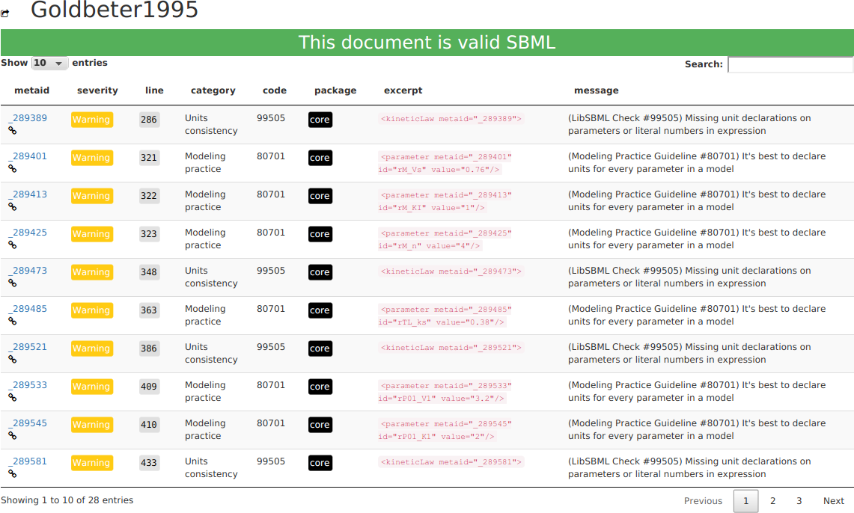
Validation
Validation report
Table with filtering & sorting
Network selections from validation results

Slide 8
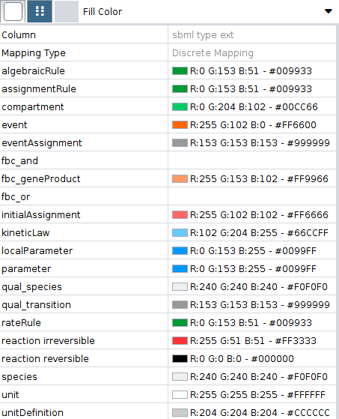
Data mapping
Data mapped to network via node & edge attributes
  sid, metaId
  Usage of attributes in Visual Mappings
Data import via CSV

Slide 9
Demo

Slide 10



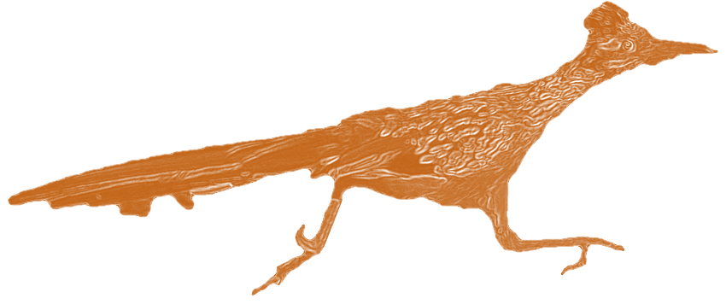
Programmatic access via REST API
cyREST
  language-agnostic, low-level RESTful API module for Cytoscape
  driving Cytoscape and cy3sbml from R/python/Julia/Node.js/Matlab/...
  access all Cytoscape data objects, including networks, tables, and Visual Styles
  Automatic layouts, image generation, …
  Use Cytoscape from Jupyter Notebook or Rstudio
  Connect your services to Cytoscape with programming language of your choice
py2cytoscape & RCy3
Examples
  Integration of cy3sbml with simulators & analysis workflows
  Coupling to roadrunner & tellurium for visualization of numerical results
Ono, Keiichiro, et al. "CyREST: Turbocharging Cytoscape Access for External Tools via a RESTful API." F1000Research 4 (2015).

Slide 11
Demo

Slide 12

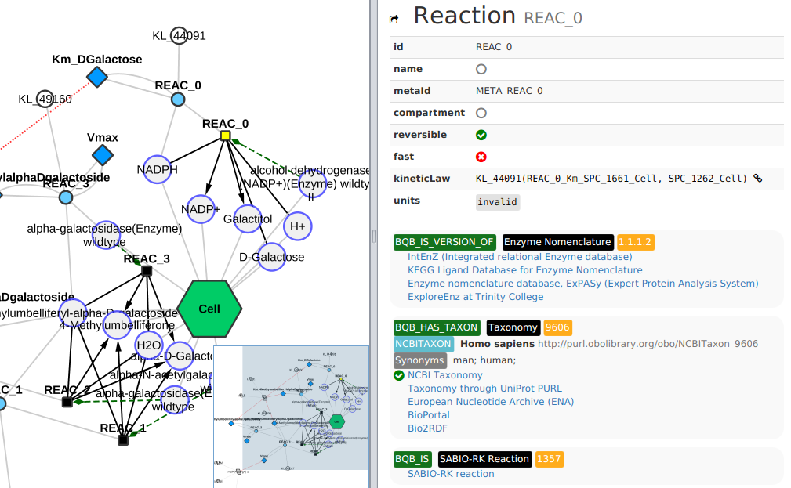
Integration with other apps
cy3sabiork
  Kinetic information from SABIO-RK
cy3fluxviz
  Visualization of FluxDistributions
cy3sabiork
https://github.com/matthiaskoenig/cy3sabiork
cy3fluxviz
https://github.com/matthiaskoenig/cy3fluxviz

Slide 13
Things to come
comp*
  Model flattening in JSBML #186
groups browsing #171, #172
  Groups subnetworks & navigation tree
layout
  Escher Layouts #42
  Layout export #71
offline modus #138
  Cache webservice info locally
Improved cofactor node, clone marker
Finalize REST API #18
  documentation, examples, finalization
SEDML networks #193
model databases via web services
  JWS online #10
  BiGG #104
Your feature request?
https://github.com/matthiaskoenig/cy3sbml/issues
Manuscript Draft
http://bit.ly/2cg7p8u

Slide 14
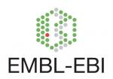






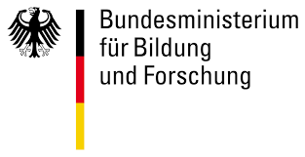

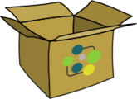




Acknowledgements
JSBML
  Nicolas Rodriguez
  Andreas Dräger
SBML
  Frank Bergmann
  Mike Hucka
  Sarah Keating
Biomodels & MIRIAM
  Nicolas Le Novère
  Nick Juty
Cytoscape
  Barry Demchak
  Lopes
  Scooter Morris
Tellurium & Roadrunner
  Kyle Medley
  Kiri Choi
  Herbert Sauro

