Slide 1

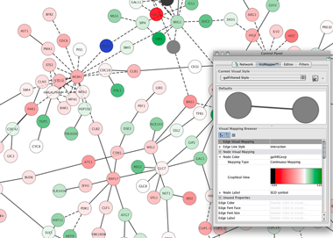
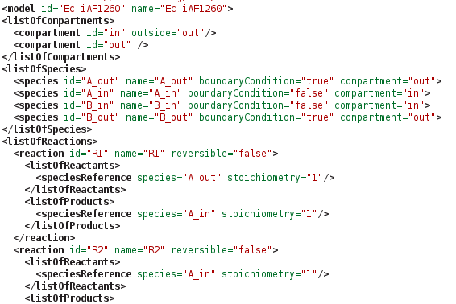
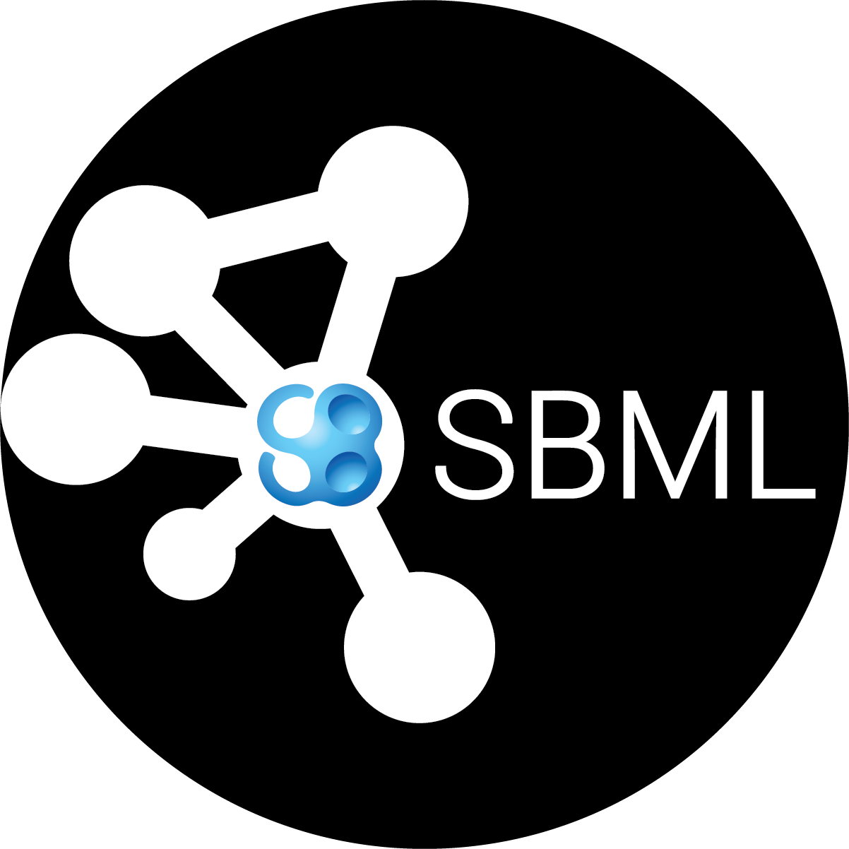
cy3sbml
Matthias König, Nicolas Rodriquez & Andreas Dräger
Charité Berlin, EMBL-EBI Hinxton, University of California, San Diego
cy3sbml
Cytoscape
cy3sbml
SBML

Slide 2
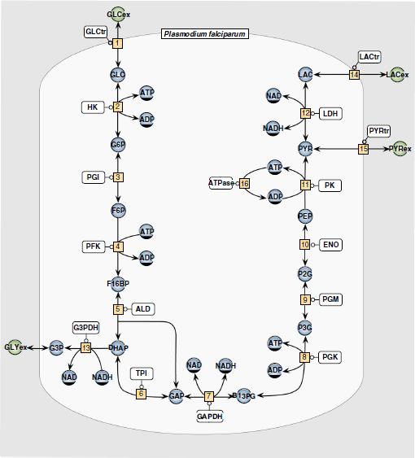
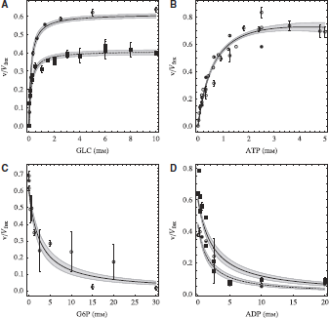
Problem
Current state
  Most computational models have underlying interaction graph
  (metabolism, signaling, protein modification, ...)
  Multitude of modeling tools, frameworks, programming languages & workflows
  No simple visualization of models & data
  in the network context
Solution
  standardized model exchange format (SBML)
  common data exchange formats (CSV, JSON)
  Easy-to-use visualization interface supporting a wide range of clients
Penkler (2015), Construction and validation of a detailed kinetic model
of glycolysis in Plasmodium falciparum, FEBS

Slide 3
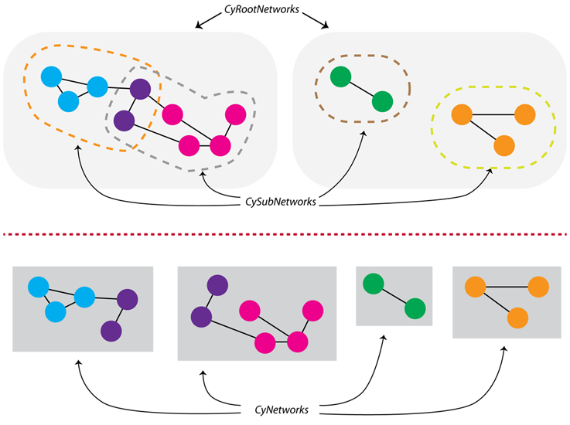
cy3sbml
Cytoscape App for the visualization of computational models & associated data in the network context
Porting & extending earlier work to
Cytoscape 3 (König 2012, König 2010)
  OSGI architecture (Apps & Services)
  Hierarchical & sub-network support
  Extended data tables
  Node images
Support SBML development
  Layout, Hierarchical Models & Flux Balance
  SBGN styles (Systems biology graphical notation)
Small models up to genome-scale hierarchical models (~100 000 nodes)
Support of model annotations
König (2012), CySBML: a Cytoscape plugin for SBML; Bioinformatics
König (2010), FluxViz - Visualization of Flux Distributions in Networks; Genome Informatics
http://chianti.ucsd.edu/cytoscape-3.2.1/API/org/cytoscape/model/package-summary.html

Slide 4
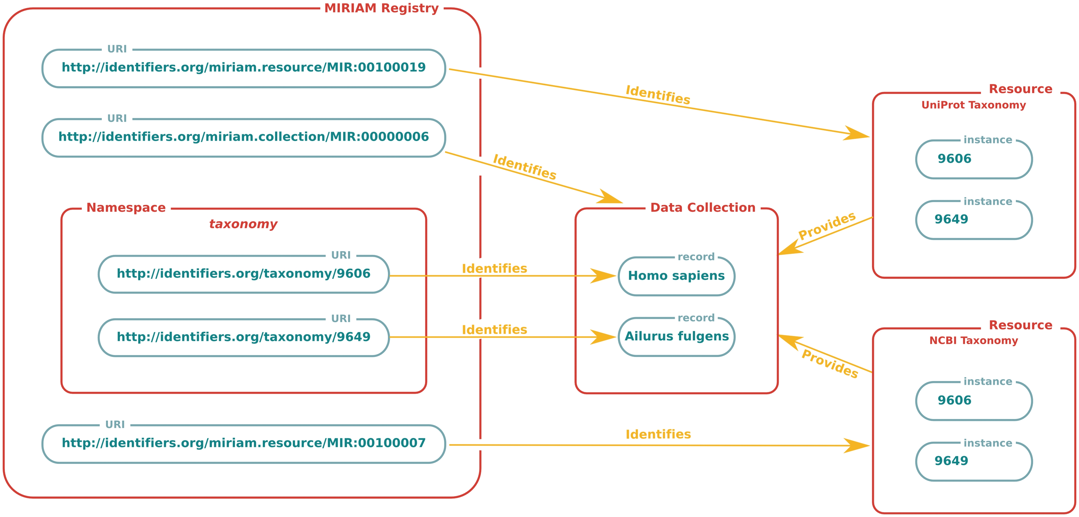
RDF annotations
Juty (2012), Identifiers.org and MIRIAM Registry: community resources to provide persistent identification; Nucleic Acids Res.

Slide 5






Integration
Minimal requirements
  SBML encoded model (& data with id column)
Support wide range of clients
  REST based API using standard exchange formats (JSON, CSV)
  python, R, matlab, …
  Simulation libraries
    FBA (COBRA, cobrapy)
    Kinetic Models (RoadRunner, Copasi)
    Gene expression networks
Extendibility
  cy3sbml API for additional Cytoscape Apps
Model repositories
  Web services & URL loading
  BioModels
  JWS online
libRoadRunner
openCOBRA
BioModels
Small tools manifesto for bioinformatics
https://github.com/pjotrp/bioinformatics

Slide 6
Information
cy3sbml status
  alpha (v0.1.3)
  first production release in 07/2015
Funding NRNB (National Resource for Network Biology)
  offers the opportunity to work with open source development team on network biology related tools and resources
Resources
  Open source: Code GPLv3, Documentation CC BY-SA 4.0
  Code
  https://github.com/matthiaskoenig/cy3sbml
  Support & Forum
  https://groups.google.com/forum/#!forum/cysbml-cyfluxviz
  Bug Tracker
  https://github.com/matthiaskoenig/cy3sbml/issues
  Email
  konigmatt@googlemail.com

