Slide 1



Modeling Liver Function Tests
1st LiSyM retreat, Hünfeld, 2017-11-21
Presentations from Pillar IV (LiFuDi)
Dr. Matthias König
LiSyM Systems Medicine of the Liver
Humboldt University Berlin, ITB
livermetabolism.com
@konigmatt

Slide 2
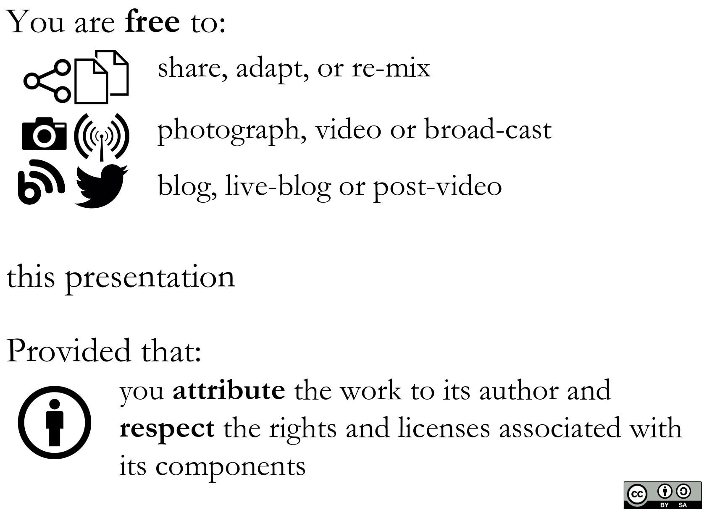
Disclosure
In relation to this presentation I declare NO conflict of interest

Slide 3
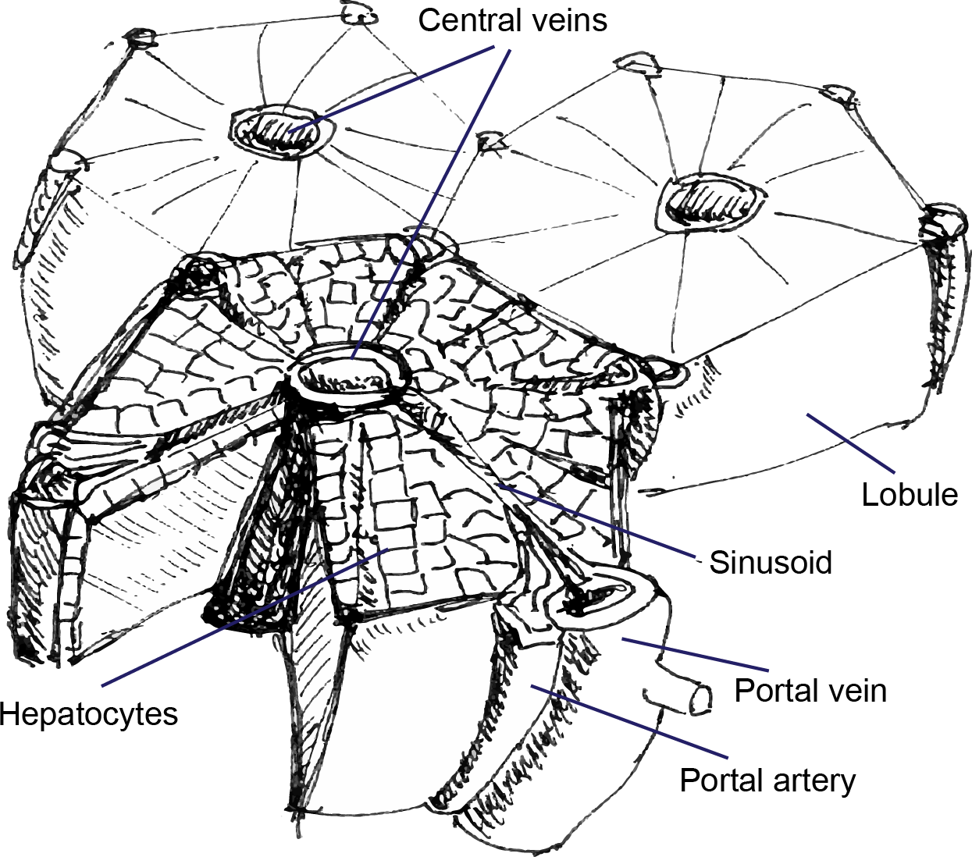
Why model liver function?
System
Liver function is complex interplay on multiple scales
physiology
morphology
perfusion
metabolism
[CC-BY-SA Matthias König]
Metabolism
Central organ of metabolism & metabolism key component for function
Detoxification & drug clearance
(most medications)
Metabolic homeostasis
(glucose, amino acids, …)
Disease
~5 million affected by liver disease in Germany
Central role in metabolic diseases like NAFLD/NASH, metabolic syndrom & diabetes
Changes in liver function key component in liver disease

Slide 4
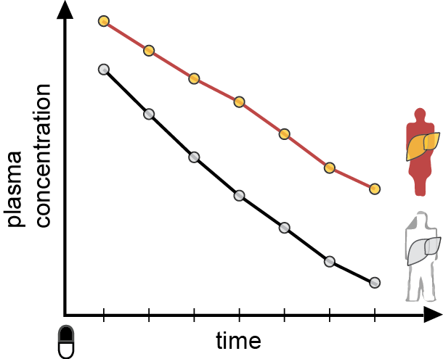
Dynamical liver function tests
Metabolic clearance key indicator of liver function
Liver specific clearance of test substance
Rate of disappearance as proxy for function
Examples
Caffeine
Galactose elimination capacity (GEC)
LiMAx Test (Methacetin)
Non-invasive & global information
  Diagnostics
  Evaluation of interventions
  Monitoring disease progression
  Functional capacities (liver transplantation & resection)
[CC-BY-SA Matthias König]

Slide 5
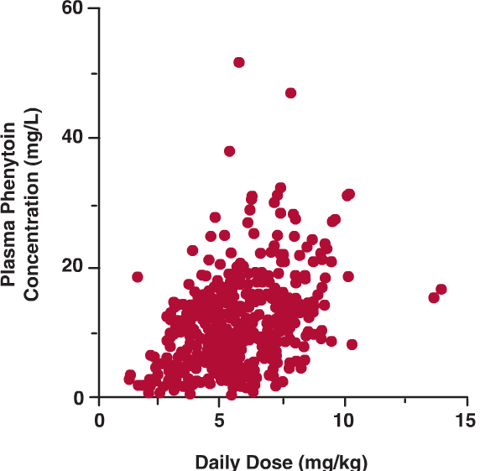
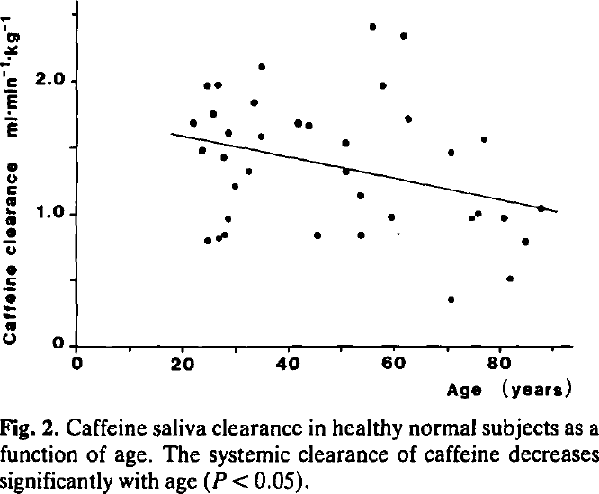
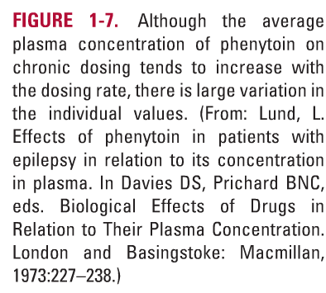
But: Large inter-individual variability
Reason for side/no effects
Correct dosing very difficult
(personalization required)
therapeutic window:
Too high: adverse effects, too low: no effects
Reason for failing clinical trials & translation
Efficacy highly person and subgroup dependent
[Clinical pharmacokinetics and pharmacodynamics:
Concepts and applications]
[Schnegg1986, Quantitative liver function in the elderly]

Slide 6



Variability Enzyme Abundance
[Archour2014]
[Clinical pharmacokinetics and pharmacodynamics:
Concepts and applications]

Slide 7



Pharmacogenomics
Individualized theraphy
Warfarin example
[Clinical pharmacokinetics and pharmacodynamics:
Concepts and applications]

Slide 8
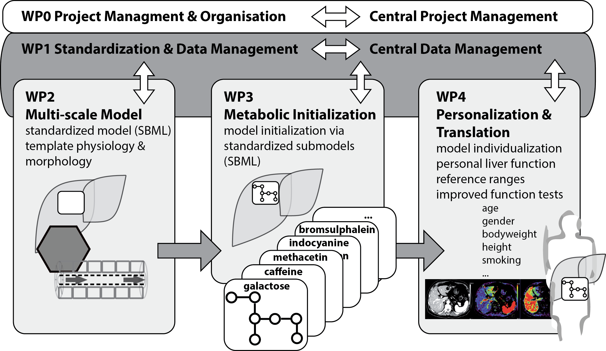
Multi-scale models for liver function tests
[CC-BY-SA Matthias König]

Slide 9
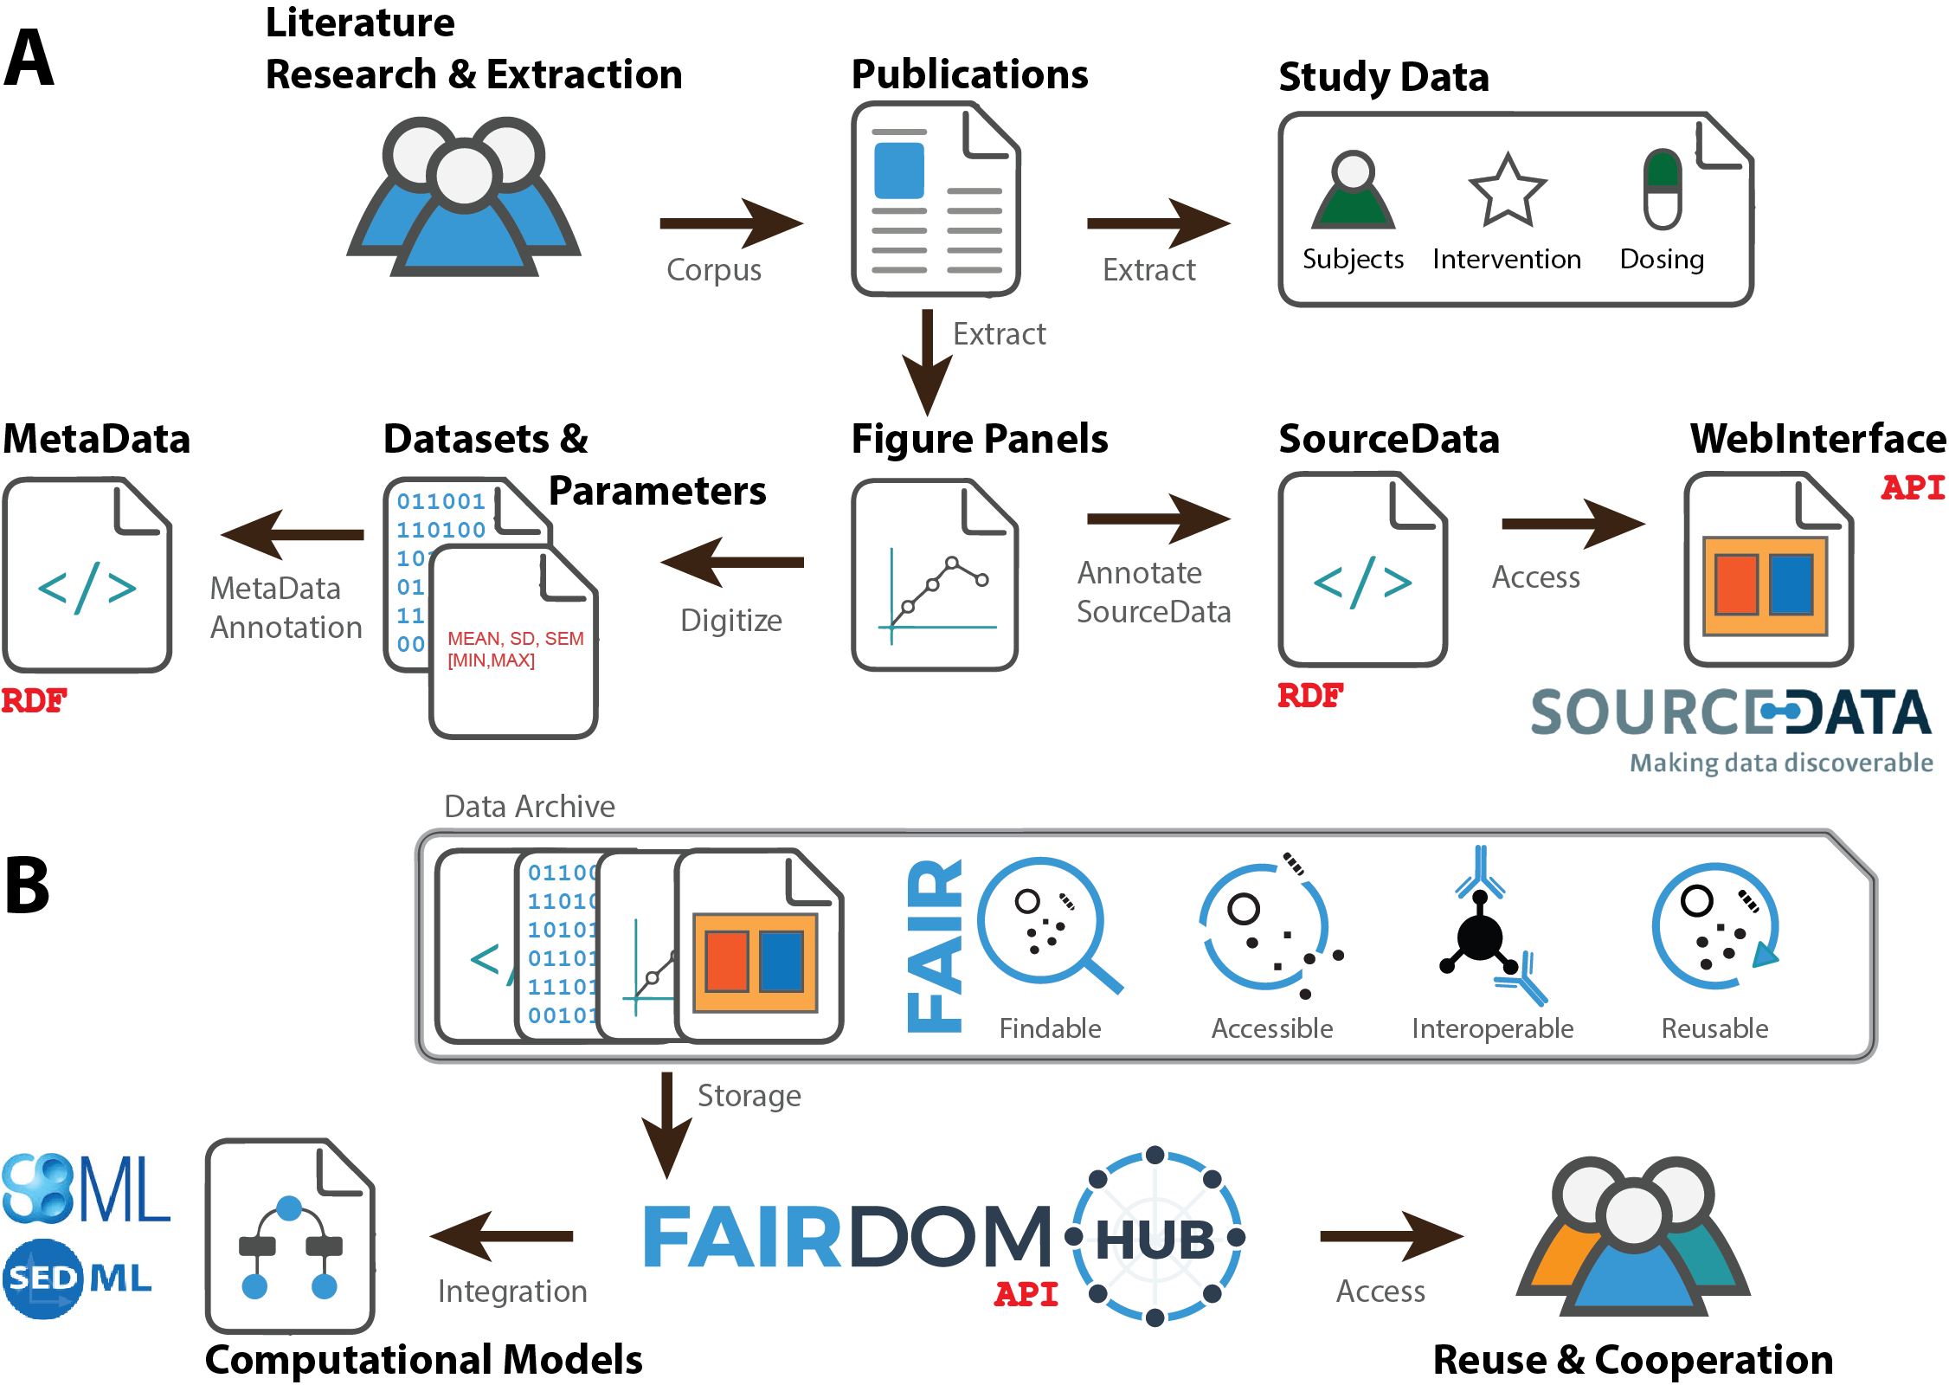
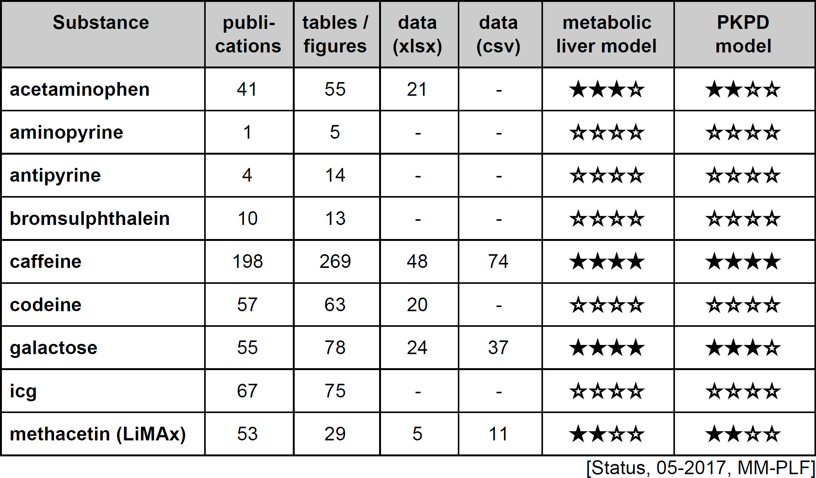
Data integration for computation models
Digitization of Publication Data
Model building (& predictions)
Clinical Trials
Model validation (not used for model building)
retrospective analysis of trials for galactose, caffeine & drug cocktails (partially blinded modeler)
[CC-BY-SA. Adapted from e:Med proposal König, Matz-Soja, Walthemath]
FAIR
Findable, Accessible, Interoperable, Reusable
Data with corresponding study data
subjects, interventions, dosing, study design
annotated high quality datasets for inegration with modeling pipeline

Slide 10
Galactose
Galactose Elimination Capacity (GEC)
[CC-BY-SA Matthias König]

Slide 11

Galactose Elimination Capacity (GEC)
König M., Marchesini G., Bianchi G. and Holzhütter HG.
A Multiscale Computational Model Predicts Human Liver Function From Single-Cell Metabolism
2017, [manuscript in preparation]

Slide 12



Multiple Indicator Dilution
Heterogeneity
Liver function depends strongly on local liver perfusion, ultrastructure & test substance
Input-Output profile after test substances

Slide 13


Liver galactose elimination, extraction ratio & clearance
Galactose Elimination [mmol/min]
Galactose Elimination [mmol/min]
Extraction Ratio [-]
Extraction Ratio [-]
Blood flow (Q) [ml/min]
Galactose [mM]
Blood flow (Q) [ml/min]
Galactose [mM]
Clearance [ml/min]
Clearance [ml/min]
Perivenious galactose [mM]
Perivenious galactose [mM]
Blood flow (Q) [ml/min]
Galactose [mM]
Blood flow (Q) [ml/min]
Galactose [mM]

Slide 14



Spatial galactose elimination
ALP (arterial liver
perfusion)
PVP (portal-venous
perfusion)
HPI (hepatic perfusion
index)
[Wang2013]
Perfusion CTs
Galactose elimination depending on
local liver perfusion
GE [µmol/min/ml(tissue)]
Galactose elimination (8mM galactose)

Slide 15
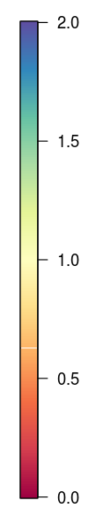
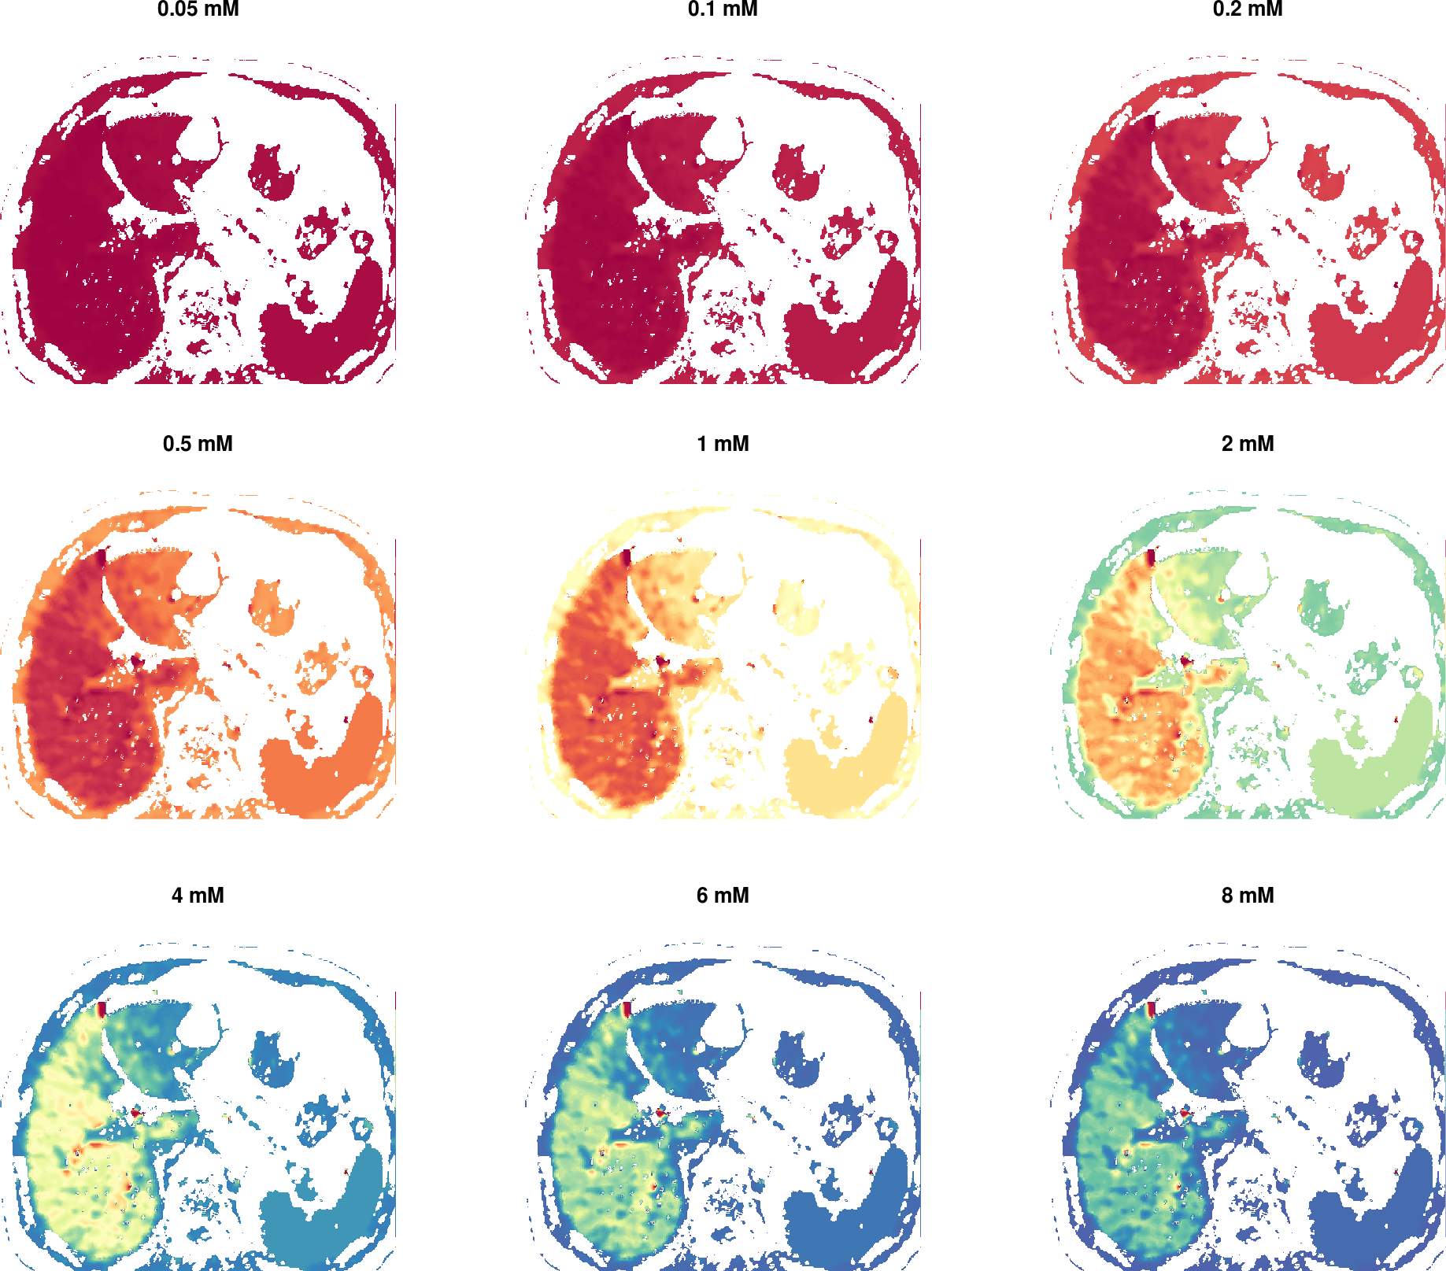
GE [µmol/min/ml(tissue)]
Galactose elimination depending on galactose

Slide 16




Personalized prediction
Individual evaluation of liver function test
Simulation of in silico population representative of the individual subject
GEC [mmol/min]
Population prediction
age [years]
Classification Cirrhosis
GEC App

Slide 17
Work in progress
Integration with PK/PD models
  time courses of whole-body distribution and urinary extraction
  In silico trials & virtual populations
  Large dataset of individual subject galactose time courses for analysis (Marchesini)
Evaluation of model performance
  Second cohort of GEC measurements (only accessed after model is finished)
Integration CT data
  Simulate spatial heterogeneity in liver function
  Integration with perfusion CT, functional CT

Slide 18


Caffeine (PK/PD model)
Why you need more coffee if you smoke?

Slide 19

PK/PD models
PharmacoKinetics/PharmacoDynamics
  combine information on the drug with knowledge on the physiology
  Tissues are linked by arterial and venous blood compartments
    organ volumes, blood flow rates, tissue-partition coefficient, permeability
  Absorption, Distribution, Metabolism, Elimination (ADME) of substances
  Easy to personalize using anthropometric information
    Bodyweight, height, gender, age, perfusion, ...
[Kuepfer2016]

Slide 20


PKPD Applications
Individual Dosing
In silico drug trials
[Kuepfer2016]

Slide 21

Caffeine (137X)
  world's most widely consumed psychoactive drug
  Metabolized in liver by CYP1A2
    to paraxanthine (17X), theobromine & theophylline
  Classical liver function test (ideal test substance)
    Time course of caffeine
    Urinary ratios of methyl-xanthines
    Caffeine/paraxanthine ratio
  Large Variability
    Effects of lifestyle on expression
    Smoking is one of such lifestyle factors
[Denaro1996]
    How is smoking affecting the clearance of caffeine ?
+
= ?

Slide 22



PK/PD
TODO: Illustrator (liver & human image)
TODO: better network image
Whole-body distribution kinetics
Kinetic model of caffeine liver metabolism
Renal clearance
100 mg oral caffeine dose

Slide 23


Analysis
  C_{max} : Maximal concentration
  T_{max} : time of maximal concentration
  AUC : area under the curve
  k_{el}: elimination rate
  fitting linear part of terminal phase (log)
  t_{1/2} : half-life (= ln2/k_{el})
  time for concentration to fall to half
  Vd: volume of distribution
  (= CL/k), dilution space
  CL: clearance (=Dose/AUC, =Dose/C(0)_{extrapolated})
Rowland2011
[Clinical pharmacokinetics and pharmacodynamics:
Concepts and applications]

Slide 24
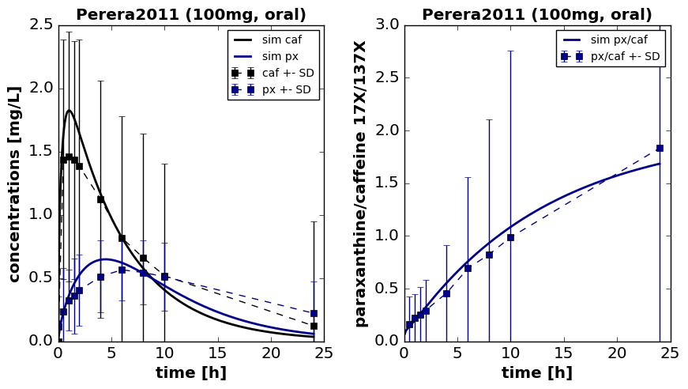
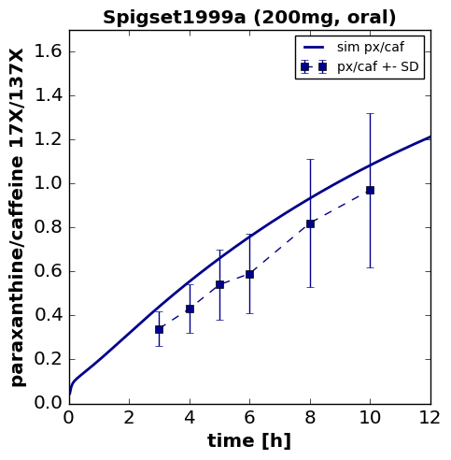





Mean model
human (70kg, male),
mean microsomal CYP1A2 content,
non-smoker
Model version 2

Slide 25
Analysis
  C_{max} : Maximal concentration
  T_{max} : time of maximal concentration
  AUC : area under the curve
  k_{el}: elimination rate
  fitting linear part of terminal phase (log)
  t_{1/2} : half-life (= ln2/k_{el})
  time for concentration to fall to half
  Vd: volume of distribution
  (= CL/k), dilution space
  CL: clearance (=Dose/AUC, =Dose/C(0)_{extrapolated})

Slide 26


CYP1A2
CYP1A2 expression altered by many lifestyle factors
  Strong effect: Smoking
Altered function test results
  clearance, half-life, kel, max value, metabolic ratios
_{CYP1A2 ▲}
CYP1A2 induction ▲
Clearance ▲
kel ▲
T1/2 ▼
Tmax ▼
px(17X)/caf(137X) ▲
_{CYP1A2 ▲}

Slide 27









Smoking
CYP1A2 smoking effect
  Distribution of liver microsome activity (log-normal) for non-smokers and smokers
  Simulation of moderate smoking effect (6-10 cigarettes, ~40% increase)
TODO: print the mean curves with S.D in comparison
Data: Spigset1999a
Data: Spigset1999a
Data: Perera2011

Slide 28





CL: Clearance

Slide 29


k_{el} : elimination rate

Slide 30



t_{1/2} : half-life

Slide 31





px/caf ratio (4h, 6h)

Slide 32


Prediction: coffee consume
Multiple dosing
Adaption to smoking status, i.e. high smokers, via dose response curve (CYP1A2 ~ smoking)

Slide 33
Work in progress
Model improvement & Parameter sensitivities
high caffeine doses & paraxanthine doses
Metabolism of additional methyl-xanthines
describe urinary profile and change of urinary metabolite ratios with smoking (CYP1A2 activity)
Simulating Virtual Populations
organ volume & blood flow scaling, adapting to respective study populations
Coupling to logistic regression model
Smoking one example of CYP1A2 induction effect
  Contraceptives, coffee consumption, genetic variants
  Individualized (population) predictions
Caffeine-drug interactions
Validation with LiSyM drug cocktail
Existing dataset of individual subject caffeine time courses

Slide 34
LiMAx (PK/PD model)
Effect of smoking

Slide 35
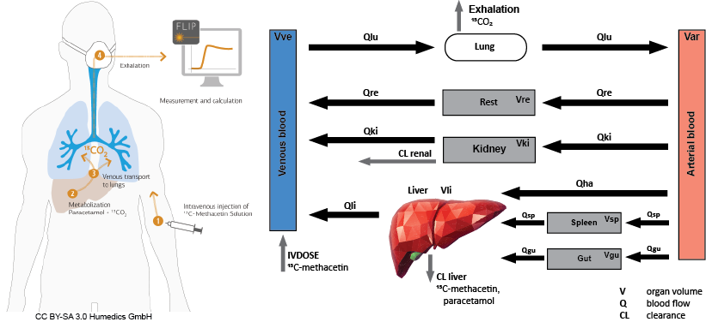
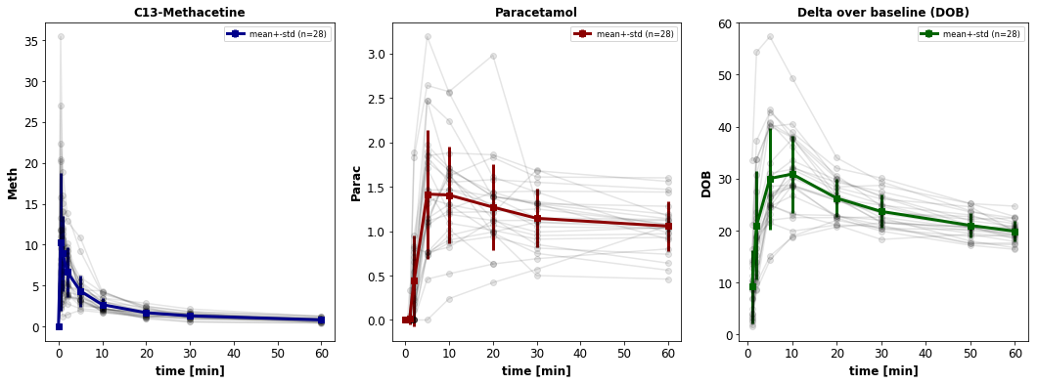
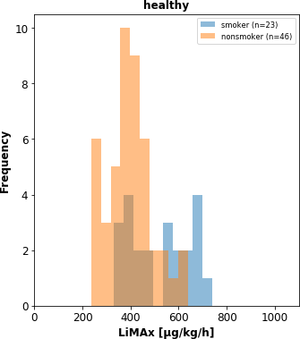
LiMAx & smoking

Slide 36
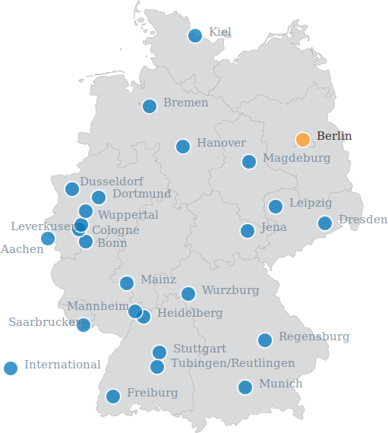



Partners & Funding
Charité Berlin, Computational Systems Biochemistry
Prof. Holzhütter
Charité Berlin, Department of General, Visceral and Transplantation Surgery
Dr. Wünsch & Prof. Stockmann
Dr Margarete Fischer-Bosch Institute of Clinical Pharmacology, Stuttgart
Dr. Ute Hofmann & Prof Schwab
University of Bologna, Institute of Internal Medicine
Prof. Marchesini & Prof. Bianchi
University of Washington, UW Bioengineering
Prof. Sauro, Kyle Medley, Kiri Choi
University of Tübingen, Zentrum für Bioinformatik Tübingen
Dr. Andreas Dräger

Slide 38
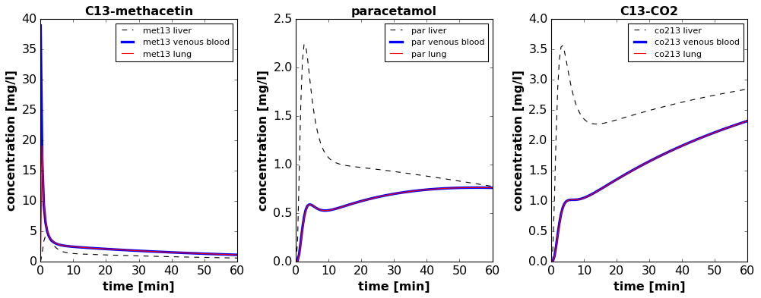
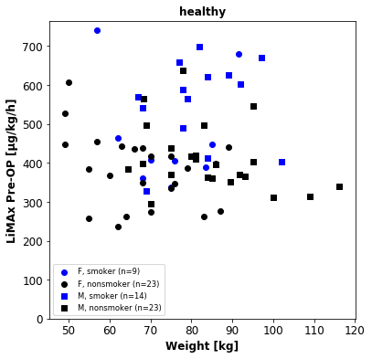
Initial Results
PK/PD model build
Retrospective analysis of LiMAx in smoking

Slide 39
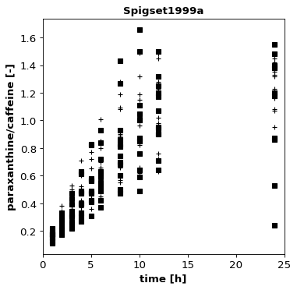
Intra-individual variability

Slide 40
Modeling
Tools, Software, Workflows

Slide 41
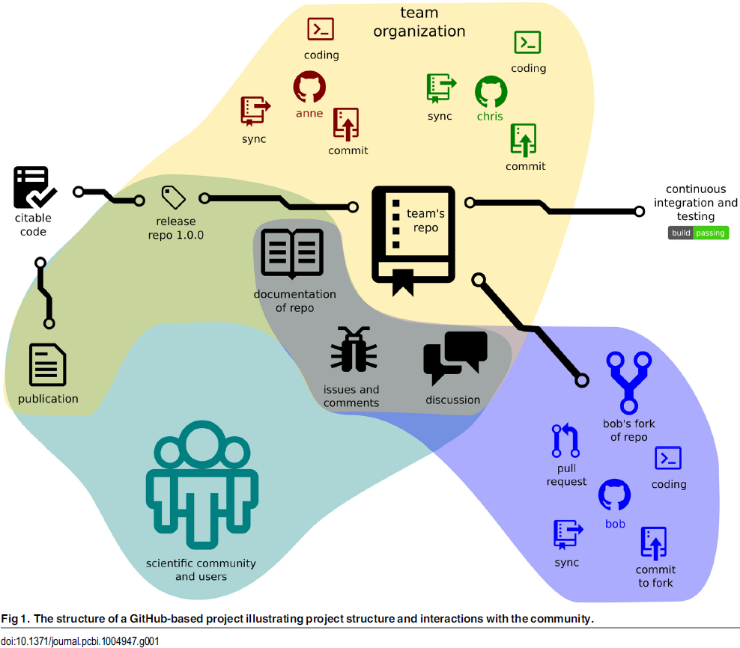



git repositories
GitHub is a code hosting platform for version control and collaboration. It lets you and others work together on projects from anywhere.
Version control
  Diffs & Branches
Collaborative editing
  Pull requests
Continuous integration
  unit tests
  Commit hooks
Releases & snapshots (citable code)
Issue tracker
Work anywhere & offline
&
CODE
DATA
Perez.Riverol2016
https://github.com/matthiaskoenig/cy3sbml/
https://github.com/matthiaskoenig/cy3sbml/commit/986ebbdd5e77d403cf031ff0a5230de4d28fc284

Slide 42

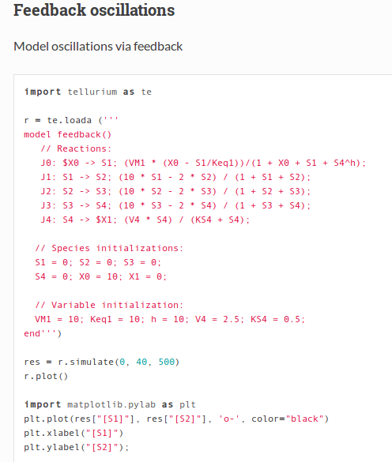
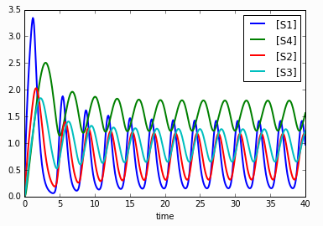
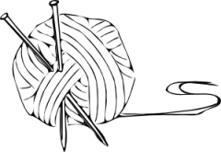
Reproducible Analyses
Dynamic report generation !
Jupyter notebooks
Web application that allows to create and share documents that contain live code, equations, visualizations and explanatory text.
Open source, interactive data science and scientific computing across over 40 programming languages.
Complete analysis, examples, test cases
http://tellurium.readthedocs.io/en/latest/notebooks.html#feedback-oscillationshttp://localhost:8888/notebooks/feedback_oscillations.ipynb
R: Knitr
Elegant, flexible and fast dynamic report generation with R
BDL example
https://github.com/matthiaskoenig/bdl-analysis
http://jupyter.org/

Slide 43
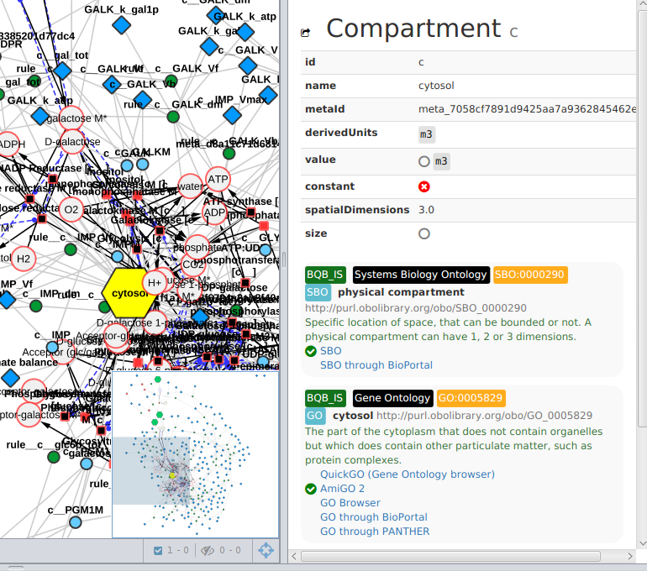


Standard Formats
Encoding of information in standard formats where possible
  Models in SBML (core, comp, fbc)
  Simulations in SED-ML
  Minimal Information for models and simulation (MIRIAM, MIASE)
Annotations to ontologies
  Knowledge integration
  Documentation
Reproducibility
  Reproducibility of results
  (roadrunner, COPASI, JWS)
Model quality
  Passes library tests
  (e.g., module unit tests, ...)
Visualization
  Iterative model cycle
König, Rodriquez, and Dräger
cy3sbml: A Cytoscape app for SBML
2017, manuscript in preparation
https://github.com/matthiaskoenig/cy3sbml

Slide 44

Standardization
Reproducible Computational Research
Integration of clinical/patient data with computational models
König M.*, Oellrich A.*, Waltemath D.*, Dobson R., Hubbard T., and Wolkenhauer O.
* equal contribution
Challenges and opportunities for system biology standards and tools in medical research
OLDS, 2016

Slide 45
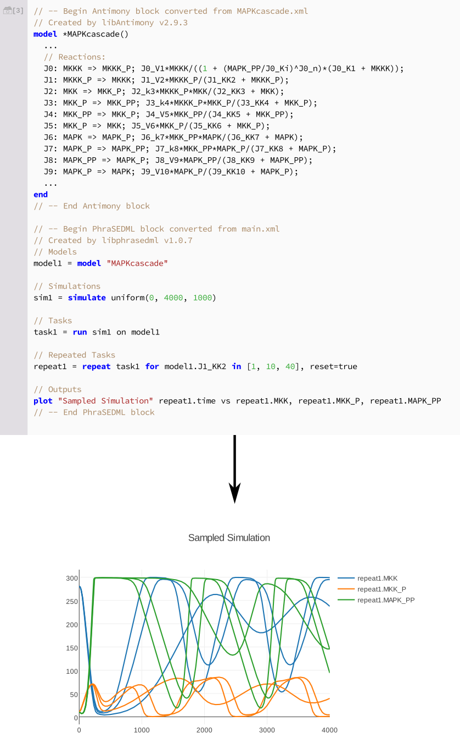
Modeling Tools
libRoadRunner: High performance SBML simulator
tellurium: Python based modeling environment (library & notebook)
Medley K, Choi K, König M; Smith L, Gu S, Joseph Hellerstein, Sealfon S., Sauro HM.
Tellurium Notebooks - An Environment for Dynamical Model Development, Reproducibility, and Reuse
[submitted, 2017]
Somogyi, Bouteiller, Glazier, König, Medley, Swat, Sauro.
libRoadRunner: a high performance SBML simulation and analysis library.
Bioinformatics. 2015

Slide 46

Visualization & Data Integration
König
cy3sabiork: A Cytoscape app for visualizing kinetic data from SABIO-RK
2016 [version 1; referees: 2 approved with reservations]
http://f1000research.com/articles/5-1736/v1
https://github.com/matthiaskoenig/cy3sabiork
König, Rodriquez, and Dräger
cy3sbml: A Cytoscape app for SBML
2017, manuscript in preparation
https://github.com/matthiaskoenig/cy3sbml

Slide 48
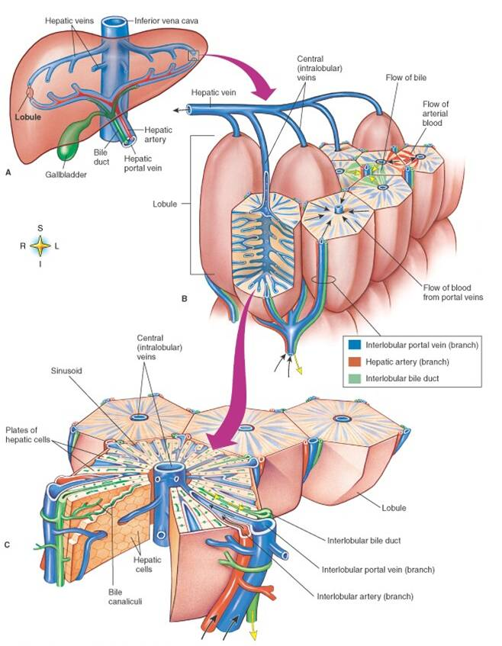
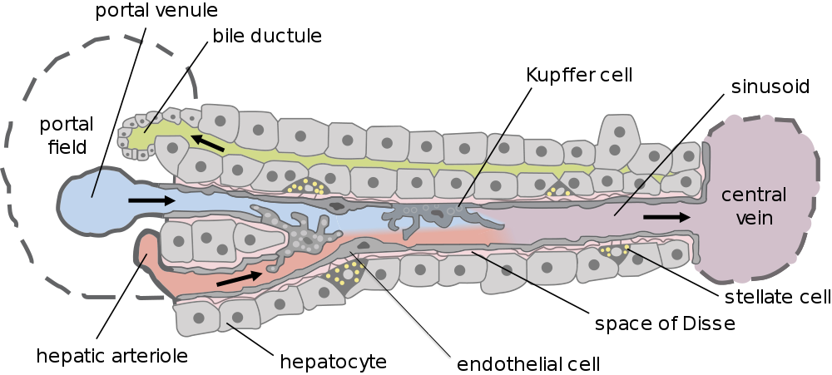
Liver in a nutshell
Liver
Hierarchical architecture
  Parallel circuit of hexagonal subunits (lobulus)
  Lobulus consists of network of sinusoids
  Hepatocytes main cell type
Dual blood supply
  Portal vein (80%)
  Hepatic artery (20%)
Lobulus
Sinusoidal unit
Hepatocyt

Slide 49
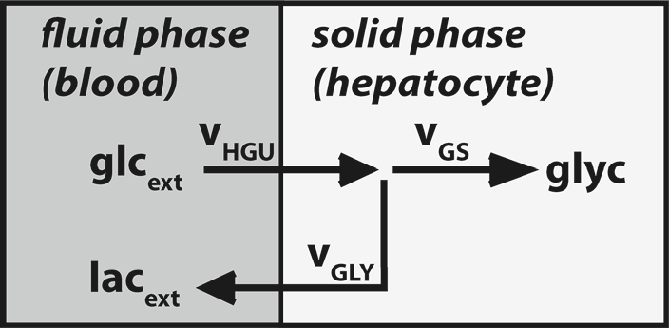
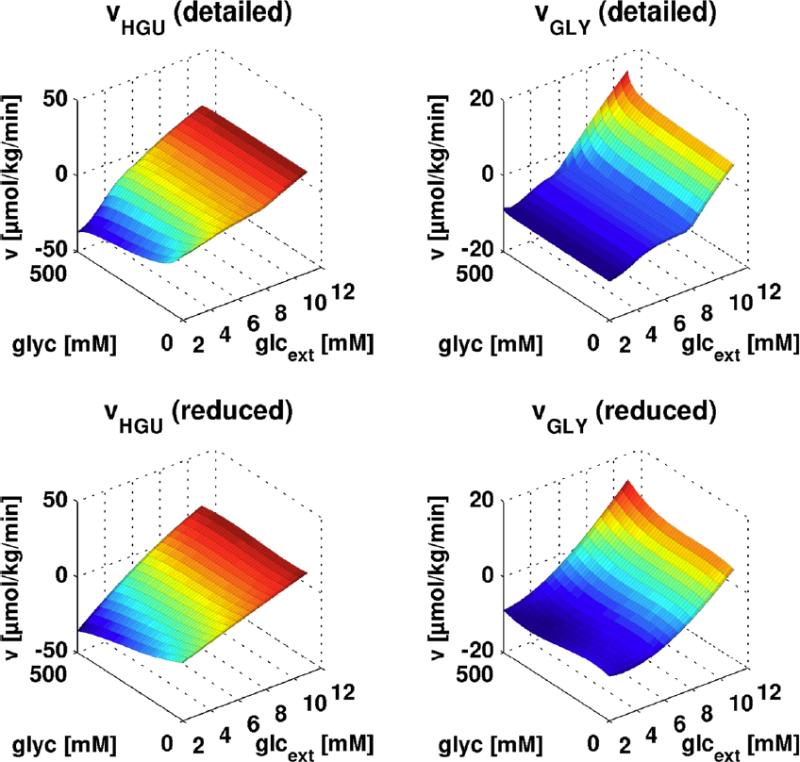
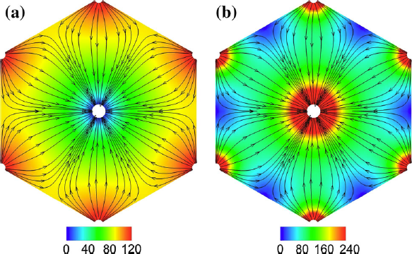

Tissue Glucose Model
Model reduction & coupling
Ricken, Werner, Holzhütter, König M., Dahmen, Dirsch
Modeling function-perfusion behavior in liver lobules including tissue,
blood, glucose, lactate and glycogen
Biomech Model Mechanobiol. 2014
Detailed model
HGU/HGP
GLY
Reduced model
Spatial glycogen distribution after 48h of meal profile
Pressure [mmHg]
Blood flow [µm/s]
Notes:
Model reduction
- key metabolic processes & model behavior conserved

Slide 50


Ultrastructural changes in aging
Pseudocapillarization
  Endothelial cells are thickened and defenestrated with old age
Cogger2003, Warren2005

Slide 51

Reduced Clearance in aging
Galactose Elimination [mmol/min]
Galactose Elimination [mmol/min]
Extraction Ratio [-]
Extraction Ratio [-]
Blood flow (Q) [ml/min]
Galactose [mM]
Blood flow (Q) [ml/min]
Galactose [mM]
Clearance [ml/min]
Clearance [ml/min]
Perivenious galactose [mM]
Perivenious galactose [mM]
Blood flow (Q) [ml/min]
Galactose [mM]
Blood flow (Q) [ml/min]
Galactose [mM]
Reduced Clearance & Extraction ratio under low concentrations (local effect)
In combination with reduced liver volume & perfusion in age can have drastic effects on drug/compound clearance

Slide 52

Kuepfer2016

Slide 53


Slide 54



Smoking cessation

Slide 55

WP3 Central Carbon Model
Kinetic model of central liver metabolism
Berndt N., Bulik S., Wallach I., König M., Stockmann M., Meierhofer D. and Holzhütter HG.
Computational Assessment of Liver Metabolism
[2016, manuscript in preparation]

Slide 56

WP3 Metabolic Modeling Liver
Kinetic models
(glucose & central metabolism, detoxification)
Flux Balance Analysis Genome-scale liver
Hybrid approaches
König M. and Holzhütter HG.
Homeostasis of blood glucose - Computer simulations of central liver functions.
systembiologie.de 2014; 8:p.53-57
König M. and Holzhütter HG.
Kinetic Modeling of Human Hepatic Glucose Metabolism in T2DM Predicts Higher Risk of Hypoglycemic Events in Rigorous Insulin Therapy
J Biol Chem. 2012
König M., Bulik S. and Holzhütter HG.
Quantifying the Contribution of the Liver to the Homeostasis of Plasma Glucose: A Detailed Kinetic Model of Hepatic Glucose Metabolism Integrated with the Hormonal Control by Insulin, Glucagon and Epinephrine
PLoS Comput Biol. 2012
Gille C, Bölling C, Hoppe A, Bulik S, Hoffmann S, Hübner K, Karlstädt A, Ganeshan R, König M, Rother K, Weidlich M, Behre J, Holzhütter HG.
HepatoNet1: a comprehensive metabolic reconstruction of the human hepatocyte for the analysis of liver physiology.
Mol Syst Biol., 6:411., 2010

Slide 57

Junior Group LiSyM:
Multi-scale Modeling for Personalized Liver Function Tests

Slide 58
WP1 Standardization
Reproducible Computational Research
Application of standard formats
Integration of clinical/patient data with computational models
König M.*, Oellrich A.*, Waltemath D.*, Dobson R., Hubbard T., and Wolkenhauer O.
* equal contribution
Challenges and opportunities for system biology standards and tools in medical research
[2016, accepted]
Wholecell Consortium (König M.)
Toward community standards and software for whole-cell modeling
IEEE Trans Biomed Eng. 2016 Jun 10.

Slide 59


Bioinformatics Analyses
https://www.ncbi.nlm.nih.gov/pmc/articles/PMC4654904/bin/12918_2015_229_Fig8_HTML.jpg
Abshagen*, König*, Hoppe A., Thomas M., Müller I., Ebert M., Weng H., Holzhütter HG., Zanger UM., Bode J., Vollmar B. and Dooley S.
* equal contribution
Pathobiochemical signatures of cholestatic liver disease in bile duct ligated mice
2015, BMC Systems Biology
https://github.com/matthiaskoenig/bdl-analysis
Circadian omics data &
Integration metabolic models
Patrick Pett, Hanspeter Herzel, Matthias König
Circadian rhythms in the mouse liver

Slide 60


WP0 Central Data Management
https://www.fairdomhub.org/projects/46
Project & assets are managed in central data management
(SEEK & fairdomhub)
Multiple meetings/TC with data management (Heidelberg, Fairdom user meeting)
Project Webpage setup
Open Access (Models) & Open Source (Code) & Open Data (?)
https://www.livermetabolism.com/

Slide 61


Time table PLF

