Slide 1
SBML & Extensions to
Encode Dynamic Flux Balance (DFBA) models
INRA workshop
Tech talks: Cell representation and RBA file formats
Dr. Matthias König
LiSyM Systems Medicine of the Liver
Humboldt University Berlin, Institute for Theoretical Biology
livermetabolism.com, konigmatt@googlemail.com

Slide 2
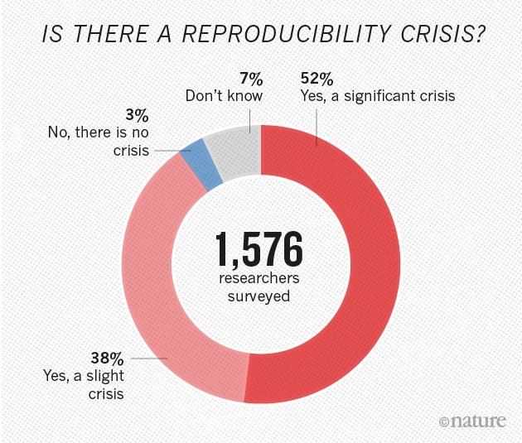
Reproducibility Crisis
“Really Reproducible Research” (1992) inspired by Stanford Professor Jon Claerbout:
“The idea is: An article about computational science in a scientific publication is not the scholarship itself, it is merely advertising of the scholarship. The actual scholarship is the complete ... set of instructions [and data] which generated the figures.”
David Donoho, 1998
Note the difference between: reproducing the computational steps and, replicating the experiments independently including data collection and software implementation.
(Both required)
https://www.nature.com/news/1-500-scientists-lift-the-lid-on-reproducibility-1.19970
https://web.stanford.edu/~vcs/talks/MSKCC-Sept15-2015-STODDEN.pdf

Slide 3
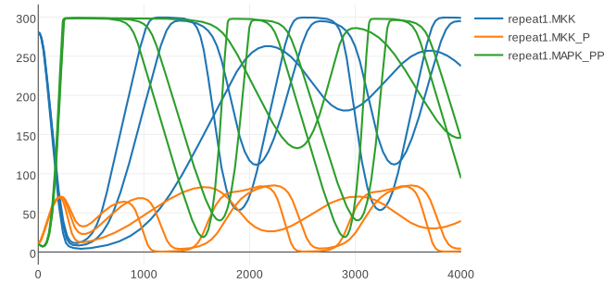

Standard Formats
Encoding of information in computer readable format
  Minimal Information for models and simulation (MIRIAM, MIASE)
Exchangeability
Reproducibility
  Reproducibility of results
  (roadrunner, COPASI, JWS)
Annotations (to ontologies)
  Knowledge integration (biological, computational)
  Documentation (what is my model component)
Quality
  Automatic validation, e.g., model quality
  (unit checking, model consistency)
Software & Tools
  Simulation, Visualization, Analysis, Repositories,
  Parameter fitting
König, Rodriquez, and Dräger
cy3sbml: A Cytoscape app for SBML
2017, manuscript in preparation
https://github.com/matthiaskoenig/cy3sbml

Slide 4





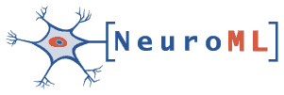
COMBINE
initiative to coordinate the development of the various community standards and formats for computational models
COMBINE meeting & HARMONY hackathon
Core standards
http://co.mbine.org/Standards#Core_COMBINE_standards
  SBML Systems Biology Markup Language
  SED-ML Simulation Experiment Description Language (SED-ML)
  SBGN Systems Biology Graphical Notation
  CellML
  SBOL Synthetic Biology Open Language Data
  NeuroML

Slide 5
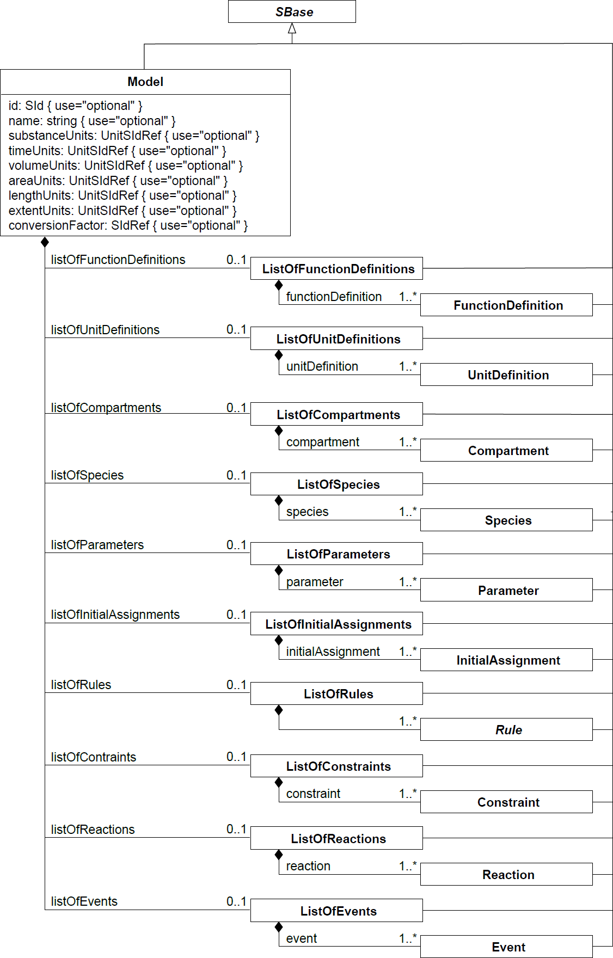
SBML core
Systems Biology Markup Language
  De facto standard for encoding computational models
Libraries: libsbml (C++, python, R, JavaScript, ... & JSBML (Java)
Components
  FunctionDefinitions
  Compartments
  Species
  Parameters
  InitialAssignments
  Rules
  Constraints
  Reactions
  Events

Slide 6
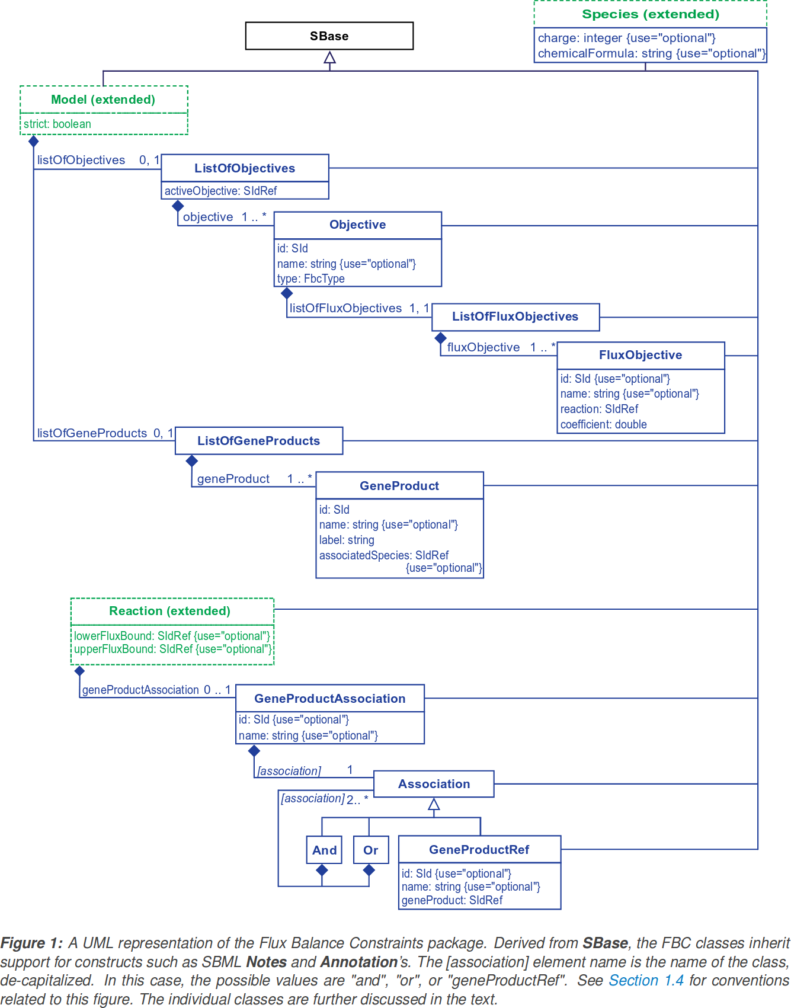
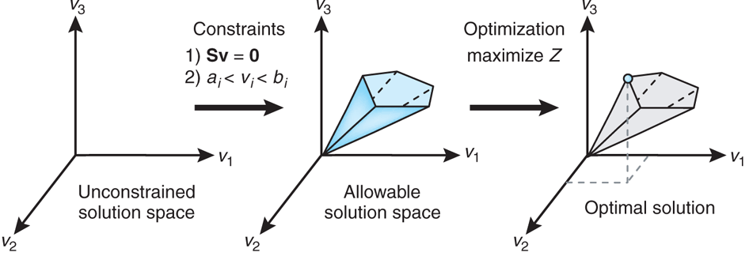
SBML fbc
FBA encoding
  Objective functions
  Gene-Reaction mapping
  Flux bounds
  Chemical formula & charge

Slide 7
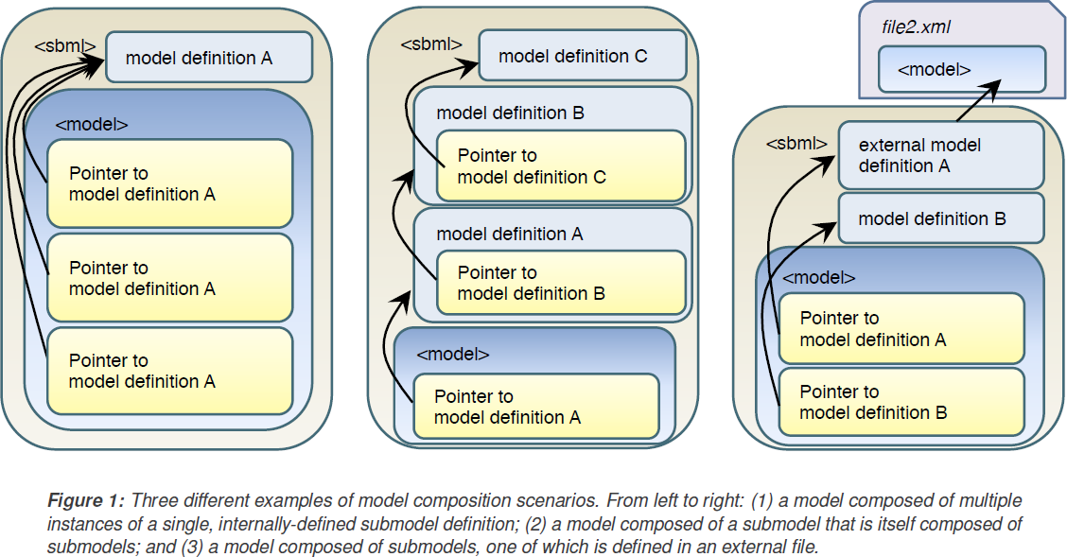
SBML comp
Hierachical model composition & Coupling of models
  ModelDefinitions, Submodels, Ports (Interfaces), ReplacedBy, ReplacementElement, Deletion

Slide 8

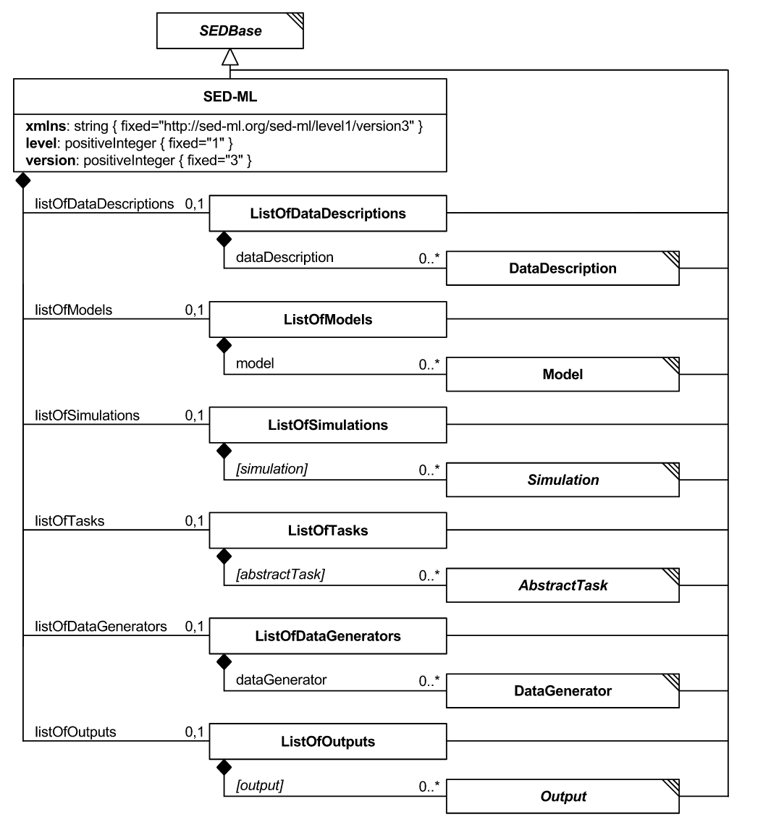
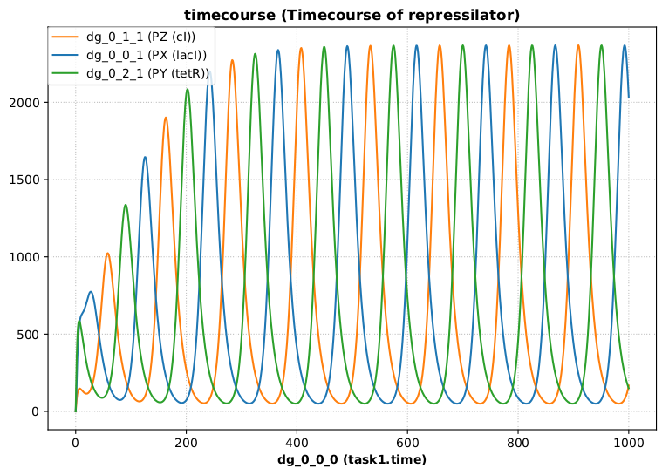
SED-ML
Simulation Experiment Description Markup Language (SED-ML)
https://sed-ml.github.io
SED-ML is an XML-based format for encoding simulation setups, to ensure exchangeability and reproducibility of simulation experiments.
https://sed-ml.github.io/

Slide 9
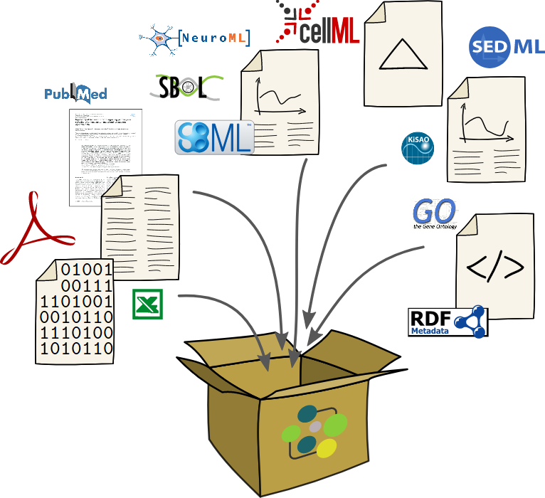
COMBINE archive
A COMBINE archive is a single file bundling the various documents necessary for a modeling and simulation project, and all relevant information. The archive is encoded using the
Open Modeling EXchange format (OMEX).

Slide 10


SBML Schema for Encoding DFBA
Matthias König*, Leandro Watanabe*, Chris Myers
*equal contributions
https://github.com/matthiaskoenig/dfba
manuscript
https://github.com/matthiaskoenig/dfba/blob/master/docs/manuscript/dfba-models-sbml.pdf
sbmlutils
Watanabe L.*, König M.*, Myers C
* equal contributions
Dynamic Flux Balance Analysis Models in SBML
[2017-11-14, submitted]

Slide 11
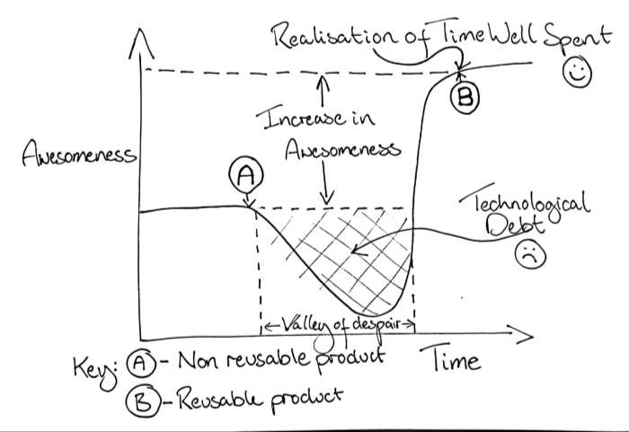
In a nutshell

Slide 12
Dynamic FBA (DFBA)
Coupling of dynamical model parts to
steady state networks (FBA)
Subset of general problem of coupling models with different simulation frameworks
(hybrid models)
  Deterministic
  Constraint-based
  Stochastic models
  Logical/boolean models
Approaches
  Coupling of ODE to FBA model
    Direct embedding of LP-Solver in ODE solver
      execution in every time step
      complex implementation (high level expertise on ODE solver design)
      Stiffness of system at borders of flux-cone
    Stationary Optimization Approach (SOA)
      Iterative stepwise evaluation of FBA problem
      Assumption: constant solution over step size
    Dynamic Optimization Approach (DOA) – Resource allocation
      Very large LP problems (explosion of dimensions via time discretization)
      No kinetics (pseudo-dynamic)

Slide 13
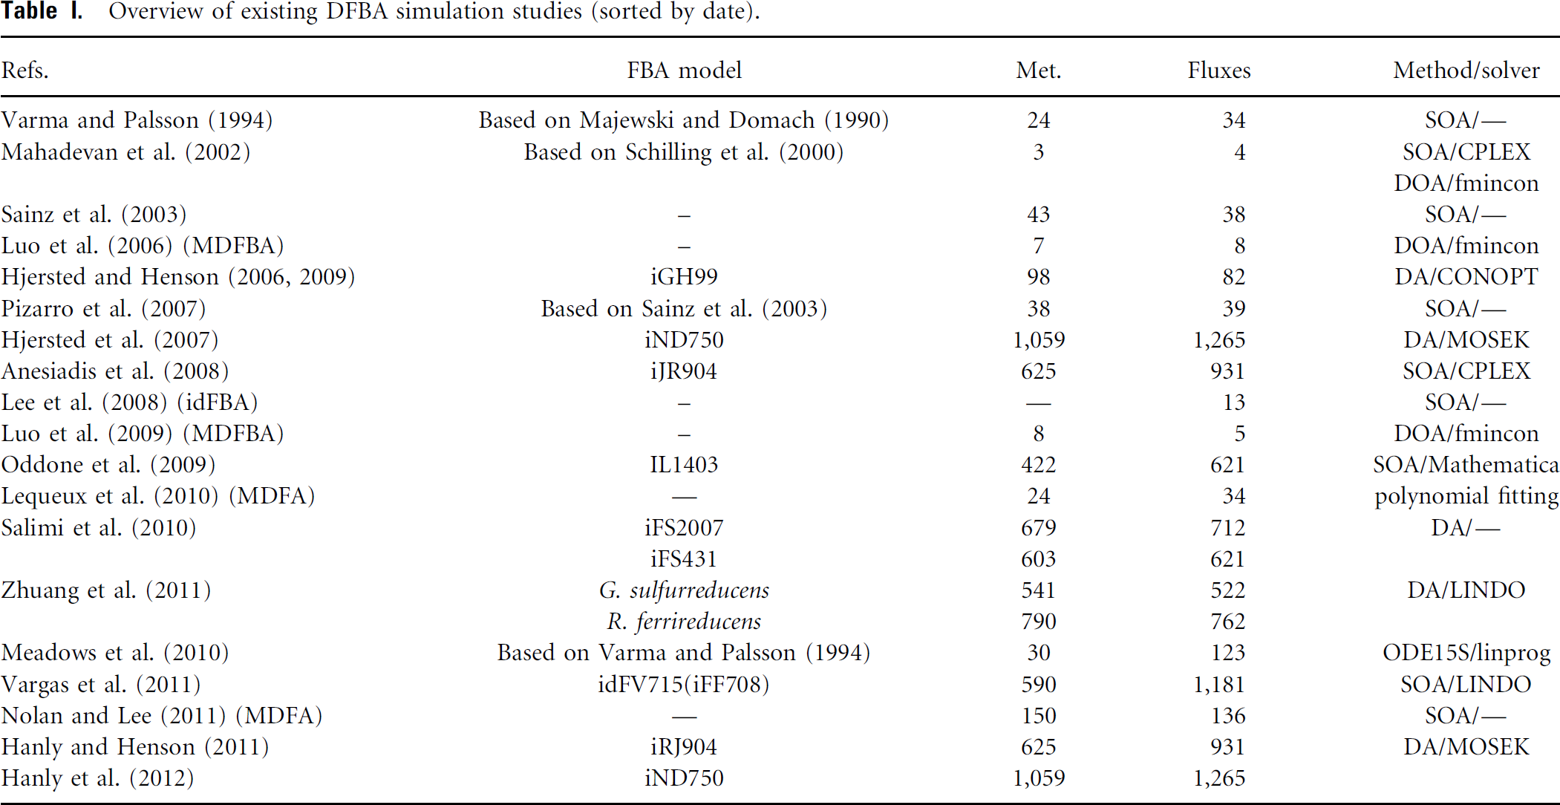
DFBA Examples
Whole-cell model (Karr et al, SOA)

Slide 14
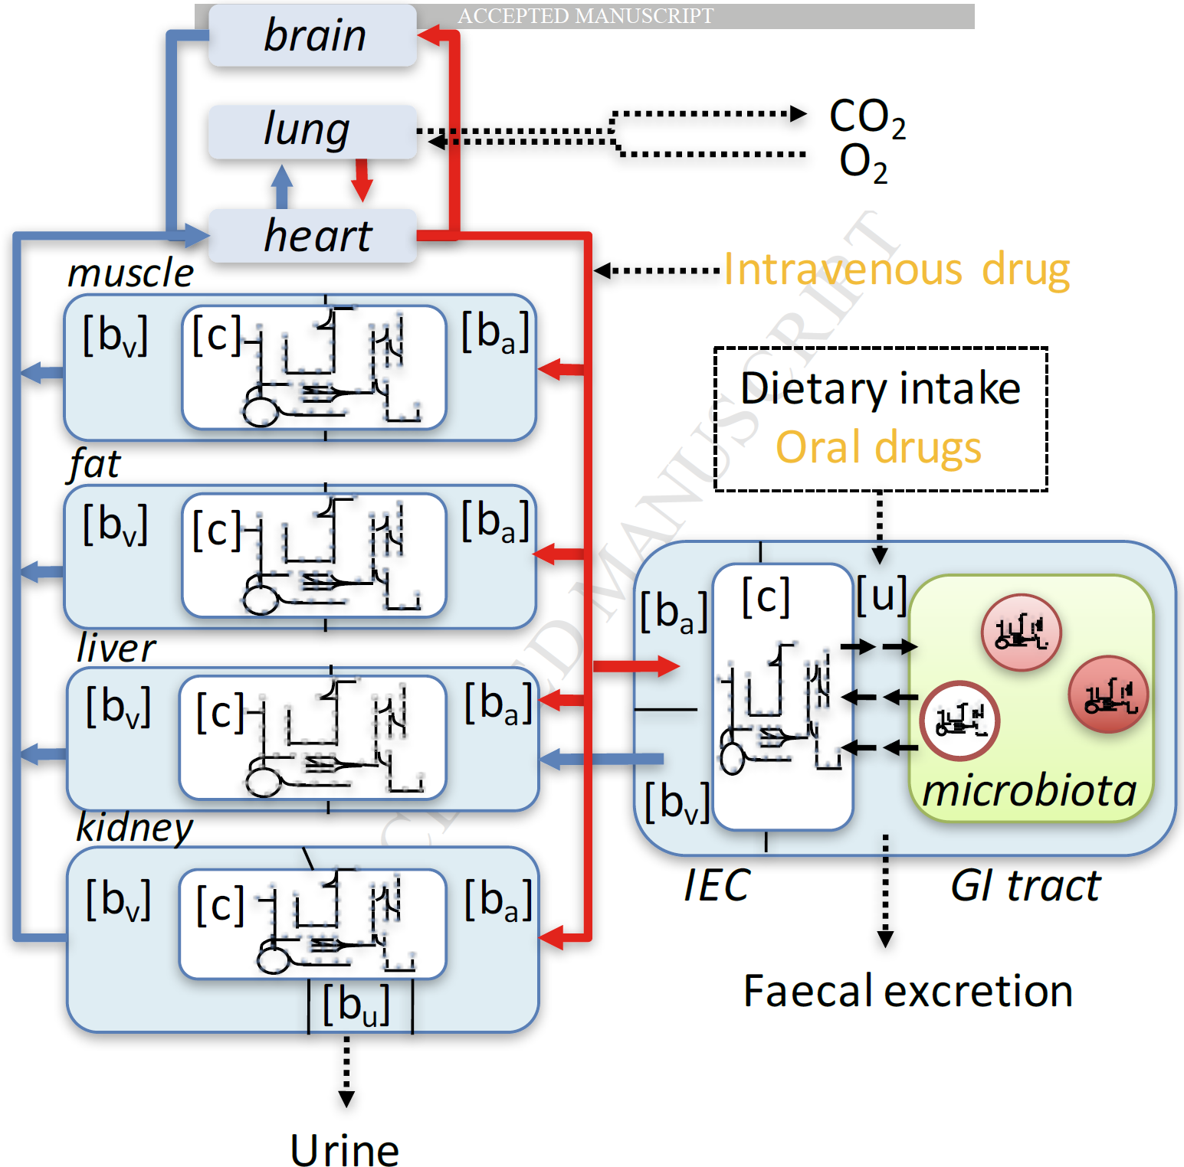
Applications & Use cases
Model embedding
  Coupling ODE pathway models to genome-scale metabolic models (liver)
Whole-body PKPD
  Coupling of tissue specific FBA models to
  whole body PKPD
  Glucose regulation
  (liver, muscle, fat, pancreas, stomach)
  Cori cycle & other multi-tissue physiological cycles
    Glucose – alanine/pyruvate shuttle
Microbiome, biofilms, communities
Bioreactors
Wholecell model
Driving FBA models with kinetic expressions
Thiele2017

Slide 15

SBML encoding
Good description for kinetic and FBA models in SBML
  core
    Kinetic models
    Compartments, Parameters, Species, Reactions, RateRules, AssignmentRules, Events, FunctionDefinitions
  fbc
    FBA encoding
    Objective functions, flux bounds, GPR encoding
  comp
    Coupling of models (hierarchical composition)
    ExternalModelDefinitions, ModelDefinitions replacements, replacedBy, deletions, ports, submodels
Annotation of model components/interfaces
    SBO terms
    allows automatized coupling
Example simulation experiments in SED-ML
Distributed as COMBINE archives

Slide 16
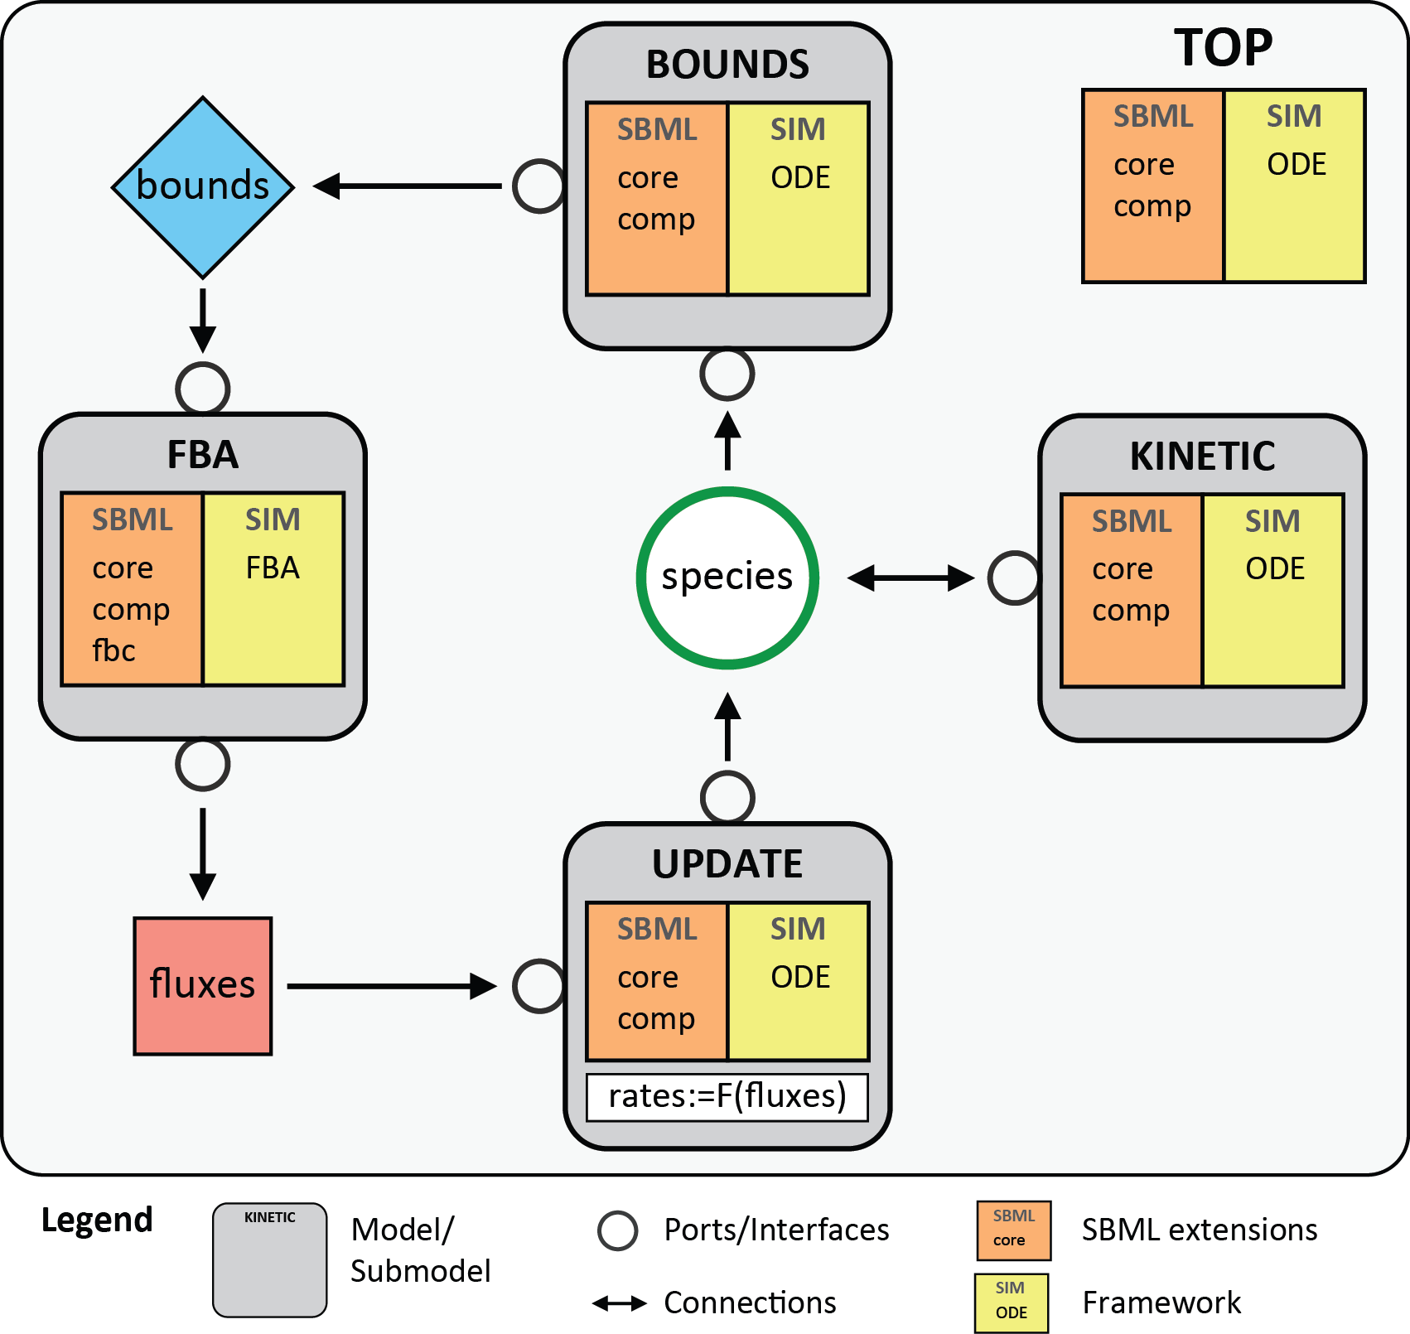
Schema overview
TOP: top model including submodel; containing global dynamic species, bounds, fluxes
KINETIC: kinetic submodel
FBA: FBA submodel
BOUNDS: calculates upper and lower bounds of FBA based on dynamic species
UPDATE: calculation of updated kinetic part from FBA solution

Slide 17
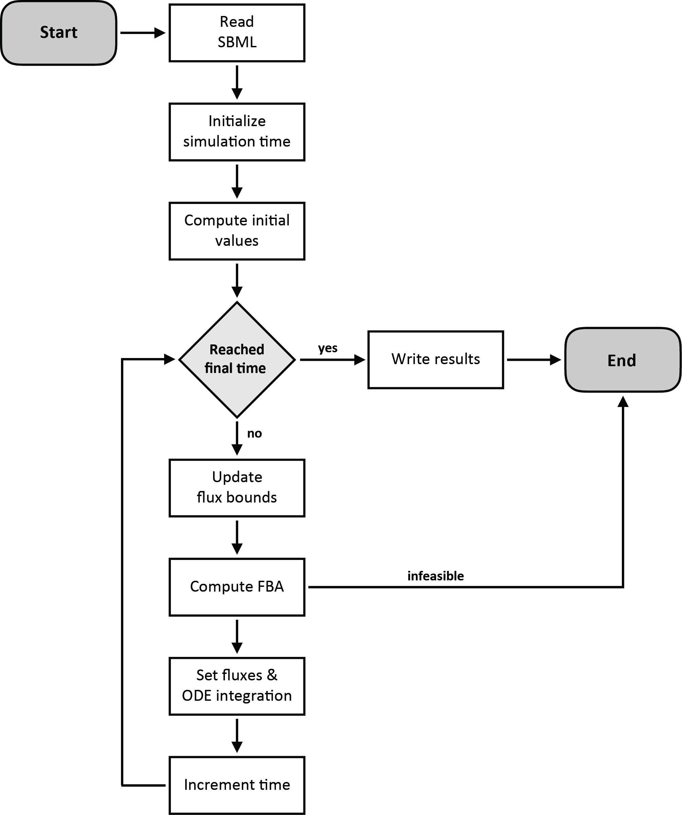
SOA-DFBA
Iterative stepwise evaluation of FBA problem
Assumption: constant solution over step size
Checking for uniqueness via Flux Variability Analysis (FVA) in time steps

Slide 18
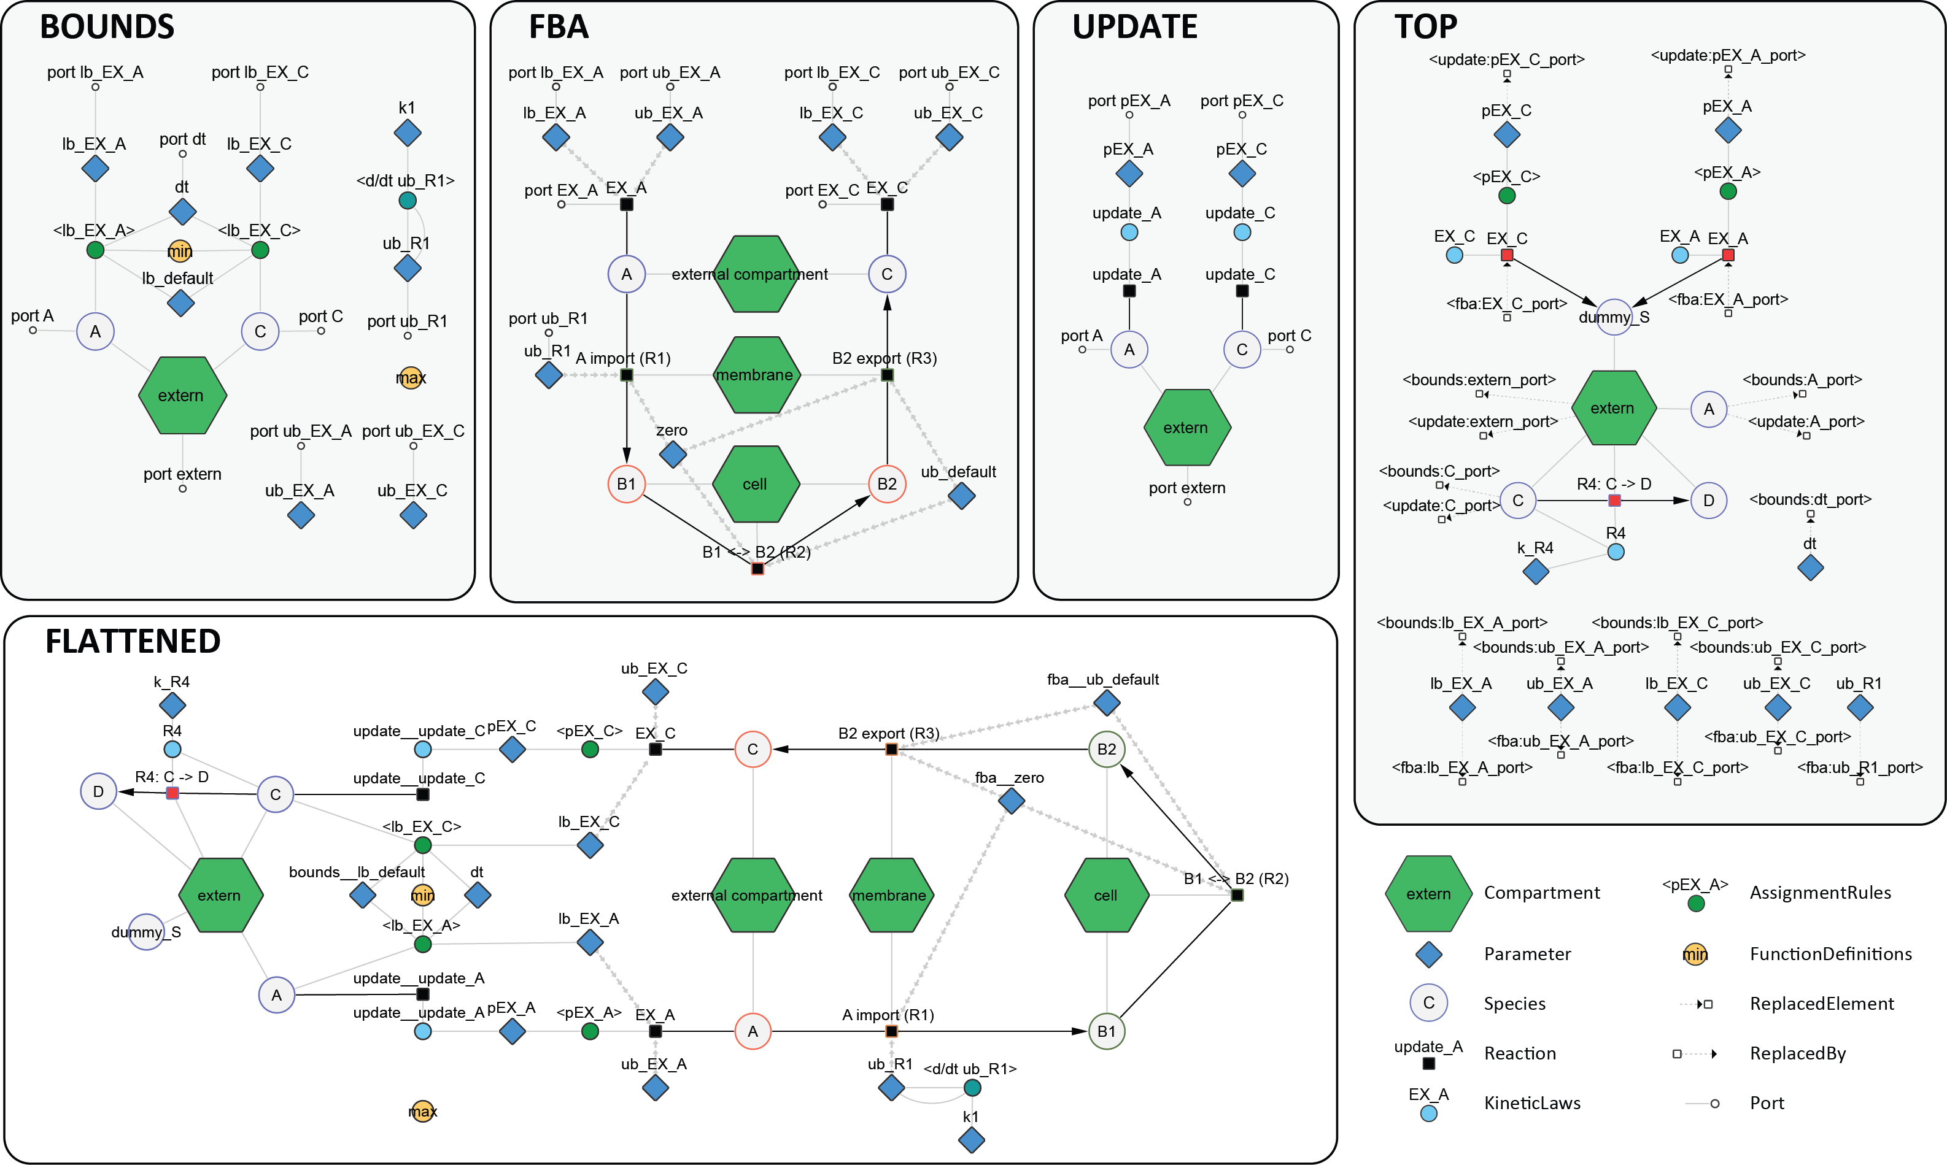
Cytoscape Demo

Slide 19
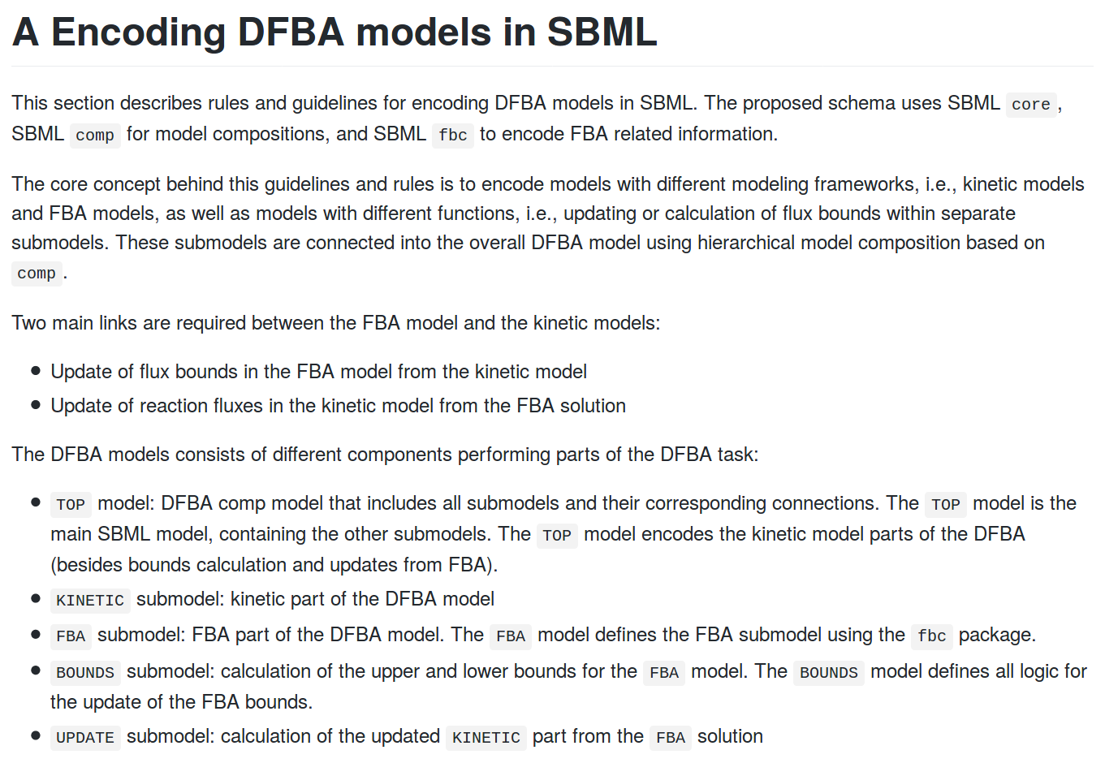
Schema Details
https://github.com/matthiaskoenig/dfba/blob/master/schema/DFBA_models_in_SBML.md

Slide 20
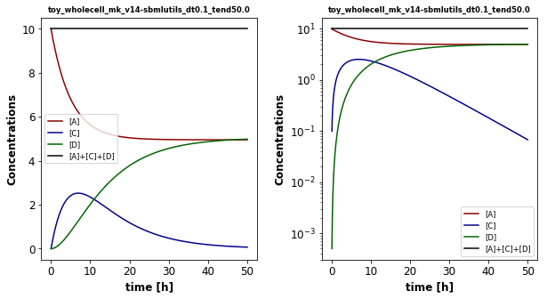
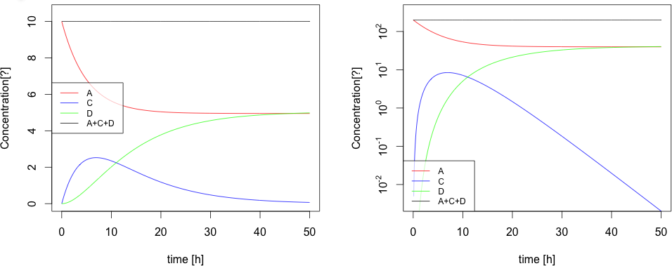
toy_wholecell

Slide 21
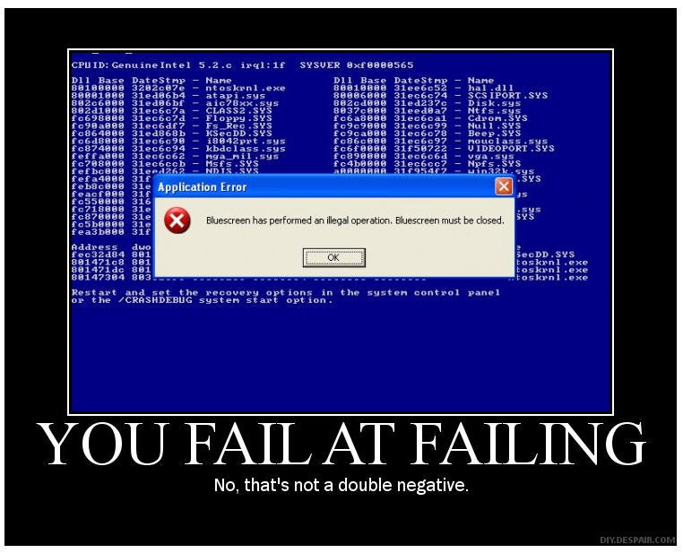
Life demo for non-believers
http://localhost:8888/notebooks/toy_wholecell/toy_wholecell.ipynb

Slide 22
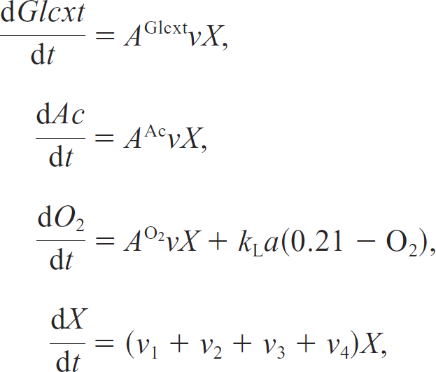
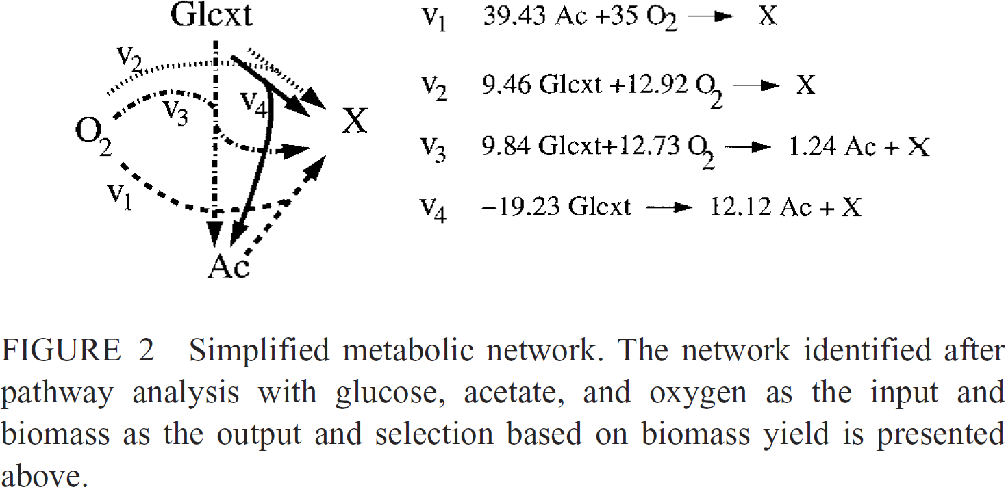
Diauxic growth
Reproducing published model
Radhakrishnan Mahadean, Jeremy S. Edwards, and Francis J. Doyle
Dynamical Flux Balance Analysis of Diauxic Growth in Escherichia coli
Biophysical Journal, 2002

Slide 23
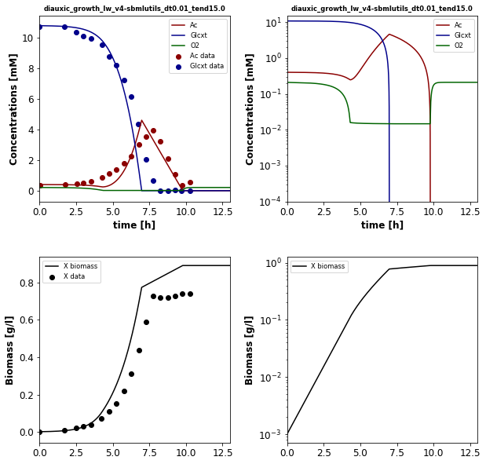
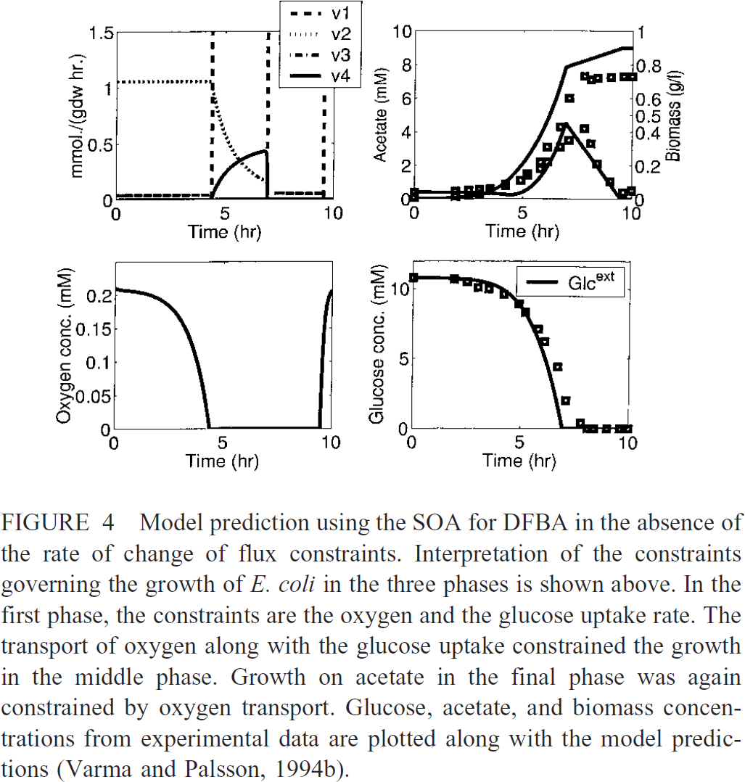
Reproducible between tools; reproducing publication
Radhakrishnan Mahadean, Jeremy S. Edwards, and Francis J. Doyle
Dynamical Flux Balance Analysis of Diauxic Growth in Escherichia coli
Biophysical Journal, 2002

Slide 24
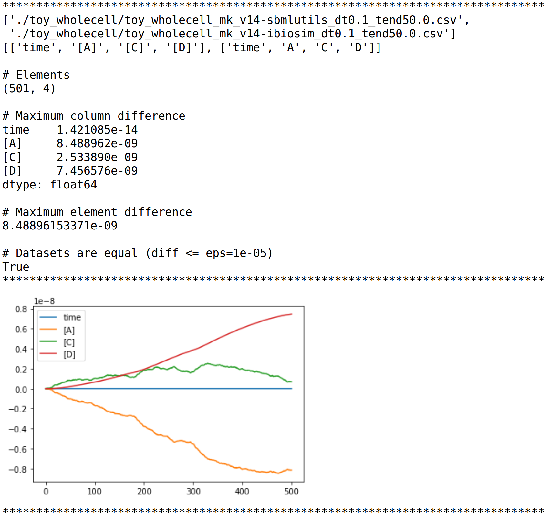
Reproducibility
https://github.com/matthiaskoenig/dfba/blob/master/models/compare.ipynb

Slide 25
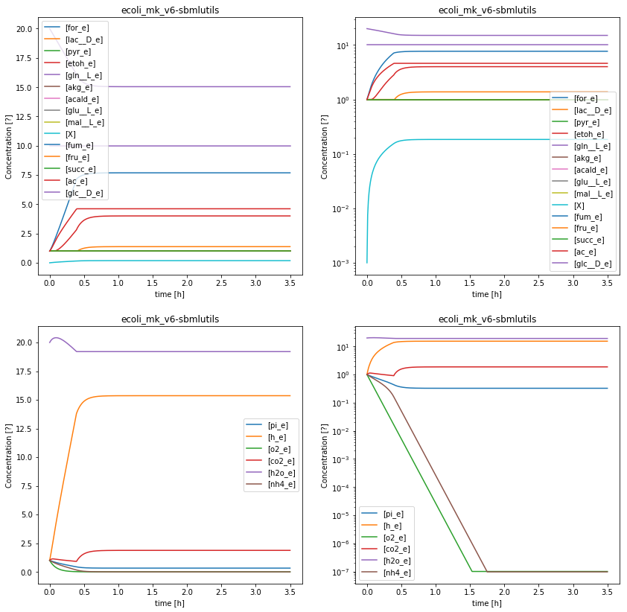
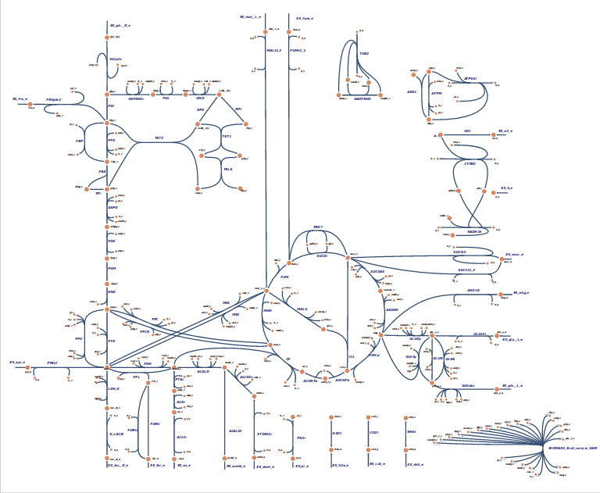
E.coli core (BiGG)
95 reactions, 72 metabolites, 137 genes, 21 exchange reactions)
automatic scripts to generate DFBA models from FBA models (via exchange reactions)
* not-unique, infeasible issues (iBioSim)

Slide 26
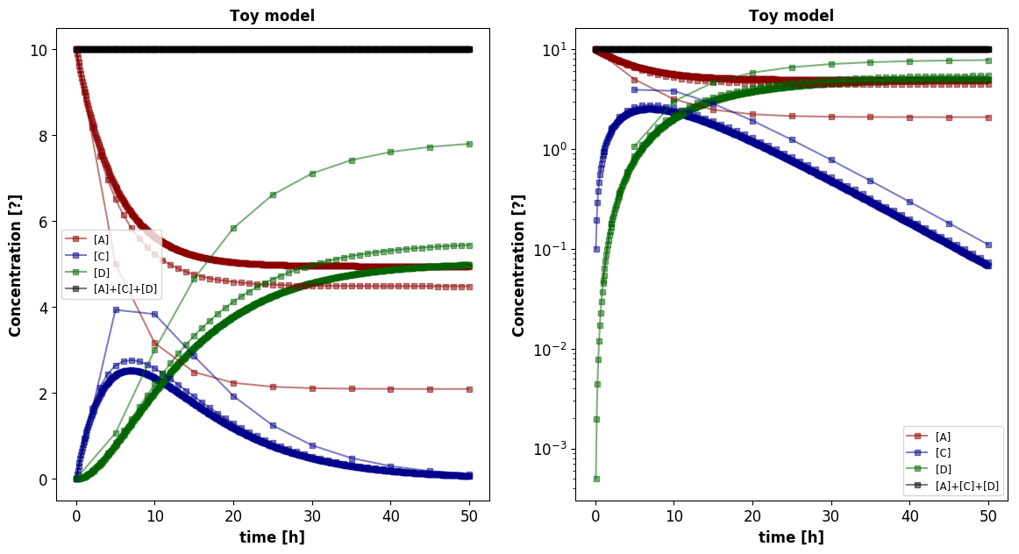
Time step effects
dt in [0.1, 1.0, 5.0]
but we are reproducibly wrong !

Slide 27
Issues & what next?
Issues
  Uniqueness & resulting problems in reproducibility
  (results depend on solution selection; see yesterday)
    FVA to check uniqueness
    pFBA (parsimonious FBA & additional constraints)
  Flattening of large models (memory issues RBC model, flattening slow)
  Encoding issues in fbc
    Additional & general LP constraints like (v1 + v2 = 10; v1 < v3)
    More complex optimizations and algorithms like parsimonous FBA (2 step optimizations)
  Implementation details have to be specified
    Order of steps, updates, ...
Outlook
  Direct embedding approach (DOA).
  This is the future, but solver specific challenges, i.e., the ODE solvers have to be extended (non-trivial)
    Should be possible to represent even today in the proposed schema
    Problem is to get a solver working

Slide 28
Tools, Software, Workflows

Slide 29
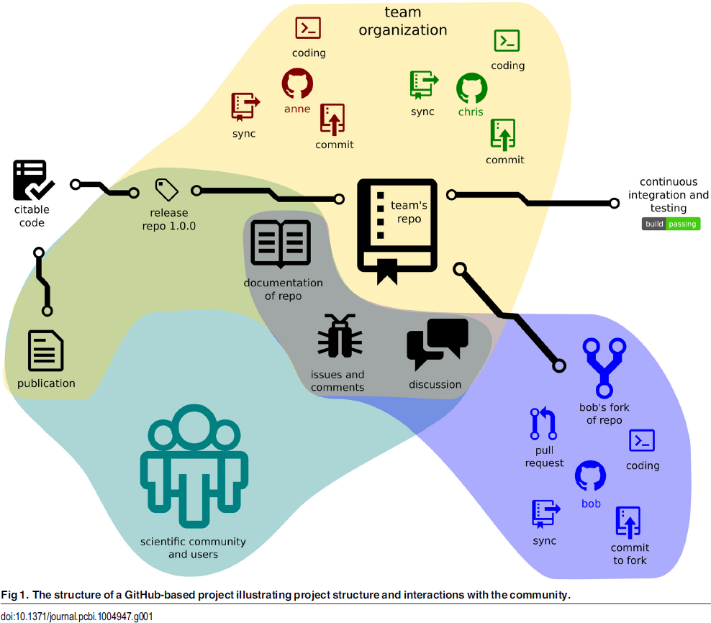

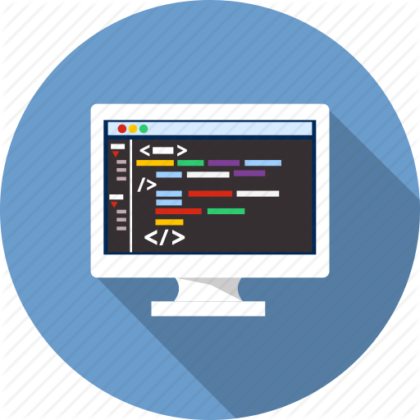
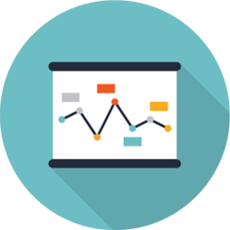
git repositories
GitHub is a code hosting platform for version control and collaboration. It lets you and others work together on projects from anywhere.
Version control
  Diffs & Branches
Collaborative editing
  Pull requests
Continuous integration
  unit tests
  Commit hooks
Releases & snapshots (citable code)
Issue tracker
Work anywhere & offline
&
CODE
DATA
Perez.Riverol2016
https://github.com/matthiaskoenig/cy3sbml/
https://github.com/matthiaskoenig/cy3sbml/commit/986ebbdd5e77d403cf031ff0a5230de4d28fc284

Slide 30

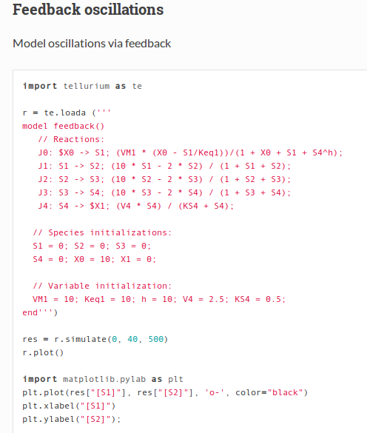
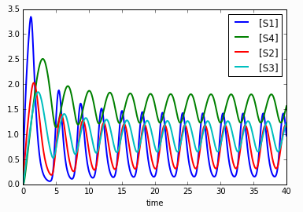

Reproducible Analyses
Dynamic report generation !
Jupyter notebooks
Web application that allows to create and share documents that contain live code, equations, visualizations and explanatory text.
Open source, interactive data science and scientific computing across over 40 programming languages.
Complete analysis, examples, test cases
http://tellurium.readthedocs.io/en/latest/notebooks.html#feedback-oscillationshttp://localhost:8888/notebooks/feedback_oscillations.ipynb
R: Knitr
Elegant, flexible and fast dynamic report generation with R
BDL example
https://github.com/matthiaskoenig/bdl-analysis
http://jupyter.org/

Slide 31
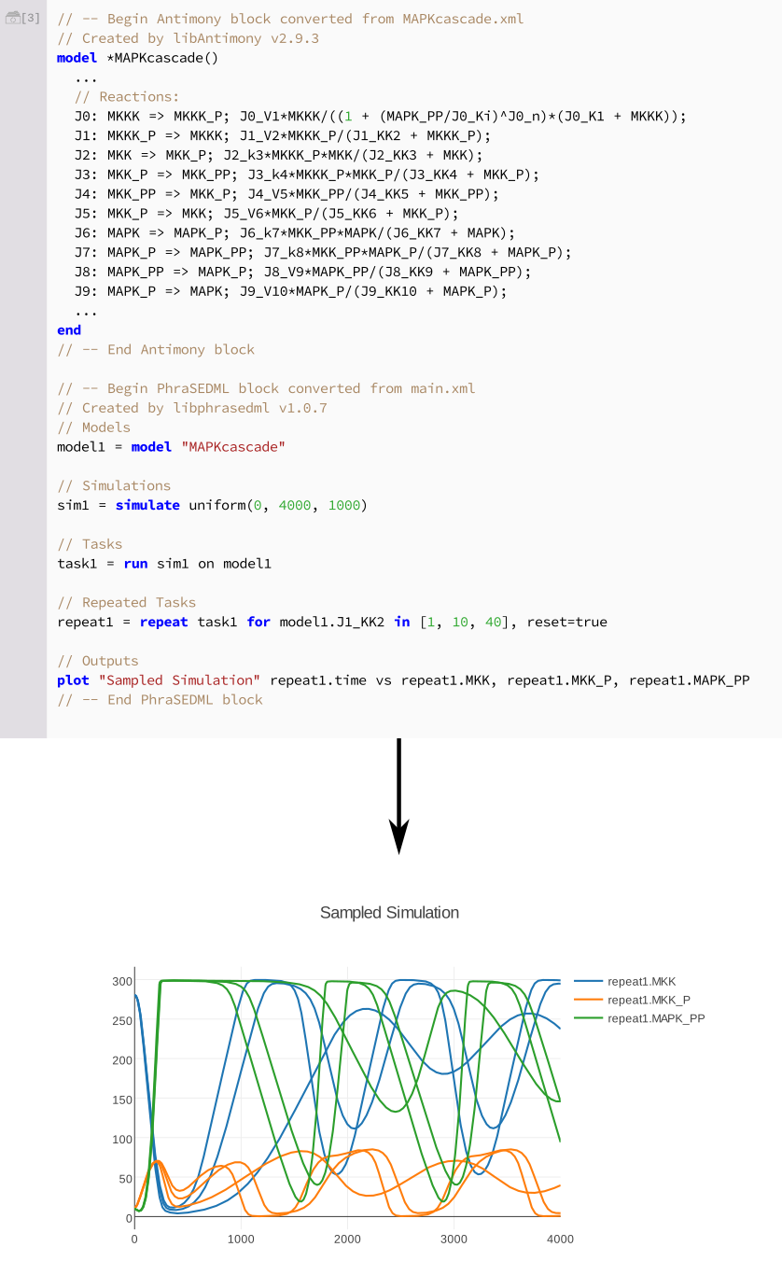
Modeling Tools
libRoadRunner: High performance SBML simulator
tellurium: Python based modeling environment (library & notebook)
Tellurium-web: web-platform for exchange of COMBINE archives
Medley K, Choi K, König M.; Smith L, Gu S, Joseph Hellerstein, Sealfon S., Sauro HM.
Tellurium Notebooks - An Environment for Dynamical Model Development, Reproducibility, and Reuse
[2017-11-14, submitted]
Somogyi, Bouteiller, Glazier, König, Medley, Swat, Sauro.
libRoadRunner: a high performance SBML simulation and analysis library.
Bioinformatics. 2015
König M., Janek G., Medley K, Kiri Choi, Sauro H
Tellurium-web
[2017, in preparation]

Slide 32


