Slide 1
Modeling tutorial
INRA workshop
Tech talks: Cell representation and RBA file formats
Dr. Matthias König
LiSyM Systems Medicine of the Liver
Humboldt University Berlin, Institute for Theoretical Biology
livermetabolism.com, konigmatt@googlemail.com

Slide 2
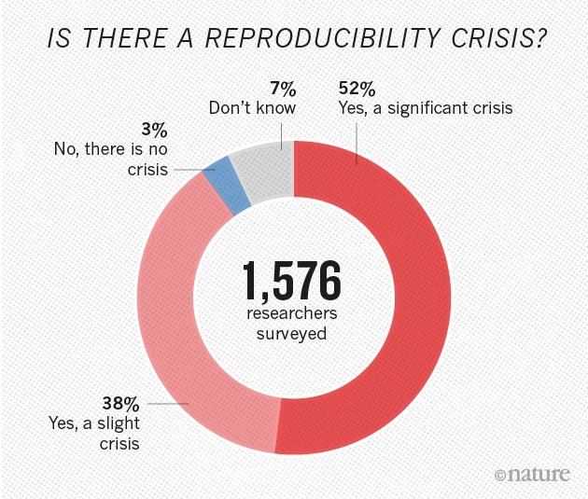
Reproducibility Crisis
“Really Reproducible Research” (1992) inspired by Stanford Professor Jon Claerbout:
“The idea is: An article about computational science in a scientific publication is not the scholarship itself, it is merely advertising of the scholarship. The actual scholarship is the complete ... set of instructions [and data] which generated the figures.”
David Donoho, 1998
Note the difference between: reproducing the computational steps and, replicating the experiments independently including data collection and software implementation.
(Both required)
https://www.nature.com/news/1-500-scientists-lift-the-lid-on-reproducibility-1.19970
https://web.stanford.edu/~vcs/talks/MSKCC-Sept15-2015-STODDEN.pdf

Slide 3
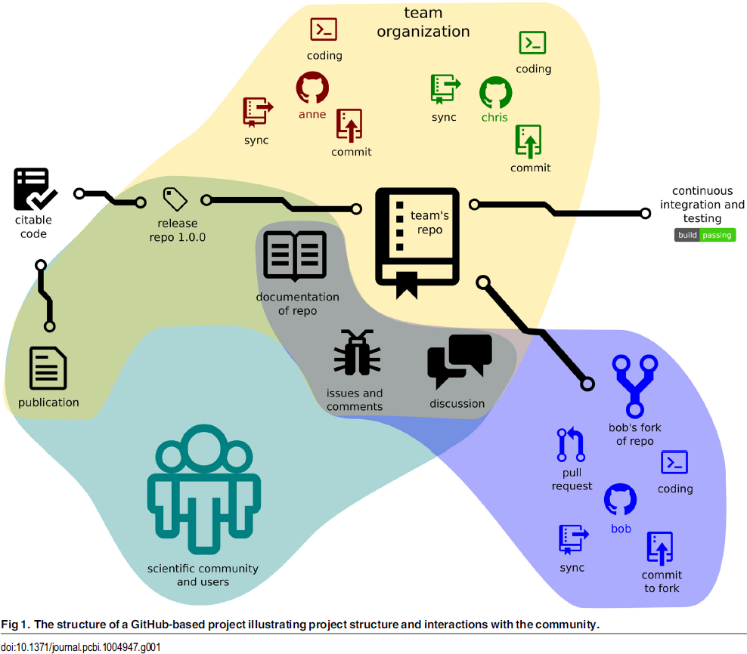

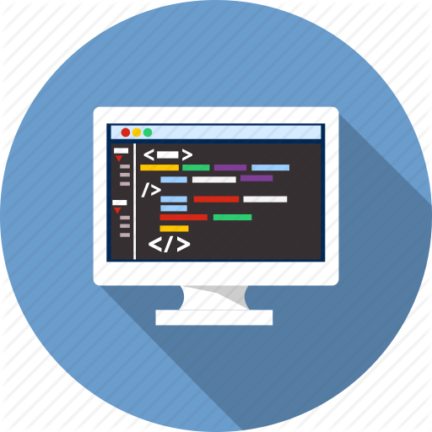
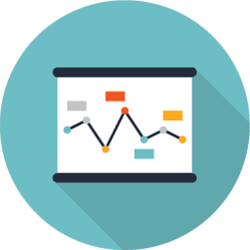
Code repositories
GitHub is a code hosting platform for version control and collaboration. It lets you and others work together on projects from anywhere.
Version control
  Diffs & Branches
Collaborative editing
  Pull requests
Continuous integration
  unit tests
  Commit hooks
Releases & snapshots (citable code)
Issue tracker
Work anywhere & offline
&
CODE
DATA
Perez.Riverol2016

Slide 4
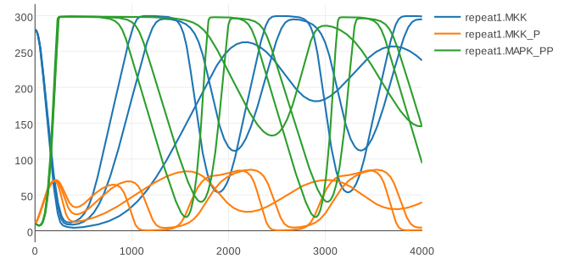
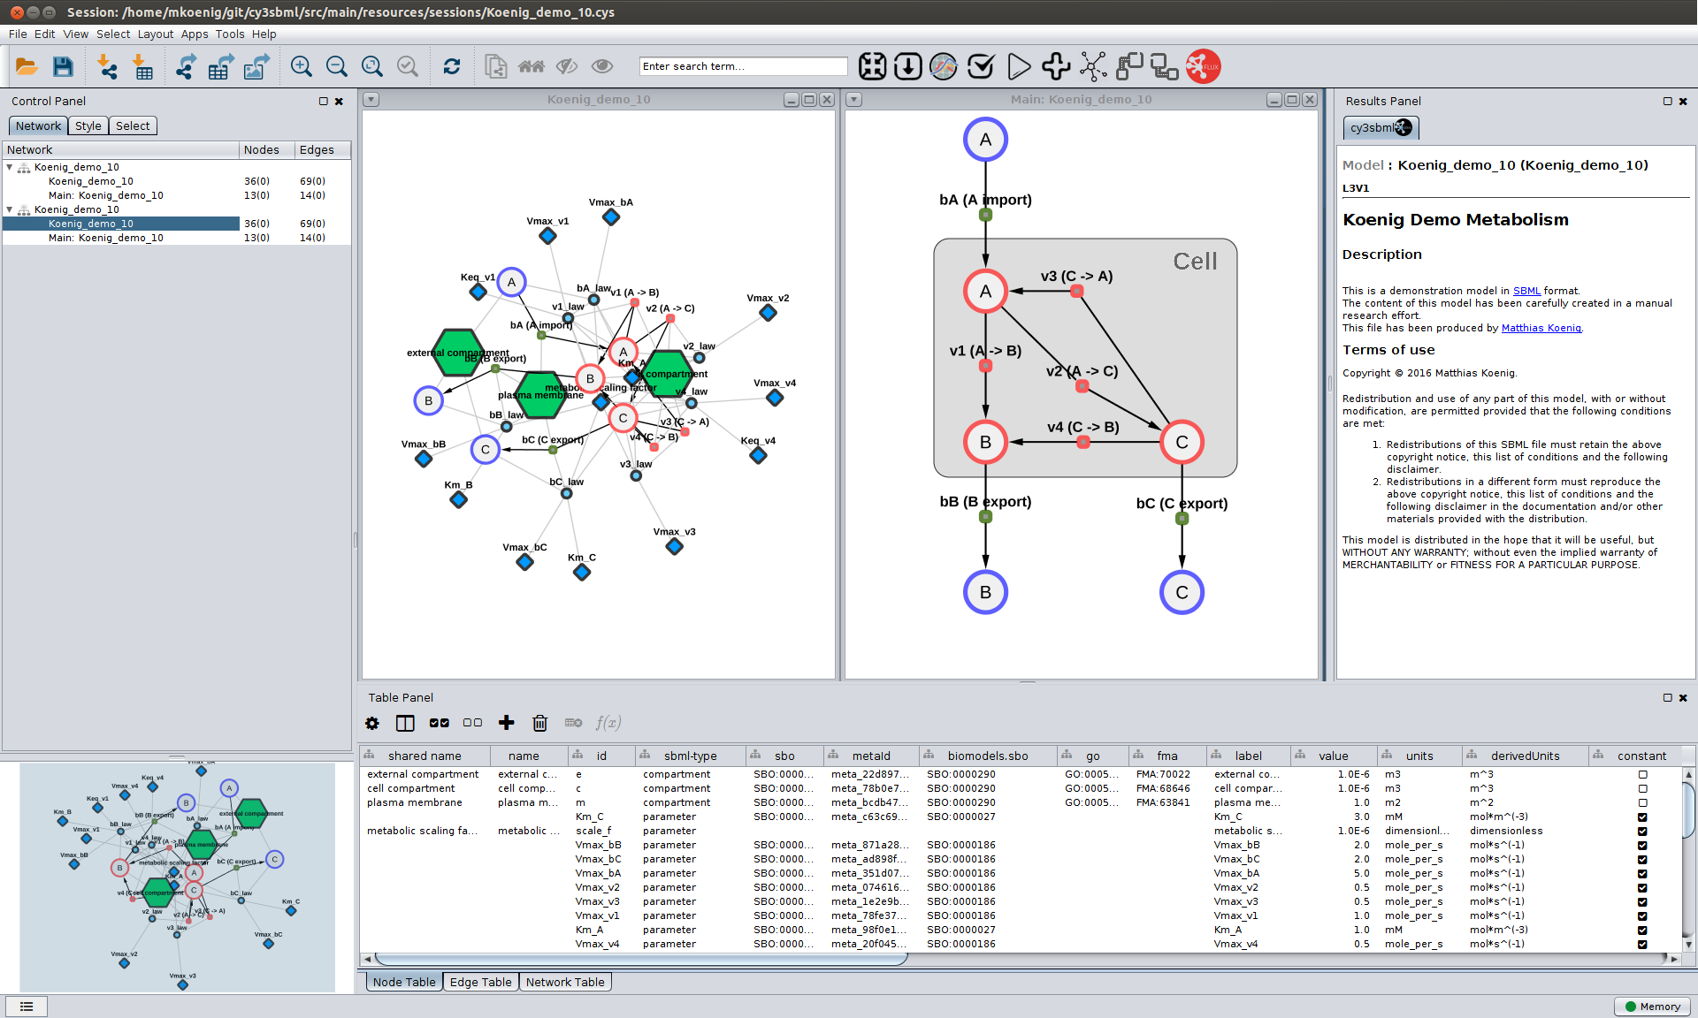
Standard Formats
Encoding of information in computer readable format
  Minimal Information for models and simulation (MIRIAM, MIASE)
Exchangeability
Reproducibility
  Reproducibility of results
  (roadrunner, COPASI, JWS)
Annotations (to ontologies)
  Knowledge integration (biological, computational)
  Documentation (what is my model component)
Quality
  Automatic validation, e.g., model quality
  (unit checking, model consistency)
Software & Tools
  Simulation, Visualization, Analysis, Repositories,
  Parameter fitting
König, Rodriquez, and Dräger
cy3sbml: A Cytoscape app for SBML
2017, manuscript in preparation
https://github.com/matthiaskoenig/cy3sbml

Slide 5

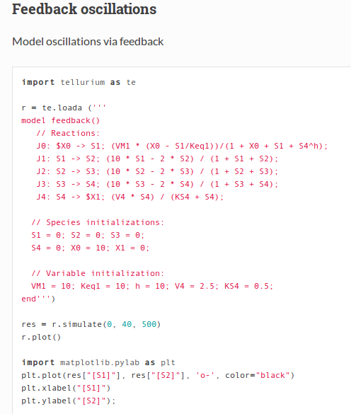
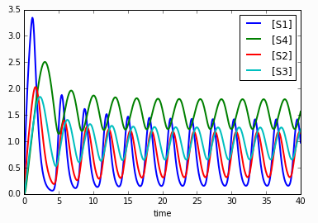

Reproducible Analyses
Dynamic report generation !
Jupyter notebooks
Web application that allows to create and share documents that contain live code, equations, visualizations and explanatory text.
Open source, interactive data science and scientific computing across over 40 programming languages.
Complete analysis, examples, test cases
http://tellurium.readthedocs.io/en/latest/notebooks.html#feedback-oscillationshttp://localhost:8888/notebooks/feedback_oscillations.ipynb
R: Knitr
Elegant, flexible and fast dynamic report generation with R
BDL example
https://github.com/matthiaskoenig/bdl-analysis
http://jupyter.org/

Slide 6
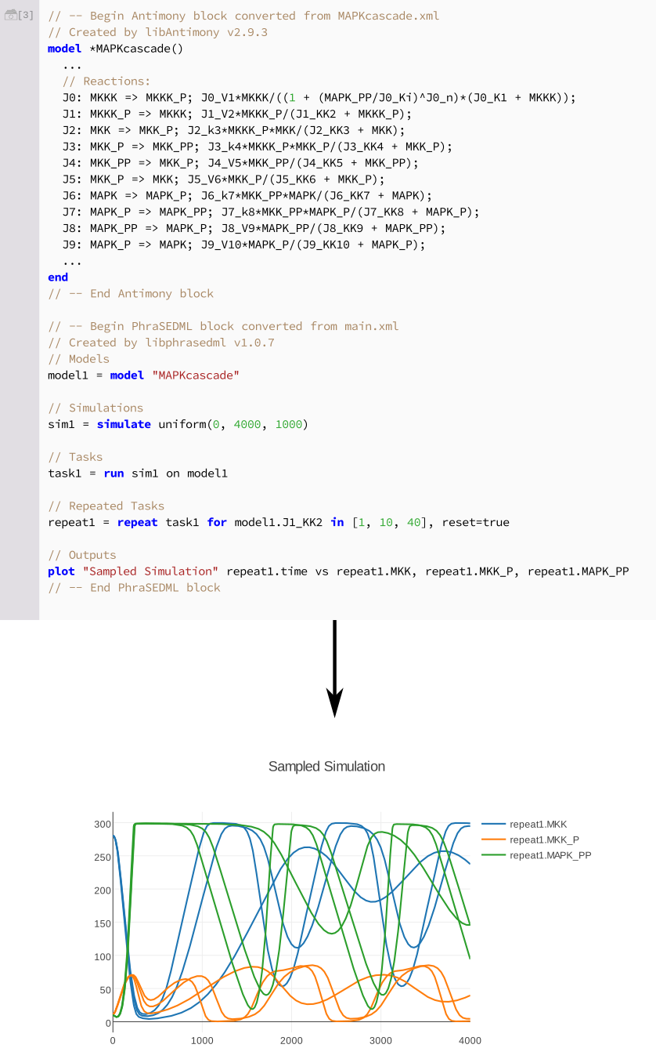
Modeling Tools
libRoadRunner: High performance SBML simulator
tellurium: Python based modeling environment (library & notebook)
http://tellurium.analogmachine.org/
Medley K, Choi K, König M.; Smith L, Gu S, Joseph Hellerstein, Sealfon S., Sauro HM.
Tellurium Notebooks - An Environment for Dynamical Model Development, Reproducibility, and Reuse
[2017-11-14, submitted]
Somogyi, Bouteiller, Glazier, König, Medley, Swat, Sauro.
libRoadRunner: a high performance SBML simulation and analysis library.
Bioinformatics. 2015
König M., Janek G., Medley K, Kiri Choi, Sauro H
Tellurium-web
[2017, in preparation]

Slide 7
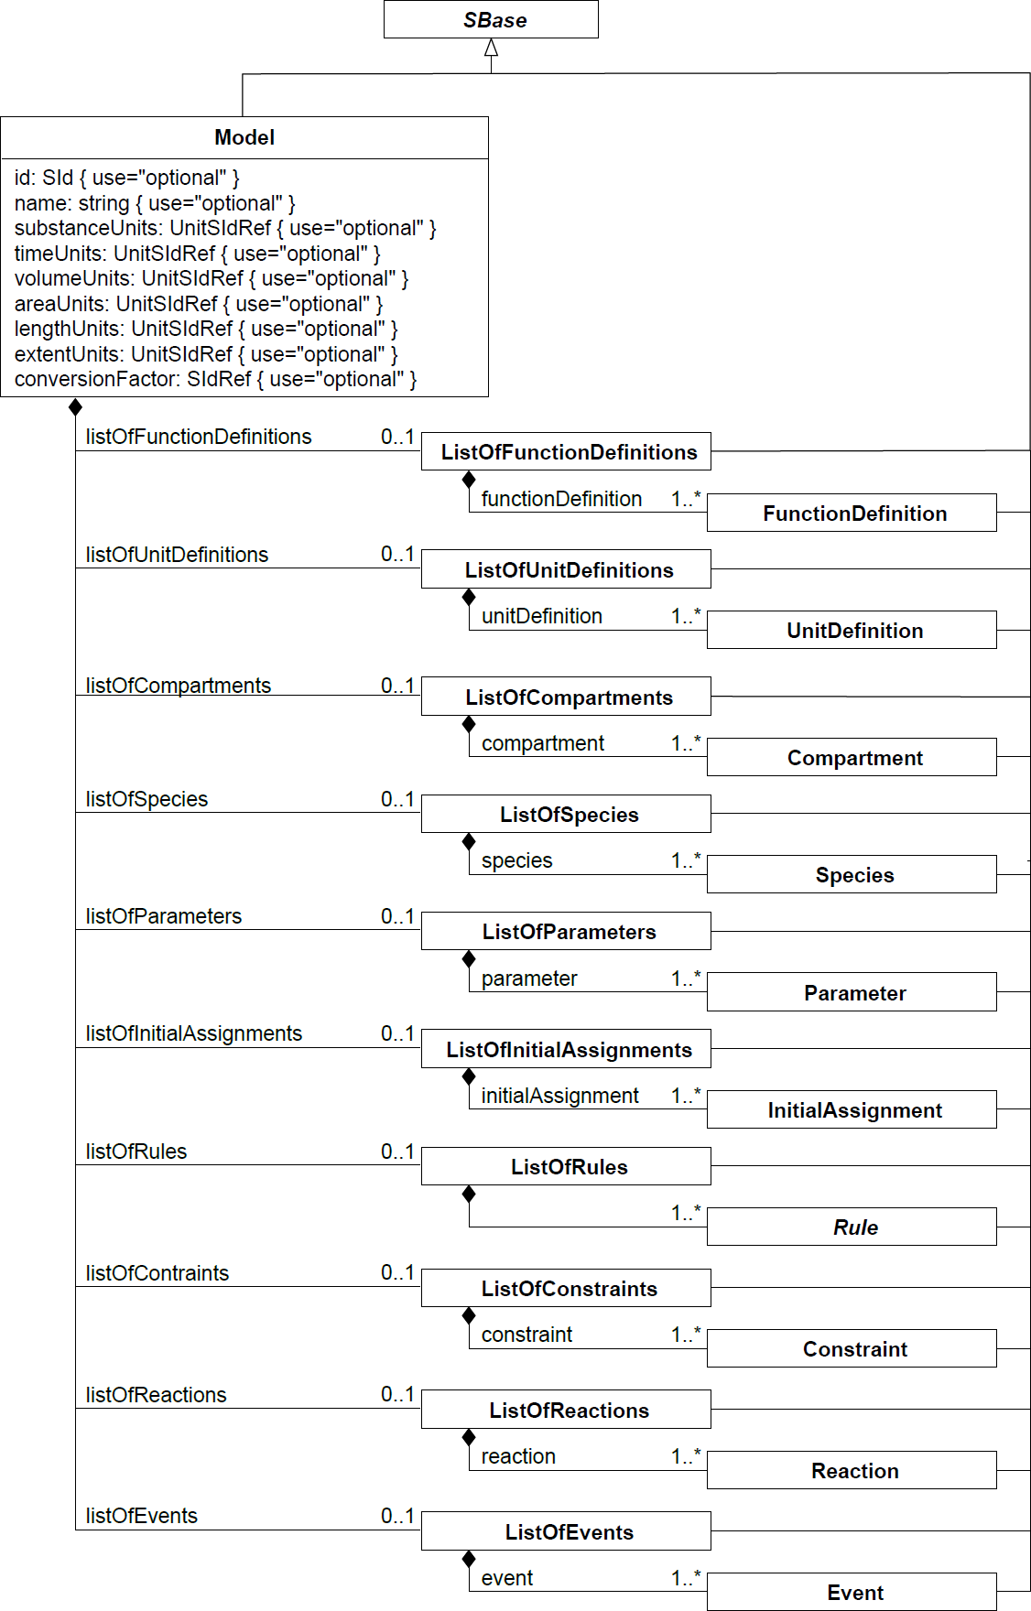

SBML
Systems Biology Markup Language
  De facto standard for encoding computational models
Libraries: libsbml (C++, python, R, JavaScript, ... & JSBML (Java)
Components
  FunctionDefinitions
  Compartments
  Species
  Parameters
  InitialAssignments
  Rules
  Constraints
  Reactions
  Events

Slide 8
What kind of models?
Ordinary differential equations (ODE)
  Metabolism
  Transcription
  Translation
  Signalling
Well stirred container

Slide 9
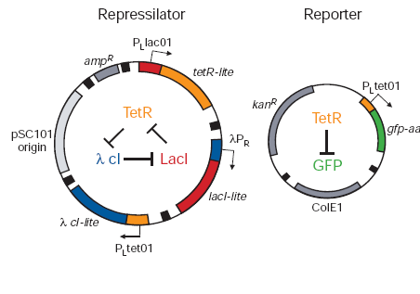
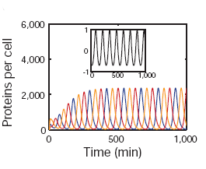
Showcase 1-Repressilator
Understanding a model from the literature/model repository
https://wwwdev.ebi.ac.uk/biomodels/
Repressilator
  Download model
  https://www.ebi.ac.uk/biomodels-main/static-pages.do?page=ModelMonth%2F2006-07
  Visualize model
  Simulate model with tellurium
  Change the paramters

Slide 10
Model building
Simple linear chain (S1 – v1-> S2)
  Mass-Action kinetics
  Stochiometric Matrix
  Steady State
  Jacobian Matrix
  Elasticities
Michaelis-Menten Kinetics (irreversible & reversible)
Hill equations (cooperativity)
Competitive Inhibtion
Running models with SED-ML

Slide 11
Stochastic Simulation
Same model in a stochastic manner

Slide 12
Map kinase network

Slide 13




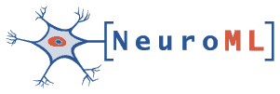
COMBINE
initiative to coordinate the development of the various community standards and formats for computational models
COMBINE meeting & HARMONY hackathon
Core standards
http://co.mbine.org/Standards#Core_COMBINE_standards
  SBML Systems Biology Markup Language
  SED-ML Simulation Experiment Description Language (SED-ML)
  SBGN Systems Biology Graphical Notation
  CellML
  SBOL Synthetic Biology Open Language Data
  NeuroML

Slide 14

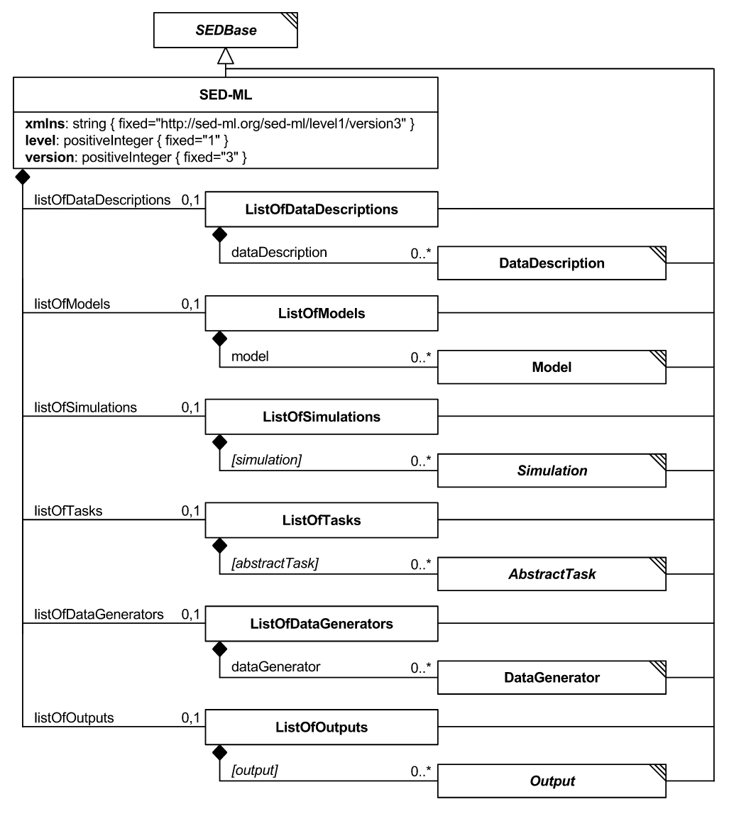
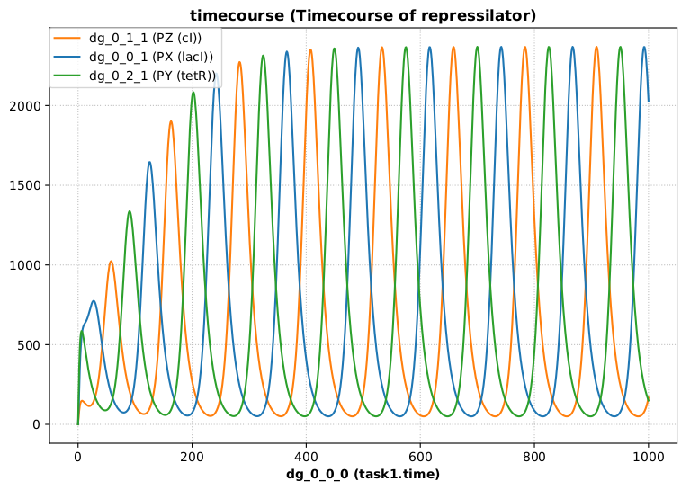
SED-ML
Simulation Experiment Description Markup Language (SED-ML)
https://sed-ml.github.io
SED-ML is an XML-based format for encoding simulation setups, to ensure exchangeability and reproducibility of simulation experiments.
https://sed-ml.github.io/

Slide 15
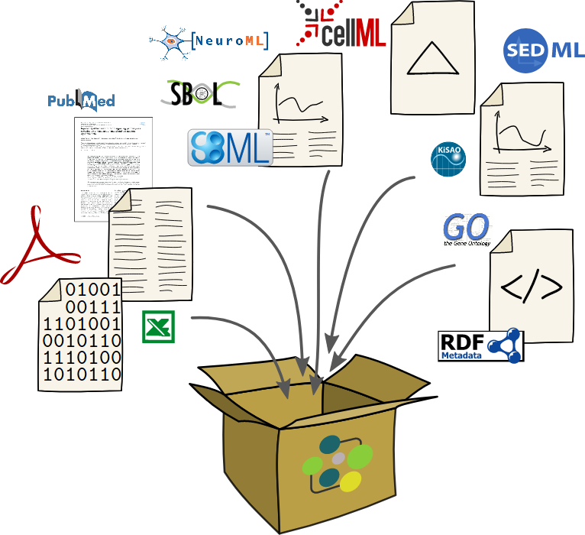
COMBINE archive
A COMBINE archive is a single file bundling the various documents necessary for a modeling and simulation project, and all relevant information. The archive is encoded using the
Open Modeling EXchange format (OMEX).

