Slide 1



ITB Tech Talks
Dr Matthias König
Humboldt University Berlin,
Institute for Theoretical Biology
livermetabolism.com
@konigmatt
01 A Quick Introduction to Version Control
with Git and GithHub

Slide 2
Version control & git
Python virtual environments
Solution to the problems

Slide 3
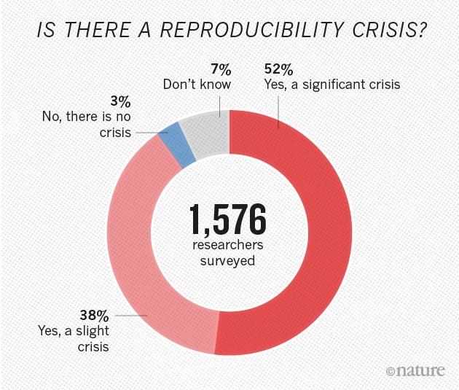
Reproducibility/Reusability Crisis
“Really Reproducible Research” (1992) inspired by Stanford Professor Jon Claerbout:
“The idea is: An article about computational science in a scientific publication is not the scholarship itself, it is merely advertising of the scholarship. The actual scholarship is the complete ... set of instructions [and data] which generated the figures.”
David Donoho, 1998
How long would it take you to reproduce your results from your last (computational) paper?
https://www.nature.com/news/1-500-scientists-lift-the-lid-on-reproducibility-1.19970
https://web.stanford.edu/~vcs/talks/MSKCC-Sept15-2015-STODDEN.pdf

Slide 4

Versioning Crisis

Slide 5
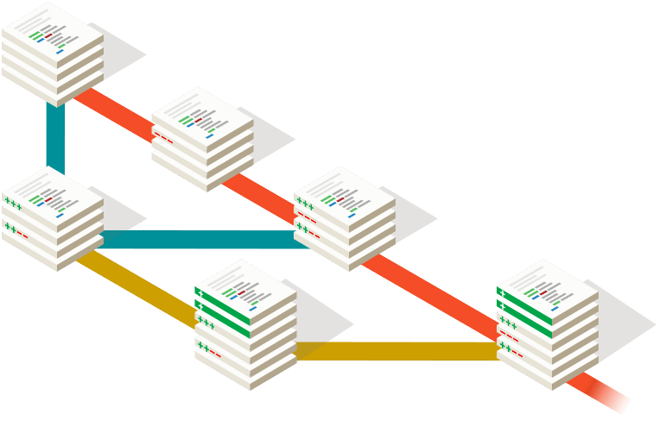


git to the rescue
Git is a free and open source distributed version control system.
  tiny footprint
  lightning fast performance
  works for everything from small to very large projects
GitHub is a code hosting platform for version control and collaboration.
  social coding
  alternatives: GitLab, BitBucket, SourceForge

Slide 6
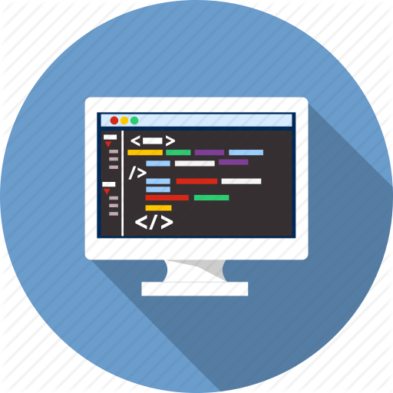

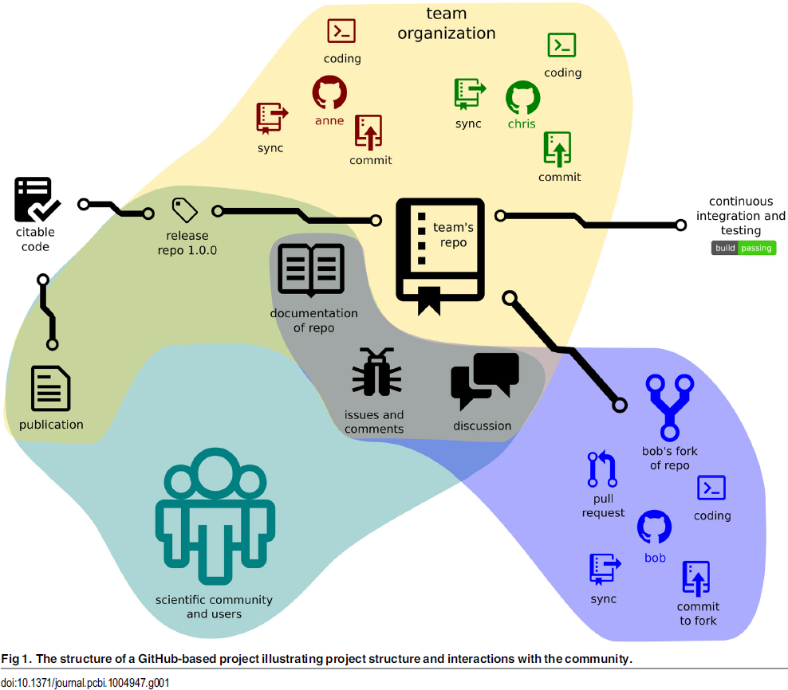
What can git do for you?
Work anywhere & offline
Decentralized backups
Version control & track changes
  diffs & branches
Revert & experiment
  revisions & branches
Collaborative editing/work
  Pull requests
Reproducible research
Releases & snapshots
  citable code
Issue tracker
Continuous integration
  unit tests
  commit hooks
&
CODE
DATA
Perez.Riverol2016

Slide 7
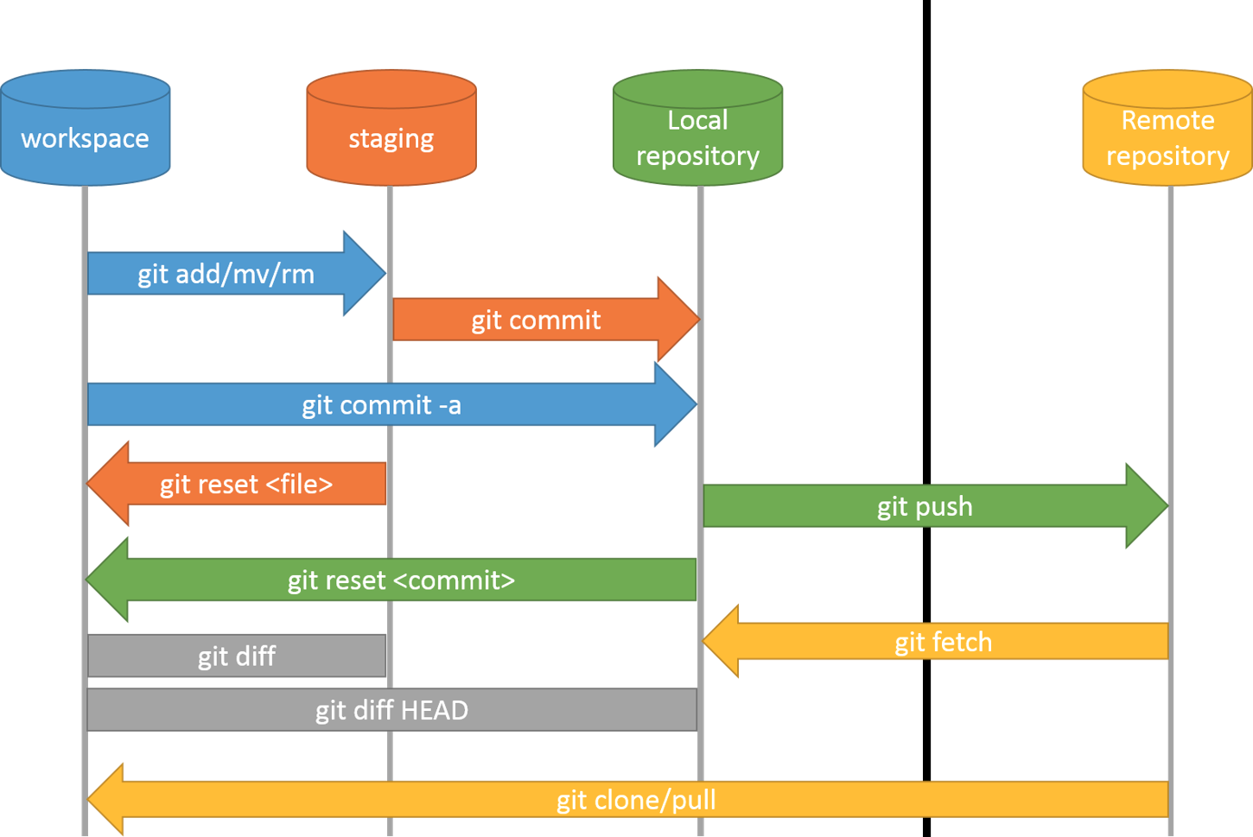
How does git work?
http://blog.podrezo.com/git-introduction-for-cvssvntfs-users/

Slide 8
References
Perez-Riverol, Y.; Gatto, L.; Wang, R.; Sachsenberg, T.; Uszkoreit, J.; Leprevost, F. d. V.; Fufezan, C.; Ternent, T.; Eglen, S. J.; Katz, D. S.; Pollard, T. J.; Konovalov, A.; Flight, R. M.; Blin, K. & Vizcaíno, J. A.
Ten Simple Rules for Taking Advantage of Git and GitHub.
PLoS computational biology, 2016, 12, e1004947
Blischak, J. D.; Davenport, E. R. & Wilson, G.
A Quick Introduction to Version Control with Git and GitHub.
PLoS computational biology, 2016, 12, e1004668
Ram, K.
Git can facilitate greater reproducibility and increased transparency in science.
Source code for biology and medicine, 2013, 8, 7
Tutorials
https://try.github.io/levels/1/challenges/1
Information/Books
https://git-scm.com/
https://git-scm.com/book/en/v2

Slide 9

ITB Tech Talks
Dr Matthias König
Humboldt University Berlin,
Institute for Theoretical Biology
@konigmatt
02 Virtual Environments in Python
https://matthiaskoenig.github.io/itbtechtalks

Slide 10

Global Package Management
starts out fine, overtime things get messy
problematic for developing in teams/multiple computers
(sync issues)
not working if multiple projects require different versions (python/package)
often no control over environment (compute server, deployment environments)
easy to break things

Slide 11
Virtual environments
Virtual environment
Isolated python environment with own python executable and dependencies
  reproducible (contains dependency & system setup)
  isolated (does not affect system)
  exchangable (computers & teams)
virtualenv is a tool to create python virtual environments
  virtualenv creates a folder which contains all the necessary executables to use the packages that a Python project would need.
virtualenvwrapper is a set of extensions to virtualenv
  wrappers for creating, deleting and managing virtual environments
Python in a Box

Slide 12
References
http://docs.python-guide.org/en/latest/dev/virtualenvs/
https://virtualenvwrapper.readthedocs.io/en/latest/
https://www.slideshare.net/ryan_blunden/virtualenv-and-pip-isolated-python-environments

Slide 13

numpy
NumPy is the fundamental package for scientific computing with Python. It contains among other things:
a powerful N-dimensional array object
sophisticated (broadcasting) functions
tools for integrating C/C++ and Fortran code
useful linear algebra, Fourier transform, and random number capabilities
Besides its obvious scientific uses, NumPy can also be used as an efficient multi-dimensional container of generic data. Arbitrary data-types can be defined. This allows NumPy to seamlessly and speedily integrate with a wide variety of databases.

Slide 14
ndarray
https://docs.scipy.org/doc/numpy/reference/generated/numpy.ndarray.html
An array object represents a multidimensional, homogeneous array of fixed-size items. An associated data-type object describes the format of each element in the array (its byte-order, how many bytes it occupies in memory, whether it is an integer, a floating point number, or something else, etc.)
Arrays should be constructed using array, zeros or empty

