Slide 1

Thank You
This PowerPoint document contains the images that you requested.
Copyright Notice
All Online Service materials, including, without limitation, text, pictures, graphics and other files and the selection and arrangement thereof are copyrighted materials of Ovid or its licensors, all rights reserved. Except for the Authorized Use specified above, you may not copy, modify or distribute any of the Online Service materials. You may not "mirror" any material contained on this Online Service on any other server. Any unauthorized use of any material contained on this Online Service may violate copyright laws, trademark laws, the laws of privacy and publicity and communications regulations and statutes.

Slide 2
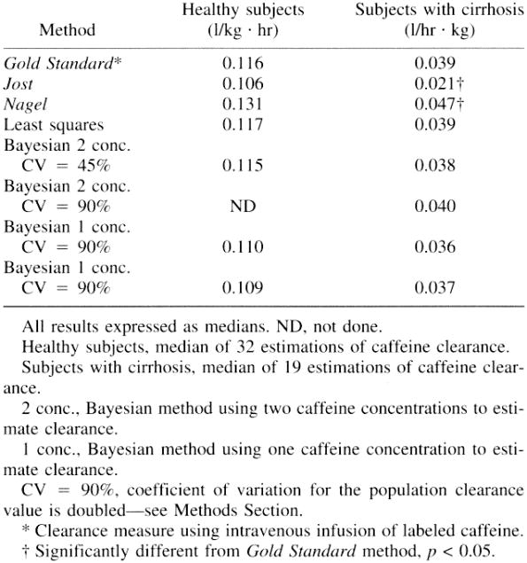
TABLE 1
Evaluation of Pharmacokinetic Methods Used to Estimate Caffeine Clearance and Comparison With a Bayesian Forecasting Method.
Denaro, Charles; Jacob, Peyton; Benowitz, Neal
Therapeutic Drug Monitoring. 20(1):78-87, February 1998.
TABLE 1 . Caffeine clearance estimated by different methods
© Lippincott-Raven Publishers. Published by Lippincott Williams & Wilkins, Inc.
2

Slide 3
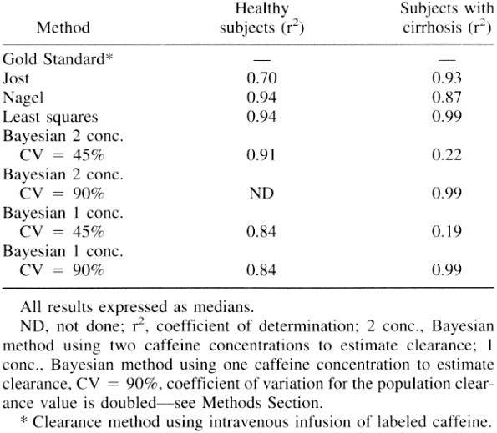
TABLE 2
Evaluation of Pharmacokinetic Methods Used to Estimate Caffeine Clearance and Comparison With a Bayesian Forecasting Method.
Denaro, Charles; Jacob, Peyton; Benowitz, Neal
Therapeutic Drug Monitoring. 20(1):78-87, February 1998.
TABLE 2 . Correlation of simplified pharmacokinetic methods to isotope-labeled caffeine clearance (Gold Standard method)
© Lippincott-Raven Publishers. Published by Lippincott Williams & Wilkins, Inc.
3

Slide 4
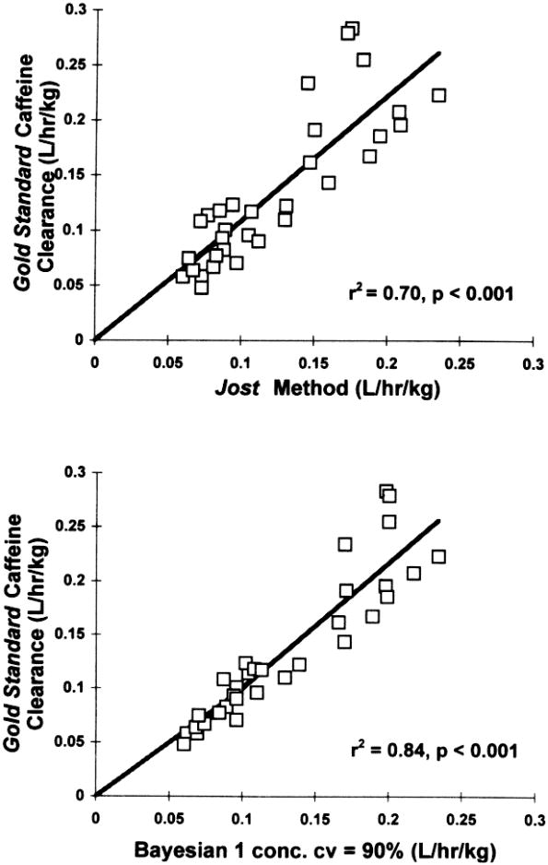
FIG. 1
Evaluation of Pharmacokinetic Methods Used to Estimate Caffeine Clearance and Comparison With a Bayesian Forecasting Method.
Denaro, Charles; Jacob, Peyton; Benowitz, Neal
Therapeutic Drug Monitoring. 20(1):78-87, February 1998.
FIG. 1 . Correlation of Jost and Bayesian 1 concentration (CV = 90%) methods to isotope-labeled caffeine clearance (Gold Standard method) in healthy subjects.
© Lippincott-Raven Publishers. Published by Lippincott Williams & Wilkins, Inc.
4

Slide 5
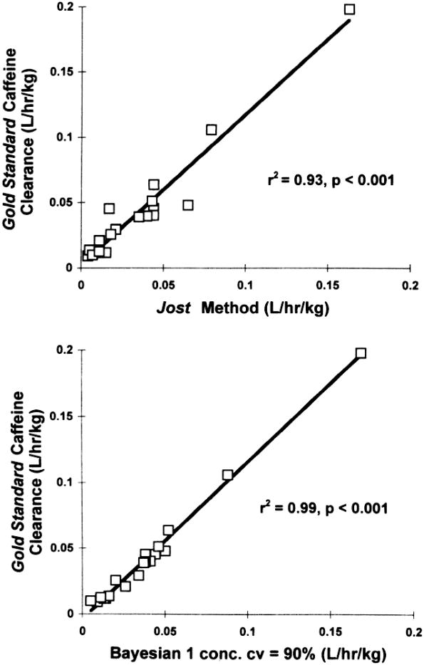
FIG. 2
Evaluation of Pharmacokinetic Methods Used to Estimate Caffeine Clearance and Comparison With a Bayesian Forecasting Method.
Denaro, Charles; Jacob, Peyton; Benowitz, Neal
Therapeutic Drug Monitoring. 20(1):78-87, February 1998.
FIG. 2 . Correlation of Jost and Bayesian 1 concentration (CV = 90%) methods to isotope-labeled caffeine clearance (Gold Standard method) in subjects with cirrhosis.
© Lippincott-Raven Publishers. Published by Lippincott Williams & Wilkins, Inc.
5

Slide 6
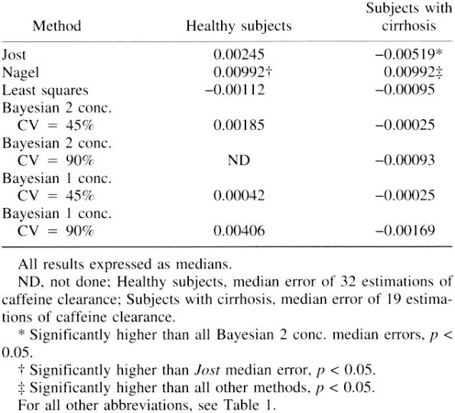
TABLE 3
Evaluation of Pharmacokinetic Methods Used to Estimate Caffeine Clearance and Comparison With a Bayesian Forecasting Method.
Denaro, Charles; Jacob, Peyton; Benowitz, Neal
Therapeutic Drug Monitoring. 20(1):78-87, February 1998.
TABLE 3 . Median error in the prediction of caffeine clearance comparing the Gold Standard clearance values to values estimated by simplified methods
© Lippincott-Raven Publishers. Published by Lippincott Williams & Wilkins, Inc.
6

Slide 7
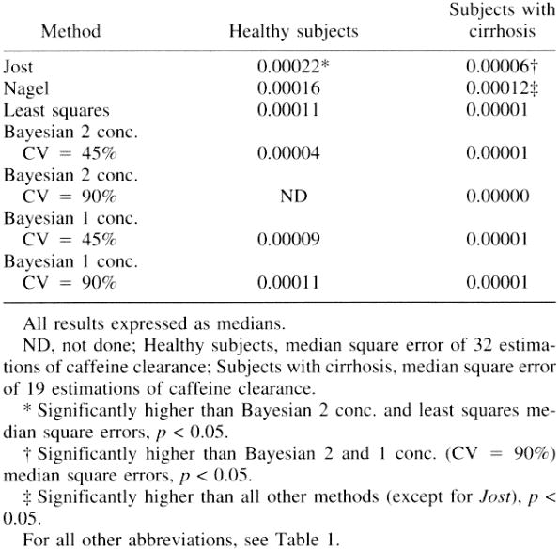
TABLE 4
Evaluation of Pharmacokinetic Methods Used to Estimate Caffeine Clearance and Comparison With a Bayesian Forecasting Method.
Denaro, Charles; Jacob, Peyton; Benowitz, Neal
Therapeutic Drug Monitoring. 20(1):78-87, February 1998.
TABLE 4 . Median square error in the prediction of caffeine clearance comparing the Gold Standard clearance values to values estimated by simplified methods
© Lippincott-Raven Publishers. Published by Lippincott Williams & Wilkins, Inc.
7

Slide 8
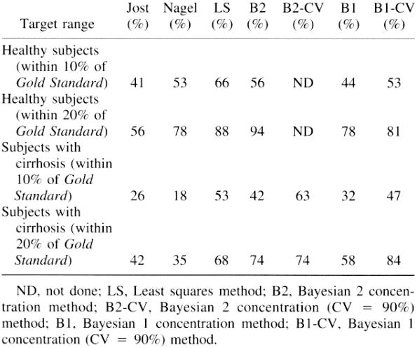
TABLE 5
Evaluation of Pharmacokinetic Methods Used to Estimate Caffeine Clearance and Comparison With a Bayesian Forecasting Method.
Denaro, Charles; Jacob, Peyton; Benowitz, Neal
Therapeutic Drug Monitoring. 20(1):78-87, February 1998.
TABLE 5 . Accuracy of prediction by each simplified method(the percentage of estimations within target range of the Gold Standard or isotope-labeled caffeine clearance value)
© Lippincott-Raven Publishers. Published by Lippincott Williams & Wilkins, Inc.
8

