Slide 1

Thank You
This PowerPoint document contains the images that you requested.
Copyright Notice
All Online Service materials, including, without limitation, text, pictures, graphics and other files and the selection and arrangement thereof are copyrighted materials of Ovid or its licensors, all rights reserved. Except for the Authorized Use specified above, you may not copy, modify or distribute any of the Online Service materials. You may not "mirror" any material contained on this Online Service on any other server. Any unauthorized use of any material contained on this Online Service may violate copyright laws, trademark laws, the laws of privacy and publicity and communications regulations and statutes.

Slide 2
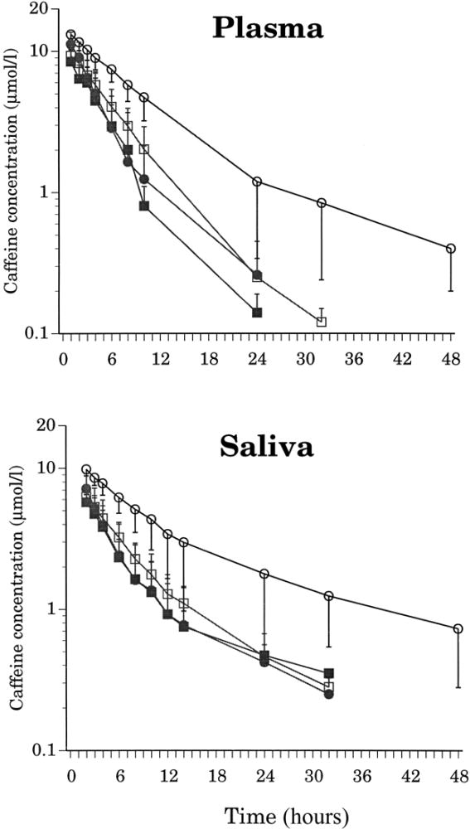
FIG. 1.
Evaluation of Caffeine as an In Vivo Probe for CYP1A2 Using Measurements in Plasma, Saliva, and Urine.
Carrillo, Juan; Christensen, Magnus; Ramos, Sara; Alm, Christina; Dahl, Marja-Liisa; Benitez, Julio; Bertilsson, Leif
Therapeutic Drug Monitoring. 22(4):409-417, August 2000.
FIG. 1. Time course of mean (+/-SD) plasma (top) and saliva (bottom) caffeine concentrations after a single oral dose (100 mg) in men (8 nonsmokers, [white square]; and 4 smokers, [black small square]) and women (6 nonsmokers, [white circle]; and 5 smokers, *).
© 2000 Lippincott Williams & Wilkins, Inc. Published by Lippincott Williams & Wilkins, Inc.
2

