Slide 1


Liver Function Tests: computational integration into systems analysis of liver function
Matthias König
LiSyM Systems Medicine of the Liver
Humboldt University Berlin, Institute for Theoretical Biology
livermetabolism.com

Slide 2

DallaMan 2006

Slide 3
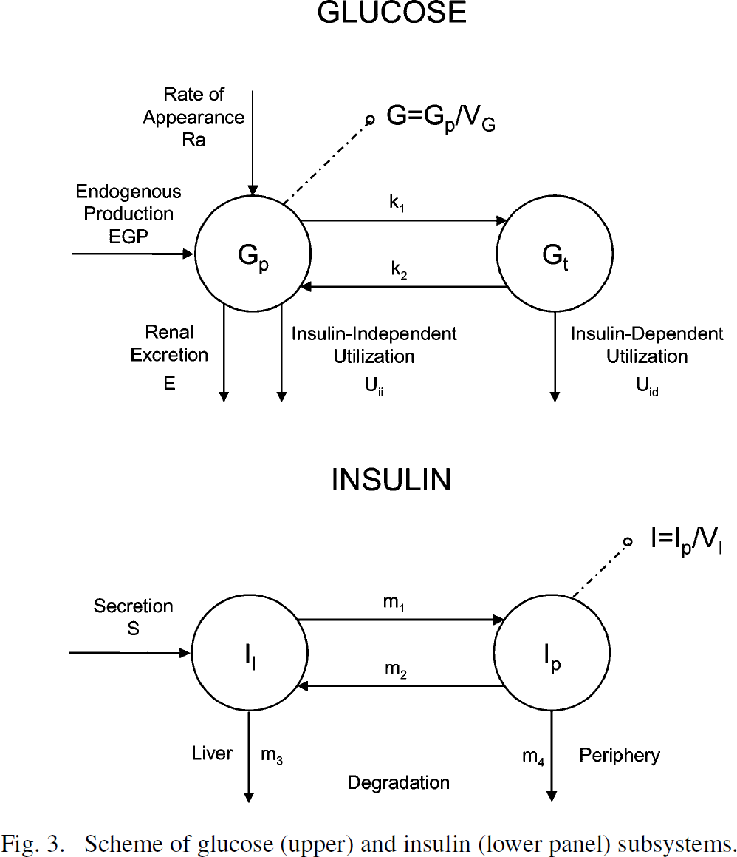


Slide 4
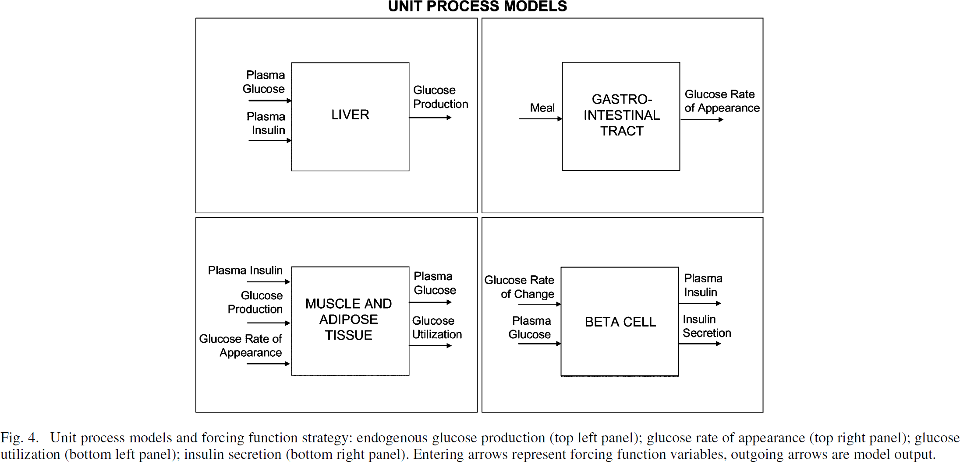

Slide 5
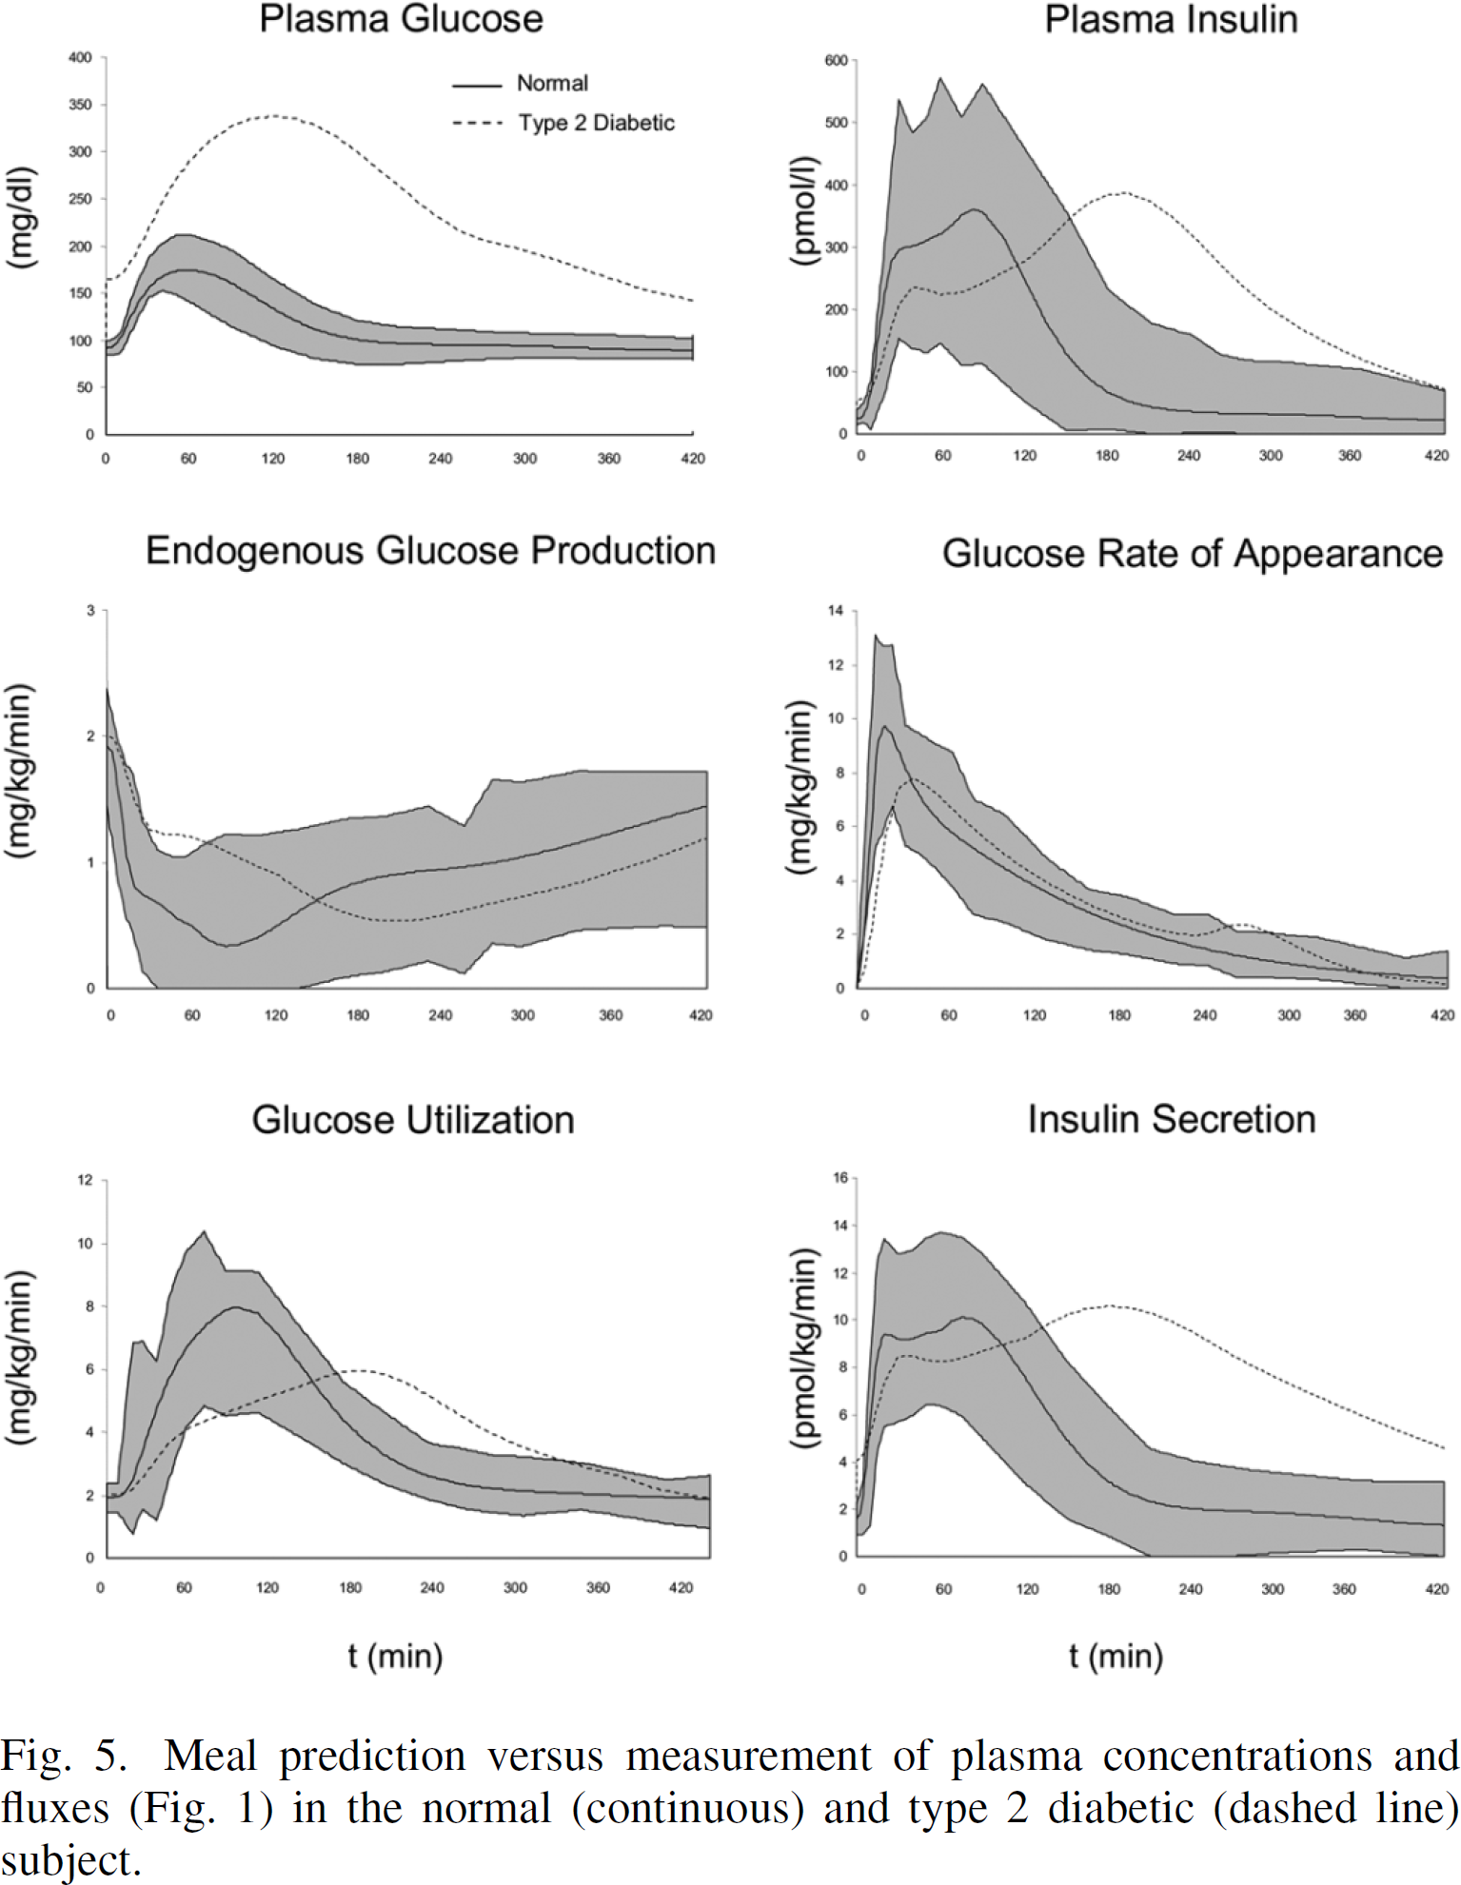
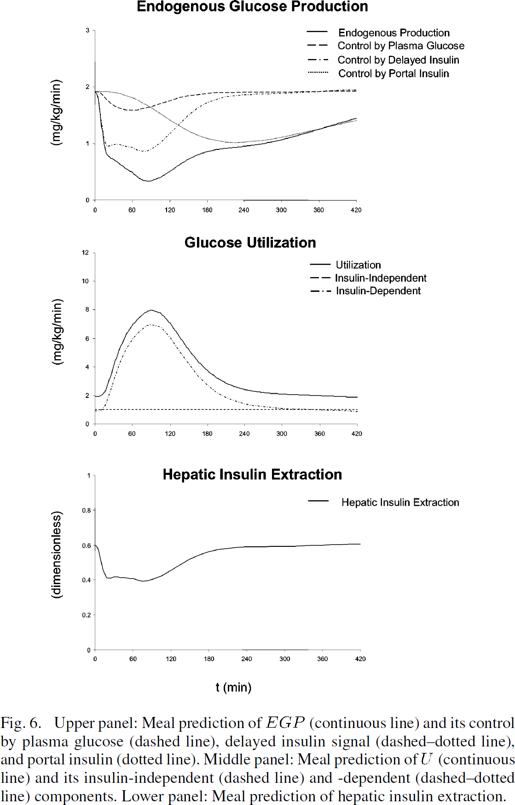

Slide 6
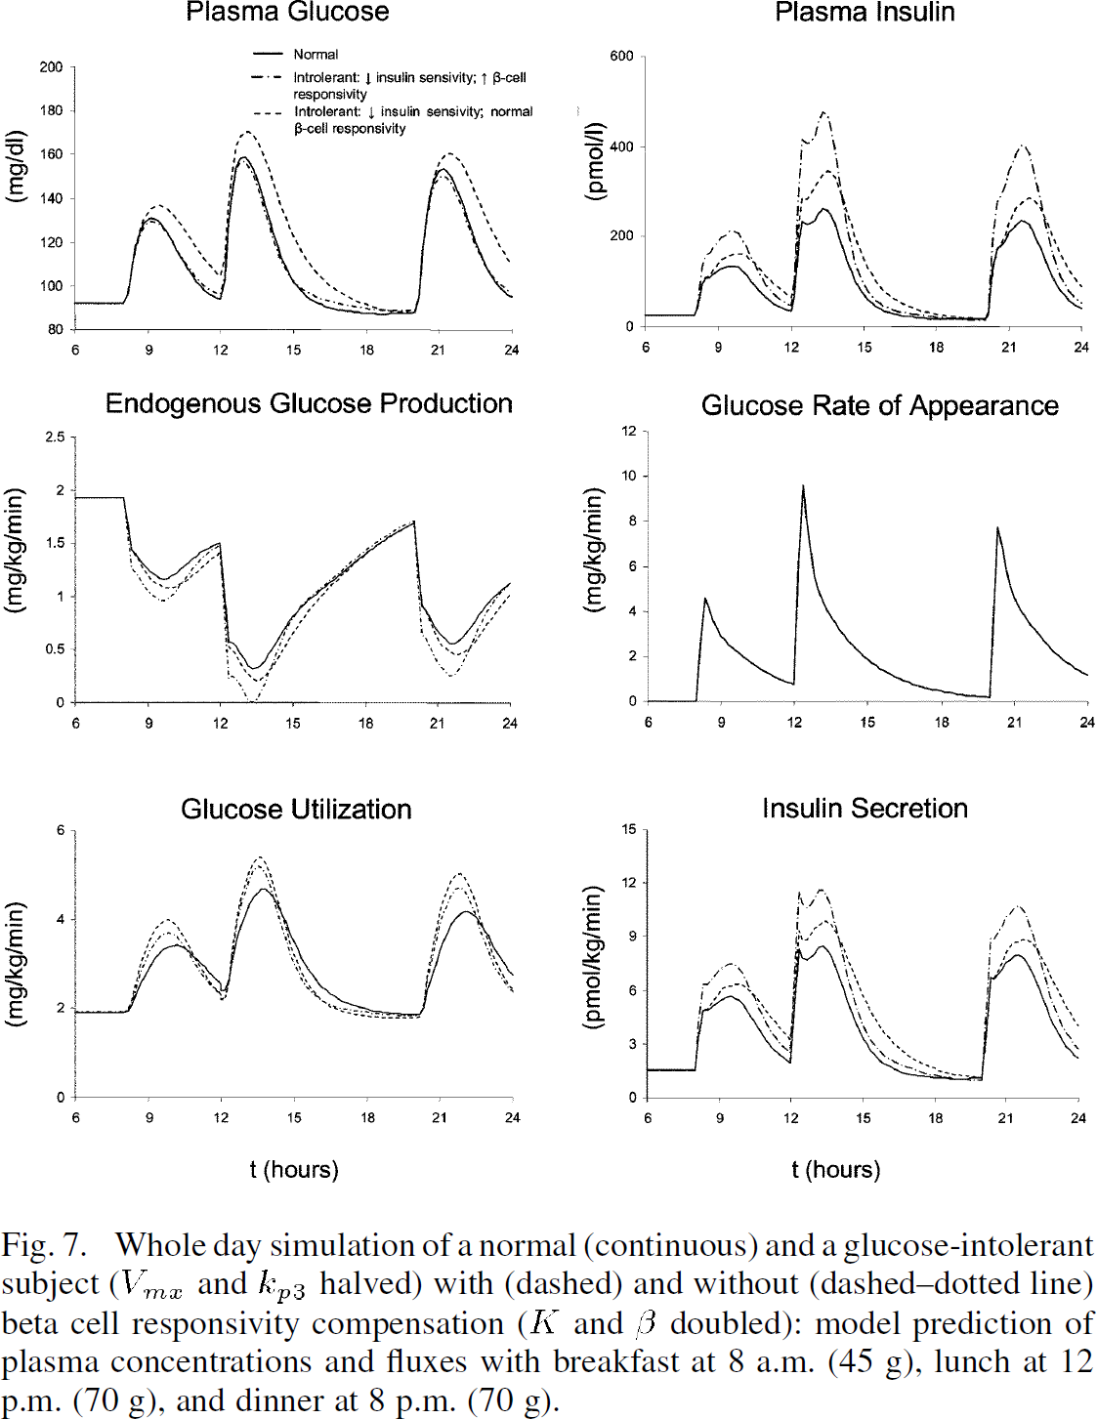

Slide 7

Liver function tests
Liver specific clearance of substance
Galactose elimination capacity (GEC)
Caffeine clearance
LiMAx Test (Methacetin)
Analysis via simple cutoff
No account for large variability in liver volume & blood flow, organ volumes
  age, gender, bodyweight, height, …
=> personalized models & cutoffs (in silico trials)
None of the liver specific information used for evaluation
  morphology, perfusion, metabolism, ultrastructure, …
=> detailed kinetic multiscale models
galactose [mg %]
time [min]

Slide 8

Personalized Liver Function Tests
Junior Group LiSyM:
Multi-scale Modeling for Personalized Liver Function Tests

Slide 9
Galactose (GEC)
König, Marchesini, Bianchi, Holzhütter

Slide 10

Galactose Elimination Capacity (GEC)
König M., Marchesini G., Bianchi G. and Holzhütter HG.
A Multiscale Computational Model Predicts Human Liver Function From Single-Cell Metabolism
2017, [manuscript in preparation]

Slide 11



Multiple Indicator Dilution
Heterogeneity
Liver function depends strongly on local liver perfusion, ultrastructure & test substance
Input-Output profile after test substances

Slide 12


Liver Galactose elimination, extraction ratio & clearance
Galactose Elimination [mmol/min]
Galactose Elimination [mmol/min]
Extraction Ratio [-]
Extraction Ratio [-]
Blood flow (Q) [ml/min]
Galactose [mM]
Blood flow (Q) [ml/min]
Galactose [mM]
Clearance [ml/min]
Clearance [ml/min]
Perivenious galactose [mM]
Perivenious galactose [mM]
Blood flow (Q) [ml/min]
Galactose [mM]
Blood flow (Q) [ml/min]
Galactose [mM]

Slide 13



Spatial galactose elimination
ALP (arterial liver
perfusion)
PVP (portal-venous
perfusion)
HPI (hepatic perfusion
index)
Wang2013
Perfusion CTs
Galactose elimination depending on
local liver perfusion
GE [µmol/min/ml(tissue)]
Galactose elimination (8mM galactose)

Slide 14




Personalized prediction
Individual evalutation of liver function test
Simulation of in silico population representative of the individual subject
Population prediction
GEC [mmol/min]
age [years]
Classification Cirrhosis
GEC App

Slide 15
Outlook
Integration with PKPD models
  time courses of whole-body distribution and urinary extraction
  In silico trials & virtual populations
  Large dataset of individual subject galactose time courses for analysis (Marchesini)
Integration CT data
  Simulate spatial heterogeneity in liver function
  Integration with perfusion CT, functional CT (Keiding?)

Slide 16
Caffeine Clearance
M. König

Slide 17




Caffeine
TODO: Illustrator (liver & human image)
TODO: better network image
100 mg oral caffeine dose
Liver function test
  Clearance via time curves; 6h plasma paraxanthine/caffeine; urinary ratios of methyl-xanthines
  CYP1A2
Whole-body PKPD
  Kinetic model of liver metabolism (clearance)
  Renal clearance
  Whole-body distribution kinetics
Denaro1996

Slide 18










Mean model
human (70kg, male),
mean microsomal CYP1A2 content,
non-smoker
Model version 2

Slide 19


CYP1A2
CYP1A2 expression altered by many lifestyle factors
  Strong effect: Smoking
Altered function test results
  clearance, half-life, kel, max value, metabolic ratios
_{CYP1A2 ▲}
CYP1A2 induction ▲
Clearance ▲
kel ▲
T1/2 ▼
Tmax ▼
px(17X)/caf(137X) ▲
_{CYP1A2 ▲}

Slide 20







Smoking
CYP1A2 smoking effect
  Distribution of liver microsome activity (log-normal) for non-smokers and smokers
  Simulation of moderate smoking effect (6-10 cigerretes, ~40% increase)
TODO: print the mean curves with S.D in comparison
Data: Spigset1999a
Data: Spigset1999a
Data: Perera2011

Slide 21





Prediction: Clearance

Slide 22


Prediction: kel

Slide 23



Prediction: half-life

Slide 24





Prediction: px/caf ratio (4h, 6h)

Slide 25
Outlook
Model improvement
high caffeine doses & paraxanthine doses
Metabolism of additional methyl-xanthines
describe urinary profile and change of urinary metabolite ratios with smoking (CYP1A2 activity)
Simulating Virtual Populations
organ volume & blood flow scaling, adapting to respective study populations
Coupling to logistic regression model
Smoking one example of CYP1A2 induction effect
  Contraceptives, coffee consumption, genetic variants
Validation with LiSyM drug cocktail
Existing dataset of individual subject caffeine time courses. Testing predictive performance with personalized simulations (personalized PKPD model & regression adaption)

Slide 26
LiMAx (Metacethin)
M.König, T. Wünsch & Prof. Stockmann

Slide 27



LiMAx
LiMAx PKPD model:
methacetine, paracetamol, CO2
Model calibration
  Existing timecourse data of methacetin, paracetamol, DOB
  Existing studies to paracetamol & CO2 distribution
Analysis: Effect of smoking on LiMAx results & test correction for smoking
  CYP1A2 substrate (analog changes like caffeine)
  Model validation with retrospective analysis of LiMAx data
Jara2015

Slide 28
Acknowledgement
Prof. Holzhütter
Prof. Marchesini & Prof. Gianchi
Tilo Wünsch & Prof. Stockmann
Researchers which make their data accessible
(you are the real heros)
LiSyM

Slide 30



Smoking cessation

Slide 31


Prediction: coffee consume
Multiple dosing
Adaption to smoking status, i.e. high smokers, via dose response curve (CYP1A2 ~ smoking)

Slide 32

WP3 Central Carbon Model
Kinetic model of central liver metabolism
Berndt N., Bulik S., Wallach I., König M., Stockmann M., Meierhofer D. and Holzhütter HG.
Computational Assessment of Liver Metabolism
[2016, manuscript in preparation]

Slide 33

WP3 Metabolic Modeling Liver
Kinetic models
(glucose & central metabolism, detoxification)
Flux Balance Analysis Genome-scale liver
Hybrid approaches
König M. and Holzhütter HG.
Homeostasis of blood glucose - Computer simulations of central liver functions.
systembiologie.de 2014; 8:p.53-57
König M. and Holzhütter HG.
Kinetic Modeling of Human Hepatic Glucose Metabolism in T2DM Predicts Higher Risk of Hypoglycemic Events in Rigorous Insulin Therapy
J Biol Chem. 2012
König M., Bulik S. and Holzhütter HG.
Quantifying the Contribution of the Liver to the Homeostasis of Plasma Glucose: A Detailed Kinetic Model of Hepatic Glucose Metabolism Integrated with the Hormonal Control by Insulin, Glucagon and Epinephrine
PLoS Comput Biol. 2012
Gille C, Bölling C, Hoppe A, Bulik S, Hoffmann S, Hübner K, Karlstädt A, Ganeshan R, König M, Rother K, Weidlich M, Behre J, Holzhütter HG.
HepatoNet1: a comprehensive metabolic reconstruction of the human hepatocyte for the analysis of liver physiology.
Mol Syst Biol., 6:411., 2010

Slide 34

WP1 Standardization
Reproducible Computational Research
Application of standard formats
Integration of clinical/patient data with computational models
König M.*, Oellrich A.*, Waltemath D.*, Dobson R., Hubbard T., and Wolkenhauer O.
* equal contribution
Challenges and opportunities for system biology standards and tools in medical research
[2016, accepted]
Wholecell Consortium (König M.)
Toward community standards and software for whole-cell modeling
IEEE Trans Biomed Eng. 2016 Jun 10.

Slide 35


Bioinformatics Analyses
https://www.ncbi.nlm.nih.gov/pmc/articles/PMC4654904/bin/12918_2015_229_Fig8_HTML.jpg
Abshagen*, König*, Hoppe A., Thomas M., Müller I., Ebert M., Weng H., Holzhütter HG., Zanger UM., Bode J., Vollmar B. and Dooley S.
* equal contribution
Pathobiochemical signatures of cholestatic liver disease in bile duct ligated mice
2015, BMC Systems Biology
https://github.com/matthiaskoenig/bdl-analysis
Circadian omics data &
Integration metabolic models
Patrick Pett, Hanspeter Herzel, Matthias König
Circadian rhythms in the mouse liver

Slide 36

WP1 Visualization & Data Integration
König
cy3sabiork: A Cytoscape app for visualizing kinetic data from SABIO-RK
2016 [version 1; referees: 2 approved with reservations]
http://f1000research.com/articles/5-1736/v1
https://github.com/matthiaskoenig/cy3sabiork
König, Rodriquez, and Dräger
cy3sbml: A Cytoscape app for SBML
2016, manuscript in preparation
https://github.com/matthiaskoenig/cy3sbml

Slide 37


Ultrastructural changes in aging
Pseudocapillarization
  Endothelial cells are thickened and defenestrated with old age
Cogger2003, Warren2005

Slide 38

Reduced Clearance in aging
Galactose Elimination [mmol/min]
Galactose Elimination [mmol/min]
Extraction Ratio [-]
Extraction Ratio [-]
Blood flow (Q) [ml/min]
Galactose [mM]
Blood flow (Q) [ml/min]
Galactose [mM]
Clearance [ml/min]
Clearance [ml/min]
Perivenious galactose [mM]
Perivenious galactose [mM]
Blood flow (Q) [ml/min]
Galactose [mM]
Blood flow (Q) [ml/min]
Galactose [mM]
Reduced Clearance & Extraction ratio under low concentrations (local effect)
In combination with reduced liver volume & perfusion in age can have drastic effects on drug/compound clearance

Slide 39


WP0 Central Data Management
https://www.fairdomhub.org/projects/46
Project & assets are managed in central data management
(SEEK & fairdomhub)
Multiple meetings/TC with data management (Heidelberg, Fairdom user meeting)
Project Webpage setup
Open Access (Models) & Open Source (Code) & Open Data (?)
https://www.livermetabolism.com/

Slide 40


Time table PLF

Slide 41

WP1/2 Modeling Tools
High performance simulators based on SBML
Python based modelling environment
Choi K., Medley JK., Cannistra C., König M., Smith L., Stocking K., and Sauro HM.
Tellurium: A Python Based Integrated Environment for Biological Modeling and Simulation
[2016, accepted]
Somogyi, Bouteiller, Glazier, König, Medley, Swat, Sauro.
libRoadRunner: a high performance SBML simulation and analysis library.
Bioinformatics. 2015
https://github.com/sys-bio/roadrunner

