Slide 1



Physiological based Models for the
Analysis of Liver Function
Dr Matthias König
LiSyM Systems Medicine of the Liver
Humboldt University Berlin, Institute for Theoretical Biology
livermetabolism.com
@konigmatt

Slide 2


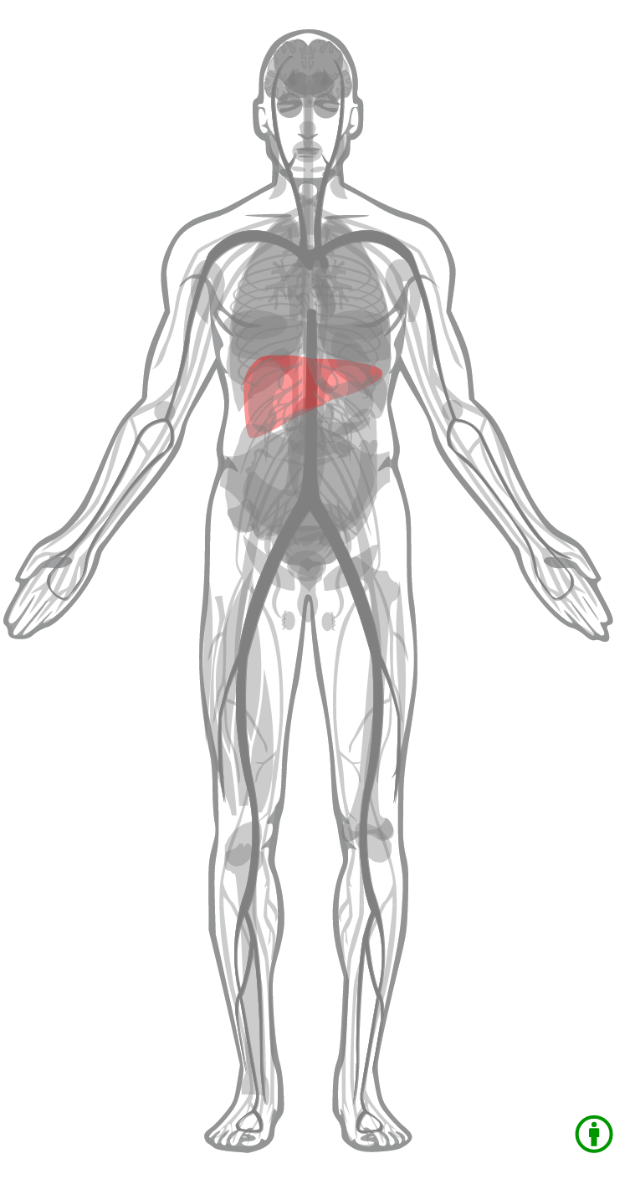
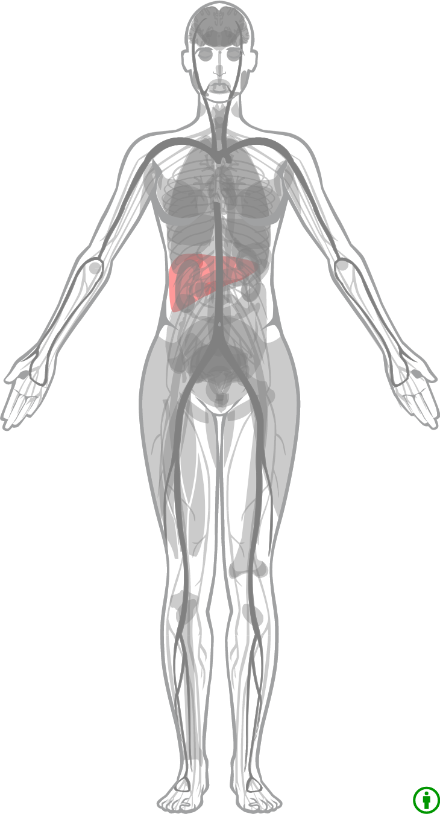

Physiological compartment models
Absorption, Distribution, Metabolism, Elimination (ADME)
Rowland2011, Expression Atlas

Slide 3
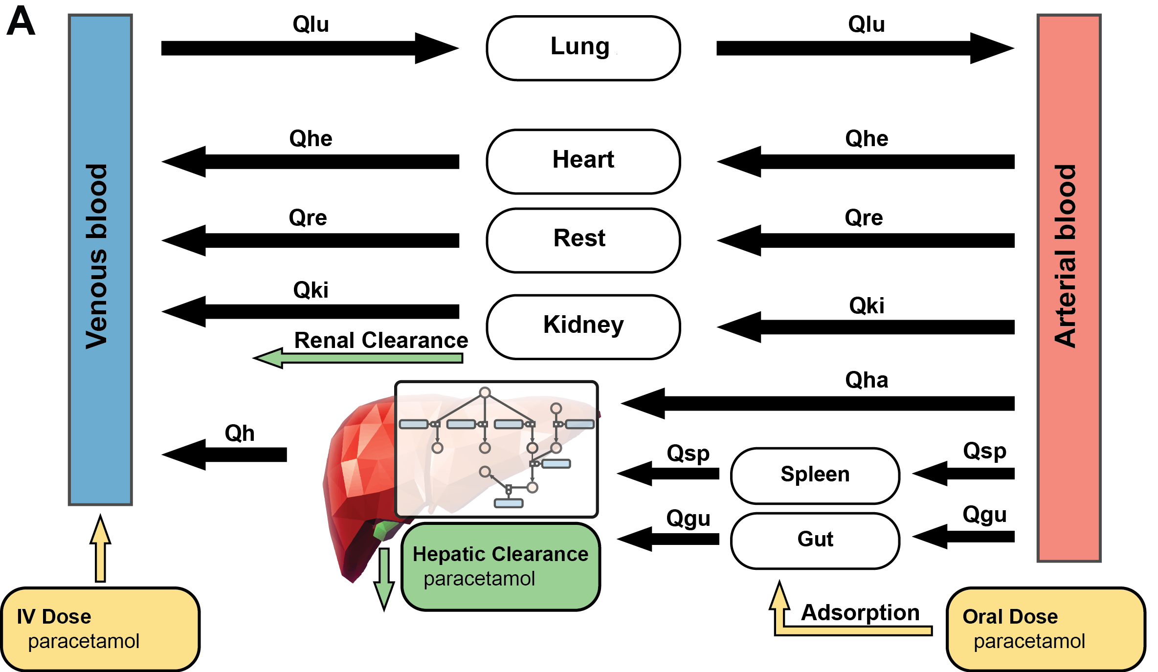
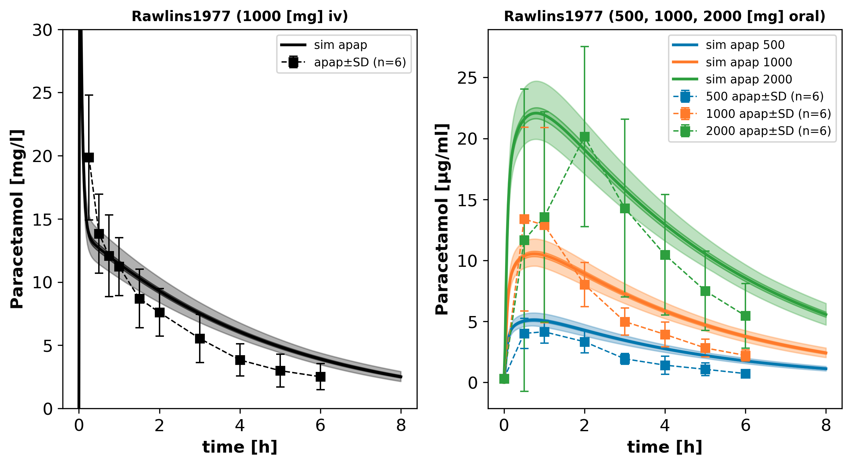
Physiological-based pharmacokinetics models (PBPK)
pharmacokinetics: determines fate of substances administered to organism
combines information on the drug with knowledge on the physiology and biology at organism level
human/animal physiology in the computer
Tissues are linked by arterial and venous blood compartments characterized by associated blood flow rates, tissue-partition coefficient , and permeability
Specific models for certain drugs & substances
Result: Time dependent concentrations of substances/drugs in organs, blood & urine
High pharmacological relevance since it enables the estimation of drug exposure not only in plasma but also at the site of action

Slide 4
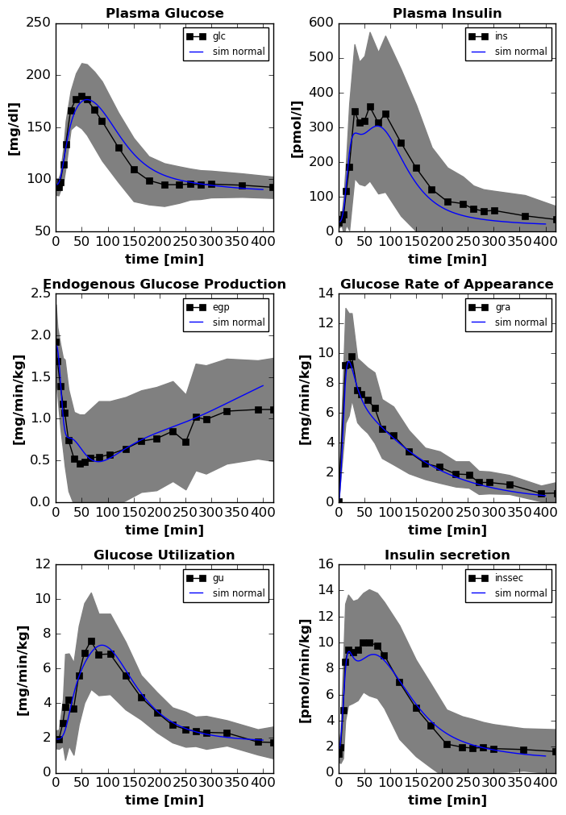

Example: Glucose-Insulin system
DallaMan2006, talk

Slide 5


Pharmacokinetic Parameters
  C_{max} : Maximal concentration
  T_{max} : time of maximal concentration
  AUC : area under the curve
  k_{el}: elimination rate
  fitting linear part of terminal phase (log)
  t_{1/2} : half-life (= ln2/k_{el})
  time for concentration to fall to half
  Vd: volume of distribution
  (= CL/k), dilution space
  CL: clearance (=Dose/AUC, =Dose/C(0)_{extrapolated})
Rowland2011

Slide 6
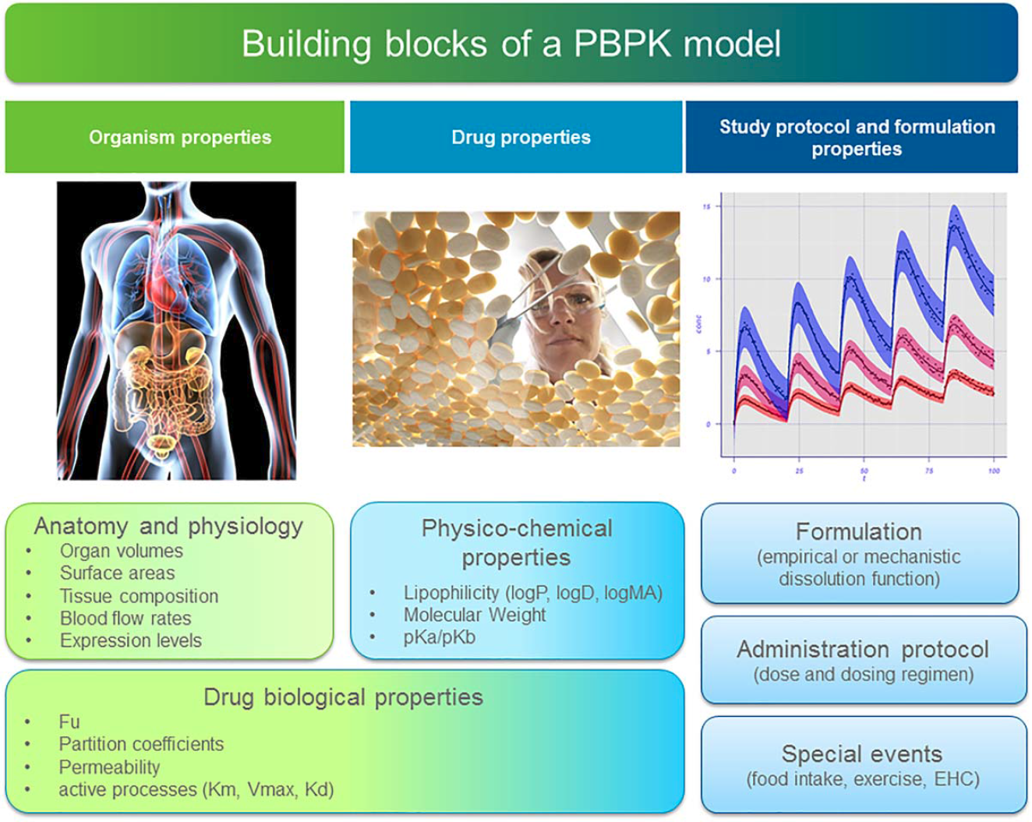
Differential equations
Compartments
  organs
State variables:
  drug & metabolite amounts
ODEs & rules
  Blood flows, Transport, Disposition
  Metabolism, Elimination
  Absorption
Parameters
  Tissue partition coefficients
  Protein binding
  Kinetic parameter (transport & elimination)
  Blood flows, organ volumes, …
Kuepfer2016

Slide 7



PBPK Applications
Individual Dosing
In silico drug trials
Kuepfer2016

Slide 8
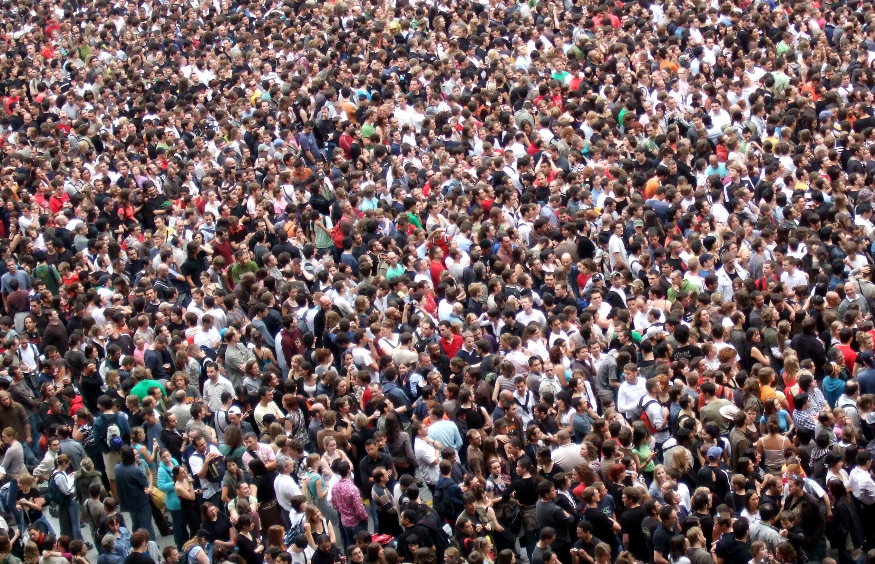


Large inter-individual variability

Slide 9



Variability Liver Enzymes
Archour2014b

Slide 10



Pharmacogenomics
Individualized theraphy
Warfarin example

Slide 11
Liver Function Tests

Slide 12
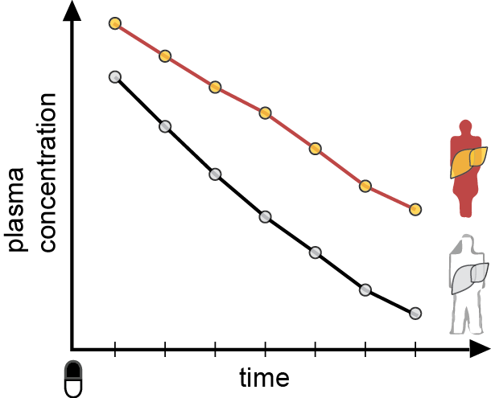
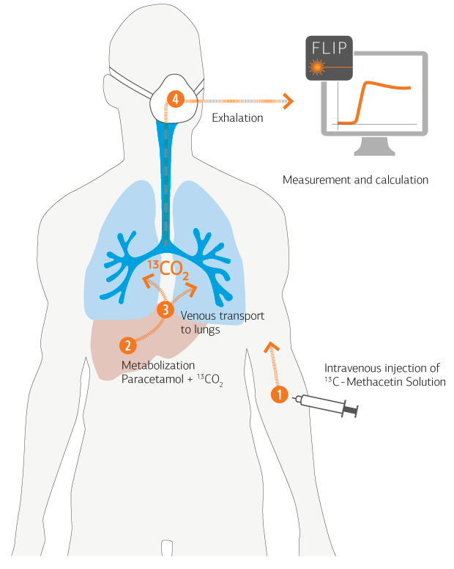
Liver Function Tests
Liver central organ of metabolism
Metabolic homeostasis (glucose, amino acids, …)
Detoxification & clearance of most drugs
Liver specific clearance of substance
Galactose elimination capacity (GEC)
LiMAx Test (Methacetin)
Caffeine clearance
Detection of product
plasma, urine, breath
Non-invasive evaluation of liver function
Transplantation & Hepatectomy
Liver disease

Slide 13
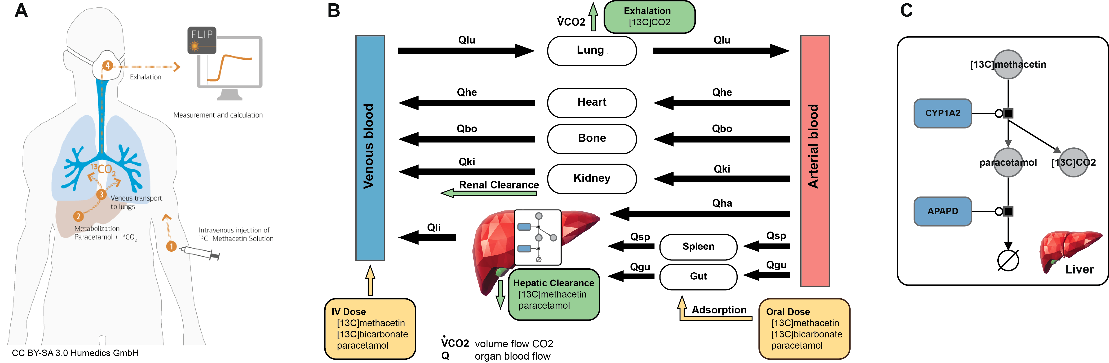
LiMAx (metacethin)

Slide 14
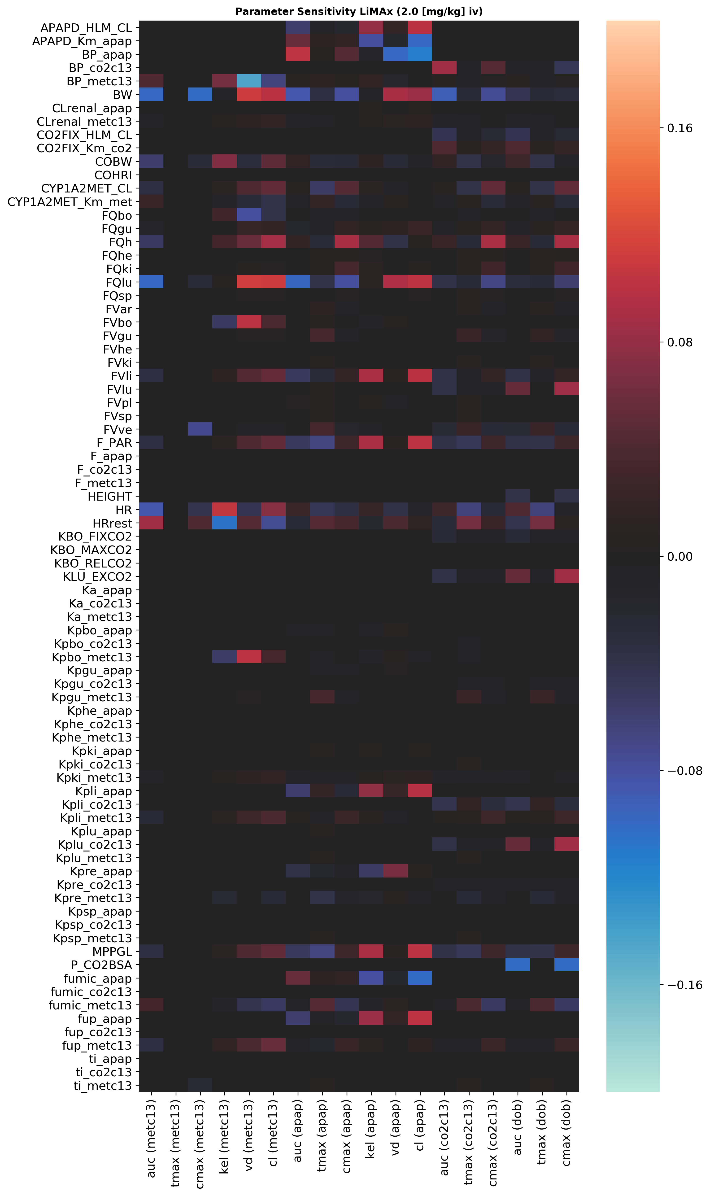
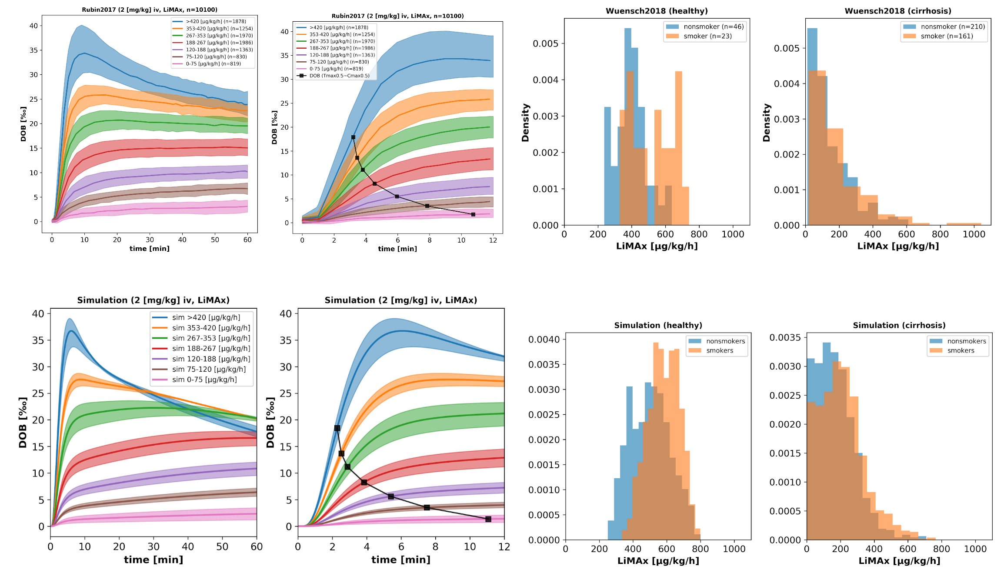
Sensitivity Analysis
Reduced liver function
Changes in Smoking & Cirrhosis

Slide 15


Caffeine PBPK
Caffeine & smoking

Slide 16


Caffeine (137X)
  world's most widely consumed psychoactive drug
  Metabolized in liver by CYP1A2
    to paraxanthine (17X), theobromine & theophylline
  Classical liver function test
    Time course of caffeine
    urinary ratios of methyl-xanthines
    Caffeine/paraxanthine ratio
  Large Variability
    Effects of lifestyle on expression
    Smoking is one of such lifestyle factors
Denaro1996
    How is smoking affecting the clearance of caffeine ?
+
= ?

Slide 17



PKPD
TODO: Illustrator (liver & human image)
TODO: better network image
Kinetic model of caffeine liver metabolism
Renal clearance
Whole-body distribution kinetics
100 mg oral caffeine dose
Denaro1996

Slide 18










Mean model
human (70kg, male),
mean microsomal CYP1A2 content,
non-smoker
Model version 2

Slide 19


CYP1A2
CYP1A2 expression altered by many lifestyle factors
  Strong effect: Smoking
Altered function test results
  clearance, half-life, kel, max value, metabolic ratios
_{CYP1A2 ▲}
CYP1A2 induction ▲
Clearance ▲
kel ▲
T1/2 ▼
Tmax ▼
px(17X)/caf(137X) ▲
_{CYP1A2 ▲}

Slide 20









Smoking
CYP1A2 smoking effect
  Distribution of liver microsome activity (log-normal) for non-smokers and smokers
  Simulation of moderate smoking effect (6-10 cigerretes, ~40% increase)
TODO: print the mean curves with S.D in comparison
Data: Spigset1999a
Data: Spigset1999a
Data: Perera2011

Slide 21





CL: Clearance

Slide 22


k_{el} : elimination rate

Slide 23



t_{1/2} : half-life

Slide 24





px/caf ratio (4h, 6h)

Slide 25


Prediction: coffee consume
Multiple dosing
Adaption to smoking status, i.e. high smokers, via dose response curve (CYP1A2 ~ smoking)

Slide 26

Caffeine Notebook
http://localhost:8888/notebooks/caffeine_pkpd/cafpkpd_model.ipynb

Slide 27
Modeling
Tools, Software, Workflows

Slide 28
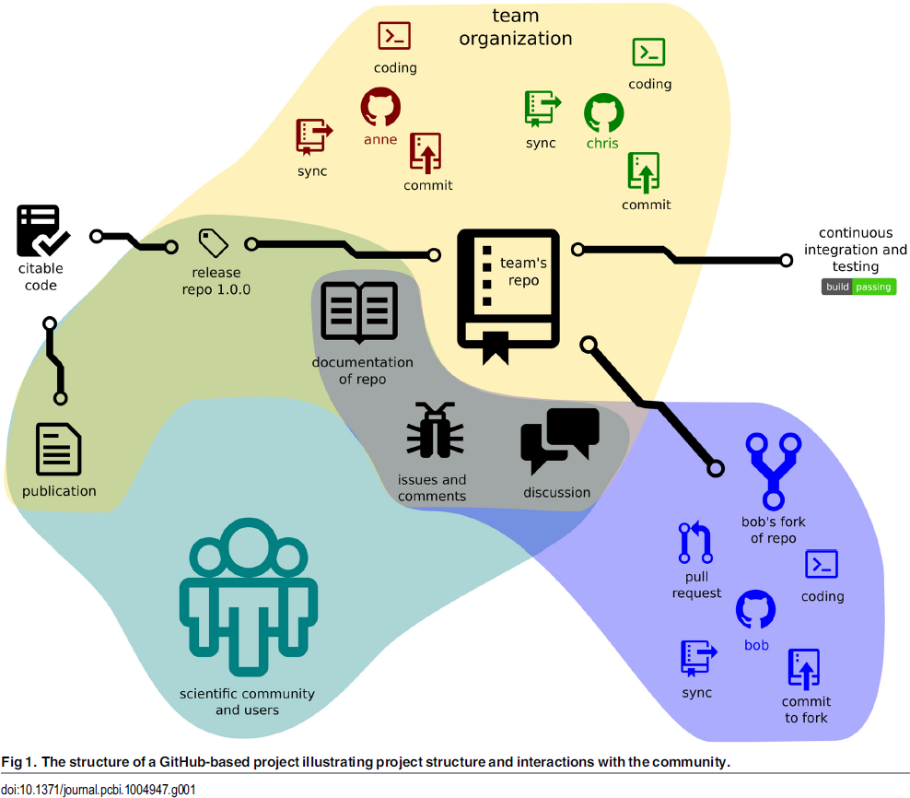


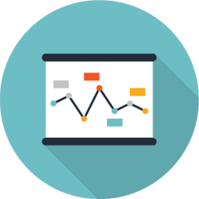
git repositories
GitHub is a code hosting platform for version control and collaboration. It lets you and others work together on projects from anywhere.
Version control
  Diffs & Branches
Collaborative editing
  Pull requests
Continuous integration
  unit tests
  Commit hooks
Releases & snapshots (citable code)
Issue tracker
Work anywhere & offline
&
CODE
DATA
Perez.Riverol2016
https://github.com/matthiaskoenig/cy3sbml/
https://github.com/matthiaskoenig/cy3sbml/commit/986ebbdd5e77d403cf031ff0a5230de4d28fc284

Slide 29

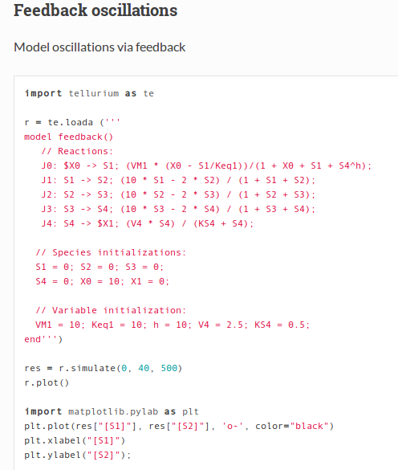
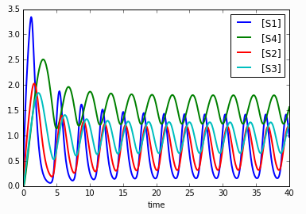
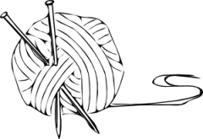
Reproducible Analyses
Dynamic report generation !
Jupyter notebooks
Web application that allows to create and share documents that contain live code, equations, visualizations and explanatory text.
Open source, interactive data science and scientific computing across over 40 programming languages.
Complete analysis, examples, test cases
http://tellurium.readthedocs.io/en/latest/notebooks.html#feedback-oscillationshttp://localhost:8888/notebooks/feedback_oscillations.ipynb
R: Knitr
Elegant, flexible and fast dynamic report generation with R
BDL example
https://github.com/matthiaskoenig/bdl-analysis
http://jupyter.org/

Slide 30
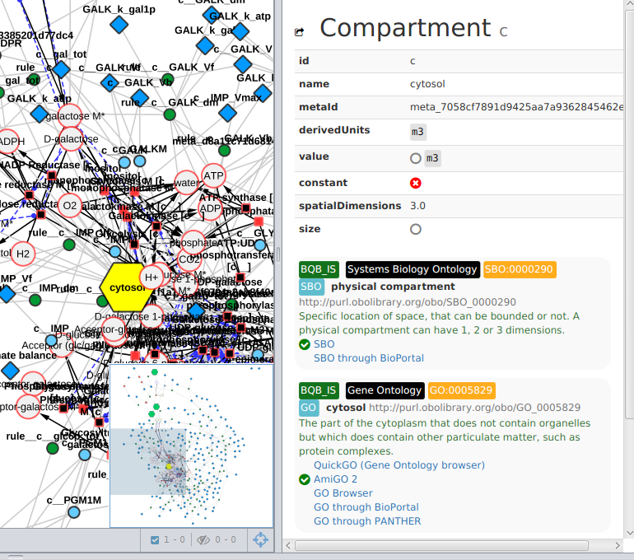


Standard Formats
Encoding of information in standard formats where possible
  Models in SBML (core, comp, fbc)
  Simulations in SED-ML
  Minimal Information for models and simulation (MIRIAM, MIASE)
Annotations to ontologies
  Knowledge integration
  Documentation
Reproducibility
  Reproducibility of results
  (roadrunner, COPASI, JWS)
Model quality
  Passes library tests
  (e.g., module unit tests, ...)
Visualization
  Iterative model cycle
König, Rodriquez, and Dräger
cy3sbml: A Cytoscape app for SBML
2017, manuscript in preparation
https://github.com/matthiaskoenig/cy3sbml

Slide 31
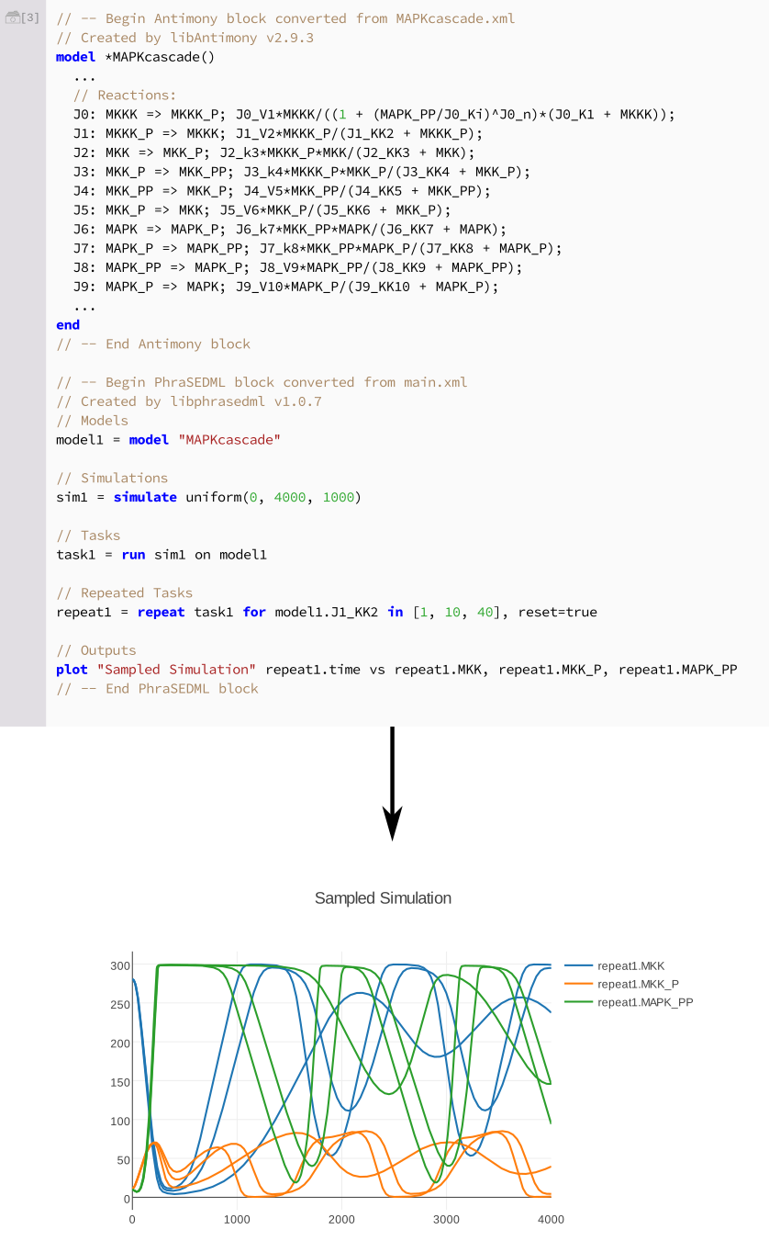
Modeling Tools
libRoadRunner: High performance SBML simulator
tellurium: Python based modeling environment (library & notebook)
Medley K, Choi K, König M; Smith L, Gu S, Joseph Hellerstein, Sealfon S., Sauro HM.
Tellurium Notebooks - An Environment for Dynamical Model Development, Reproducibility, and Reuse
[submitted, 2017]
Somogyi, Bouteiller, Glazier, König, Medley, Swat, Sauro.
libRoadRunner: a high performance SBML simulation and analysis library.
Bioinformatics. 2015

Slide 32

Visualization & Data Integration
König
cy3sabiork: A Cytoscape app for visualizing kinetic data from SABIO-RK
2016 [version 1; referees: 2 approved with reservations]
http://f1000research.com/articles/5-1736/v1
https://github.com/matthiaskoenig/cy3sabiork
König, Rodriquez, and Dräger
cy3sbml: A Cytoscape app for SBML
2017, manuscript in preparation
https://github.com/matthiaskoenig/cy3sbml

Slide 33
Tutorial
http://bit.ly/pkpd-tutorial

