Slide 1
Theory

Slide 2
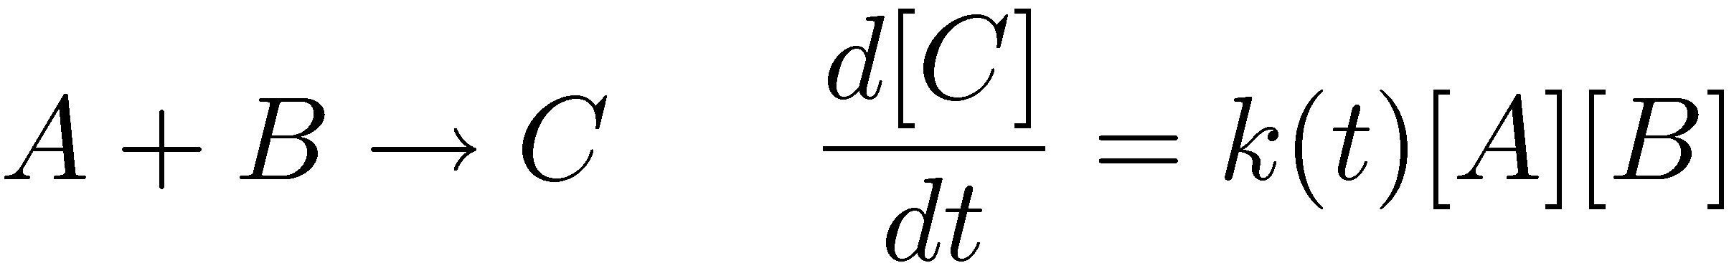
Modeling of Biochemical Reaction Systems
Assumptions:
The reaction systems are spatially homogeneous at every moment of time evolution.
The underlying reaction rates are described by the mass action law.
Model Description:
Variables: Entities that change in time governed by chemical reactions. In the example below, [A], [B], [C].
Parameters: Entities that do not change or change independently of the chemical reactions, can be perturbed by external intervention: k(t).
Time evolution:

Slide 3
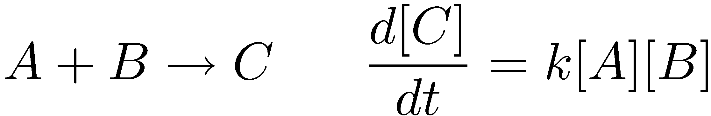
Deterministic or Stochastic Models
When the number of molecules is large (> ~1000 per cell):
Concentrations fluctuate in a continuous manner.
Concentration fluctuations are negligible.
Time evolution is described deterministically.
E.g.,
When the number of molecules is small (< ~1000 per cell):
Concentrations fluctuate in a discrete manner.
Concentrations fluctuate significantly.
The number of LacI tetrameric repressor protein in E.coli ~ 10 molecules.
If one LacI repressor binds to a promoter region, the number of free LacI repressors = 9.
10% change in its concentration and number!
Time evolution is described stochastically.

Slide 4
Numerical Simulation Algorithms
Stochastic Models
The master equations
Gillespie’s stochastic simulation algorithm and its variants.
Deterministic Models
Ordinary differential equations
Standard libraries e.g., CVODE, etc.

Slide 5
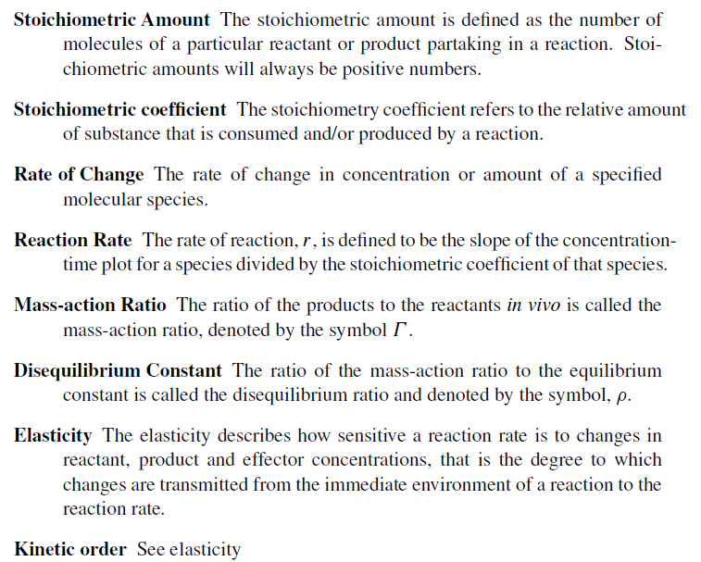
Basic Terms

Slide 6
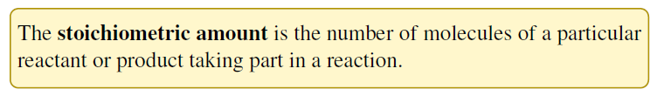
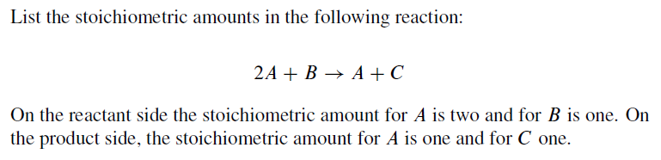
Stoichiometric Amounts
Page 3 in book

Slide 7
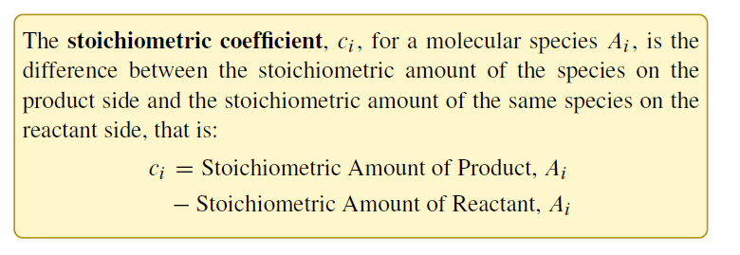
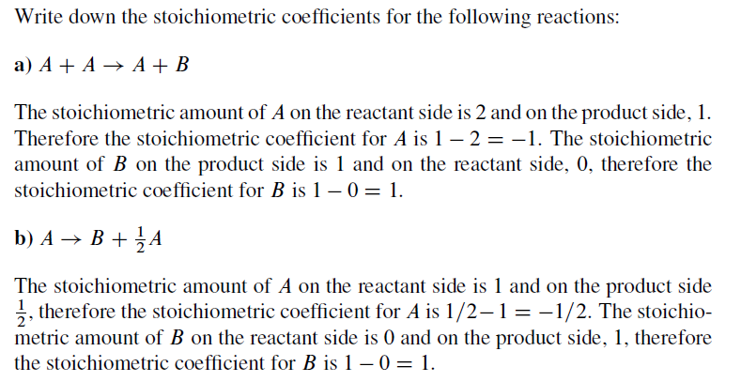
Stoichiometric Coefficients
Page 6/7 in book

Slide 8
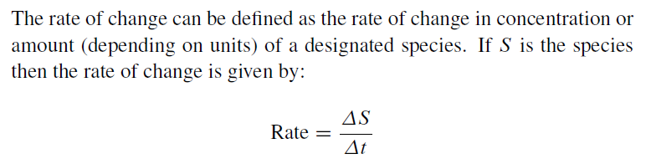

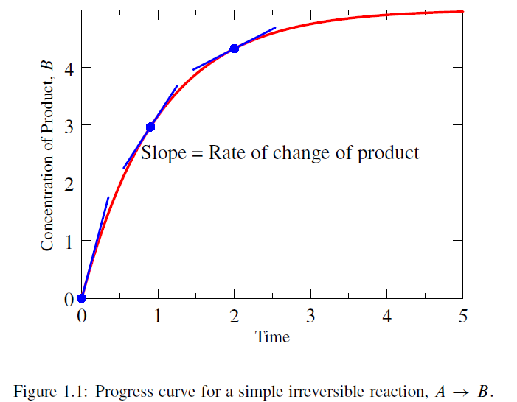
Rate of Change
Page 5 in book

Slide 9
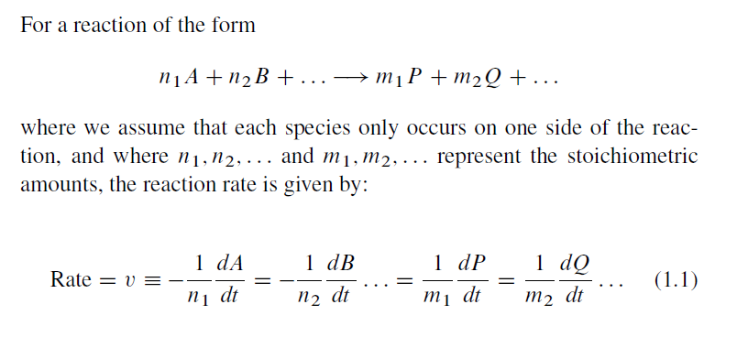
Reaction Rate (v)
Page 8/9 in book
A reaction rate is the rate of change normalized with respect
to the stoichiometric coefficient.

Slide 10





Reaction Rate: Rate Laws
Mass-action
Michaelis-Menten
Reversible Michaelis-Menten
Hill Equation
Cooperatively + Allosteric Equation
See “Enzyme Kinetics for Systems Biology” for Details

Slide 11
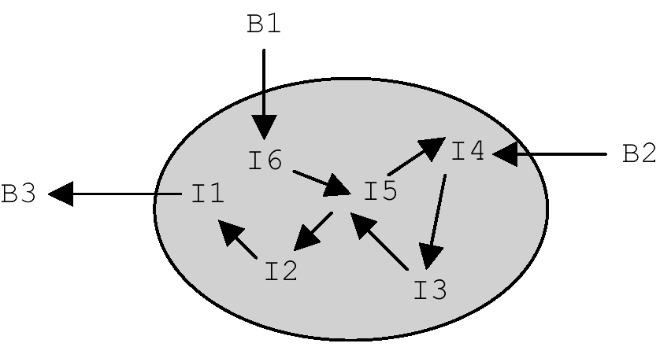
Boundary and Floating Species
Internal or Floating Species
Boundary Species
System
A Boundary Species is under the direct control of the modeler

Slide 12
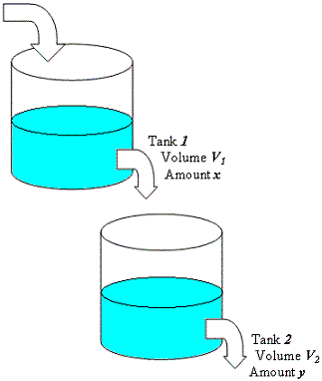
Transients and Steady State
Transient
Steady State

Slide 13
Hands On Exercises
Tellurium

Slide 14
Closed System
Build a model of a closed system: Xo -> S1 -> S2 -> X1
Xo -> S1 v = k1*Xo - k2*S1
S1 -> S2 v = k3*S1 - k3*S2
S2 -> X1 v = k5*S2 - k6*X1
Xo = 4; X1 = 0;
k1 = 1.2; k2 = 0.45;
k3 = 0.56; k4 = 0.2;
k5 = 0.89; k6 = 0;
Questions:
Carry out a simulation and plot the time course for the system t = 0 to t = 50.
Once the system settles down what is the net flux through the pathway?

Slide 15
Coffee Break

Slide 16
System Quantities
Variables:
State Variables, Dynamical Variables, Floating Species
In principle only indirectly under the control of the
Experimentalist. Determined by the system.
2. Parameters:
Kinetic Constants, Boundary Species (fixed)
In principle under the direct control of the experimentalist

Slide 17

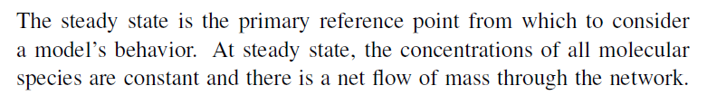


Steady State

Slide 18
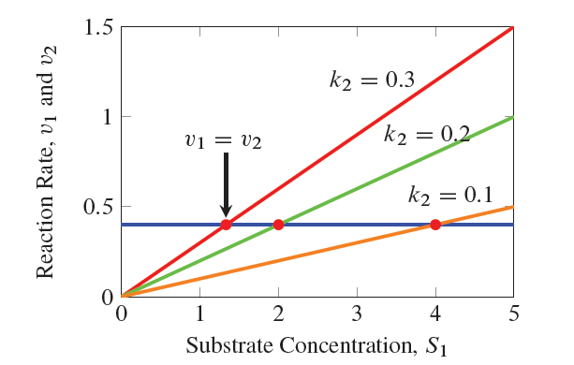
Steady State

Slide 19



Steady State

Slide 20
Open System
Turn the close system you build into an open system by fixing
Xo and X1.
Questions:
Carry out a simulation and plot the time course for the system t = 0 to t = 50.
Once the system settles down what is the net flux through the pathway?

Slide 21
Open System, Steady State
r.steadystate();
This method returns a single number.
This number indicates how close the solution is to the steady state.
Numbers < 1E-5 usually indicate it has found a steady state.
Confirm using print r.dv() <- prints rates of change

Slide 22
Useful Model Variables
r.dv() <- returns the rates of change vector dx/dt
r.sv() <- returns vector of current floating species
concentrations
r.fs() <- returns list of floating species
names (same order as sv)

Slide 23
Useful Model Variables
r.pv() <- returns vector of all current parameter values
r.ps() <- returns list of kinetic parameter names
r.bs() <- returns list of boundary species names

Slide 24
Applying Perturbations in Tellurium
m1
m
import tellurium as te
import numpy
r = te.loada (```
# Model Definition
v1: $Xo -> S1; k1*Xo;
v2: S1 -> $w; k2*S1;
# Initialize constants
k1 = 1; k2 = 1; S1 = 15; Xo = 1;
```)
# Time course simulation
m1 = r.simulate (0, 15, 100, [“Time”,”S1”]);
r.model.k1 = r.model.k1 * 6;
m2 = r.simulate (15, 40, 100, [“Time”,”S1”]);
r.model.k1 = r.model.k1 / 6;
m3 = r.simulate (40, 60, 100, [“Time”>,”S1”]);
m = numpy.vstack ((m1, m2, m3)); # Merge data
r.plot (m)
m2
vstack ((m1, m2)) -> m
(augment by row)

Slide 25
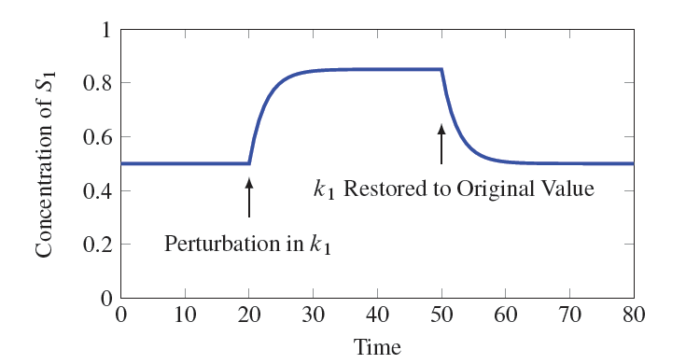
Perturbations to Parameters

Slide 26
Perturbations to Variables
import tellurium as te
import numpy
r = te.loada ('''
$Xo -> S1; k1*Xo;
S1 -> $X1; k2*S1;
k1 = 0.2; k2 = 0.4; Xo = 1; S1 = 0.5;
''')
# Simulate the first part up to 20 time units
m1 = r.simulate (0, 20, 100, ["time", "S1"]);
# Perturb the concentration of S1 by 0.35 units
r.model.S1 = r.model.S1 + 0.35;
# Continue simulating from last end point
m2 = r.simulate (20, 50, 100, ["time", "S1"]);
# Merge and plot the two halves of the simulation
r.plot (numpy.vstack ((m1, m2)));

Slide 27
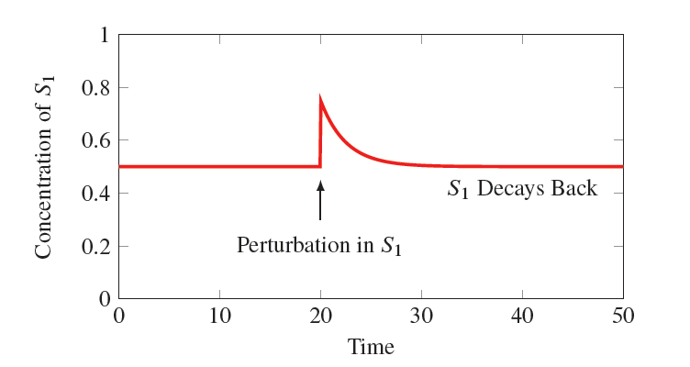
Perturbations to Variables

Slide 28
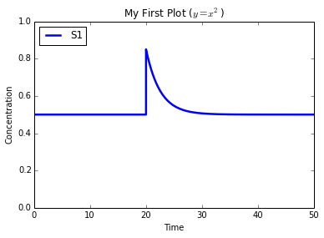
More on Plotting
import tellurium as te
import numpy
import matplotlib.pyplot as plt
r = te.loada ('''
$Xo -> S1; k1*Xo;
S1 -> $X1; k2*S1;
k1 = 0.2; k2 = 0.4; Xo = 1; S1 = 0.5;
''')
# Simulate the first part up to 20 time units
m1 = r.simulate (0, 20, 100, ["time", "S1"]);
r.model.S1 = r.model.S1 + 0.35;
m2 = r.simulate (20, 50, 100, ["time", "S1"]);
plt.ylim ((0,1))
plt.xlabel ('Time')
plt.ylabel ('Concentration')
plt.title ('My First Plot ($y = x^2$)')
r.plot (numpy.vstack ((m1, m2)));

Slide 29
Three Important Plot Commands
r.plot (result) # Plots a legend
te.plotArray (result) # No legend
te.setHold (True) # Overlay plots

Slide 30
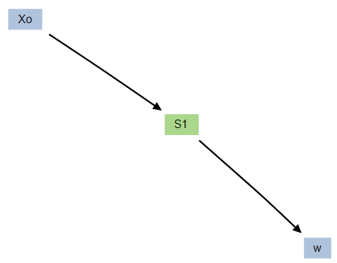
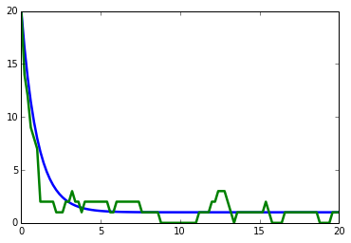
Plotting Overlay Example
import tellurium as te
import numpy
import matplotlib.pyplot as plt
# model Definition
r = te.loada ('''
v1: $Xo -> S1; k1*Xo;
v2: S1 -> $w; k2*S1;
//initialize. Deterministic process.
k1 = 1; k2 = 1; S1 = 20; Xo = 1;
''')
m1 = r.simulate (0,20,100);
# Stochastic process
r.resetToOrigin()
m2 = r.gillespie (0, 20, 100, ['time', 'S1'])
# plot all the results together
te.setHold (True)
te.plotArray (m1)
te.plotArray (m2)

Slide 31
Specifying Events
import tellurium as te
import numpy
import matplotlib.pyplot as plt
import roadrunner
roadrunner.Config.setValue (roadrunner.Config.LOADSBMLOPTIONS_CONSERVED_MOIETIES, False)
r = te.loada ('''
$Xo -> S1; k1*Xo;
S1 -> $X1; k2*S1;
k1 = 0.2; k2 = 0.4; Xo = 1; S1 = 0.5;
at (t > 20): S1 = S1 + 0.35
''')
# Simulate the first part up to 20 time units
m = r.simulate (0, 20, 100, ["time", "S1"]);
plt.ylim ((0,1))
plt.xlabel ('Time')
plt.ylabel ('Concentration')
plt.title ('My First Plot ($y = x^2$)')
r.plot (numpy.vstack ((m1, m2)));

Slide 32
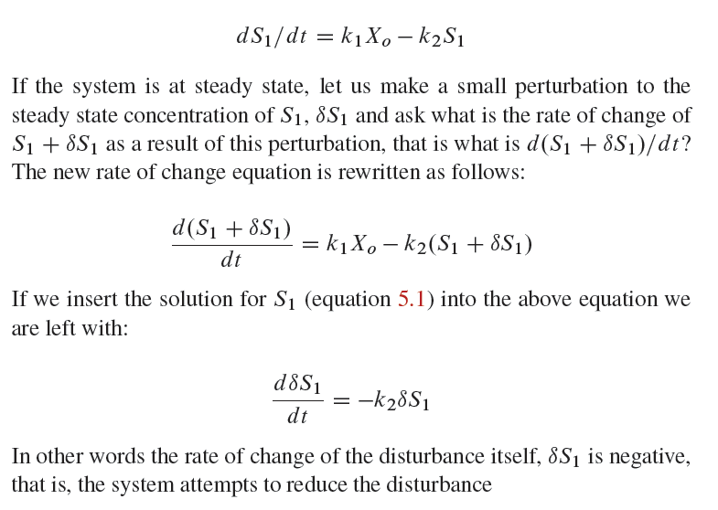
Why the disturbance is stable

Slide 33
Solving ODEs
What if I only have a set of ODES?
dy/dt = -k*y
r = te.loada (‘’’
y’ = -k*y; # Note the apostrophe
y = 1; k = 0.2;
‘’’)

Slide 34
Solving ODEs
When you run simulate make sure you specify the ode variables!
r = te.loada ('''
y’ = -k*y; # Note the apostrophe
y = 1; k = 0.2;
''')
result = r.simulate (0, 10, 50,['time', 'y'])
r.plot (result)

Slide 35
Simulate the Chaotic Lorenz System
Simulate the Lorenz System.
dx/dt = sigma*(y – x)
dy/dt = x*(rho – z) – y
dz/dt = x*y – beta*z
x = 0.96259; y = 2.07272; z = 18.65888;
sigma = 10; rho = 28; beta = 2.67;
Simulate t=0 to t=20
http://en.wikipedia.org/wiki/Lorenz_system

Slide 36
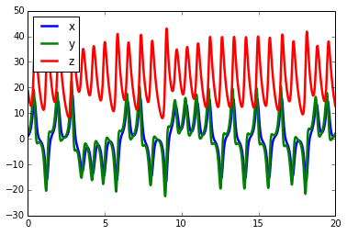
Solving ODEs
import tellurium as te
r = te.loada ('''
x' = sigma*(y - x);
y' = x*(rho - z) - y;
z' = x*y - beta*z;
x = 0.96259; y = 2.07272; z = 18.65888;
sigma = 10; rho = 28; beta = 2.67;
''')
result = r.simulate (0, 20, 1000, ['time', 'x', 'y', 'z'])
r.plot (result)

Slide 37
How Can I Exchange Models?
SBML (Systems Biology Markup Language): de facto standard for
representing cellular networks. A large number (>200) of tools support SBML.
CellML: Stores models in mathematical form, therefore is quite general, but
biological information is lost. Not possible to reconstruct network. Less than a
hand-full of tools support CellML
SBGN: A proposed standard for visually representing cellular networks. No
persistent format has yet been devised which limits its use in software.
Matlab: Proprietary math based scripting language

Slide 38
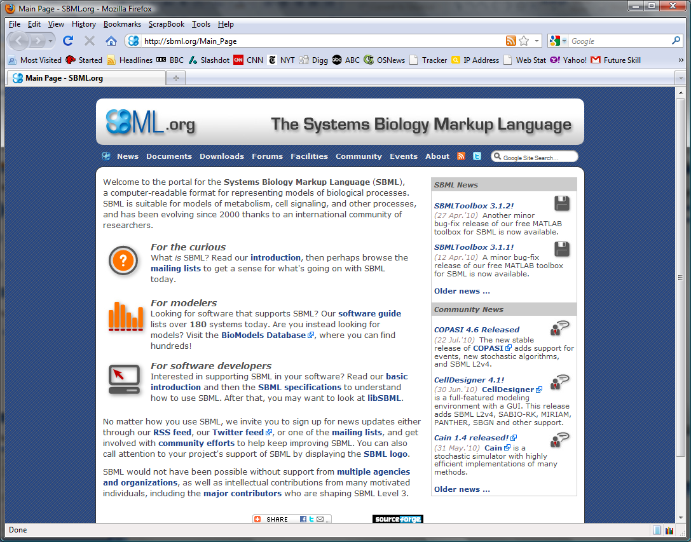
SBML

Slide 39
Systems Biology Markup Language
Originally developed in 2000 to allow users to exchange models between the small number of simulators that existed at that time.
Since then it has become the de facto standard for model exchange in systems biology
SBML represents models using XML by describing:
Compartment
Molecular Species
Chemical and Enzymatic Reactions (including gene regulatory)
Parameters
Kinetic Rate Laws
Additional Mathematical Equations when necessary

Slide 40
Systems Biology Markup Language
<?xml version="1.0" encoding="UTF-8"?>
<!-- Created by XMLPrettyPrinter on 7/30/2012 -->
<sbml xmlns = "http://www.sbml.org/sbml/level2" level = "2" version = "1">
<model id = "cell">
<listOfCompartments>
<compartment id = "compartment" size = "1"/>
</listOfCompartments>
<listOfSpecies>
<species id = "S1" boundaryCondition = "true" initialConcentration = "1" compartment = "compartment"/>
<species id = "S3" boundaryCondition = "true" initialConcentration = "0" compartment = "compartment"/>
<species id = "S2" boundaryCondition = "false" initialConcentration = "1.33" compartment = "compartment"/>
</listOfSpecies>
<listOfParameters>
<parameter id = "k1" value = "3.4"/>
<parameter id = "k2" value = "2.3"/>
</listOfParameters>
<listOfReactions>
<reaction id = "J1" reversible = "false">
<listOfReactants>
<speciesReference species = "S1" stoichiometry = "1"/>
</listOfReactants>
<listOfProducts>
<speciesReference species = "S2" stoichiometry = "1"/>
</listOfProducts>

Slide 41
Systems Biology Markup Language
<kineticLaw>
<math xmlns = "http://www.w3.org/1998/Math/MathML">
<apply>
<times/>
<ci>
k1
</ci>
<ci>
S1
</ci>
</apply>
</math>
</kineticLaw>
</reaction>
<reaction id = "J2" reversible = "false">
<listOfReactants>
<speciesReference species = "S2" stoichiometry = "1"/>
</listOfReactants>
<listOfProducts>
<speciesReference species = "S3" stoichiometry = "1"/>
</listOfProducts>
<kineticLaw>
<math xmlns = "http://www.w3.org/1998/Math/MathML">
<apply>
<times/>
<ci>
k2
</ci>
<ci>
S2
</ci>
</apply>
</math>
</kineticLaw>
</reaction>
</listOfReactions>
</model>
</sbml>

Slide 42
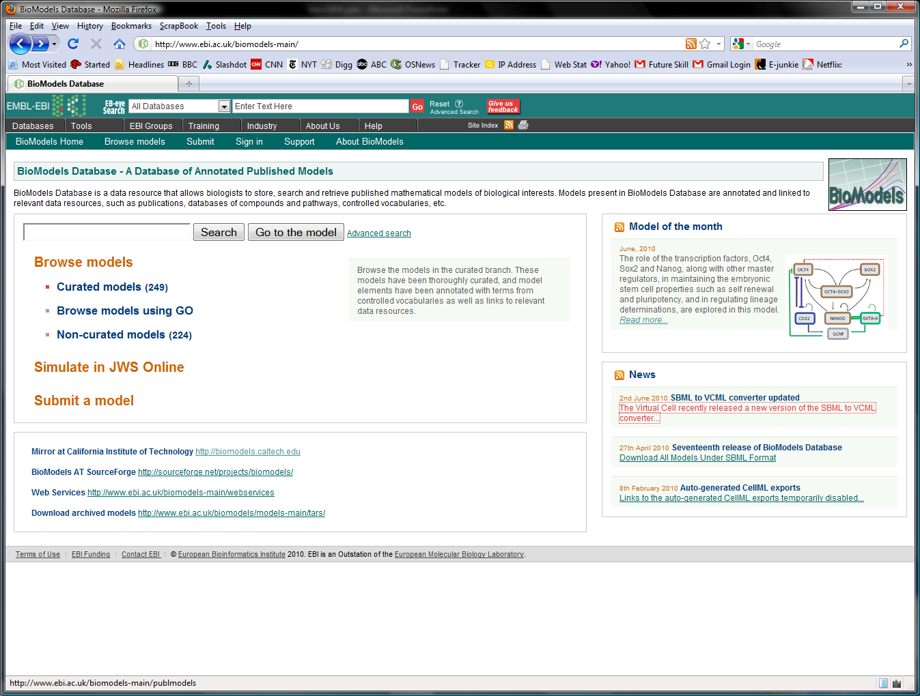
Model Repositories
421 Curated
models as of
July 2012
433 Non-curated
Models.
Biomodels.net
At the EBI near
Cambridge, UK

Slide 43
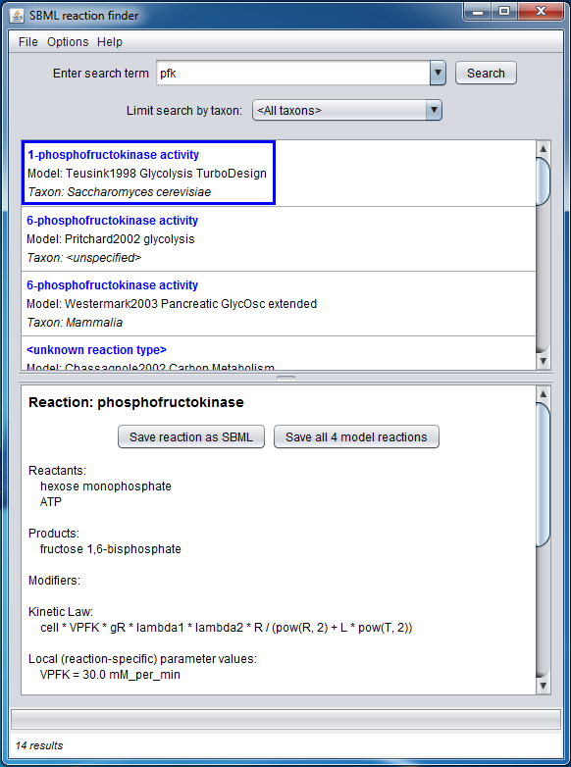
Parts Repository: Max Neals
This tools decomposes all biomodels
into their constituent parts.
For example, search for pfk to locate
all pfk parts in the biomodels
database.
See the following web site for details:
http://sites.google.com/site/semanticsofbiologicalprocesses/projects/sbmlrxnfinder

Slide 44

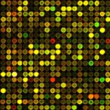

SBML Ecosystem
SBML
Unambiguous Model Exchange
Diagrams
Databases
Simulator Comparison and Compliance
Semantic Annotations
Journals
Parts Repositories
SEDML: Simulation Experiment Description Language
SBGN : Systems Biology Graphical Notation

Slide 45
Exporting/Importing Models
Importing:
1. Antimony (using loada)
2. SBML (using roadrunner.RoadRunner (sbml model)
Exporting:
1. r.getAntimony()
2. r.getSBML()
3. r.getMatlab()

Slide 46
Exercise
Build a simple model and export
the SBML and Matlab

Slide 47
Parameter Scan
# Parameter Scan
import tellurium as te
import numpy
r = te.loada ('''
J1: $X0 -> S1; k1*X0;
J2: S1 -> $X1; k2*S1;
X0 = 1.0; S1 = 0.0; X1 = 0.0;
k1 = 0.4; k2 = 2.3;
''')
m = r.simulate (0, 4, 100, ["Time", "S1"])
for i in range (0,4):
r.model.k1 = r.model.k1 + 0.1
r.reset()
m = numpy.hstack ((m, r.simulate (0, 4, 100, ['S1'])))
#m[:,1] *= 5
te.plotArray (m)

