Slide 1
ProjeCTs

Slide 2
Homeostasis
A homeostatic system is one that resists internal change when external parameters are perturbed. We will illustrate two such networks: one that shows perfect adaptation and another that near adaptation.
Perfect adaptation describes a system that recovers from a perturbation without any error (thus perfectly). There are a number of approaches to achieving perfect adaptation, one is via integral control and another, simpler approach, is via coordinate stimulation. In this tutorial we will illustrate perfect adaptation using coordinate stimulation.
A simpler and perhaps more common method for achieving homeostasis is to use negative feedback to resist external perturbations. Unlike systems which show perfect adaptation, systems which employ negative feedback cannot completely restore a disturbance.

Slide 3
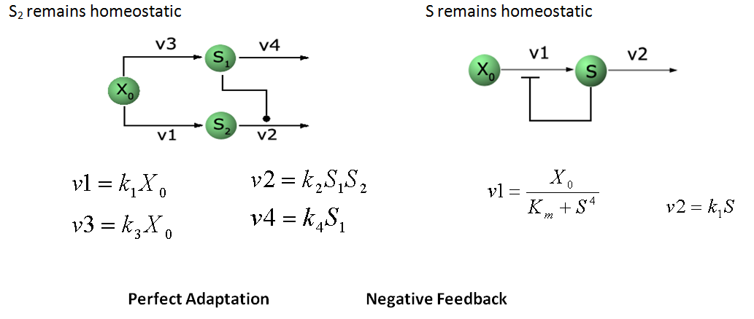
Homeostasis

Slide 4
Perfect Adaptation
r = te.loada(‘’’
$Xo -> S2; k1*Xo;
S2 -> $w; k2*S1*S2;
$Xo -> S1; k3*Xo;
S1 -> $w; k4*S1;
at (time > 10): Xo = Xo * 2;
at (time > 15): Xo = Xo/2;
# initialize
k1 = 1; k2 = 1;
k3 = 1; k4 = 1;
Xo = 1.0;
‘’’)

Slide 5
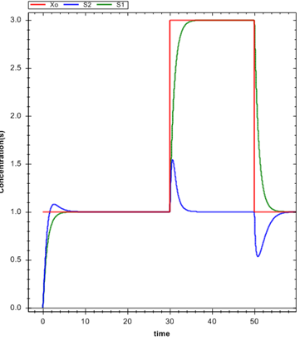
Exercise: Build a model that shows perfect adaptation.

Slide 6
Negative Feedback
r = te.loada ('''
$Xo -> S; Xo/(km + S^h);
S -> $w; k1*S;
# initialize
h = 1; # Hill coefficient
k1 = 1; km = 0.1;
S = 1.5; Xo = 2
at (time > 10): Xo = 5;
at (time > 20): Xo = 2;
''')

Slide 7
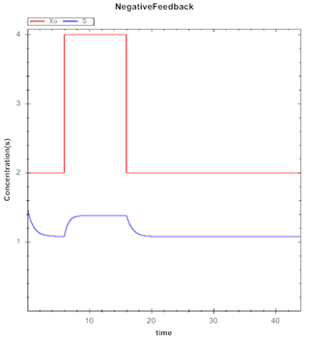
Negative Feedback

Slide 8
Positive Feedback
Enter the following model:
r = te.loada (‘’’
$Xo -> S1;
1 + Xo*(32+(S1/0.75)^3.2)/(1 +(S1/4.3)^3.2);
S1 -> $X1; k1*S1;
Xo = 0.09; X1 = 0.0;
S1 = 0.5; k1 = 3.2;
‘’’)

Slide 9
Exercises
Carry out a time course scan on the positive feedback model.
Scan over different starting points for S1
To help you get started:
Plot 12 time course curves, start S1 at 0.05 and incrementing S1 by 1.0 for each time course simulation.
What do you observe?

Slide 10
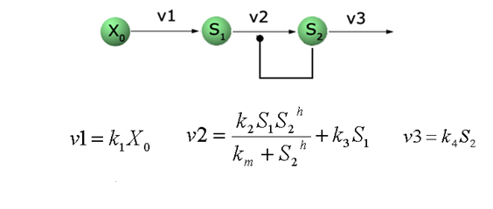
Relaxation Oscillator
A relaxation oscillator utilizes a positive feedback coupled to a negative feedback loop.

Slide 11
Relaxation Oscillator
r = te.loada (‘’’
v1: $Xo -> S1; k1*Xo;
v2: S1 -> S2; k2*S1*S2^h/(10 + S2^h) + k3*S1;
v3: S2 -> $w; k4*S2;
# Initialize
h = 2; # Hill coefficient
k1 = 1; k2 = 2; Xo = 1;
k3 = 0.02; k4 = 1;
‘’’)

